Slide 1
XSLT
eXtensible Stylesheet Language Transformations —
язык преобразования XML-документов
Подготовил
Мицкевич В.С.

Slide 2
Аббревиатура XSLT происходит от
XSL Transformations (XSL преобразования), а
XSL – от Extensible Stylesheet Language (расширяемый язык таблиц стилей).
Таблицы XSL стилей –это XML документы, которые могут быть загружены и разобраны, как и любые другие XML документы.

Slide 3
<xsl:stylesheet version="1.0"
xmlns:xsl="http://www.w3.org/1999/XSL/Transform">
<xsl:transform version="1.0"
xmlns:xsl="http://www.w3.org/1999/XSL/Transform">
xmlns:xsl="http://www.w3.org/1999/XSL/Transform"- пространствa имен XSLT

Slide 4
<?xml version="1.0" encoding="UTF-8"?>
<catalog>
<cd>
<title>The Essential Ozzy Osbourne</title>
<artist> Ozzy Osbourne </artist>
<price>10</price>
</cd>
…
</catalog>

Slide 5
<?xml version="1.0" encoding="UTF-8"?>
<xsl:stylesheet version="1.0"
xmlns:xsl="http://www.w3.org/1999/XSL/Transform">
<xsl:template match="/">
<html>
<body>
<h2>My CD Collection</h2>
<table border="1">
<tr bgcolor="#9acd32">
<th>Title</th>
<th>Artist</th>
</tr>
<xsl:for-each select="catalog/cd">
<tr>
<td><xsl:value-of select="title"/></td>
<td><xsl:value-of select="artist"/></td>
</tr>
</xsl:for-each>
</table>
</body>
</html>
</xsl:template>
</xsl:stylesheet>

Slide 6
<?xml version="1.0" encoding="UTF-8"?>
<?xml-stylesheet type="text/xsl" href="cdcatalog.xsl"?>
<catalog>
<cd>
<title>The Essential Ozzy Osbourne</title>
<artist> Ozzy Osbourne </artist>
<price>10</price>
</cd>
…
</catalog>

Slide 7
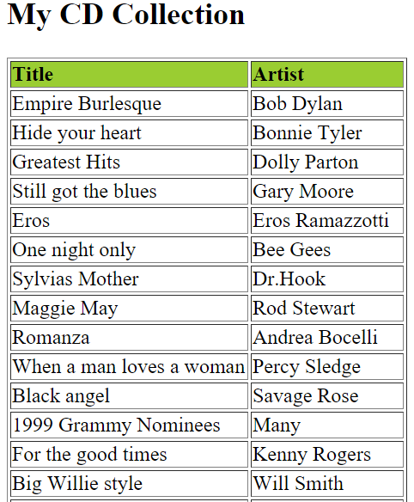
Результат

Slide 8
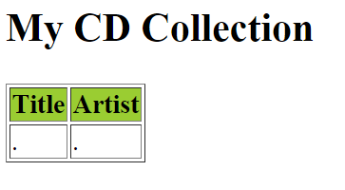
<xsl:template>
<?xml version="1.0" encoding="UTF-8"?>
<xsl:stylesheet version="1.0"
xmlns:xsl="http://www.w3.org/1999/XSL/Transform">
<xsl:template match="/">
<html>
<body>
<h2>My CD Collection</h2>
<table border="1">
<tr bgcolor="#9acd32">
<th>Title</th>
<th>Artist</th>
</tr>
<tr>
<td> . </td>
<td> . </td>
</tr>
</table>
</body>
</html>
</xsl:template>
</xsl:stylesheet>
match="/"
Атрибут match используется, чтобы связать шаблон с элементом XML.

Slide 9
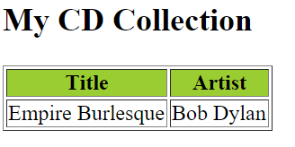
<xsl:value-of>
используется для извлечения значения выбранного узла
<?xml version="1.0" encoding="UTF-8"?>
<xsl:stylesheet version="1.0"
xmlns:xsl="http://www.w3.org/1999/XSL/Transform">
<xsl:template match="/">
<html>
<body>
<h2>My CD Collection</h2>
<table border="1">
<tr bgcolor="#9acd32">
<th>Title</th>
<th>Artist</th>
</tr>
<tr>
<td> <xsl:value-of select="catalog/cd/title"/> </td>
<td> <xsl:value-of select="catalog/cd/artist"/> </td>
</tr>
</table>
</body>
</html>
</xsl:template>
</xsl:stylesheet>

Slide 10
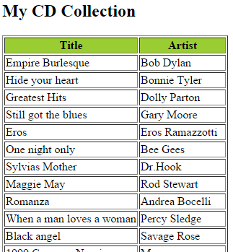
<xsl:for-each>
позволяет создавать циклы в XSLT
<?xml version="1.0" encoding="UTF-8"?>
<xsl:stylesheet version="1.0"
xmlns:xsl="http://www.w3.org/1999/XSL/Transform">
<xsl:template match="/">
<html>
<body>
<h2>My CD Collection</h2>
<table border="1">
<tr bgcolor="#9acd32">
<th>Title</th>
<th>Artist</th>
</tr>
<xsl:for-each select="catalog/cd">
<tr>
<td> <xsl:value-of select="title"/> </td>
<td> <xsl:value-of select="artist"/> </td>
</tr>
</xsl:for-each>
</table>
</body>
</html>
</xsl:template>
</xsl:stylesheet>

Slide 11
<xsl:for-each>
позволяет создавать циклы в XSLT
<?xml version="1.0" encoding="UTF-8"?>
<xsl:stylesheet version="1.0"
xmlns:xsl="http://www.w3.org/1999/XSL/Transform">
<xsl:template match="/">
<html>
<body>
<h2>My CD Collection</h2>
<table border="1">
<tr bgcolor="#9acd32">
<th>Title</th>
<th>Artist</th>
</tr>
<xsl:for-each select="catalog/cd[artist='Bob Dylan']">
<tr>
<td> <xsl:value-of select="title"/></td>
<td> <xsl:value-of select="artist"/></td>
</tr>
</xsl:for-each>
</table>
</body>
</html>
</xsl:template>
</xsl:stylesheet>
= равно
!= не равно
&lt; меньше чем
&gt; больше чем

Slide 12
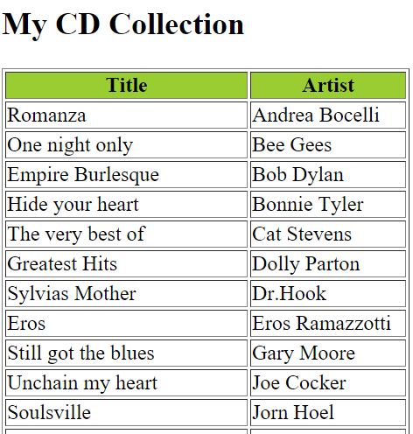
<xsl:sort>
используется для сортировки вывода
<?xml version="1.0" encoding="UTF-8"?>
<xsl:stylesheet version="1.0"
xmlns:xsl="http://www.w3.org/1999/XSL/Transform">
<xsl:template match="/">
<html>
<body>
<h2>My CD Collection</h2>
<table border="1">
<tr bgcolor="#9acd32">
<th>Title</th>
<th>Artist</th>
</tr>
<xsl:for-each select="catalog/cd">
<xsl:sort select="artist"/>
<tr>
<td><xsl:value-of select="title"/></td>
<td><xsl:value-of select="artist"/></td>
</tr>
</xsl:for-each>
</table>
</body>
</html>
</xsl:template>
</xsl:stylesheet>

Slide 13
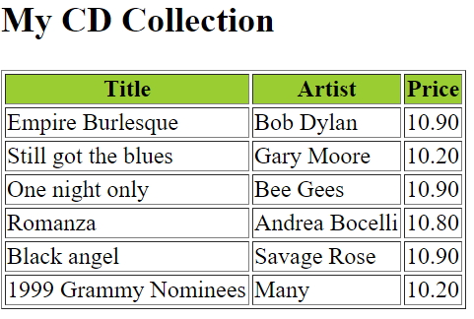
<xsl:if>
для проверки условия в отношении содержания XML-файла
<?xml version="1.0" encoding="UTF-8"?>
<xsl:stylesheet version="1.0"
xmlns:xsl="http://www.w3.org/1999/XSL/Transform">
<xsl:template match="/">
<html>
<body>
<h2>My CD Collection</h2>
<table border="1">
<tr bgcolor="#9acd32">
<th>Title</th>
<th>Artist</th>
<th>Price</th>
</tr>
<xsl:for-each select="catalog/cd">
<xsl:if test="price &gt; 10">
<tr>
<td><xsl:value-of select="title"/></td>
<td><xsl:value-of select="artist"/></td>
<td><xsl:value-of select="price"/></td>
</tr>
</xsl:if>
</xsl:for-each>
</table>
</body>
</html>
</xsl:template>
</xsl:stylesheet>

Slide 14
<xsl:choose>
<xsl:choose>
<xsl:when test="expression">
... some output ...
</xsl:when>
<xsl:otherwise>
... some output ....
</xsl:otherwise>
</xsl:choose>

Slide 15
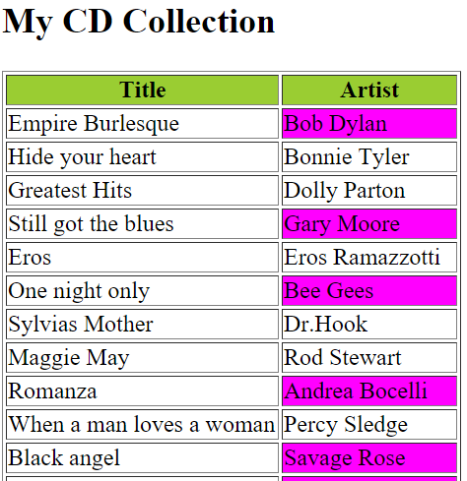
<xsl:choose>
<xsl:template match="/">
<html>
<body>
<h2>My CD Collection</h2>
<table border="1">
<tr bgcolor="#9acd32">
<th>Title</th>
<th>Artist</th>
</tr>
<xsl:for-each select="catalog/cd">
<tr>
<td><xsl:value-of select="title"/></td>
<xsl:choose>
<xsl:when test="price &gt; 10">
<td bgcolor="#ff00ff">
<xsl:value-of select="artist"/></td>
</xsl:when>
<xsl:otherwise>
<td><xsl:value-of select="artist"/></td>
</xsl:otherwise>
</xsl:choose>
</tr>
</xsl:for-each>
</table>
</body>
</html>
</xsl:template>
</xsl:stylesheet>

Slide 16
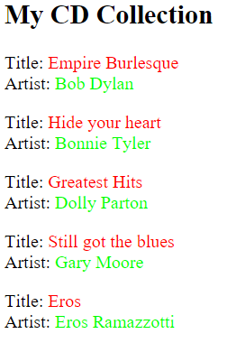
<xsl:apply-templates>
применяет шаблонные правила к узлам указанным в атрибуте select. Если атрибут select опущен, то применяет ко всем дочерним узлам текущего узла.
<xsl:template match="/">
<html>
<body>
<h2>My CD Collection</h2>
<xsl:apply-templates/>
</body>
</html>
</xsl:template>
<xsl:template match="cd">
<p>
<xsl:apply-templates select="title"/>
<xsl:apply-templates select="artist"/>
</p>
</xsl:template>
<xsl:template match="title">
Title: <span style="color:#ff0000">
<xsl:value-of select="."/></span>
<br />
</xsl:template>
<xsl:template match="artist">
Artist: <span style="color:#00ff00">
<xsl:value-of select="."/></span>
<br />

Slide 17
<?xml version="1.0" encoding="UTF-8"?>
<xsl:stylesheet version="1.0"
xmlns:xsl="http://www.w3.org/1999/XSL/Transform">
<xsl:template match="/">
<html>
<body>
<h2>My CD Collection</h2>
<table border="1">
<tr bgcolor="#9acd32">
<th style="text-align:left">Title</th>
<th style="text-align:left">Artist</th>
</tr>
<xsl:for-each select="catalog/cd">
<tr>
<td><xsl:value-of select="title" /></td>
<td><xsl:value-of select="artist" /></td>
</tr>
</xsl:for-each>
</table>
</body>
</html>
</xsl:template>
</xsl:stylesheet>

Slide 18
<html><head><script>
function loadXMLDoc(filename)
{
if (window.ActiveXObject)
{ xhttp = new ActiveXObject("Msxml2.XMLHTTP"); }
else { xhttp = new XMLHttpRequest(); }
xhttp.open("GET", filename, false);
try {xhttp.responseType = "msxml-document"} catch(err) {} // Helping IE11
xhttp.send("");
return xhttp.responseXML;
}
function displayResult()
{
xml = loadXMLDoc("cdcatalog.xml");
xsl = loadXMLDoc("cdcatalog.xsl");
// code for IE
if (window.ActiveXObject || xhttp.responseType == "msxml-document")
{
ex = xml.transformNode(xsl);
document.getElementById("example").innerHTML = ex;
}
// code for Chrome, Firefox, Opera, etc.
else if (document.implementation && document.implementation.createDocument)
{
xsltProcessor = new XSLTProcessor();
xsltProcessor.importStylesheet(xsl);
resultDocument = xsltProcessor.transformToFragment(xml, document);
document.getElementById("example").appendChild(resultDocument);
}
}
</script>
</head>
<body onload="displayResult()">
<div id="example" />
</body></html>
XML в XHTML в Браузере

Slide 19
PHP Code: Transform XML to XHTML on the Server
<?php
// Load XML file
$xml = new DOMDocument;
$xml->load('cdcatalog.xml');
// Load XSL file
$xsl = new DOMDocument;
$xsl->load('cdcatalog.xsl');
// Configure the transformer
$proc = new XSLTProcessor;
// Attach the xsl rules
$proc->importStyleSheet($xsl);
echo $proc->transformToXML($xml);
?>

