Slide 1
Apache Hadoop HBase
LAXMI RAMCHANDRA SHEJWAL
ROLL NO : 17

Slide 2

Apache Hadoop HBase
What is it ?
Why use it ?
Architecture
Components
Application
Advantages
Disadvantages

Slide 3
Hbase – What is it ?
A Hadoop Data Store
A noSQL store for big data
It is Open Source, written in Java
It is a distributed database
Automatic sharding, table data spread over cluster
Automatic region server fail over

Slide 4
Hbase – Why / When use it ?
Data in billions of rows
Complex data
High volume of I/O
High level of data nodes, 5 +
No need for extra RDBMS functions i.e. transactions

Slide 5
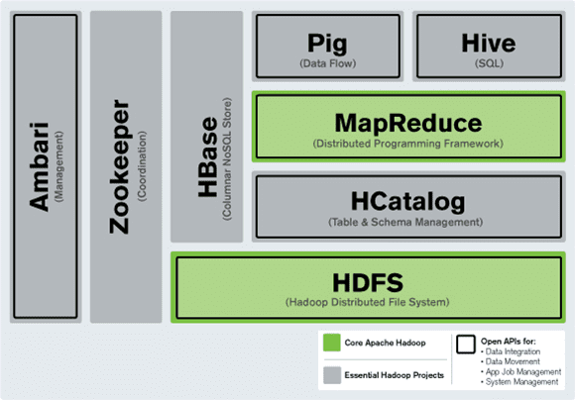
Where DOES HBASE SIT IN RELATION TO HADOOP ?
Hbase Architecture

Slide 6
HBase – Architecture
HBASE is a data store
Uses Handoop for distributed storage
Data stored across region servers
Region server data spread across HDFS data nodes
A write ahead log (WAL) is used to record changes

Slide 7
Features
HBase is linearly scalable.
It has automatic failure support.
It provides consistent read and writes.
It integrates with Hadoop, both as a source and a destination.
Build to overcome drawbacks of HDFS as it allows fast random read and writes in an optimized way
It has easy java API for client.
It provides data replication across clusters

Slide 8
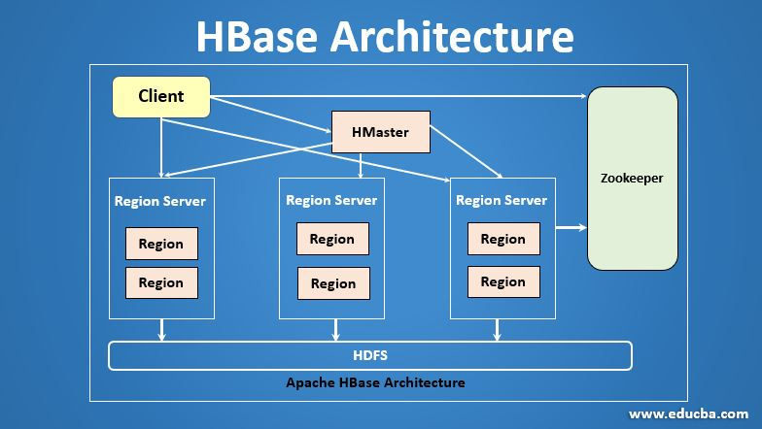
Architecture

Slide 9
Components
HMaster
HMaster in HBase is a process which helps to assign the regions to region servers. It balances the loads by assigning the regions.
HMaster manages the Hadoop clusters.
Helps to create, modify and delete tables in the database.
It also cares about different tasks when the client wants to change the schema or metadata

Slide 10
REGION SERVER
The Region Servers are the main working nodes. It handles the Read, write, modify requests from the clients.The Region Servers runs on every node in Hadoop Cluster
It has read cache called Block Cache, read data are stored in the read cache, and when the cache is full, recently used data is removed
Another cache is present here called MemStore. It is the write cache. It stored new data that is not yet stored in the disks. Each Column-Family has different write cache in it
It has the actual storage file called HFile. It stores the actual data on a disk

Slide 11
ZOOKEEPER
This is an Open-Source server which enables the reliable distributed coordination. Zookeeper is a centralized service that maintains the configuration information. It also maintains distributed synchronization etc
Zookeeper service keeps track on all region servers in HBase

Slide 12
Applications
Processing huge data (in PB/TB usually).
High Throughput for random Read & Write
Companies such as Facebook, Twitter, Yahoo, and Adobe use Hbase internally.
Hbase is used in medical to store genome sequences
It is used in sports to store data for better prediction and analytics
Hbase is also used in ecommerce to store billions of data

Slide 13
Advantages
Random and consistent Reads/Writes access in high volume request
Auto failover and reliability
Flexible, column-based multidimensional map structure
Columns can be added and removed dynamically
Hbase provide java API’s
Auto Partitioning and sharding
Low latency access to data
HBase allows data compression and is ideal for sparse data

Slide 14
Disadvantages
When only one HMaster is used, there is a possibility of failure
There is no support for transactions
Sorted only on keys
There is no support for sql structures
Some of the traditional models features cannot supported by Hbase

Slide 15
THANK YOU

