Slide 1
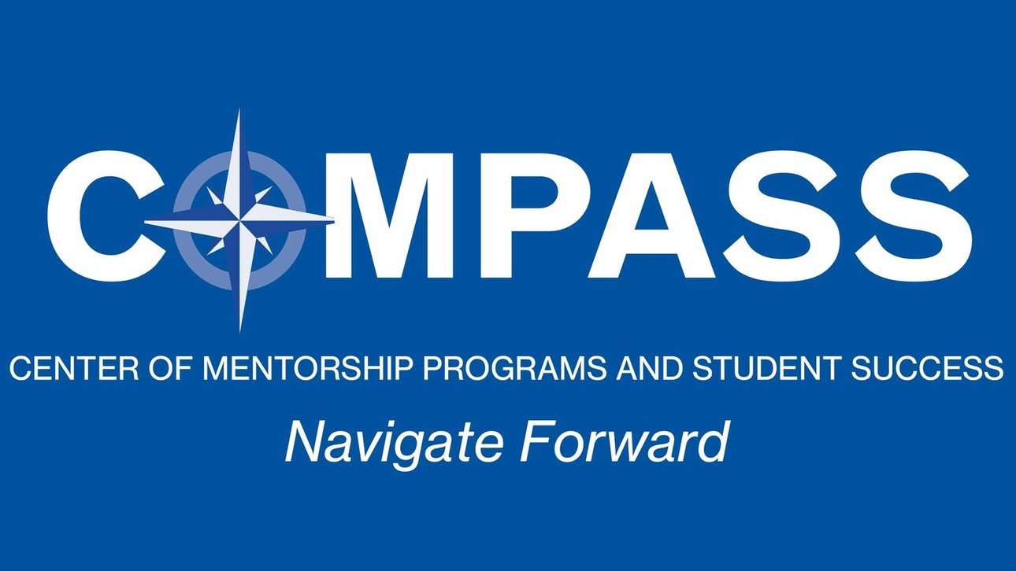

Slide 2

What is COMPASS?
Mission: Guide students to develop personalized strategies for academic success and career readiness.
Approach: Connects mentees with faculty, peer, or alumni mentors.
Philosophy: Based on B-E-P-A-C framework.

Slide 3
The B-E-P-A-C Framework
Belief – Cultivate high expectations.
01
Effort – Inspire hard work and commitment.
02
Progression – Build momentum toward success.
03
Accountability – Encourage responsibility and ownership.
04
Confidence – Instill self-assurance through achievements.

Slide 4
Why Mentorship Matters?
Builds academic and personal confidence
Provides guidance and accountability
Expands career and networking opportunities
Encourages resilience and growth

Slide 5
Expectations for Our Mentorship
Support, encouragement, and honest feedback
Guidance on academics, goals, and resources
Respect for your time and experiences

Slide 6
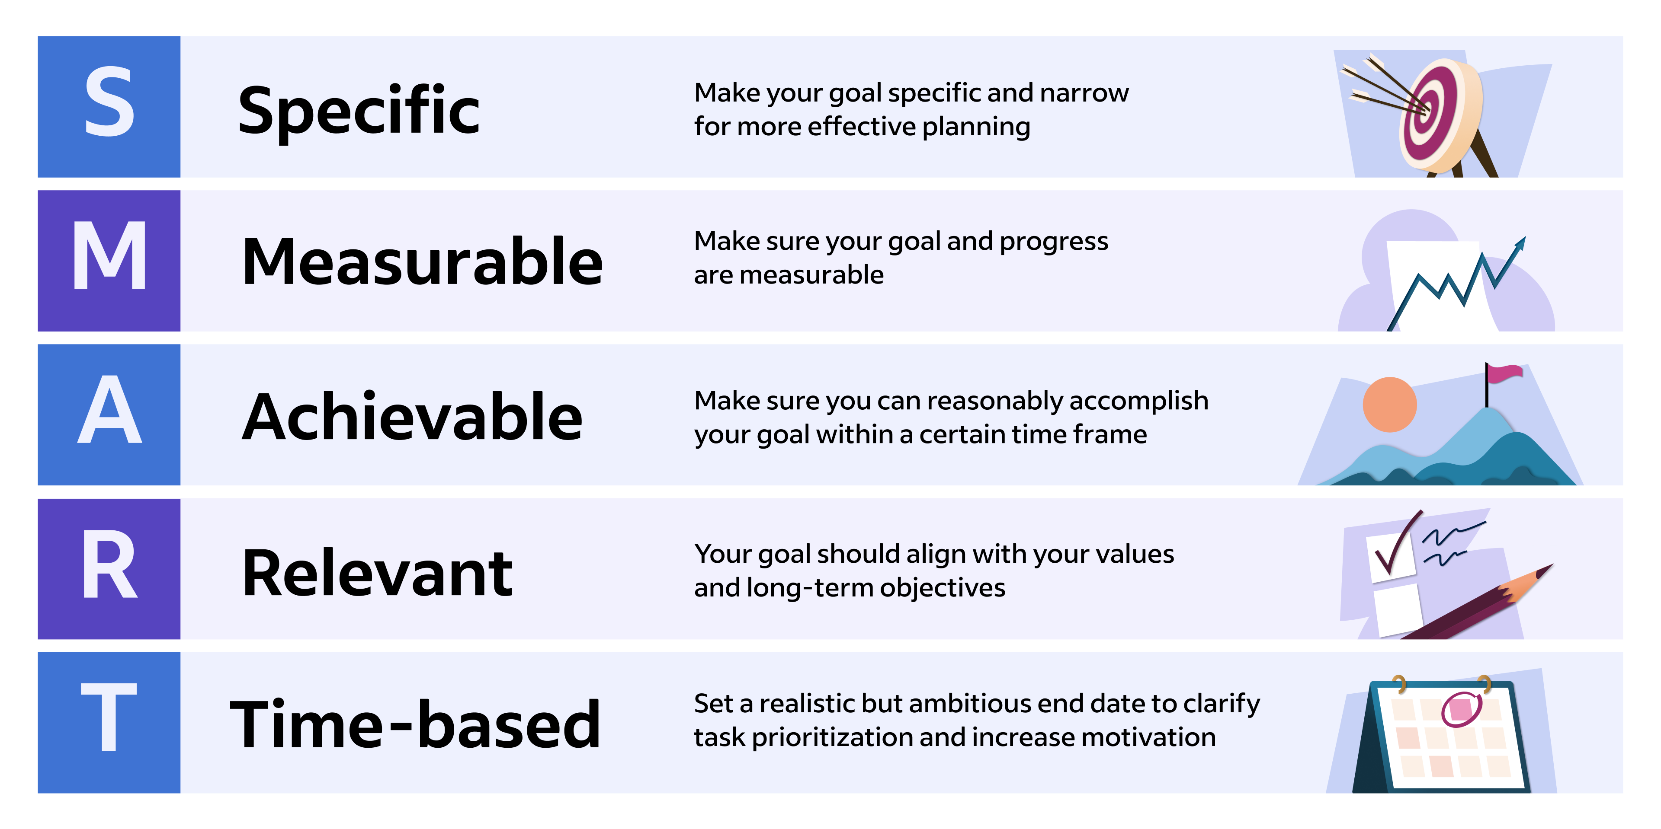

Slide 7
Resources for Students
Academic Support: Tutoring Services, Virtual Communication Lab, Hunt Library.
Career Development: Career Services, Student Employment Office, Networking.
Wellness: Counseling Centers, TELUS Student Support.
Additional Support: eUnion, SWE Mentoring Program, Military & Veterans Office.

Slide 8
1. VECTOR & The Virtual Communication Lab (VCL)
What is it? VECTOR (Virtual Environment for Communication: Teaching, Outreach & Research) supports students and faculty in mastering all forms of communication—written, spoken, visual, and digital.
What does the VCL offer?
Free one-on-one tutoring and workshops
Help at any stage of communication projects—from brainstorming to polishing
An online resource library with tools for grammar, presentations, APA formatting, and more
Nearly all students report stronger communication confidence after using the VCL

Slide 9
2. Academic Advancement Center (AAC – Tutoring)
What is it? The Academic Advancement Center (AAC) provides free peer tutoring for foundational 100- and 200-level general education courses, ensuring students start strong academically.
What does it offer?
Tutoring Labs in Math, Physics, Chemistry, and Engineering (whiteboard tables for collaborative learning, computers, and quick-print station)
Supplemental Instruction (SI) sessions for courses like Math, Physics
Online Tutoring via tutor.com through Canvas
How does it work? All peer tutors and SI Leaders are trained and work closely with faculty, ensuring the help you get is directly relevant to class lectures.

Slide 10
3. Library & Research Services
What is it? ERAU libraries (Hunt Library, Hazy Library, and Worldwide Online Library) provide academic resources, research support, and personalized guidance.
What does it offer?
“Ask a Librarian” – Quick chat or email support for research questions, citation help, and source-finding.
Meet with a Librarian – Schedule one-on-one sessions either in-person or online for deeper, project-specific help.
Online Resources – Access databases, journals, textbooks, and citation tools like RefWorks.
Why it matters: Students often waste hours searching for credible sources—librarians streamline that process and help ensure work is scholarly and citation-ready.

Slide 11

Thank you for joining today’s COMPASS mentorship session!

