Slide 1
CuSP: A Customizable Streaming Edge Partitioner for Distributed Graph Analytics
Loc Hoang Roshan Dathathri
Gurbinder Gill Keshav Pingali

Slide 2
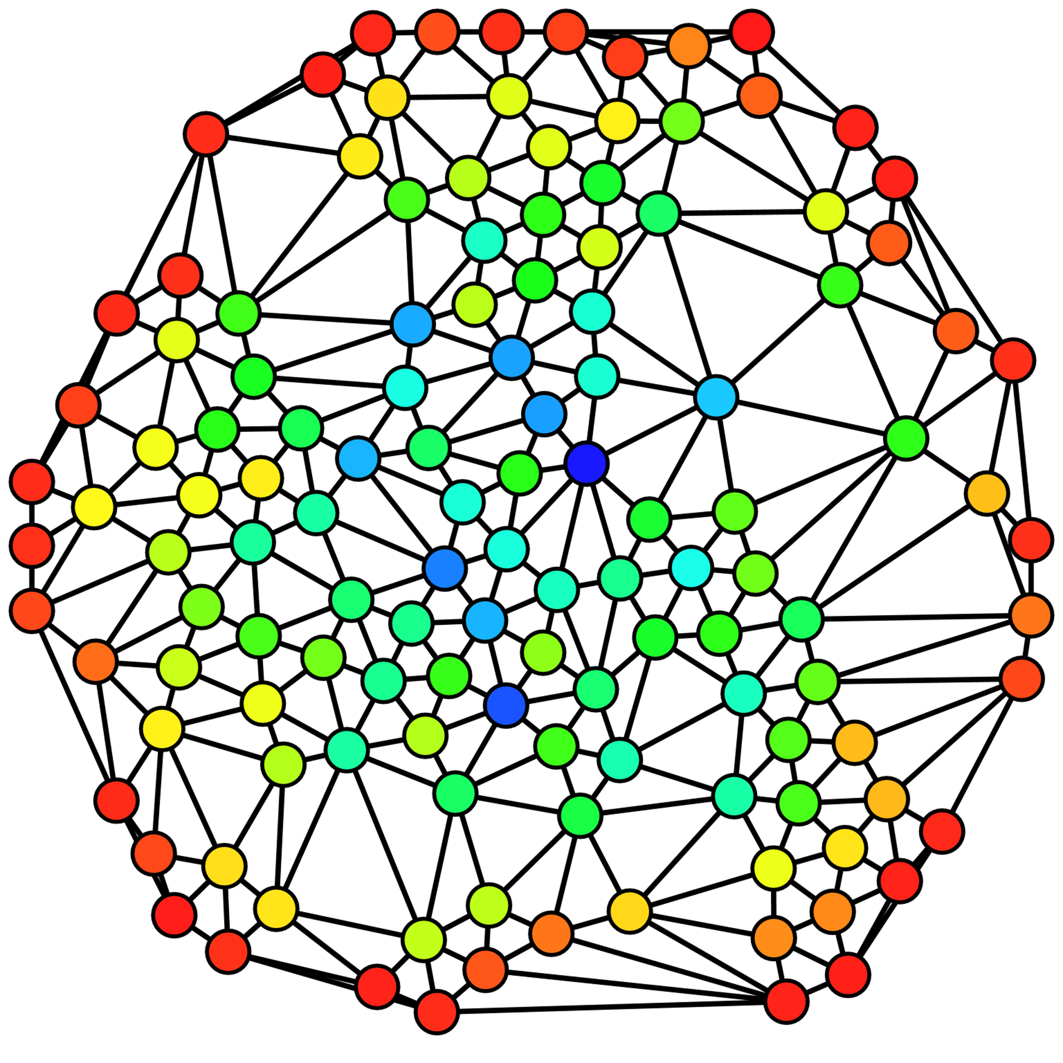
Distributed Graph Analytics
Analytics on unstructured data
Finding suspicious actors in crime networks
GPS trip guidance
Web page ranking
Datasets getting larger (e.g., wdc12 1TB): process on distributed clusters
D-Galois [PLDI18], Gemini [OSDI16]
Image credit: Claudio Rocchini, Creative Commons Attribution 2.5 Generic

Slide 3
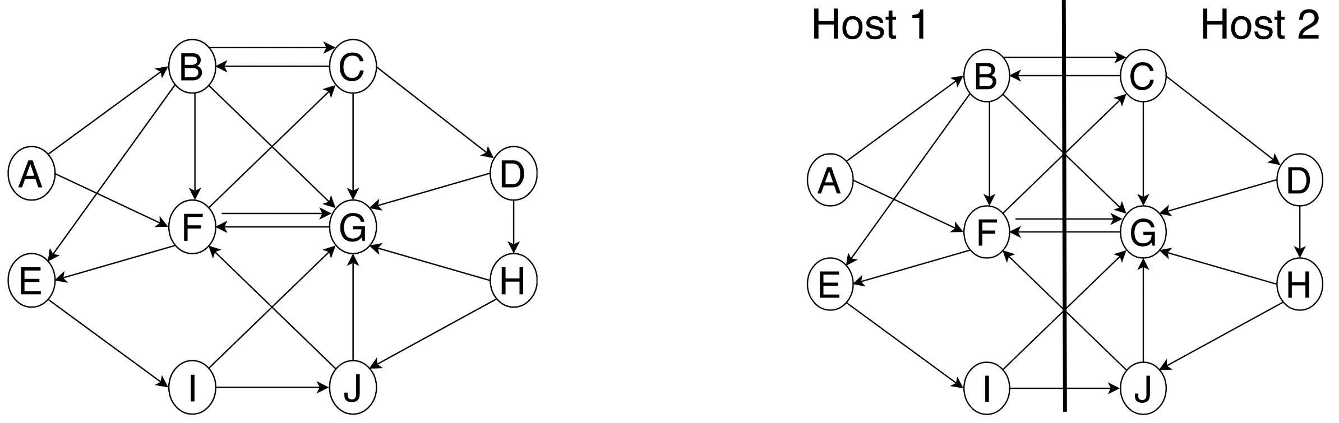
Graph Partitioning for Distributed Computation
Graph is partitioned across machines using a policy
Machine computes on local partition and communicates updates to others as necessary (bulk-synchronous parallel)
Partitioning affects application execution time in two ways
Computational load imbalance
Communication overhead
Goal of partitioning policy: reduce both

Slide 4
Graph Partitioning Methodology
Two kinds of graph partitioning
Offline: iteratively refine partitioning
Online/streaming: partitioning decisions made as nodes/edges streamed in
Class | Invariant | Examples
Offline | Edge-Cut | Metis, Spinner, XtraPulp
Online/Streaming | Edge-Cut | Edge-balanced Edge-cut, Linear Weighted Deterministic Greedy, Fennel
 | Vertex-Cut | PowerGraph, Hybrid Vertex-cut, Ginger, High Degree Replicated First, Degree-Based Hashing
 | 2D-Cut | Cartesian Vertex-cut, Checkerboard Vertex-cut, Jagged Vertex-cut

Slide 5
Motivation
Problems to consider:
Generality
Previous partitioners implement limited number of policies
Need variety of policies for different execution settings [Gill et al. VLDB19]
Speed
Partitioning time may dominate end-to-end execution time
Quality
Partitioning should allow graph applications to run fast
Goal: Given abstract specification of policy, create partitions quickly to run with graph applications

Slide 6
Customizable Streaming Partitioner (CuSP)
Abstract specification for streaming partitioning policies
Distributed, parallel, scalable implementation
Produces partitions 6x faster than state-of-the-art offline partitioner, XtraPulp [IPDPS17], with better partition quality

Slide 7
Outline
Introduction
Distributed Execution Model
CuSP Partitioning Abstraction
CuSP Implementation and Optimizations
Evaluation

Slide 8
Background: Adjacency Matrix and Graphs
Destination
A
B
C
D
A
B
A
B
Source
C
C
D
D
Graphs can be represented as adjacency matrix

Slide 9
Partitioning with Proxies: Masters/Mirrors
A
B
C
D
A
B
A
Host 1
Host 2
B
C
C
D
D
Assign edges uniquely
Host 3
Host 4

Slide 10
Partitioning with Proxies: Masters/Mirrors
A
B
C
D
A
B
A
Host 1
Host 2
B
A
B
A
B
C
C
D
D
Assign edges uniquely
Create proxies for endpoints of edges
C
C
D
Host 3
Host 4
B
C
D
D

Slide 11
Partitioning with Proxies: Masters/Mirrors
A
B
C
D
A
B
A
Host 1
Host 2
B
A
B
A
B
C
C
D
D
Assign edges uniquely
Create proxies for endpoints of edges
Choose a master proxy for each vertex; rest are mirrors
C
C
D
Host 3
Host 4
B
C
D
D
Master Proxy
Mirror Proxy

Slide 12
Partitioning with Proxies: Masters/Mirrors
A
B
C
D
A
B
A
Host 1
Host 2
B
A
B
A
B
C
C
D
D
Captures all streaming partitioning policies!
Assign edges uniquely
Create proxies for endpoints of edges
Choose a master proxy for each vertex; rest are mirrors
C
C
D
Host 3
Host 4
B
C
D
D
Master Proxy
Mirror Proxy

Slide 13
Responsibility of Masters/Mirrors
Mirrors act as cached copies for local computation
Masters responsible for managing/communicating canonical value
Host 1
Host 2
Host 3
A
B
B
C
B
D
Master Proxy
Mirror Proxy

Slide 14
Responsibility of Masters/Mirrors
Example: breadth-first search
Initialize distance values of source (A) to 0, infinity everywhere else
Host 1
Host 2
Host 3
0
∞
∞
∞
∞
A
B
B
C
B
∞
D
Master Proxy
Mirror Proxy
Node Value

Slide 15
Responsibility of Masters/Mirrors
Do one round of computation locally: update distances
Host 1
Host 2
Host 3
0
1
∞
∞
∞
A
B
B
C
B
∞
D
Master Proxy
Mirror Proxy
Node Value

Slide 16
Responsibility of Masters/Mirrors
After local compute, communicate to synchronize proxies [PLDI18]
Reduce mirrors onto master (“minimum” operation)
Host 1
Host 2
Host 3
0
1
1
∞
∞
A
B
B
C
B
∞
D
Master Proxy
Mirror Proxy
Node Value

Slide 17
Responsibility of Masters/Mirrors
After local compute, communicate to synchronize proxies [PLDI18]
Reduce mirrors onto master (“minimum” operation)
Broadcast updated master value back to mirrors
Host 1
Host 2
Host 3
0
1
1
∞
1
A
B
B
C
B
∞
D
Master Proxy
Mirror Proxy
Node Value

Slide 18
Responsibility of Masters/Mirrors
Next round: compute, then communicate again as necessary
Placement of masters and mirrors affects communication pattern
Host 1
Host 2
Host 3
0
1
1
2
1
A
B
B
C
B
2
D
Master Proxy
Mirror Proxy
Node Value

Slide 19
Outline
Introduction
Distributed Execution Model
CuSP Partitioning Abstraction
CuSP Implementation and Optimizations
Evaluation

Slide 20
What is necessary to partition?
Insight: Partitioning consists of
Assigning edges to hosts and creating proxies
Choosing host to contain master proxy
User only needs to express streaming partitioning policy as
assignment of master proxy to host
assignment of edge to host
Class | Invariant | Examples
Online/Streaming | Edge-Cut | Edge-balanced Edge-cut, LDG, Fennel
 | Vertex-Cut | PowerGraph, Hybrid Vertex-cut, Ginger, HDRF, DBH
 | 2D-Cut | Cartesian Vertex-cut, Checkerboard Vertex-cut, Jagged Vertex-cut

Slide 21
Two Functions For Partitioning
User defines two functions
getMaster(prop, nodeID): given a node, return the host to which the master proxy will be assigned
getEdgeOwner(prop, edgeSrcID, edgeDstID): given an edge, return the host to which it will be assigned
“prop”: contains graph attributes and current partitioning state
Given these, CuSP partitions graph

Slide 22
Outgoing Edge-Cut with Two Functions
All out-edges to host with master
getMaster(prop, nodeID): // Evenly divide vertices among hosts
blockSize = ceil(prop.getNumNodes() / prop.getNumPartitions())
return ﬂoor(nodeID / blockSize)
getEdgeOwner(prop, edgeSrcID, edgeDstID): // to src master
return masterOf(edgeSrcID)
Host 1
Host 2
A
B
C
D
A
B
B
A
B
C
C
D
D
Host 3
Host 4
A
A
C
D
C
D
Master Proxy
Mirror Proxy

Slide 23
Cartesian Vertex-Cut with Two Functions
2D cut of adjacency matrix:
getMaster: same as outgoing edge-cut
getEdgeOwner(prop, edgeSrcID, edgeDstID): // assign edges via 2d grid
ﬁnd pr and pc s.t. (pr × pc) == prop.getNumPartitions()
blockedRowOffset = ﬂoor(masterOf(edgeSrcID) / pc) * pc
cyclicColumnOffset = masterOf(edgeDstID) % pc
return (blockedRowOffset + cyclicColumnOffset)
Host 1
Host 2
A
B
C
D
A
A
B
A
B
B
C
D
C
D
Host 3
Host 4
A
C
D
C
D
Master Proxy
Mirror Proxy

Slide 24
CuSP Is Powerful and Flexible
Master Functions: 4
Contiguous: blocked distribution of nodes
ContiguousEB: blocked edge distribution of nodes
Fennel: streaming Fennel node assignment that attempts to balance nodes
FennelEB: streaming Fennel node assignment that attempts to balance nodes and edges during partitioning
EdgeOwner Functions: 3 x 2 (out vs. in-edges)
Source: edge assigned to master of source
Hybrid: assign to source master if low out-degree, destination master otherwise
Cartesian: 2-D partitioning of edges
Policy | getMaster | getEdgeOwner
Edge-balanced Edge-Cut (EEC) | ContiguousEB | Source
Hybrid Vertex-Cut (HVC) | ContiguousEB | Hybrid
Cartesian Vertex-Cut (CVC) | ContiguousEB | Cartesian
FENNEL Edge-Cut (FEC) | FennelEB | Source
Ginger Vertex-Cut (GVC) | FennelEB | Hybrid
Sugar Vertex-Cut (SVC) | FennelEB | Cartesian
Define corpus of functions and get many policies: 24 policies!

Slide 25
Outline
Introduction
Distributed Execution Model
CuSP Partitioning Abstraction
CuSP Implementation and Optimizations
Evaluation

Slide 26
Problem Statement
Given n hosts, create n partitions, one on each host
Input: Graph in binary compressed sparse-row, CSR, (or compressed sparse-column, CSC) format
Reduces disk space and access time
Output: CSR (or CSC) graph partitions
Format used by in-memory graph frameworks

Slide 27
How To Do Partitioning (Naïvely)
Naïve method: send node/edges to owner immediately after calling getMaster or getEdgeOwner, construct graph as data comes in
Drawbacks
Overhead from many calls to communication layer
May need to allocate memory on-demand, hurting parallelism
Interleaving different assignments without order makes opportunities for parallelism unclear

Slide 28
CuSP Overview
Partitioning in phases
Determine node/edge assignments in parallel without constructing graph
Send info informing hosts how much memory to allocate
Send edges and construct in parallel
Separation of concerns opens opportunity for parallelism in each phase

Slide 29
Phases in CuSP Partitioning: Graph Reading
Graph Reading: each host reads from separate portion of graph on disk
Disk
Graph

Slide 30
Phases in CuSP Partitioning: Graph Reading
Graph Reading: each host reads from separate portion of graph on disk
Host 1
Disk Read
Graph Reading from Disk
Disk
Graph
Host 2
Graph Reading from Disk
Time

Slide 31
Phases in CuSP Partitioning: Graph Reading
Graph Reading: each host reads from separate portion of graph on disk
Split graph based on nodes, edges, or both
Host 1
Disk Read
Graph Reading from Disk
Disk
Graph
Host 2
Graph Reading from Disk
Time

Slide 32
Phases in CuSP Partitioning: Master Assignment
Master Assignment: loop through read vertices and call getMaster and save assignments locally
Host 1
Disk Read
Graph Reading from Disk
Master Assignment
Disk
Graph
Host 2
Graph Reading from Disk
Master Assignment
Time

Slide 33
Phases in CuSP Partitioning: Master Assignment
Master Assignment: loop through read vertices and call getMaster and save assignments locally
Periodically synchronize assignments (frequency controlled by user)
Host 1
Disk Read
Communication
Graph Reading from Disk
Master Assignment
Disk
Graph
Master Assignments
Host 2
Graph Reading from Disk
Master Assignment
Time

Slide 34
Phases in CuSP Partitioning: Edge Assignment
Edge Assignment: loops through edges it has read and calls getEdgeOwner (may periodically sync partitioning state)
Host 1
Disk Read
Communication
Graph Reading from Disk
Master Assignment
Edge Assignment
Disk
Graph
Master Assignments
Host 2
Graph Reading from Disk
Master Assignment
Edge Assignment
Time

Slide 35
Phases in CuSP Partitioning: Edge Assignment
Edge Assignment: loops through edges it has read and calls getEdgeOwner (may periodically sync partitioning state)
Do not send edge assignments immediately; count edges that must be sent to other hosts later, send out that info at end
Host 1
Disk Read
Communication
Graph Reading from Disk
Master Assignment
Edge Assignment
Disk
Graph
Master Assignments
Edge Counts,
(Master/)Mirror Info
Host 2
Graph Reading from Disk
Master Assignment
Edge Assignment
Time

Slide 36
Phases in CuSP Partitioning: Graph Allocation
Graph Allocation: Allocate memory for masters, mirrors, edges based on received info from other hosts
Host 1
Disk Read
Communication
Graph Reading from Disk
Master Assignment
Edge Assignment
Graph Allocation
Disk
Graph
Master Assignments
Edge Counts,
(Master/)Mirror Info
Host 2
Graph Reading from Disk
Master Assignment
Edge Assignment
Graph Allocation
Time

Slide 37
Phases in CuSP Partitioning: Graph Construction
Graph Construction: Construct in-memory graph in allocated memory
Host 1
Disk Read
Communication
Graph Reading from Disk
Master Assignment
Edge Assignment
Graph Allocation
Graph Construction
Disk
Graph
Master Assignments
Edge Counts,
(Master/)Mirror Info
Host 2
Graph Reading from Disk
Master Assignment
Edge Assignment
Graph Allocation
Graph Construction
Time

Slide 38
Phases in CuSP Partitioning: Graph Construction
Graph Construction: Construct in-memory graph in allocated memory
Send edges from host to owners
Host 1
Disk Read
Communication
Graph Reading from Disk
Master Assignment
Edge Assignment
Graph Allocation
Graph Construction
Disk
Graph
Master Assignments
Edge Counts,
(Master/)Mirror Info
Edge Data
Host 2
Graph Reading from Disk
Master Assignment
Edge Assignment
Graph Allocation
Graph Construction
Time

Slide 39

CuSP Optimizations I: Exploiting Parallelism
Loop over read nodes/edges with Galois [SOSP13] parallel loops and thread safe data structures/operations
Allows calling getMaster and getEdgeOwner in parallel
Parallel message packing/unpacking in construction
Key: memory already allocated: threads can deserialize into different memory regions in parallel without conflict

Slide 40
CuSP Optimizations II: Efficient Communication (I)
Elide node ID during node metadata sends: predetermined order
Buffering messages in the software
4.6x improvement from buffering 4MB instead of no buffering

Slide 41
CuSP Optimizations II: Efficient Communication (II)
CuSP may periodically synchronize partitioning state for getMaster and getEdgeOwner to use
Host 1
Disk Read
Communication
Graph Reading from Disk
Master Assignment
Edge Assignment
Graph Allocation
Graph Construction
Disk
Graph
Master Assignments
Partitioning State
Edge Counts
Edge Data
Host 2
Graph Reading from Disk
Master Assignment
Edge Assignment
Graph Allocation
Graph Construction
Time

Slide 42
CuSP Optimizations II: Efficient Communication (II)
CuSP may periodically synchronize partitioning state for getMaster and getEdgeOwner to use
If partitioning state/master assignment unused, can remove this synchronization
Host 1
Disk Read
Communication
Graph Reading from Disk
Master Assignment
Edge Assignment
Graph Allocation
Graph Construction
Disk
Graph
Edge Counts
Edge Data
Host 2
Graph Reading from Disk
Master Assignment
Edge Assignment
Graph Allocation
Graph Construction
Time

Slide 43
Outline
Introduction
Distributed Execution Model
CuSP Partitioning Abstraction
CuSP Implementation and Optimizations
Evaluation

Slide 44
Experimental Setup (I)
Compared CuSP partitions with XtraPulp [IPDPS17], state-of-art offline partitioner
Partition quality measured with application execution time in D-Galois [PLDI18], state-of-art graph analytics framework
breadth first search (bfs)
connected components (cc)
pagerank (pr)
single-source shortest path (sssp)

Slide 45
Experimental Setup (II)
Platform: Stampede2 supercomputing cluster
128 hosts with 48 Intel Xeon Platinum 8160 CPUs
192GB RAM
Five inputs
 | kron30 | gsh15 | clueweb12 | uk14 | wdc12
|V| | 1,073M | 988M | 978M | 788M | 3,563M
|E| | 17,091M | 33,877M | 42,574M | 47,615M | 128,736M
|E|/|V| | 15.9 | 34.3 | 43.5 | 60.4 | 36.1
Max OutDegree | 3.2M | 32,114 | 7,447 | 16,365 | 55,931
Max InDegree | 3.2M | 59M | 75M | 8.6M | 95M
Size on Disk (GB) | 136 | 260 | 325 | 361 | 986

Slide 46
Experimental Setup (III)
Six policies evaluated
EEC, HVC, and CVC:
master assignment requires no communication
FEC, GVC, and SVC:
communication in master assignment phase (FennelEB uses current assignments to guide decisions)
Policy | getMaster | getEdgeOwner
Edge-balanced Edge-Cut (EEC) | ContiguousEB | Source
Hybrid Vertex-Cut (HVC) | ContiguousEB | Hybrid
Cartesian Vertex-Cut (CVC) | ContiguousEB | Cartesian
FENNEL Edge-Cut (FEC) | FennelEB | Source
Ginger Vertex-Cut (GVC) | FennelEB | Hybrid
Sugar Vertex-Cut (SVC) | FennelEB | Cartesian

Slide 47
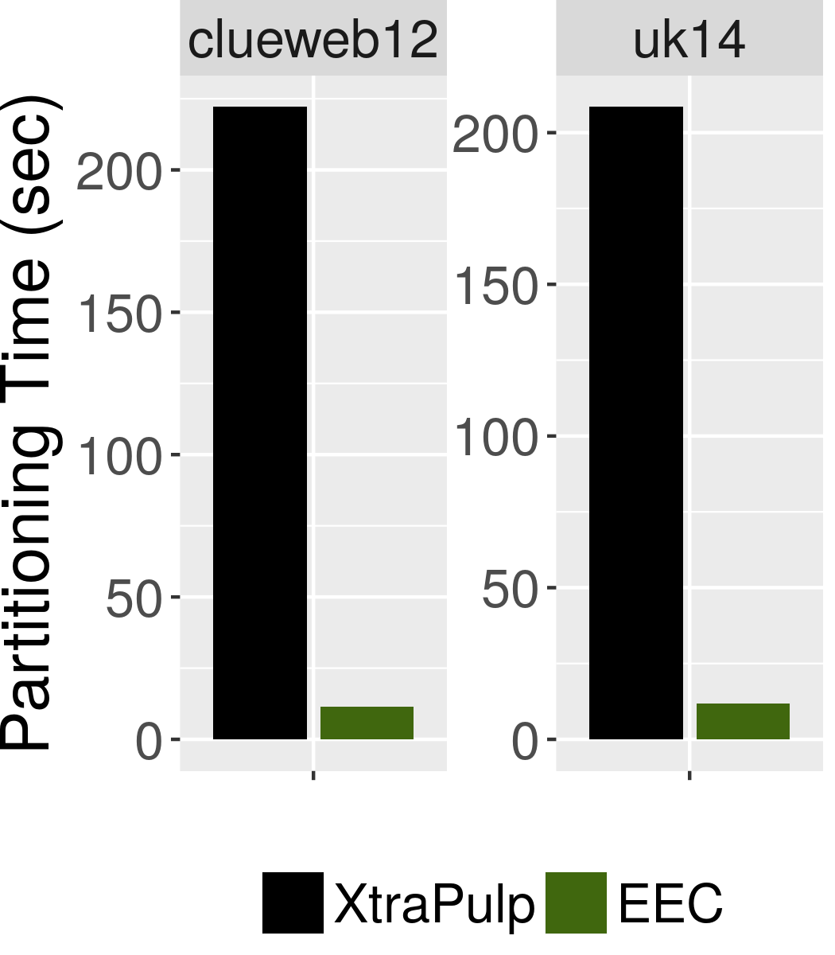
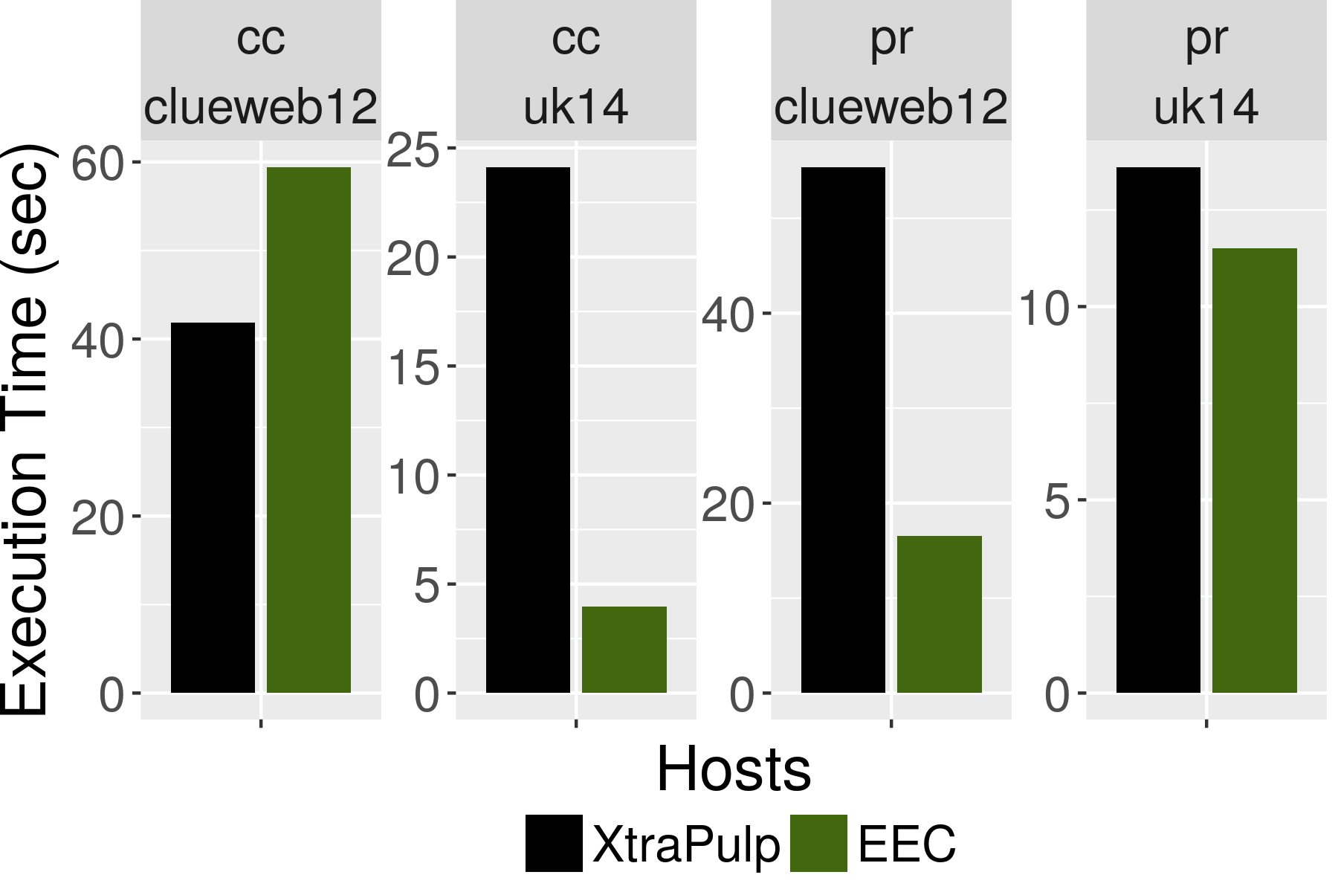
Partitioning Time and Quality for Edge-cut
CuSP EEC partitioned 22x faster on average
; quality not compromised

Slide 48
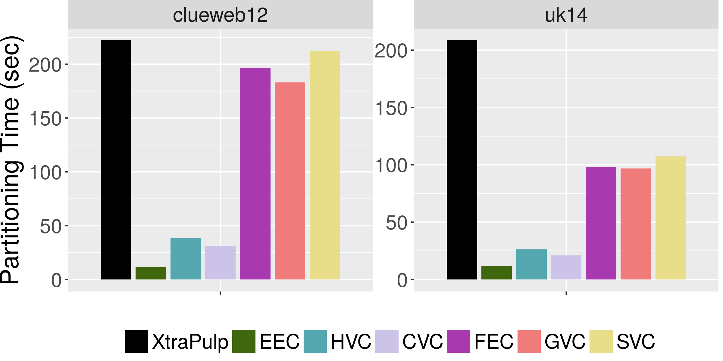
Partitioning Time for CuSP Policies
Additional CuSP policies implemented in few lines of code

Slide 49
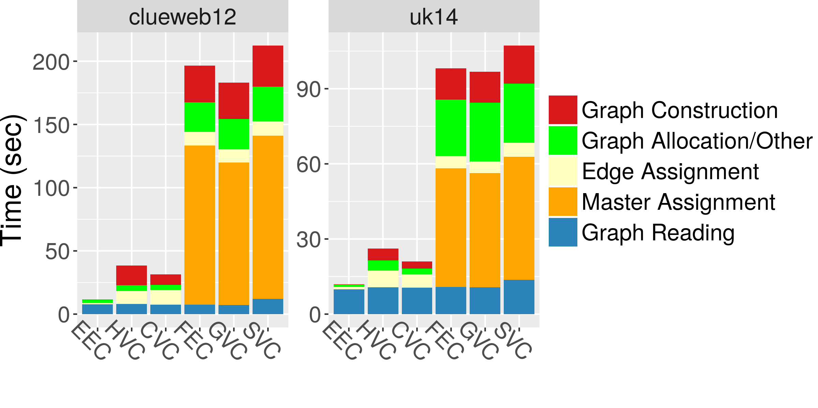
Partitioning Time Phase Breakdown

Slide 50
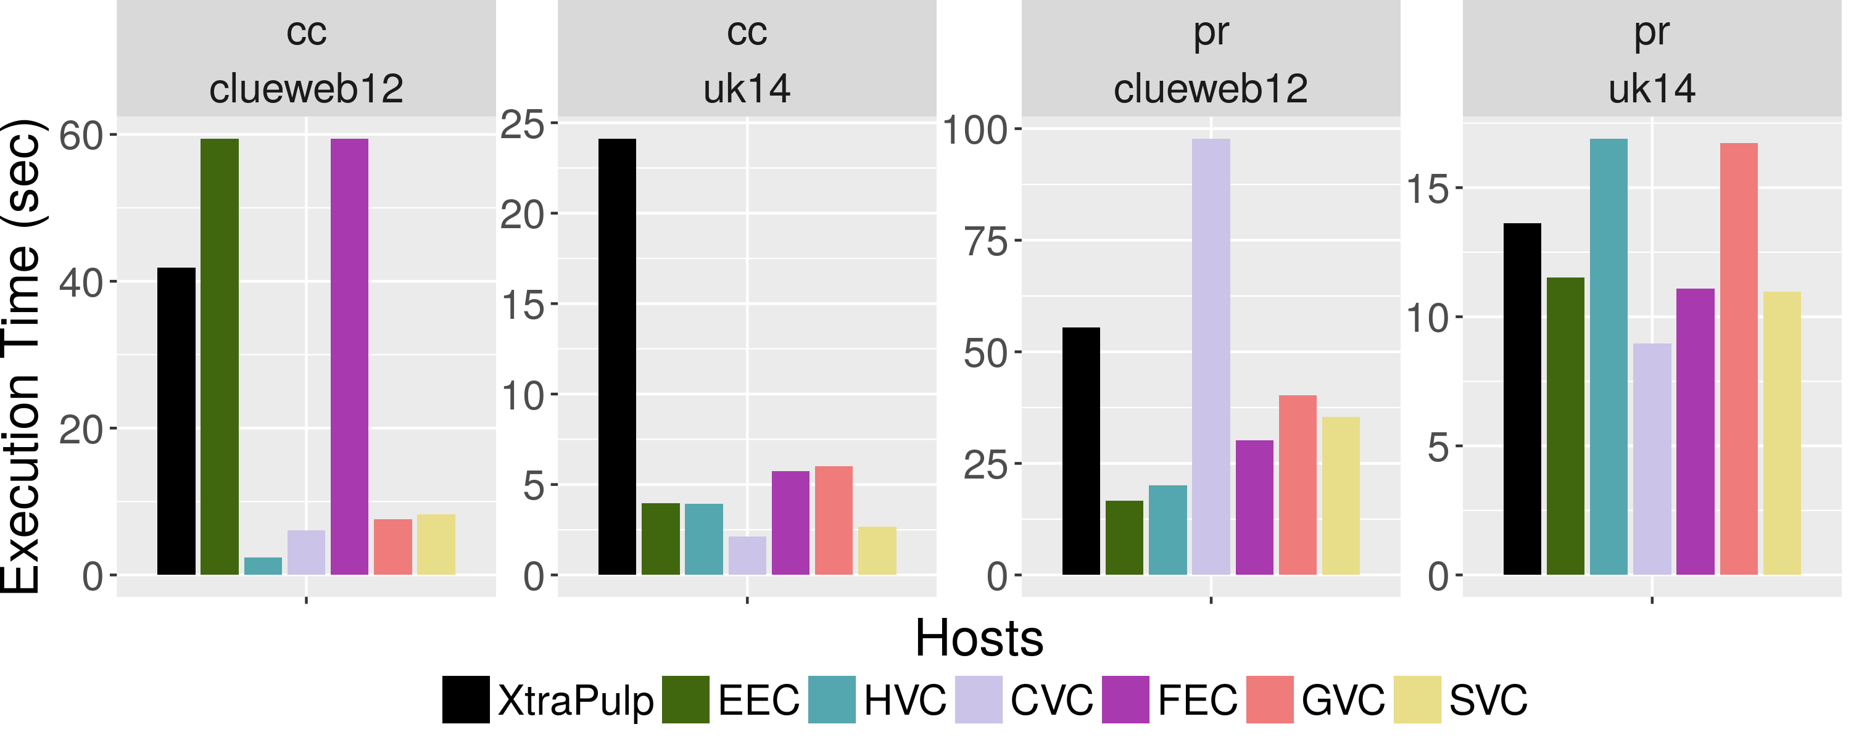
Partitioning Quality at 128 Hosts
No single policy is fastest: depends on input and benchmark

Slide 51
Experimental Summary: Average Speedup over XtraPulp
CuSP is general and programmable
EEC
HVC
CVC
FEC
GVC
SVC

Slide 52
Experimental Summary: Average Speedup over XtraPulp
CuSP is general and programmable
CuSP produces partitions quickly
 | Partitioning Time
EEC | 21.9x
HVC | 10.2x
CVC | 11.9x
FEC | 2.4x
GVC | 2.4x
SVC | 2.3x

Slide 53
Experimental Summary: Average Speedup over XtraPulp
CuSP is general and programmable
CuSP produces partitions quickly
CuSP produces better quality partitions
 | Partitioning Time | Application Execution Time
EEC | 21.9x | 1.4x
HVC | 10.2x | 1.2x
CVC | 11.9x | 1.9x
FEC | 2.4x | 1.1x
GVC | 2.4x | 0.9x
SVC | 2.3x | 1.6x

Slide 54
Conclusion
Presented CuSP:
General abstraction for streaming graph partitioners that can express many policies with small amount of code: 24 policies!
Implemented abstraction
6x faster partitioning time than state-of-the-art XtraPulp
Better quality than XtraPulp edge-cut on graph analytics programs

Slide 55
Source Code
CuSP available in Galois v5.0
Use CuSP and Gluon to make shared memory graph frameworks run on distributed clusters
http://iss.ices.utexas.edu/?p=projects/galois
GPU
IrGL/CUDA/...
Gluon Plugin
CPU
Gluon Comm. Runtime
Galois/Ligra/...
CPU
Gluon Plugin
Gluon Comm. Runtime
Gluon Comm. Runtime
CuSP
CuSP
Network (LCI/MPI)
Network (LCI/MPI)

