Slide 1

Shellf Presentation and Company Overview
Shellf.

Slide 2




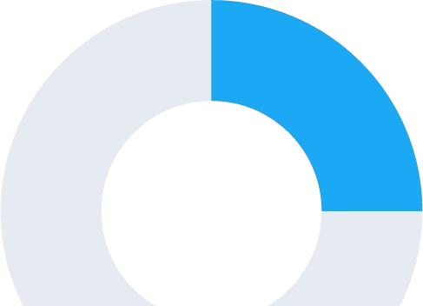
We are a book recommendation company.

Slide 3


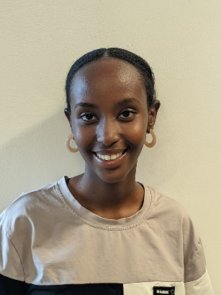
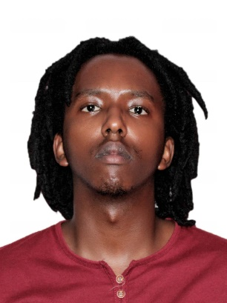





Meet The Team.
LESLIE ISARO.
MWAI KIMIRI.
RAPHAEL MUSOKE.

Slide 4

Problem Statement
Developing a nuanced understanding of diverse cultures within a one-year timeline through targeted educational programs and cross-cultural dialogue through literature to foster inclusivity and harmonious community interactions.

Slide 5



but shellf is so much more
Shellf offers you recommendations of books from different African countries contributed by primary sources from the select country.
Shellf offers curated links to where to acquire the books from.
Shellf offers the opportunity to rate the books on a scale of 1-5 thus allow for data oriented user contribution.

Slide 6
$138.25B
Other continents
TAM
$1.2B
Africa
Sources:
https://smebluepages.com/literature-industry-statistics-in-africa/#:~:text=Industry%20Statistics%3A%20According%20to%20a,being%20the%20largest%20book%20markets.

Slide 7

User experience on Shellf
01
02
User is prompted for a country selection from the list of ten countries each represented by a digit from 1 to 10.
The user can then view the book recommendations as well as a link on where to buy them.
User is greeted with a menu explaining what shellf is.
The user sees a menu of ten countries each with 10 book recommendations.
04
03
The users feedback on rating is stored in a shellf MySQL database. The user can view the average rating of a book by selecting 11.
- The user is also automatically prompted to rate a book.
- The user enters the title then the rating which is from 1-5, five being the best.

Slide 8
Thank You.

