Slide 1
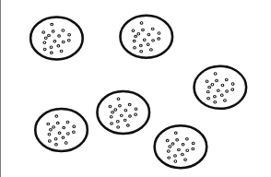
Last assumption
Independence of observations
Longitudinal Data
  Repeated measures on the same individuals over time
Hierarchical Data
  Multiple levels
  E.g., patients seen by different doctors
  Solution: Aggregate – merge patient data per doctor (doctor’s are independent)
  Solution: Analysis within the group (run six regressions for the six doctors)
  Solution: Mixed Models
Y ~ Fixed + (1|Random)
Notes:
Within each group the relationship is negative, but between groups, the relationship is positive.
While we will have random variation due to each patient (say we’re looking at effect of treatment on patient recovery) there might ALSO be random variation due to doctor’s, which is a repeated variable in our dataset...
One row for patient then multiple patients all with the same doctor. We aren’t interested in the effect of doctor on recovery, but we want to control for the fact that some patients had 1 doctor and some had another... This is random variation that we don’t want to model explictely... We don’t want to add another cateogorical variable with 6 or MORE levels... And try to create precise estimates for each doctor is then almost the same as running 6 indepenent models. We want this to modeled as ”NOISE”.
This also controls for non-independence. We often use random effects for individual ID if we have repeated measures for individuals over time.
Random effects also assume that the levels of a random effect are NOT representative but a random sample from the population

Slide 2
Random effects
Control for other sources of random variability in our data (random effects contribute to explaining *residual* variance)
Control for repeated measures and non-independence
Levels of a random effect are not representative, instead they are a random sample from the larger population
  E.g. Doctor as a random effect / grouping variable; they are a random sample of 6 doctors
  E.g. Individual ID. Each individual is randomly selected for inclusion in the dataset
  E.g., Day, Month, Year, Season, PopulationID, GroupID
Generally variables not related to our hypothesis
Do not necessarily care about the specific parameters (e.g. how doctor A differs from B)
Categorial variables only!
Rule of thumb: At least 5 different levels within the random variable
Notes:
With fixed effects, we generally aim to sample the full distribution of probable values.

Slide 3
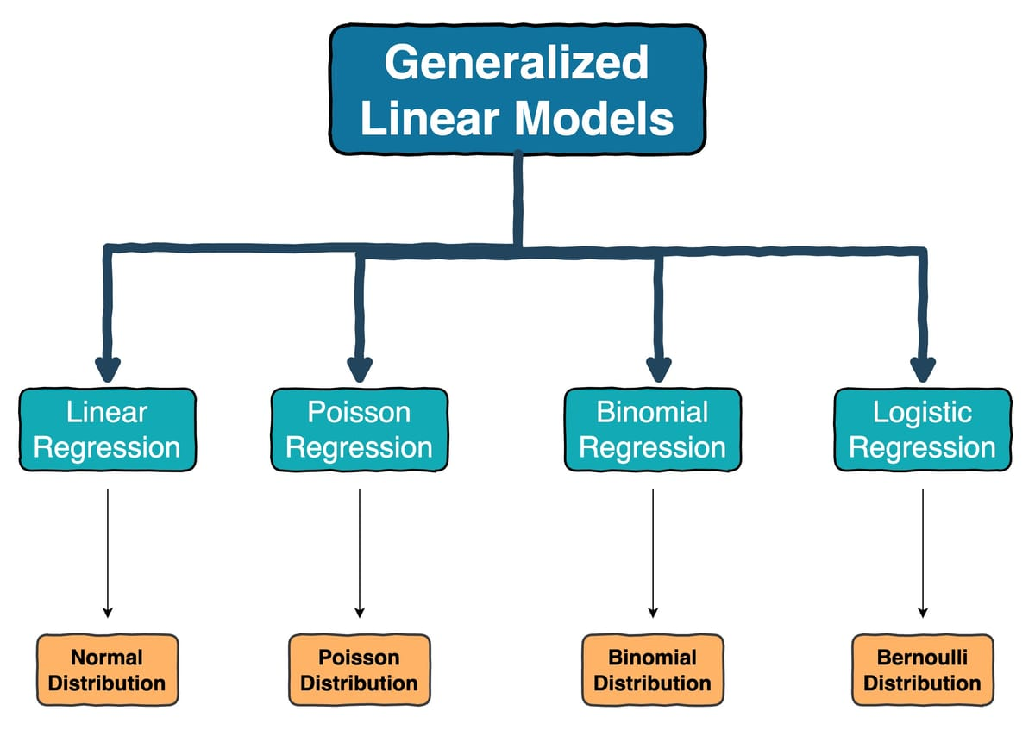
Beta Regression
Beta Distribution

Slide 4
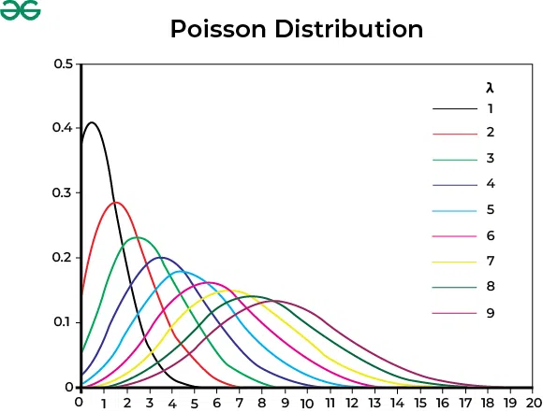
Poisson Regression – Count Data
Link function:
log link
Response distribution:
Poisson
Variance structure:
Var(Y) = Mean(Y)
Checking model fit:
  Uniformity (Residuals)
  Overdispersion: Var(Y) > Mean(Y)
  Zero-inflation: too many zeros
Notes:
Not the same as just log-transforming your response variable… it also assumes variance distribution follows a Poisson rather than Normal distribution

Slide 5
Binomial Regression
Bernoulli – 0/1
(S ~ A + B, family=binomial)
Link: logit
Response distribution: Binomial
Variance structure:
p(1-p)
Checking model fit:
  Uniformity (Residuals)
Binary (# success / # of failures)
(cbind(countS, countF) ~ A + B, family=binomial)
Link: logit
Response distribution: Binomial
Variance structure:
np(1-p)
Checking model fit:
  Uniformity (Residuals)
  Overdispersion
  Zero-Inflation

Slide 6
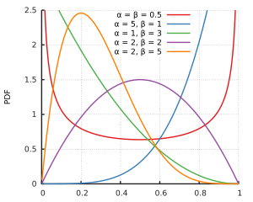
Beta Regression: Proportion data
Link function:
logit
Response distribution:
Beta
Variance structure:
Var(Y)=μ(1−μ)​ / 1+ϕ
Checking model fit:
  Uniformity (Residuals)
  Variance structure (Residuals)
  Zero-inflation: too many zeros
Notes:
Can’t include values of 0 and 1 because the regression then goes to infinity at these values!!

