Slide 1
How to approach (statistical) models:
Models are used to make generalizations about the natural world
The natural world is a ‘noisy’ place, so all statistical models are therefore wrong at some level, but can be good enough to improve understanding
Don’t be discouraged, rather view models as a puzzle to be solved
Notes:
Example of a map vs world

Slide 2
A model

Slide 3
Testing hypotheses with statistics
Our Objective:
To put data into models to assess the determinants of biological variation
So we can ask, is there a difference in means (the summary of the variation in our response variable) that is a function of our independent variable(s)?
To ultimately relate our model back to our hypothesis using null hypothesis significance testing
Notes:
we want to build a biologically relevant model that allows to make predictions or assess associations for individuals that we have sampled from our population
Then we want to determine whether there is support for our hypothesis using null hypothesis significance testing.

Slide 4
Testing hypotheses with statistics
Question – Do meerkats stick closer to the den when there is a predator threat?
Null hypothesis, H₀ – there is no effect on travel distance of a predator dummy
Generally predicts no difference/effect with an estimate of zero
No support for the hypothesis of interest
Alternative hypothesis, H_{A} – there is an effect on travel distance of a predator dummy
One-tailed: Meerkats travel less
Two-tailed: Meerkats travel distance will differ
Generally predicts that the two groups differ
Notes:
This is a one-tailed test because we specified the expected direction of the association.
Two-tailed tests do not specify a direction, just that there is an expected, non-zero, difference between the groups

Slide 5
Testing hypotheses with statistics
Question – Do meerkats stick closer to the den when there is a predator threat?
Null hypothesis, H₀ – there is no effect on travel distance of a predator dummy
Alternative hypothesis, H_{A} – there is an effect on travel distance of a predator dummy
Statistical test on the null hypothesis:
P-value: the probability that our sample mean came from the null distribution of sample means
P-value: the probability of getting our data if the null hypothesis is true!
Typically use a cut-off of 0.05 (small is good!)
If the probability (p-value) is very small.... Then we reject the null hypothesis and “accept” the alternative
Notes:
In reality, no scientific paper spell out the whole null vs alternative hyopthesis. This is purely used for statistical understanding/correctness.

Slide 6
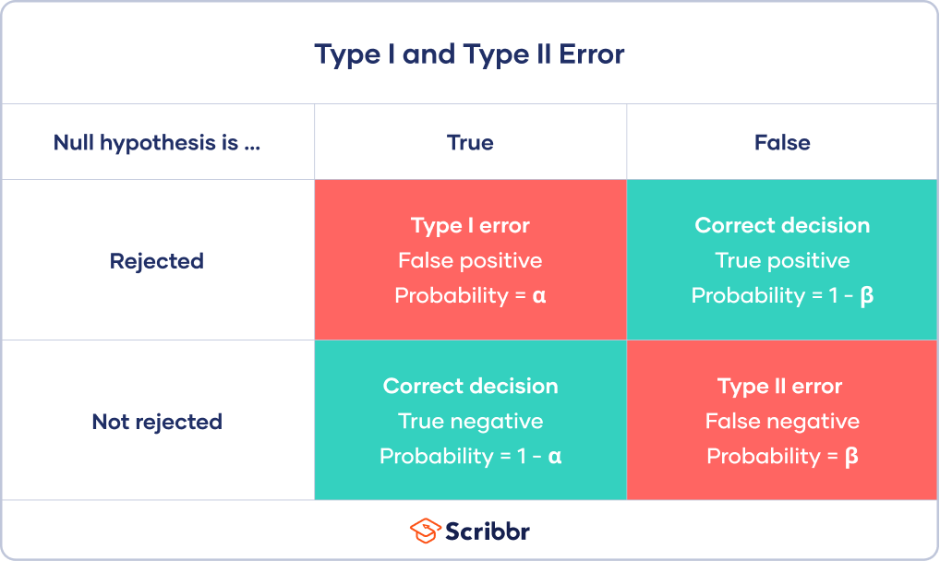
Type 1 and Type 2 Error
Notes:
Alpha – the level of risk we choose to take with p-values... We reject null if our p-value is less than this alpha.. This means over the long run we have roughly a 5% chance of rejecting null when the null is true. So 1 in 20 of our statistical tests could very well lead to false conclusions!
1-alpha is the probability of correctly rejecting the null..
Beta is type 2 error, probabiliyt of a false negative (show graph)
Power is 1-B... And this is an important value because it’s the probability of saying yes there is an effect if there really is one... And it’s typically less than 95% but again we can never estimate it for our data because we don’t know the true population mean.
But we can estimate power before we do a study with the idea that.. If the effect size is X... what sample size do we need to acheive % power? If we do this post-hoc using our effect size, it will return our exact sample size (if our test was significant).

Slide 7
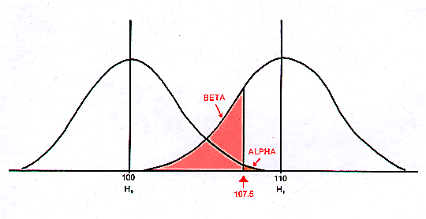
Notes:
Power is 1-beta (so the rest of this curve
We don’t know the H1 true population mean... So we can never truly calculate beta and power. This is why most of statistics revolves around null hypothesis testing, because this gives us a solid number (usually zero) that we can reliably compare our mean to. We can somewhat confidently say it’s NOT zero.

Slide 8
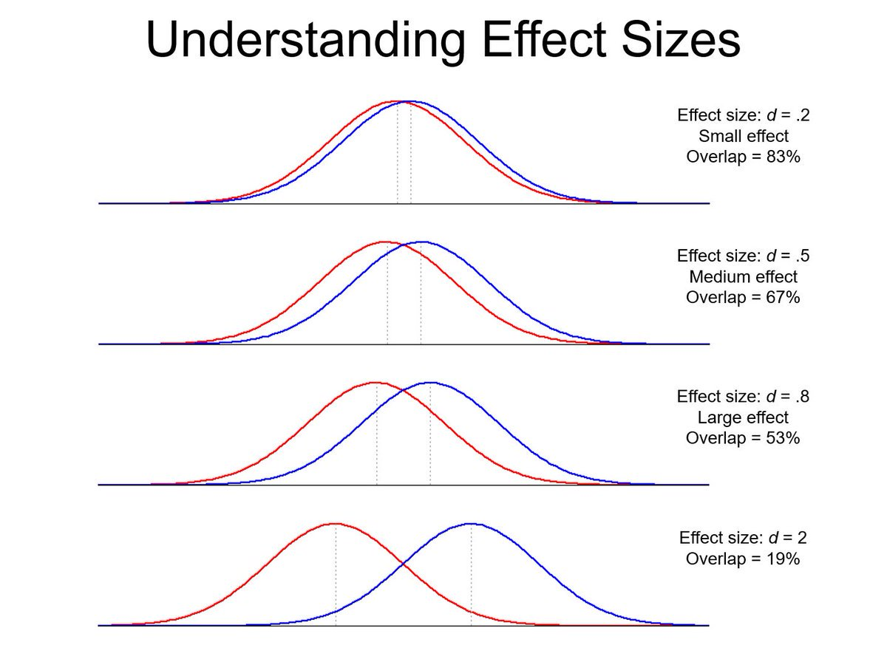
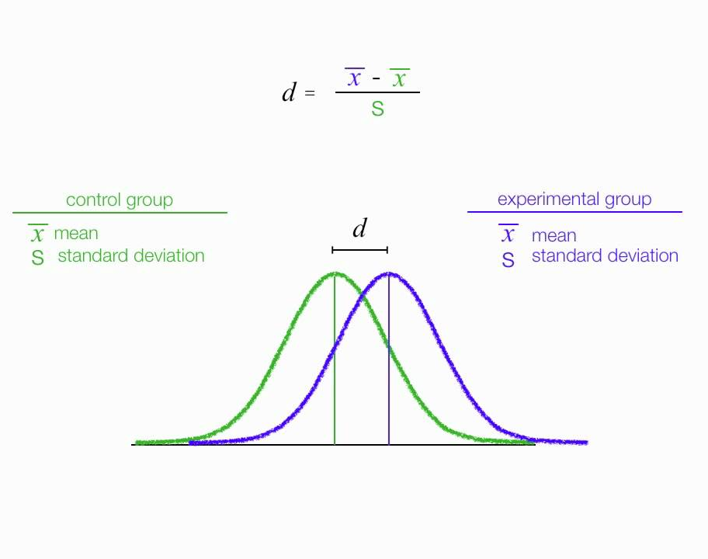
Effect Size
Notes:
So, if we can use estimates of effect size from other studies to make a guess about what sample size we need for high power (typically 80%) then what IS effect size?

Slide 9
A priori Power Tests
Notes:
Draw curves.. Sample sizes affect SE which affect these curves.... We want to know how big of a sample size we need to detect X effect...
Draw the null hypothesis distribution of sampling means… estimate of effect size (how far out), then how big sample size to get the null curve skinny enough to reach significance

Slide 10
Independent vs dependent variables
Dependent variable (response variable)
Typically the variable which our hypothesis refers to
Variable we want to measure the change or variation in
Outcome or effect
Dependent on other variables
Y-axis
Independent variables (predictor variables)
Manipulated factor
Cause
Explanatory variable that explains variation in the response variable
What influences the outcome
X-axis
X causes/affects Y

Slide 11
Is the response variable continuous
Which statistical test?
Yes
No
Is the predictor variable continuous
Is the predictor variable categorical count data?
No, it is/they are categorical
Yes
Yes
How many groups?
Correlation/regression
Chi-squared test
1 or 2
>2
Two continuous variables
Two or more groups, count data, categorical variables
T-test
ANOVA
Two or more groups, categorical predictor, continuous response
One sample
Two sample
Paired
What’s your data?
Categorical predictor, continuous response
2
T-test
ANOVA
Two groups, categorical predictor, continuous response
Two or more groups, categorical predictor, continuous response

Slide 12
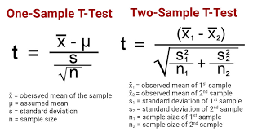
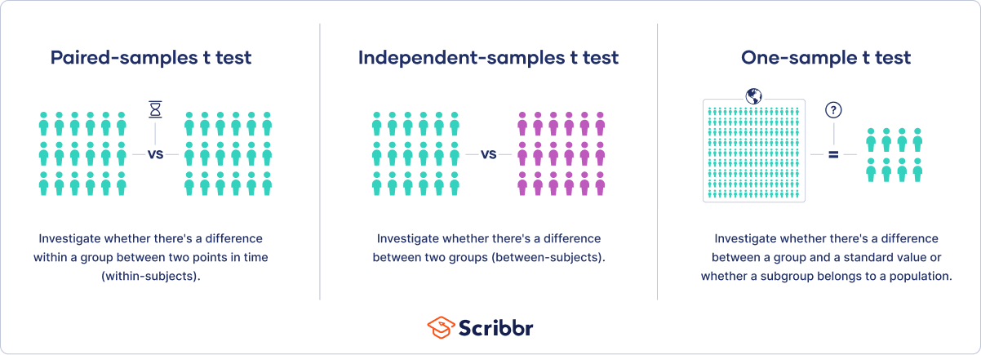
T-Tests
1 continuous response variable
1 to 2 “groups”

Slide 13
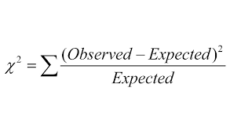
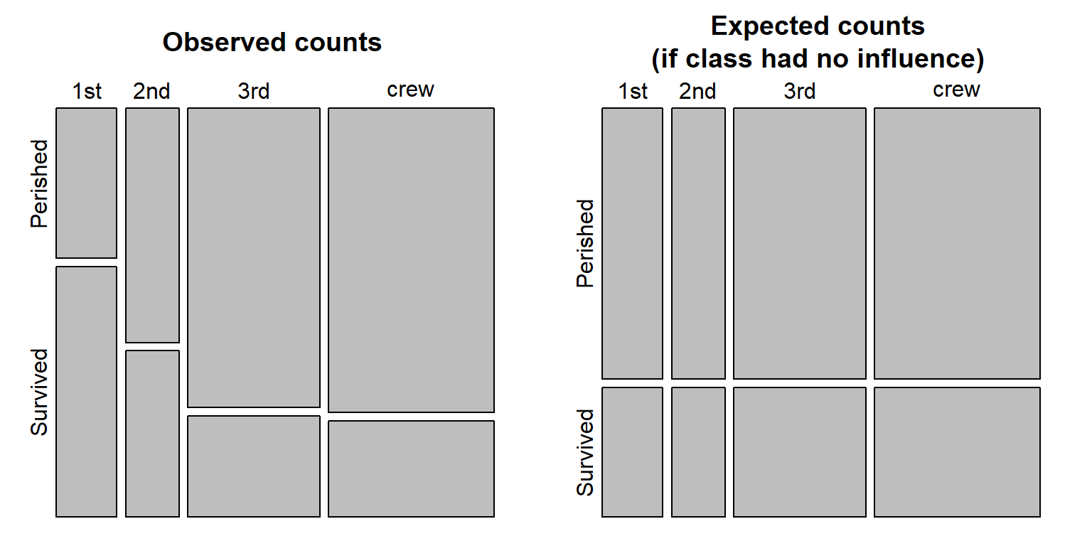
Chi-Square
Count variables (categorical vs categorical)

Slide 14
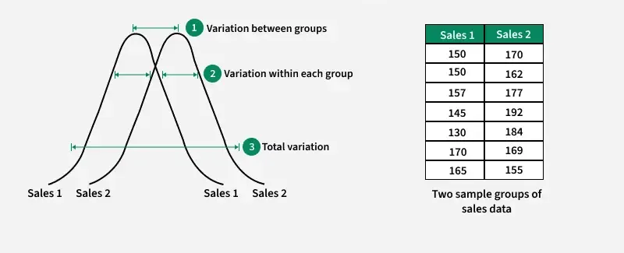
ANOVA – Analysis of Variance
1 continuous response variable
2+ groups

Slide 15
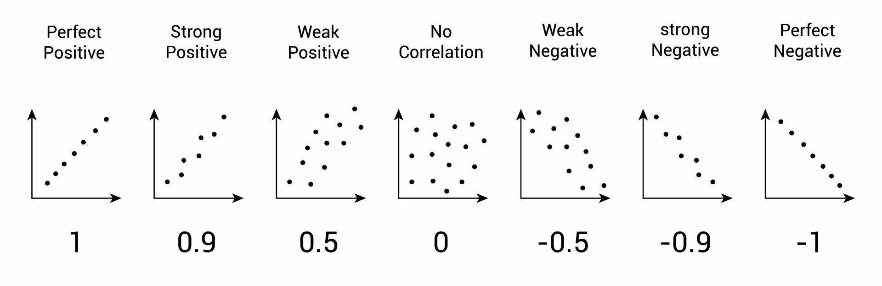
Correlation
2 continuous variables (response and predictor)

Slide 16
Parametric Test Assumptions
Assume data follow a certain distribution (often normal)
CLT applies for mildly skewed data at N ~ 30, moderately skewed N ~ 50-100, highly skewed or discrete distribution then distribution of sample might never be normal
Rely on parameters like the mean and standard deviation.
Examples: t-test, ANOVA, Pearson correlation, linear regression.
Pros: More power when assumptions are met.

Slide 17
Non-Parametric Tests
Make fewer assumptions about distributions.
Use ranks or medians instead of means.
Examples: Wilcoxon rank-sum (Mann–Whitney U), Kruskal–Wallis, Spearman correlation.
Pros: Safer for small samples, skewed/outlier-heavy data.
Cons: Less power if parametric assumptions are actually fine.
When to use:
Dependent variable not normally distributed (esp. with small n).
Ordinal data (rankings, categories).
Extreme outliers that can’t be reasonably removed.
Notes:
DV not normally distributed (esp. with small n).
Ordinal data (rankings, categories).
Extreme outliers that can’t be reasonably removed.

Slide 18
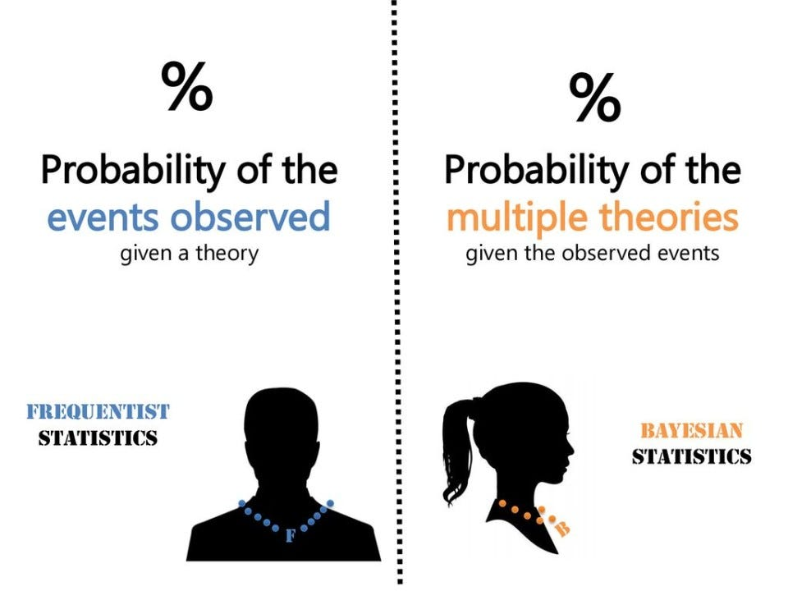

Slide 19
Attributes: | Bayesian: | Frequentist:
What is it? | Probability distribution around the parameters | Parameters are fixed and a single point
What does it question? | Given the data, what is the probability of the hypothesis? | Given the null hypothesis, what is the probability of the data?
What does it require? | Prior knowledge/information and any dataset. | A stopping criterion
What does it output? | A for or against probability about the hypothesis. | point estimate (p-value)
Main advantage | Backed up with evidence and can apply new information | They are simple and easy to use, and does not need prior knowledge
Main disadvantage | Requires advanced statistics | Highly dependent on the sample size, and only give a yes or no output
When should I use it? | Limited your data when you have priors Uses more computing power | With a large amount of data

