Slide 1
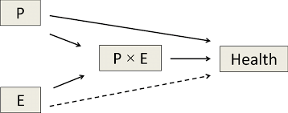
Interaction Effect

Slide 2
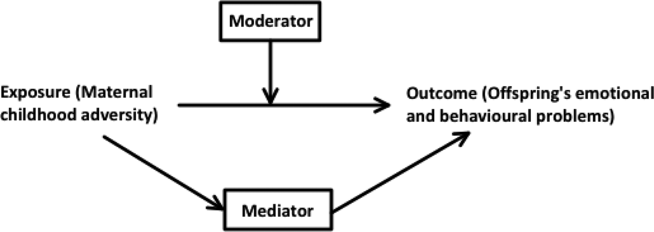
Moderators

Slide 3
Confound
Covariate
Mediator
Predictor 1
Predictor 1 x 2
Response
Predictor 2
Moderator

