Slide 1
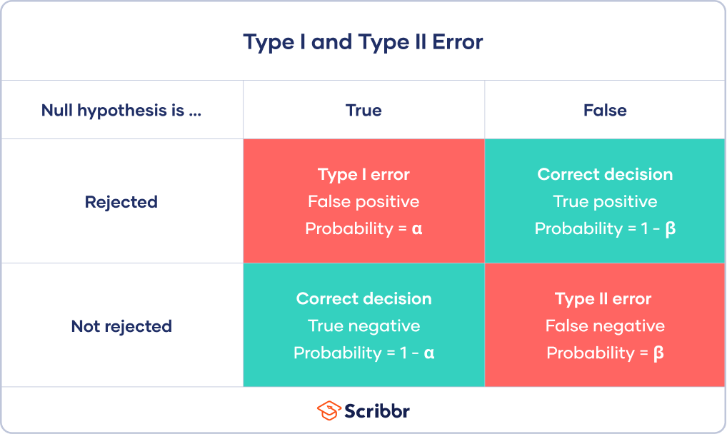
Type 1 and Type 2 Error
Notes:
Alpha – the level of risk we choose to take with p-values... We reject null if our p-value is less than this alpha.. This means over the long run we have roughly a 5% chance of rejecting null when the null is true. So 1 in 20 of our statistical tests could very well lead to false conclusions!
1-alpha is the probability of correctly rejecting the null.. So we have a 95% probability of finding non-significant effect is the null is true.
Beta is the probability of type 2 error (or a false negative, we accept the null hypothesis when the alternative hypothesis is actually true). It is impossible to know what beta TRULY is.
Power is 1-B... And this is an important value because it’s the probability of saying yes there is an effect if there really is one... And it’s typically less than 95% but again we can never estimate it for our data because we don’t know the true population mean.
But we can estimate power before we do a study with the idea that.. If the effect size is X... what sample size do we need to acheive % power? If we do this post-hoc using our effect size, it will return our exact sample size (if our test was significant).

Slide 2
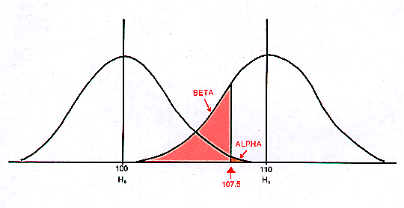
Notes:
We don’t know the true population... But we can make a guess about the size of an effect we’re trying to detect that is biologically meaningful. And we can estimate standard deviation from previous studies or pilot data.

Slide 3
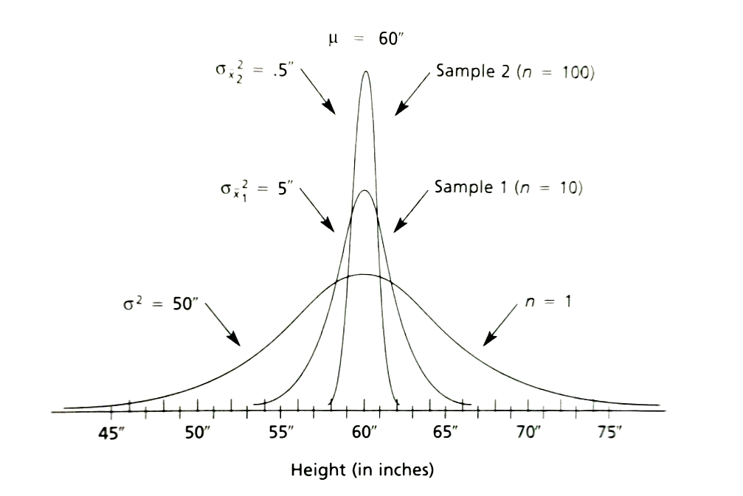
A priori Power Tests
Standard error = 0.5”
Distribution of sample means
Distribution of sample means
Standard error = 1.59”
Distribution of scores
Standard deviation = 5”
Notes:
How skinny do we need our distribution of sample means to be to NOT overlap too much with the distribution of sample means for the null hypothesis?

Slide 4
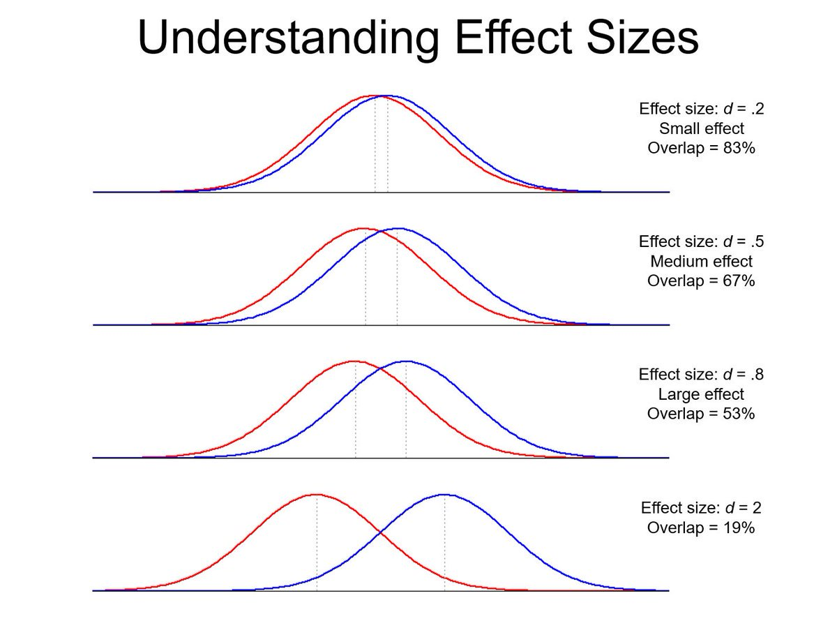
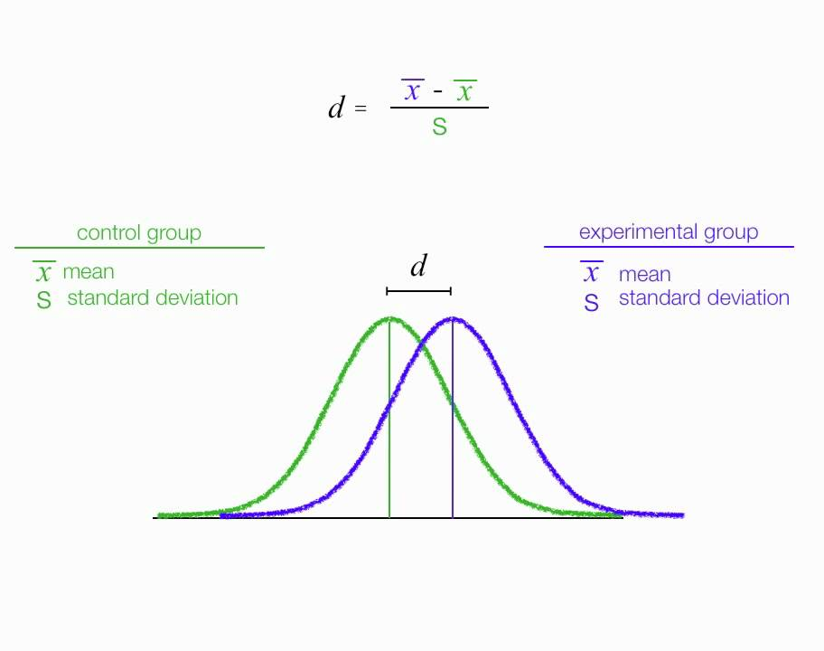
Effect Size
Notes:
So, if we can use estimates of effect size from other studies to make a guess about what sample size we need for high power (typically 80%) then what IS effect size?

Slide 5
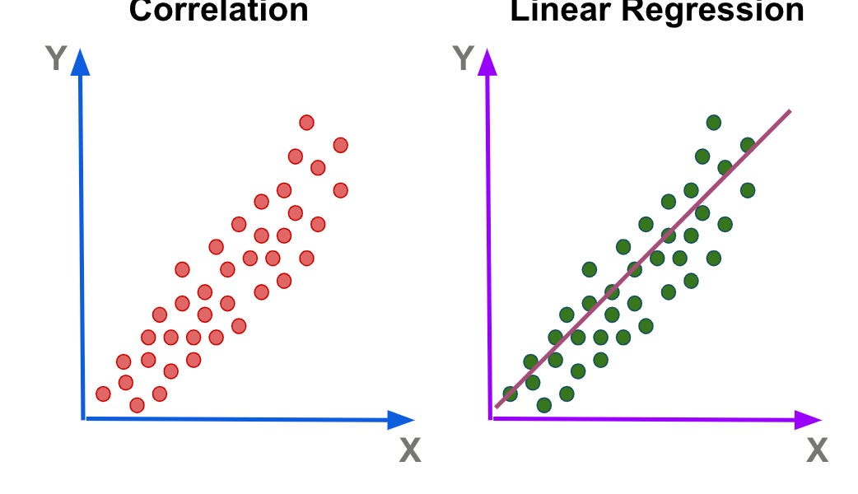
Correlation vs Regression
r=0.5
y = mx + b
Notes:
Correlation is just about the association between two variables. An r value tells us how tight or loose that association is.
Regression gives similar results to correlation, but instead of an r value that describes the cloud of points, with regression use a line-of-best-fit and extract information like the slope and intercept of the line. We can use this “model” to make a predictions about where we expect y to be based on any given value of x.

Slide 6
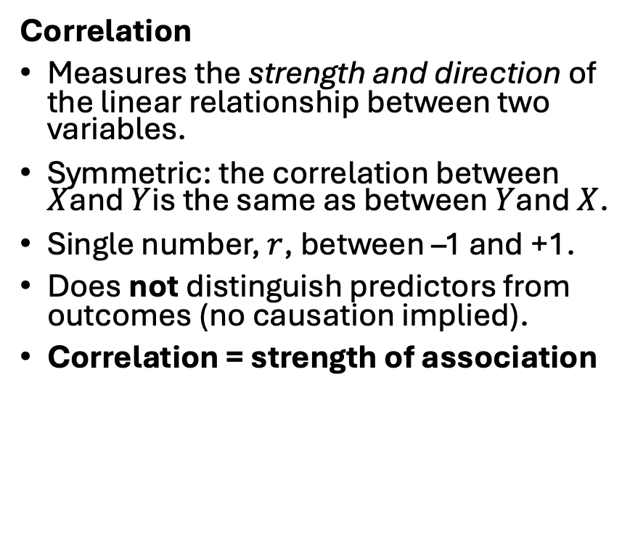
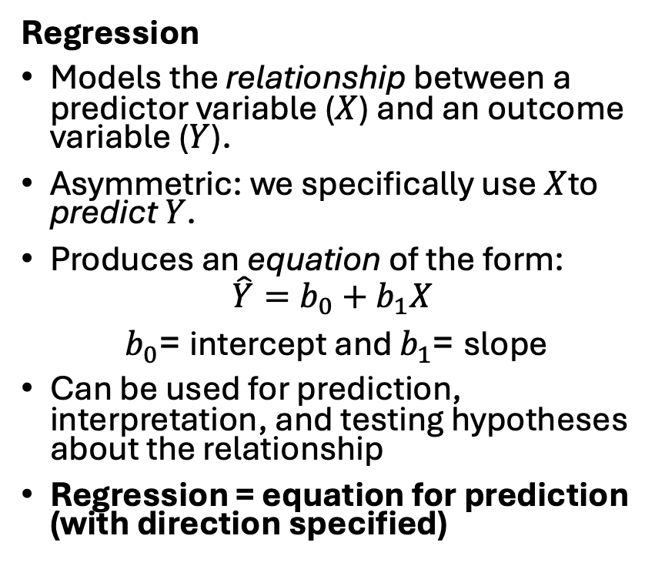
Correlation vs Regression
Correlation
Measures the strength and direction of the linear relationship between two variables.
Symmetric: the correlation between $X$and $Y$is the same as between $Y$and $X$.
Single number, $r$, between –1 and +1.
Does not distinguish predictors from outcomes (no causation implied).
Correlation = strength of association
Regression
Models the relationship between a predictor variable ($X$) and an outcome variable ($Y$).
Asymmetric: we specifically use $X$to predict $Y$.
Produces an equation of the form:
$$\hat{Y}=b_{0}+b_{1}X$$
$b_{0}$= intercept and $b_{1}$= slope
Can be used for prediction, interpretation, and testing hypotheses about the relationship
Regression = equation for prediction (with direction specified)
Notes:
This is just a cheatsheet for your records, the key takeway is that correlation is the strength of the association whereas regression is an equation for prediction.

Slide 7
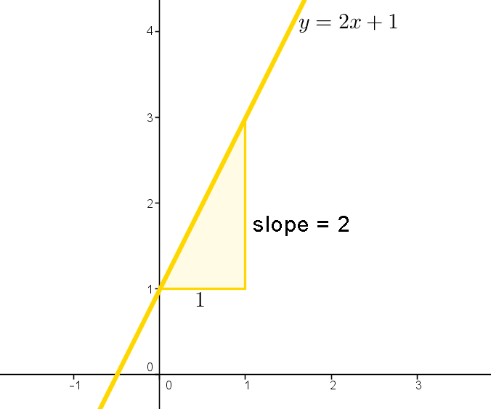
Linear Algebra
In algebra (a straight line equation):
y = mx + b
y = the outcome (dependent variable, the vertical axis).
x = the input (independent variable, horizontal axis).
m = slope (rise over run; how much y changes when x increases by 1).
b = intercept (value of y when x = 0).
This is purely deterministic: once you set x, y is exactly determined
Notes:
Does everyone vaguely remember this back from algebra a long time ago?

Slide 8
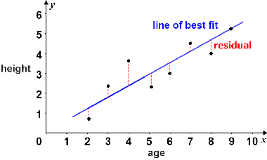
Regression Equations
ŷ_{i} = b₀ + b₁x_{i}
In regression:
y_{i​} = b₀​ + b₁​x_{i} ​+ e_{i}​
y_{i​} = observed outcome for the i^{th} data point
b₀ = intercept (estimated from data; the mean value of y when x = 0)
b₁ = slope coefficient (estimated from data; expected change in y for a 1-unit increase in x)
x_{i} = predictor (independent variable for the i^{th} data point)
e_{i} ​ = residual error (the difference between the observed y_{i​} and the predicted value ŷ_{i} ​)
Key difference: the regression model assumes data are noisy. The equation doesn’t claim y lies exactly on the line; instead, it says:
Observed value = Predicted (line) + Random error
y_{i}
e_{i}
x_{i}
Notes:
Just like with algebra we can estimate b0 and estimate b1 AND we can take a value for x and get a predicted y-hat.
We also get an estimate for E (the residuals).
The math for calculating b0 b1 and e is complicated, so we almost always let the computers do this for us.
Xi and yi are YOUR RAW DATA

Slide 9
Assumptions
The relationship between the independent and dependent variable is linear: the line of best fit through the data points is a straight line (rather than a curve or some sort of grouping factor).
Independence of observations: the observations in the dataset were collected using statistically valid sampling methods, and there are no hidden relationships among observations.
Normality: The residuals follow a normal distribution.
Homogeneity of variance (homoscedasticity): the size of the error (residuals) in our prediction doesn’t change significantly across the values of the independent variable.
Notes:
Almost the same as for ANOVA!

Slide 10
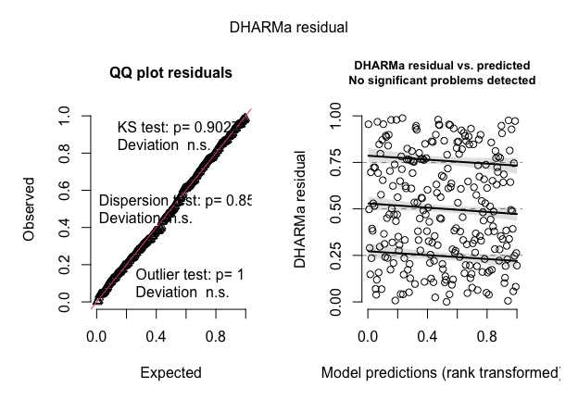
Ideal residual diagnostics

Slide 11
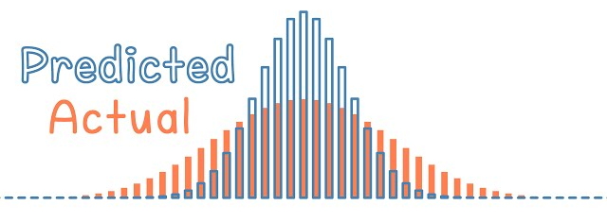
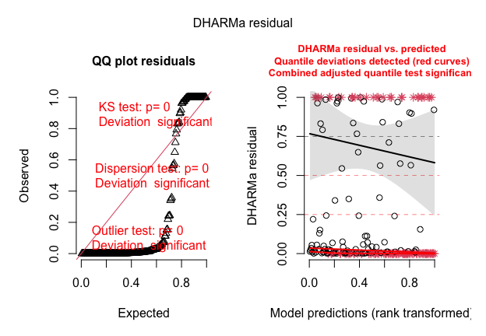
Less than ideal: Overdispersion
Notes:
This this is how overdispersion looks like in the DHARMa residuals. Note that we get more residuals around 0 and 1, which means that more residuals are in the tail of distribution than would be expected under the fitted model. Usually model misfit, meaning we’re fitting a simple linear regression when maybe we should be doing something like binomial, poisson, or negative binomial. This is typically for data where y is not a normally distributed, continuous variable.

Slide 12
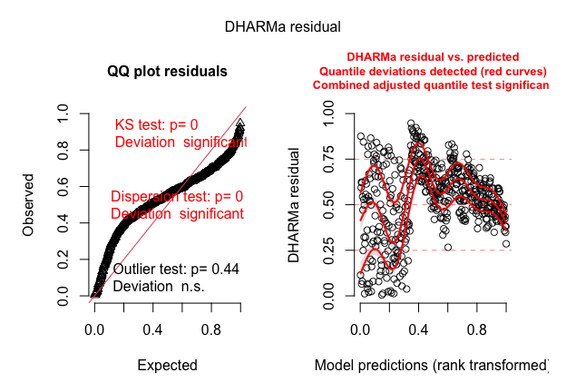
Less than ideal: Underdispersion
Notes:
Next, this is an example of underdispersion. Here, we get too many residuals around 0.5, which means that we are not getting as many residuals as we would expect in the tail of the distribution than expected from the fitted model. This is often caused by overfitting the model, meaning we’ve added so many variables that the model is too complex.

Slide 13
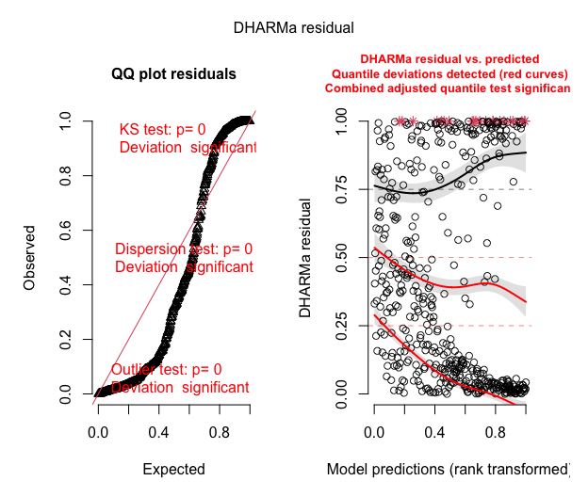
Less than ideal: zero-inflated data
Notes:
This is from zero-inflated data, which looks similar to overdispersion with too many residuals close to 0 and 1. We also see a “pattern” in the residuals vs predicted as opposed to a homogenous cloud. Across our predicted values for y at high values of y all the residuals are clumped at zero and 1. Though the model is doing a good with predicted values closer to zero... The residuals look almost normal there (the left side of the plot).

Slide 14
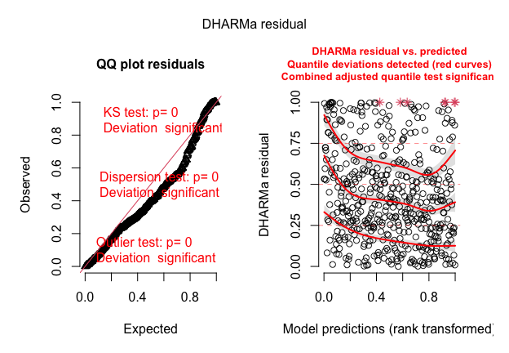
Less than ideal: Heteroscedasticity
Notes:
Basically, it means that the level of over/underdispersion depends on another parameter in the model.

Slide 15
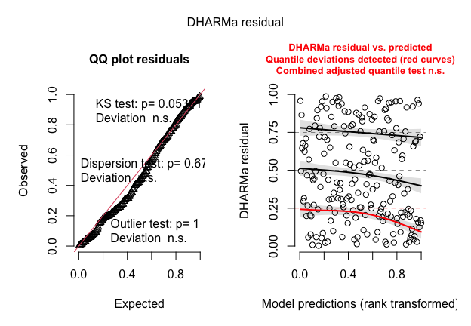
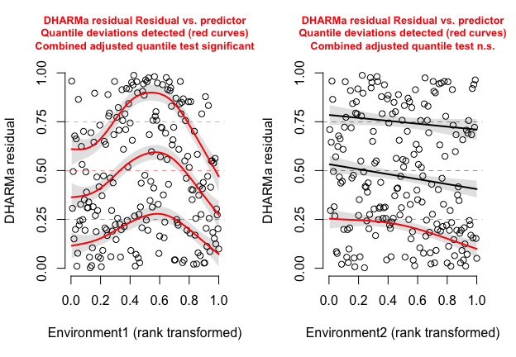
Less than ideal: Missing a quadratic effect
Notes:
Relationship not linear! This is a model with two predictors, environment 1 and environment 2, the plot for environment 1 x residual shows us that we’ve got a systemetic problem with higher error towards the middle of our distribution of x.
But how much does this affect how well our model describes our data?

