Slide 1
Vocab
X (or X1, X2, X3)
Independent variables Y <- X
Predictor variables Y <- X
Treatments Y <- X
Exposures Y <- X
Causes Y <- X
Covariates Y <- Cv
Mediators Y <- M <- X
Moderators Y <- X + X:M
Confounds Y <- X + Cf
Interactions Y <- X1*X2
Fixed Effects Y <- X
(Random Effects) Y <- (1|R)
Dependent variable
Response variable
Outcome
Y
~
<-
←

Slide 2
Identify the relationships #1:
Getting more sleep usually reduces stress.
But for people who drink a lot of caffeine, sleep doesn’t help much—the relationship between sleep and stress depends on caffeine intake.
Sleep
Caffeine
Stress
Notes:
How does caffeine change the slope of the relationship between sleep and stress?
MODERATOR!

Slide 3
Identify the relationships #2:
People with higher education tend to have better health. But education also increases income, and higher income allows access to healthier food and healthcare.
Does education affect health directly or indirectly through income?
Income
Health
Education
Notes:
Arrange a DAG!
Test it in R
**THIS IS A MEDIATOR

Slide 4
Identify the relationships #3:
In a behavioral ecology experiment, prey vigilance increases when predators are nearby.
However, this effect is stronger in species that live in open habitats than those in dense forests.
Vigilance
Habitat
Predator Density
Notes:
Interaction effect

Slide 5
Identify the relationships: #4
Researchers find that people who live nearer parks and green spaces report better mental health.
However, neighborhoods with more green space also tend to have higher socioeconomic status (SES), and higher SES is itself linked to better mental health.
Green
SES
Mental Health
Notes:
Confound!

Slide 6
#4: Bonus: “Colliders”
Suppose that both intelligence and athletic ability increase the chance of being accepted to an elite school.
If we only look at students within that school, intelligence and athletic ability appear negatively correlated even though they’re independent in the population.
Intelligence
Elite School
Athletic Ability

Slide 7
Assumptions are about model fit
If the model fits the data adequately:
  A nice straight line will match the pattern of data points (x,y)
  Residuals will be normally distributed (hist, qqplot)
  Residuals will be homogenous across all levels of the predicted variable
  Correlations between predictors are not so strong that the model can’t identify which one is influencing the response variable
Non-linear relationship- what happens to model fit?
Notes:
Do R example for non-linear predictor

Slide 8
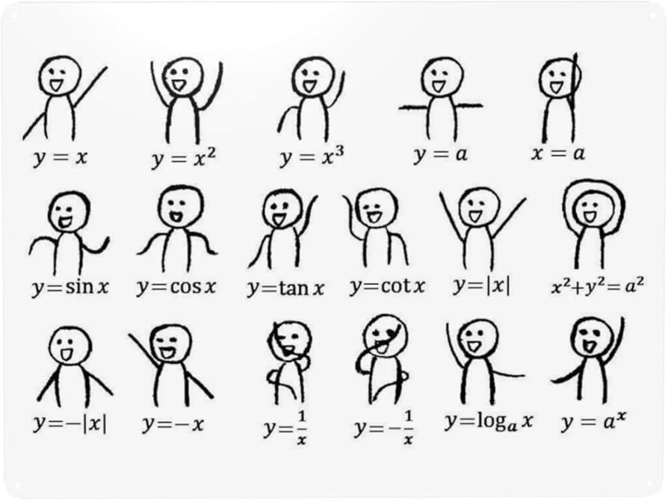
Notes:
A = intercept only model

Slide 9
Variance Inflation Coefficients
When two variables are highly correlated this can reduce the regression model’s ability to partition variance among different predictors
Inflates the variation (standard deviation) for the highly correlated variables and both may become non-significant (even if one of them is actually a strong casual predictor!)
VIFs tell us how much variation is inflated due to correlation between variables (not just how much they correlate)

Slide 10
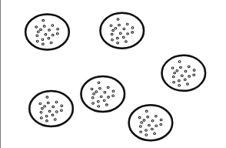
Last assumption
Independence of observations
Longitudinal Data
  Repeated measures on the same individuals over time
Hierarchical Data
  Multiple levels
  E.g., patients seen by different doctors
  Solution: Aggregate – merge patient data per doctor (doctor’s are independent)
  Solution: Analysis within the group (run six regressions for the six doctors)
  Solution: Mixed Models
Y ~ Fixed + (1|Random)
Notes:
Within each group the relationship is negative, but between groups, the relationship is positive.
While we will have random variation due to each patient (say we’re looking at effect of treatment on patient recovery) there might ALSO be random variation due to doctor’s, which is a repeated variable in our dataset...
One row for patient then multiple patients all with the same doctor. We aren’t interested in the effect of doctor on recovery, but we want to control for the fact that some patients had 1 doctor and some had another... This is random variation that we don’t want to model explictely... We don’t want to add another cateogorical variable with 6 or MORE levels... And try to create precise estimates for each doctor is then almost the same as running 6 indepenent models. We want this to modeled as ”NOISE”.
This also controls for non-independence. We often use random effects for individual ID if we have repeated measures for individuals over time.
Random effects also assume that the levels of a random effect are NOT representative but a random sample from the population

Slide 11
Random effects
Control for other sources of random variability in our data (random effects contribute to explaining *residual* variance)
Control for repeated measures and non-independence
Levels of a random effect are not representative, instead they are a random sample from the larger population
  E.g. Doctor as a random effect / grouping variable; they are a random sample of 6 doctors
  E.g. Individual ID.. Each individual is randomly selected for inclusion in the dataset
Generally not related to our hypothesis
Do not necessarily care about the specific parameters (e.g. how doctor A differs from B)
Notes:
With fixed effects, we generally aim to sample the full distribution of probable values.

