Slide 1
Regression Equations
ŷ_{i} = b₀ + b₁x_{i}
y_{i}
e_{i}
y_{i​} = b₀​ + b₁​x_{i} ​+ e_{i}​
y_{i​} = observed outcome for the i^{th} data point
b₀ = intercept
b₁ = slope coefficient
x_{i} = predictor
e_{i} ​ = residual error
x_{i}
Notes:
Just like with algebra we can estimate b0 and estimate b1 AND we can take a value for x and get a predicted y-hat.
We also get an estimate for E (the residuals).
The math for calculating b0 b1 and e is complicated, so we almost always let the computers do this for us.
Xi and yi are YOUR RAW DATA

Slide 2
Regression Assumptions
Linearity of relationship between x and y
Independent observations
Normality of residuals
Homoscedasticity of residuals
No multicollinearity (predictors are not too highly correlated with each other)

Slide 3
How are height and weight related?
Notes:
Draw on the whiteboard
Height - > weight
Statistically it’s equally probable that weight causes height as height causes weight… but we know based on human biology that changing someone’s weight does not affect height, but as a person’s height changes their weight also changes.
So we model a simple linear regression as weight ~ height
Slope, tell us if we change height, how much does weight change?!

Slide 4
How are height, weight, and sex related?
*multiple regression isn’t asking how do both sex and height affect weight (you could do 2 simple regressions for this) *multiple regression asks how they affect weight while controlling for the effect of the other!
Notes:
Sex affects both height and weight
Weight ~ sex (total effect of sex on weight including sex’s effect on height)
Height ~ sex (total and direct effect of sex on height)
Weight ~ height + sex (direct effect of sex on weight)
Three different questions:
Causal effect of H on W? Casual effect of S on W? (part goes through the H path) (don’t put H in model) Direct causal effect of S on W?
Go to R.

Slide 5
Does exercise improve lung function?
What do we need to control for?
Notes:
Draw DAG

Slide 6
Plant growth experiment
Growing plants in a greenhouse
Fungus reduces growth
Test for the effect of an anti-fungal treatment
Measure:
Beginning Height
End Height
Fungal status after treatment (0/1)
Treatment status (0/1)
What is our hypothesis and null hypothesis?
What is our response variable?
What predictor variables should we use?

Slide 7
Plant growth experiment
Notes:
Draw DAG
Growth, treatment, fungus

Slide 8
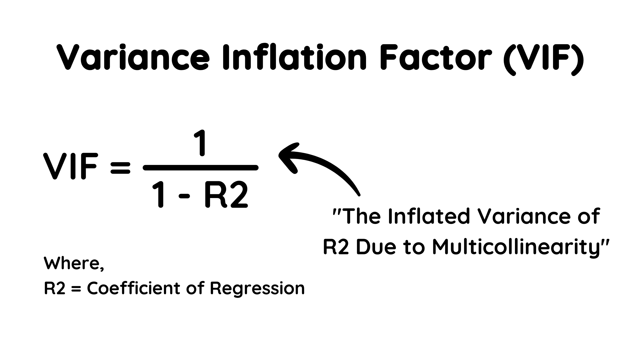
Multicollinearity – what does this mean?
If A and B are super highly correlated then the model will have a difficult time statistically separating their effects

