Slide 1
What is survival analysis?
A set of statistical tools for time-to-event data
“Event” can be anything: death, failure, leaving a study site, egg hatching, relapse, solving success, hunt success, etc.
Key feature: Some individuals do not experience the event during the study → censoring
Models: Kaplan–Meier, Cox proportional hazards, parametric survival models

Slide 2
Why use survival analysis?
Different individuals are followed for different lengths of time
Some observations are incomplete (sometimes the event never occurs)
You want to compare groups on both the duration/count and whether or not the event occurs!
You want to incorporate covariates to understand what speeds/slows the event
Avoids treating survival time as a simple continuous variable (with an arbitrary upper limit for those in which the event didn’t occur) OR just using a binary for event (0/1) which doesn’t allow you to analyze the amount of time and how that affects the probability of the event
Ignoring censoring (which biases means downward)

Slide 3
Key Concepts
Time variable (t)
Time until event (e.g., days alive, time to desert territory)
Event indicator (1/0)
1 = event occurred
0 = censored (still alive, still on territory, etc.)
Censoring
Right-censoring: most common
Occurs when you stop observing before the event
Usually by design (collect data for X timespan)
Hazard
Instantaneous risk of the event at time t

Slide 4
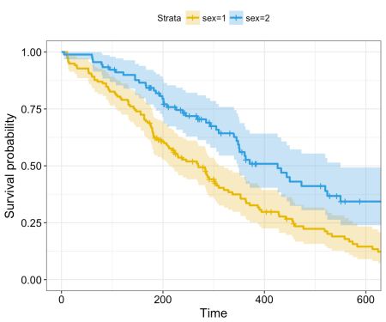
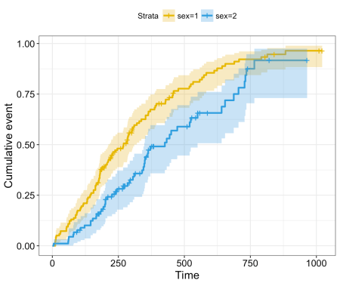
Survival Curves

Slide 5
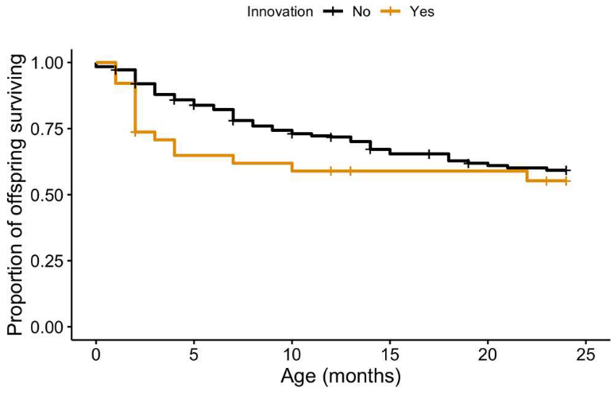
Survival Curves

Slide 6
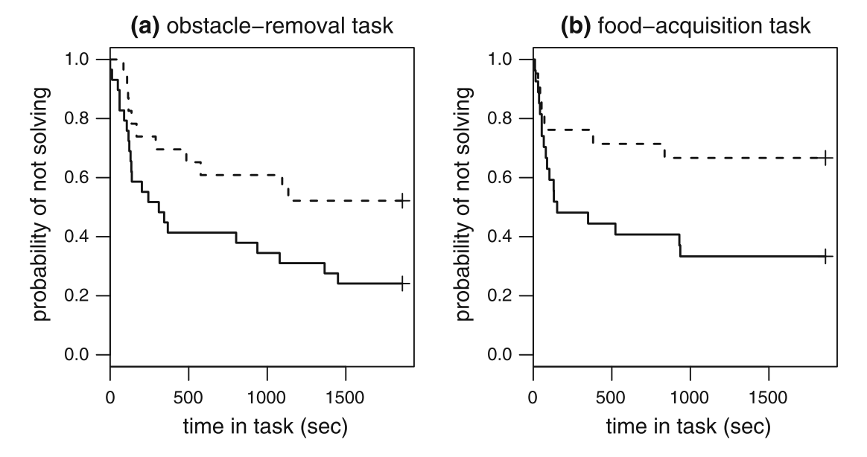
Survival Curves

Slide 7
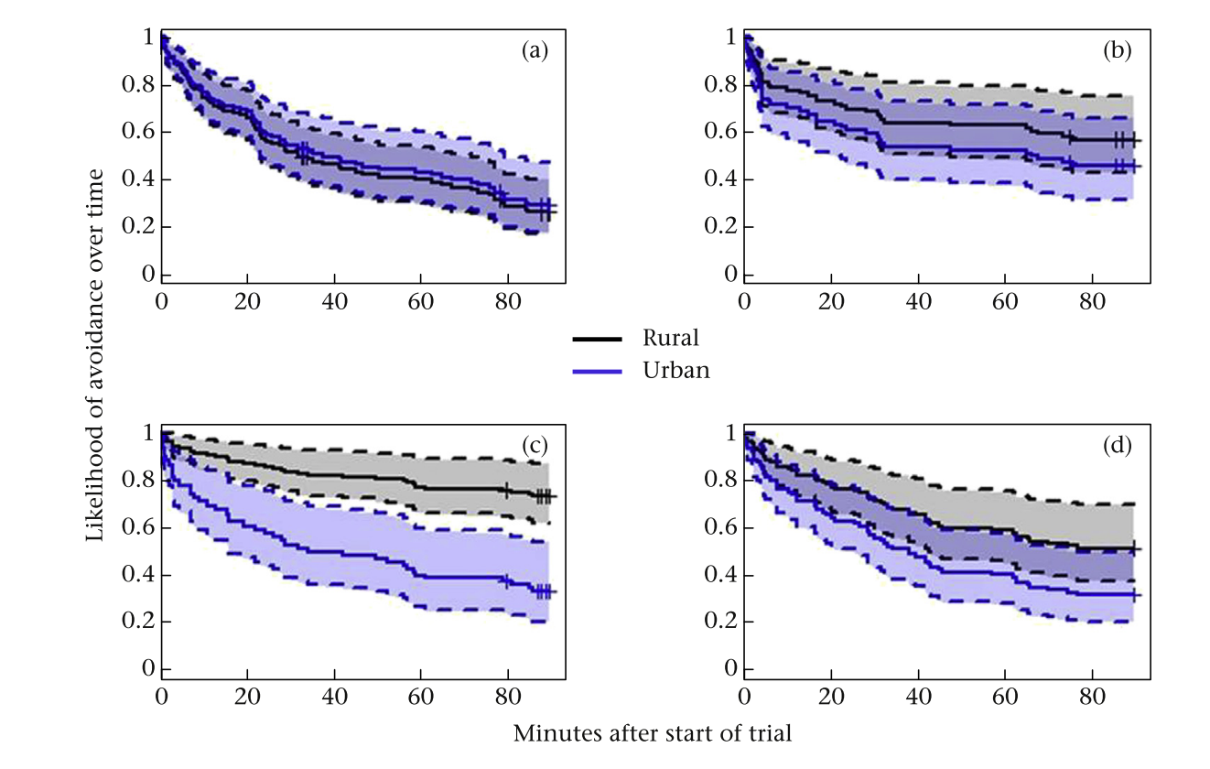
Survival Curves

Slide 8
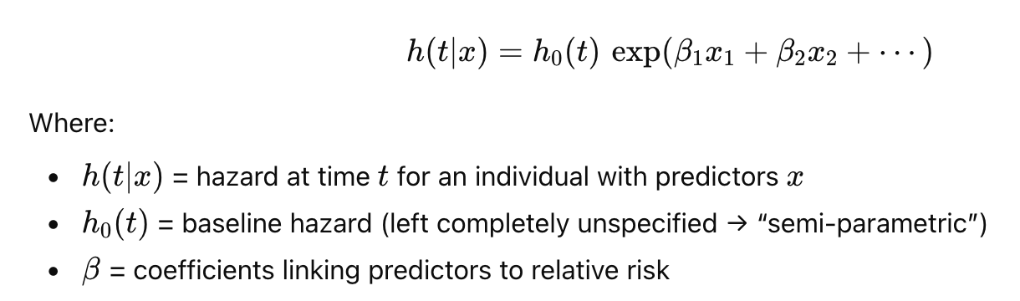

Cox Proportional Hazards Model
Hazard Ratio (HR):
HR > 1 → the event happens faster / risk is higher
HR < 1 → the event happens slower / risk is lower
HR = 1 → no effect

Slide 9
Assumptions
Proportional hazards: The effect of a predictor is constant over time
(i.e., covariates multiply the hazard, but don’t change how the hazard curve changes with time)
Linearity of continuous covariates on the log-hazard scale
Independent censoring
Independent observations (or use frailty terms for random effects)
Notes:
People who are censored should, on average, have the same future risk as those who remain under observation—assuming they have the same covariate values. So if some individuals have 4 years of data while some individuals were observed out to 6 or 7 years there shouldn’t be any difference in their underlying risk.

Slide 10
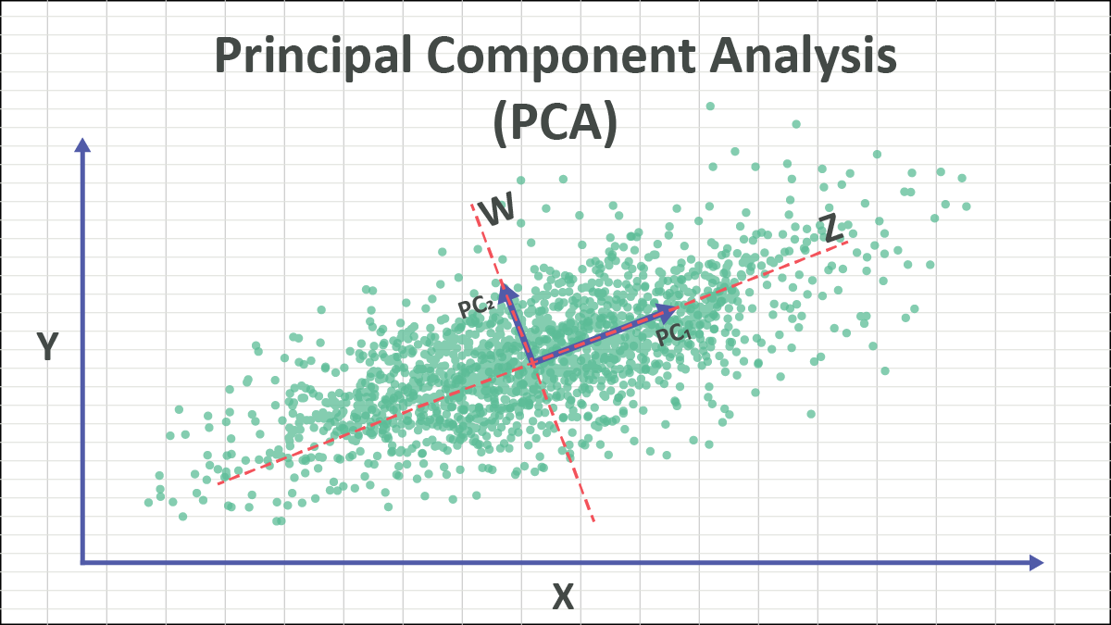
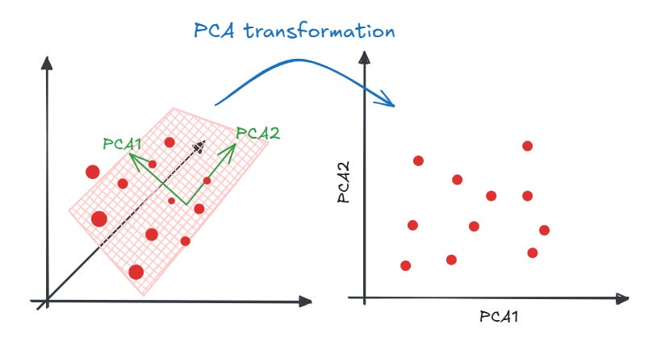
What is Principal Component Analysis (PCA)?
A dimension-reduction technique that transforms a set of correlated variables into a smaller set of uncorrelated variables called principal components (PCs).
PC1 explains the largest amount of variation in the data
PC2 explains the next-largest, and is orthogonal to PC1
Notes:
PCA is based on the covariance/correlation matrix
Key: Represent many variables using a few summary axes that capture the major patterns of variation.
The direction where points vary the most → PC1
The next most-variable direction at right angles → PC2
And so on
Each PC is a weighted combination of the original variables.

Slide 11
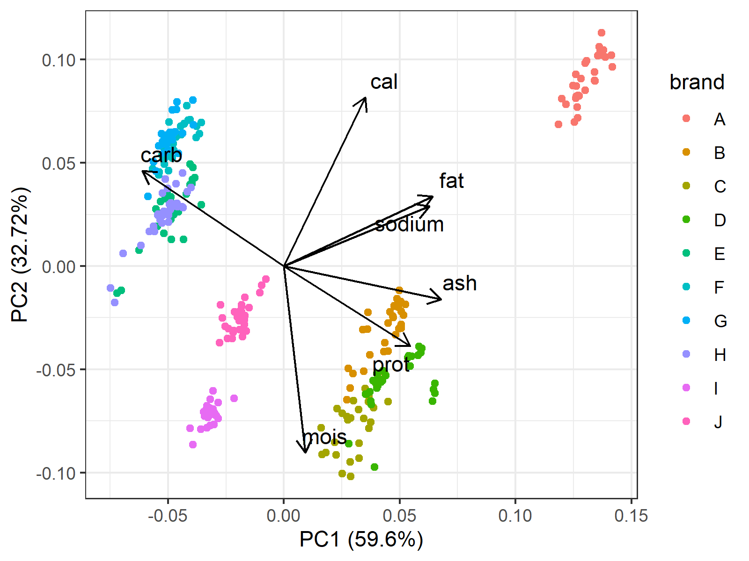
When/why to use PCA?
Simplifying datasets
Removing multicollinearity
Visualizing multivariate patterns
Identifying latent behavioral/physiological syndromes
Preprocessing

Slide 12
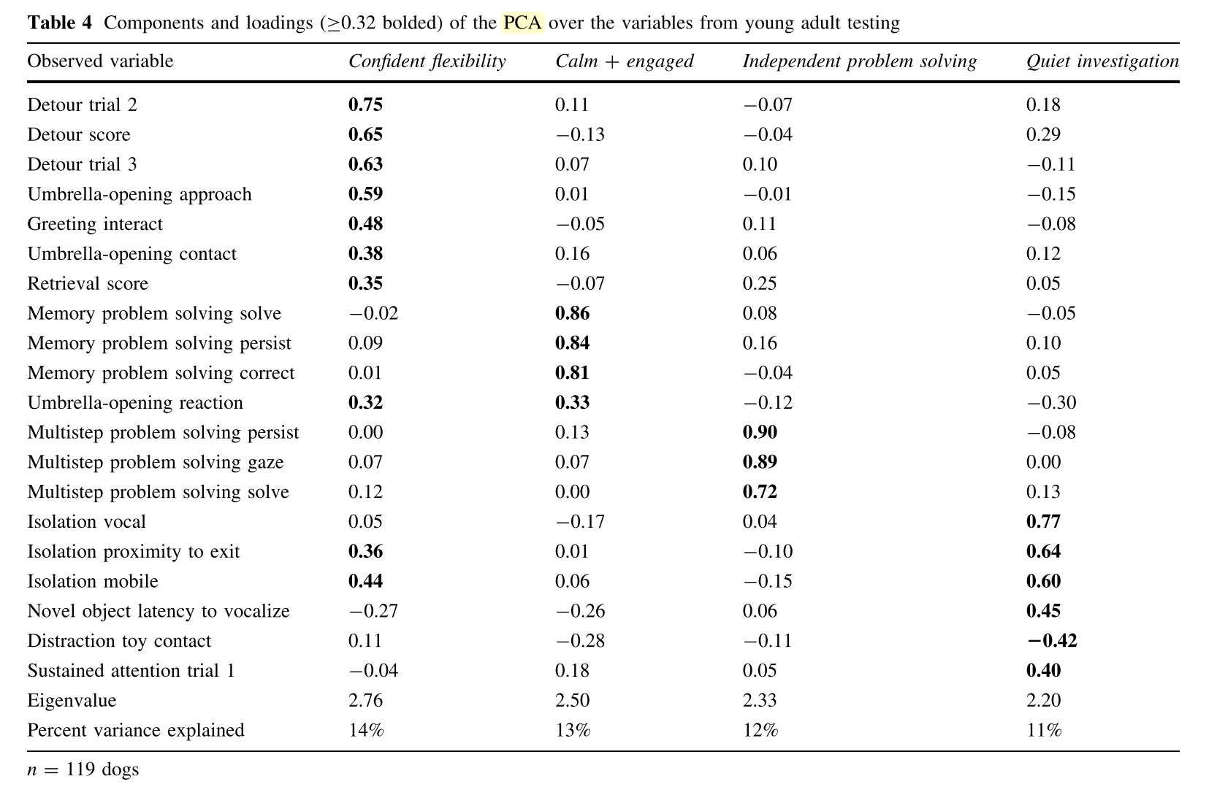
PCA in Animal Behavior
Animal behavior datasets are often:
Multivariate
Correlated
Noisy
Hard to visualize
Examples:
Measuring boldness using ≥10 behaviors
Acoustic call features
Gait/posture metrics
Hormone panels (cortisol, DHEA, testosterone)
Multidimensional foraging decisions
PCA helps by:
Reducing complexity
Generating interpretable behavioral axes
Avoiding collinearity in regression/SEM
Visualizing clusters or syndromes

