Slide 1
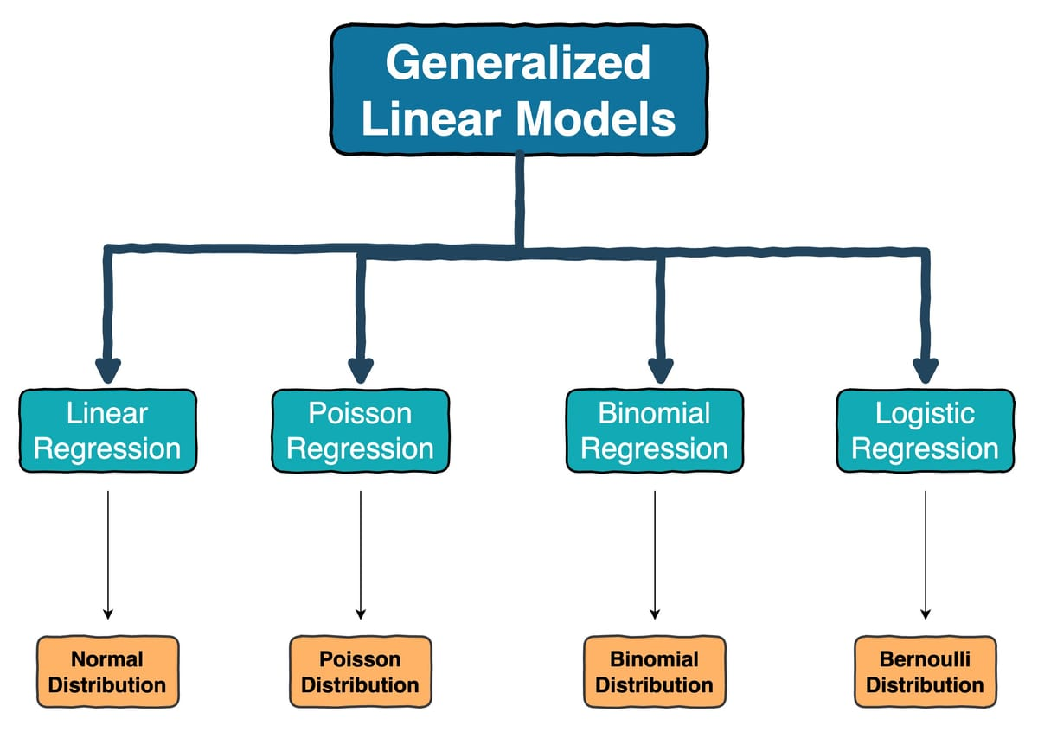
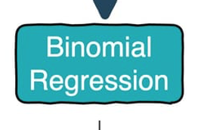
Beta Regression
Beta Distribution

Slide 2
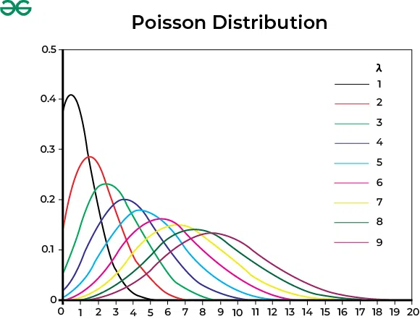
Poisson Regression – Count Data
Link function:
log link
Response distribution:
Poisson
Variance structure:
Var(Y) = Mean(Y)
Checking model fit:
  Uniformity (Residuals)
  Overdispersion: Var(Y) > Mean(Y)
  Zero-inflation: too many zeros
Notes:
Not the same as just log-transforming your response variable… it also assumes variance distribution follows a Poisson rather than Normal distribution

Slide 3
Binomial Regression
Bernoulli – 0/1
(S ~ A + B, family=binomial)
Link: logit
Response distribution: Binomial
Variance structure:
p(1-p)
Checking model fit:
  Uniformity (Residuals)
  Zero-Inflation
Binary (# success / # of failures)
(cbind(countS, countF) ~ A + B, family=binomial)
Link: logit
Response distribution: Binomial
Variance structure:
np(1-p)
Checking model fit:
  Uniformity (Residuals)
  Overdispersion
  Zero-Inflation

Slide 4
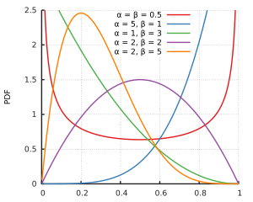
Beta Regression: Proportion data
Link function:
logit
Response distribution:
Beta
Variance structure:
Var(Y)=μ(1−μ)​ / 1+ϕ
Checking model fit:
  Uniformity (Residuals)
  Variance structure (Residuals)
  Zero-inflation: too many zeros
Notes:
Can’t include values of 0 and 1 because the regression then goes to infinity at these values!!

Slide 5
Inter-Rater Reliability in Behavior Data
Why do we need it?
Ensures behavioral coding is consistent across observers
Critical when using subjective or fine-grained behavioral definitions
Required for most behavioral ecology, animal cognition, and ethology projects
Common metrics:
ICC (Intraclass Correlation Coefficient) — continuous outcomes
Cohen’s κ / Fleiss’ κ — categorical or occurrence data
Bland–Altman plots — assessing agreement

Slide 6
Choosing the right reliability metric
1. Point events (startle, rearing, vocalizations)
Occurrence: yes/no = Cohen’s or Fleiss’ κ
Count per trial = ICC or correlation
Time of occurrence (timestamp) = agreement yes/no
2. Duration behaviors (walk, pause)
Total duration per trial = ICC or correlation
Latency-to-first-occurrence = ICC or correlation
Start/stop times = agreement = Cohen’s or Fleiss’ κ

Slide 7
Intraclass Correlation Coefficient
The value of an ICC lies between 0 to 1, with 0 indicating no reliability among raters and 1 indicating perfect reliability.
An intraclass correlation coefficient, according to Koo & Li:
  Less than 0.50: Poor reliability
  Between 0.5 and 0.75: Moderate reliability
  Between 0.75 and 0.9: Good reliability
  Greater than 0.9: Excellent reliability
Notes:
Same as what we get for random effects in our mixed models!

Slide 8
Cohen’s κ and Fleiss’ κ
Cohen’s κ: agreement between two raters, categorical data
Fleiss’ κ: 3+ raters
κ adjusts for chance agreement
Interpretation (Landis & Koch, 1977 — use cautiously):
  <0.0: less than chance
  0.0–0.20: slight
  0.21–0.40: fair
  0.41–0.60: moderate
  0.61–0.80: substantial
  0.81–1.0: excellent

