Slide 1
Class Project

Slide 2
Regression Equations
ŷ_{i} = b₀ + b₁x_{i}
y_{i}
e_{i}
y_{i​} = b₀​ + b₁​x_{i} ​+ e_{i}​
y_{i​} = observed outcome for the i^{th} data point
b₀ = intercept
b₁ = slope coefficient
x_{i} = predictor
e_{i} ​ = residual error
x_{i}
Notes:
Just like with algebra we can estimate b0 and estimate b1 AND we can take a value for x and get a predicted y-hat.
We also get an estimate for E (the residuals).
The math for calculating b0 b1 and e is complicated, so we almost always let the computers do this for us.
Xi and yi are YOUR RAW DATA

Slide 3
Regression Assumptions
Linearity of relationship between x and y
Independent observations
Normality of residuals
Homoscedasticity of residuals
No multicollinearity (predictors are not too highly correlated with each other)

Slide 4
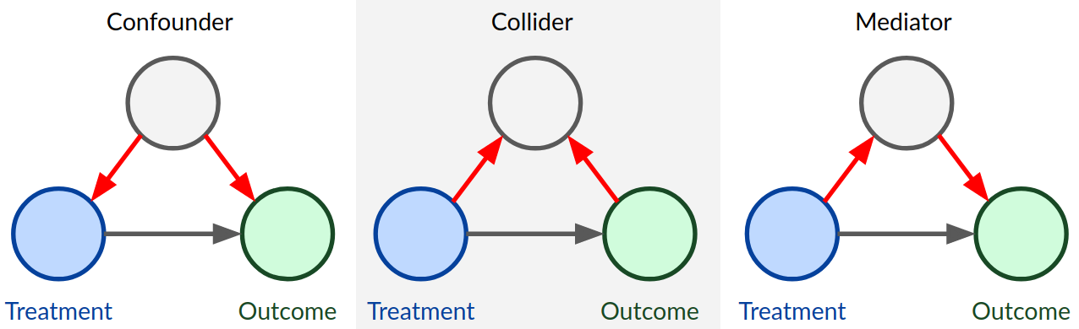
Notes:
Whether or not a confound is a problem depends on which paths the true relationship goes and what happens when we add them to the model.

Slide 5
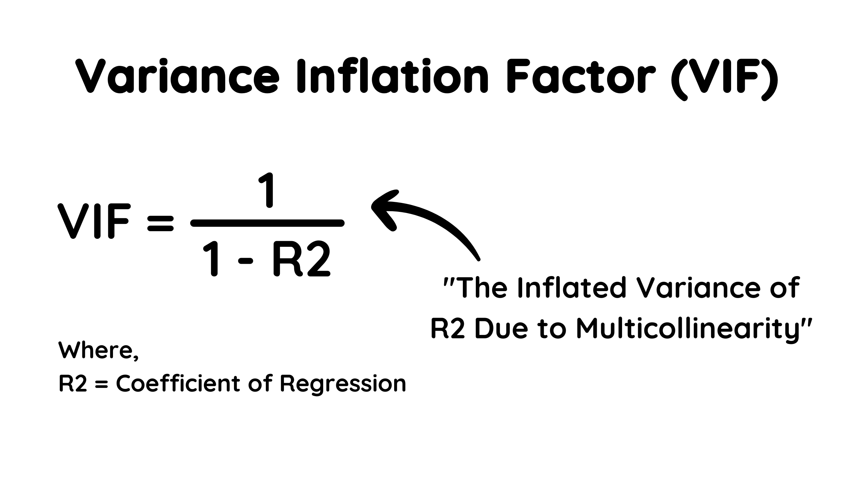
Multicollinearity – what does this mean?
If A and B are super highly correlated then the model will have a difficult time statistically separating their effects

