Slide 1
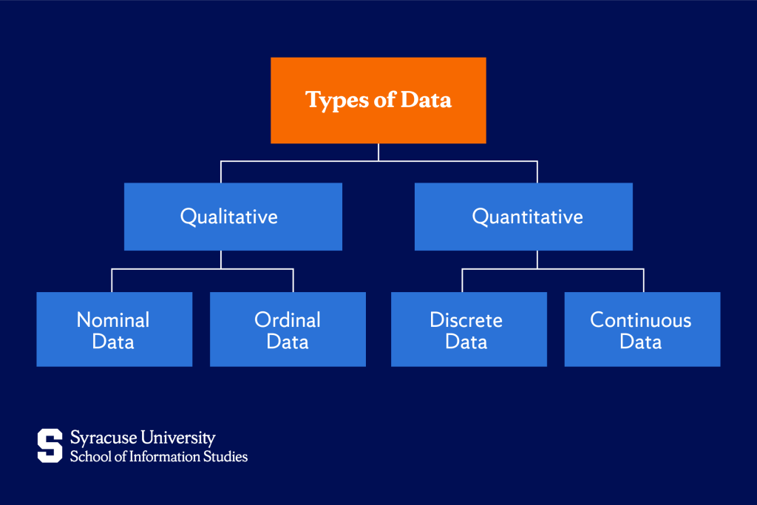

Slide 2
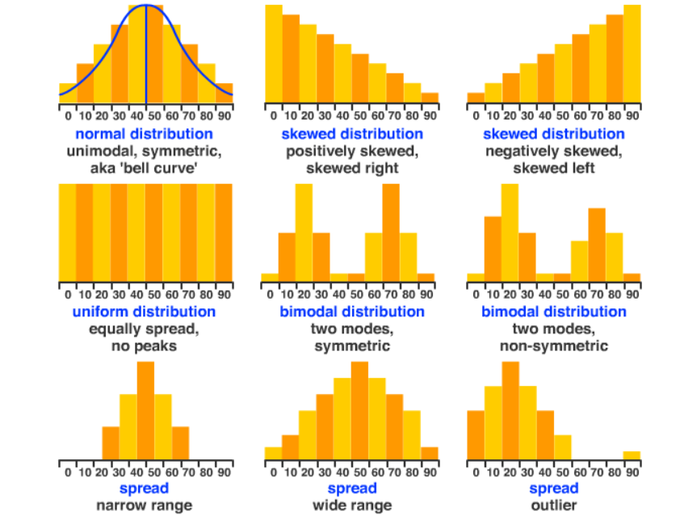
Symmetrical or skewed?
Uniform (flat) or modal (with peaks)?
High or low variation?
Outliers?
Notes:
This information can tell us a lot of about our data... And is important if we’re testing hypotheses or making predictions.

Slide 3
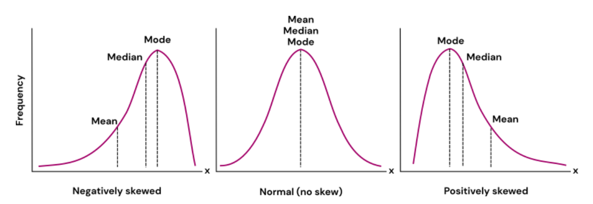
Measures of Central Tendency
Mean, median, and mode
Notes:
The best way to start, before doing any stats, is to get an idea of what a dataset looks like. What kind of data, what is the shape of distribution, and what are the measures of central tendency?

Slide 4
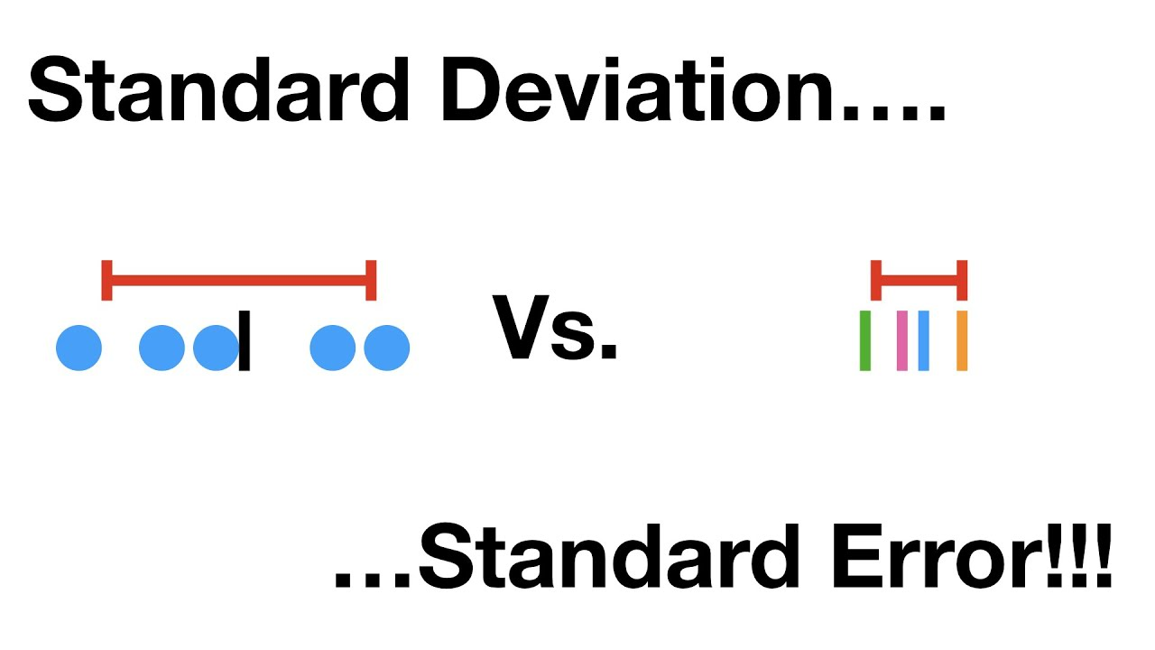
Measures of Variance
Notes:
SD is the “typical” distance from the mean. How far is a typical value from the mean value? (i.e. what is the standard deviation from the mean?) this is synonymous with “typical distance”
With standard error we start getting into the idea of a sample vs the population and we’ll talk more about samples vs population next week.
I always say “standard error of the mean” in my head to remember that SE is the variation we expect around the mean and SD if the variation in our data.

Slide 5
Recommended reading for review:
Khan Academy Lesson

