Slide 1
Case Study: Investigation of how hotel bookings differ by platform and region
BY LUCINDA KHALIL
Notes:
I’ve chosen to mainly focus on how users are using the various platforms and how this has changed over time

Slide 2
Contents
Summary of insights
Note on hypothesis testing
More in-depth exploration
Business recommendations
Further analysis

Slide 3
Summary of INSIGHTS
Statistically significant increase in use of mobile devices - mainly the application
Bookings with a smaller window are more likely to be made via a mobile device, but bookings with longer windows are not more likely to be made on a desktop device
Mobile devices are most popular in the US and least popular in Latin America
Higher value trips are more likely to be made via desktop
Bookings of larger groups are more likely to be made via desktop
Notes:
Here is a quick summary of the insights and I’ll go into more detail for each of these

Slide 4
p-value < 0.05
↓
STATISTICALLY SIGNIFICANT
Notes:
Throughout the presentation I’ll mention hypothesis tests a couple of times, and I’ve used a significance level of 0.05
and in case you aren’t familiar with this all you need to remember is if the p-value is less than 0.05 then we have some kind of significant result
But I’ll be very clear about this as we go along

Slide 5
Overall growth
17.0%
Desktop growth
7.92%
Mobile growth
26.1%
Notes:
Between November 2016 and November 2017 there has been an overall increase in the number of bookings by 17%
And desktop bookings have grown by 7.92%
Whereas mobile bookings have grown much quicker by 26.1%

Slide 6
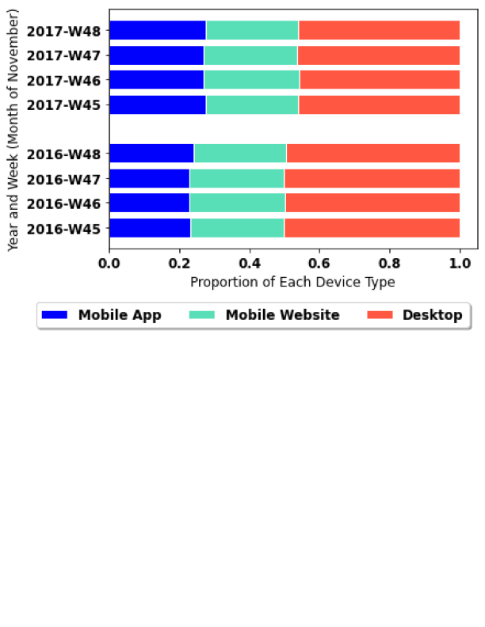
How has the proportion of mobile bookings changed between 2016 and 2017?
INCREASED
2016
Mobile
Average:
50.1%
2017
Mobile
Average:
54.0%
p = 0.0143
Notes:
Here we are looking at the proportions of bookings so the overall growth of the company is not accounted for and we can just look at how the distribution across different platforms has changed
Here you can see how the bookings during November of 2016 and 2017 are split by device type
There is about a 3.9% increase in the proportion of bookings made through the mobile app and website.
I carried out a Mann-Whitney hypothesis test to see if this increase was significant which resulted in a p-value of 0.0143 and because this is comfortably less than 0.05, we can say that there HAS been a significant increase between the years.

Slide 7
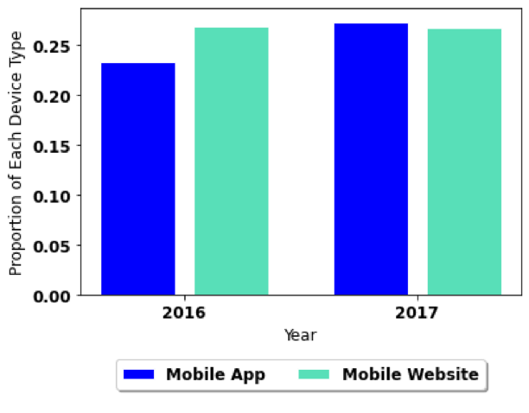
What platform are new mobile customers using?
App:
23.3%
27.3%
p = 0.0143
Website:
26.8%
26.7%
p = 0.829
Notes:
More specifically, we can look at the mobile app and mobile website users.
The proportion of app users increased by 4%, and the proportion of website users actually decreased by 0.1%

Slide 8
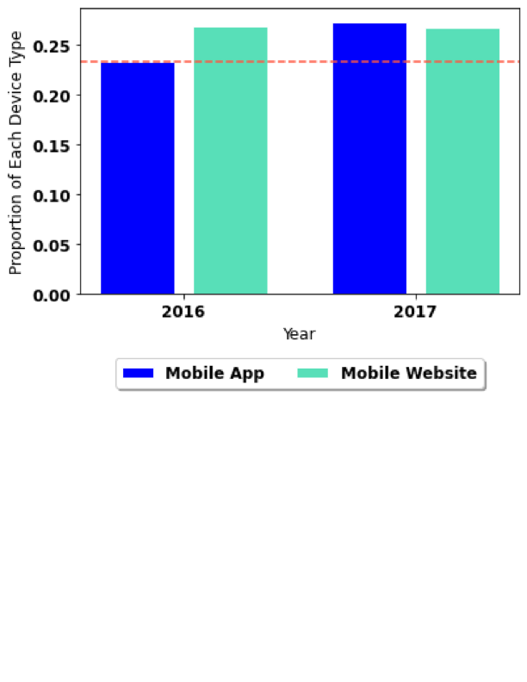
What platform are new mobile customers using?
App:
23.3%
27.3%
p = 0.0143
Website:
26.8%
26.7%
p = 0.829
The increase in
mobile users is
mainly app users
Notes:
And so we can see that the overall increase in mobile users that we saw previously is mainly made up almost entirely of application users. The orange line hopefully makes this clearer.
And the p value corresponding to the app proportions is significant, whereas the website p value is not.
Note that these are proportions and the raw number of bookings made through the mobile website has still increased, but has done so proportionally to the total growth in bookings

Slide 9
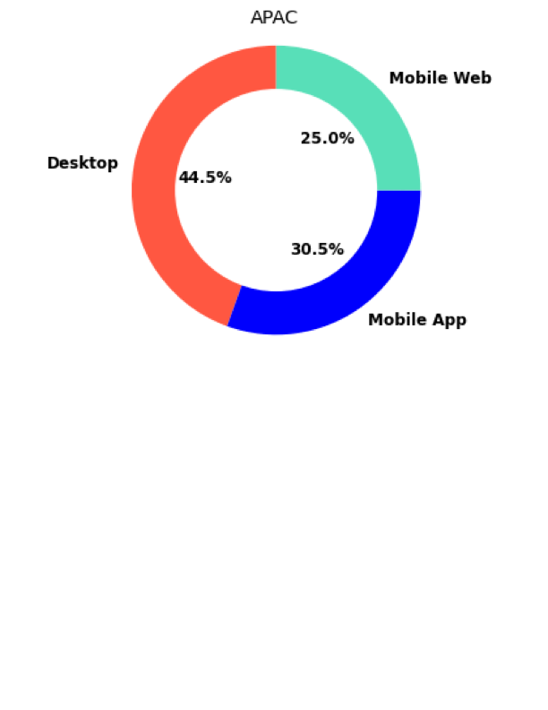
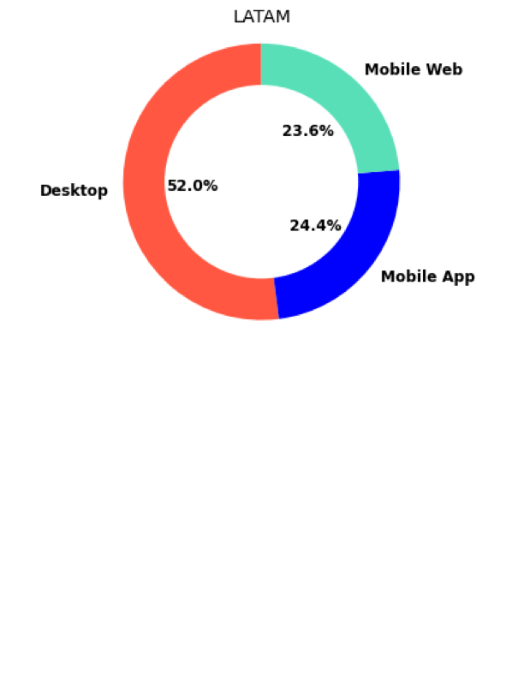
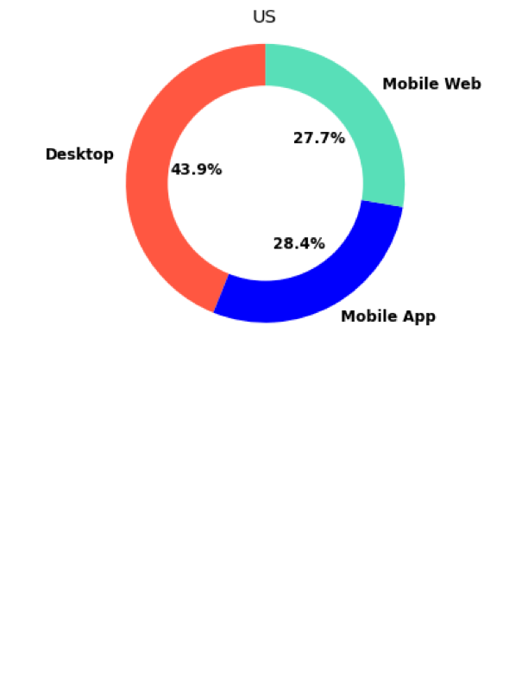
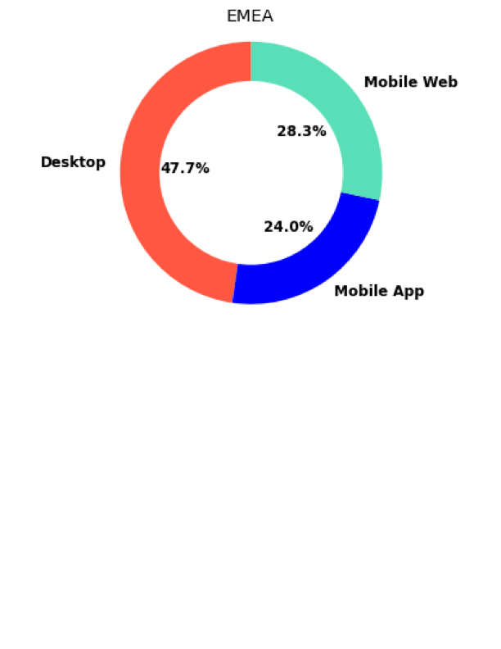
Where are the mobile users located?
Notes:
Now we consider just the 2017 data since it is the closest there is to a “current state”
These pie charts show how users within each super region are making their bookings.
Most notably, Latin America is the only region where the majority of bookings are still made via desktop, but of the users who are using mobile devices, the app is slightly more popular
The US has adapted the most to mobile devices, followed by APAC then EMEA

Slide 10

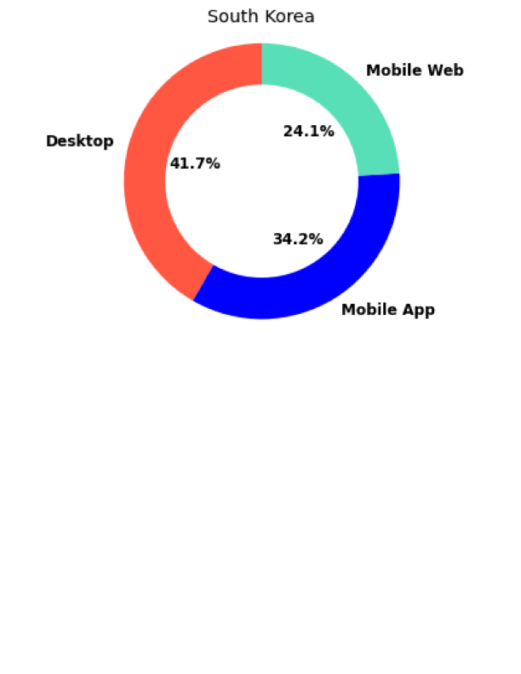
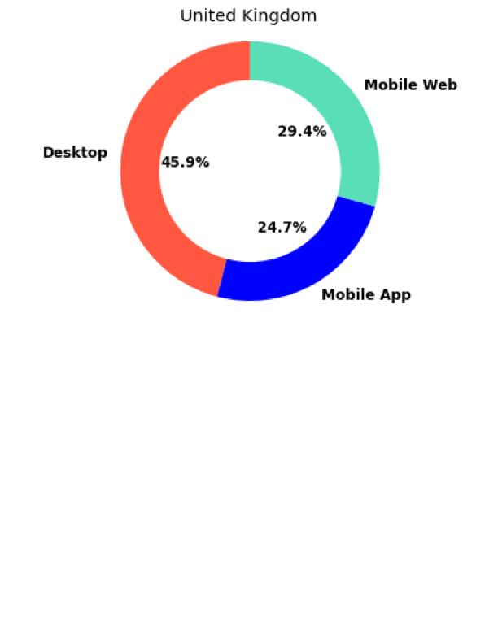
Where is each platform the most popular?
Notes:
Now we can look more closely at the actual countries that bookings are made from
I’ve picked out a few of the most notable pie charts for the countries from which customers are making bookings. The rest can be found in the file with my working.
Brazil is the only latin American country in this data set so just like we saw before, use of desktop is most prevalent here.
Use of the mobile app is most popular in south korea at 34.2% which is significantly higher than most other countries which fall between 22 and 29%.
And we can also see that the UK is where the mobile website is most popular.

Slide 11
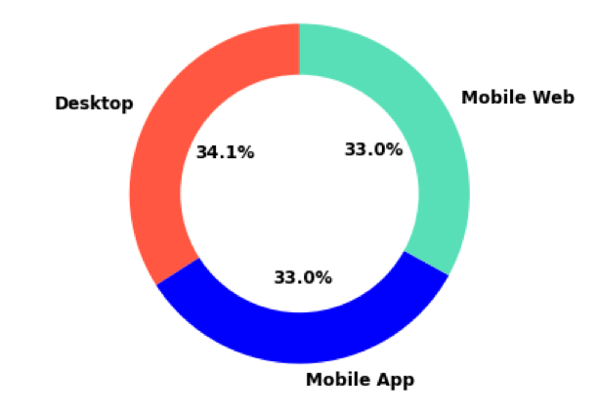
What platform is used for bookings within the same country?
Almost 2/3 of bookings made within the same country are made using a mobile device
Notes:
There is a pretty even split between the 3 platform types when we only consider bookings made for hotels in the same country
This is much more skewed to mobile devices compared to the entire dataset which is much closer to a 50/50 split
So we can say that a customer booking a hotel in the same country is more likely to be using a mobile device.

Slide 12
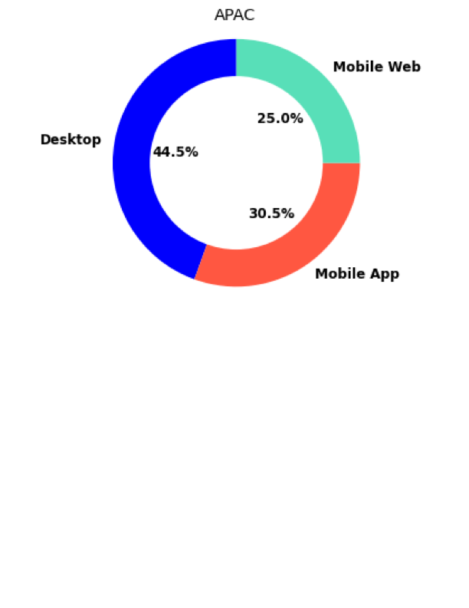
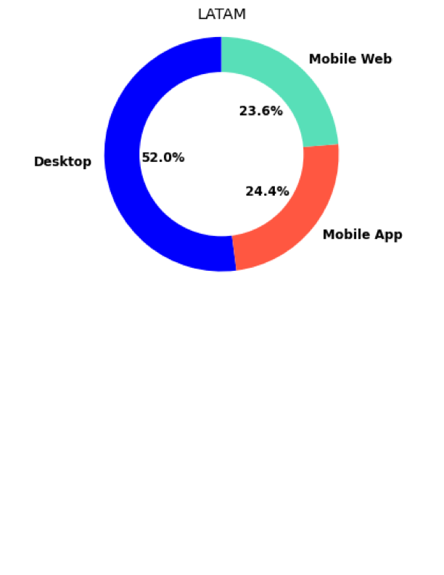
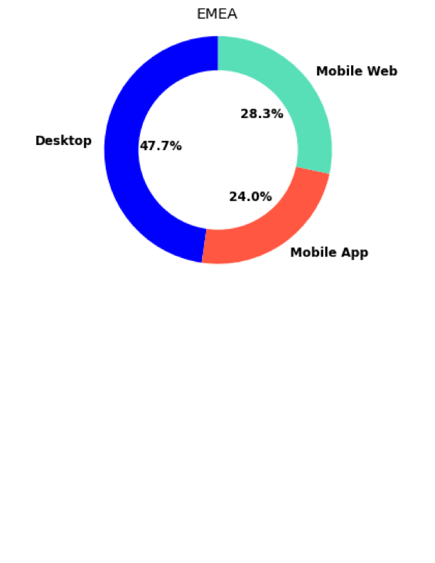
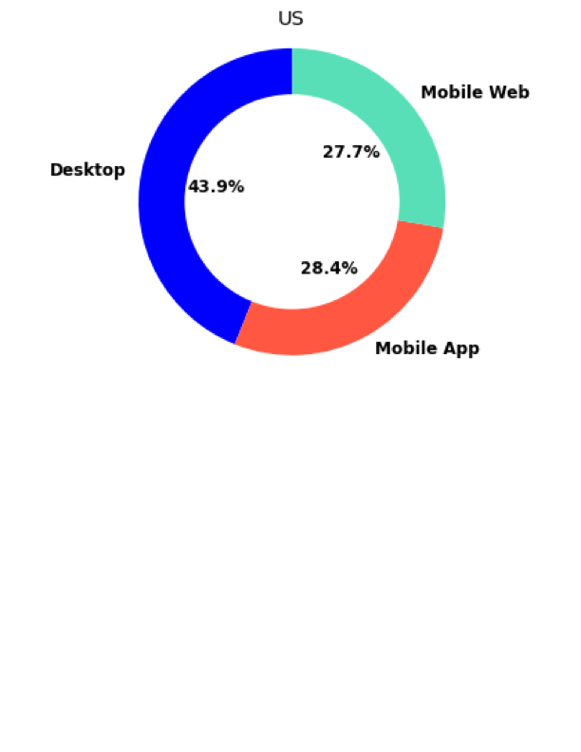
Where are the mobile users located?

Slide 13
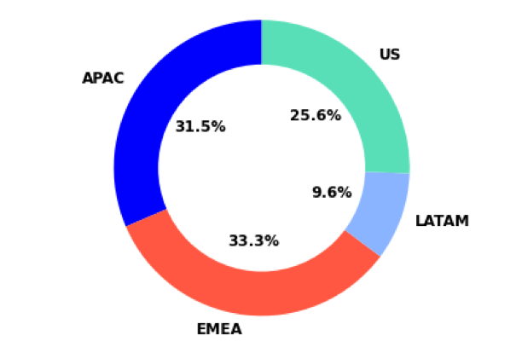
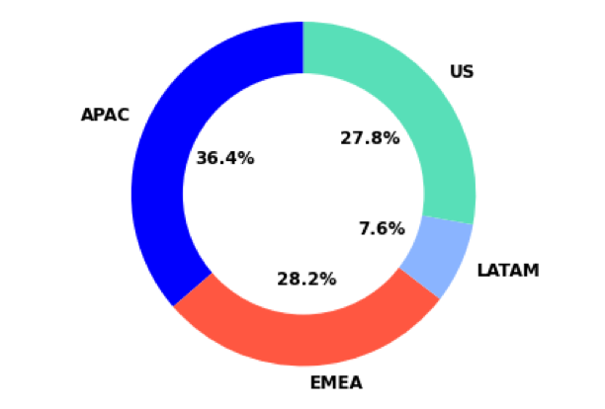

Where are the mobile users located?
DESKTOP
MOBILE APP
MOBILE WEBSITE

Slide 14
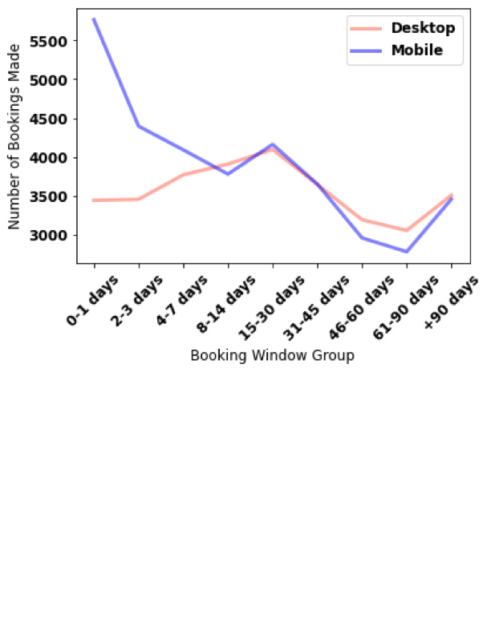
How far in advance are users booking?
59.5% of bookings made 0-3 days before the trip takes place are booked via the mobile app or website*
Otherwise mostly consistent
*’Post Book’ group has been ignored
Notes:
This line graph shows the time between when a booking is made and when the customer checked in. Its clear to see that bookings with very small windows are more likely to be made through a mobile device
In fact 59.5% of bookings made 0 to 3 days before check in are made through mobile (compared to 54% which is the average across all of the data.
Aside from this the differences are relatively small and I would say more likely down to natural variation

Slide 15
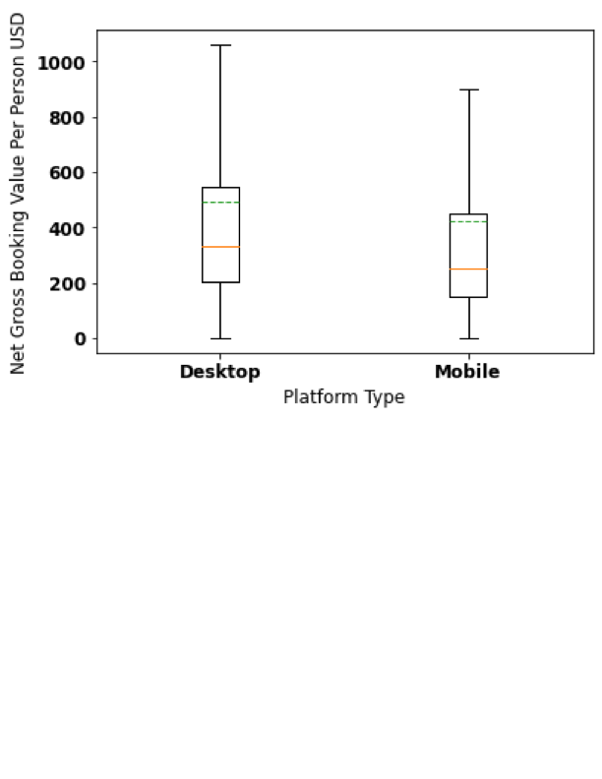
What platform is preferred for higher value bookings?
Including extreme values:
p = 0.00
Excluding extreme values:
p = 0.00
A user booking a more expensive trip is more likely to use desktop
Notes:
To investigate this I looked at the Net Gross Booking Value divided by the number of orders, so its actually the average amount spent per traveler.
The boxplots show that there is definitely a skew towards higher value bookings being made through desktop
The values are approximately normally distributed so I conducted a t-test which is a hypothesis test to determine of the means of the two sets are significantly different.
I carried this out both with and without the “outlier” values and in both cases, the p value was 0 to at least about 20 decimal places – which means that the data very strongly suggests that higher value bookings are made with a desktop.
Orange line is median, green dashed is mean

Slide 16
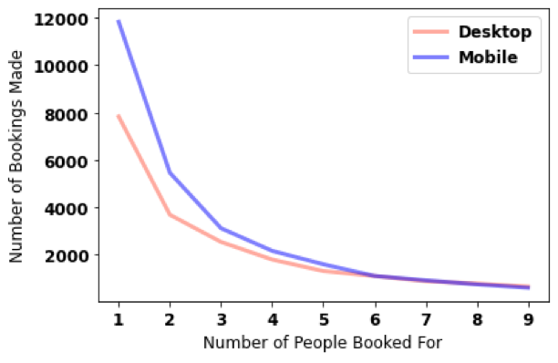
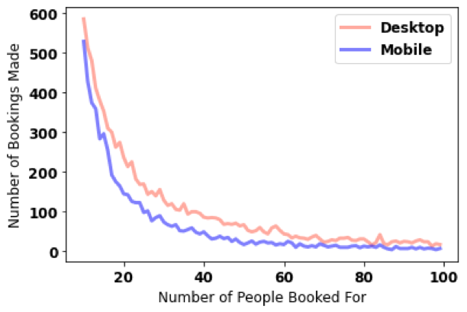
What platforms are used for different sizes of bookings?
Smaller bookings are generally more likely to be made on a mobile device
Larger bookings are generally more likely to be made on a desktop device
Notes:
Smaller sized bookings, specifically those for 5 people and below are more likely to be made through a mobile device
As booking size increases, we see that desktop begins to take over, and we see that a user making a large group booking is more likely to do it via a desktop.

Slide 17
My Recommendations
Invest in development of the mobile application
Ensure that the app is highlighting the best deals to users
Increase advertising for the application in Latin America and EMEA
Further develop the desktop site experience with reviews/details of hotels
Provide deals for large group bookings on the desktop site
Notes:
Invest in development of the mobile application, since this is the fastest growing market. Making is quicker and easier to book a hotel will attract and retain more of the users who are booking for individuals and small groups at less expensive hotels
Ensure that the app is highlighting the best deals to users, again since we’ve seen that these customers are spending less, an offer may be more likely to be clicked on through a mobile device than on desktop
Increase advertising for the application in Latin America and EMEA since use of desktop was most common here. Making booking more convenient in these areas could help to capture the market of users looking to quickly book less expensive hotels
Further develop the desktop site experience with reviews/details of hotels. Since users are typically booking more expensive hotels through a desktop, they will likely spend more time and effort deciding, so streamlining this process would be beneficial
Provide deals for large group bookings on the desktop site, since we’ve seen that large family or company holidays are typically booked through a desktop

Slide 18
Further Analysis
Given a more precise date/time of when bookings are made, could look for trends in when mobile devices are more commonly used
Given the “Super Region” associated with each “Property Country”, could investigate whether customers booking through mobile devices are more/less likely to travel within the same region or outside of it
Notes:
Given a more precise date/time of when bookings are made, could look for trends in when mobile devices are more commonly used

Slide 19
Thank you for listening!

