Slide 1


Hermes2d
C++ library for rapid development of adaptive
hp-FEM / hp-DG solvers
Lukas Korous

Slide 2
Hermes2d Overview
What it is?
C++ multi-platform (Win, Linux, MacOS) library for rapid prototyping of FEM & DG solvers
“When you want to solve a non-trivial PDE in 2d with the least possible effort. And you know some C/C++.”
“When you want to test drive something small (a preconditioner, error estimate, FE space), and you don’t want to write all the rest for it. And you know some OOP in C++.”
How can I try it out?
https://github.com/hpfem/hermes
On Linux
Download, get dependencies via package managers, configure, build
On Windows
Download, get dependencies from https://github.com/l-korous/hermes-windows, configure, build
What technologies are used in Hermes2d?
(Modern) C++, well documented, and exception-safe
OpenMP for parallelization of the most CPU-intensive tasks
Real-time OpenGL visualization
External linear solvers (UMFPACK, PARALUTION, MUMPS, PETSc)
Usual exchange formats (XML, BSON, VTK, ExodusII, MatrixMarket, Matlab)
Hermes2D – Lukas Korous

Slide 3
Hermes2d Overview > Features
What can it do?
Stationary / Time-dependent / Harmonic equations
Number of manual, and automatic mesh refinement (AMR) options
Granular AMR setup based on customizable error estimate calculations
Nonlinear equation handling using Newton’s and Picard’s method
Fully automatic & configurable Newton’s method with damping coefficient control, jacobian reuse control, arbitrary stopping criteria control
Time-adaptivity, Space-time adaptivity using embedded Runge-Kutta methods
Time-error space distribution, arbitrary calculations of any error estimate pluggable into AMR, and time-step controllers
Weak & Strong coupled problems
No matter what the coupling is, when you can write the weak formulation of your problem on paper, you can do that in Hermes2d as well.
What it cannot do (does not do)
Problem specific optimizations, caching, shortcuts, etc.
But #1: In some cases, the Hermes2D API provides methods that can be used for some optimizations.
But #2: Due to the use of OOP, users of the library are welcome to sub-class Hermes2d core classes and implement the missing functionality.
Hermes2D – Lukas Korous

Slide 4
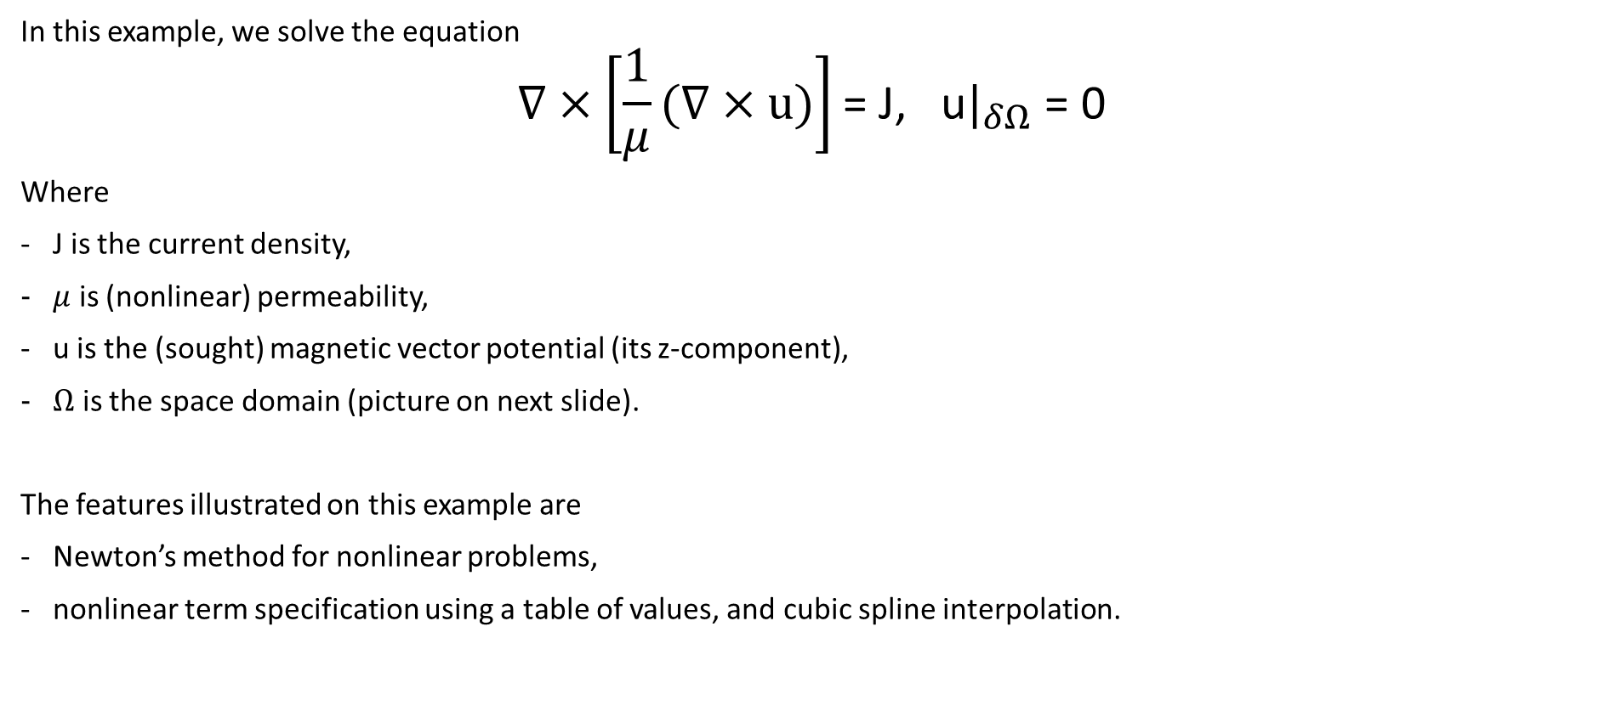
Examples > Magnetostatics
In this example, we solve the equation
$$∇×\left[\frac{1}{μ}(∇×\text{u}\text{)}\right]\text{= }\text{J}\text{, }\text{u}|_{δΩ}\text{ = 0}$$
Where
J is the current density,
$μ$ is (nonlinear) permeability,
u is the (sought) magnetic vector potential (its z-component),
$Ω$ is the space domain (picture on next slide).
The features illustrated on this example are
Newton’s method for nonlinear problems,
nonlinear term specification using a table of values, and cubic spline interpolation.
Hermes2D – Lukas Korous

Slide 5
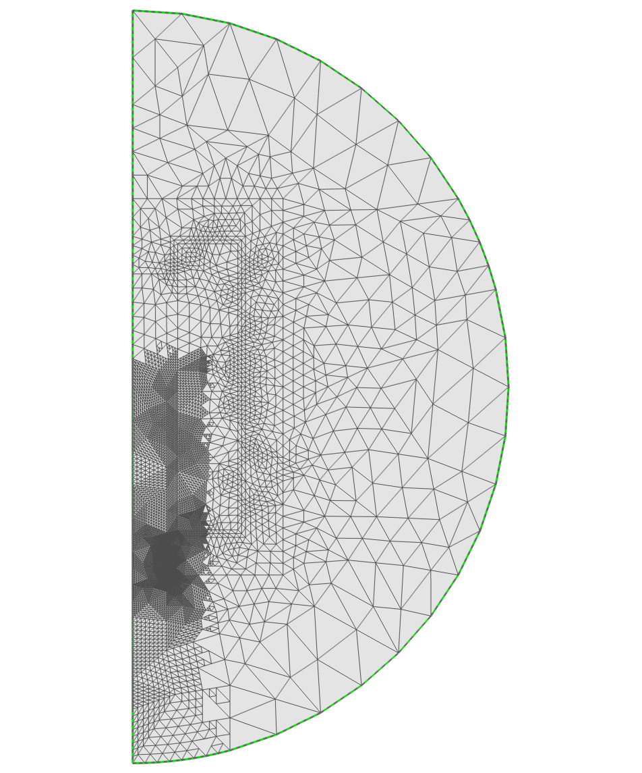
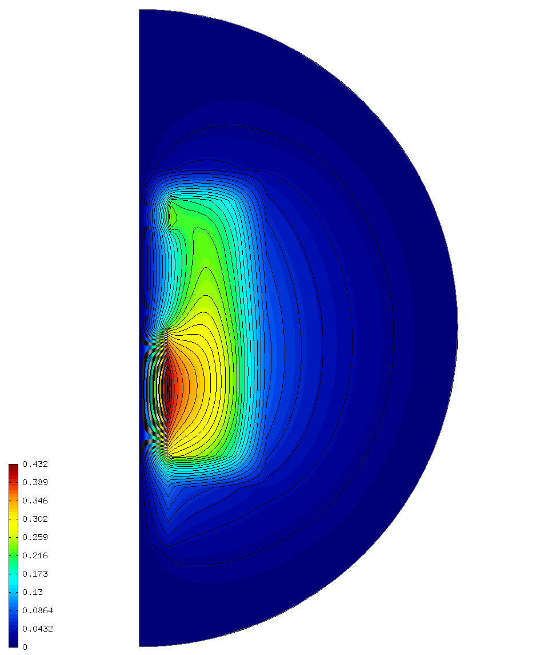

Examples > Magnetostatics
Domain $Ω$ with
triangular mesh
Solution –
vector potential u
Hermes2D – Lukas Korous

Slide 6
Examples > Magnetostatics
Refining the mesh according to a criterion
mesh->refine_by_criterion(&refinement_criterion);
- header: int refinement_criterion(Element* e), returning whether or not to refine a particular Element.
Used to refine the mesh in the TODO – DOPLNIT
CubicSpline class used for nonlinearity description
// Define nonlinear magnetic permeability via a cubic spline.
std::vector<double> mu_inv_pts({ 0.0, 0.5, 0.9, ... });
std::vector<double> mu_inv_val({ 1. / 1500.0, 1. / 1480.0, 1. / 1440.0, ... });
CubicSpline mu_inv_iron(mu_inv_pts, mu_inv_val, ...);
Newton’s method for a strong nonlinearity
// Automatic damping ratio – if a step is unsuccessful, damping factor will be multiplied by this, if successful, it will be divided by this.
newton.set_auto_damping_ratio(1.5);
// Initial damping factor – we can start with a small one, automation will increase it if possible.
newton.set_initial_auto_damping_coeff(.1);
// The redidual norm after a step must be at most this factor times the norm from the previous step to pronounce the step ‘successful’.
// Now for very strong nonlinearities, we may even need this > 1.
newton.set_sufficient_improvement_factor(1.25);
// This is a strong nonlinearity, where we can’t afford to reuse Jacobian matrix from a step in subsequent steps.
newton.set_max_steps_with_reused_jacobian(0);
// Maximum number of iterations. Hermes will throw an exception if this number is exceeded and the tolerance is not met.
newton.set_max_allowed_iterations(100);
// The tolerance – simple in this case, but can be a combination of relative / absolute thresholds of residual norm, solution norm, solution difference norm, ...
newton.set_tolerance(1e-8, Hermes::Solvers::ResidualNormAbsolute);
Hermes2D – Lukas Korous

Slide 7
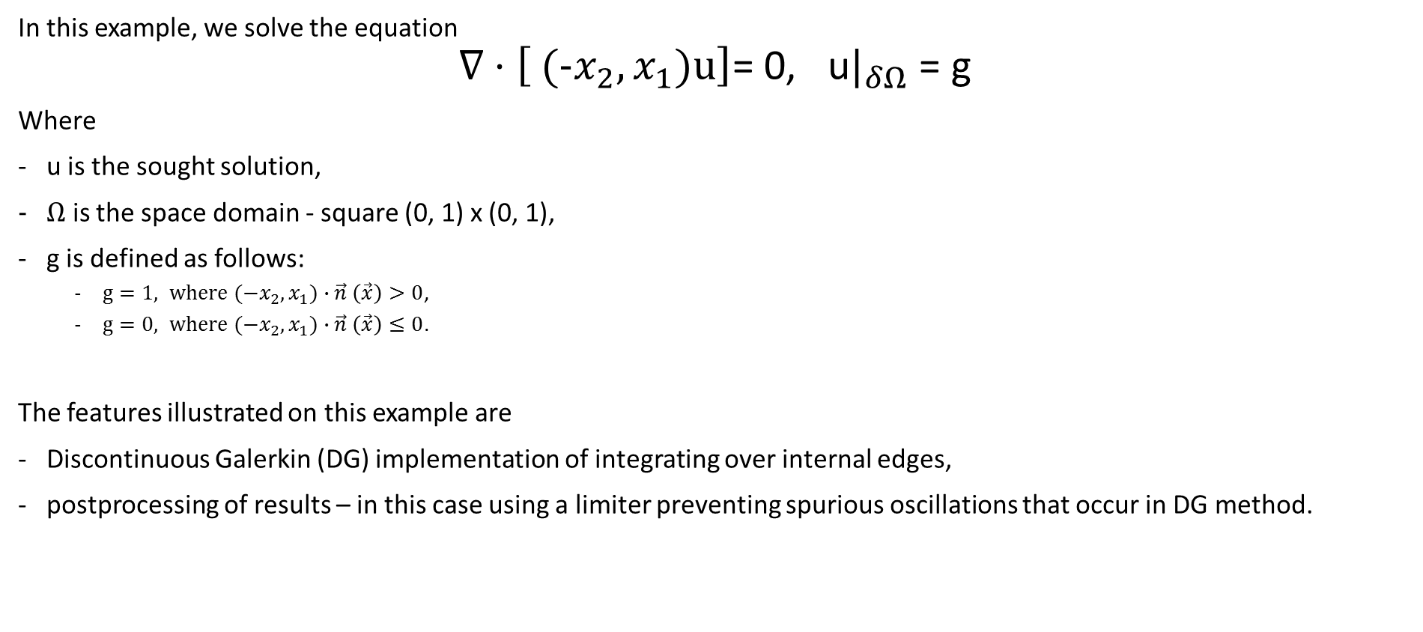
Examples > Advection
In this example, we solve the equation
$$∇⋅\left[ (\text{−}x_{2}, x_{1}\text{)}\text{u}\right]\text{= }\text{0, }\text{u}|_{δΩ}\text{ = }\text{g}$$
Where
u is the sought solution,
$Ω$ is the space domain - square (0, 1) x (0, 1),
g is defined as follows:
$g=1, where (\text{−}x_{2}, x_{1}\text{)}∙\vec{n} \left(\vec{x}\right)>0$,
$g=0, where (\text{−}x_{2}, x_{1}\text{)}∙\vec{n} \left(\vec{x}\right)≤0$.
The features illustrated on this example are
Discontinuous Galerkin (DG) implementation of integrating over internal edges,
postprocessing of results – in this case using a limiter preventing spurious oscillations that occur in DG method.
Hermes2D – Lukas Korous

Slide 8
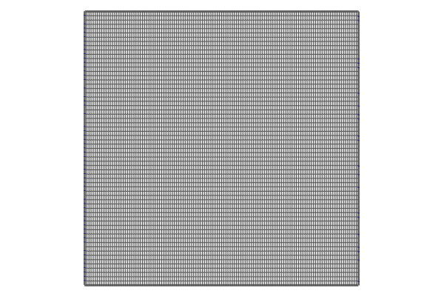
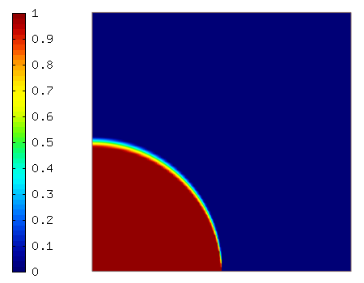

Examples > Advection
Domain $Ω$ with
quadrilateral mesh
Solution
Hermes2D – Lukas Korous

Slide 9
Examples > Advection
Integration over internal edges
Regular forms (simplified)
matrix_form(int n, double *wt, Func<double> *u, Func<double> *v)
n ... Number of integration points
wt ... Integration weights
u ... Basis function values(, derivatives) in the integration points
v ... Test function values(, derivatives) in the integration points
DG forms (simplified)
matrix_form(int n, double *wt, DiscontinuousFunc<double> *u, DiscontinuousFunc<double> *v)
n, wt ... As above
u, v ... DiscontinuousFunc<double> = { Func<double> u->central, Func<double>* u->neighbor } ... Only one is filled for each matrix_form call.
Postprocessing
e.g. Vertex-based limiter (Kuzmin, D.: A vertex-based hierarchical slope limiter for -adaptive discontinuous Galerkin methods, JCAM, 233(12):3077-3085)
// sln_vector ... Algebraic system solution
// space ... FE space of the solution
// Instantiate the limiter
PostProcessing::VertexBasedLimiter limiter(space, sln_vector);
// Get a limited solution, already as a Hermes2D Solution object
Hermes::Hermes2D::Solution<double> limited_sln = limiter.get_solution();
Hermes2D – Lukas Korous

Slide 10


Examples > Advection > Automatic adaptivity (AMR)
We solve the same problem – equation & boundary conditions:
$$∇⋅\left[ (\text{−}x_{2}, x_{1}\text{)}\text{u}\right]\text{= }\text{0, }\text{u}|_{δΩ}\text{ = }\text{g}$$
But this time, we start from a very coarse mesh:
And we employ AMR (h-adaptivity) to get results on the next slide.
Hermes2D – Lukas Korous

Slide 11
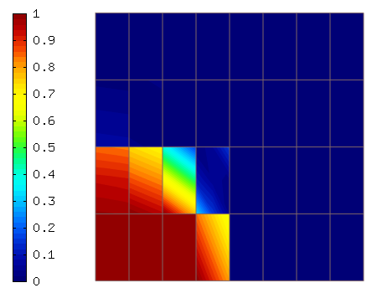
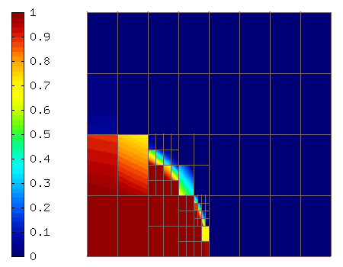

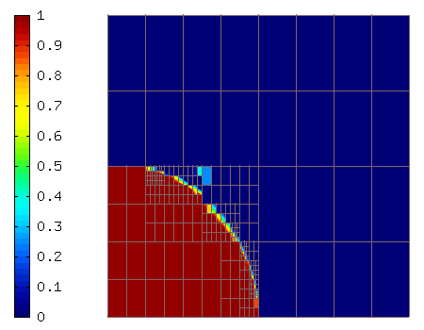
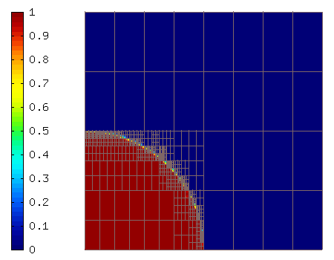
Examples > Advection > Automatic adaptivity (AMR)
AMR step 1, Element count: 32
AMR step 2, Element count: 116
AMR step 3, Element count: 272
AMR step 4, Element count: 504
AMR step 5, Element count: 848
Hermes2D – Lukas Korous

Slide 12
Examples > Advection > Automatic adaptivity (AMR)
int adaptivity_step = 1; bool done = false;
do
{
// Construct globally refined reference mesh and setup reference space.
Mesh::ReferenceMeshCreator ref_mesh_creator(mesh);
MeshSharedPtr ref_mesh = ref_mesh_creator.create_ref_mesh();
Space<double>::ReferenceSpaceCreator refspace_creator(space, ref_mesh, USE_TAYLOR_SHAPESET ? 0 : 1);
SpaceSharedPtr<double> refspace = refspace_creator.create_ref_space();
// Solve the problem on the reference space.
linear_solver.set_space(refspace);
linear_solver.solve();
// Get the Hermes2D Solution object from the solution vector.
Solution<double>::vector_to_solution(linear_solver.get_sln_vector(), refspace, refsln);
// Project the reference solution to the coarse space in L2 norm for error calculation.
OGProjection<double>::project_global(space, refsln, sln, HERMES_L2_NORM);
// Calculate element errors and total error estimate.
errorCalculator.calculate_errors(sln, refsln);
double total_error_estimate = errorCalculator.get_total_error_squared() * 100;
// If error is too large, adapt the (coarse) space.
if (error_estimate > ERR_STOP)
adaptivity.adapt(&selector);
else
done = true;
// Increase the step counter.
adaptivity_step++;
} while (done == false);
Hermes2D – Lukas Korous

Slide 13
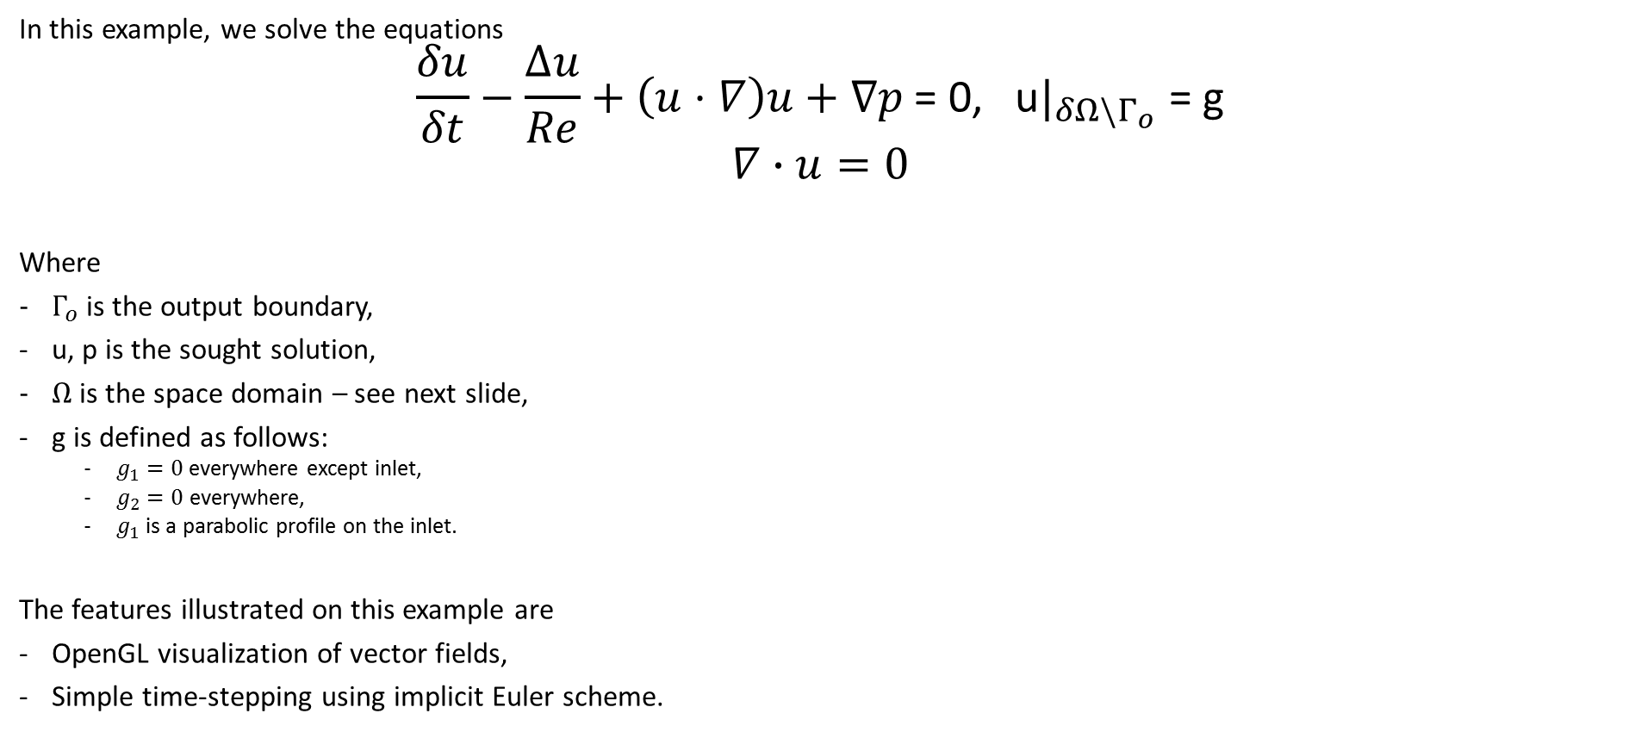
Examples > Navier-Stokes
In this example, we solve the equations
$$\frac{δu}{δt}−\frac{∆u}{Re}+\left(u⋅∇\right)u+∇p \text{= 0, }\text{u}|_{δΩ\backslash Γ_{o}}\text{ = }\text{g}$$
$$∇∙u=0$$
Where
$Γ_{o}$ is the output boundary,
u, p is the sought solution,
$Ω$ is the space domain – see next slide,
g is defined as follows:
$g_{1}=0$everywhere except inlet,
$g_{2}=0$everywhere,
$g_{1}$ is a parabolic profile on the inlet.
The features illustrated on this example are
OpenGL visualization of vector fields,
Simple time-stepping using implicit Euler scheme.
Hermes2D – Lukas Korous

Slide 14
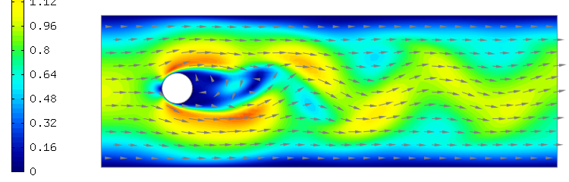
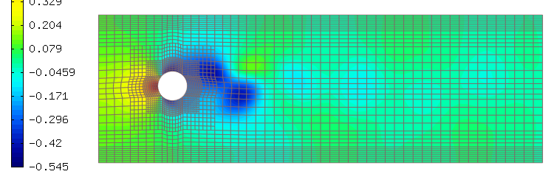
Examples > Navier-Stokes > OpenGL visualization of vector fields
Solution
Velocity (vector field) top
Pressure bottom
t = 30s
Hermes2D – Lukas Korous

Slide 15
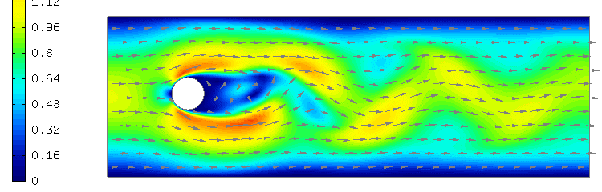
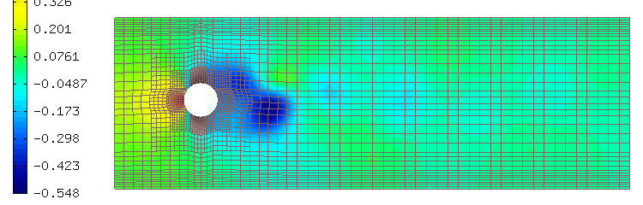
Examples > Navier-Stokes > OpenGL visualization of vector fields
Solution
Velocity (vector field) top
Pressure bottom
t = 40s
Hermes2D – Lukas Korous

Slide 16
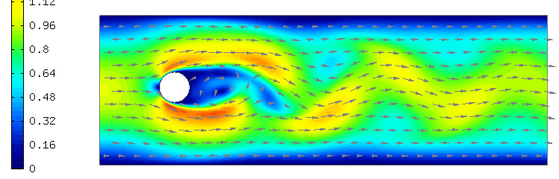
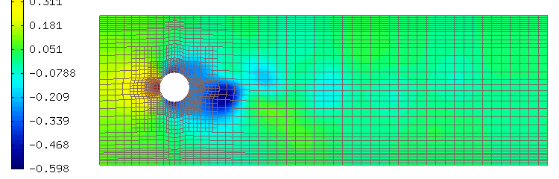
Examples > Navier-Stokes > OpenGL visualization of vector fields
Solution
Velocity (vector field) top
Pressure bottom
t = 55s
Hermes2D – Lukas Korous

Slide 17
Examples > Navier-Stokes
Simple time-stepping using implicit Euler scheme
for (int time_step = 1; time_step <= T_FINAL / TAU; time_step++, current_time += TAU)
{
// Update time-dependent essential BCs.
newton.set_time(current_time);
// Solve Newton.
// Weak formulation implements the implicit Euler scheme, and uses previous time step solutions.
newton.solve(coeff_vec);
// Get the solutions, insert as Hermes2D Solution object into the previous time step solutions.
Hermes::Hermes2D::Solution<double>::vector_to_solutions(newton.get_sln_vector(), spaces, sln_prev_time);
// Visualization.
vview.set_title("Velocity, time %g", current_time);
vview.show(xvel_prev_time, yvel_prev_time);
pview.set_title("Pressure, time %g", current_time);
pview.show(p_prev_time);
}
Hermes2D – Lukas Korous

Slide 18
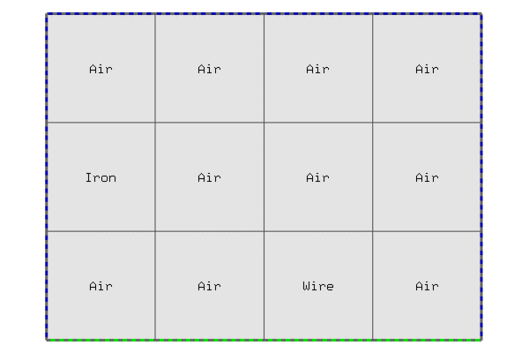
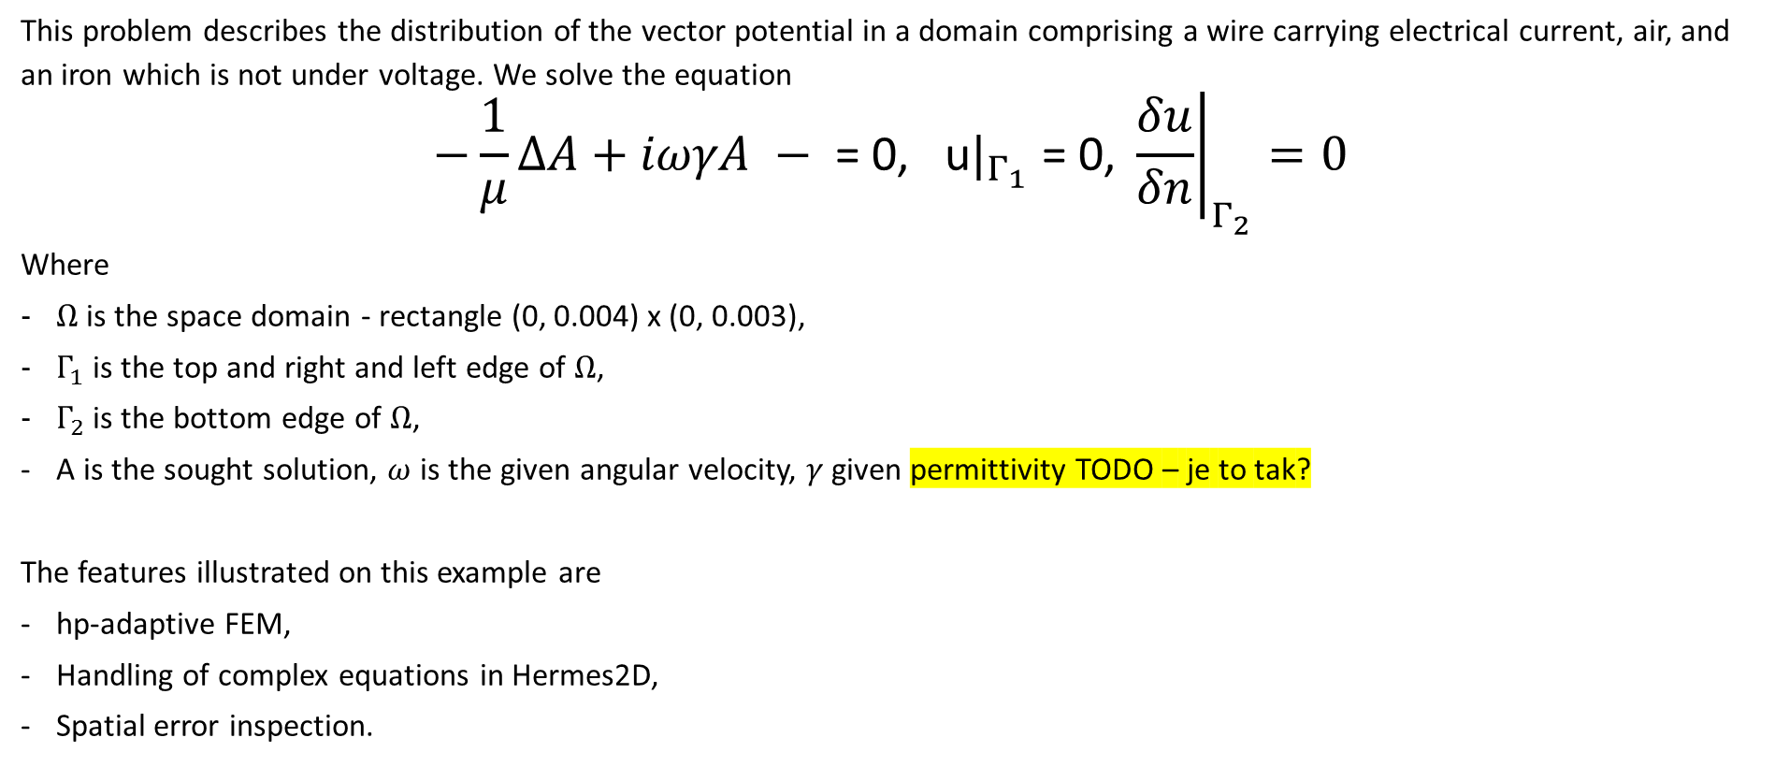
Example > Complex
This problem describes the distribution of the vector potential in a domain comprising a wire carrying electrical current, air, and an iron which is not under voltage. We solve the equation
$$−\frac{1}{μ}∆A+iωγA − \text{= 0, }\text{u}|_{Γ_{1}}\text{ = }\text{0, }{\left.\frac{δu}{δn}\right|}_{Γ_{2}}=0$$
Where
$Ω$ is the space domain - rectangle (0, 0.004) x (0, 0.003),
$Γ_{1}$ is the top and right and left edge of $Ω$,
$Γ_{2}$ is the bottom edge of $Ω$,
A is the sought solution, $ω$ is the given angular velocity, $γ$ given permittivity TODO – je to tak?
The features illustrated on this example are
hp-adaptive FEM,
Handling of complex equations in Hermes2D,
Spatial error inspection.
Hermes2D – Lukas Korous

Slide 19
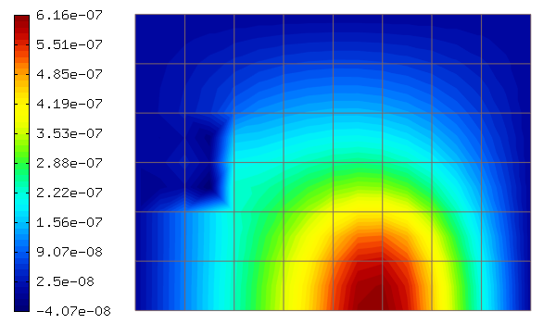
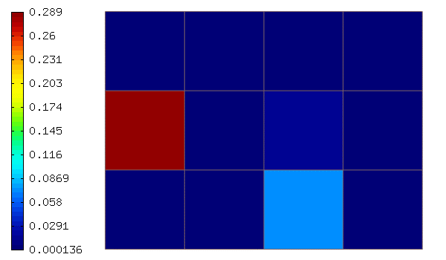
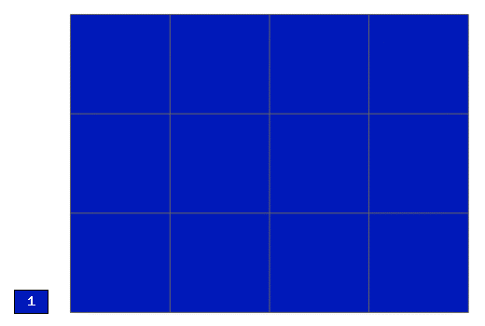
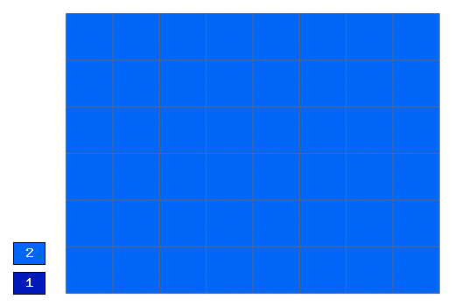
Example > Complex > hp-FEM step #1
Solution
Reference space
Spatial error inspection
Element-wise error for the coarse mesh
Coarse mesh
Fine mesh
Hermes2D – Lukas Korous

Slide 20
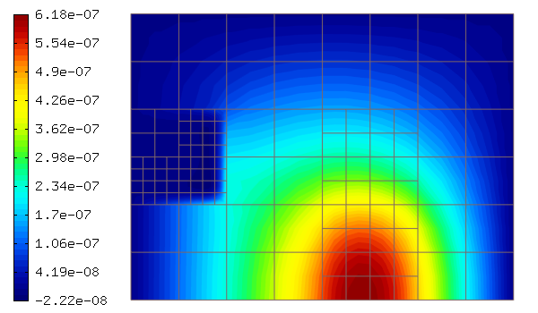
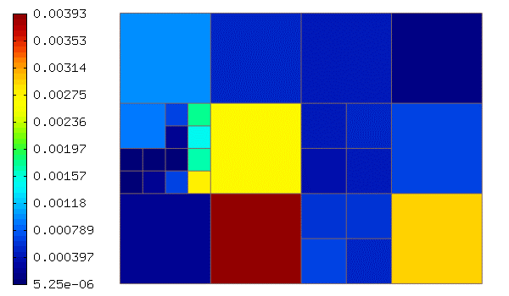
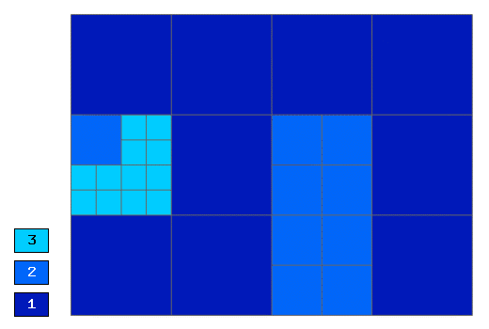
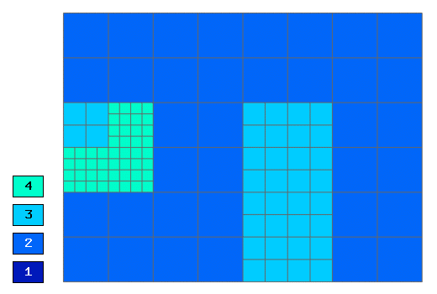
Example > Complex > hp-FEM step #5
Solution
Reference space
Spatial error inspection
Element-wise error for the coarse mesh
Coarse mesh
Fine mesh
Hermes2D – Lukas Korous

Slide 21
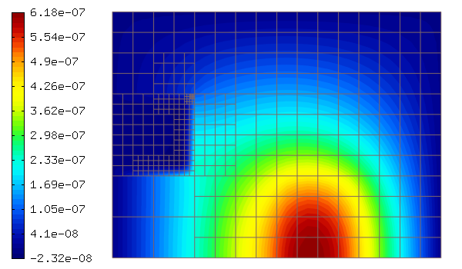
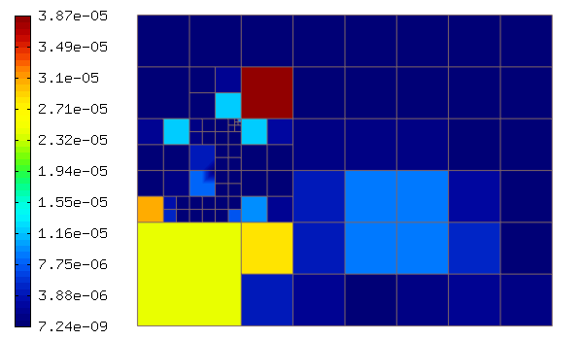
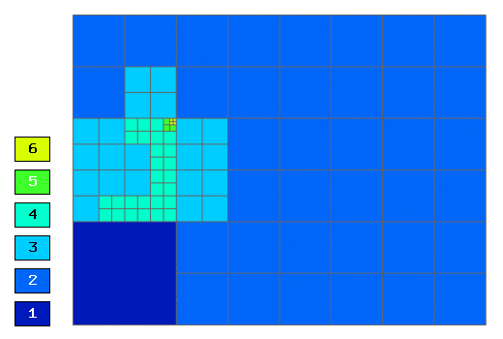
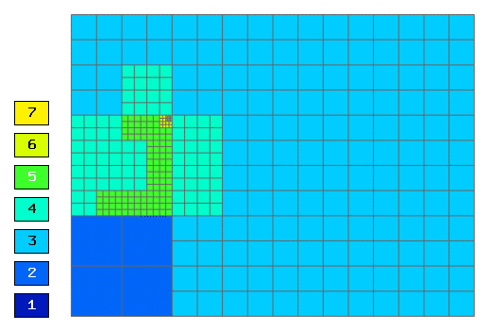
Example > Complex > hp-FEM step #15
Solution
Reference space
Spatial error inspection
Element-wise error for the coarse mesh
Coarse mesh
Fine mesh
Hermes2D – Lukas Korous

Slide 22
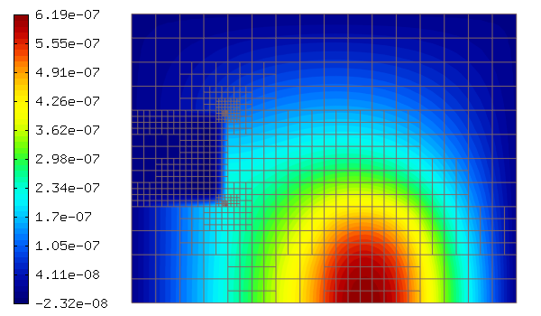
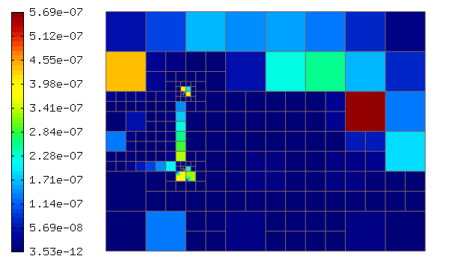
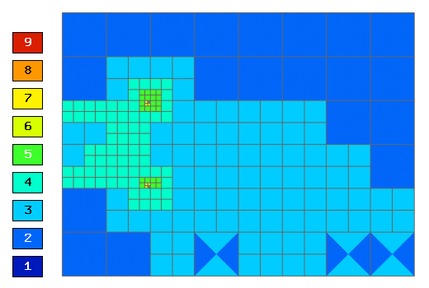
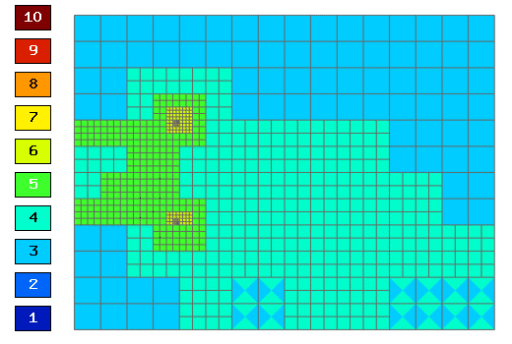
Example > Complex > hp-FEM step #29
Solution
Reference space
Spatial error inspection
Element-wise error for the coarse mesh
Coarse mesh
Fine mesh
Hermes2D – Lukas Korous

Slide 23
Example > Complex
Handling of complex equations in Hermes2D
Very easy, all relevant Hermes2d classes have the number (real | complex) as their template argument:
For real numbers we use double: H1Space<std::complex<double> >(mesh, boundary_conditions)
For complex numbers we use std::complex<double>: H1Space<std::complex<double> >(mesh, boundary_conditions)
hp-adaptive FEM
Basic settings to control the AMR process
// Error calculation & adaptivity. We specify the norm here, and the type of error
DefaultErrorCalculator<::complex, HERMES_H1_NORM> errorCalculator(RelativeErrorToGlobalNorm);
// Stopping criterion for an adaptivity step. Influences the number of elements refined at each step.
AdaptStoppingCriterionSingleElement<::complex> stoppingCriterion(0.9);
// Adaptivity processor class. Gets the error calculator and stopping criterion
Adapt<::complex> adaptivity(&errorCalculator, &stoppingCriterion);
// Stopping criterion for adaptivity.
const double TOTAL_ERROR_ESTIMATE_STOP = 1e-3;
Hermes2D – Lukas Korous

Slide 24
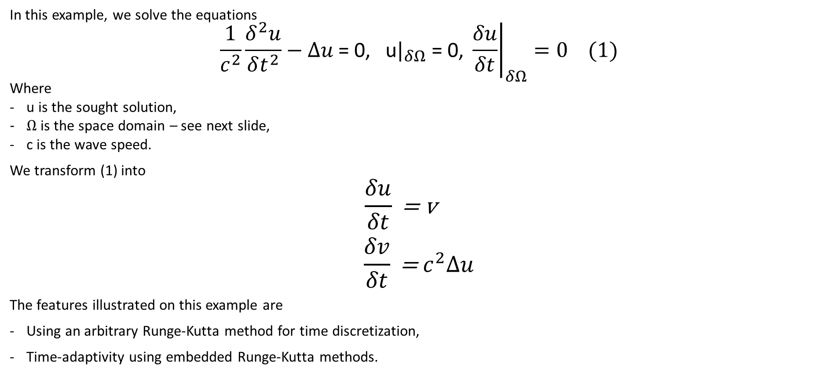
Examples > Wave Equation
In this example, we solve the equations
$$\frac{1}{c^{2}}\frac{δ^{2}u}{δt^{2}}−∆u \text{= 0, }\text{u}|_{δΩ}\text{ = }\text{0, }{\left.\frac{δu}{δt}\right|}_{δΩ}=0 (1)$$
Where
u is the sought solution,
$Ω$ is the space domain – see next slide,
c is the wave speed.
We transform (1) into
$$\frac{δu}{δt}\text{ = }\text{v}$$
$$\frac{δv}{δt}\text{ =}{ c}^{2}Δu$$
The features illustrated on this example are
Using an arbitrary Runge-Kutta method for time discretization,
Time-adaptivity using embedded Runge-Kutta methods.
Hermes2D – Lukas Korous

Slide 25
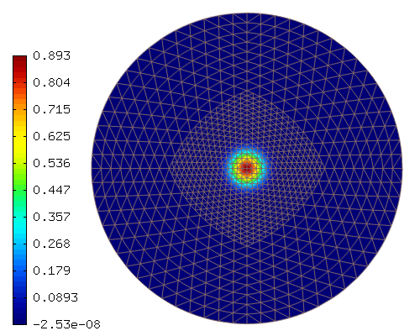
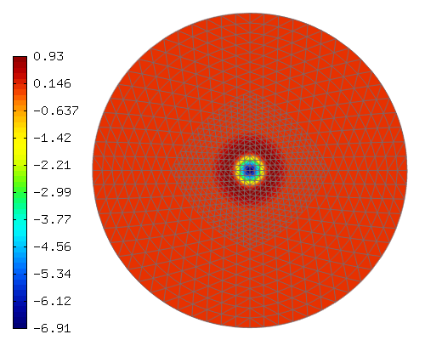
Example > Wave Equation
u (left), v(right), t = 1e-2s
Hermes2D – Lukas Korous

Slide 26
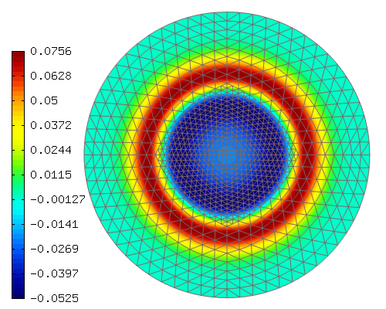
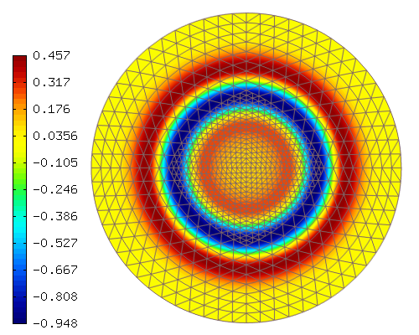
Example > Wave Equation
u (left), v(right), t = 5.1e-1s
Hermes2D – Lukas Korous

Slide 27
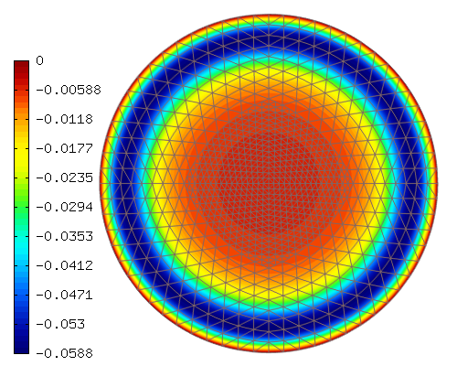
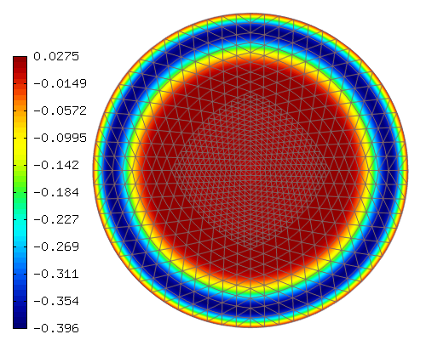
Example > Wave Equation
u (left), v(right), t = 1.01s
Hermes2D – Lukas Korous

Slide 28
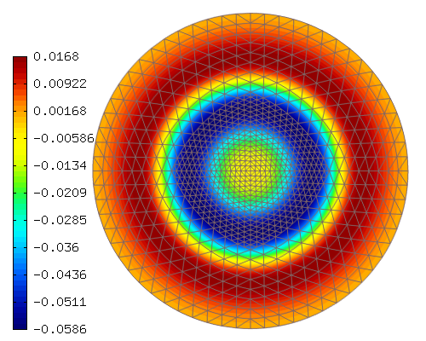
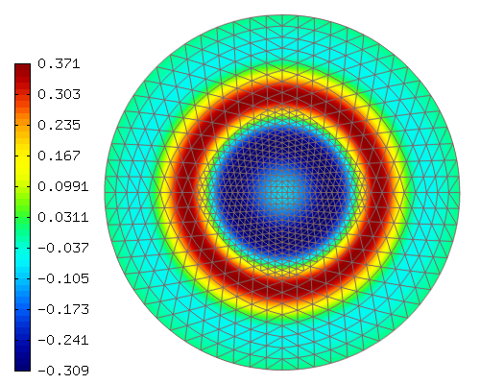
Example > Wave Equation
u (left), v(right), t = 1.51s
Hermes2D – Lukas Korous

Slide 29
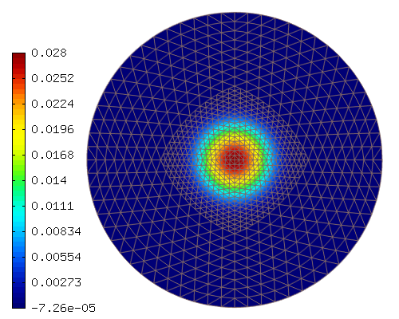
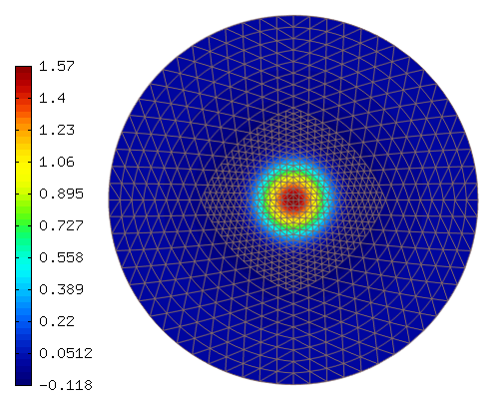
Example > Wave Equation
u (left), v(right), t = 2.01s
Hermes2D – Lukas Korous

Slide 30
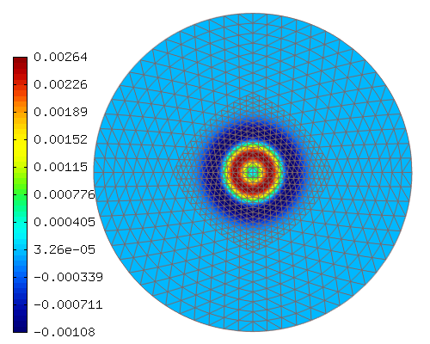
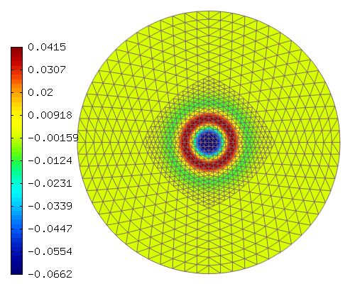
Example > Wave Equation
Time-adaptivity using embedded Runge-Kutta methods
runge_kutta.rk_time_step_newton(previous_solution, new_solution, time_error_function);
...
Hermes::Hermes2D::Views::ScalarView time_error_view;
time_error_view.show(time_error_function);
...
DefaultNormCalculator<double, HERMES_H1_NORM> normCalculator;
normCalculator.calculate_norms(time_error_function);
double relative_time_error_estimate = normCalculator.get_total_norm_squared() * 100.;
Image – temporal error in u (top), v (bottom), t = 0.3s
Hermes2D – Lukas Korous

Slide 31
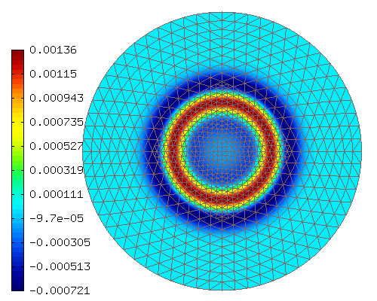

Example > Wave Equation
Time-adaptivity using embedded Runge-Kutta methods
runge_kutta.rk_time_step_newton(previous_solution, new_solution, time_error_function);
...
Hermes::Hermes2D::Views::ScalarView time_error_view;
time_error_view.show(time_error_function);
...
DefaultNormCalculator<double, HERMES_H1_NORM> normCalculator;
normCalculator.calculate_norms(time_error_function);
double relative_time_error_estimate = normCalculator.get_total_norm_squared() * 100.;
Image – temporal error in u (top), v (bottom), t = 0.8s
Hermes2D – Lukas Korous

Slide 32

Example > Benchmark Interior Layer
We solve the equation
$$−∆u \text{= }\text{f}\text{, }\text{u}|_{δΩ}\text{ = }\tilde{f}$$
Where
$Ω$ is the space domain - square (0, 1) x (0, 1),
$\tilde{f}$ is the (known) exact solution,
$f$ is the Laplacian of the exact solution,
u is the sought solution
The features illustrated on this example are
Calculating exact error,
Anisotropic refinements usage in AMR.
Hermes2D – Lukas Korous

Slide 33


Example > Benchmark Interior Layer
solution (left), FE space (right), adaptivity step #1
Hermes2D – Lukas Korous

Slide 34


Example > Benchmark Interior Layer
solution (left), FE space (right), adaptivity step #2
Hermes2D – Lukas Korous

Slide 35


Example > Benchmark Interior Layer
solution (left), FE space (right), adaptivity step #3
Hermes2D – Lukas Korous

Slide 36


Example > Benchmark Interior Layer
solution (left), FE space (right), adaptivity step #6
Hermes2D – Lukas Korous

Slide 37


Example > Benchmark Interior Layer
solution (left), FE space (right), adaptivity step #11
Hermes2D – Lukas Korous

Slide 38


Example > Benchmark Interior Layer
solution (left), FE space (right), adaptivity step #19
Hermes2D – Lukas Korous

Slide 39
Example > Benchmark Interior Layer
Calculating exact error – through sub-classing existing Hermes2D class ExactSolutionScalar<double>:
class CustomExactSolution : public ExactSolutionScalar<double>{
public:
// Implement the actual function expression.
virtual double value(double x, double y) const;
// Implement the derivatives expression.
virtual void derivatives (double x, double y, double& dx, double& dy) const;
// Overwrite the expression calculating polynomial order (for integration order deduction).
virtual Ord value(Ord x, Ord y) const;
};
and then employing standard ErrorCalculator<double> class for error calculation
Anisotropic refinements usage in AMR
// Predefined list of element refinement candidates.
// H2D_HP_ANISO stands for h-, and p-candidates, anisotropic in shape, and polynomial orders.
const CandList CAND_LIST = H2D_HP_ANISO;
// Class which for each element selected for refinement, selects the best refinement candidate.
H1ProjBasedSelector<double> selector(CAND_LIST);
...
// As before, adapt the FE space – using the selector provided
adaptivity.adapt(&selector);
Hermes2D – Lukas Korous

