Slide 1

SCHEDULOGY
Power of Scheduling Algorithms
for
Task & Project Management
How is SCHEDULOGY different?
www.schedulogy.com

Slide 2
SCHEDULOGY
How is SCHEDULOGY different?
There is a plenty of calendar and meeting schedule apps out there.
What do they have in common?
They fail at the most important goal – to save your time.
For SCHEDULOGY, saving your time is EVERYTHING.
www.schedulogy.com

Slide 3
SCHEDULOGY
How does SCHEDULOGY save your time?
“What can be done by an algorithm, should be done by an algorithm.”
Find a common time slot for all meeting attendees
Software knows everybody’s calendar, why would you need to select times that suit you and then your colleagues would have to do the same to tediously agree on a time that will change twice anyway?
Reschedule your meetings based on external changes
People get sick, priorities change, customers change their minds, family stuff happens, … – are you seriously not sick & tired of reorganizing your calendar all the time?
www.schedulogy.com

Slide 4
SCHEDULOGY
This is your normal calendar – all meetings are fixed, and changing the time is too much of a hassle (e-mails, calls, dependencies), even though it may be more efficient to have it changed.
Weekly call with Amanda
Board meeting Q3/2020
NBV study review
Review the TER account
1:1 with Henry
Review of new applicants with HR
Advisory board
Brainstorming session with IXB team about ESB implementation
Pick up Mary from the airport
Reserved time for ESB implementation readiness check
Management review
www.schedulogy.com

Slide 5
SCHEDULOGY
Do all the meetings really need to happen at that exact time? The blue ones probably yes, but the orange ones? Not necessarily! See the next slide for details.
Weekly call with Amanda
Board meeting Q3/2020
NBV study review
Review the TER account
1:1 with Henry
Review of new applicants with HR
Advisory board
Brainstorming session with IXB team about ESB implementation
Pick up Mary from the airport
Reserved time for ESB implementation readiness check
Management review
www.schedulogy.com

Slide 6
SCHEDULOGY
Let us focus on these two items in your calendar. And why the terminology used in SCHEDULOGY is Event and Task.
Board meeting Q3/2020
It is a good idea to set some cornerstone Events like this one in the calendar. These are some dates, set in stone, that do not change, among other reasons because these must be announced way in advance, therefore the dates also appear in official documents, frequently distributed to the general public.
Review of new applicants with HR
Let us look at this one from the planning perspective. What we really have is this Task:
What: Review of new applicants with HR
Who: Helen (head of HR for my department), her assistant Peter, and myself
When: due before the end of the week
How long: 2 hours
This is exactly how these are modelled in SCHEDULOGY. And when will the Task be scheduled in the calendar? Exactly when the conditions are met (before the due date, when there is enough time in everybody’s calendar at the same time).
www.schedulogy.com

Slide 7
SCHEDULOGY
Inspecting closely the model calendar, there is a problem with the previous re-thinking of some (most) of the calendar items into Tasks:
Brainstorming session with IXB team about ESB implementation
If we think (regardless of the tool used) of these two as Tasks:
Reserved time for ESB implementation readiness check
Who: just myself
When: anytime before the Brainstorming session with IXB team
How long: 2 hours
Brainstorming session with IXB team about ESB implementation
Who: IXB team and myself
When: due before the end of the week
How long: 2 hours
Reserved time for ESB implementation readiness check
Again, this is exactly how these are modelled in SCHEDULOGY:
Tasks in SCHEDULOGY may depend on one another. Task A being dependent on Task B means that any work on Task A may be started only as soon as all work on Task B is finished.
Tasks can be also dependent on Events, but Events as they have fixed start, cannot depend on anything.
www.schedulogy.com

Slide 8
SCHEDULOGY
SCHEDULOGY does not “just” improve your Calendar. It also goes a step further, building on lessons learned in enterprise job scheduling, and mathematical theory of constraint satisfaction problems.
NBV study review
Look at these two Tasks. They are in your calendar. But, let us try to model one of them regardless of the tool, and let us be open-minded:
NBV study review
Who: myself, or Joseph, or Cindy
When: due before the end of the week
How long: 1 hour
Review the TER account
Right, it is not necessarily myself who needs to do it.
That might have been agreed upon previously, but what if I can’t make it before the due date (something came up), and Joseph or Cindy would be perfectly able to? I would need another call or two, another inefficiency.
If I modelled it as the above, as soon as I were not able to do it, it would get automatically reassigned to whoever can.
Yet again, this is exactly how Tasks can be modelled in SCHEDULOGY.
www.schedulogy.com

Slide 9
SCHEDULOGY
Use Case #1 – Personal Task Management
No need to track items in your Calendar and the To-Do list separately.
SCHEDULOGY will schedule tasks into precisely at-the-time available free slots, so that deadlines are met, and no overtime is needed.
There is no need for the user to specify when exactly to reserve time to work on a task, if the task can be worked on anytime.
No need to react to changes (new tasks, prolonged meetings) either – SCHEDULOGY takes care of this automatically.
www.schedulogy.com

Slide 10
SCHEDULOGY
Use Case #2 – Handling Task Dependencies
Task Management in a large team is a very complex problem to solve due to inter-task dependencies between tasks performed by different people.
Such problems arise typically in manufacturing, shift scheduling, production planning, and powerful algorithms have been developed for exactly those purposes.
SCHEDULOGY leverages these algorithms, to improve teamwork and effectivity in natural environment where individual and dependent work steps are highly distributed among members of the team.
www.schedulogy.com

Slide 11
SCHEDULOGY
Use Case #3 – Meeting Time
Corporate meetings where calendars of very busy people need to be coordinated and a common time slot found, are both very important, and very annoying to schedule and reschedule.
With SCHEDULOGY, all this is taken care of. The necessary input just follows common sense – how long the meeting should be, and until when it should happen – SCHEDULOGY schedules the meeting automatically.
No need for you to select 5 suitable times, which will likely not suit your colleague, or for you to go to your colleagues’ calendars and think what they may or may not re-schedule.
www.schedulogy.com

Slide 12
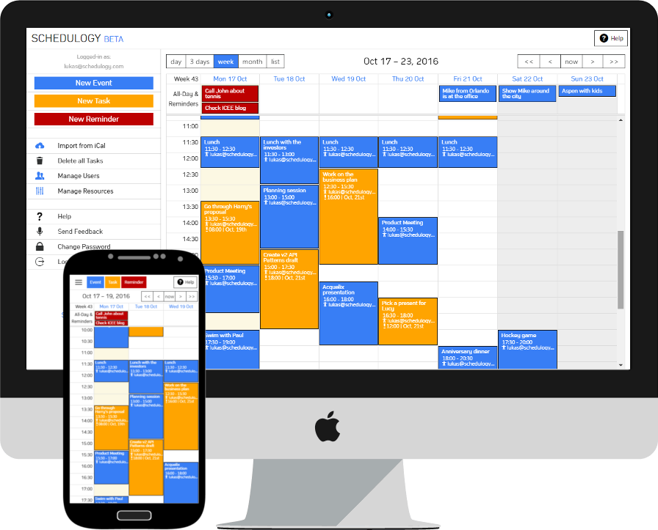
SCHEDULOGY
“What can be done by an algorithm, should be done by an algorithm.”
www.schedulogy.com

