Slide 1
PORTFOLIO CASE STUDY · ANALYTICS ENGINEERING
A governed, multi-agent analytics engineering system.
Maldros ran a full analytics investigation — from a raw business question to an executive briefing — autonomously in 288.9 seconds, and the governance held the whole way.
Single-operator simulation · 9 agents in working code · 6 phases validated via simulation · nothing production-deployed
Notes:
Portfolio case study for the Maldros system. Maturity states are labeled throughout: design-complete, validated via simulation, production-deployed (none). The 288.9s runtime is the least interesting result — governance held (94.6% citation coverage on the released report, three L1 vetoes, no auto-approve) is the differentiator.

Slide 2
EXECUTIVE SUMMARY
A full governed investigation ran in 288.9 seconds — and the abuse it surfaced was invisible to every aggregate view.
A single analytics engineer cannot, by hand, hold a semantic layer consistent, keep pipelines healthy, review experiments with real statistical rigor, and turn all of it into a defensible executive briefing. Maldros runs that entire lifecycle end-to-end. The differentiator is not the speed — it is that governance stayed intact the whole way.
288.9s
94.6%
16.54×
6
Autonomous end-to-end run
Governance held · the differentiator
The signal every aggregate missed
Capability phases validated
Orchestrator → Analyst → Statistician → Storyteller
88 of 93 claims cited; enforced by veto
41-account cluster vs 0.946× population
via simulation · synthetic dataset
Source: case study Topic 1 · Phase 1 investigation, Discovery Report 84c4e728 · validated via simulation.
Notes:
L1 executive summary. The four KPIs validate the finding. Amber focal = 94.6% citation coverage, the governance number. Nothing here is live production impact.

Slide 3
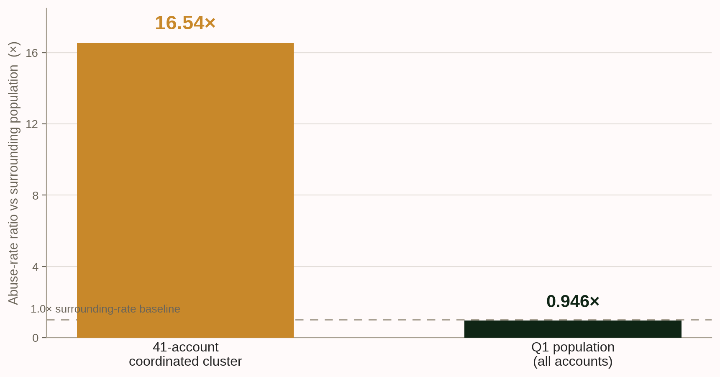
EVIDENCE · THE PHASE 1 FINDING
The signal was concentration, not volume.
The Q1 population-level abuse rate was 0.946× the non-Q1 average — not a spike. A 41-account coordinated cluster ran at 16.54× the surrounding rate, carrying $5.89M in synthetic-domain financial impact. A threshold on the aggregate would have seen nothing.
Source: Phase 1 investigation · Discovery Report 84c4e728 · synthetic dataset (750K api_events, 18-month horizon) · validated via simulation.
Notes:
The one chart in the deck, placed as evidence after the finding — the deck never opens on a chart (§7). Amber focal = the 41-account cluster bar. Axis is zero-based; the dashed line marks the 1.0× surrounding-rate baseline.

Slide 4
GOVERNANCE
Governance is enforced in the architecture, not by convention — a deterministic Layer 1 holds a veto the language model cannot override.
In the five-layer inference stack, Layer 1 is heuristic and deterministic; Layer 5 is the LLM orchestrator. L1 blocks are final — a known-bad data signature is not out-voted by the model's narrative assessment. Correctness becomes a property of the structure, not a hope about the model's judgment on any given run.
5
12
6
Inference-stack layers · L1 vetoes L5
Permanently-locked Design Invariants
Permanently-locked operator directives
Source: case study Topics 4, 8 & 9 · five-layer inference stack; twelve Design Invariants · design-complete, exercised in simulation.
Notes:
Finding slide. Amber focal = the 5-layer inference stack, where L1 vetoes L5. Sets up slide 5, which shows the two concrete enforcement mechanisms.

Slide 5
GOVERNANCE · HOW IT IS ENFORCED
Two enforcement problems, two mechanisms: some outputs cannot be produced, and some actions cannot be taken without a human saying yes.
Some outputs cannot be produced
Some actions cannot be taken
Three deterministic Storyteller L1 vetoes — causal-language, citation coverage, and omission audit — block a draft before it can ship. In Phase 1 the released report reached 94.6% citation coverage (88 of 93 claims); 14 of 18 development runs were blocked first.
The Confirmation Gate fires on nine triggers written in code, not policy. It never auto-approves — not on timeout, not on operator absence. One self-generated Phase 7 improvement proposal is held at the gate right now, awaiting human sign-off.
The proposal waiting at the gate is proof the no-auto-approve rule works — not a backlog.
Source: case study Topic 9 · three Storyteller L1 vetoes; Confirmation Gate (nine triggers, no auto-approve) · validated via simulation.
Notes:
Evidence for slide 4. Amber focal = the single insight line: the held Phase 7 proposal proves the no-auto-approve rule works. P-060: 14 of 18 development runs blocked before one cleared all three vetoes.

Slide 6
CAPABILITY
Across six validated phases, the system delivered analyst-quality work at machine speed — with governance intact, not traded away to get there.
Each phase was validated by its own result rather than rolled into a single composite number: investigation, self-healing, experiment analysis, self-improvement, invention, and full autonomous audit. Reporting by phase is the honest form — it shows exactly what was exercised, and what was not.
1
2
3
4
5
6
Investigation
Self-healing
Experiments
Self-improvement
Invention
Full audit
Source: case study Topic 3 & Topic 12 · Phases 1–6, each validated via simulation on the synthetic dataset.
Notes:
Finding slide. Amber focal = Phase 5 (Invention / The Forge) — the genuinely novel capability. Slide 7 is the phase-by-phase evidence table.

Slide 7
EVIDENCE · PHASE BY PHASE
Every phase was validated by result, not by a single composite number.
PHASE | WHAT RAN | RESULT
1 · First end-to-end | Question → briefing, zero human steps between | 288.9s; 41-account cluster surfaced at 16.54×
2 · Self-healing | 3 injected failure classes | All detected, classified, autonomously remediated
3 · Experiment analysis | 3 experiments, analyzed blind | 3 / 3 correct: NO_SHIP · HOLD · SHIP — none pre-labeled
4 · Self-improvement | 10-cycle compounding run | Measured 40–53% edit-distance step, then flat
5 · The Forge (invention) | A novel detection framework | “Spectral Coordination Sieve” → Conditionally Robust
6 · Full autonomous audit | 175 artifacts routed | 100% correct Mode A / B (89 / 86); 73.6s, no scaffolding
None pre-labeled. No human scaffolding at any intermediate step. The one place a human was required — the gate — is the one place a human is meant to be.
Source: case study Topic 12 · Phases 1–6 · validated via simulation · synthetic dataset · nothing production-deployed.
Notes:
Evidence table for slide 6. P-038 lock: Phase 4 is the measured 40–53% edit-distance step then flat — never the design-target multipliers. Amber focal = the closing insight line.

Slide 8
ARCHITECTURE
Narrow mandates produce auditable failures; monolithic agents produce inscrutable ones.
Nine agents each carry one mandate paired with exactly the toolset it requires — the Red-Team Agent has no live-data or production access; the Diagnostic Agent has no write access. When something fails, the bounded scope makes the failure legible instead of burying it inside one all-powerful model. The stack is concrete: DuckDB over Parquet, Python (pandas / polars / networkx), orchestrated through Claude Code.
9
7
8
Narrow-mandate agents · mandate + toolset paired
Architectural layers
Cross-disciplinary CDI Layer domains
Nine bounded agents: Orchestrator · Data Architect · Analyst · Statistician · Storyteller · Diagnostic · Healing · Red-Team · Forge
Source: case study Topic 6 · nine agents in working code (eight investigation/operations agents plus the Phase 5 Forge); seven-layer architecture; CDI Layer (8 domains) · design-complete, exercised in simulation.
Notes:
Finding slide. Amber focal = the 8 narrow-mandate agents. Stack named explicitly (DuckDB, Parquet, Python, Claude Code) per the project lock.

Slide 9
ENGINEERING METHODOLOGY
The build discipline is the first deliverable, not the last check.
The system was built the way it audits investigations. A three-document specification hierarchy resolves conflicts by deterministic precedence; a persistent Memory / Progression / Change-Tracker layer carries context across sessions; and every phase transition passes a mandatory gap-audit before the next begins. The same auditability the system produces on its findings governs how it was made.
3
9 / 9
0
Specification docs · deterministic precedence
Phase 0 exit criteria · confirmed, not assumed
Phases rebuilt from context loss
system prompt > architecture > implementation
gap-audited before Phase 1 began
continuity layer held across sessions
Source: case study Topic 5 · three-document spec hierarchy; Phase 0 nine exit criteria (all confirmed) · D-8 gap-audit discipline.
Notes:
Finding slide. Amber focal = 9/9 Phase 0 exit criteria confirmed. The methodology is itself an engineering-process story.

Slide 10
BUSINESS VALUE · MODELED AT CONCURRENT FRONTIER SCALE
At concurrent frontier scale, the cost of running the system is not the binding constraint.
Modeled across three concurrent scenarios — 15 / 30 / 60 analyst seats, roughly 750 / 3,900 / 15,000 investigations a year — the incremental cash cost is dominated by the platform-engineering headcount to operate the system, not by model tokens or the warehouse (DuckDB in simulation, BigQuery as the production target).
$210K–$800K
45:1–50:1
Days
$58M–$338M
Incremental cash cost · per year
General-composite ROI
Arithmetic payback
Enterprise value · 5–10×
[Projected] · platform-eng-dominated
[Projected] · ~84:1–98:1 with fraud domain
[Projected] · sub-ten-day
[Projected] · general composite
Every figure is [Projected] from a synthetic-domain simulation, not live revenue. The sub-ten-day payback is arithmetically correct and operationally misleading — plan to the milestone sequence (first governed investigation in month one; compounding value over months two-to-six), not the ratio.
Source: case study Appendix C §12 · concurrent frontier-scale cost model (15 / 30 / 60 seats) · all figures [Projected].
Notes:
Finding + evidence. Amber focal = the ROI band. Honest framing preserved: figures are projected from a synthetic-domain simulation; plan to the milestone sequence, not the payback ratio.

Slide 11
BUILD STATUS · WHAT IS AND IS NOT BUILT
A single-operator simulation, stated honestly — the boundary is an engineering asset, not a confession.
Nine agents in working code. Six phases validated via simulation. Nothing production-deployed. Four limitations apply, each stated precisely and each mapped to one bounded task:
Synthetic, not live, data → ingestion + transfer validation
No live operator UI — an approved mockup only → wire the console to data
Analyst query logic built around its demonstrated investigation → query generalization
One Phase 7 proposal held at the gate → human sign-off
Read the full case study for the evidence behind every claim. The honest boundary — precision about what the system does not yet do — is the same standard the system enforces on its own reports. That discipline is the differentiator.
Maldros · maturity states labeled throughout: design-complete · validated via simulation · production-deployed (none).
Notes:
Conclusion slide. The recommendation (amber block) closes the FINDING→IMPACT→EVIDENCE→RECOMMENDATION arc at the document level. Each of the four limitations maps to one bounded task; the held Phase 7 proposal is governance functioning correctly, not a flaw.

