Slide 1
Detection and Replacement of Implicit Subjects
A rule-based approach
Lukas Rossi
05.12.2023

Slide 2
Requirements
Implementation
Personal data shall be accurate and, where necessary, kept up to date.
=?
The user must update their data when it changes.

Slide 3
Personal data shall be processed [by the controller] lawfully, fairly and in a transparent manner in relation to the data subject.
After selecting a product…
After the customer selects a product…
Passive
Gerund
Select one.
The purposes of the processing [by the controller] for which the personal data are intended as well as the legal basis for the processing.
You select one.
Imperative
Nominalized verbs

Slide 4
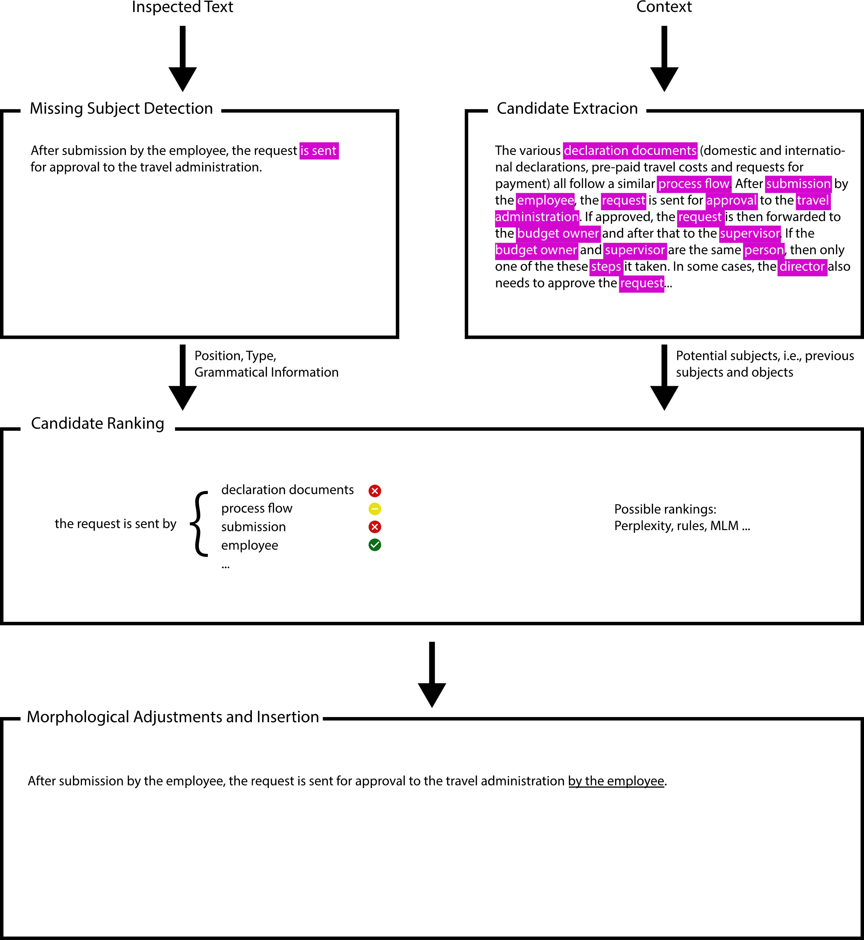

Slide 5
Possible Candidate Ranking Metrics
(Imperative Pruning)
Perplexity
Similarity to existing facts
Physical Proximity
Importance in the context (e.g., TF-IDF)
…

Slide 6
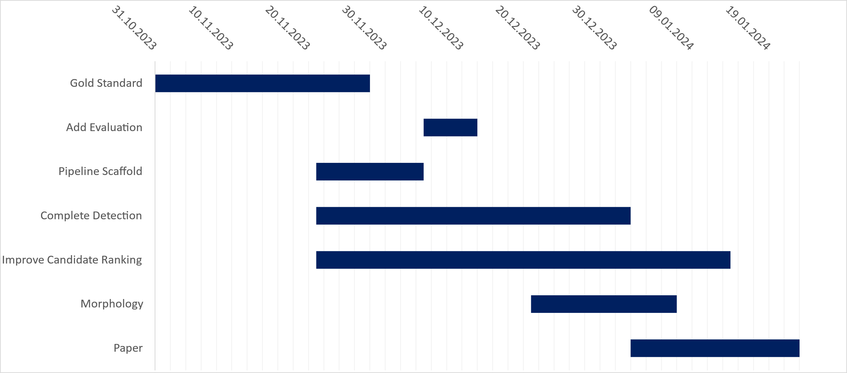
Project Plan
Today

Slide 7
Code

Slide 8
Current Ranking Idea
- Perplexity Pruning,
- Extraction of agent, predicate, patient triplets from candidates
- Calculate pairwise similarity scores between the candidate triplets and the target concatenated with candidate
- If high similarity found match else fall back to proximity.

