Slide 2
Objectives:
Understand course viewpoint: Portfolio Manger.
Understand portfolio manager incentives.
Understand two main types of funds.
Understand benchmarks.

Slide 3
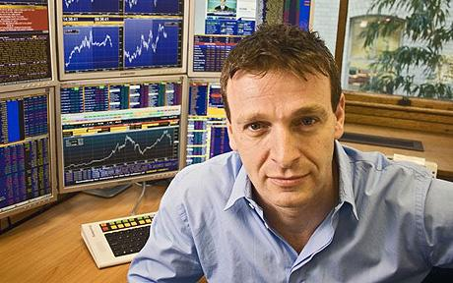
Viewpoint
I assume you want to be a portfolio manager.

Slide 4
Portfolio Manager / Hedge Fund Incentives
Expense ratio
Used by mutual funds & ETFs.
Usually less than 1%.
“Two and twenty”
Classic structure for hedge funds.
$1M with 20% / year = $60K/year.
How/why different?

Slide 5
How to Attract Investors?
Know your audience:
Individuals
Institutions:
Harvard Foundation
CalPERS
Funds of Funds

Slide 6
How to Attract Investors?
Must have track record, or
Very compelling story and back test.
Fit in a “pigeon hole?”
What do investors want to see?

Slide 7
Two Main Types of Fund Goals
Reference to a benchmark (pigeon hole).
Absolute return.

Slide 8
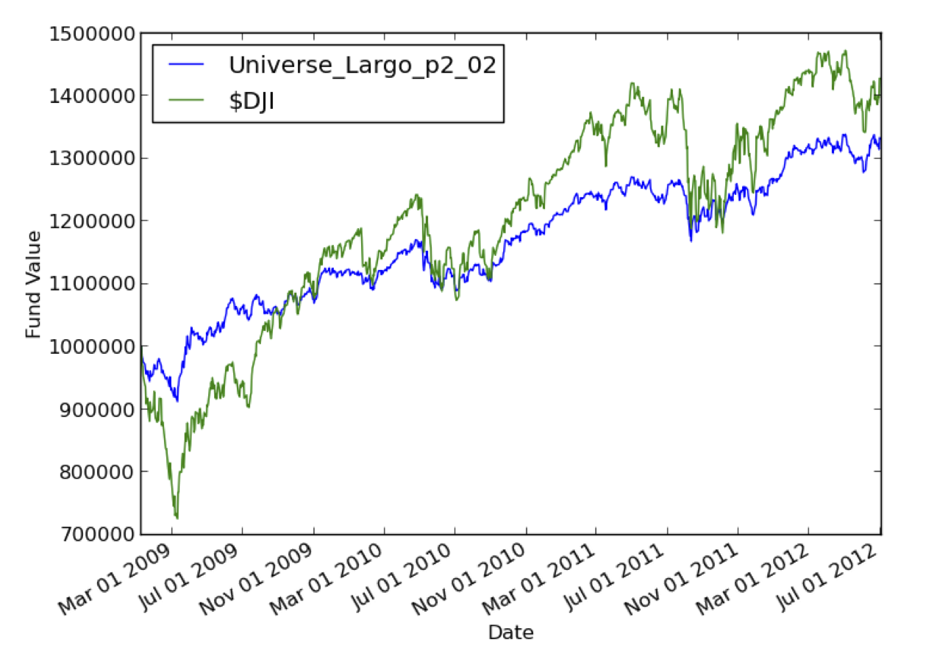
Example: Compare with Benchmark
Thanks Lucena Research

Slide 9
What are Investors Looking For?

Slide 10
Common Metrics
Annual return.
Risk: Standard deviation of return.
Risk: Draw down.
Reward/Risk: Sharpe Ratio.
Reward/Risk: Sortino Ratio.
Jensen’s Alpha.

Slide 11
Example
 | Return | Sharpe | STDEV | D-down | Corr
Fund | 33% | .94 | 0.58% | -8.67% | 0.89
$DJI | 43% | .63 | 1.23% | -27.38% | 1.00

Slide 12
Annual Return
metric = (value[end]/value[start]) – 1
Example: $100 to $110:
(110/100) – 1 = 0.10 = 10%

Slide 13
Standard Deviation of Daily Return
daily_rets[i] = (value[i]/value[i-1]) – 1
std_metric = stdev(daily_rets)

Slide 14
Max Draw Down

Slide 15

Sharpe Ratio
metric = (average(daily_rets)/stdev(daily_rets)) * sqrt(250)

Slide 16
Homework 1
Find online broker to “paper trade.”
Invest $1M in 4 equities.
Assess your portfolio for 2011:
Annual return
Average daily return
Stdev of daily return
Sharpe Ratio
Compare with benchmark: SPY
Submit
.pdf printout of your spreadsheet.
Screenshot of your portfolio online.

Slide 17
Demo Using Excel

