Slide 2
What are Investors Looking For?

Slide 3
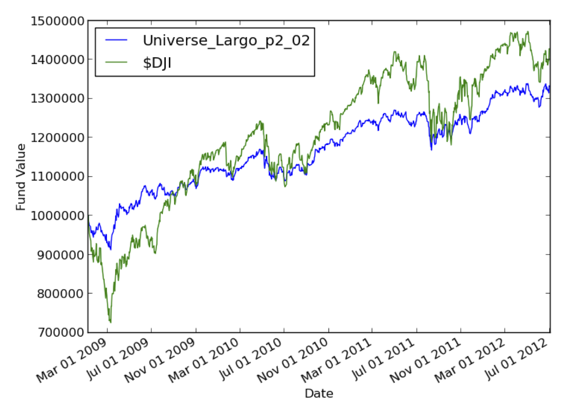
Common Metrics
Annual return.
Risk: Standard deviation of return.
Risk: Draw down.
Reward/Risk: Sharpe Ratio.
Reward/Risk: Sortino Ratio.
Jensen’s Alpha.

Slide 4
Example
 | Return | Sharpe | STDEV | D-down | Corr
Fund | 33% | .94 | 0.58% | -8.67% | 0.89
$DJI | 43% | .63 | 1.23% | -27.38% | 1.00

Slide 5
Annual Return
metric = (value[end]/value[start]) – 1
Example: $100 to $110:
(110/100) – 1 = 0.10 = 10%

Slide 6
Standard Deviation of Daily Return
daily_rets[i] = (value[i]/value[i-1]) – 1
std_metric = stdev(daily_rets)

Slide 7
Max Draw Down

Slide 8

Sharpe Ratio
Reward/Risk = How much reward are you getting for your risk?
metric = (average(daily_rets)/stdev(daily_rets)) * sqrt(250)

Slide 9
Homework 1
Find online broker to “paper trade.”
Invest $1M in 4 equities.
Assess your portfolio for 2011:
Annual return
Average daily return
Stdev of daily return
Sharpe Ratio
Compare with benchmark: SPY
Submit
.pdf printout of your spreadsheet.
Screenshot of your portfolio online.

Slide 10
Demo Using Excel

