Slide 2
How To Compare Similar Portfolios?
daily_rets[i] = (value[i]/value[i-1]) – 1
std_metric = stdev(daily_rets)

Slide 3
Sharpe Ratio
Most “important” measure of asset performance.
How well does the return of an asset compensate the investor for the risk taken?
The higher the Sharpe ratio the better.
When comparing two assets each with the same return, higher Sharpe ratio gives more return for the same risk.

Slide 4

Sharpe Ratio
Reward/Risk = How much reward are you getting for your risk?
metric = k * mean(daily_rets)/stdev(daily_rets))
k = sqrt(250) for daily returns

Slide 5
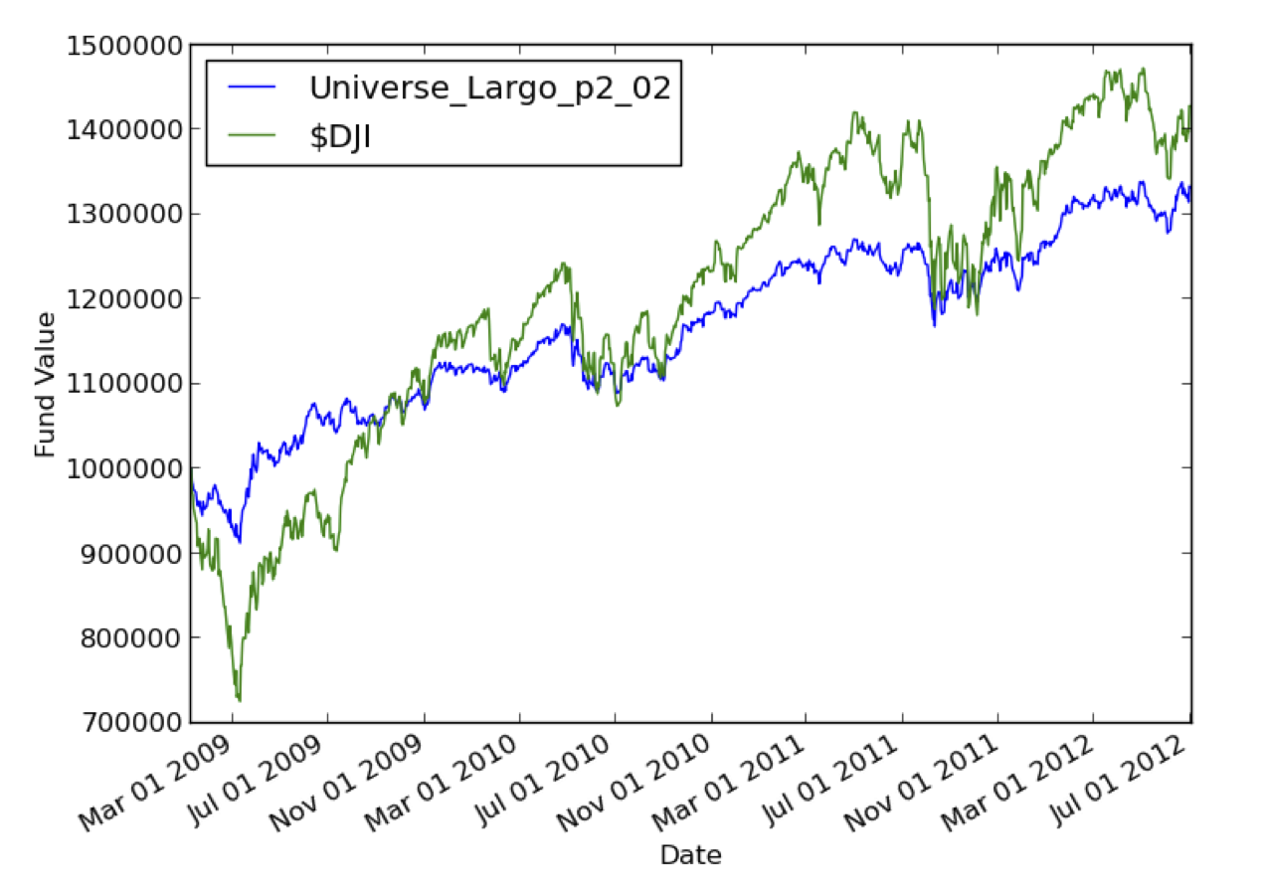
Example
 | Return | Sharpe | STDEV | D-down | Corr
Fund | 33% | .94 | 0.58% | -8.67% | 0.89
$DJI | 43% | .63 | 1.23% | -27.38% | 1.00

