Slide 2
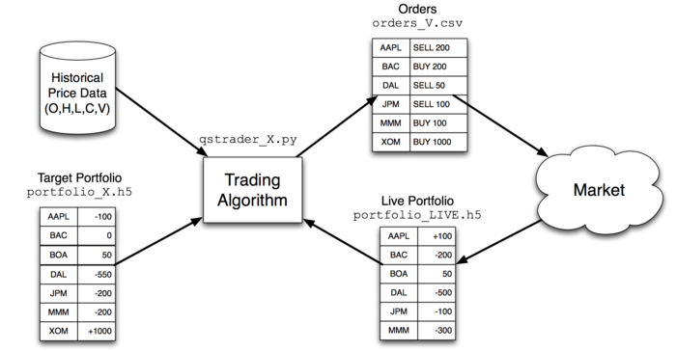
Inside a (slower) Quant Shop

Slide 3
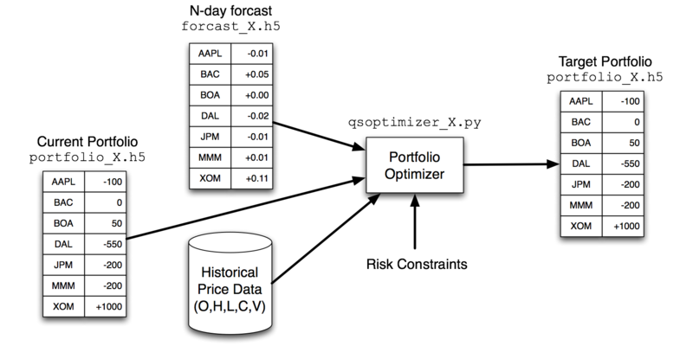
Inside a Quant Shop

Slide 4
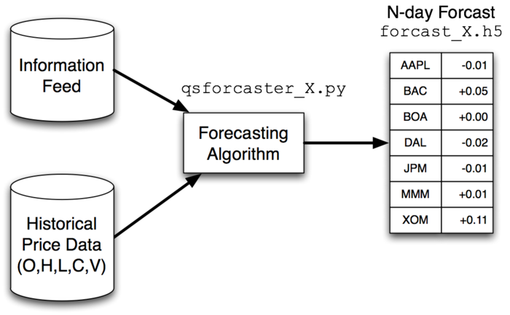
Inside a Quant Shop

Slide 5
Objectives:
Understand order types.
Understand order book at exchanges.
Understand how buy/sell orders drive prices up or down.
Understand the basic infrastructure of an exchange.
Understand the major computational components of a hedge fund.

