Slide 1
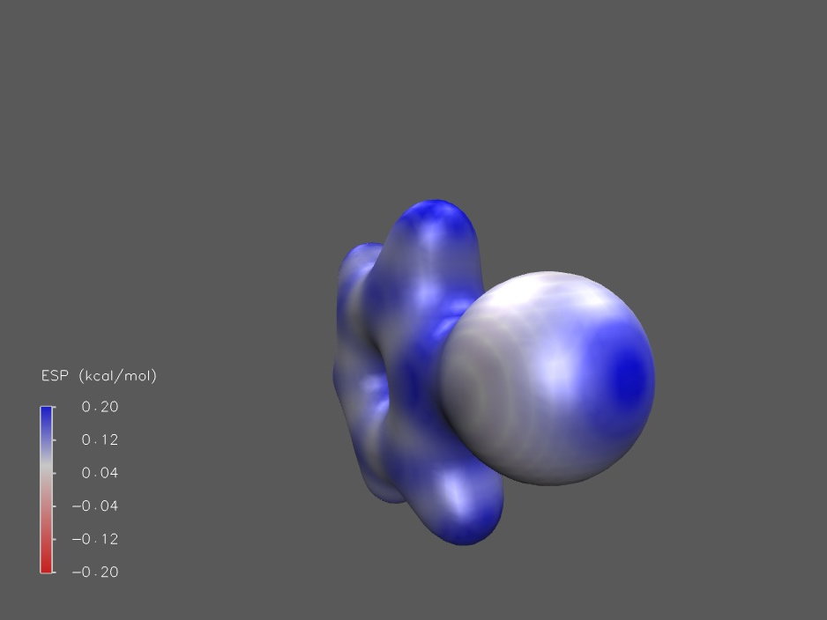
Deriving Off-site Charge Parameters to Model Anisotropic Charge Distributions in Phenyl Halides
IGC Group Talk 2017-12-13 by Lukas Schreder, Research Project I
PhCl
MP2/Def2TZVP

Slide 2
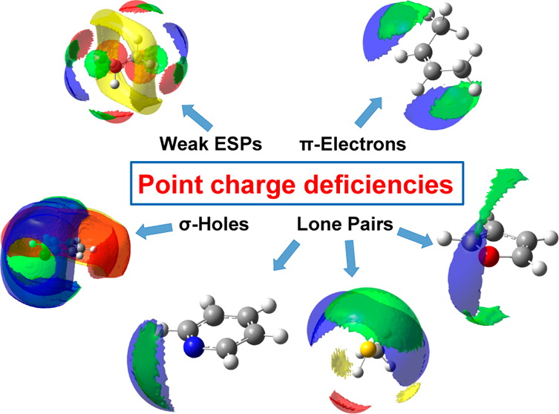
Point Charges Fail to Reproduce Critical Electronic Properties
Charge anisotropies are often neglected in MD
Many forcefields support Virtual Sites (but not all, e.g. GAFF), which are often used as a makeshift solution
Almost all heteroatoms require multipole descriptions
Kramer et al.; J. Chem. Theory Comput., 2014, 10 (10), pp 4488–4496
Lukas Schreder
2017-12-13

Slide 3
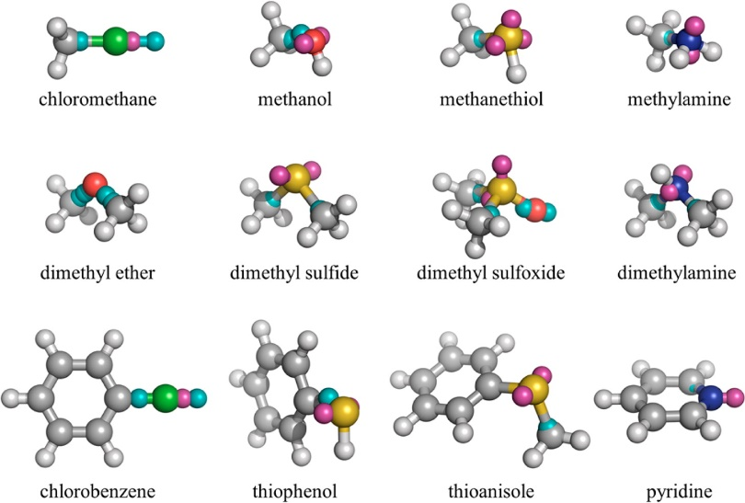
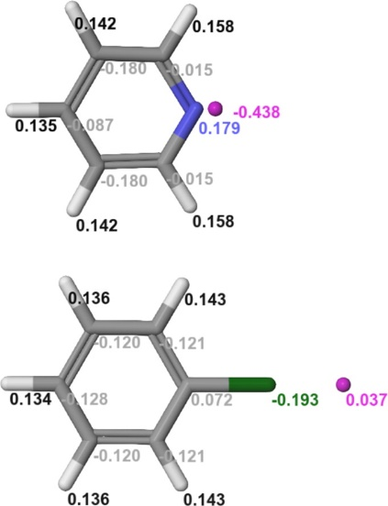
Previous Approaches are Expensive to Compute
Cole et al.: Simplex minimization against RMSE of Dipole and Quadrupole moments with up to 3 virtual sites per atom
Harder et al.: Fitting against ESP error and MD data (hydration free energy)
Cole et al.; J. Chem. Theory Comput., 2016, 12 (5), pp 2312–2323
Harder et al.; J. Chem. Theory Comput., 2016, 12 (1), pp 281–296
Lukas Schreder
2017-12-13

Slide 4
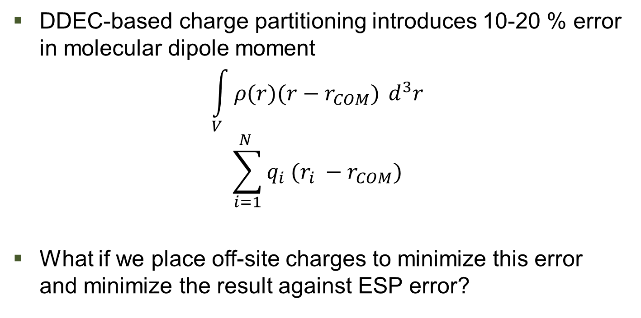
Correcting Fundamental Electronic Properties with Off-site Charges
Lukas Schreder
2017-12-13

Slide 5
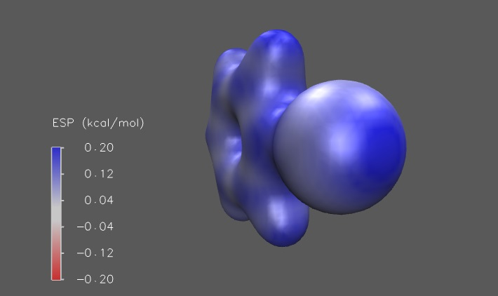
Finding Possible Use Cases: Halogens
PhBr
MP2/Def2TZVP
Lukas Schreder
2017-12-13

Slide 6
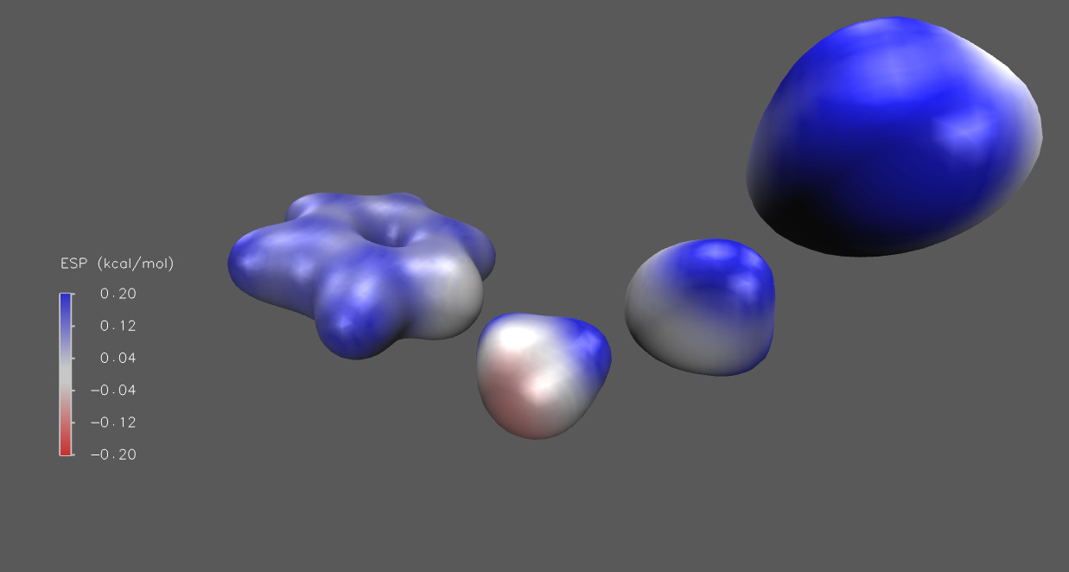
Finding Possible Use Cases: Heterocycles
PYRTHA
TPSSh/aug-cc-pVDZ
Lukas Schreder
2017-12-13

Slide 7
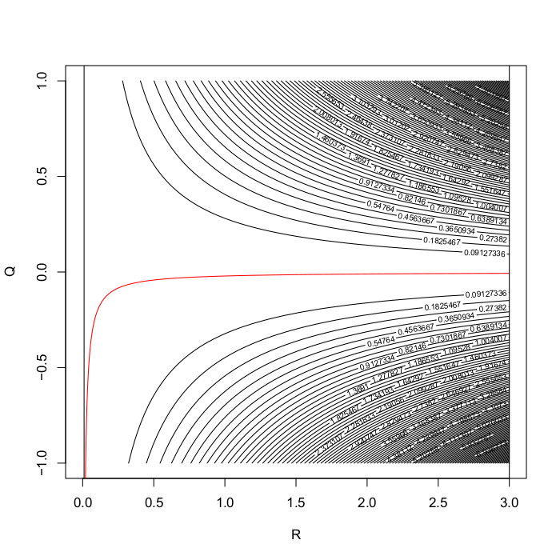
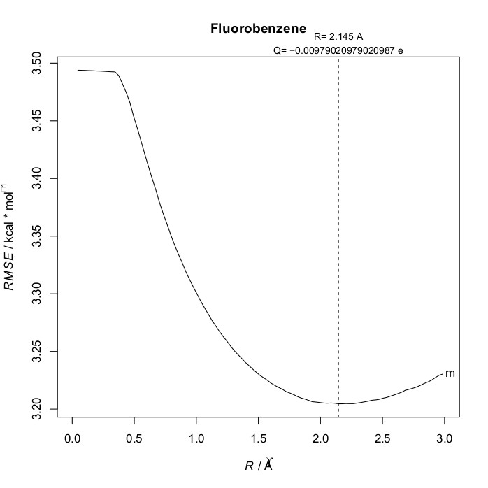
Dipole Error and ESP Error Minimization Deliver Reasonable Parameter Estimates
No σ-hole, negative Off-Site Charge
Lone pairs might be approachable in highly negative atoms
Lukas Schreder
2017-12-13

Slide 8
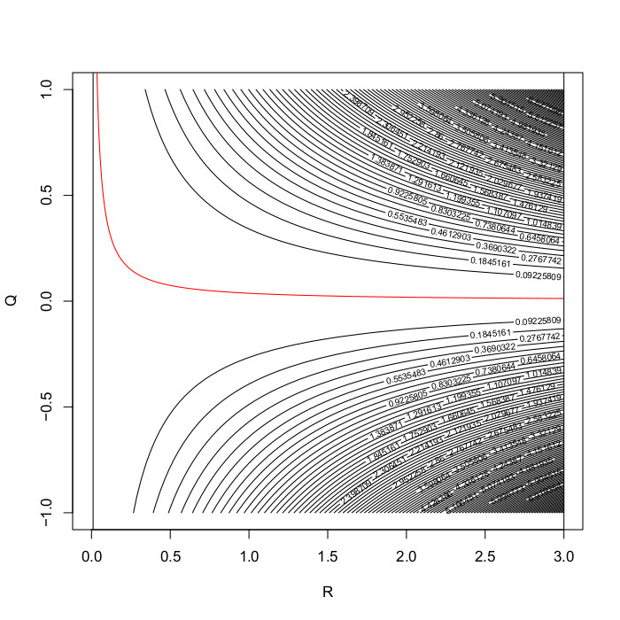
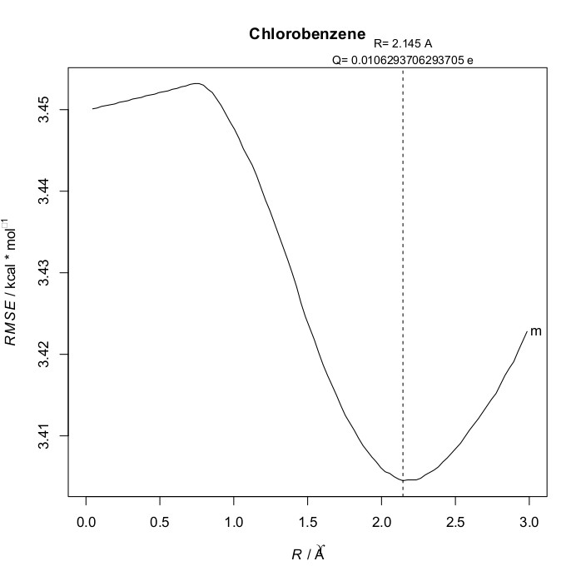
Dipole Error and ESP Error Minimization Deliver Reasonable Parameter Estimates
σ-hole shows its effect
Compatible with earlier parametrizations
Lukas Schreder
2017-12-13

Slide 9
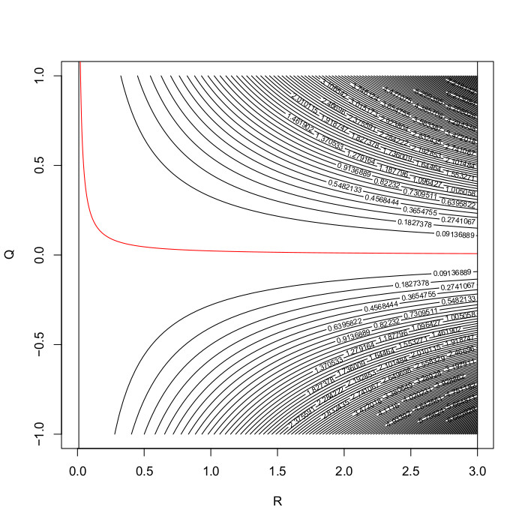
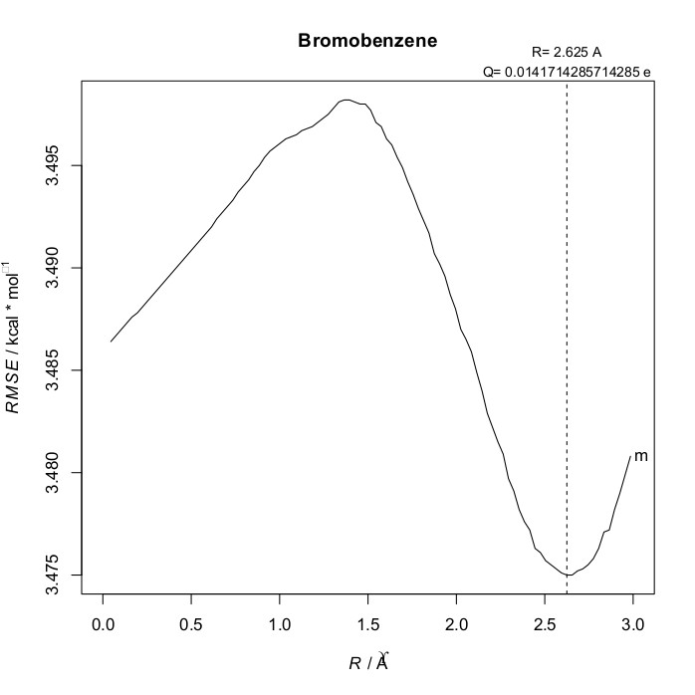
Dipole Error and ESP Error Minimization Deliver Reasonable Parameter Estimates
Trend continues to follow the lower electronegativity
Minima becomes less pronounced
Lukas Schreder
2017-12-13

Slide 10
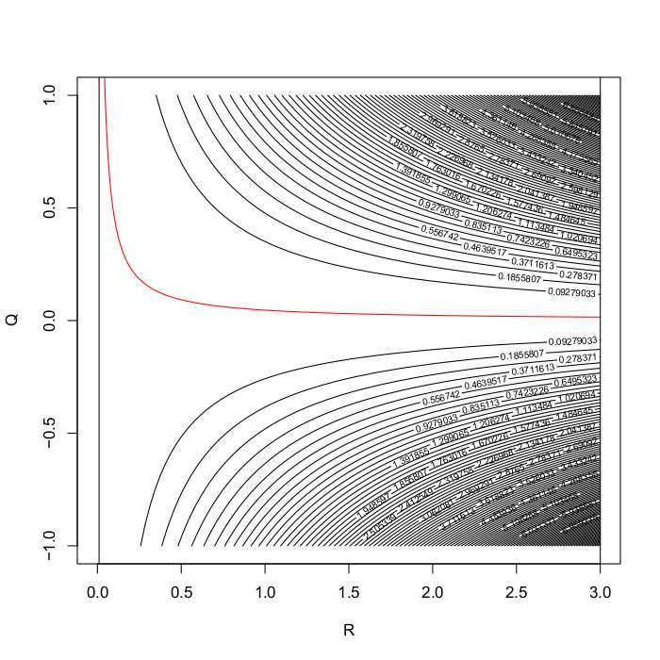
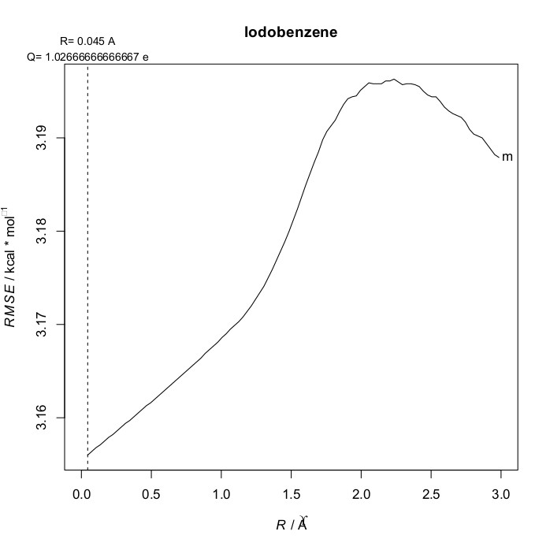
Dipole Error and ESP Error Minimization Deliver Reasonable Parameter Estimates
No parameters found
σ-hole is probably neutralized by EDG
Lukas Schreder
2017-12-13

Slide 11
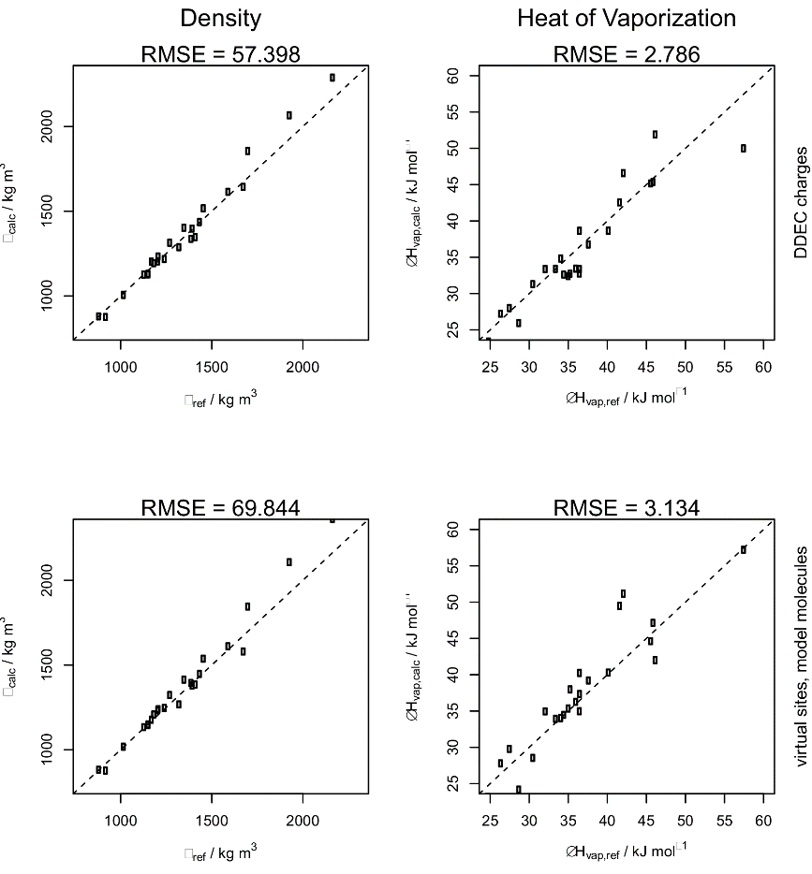
This Approach Limits Use Cases...
Only molecules with a significant permanent dipole allow for sensible charge placement
Many structures do not profit from individually computed parameters
Parameters from reasonably similar model atoms often produced better results
Lukas Schreder
2017-12-13

Slide 12
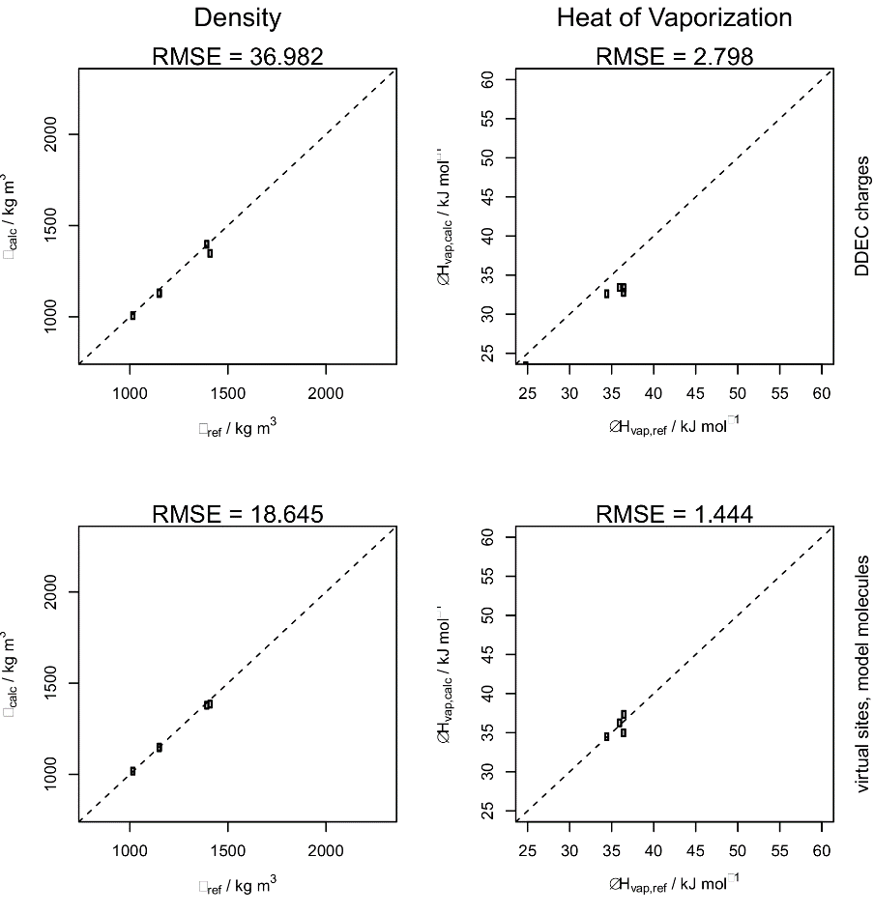
... But can help to Reproduce Liquid Properties in Small Molecules
A subset of Aryl halides showed significant improvements (-50% RMSE)
But there are only 5 in the benchmark set
So I made my own set
Lukas Schreder
2017-12-13

Slide 13
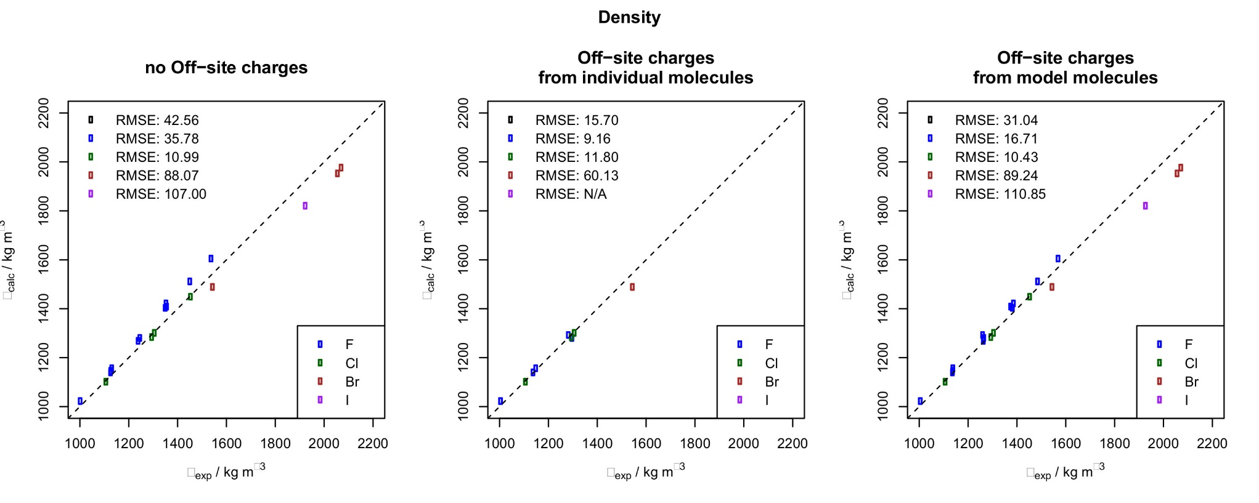
Application to Phenyl Halides
Lukas Schreder
2017-12-13

Slide 14
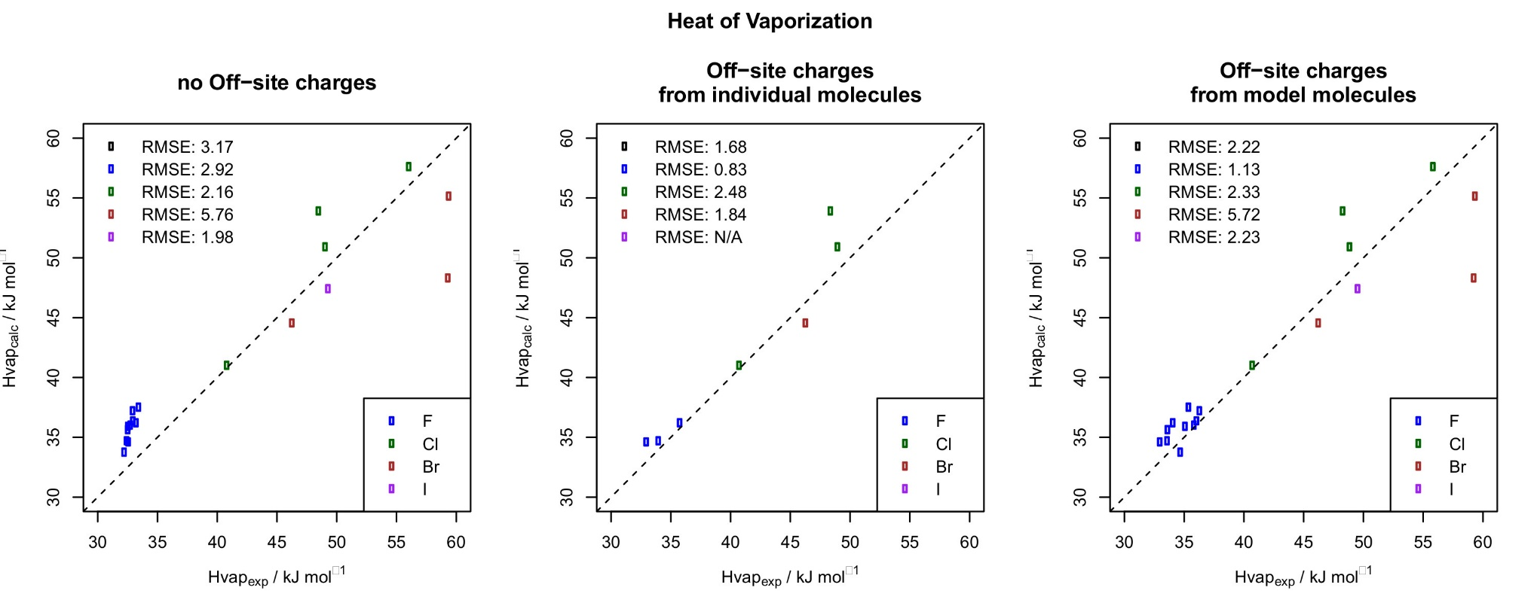
Application to Phenyl Halides
Lukas Schreder
2017-12-13

Slide 15
Conclusion
Very good results for Aryl Fluorides
Situational improvements for Aryl Chlorides and Bromides
(probably) not applicable to Aryl Iodines
Individual parametrization is often not worth the extra effort
More practical: Use simple model molecules to determine parameters for large molecules
Lukas Schreder
2017-12-13

Slide 16
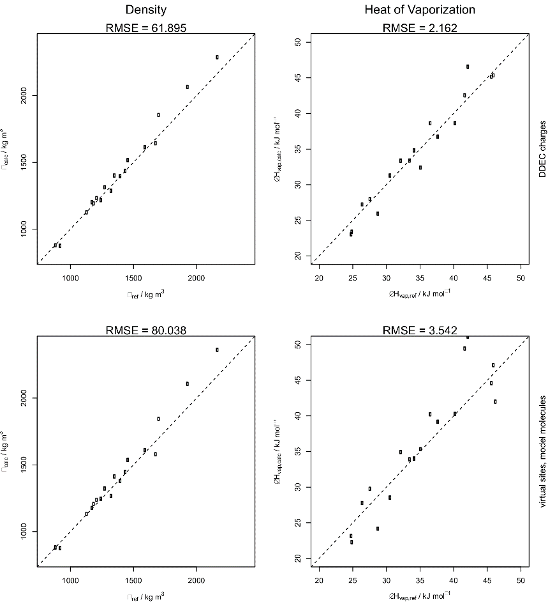
Advancing the Idea Beyond Phenyl Halides
What about Alkyl Halides?
Can we find similar approaches to...
  Lone pairs?
  Multiple bonds?
Lukas Schreder
2017-12-13

Slide 17

Questions?
Lukas Schreder
2017-12-13

Slide 18
Thank You For Everything!
Lukas Schreder
2017-12-13

Slide 19
Sources
Kramer et al.; J. Chem. Theory Comput., 2014, 10 (10), pp 4488–4496
Cole et al.; J. Chem. Theory Comput., 2016, 12 (5), pp 2312–2323
Harder et al.; J. Chem. Theory Comput., 2016, 12 (1), pp 281–296
Caleman et al.; J. Chem. Theory Comput., 2012, 8 (1), pp 61–74
Lukas Schreder
2017-12-13

Slide 20
Software Citations
Gaussian 09, Revision A.02, M. J. Frisch, G. W. Trucks, H. B. Schlegel, G. E. Scuseria, M. A. Robb, J. R. Cheeseman, G. Scalmani, V. Barone, G. A. Petersson, H. Nakatsuji, X. Li, M. Caricato, A. Marenich, J. Bloino, B. G. Janesko, R. Gomperts, B. Mennucci, H. P. Hratchian, J. V. Ortiz, A. F. Izmaylov, J. L. Sonnenberg, D. Williams-Young, F. Ding, F. Lipparini, F. Egidi, J. Goings, B. Peng, A. Petrone, T. Henderson, D. Ranasinghe, V. G. Zakrzewski, J. Gao, N. Rega, G. Zheng, W. Liang, M. Hada, M. Ehara, K. Toyota, R. Fukuda, J. Hasegawa, M. Ishida, T. Nakajima, Y. Honda, O. Kitao, H. Nakai, T. Vreven, K. Throssell, J. A. Montgomery, Jr., J. E. Peralta, F. Ogliaro, M. Bearpark, J. J. Heyd, E. Brothers, K. N. Kudin, V. N. Staroverov, T. Keith, R. Kobayashi, J. Normand, K. Raghavachari, A. Rendell, J. C. Burant, S. S. Iyengar, J. Tomasi, M. Cossi, J. M. Millam, M. Klene, C. Adamo, R. Cammi, J. W. Ochterski, R. L. Martin, K. Morokuma, O. Farkas, J. B. Foresman, and D. J. Fox, Gaussian, Inc., Wallingford CT, 2016.
Lukas Schreder
2017-12-13

Slide 21
Software Citations
Humphrey, W., Dalke, A. and Schulten, K., "VMD - Visual Molecular Dynamics", J. Molec. Graphics, 1996, vol. 14, pp. 33-38. URL http://www.ks.uiuc.edu/Research/vmd/
R Core Team (2017). R: A language and environment for statistical computing. R Foundation for Statistical computing, Vienna, Austria. URL https://www.R-project.org/.
MATLAB and Statistics Toolbox Release 2015a, The MathWorks, Inc., Natick, Massachusetts, United States.
D. van der Spoel, E. Lindahl, B. Hess, and the GROMACS development team, GROMACS User Manual version 4.6.7, www.gromacs.org (2014)
Lukas Schreder
2017-12-13

Slide 22

Lukas Schreder
2017-12-13

