Slide 1
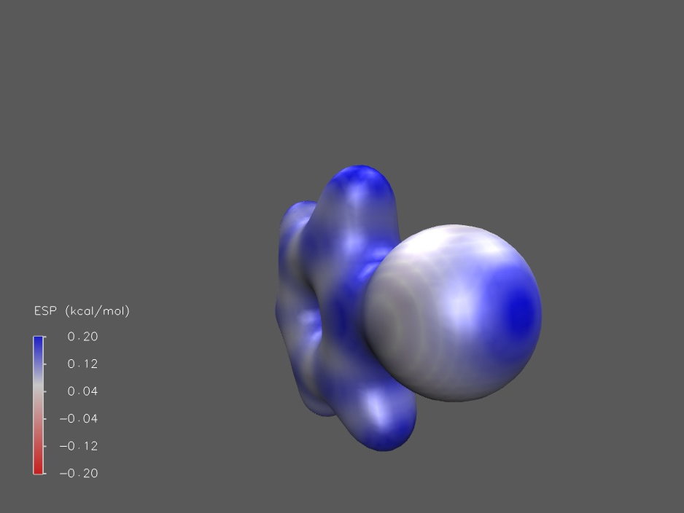
Deriving Off-site Charge Parameters to Model Anisotropic Charge Distributions in Phenyl Halides
IGC Group Talk 2017-12-13 by Lukas Schreder, Research Project I
PhCl
MP2/Def2TZVP

Slide 2
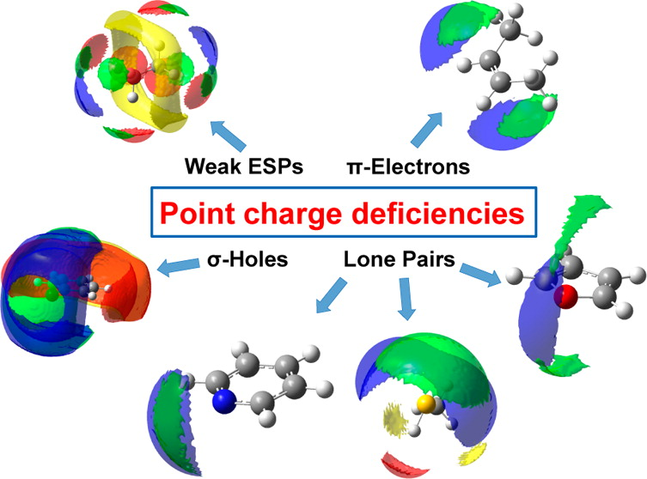
Point Charges Fail to Reproduce Critical Electronic Properties
Charge anisotropies are often neglected in MD
Many forcefields support Virtual Sites (but not all, e.g. GAFF), which are often used as a makeshift solution
Almost all heteroatoms require multipole descriptions
Kramer et al.; J. Chem. Theory Comput., 2014, 10 (10), pp 4488–4496

Slide 3
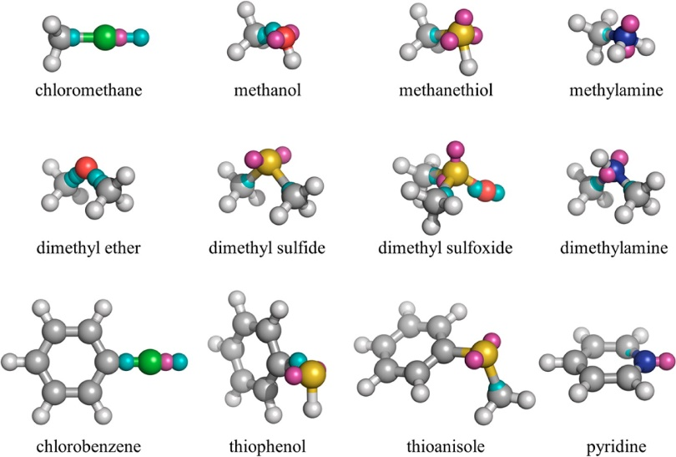
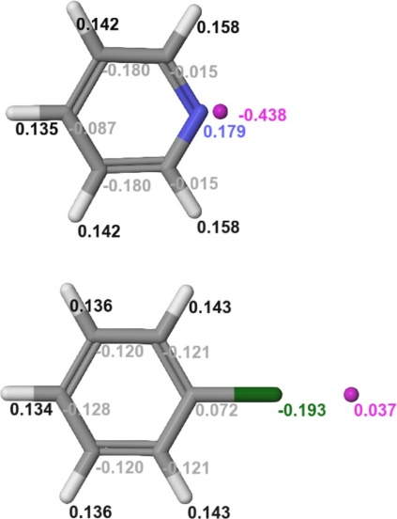
Previous Approaches are Expensive to Compute
Cole et al.: Simplex minimization against RMSE of Dipole and Quadrupole moments with up to 3 virtual sites per atom
Harder et al.: Fitting against ESP error and MD data (hydration free energy)
Cole et al.; J. Chem. Theory Comput., 2016, 12 (5), pp 2312–2323
Harder et al.; J. Chem. Theory Comput., 2016, 12 (1), pp 281–296

Slide 4
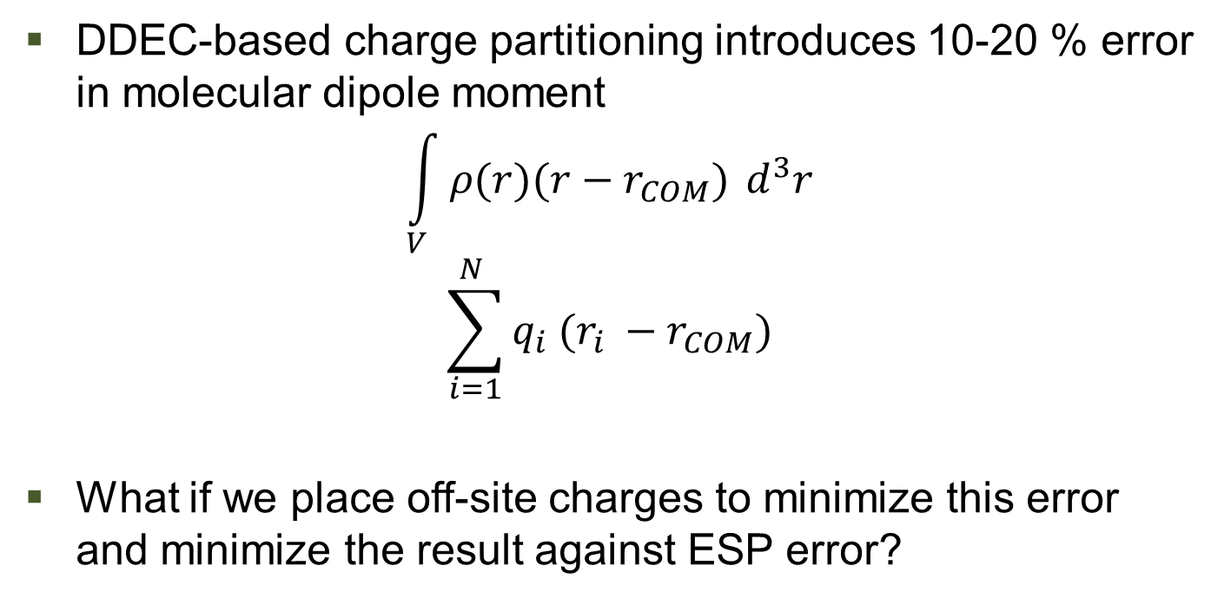
Correcting Fundamental Electronic Properties with Off-site Charges
DDEC-based charge partitioning introduces 10-20 % error in molecular dipole moment
$$\int_{V}^{ }{ρ(r)(r−r_{COM})} d^{3}r$$
$$\sum_{i=1}^{N }{q_{i} (r_{i} −r_{COM})}$$
What if we place off-site charges to minimize this error and minimize the result against ESP error?

Slide 5
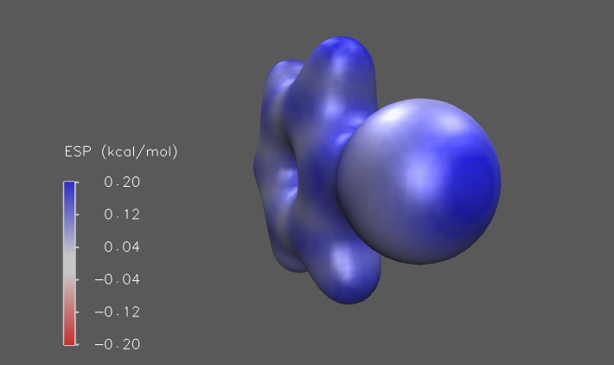
Finding Possible Use Cases: Halogens
PhBr
MP2/Def2TZVP

Slide 6
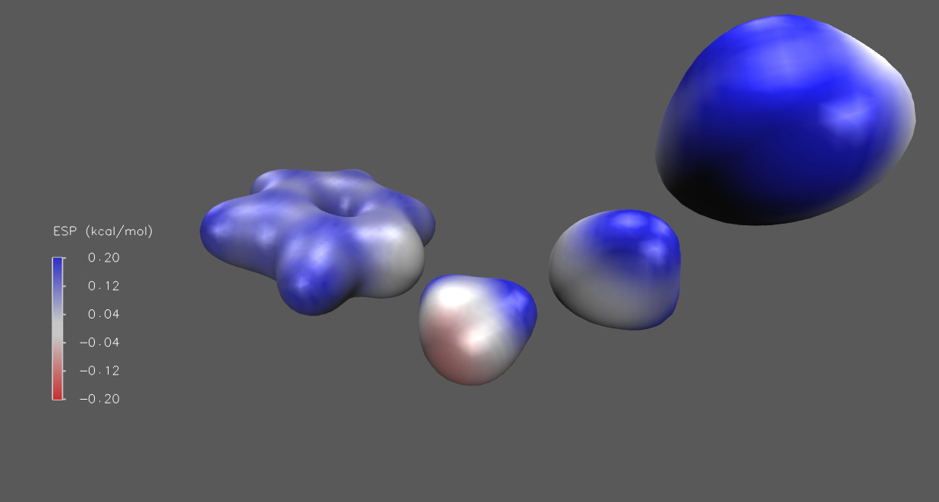
Finding Possible Use Cases: Heterocycles
PYRTHA
TPSSh/aug-cc-pVDZ

Slide 7
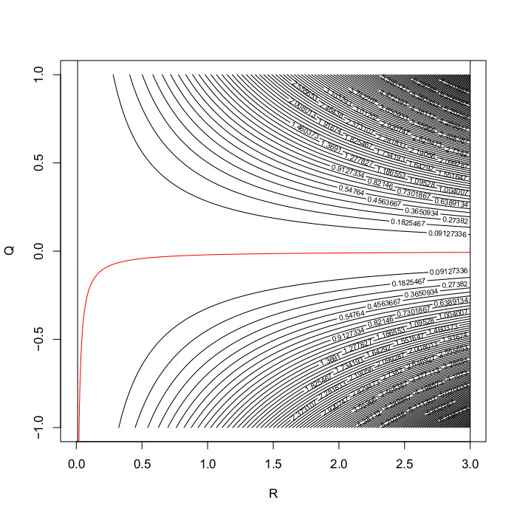
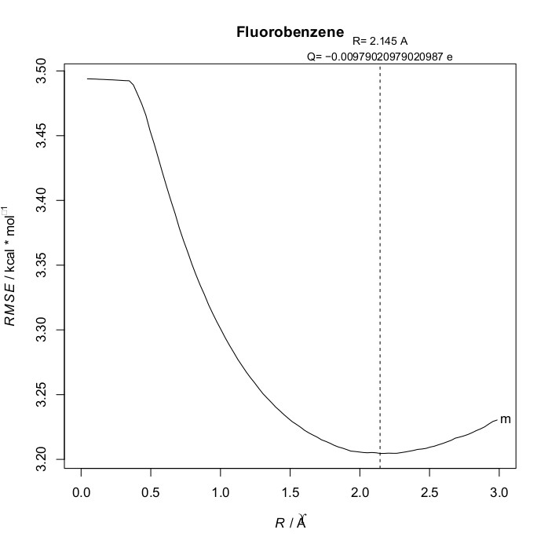
Dipole Error and ESP Error Minimization Deliver Reasonable Parameter Estimates
No σ-hole, negative Off-Site Charge
Lone pairs might be approachable in highly negative atoms

Slide 8
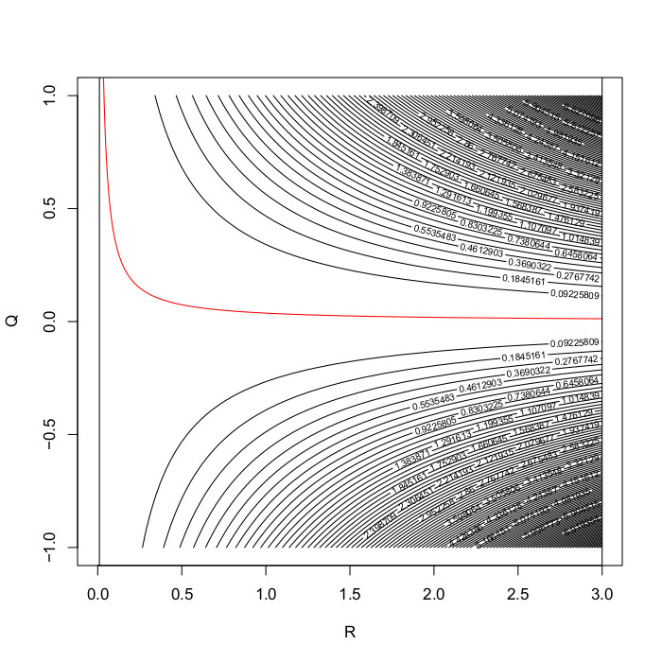
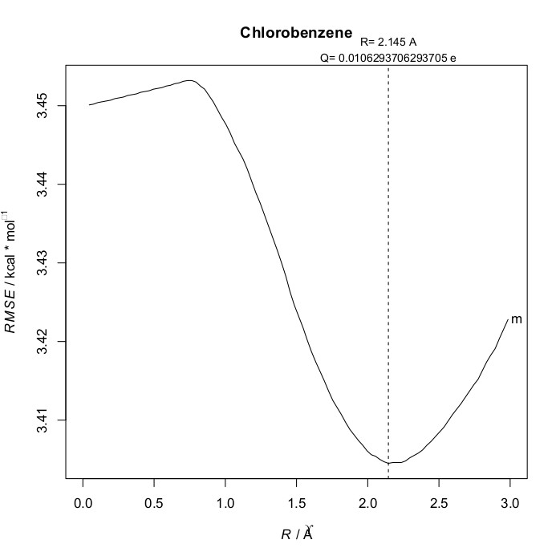
Dipole Error and ESP Error Minimization Deliver Reasonable Parameter Estimates
σ-hole shows its effect
Compatible with earlier parametrizations

Slide 9
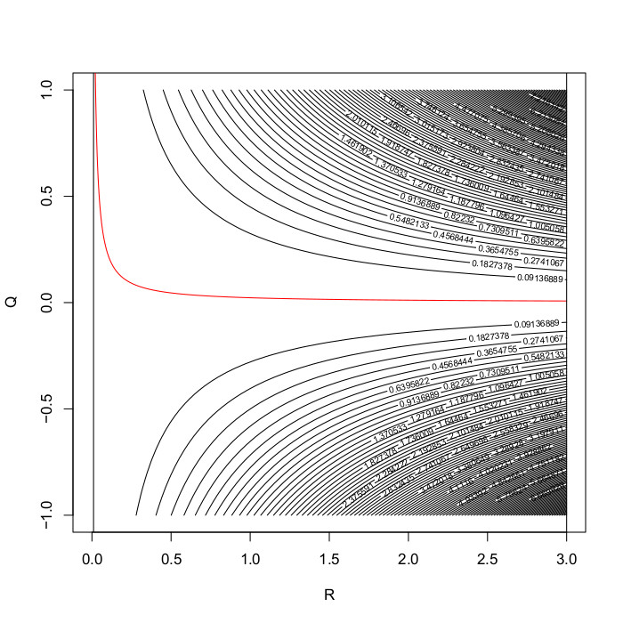
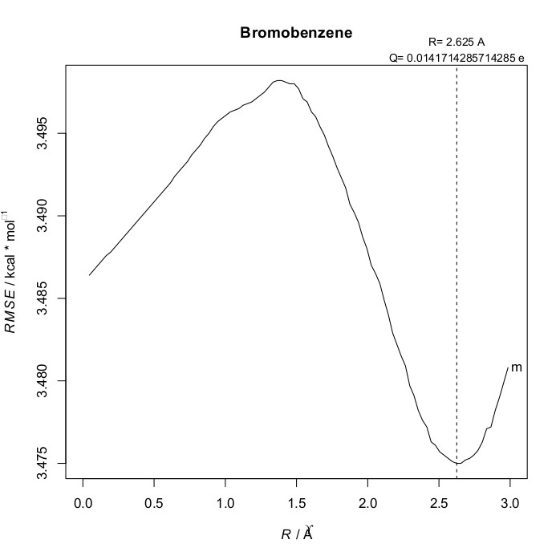
Dipole Error and ESP Error Minimization Deliver Reasonable Parameter Estimates
Trend continues to follow the lower electronegativity
Minima becomes less pronounced

Slide 10
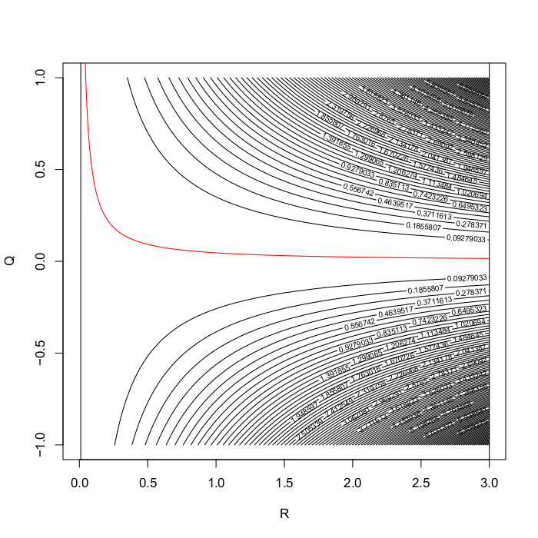
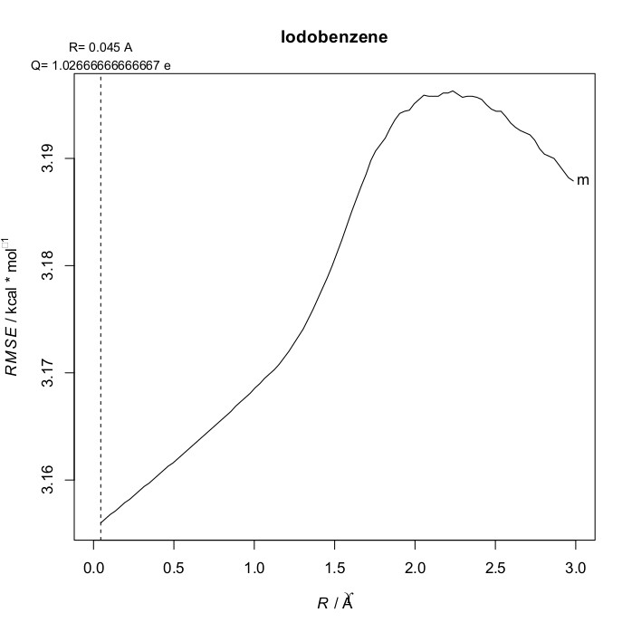
Dipole Error and ESP Error Minimization Deliver Reasonable Parameter Estimates
No parameters found
σ-hole is probably neutralized by EDG

Slide 11
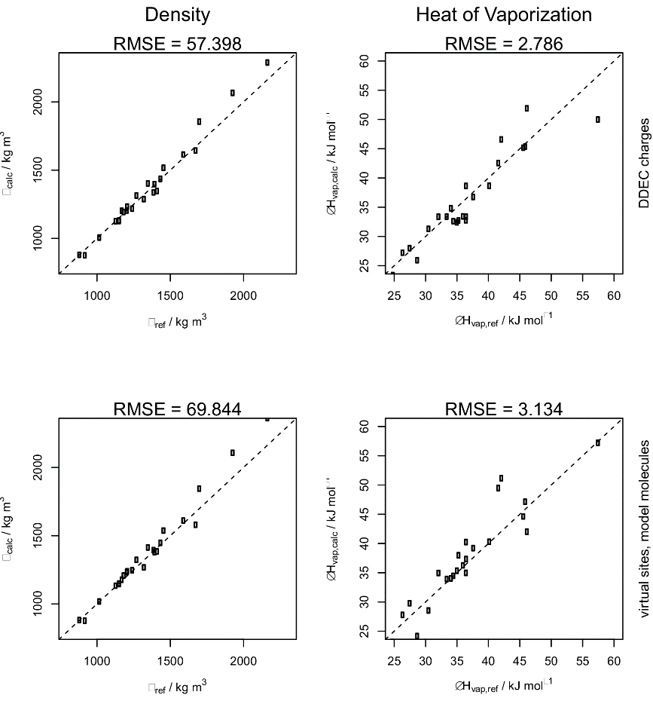
This Approach Limits Use Cases...
Only molecules with a significant permanent dipole allow for sensible charge placement
Many structures do not profit from individually computed parameters
Parameters from reasonably similar model atoms often produced better results

Slide 12
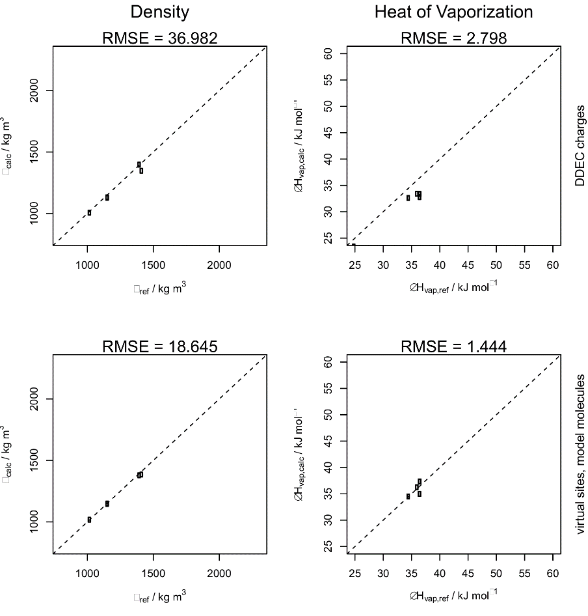
... But can help to Reproduce Liquid Properties in Small Molecules
A subset of Aryl halides showed significant improvements (-50% RMSE)
But there are only 5 in the benchmark set
So I made my own set

Slide 13
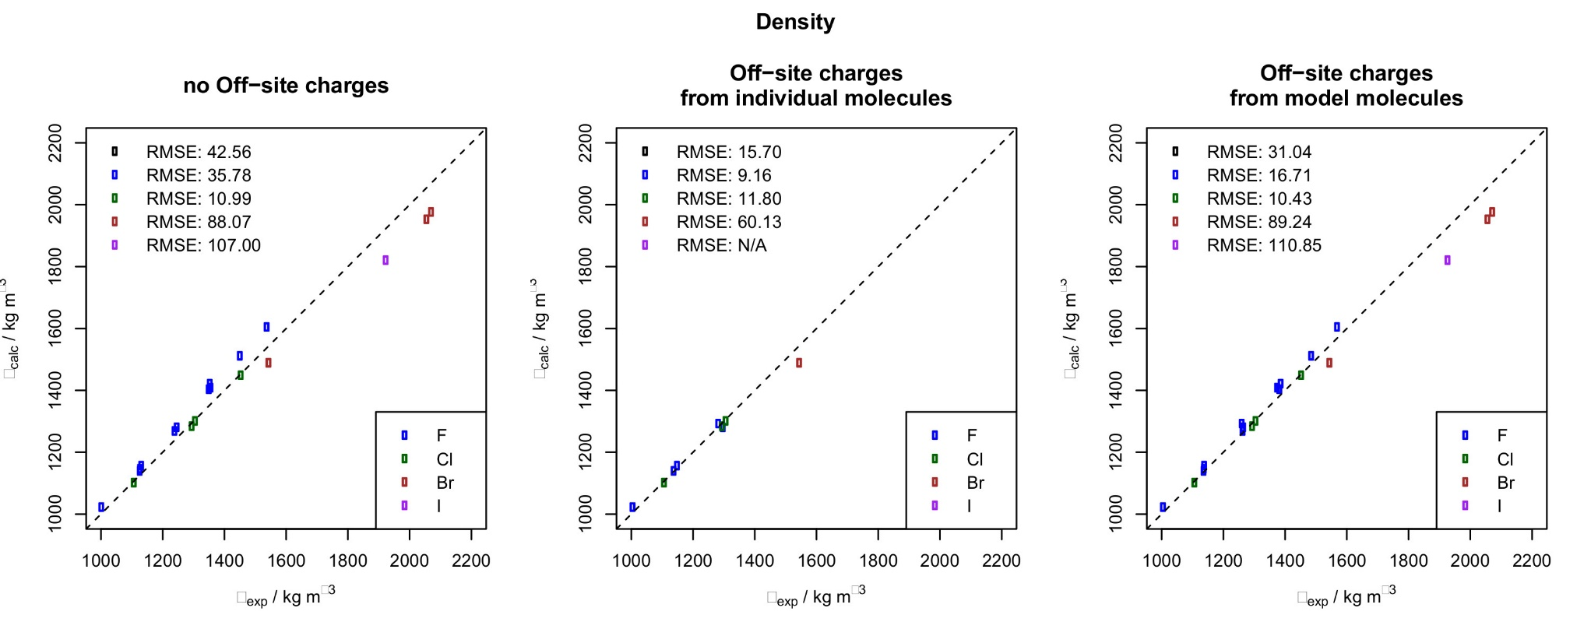
Application to Phenyl Halides

Slide 14
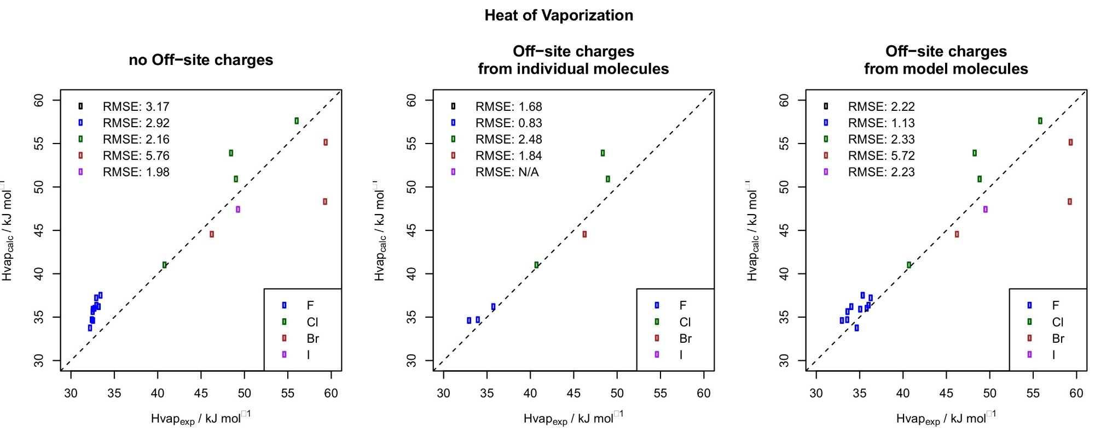
Application to Phenyl Halides

Slide 15
Conclusion
Very good results for Aryl Fluorides
Situational improvements for Aryl Chlorides and Bromides
(probably) not applicable to Aryl Iodines
Individual parametrization is often not worth the extra effort
More practical: Use simple model molecules to determine parameters for large molecules

Slide 16
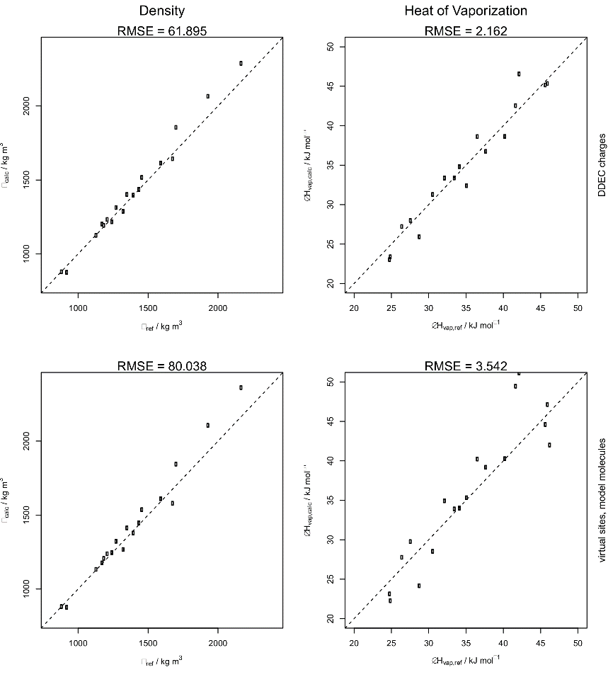
Advancing the Idea Beyond Phenyl Halides
What about Alkyl Halides?
Can we find similar approaches to...
Lone pairs?
Multiple bonds?

Slide 17
Questions?

Slide 18
Thank You For Everything!

Slide 19
Sources
Kramer et al.; J. Chem. Theory Comput., 2014, 10 (10), pp 4488–4496
Cole et al.; J. Chem. Theory Comput., 2016, 12 (5), pp 2312–2323
Harder et al.; J. Chem. Theory Comput., 2016, 12 (1), pp 281–296
Caleman et al.; J. Chem. Theory Comput., 2012, 8 (1), pp 61–74

Slide 20
Software Citations
Gaussian 09, Revision A.02, M. J. Frisch, G. W. Trucks, H. B. Schlegel, G. E. Scuseria, M. A. Robb, J. R. Cheeseman, G. Scalmani, V. Barone, G. A. Petersson, H. Nakatsuji, X. Li, M. Caricato, A. Marenich, J. Bloino, B. G. Janesko, R. Gomperts, B. Mennucci, H. P. Hratchian, J. V. Ortiz, A. F. Izmaylov, J. L. Sonnenberg, D. Williams-Young, F. Ding, F. Lipparini, F. Egidi, J. Goings, B. Peng, A. Petrone, T. Henderson, D. Ranasinghe, V. G. Zakrzewski, J. Gao, N. Rega, G. Zheng, W. Liang, M. Hada, M. Ehara, K. Toyota, R. Fukuda, J. Hasegawa, M. Ishida, T. Nakajima, Y. Honda, O. Kitao, H. Nakai, T. Vreven, K. Throssell, J. A. Montgomery, Jr., J. E. Peralta, F. Ogliaro, M. Bearpark, J. J. Heyd, E. Brothers, K. N. Kudin, V. N. Staroverov, T. Keith, R. Kobayashi, J. Normand, K. Raghavachari, A. Rendell, J. C. Burant, S. S. Iyengar, J. Tomasi, M. Cossi, J. M. Millam, M. Klene, C. Adamo, R. Cammi, J. W. Ochterski, R. L. Martin, K. Morokuma, O. Farkas, J. B. Foresman, and D. J. Fox, Gaussian, Inc., Wallingford CT, 2016.

Slide 21
Software Citations
Humphrey, W., Dalke, A. and Schulten, K., "VMD - Visual Molecular Dynamics", J. Molec. Graphics, 1996, vol. 14, pp. 33-38. URL http://www.ks.uiuc.edu/Research/vmd/
R Core Team (2017). R: A language and environment for statistical computing. R Foundation for Statistical computing, Vienna, Austria. URL https://www.R-project.org/.
MATLAB and Statistics Toolbox Release 2015a, The MathWorks, Inc., Natick, Massachusetts, United States.
D. van der Spoel, E. Lindahl, B. Hess, and the GROMACS development team, GROMACS User Manual version 4.6.7, www.gromacs.org (2014)

Slide 22


