Slide 1

CUSTOMER SHOPPING BEHAVIOUR
CCDS 321 - DATA MINING
Jou
Members
Contributions
Lamees Alharthi
Joudi Abdulhadi
Layan Abdullah
Hala Alsubaie
Task 1 & Task 3- Part 1
Task 2 & Task 3- Part 2
Task 2 & Task 3- Part 2
Task 1 & Task 3- Part 1

Slide 2

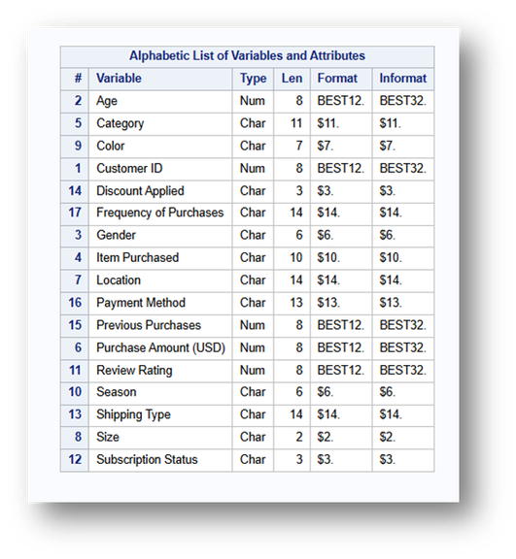
PROBLEM STATEMENT
Shopping businesses face challenges in understanding customer behaviour, payment preferences, and purchase frequency. This project aims to help businesses improve through data cleaning, analysis, and pattern recognition to predict customers' subscription behaviour based on Age, Gender, Shipping Type, and Item Purchased.
OBJECTIVES
· clean and preprocess the data before modeling.
· build a model that predicts whether the customer will subscribe or not.
· evaluate the model’s performance and interpret the results.
DATASET DESCRIPTION
This dataset describes customer shopping behavior, with 5,050 observations and 17 attributes, which contains 13 categorical and 4 numerical, covering customer information, purchase details, and behavioral attributes such as age, purchase amount, and subscription status.

Slide 3
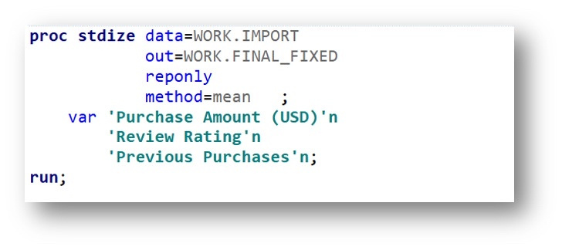
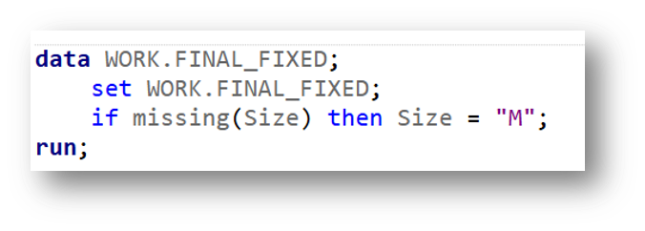
DATA CLEANING
  Missing Data Handling
  Method for numerical variables (Purchase Amount, Review Rating, Previous Purchases):
→ Mean imputation
  Method for categorical variable (Size):
→ Mode imputation (most frequent value = "M")
  Duplicate Records
  Removed 50 duplicate rows
  Rows changed from 5,050 to 5,000

Slide 4
  Inconsistent Values
  Fixed repeated labels in Season and Frequency of Purchases
  Autumn → Fall
  Fortnightly → Bi-Weekly
  Every 3 Months → Quarterly
  Outliers
  Removed high Purchase Amount outliers
  Outliers were mainly in Shirt, Shoes, and Watch
  Final rows became 4,868

Slide 5
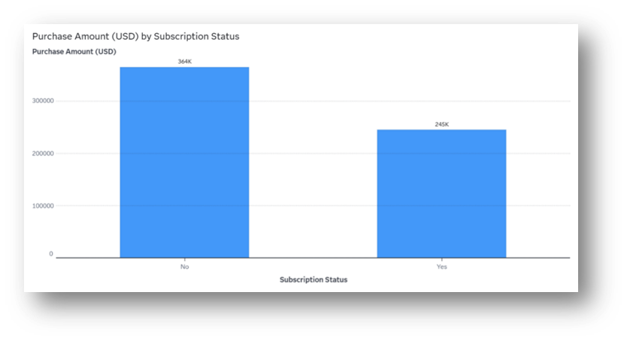
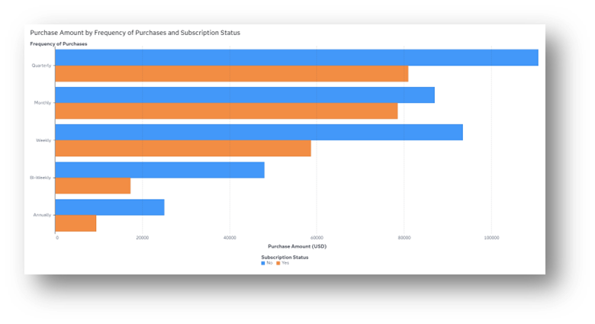
EXPLORATORY DATA ANALYSIS
  BAR CHART ANALYSIS
Bar Chart Analysis The bar chart compares the total Purchase Amount (USD) between subscribers and non-subscribers.
  GROUPED BAR CHART
The bar chart shows the total Purchase Amount for each purchase frequency category, grouped by SubscriptionStatus.

Slide 6
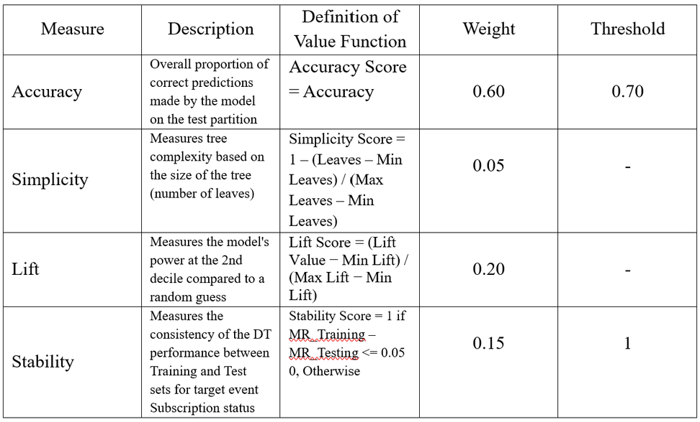
EVALUATION APPROACH
COMBINATION FUNCTION
Composite Performance Score Formula:

Slide 7
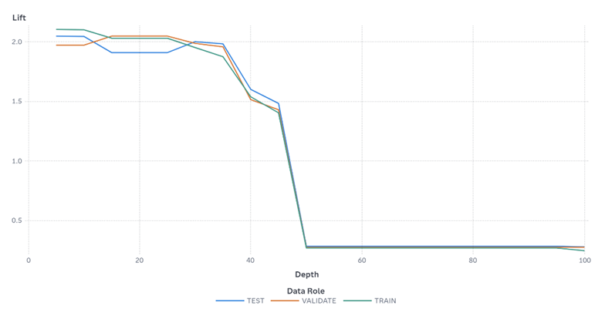
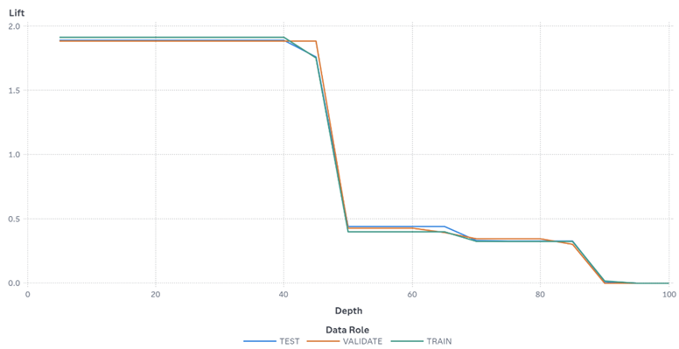
SUMMARY OF RESULTS
The decision trees were evaluated using performance measures such as Accuracy, Simplicity, Lift, and Stability. The Lift values show that Entropy and Gini have the highest Lift value and CHAID has a lower value. However, the DT7 and DT11 get the best overall score of 0.841.
LIFT CHART
Figure 1 – Lift of Decision tree 7
Figure 2 – Lift of Decision tree 1
The lift chart above compares DT1 and DT7 for the target event Subscription Status. At the second decile (20% depth), DT1 achieved a Lift of 1.91, while DT7 achieved a higher Lift of 2.1, meaning DT7 captured more subscribers than random selection. In addition, DT7 showed more consistent and stable Lift performance than DT1, indicating that DT7 is the more stable model.

Slide 8
DIFFERENT COMBINATION
Parameters:
  Criterion: GINI
  Max Branches: 2
  Max Depth: 4
  Min Leaf Size: 100
Results:
  Accuracy = 0.7694
  Simplicity = 0.9688
  Lift = 1.494
  Stability = 1.0
  Overall Score: 0.860 → better than previous best (0.842)

Slide 9
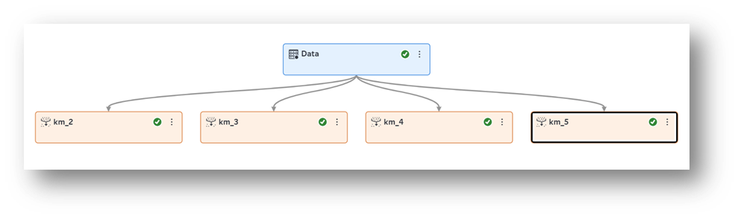
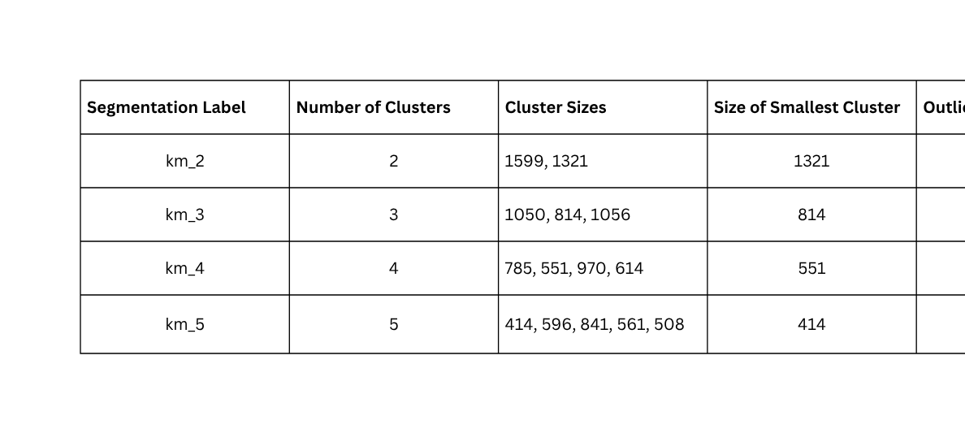
CUSTOMER SEGMENTATION
  km_3 Segmentation:

Slide 10
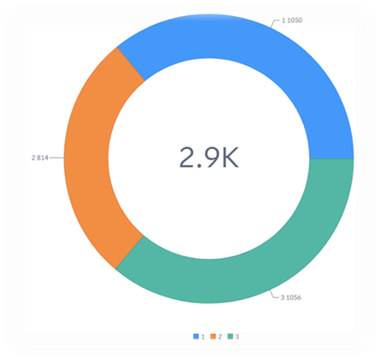
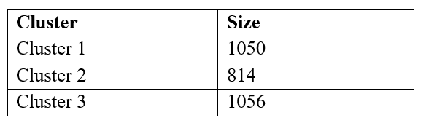
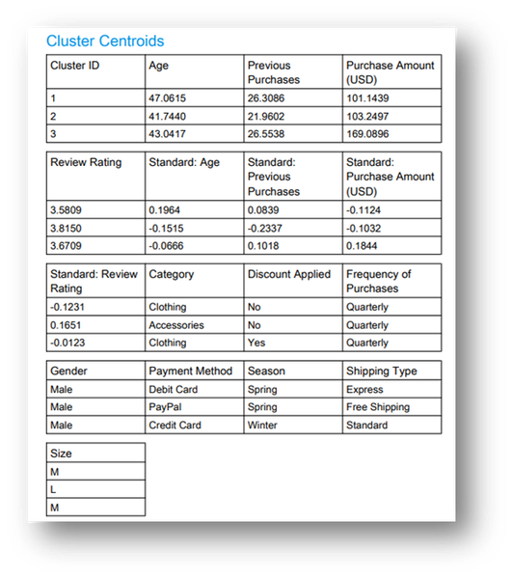
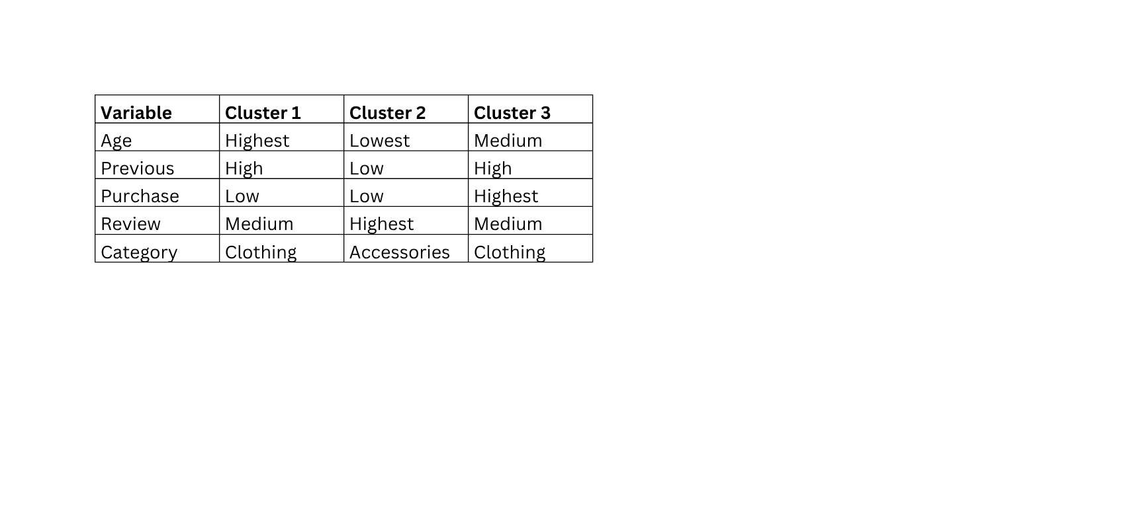
CUSTOMER SEGMENTATION
  km_3 Segmentation:
all clusters are more than 10% of the dataset, so there is no outlier cluster.
the smallest cluster is Cluster 2 with 814 customers, and it is greater than 10% of the dataset.

Slide 11
DECISION TREE COMPARISON
  Different DT models were compared using accuracy and simplicity
  Simplicity was measured using the number of leaves after pruning
  CHAID_2 and Gini_2 achieved the highest overall score (0.9680)
  Both models gave good accuracy with simpler tree structures
  Simpler trees performed better than deeper trees
BEST MODELS
  CHAID_2 → 0.9680
  Gini_2 → 0.9680

Slide 12
DT FOR CLUSTER ANALYSIS
  Models tested: 8 (2 vs 4 branches, min leaf size = 244)
  Best models (Score = 0.8503):
· Entropy_2
· Gini_2
· InfoGain_2
· InfoGain_4
  Key findings:
· 2-branch models performed better than 4-branch models
· CHAID models had Lift = 0 → worst performance
COMPARISON WITH TASK 2
  In Task 2, all DT achieved the same accuracy of 0.9466.In Task 3, CHAID_2 and CHAID_4 achieved the highest accuracy of 0.7864.so,This shows that the DTs in Task 2 achieved higher accuracy than the DT from Task 3.

