Slide 1
arena
AllocateAligned
AllocateFallback
AllocateNewBlock
Allocate

Slide 2
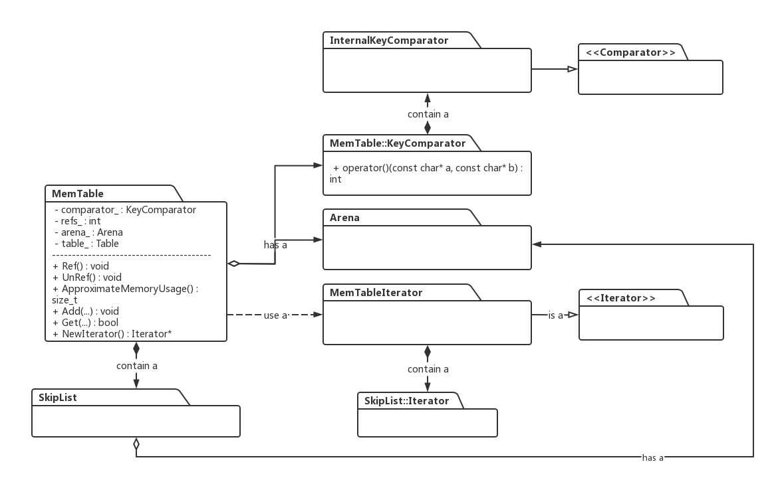

Slide 3
memtableKey
InternalKey_Size
(varInt)
userKey
(var)
(sequence<<8)|value type (8 Byte)
InternalKey
userKey
(var)
sequence
ParsedInternalKey
value type

Slide 4
Data Block
Data Block
Data Block
data_iter_
Data Block
...
IndexBlock
index_iter_
BlockHandle

Slide 5
p
p + filter_offset_1
filter Slice_1
p + filter_offset_2
filter Slice_2
p + filter_offset_3
Slice result_
filter Slice_3
p + filter_offset_4
filter data
filter Slice_4
Filter data
...
...
...
p + filter_offset_m
filter Slice_n
filter offset_1=0
filter offset_2
std::vector<uint32_t> filter_offsets_
filter offset_3
filter offset
filter offset_4
Filter offset
...
...
...
filter offset_m
result_.size()
kFilterBaseLg
m >= n

Slide 6
std::string keys_
k1
k2
k3
k4
k5
k...
kn-1
kn
s[0] = 0
s[1]
s[2]
s[3]
s[4]
...
s[n-1]
s[n]
std::vector<size_t> start_

Slide 7
filter map
k_(1B)

Slide 8
filter block content
data_
Filters data
start
limit
offset_
filter index
fil. data. size
base

Slide 9
map
block_1_offset = 0
b
filter Slice1
filter offset_1=0
filter Slice2
filter offset_2=a
map
block_2_offset = 5000
filter offset_3=a
filter offset_4=b
filter offset_5=b
block_offset/2048 = 5

Slide 10
map
block_1_offset = 0
a
filter Slice1
filter offset_1=0
filter offset_2=a
block_offset/2048 = 2

Slide 11
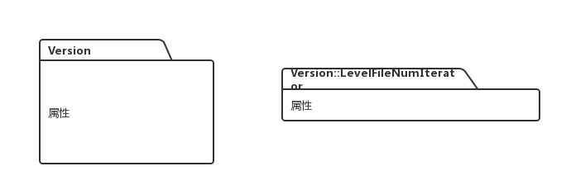

Slide 12
current
构造函数
current
prev
Version 0
Dummy Version
prev
next
next
prev
next
Dummy Version
current
prev
next
V newest
Dummy Version
Version 0
next
prev
next
.....
prev
prev

Slide 13
LRUHandle**
list_
next_hash
next_hash
Bucket1
p1
new
n
n
Bucket2
p2
...
...
next_hash
pn
n
n
Bucketn
LRUHandle*[]

Slide 14
next_hash
FindPointer()
return
new Handle
next_hash
next_hash
next_hash
LRUHandle
Old Handle
LRUHandle

Slide 15
T1(Core1)
T2(Core2)
T3(Core3)
T4(Core4)
过去
x = 1
y = 1
x = 1
y = 1
y = 1
x = 1
未来
T1(Core1)
T2(Core2)
过去
x = 1
read x
read y
y = 1
未来

Slide 16
user
ShardedLRUCache
key
hash
LRUCache
LRUCache
LRUCache
LRUCache
1
2
...
16

Slide 17
iter
next
user_key越来越大；
对于相同的user_Key，Seq越来越小，即越来越旧

