Slide 1
Full Project Presentation
GlamMatch
Software Engineering — All Sprints
Personalized Styling &
Salon Connector App
Ayza Ahmed
24L-2577
Project Lead & Requirements Engineer
Eman Adil
24L-2589
Backend & Database Developer
Anoushay Fatima
24L-2585
Frontend Developer, UI/UX & QA Tester
May 2026

Slide 2
Table of Contents
A
E
Project Introduction
Architecture
B
F
Advantages & Constraints
Implementation Screenshots
C
G
Non-Functional Requirements
Work Division
D
H
Design
Lessons Learnt

Slide 3
a. Project Introduction
GlamMatch
Tech Stack
Personalized Styling & Salon Connector App
Frontend:
HTML5, CSS3, Vanilla JS SPA
GlamMatch is a web-based styling assistant that provides personalized color, wardrobe, and beauty recommendations based on a user's skin tone, undertone, body type, and face shape. The platform also connects users with nearby beauty parlours for appointment booking, real-time chat, and reviews.
Backend:
Python 3.8+, Flask REST API
Database:
SQLite (13 tables)
Auth:
JWT Bearer Tokens
Sprint 1
Core Styling System
Auth, Undertone Quiz, Color Palette, Body Type
AI / Analysis:
face-api.js (client-side)
28 pts
Total APIs:
33 REST Endpoints
Sprint 2
Advanced Styling
Photo Analysis, Wardrobe, Products, Face Shape
39 pts
User Stories:
16 across 3 Sprints
Sprint 3
Salon Connector
Discovery, Booking, Chat, Reviews, Admin
28 pts
Story Points:
95 total (all completed)

Slide 4
b. Advantages & Constraints
Advantages
Constraints
No-install SPA — runs entirely in the browser from a single index.html, making it instantly accessible with zero setup for end users.
SQLite single-file database — not suitable for high concurrency or multi-server deployment; would need migration to PostgreSQL for production scale.
AI-powered in the browser — face-api.js runs TinyFaceDetector models client-side; no photos leave the device, protecting user privacy.
Monolithic backend — all 33 routes live in one app.py file; growing feature sets will require refactoring into modules or microservices.
Undertone & body-type personalisation — quiz-driven classification delivers accurate style, wardrobe, and makeup recommendations tailored per user.
No real-time communication — chat polls the REST API rather than using WebSockets; message delivery has inherent latency.
End-to-end salon workflow — discovery, admin CNIC verification, bookings with smart rules (2-hr lock, 90-day cap), live chat, and reviews in one platform.
Client-side AI accuracy — face-api.js landmark detection depends on photo quality and lighting; low-resolution selfies can yield incorrect face-shape results.
Automated database lifecycle — tables are created and seeded on first run; missing columns are auto-migrated, so deployment needs no manual DB steps.
Prototype CNIC storage — CNIC front/back images are stored as base64 in SQLite text columns; a production system requires encrypted file storage.

Slide 5
c. Non-Functional Requirements
Two key NFRs that shaped all development decisions:
NFR 1
Metric
Target
Implementation
Performance
Quiz & palette load
< 3 seconds on 10 Mbps broadband
Lightweight SPA — no page reload; API responds in < 200 ms on local server
Auth API response
< 1.5 seconds under normal load
bcrypt hash verification + JWT issue handled in-process; SQLite indexed lookup
face-api.js models
< 2 seconds model load
TinyFaceDetector (193 KB) + FaceLandmark68 (350 KB) served statically
NFR 2
Requirement
Specification
Implementation
Password storage
Never store plaintext passwords
bcrypt hashing applied on registration; only hash persisted in DB
Security
Session management
JWT tokens, max 24 hrs validity
@auth decorator validates Bearer token on every protected route
Admin access
Separate auth, never via user JWT
Static admin code checked via admin_required decorator; returns 401 on failure
Data privacy
Quiz/styling data — account-holder only
All user-data routes enforce JWT uid check; other users cannot access

Slide 6
d. Design
Sprint 1 — Core Styling System
▸ Login & Register screens: card-based forms with JWT-secured sessions and inline field validation.
▸ Undertone Quiz: step-by-step question flow with progress bar; warm/cool/neutral classification with result summary.
▸ Color Palette screen: clothing and makeup swatch grids with hex codes; separate 'Colors to Avoid' section.
▸ Body Type Questionnaire: proportion questions → Hourglass / Pear / Apple / Rectangle / Inverted Triangle with clothing shape tips.
Sprint 2 — Advanced Styling
▸ Photo Upload screen: circular upload zone with selfie guidance; face-api.js processes image client-side (no server upload).
▸ Analysis Results screen: Skin Tone card + Face Shape card with privacy prompt; results saved to profile.
▸ Product Recommendations: tabbed (Makeup / Clothing) cards with swatch, brand, and wishlist heart icon.
▸ My Wardrobe & Outfits: grid of uploaded items with dominant-color badges; event-type chips generate outfit combinations.
▸ Style Suggestions: accordion sections for Hairstyle, Hijab, Earrings — illustrated cards with bookmark capability.
Sprint 3 — Salon Connector Platform
▸ Salon Finder: search bar, city/service/price filters, salon cards showing rating, address, price range, and services.
▸ Salon Profile: full details, service catalog, working hours, ratings, Book Appointment entry point.
▸ Booking Screen: service dropdown, date/time picker, client name, phone, optional note; real-time validation feedback.
▸ My Bookings: status badges (pending/confirmed/rejected/cancelled/completed), cancel action, 2-hr lock indicator.

Slide 7
e. Architecture
Three-Tier Layered (N-Tier) Architecture
Each tier has a single responsibility and communicates only with adjacent tiers.
Tier 1
Presentation Layer
Tier 2
Application Layer
Tier 3
Data Layer
HTML5 + CSS3 + Vanilla JS
Python 3.8+ + Flask + PyJWT
SQLite 3 — single .db file
• Single Page Application in one index.html
• 33 REST API endpoints — auth, quizzes, styling, wardrobe, salon portal
• 13 tables total: 5 Sprint 1 + 5 Sprint 2 + 3 Sprint 3
• 15+ screens shown/hidden dynamically (no page reload)
⇄
• @auth decorator validates JWT on every protected route
⇄
• Tables auto-created and seeded on first run
• face-api.js runs TinyFaceDetector + FaceLandmark68 in browser
HTTP
REST API
• Quiz scoring algorithm classifies undertone and body type
sqlite3
library
• Missing columns auto-migrated — no manual DB steps needed
• JWT stored in localStorage; attached as Bearer on every request
• 2-hour cancellation lock + 90-day booking cap enforced here
• Accessed via Python built-in sqlite3 library (no ORM)
• Dark/Light mode toggle managed at this tier
• SMTP client sends password-reset emails via Gmail
• Foreign keys enforced via PRAGMA foreign_keys = ON

Slide 8
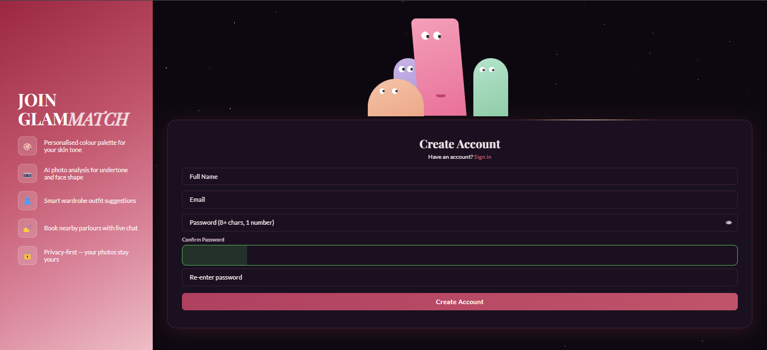
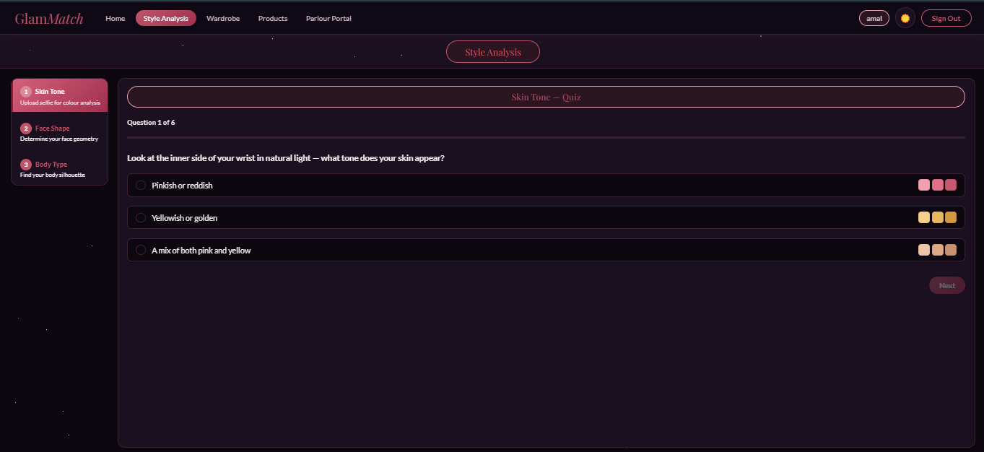
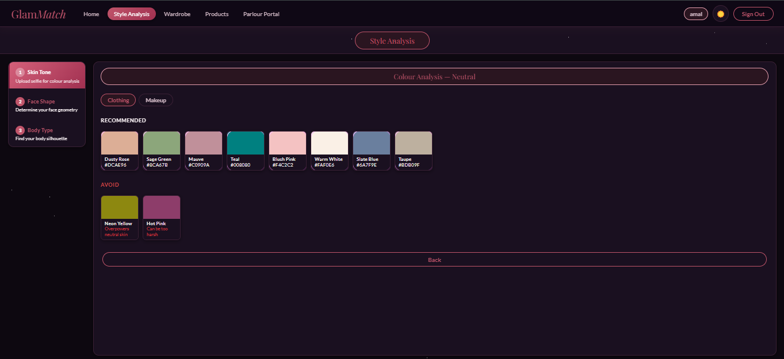
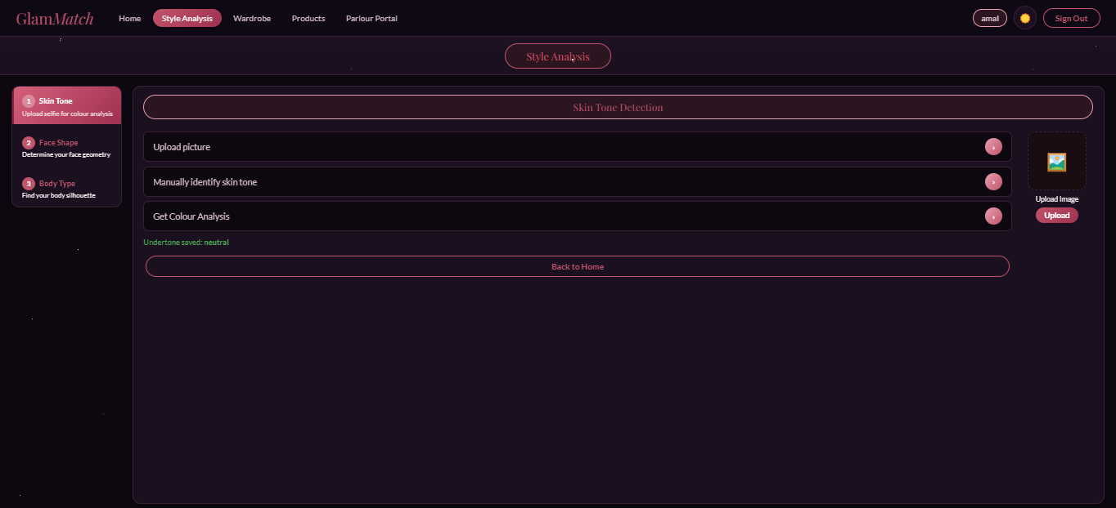
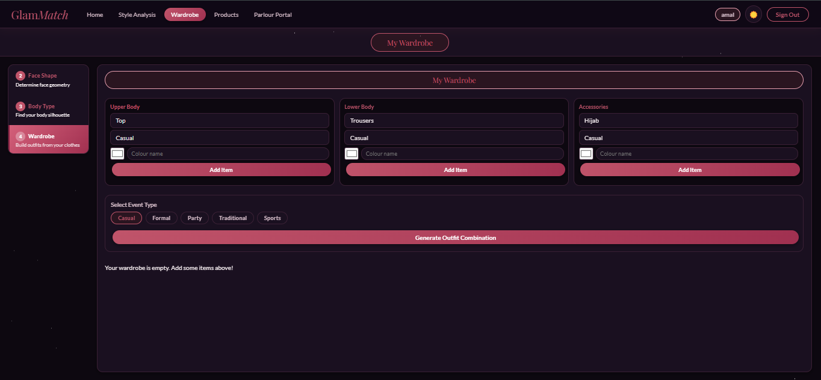
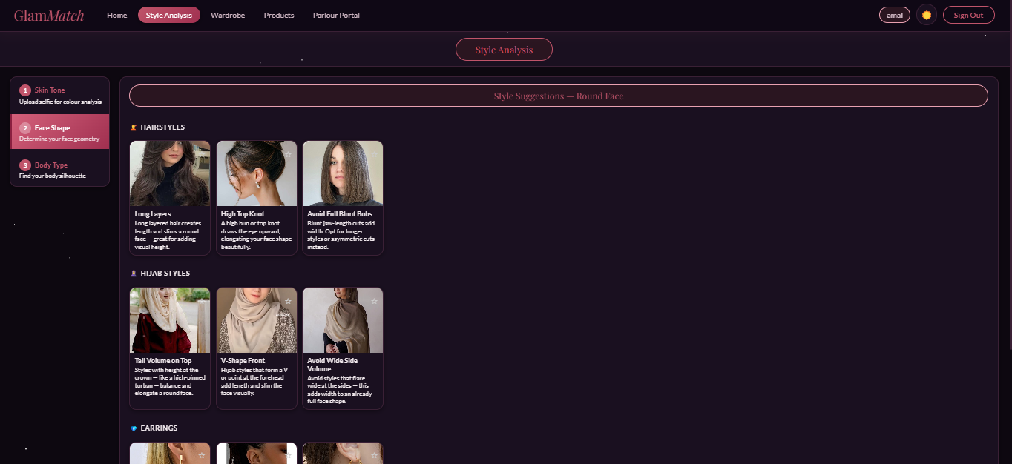
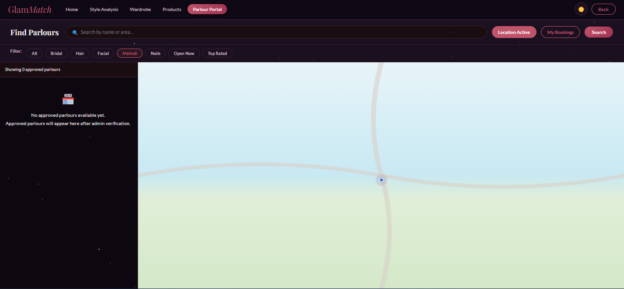
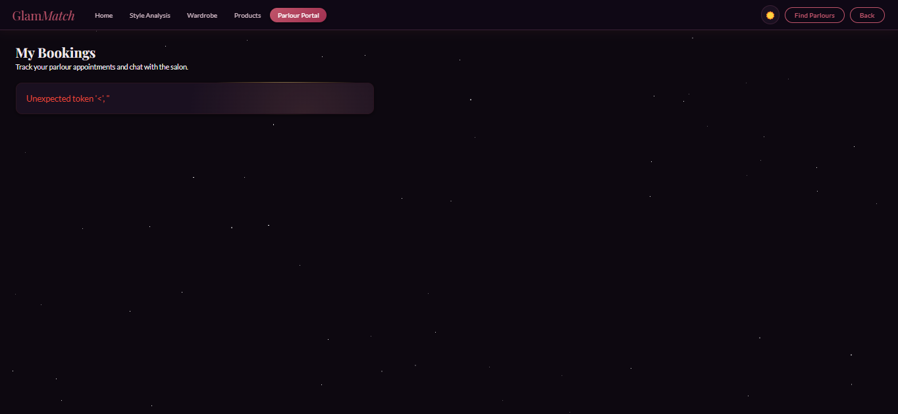
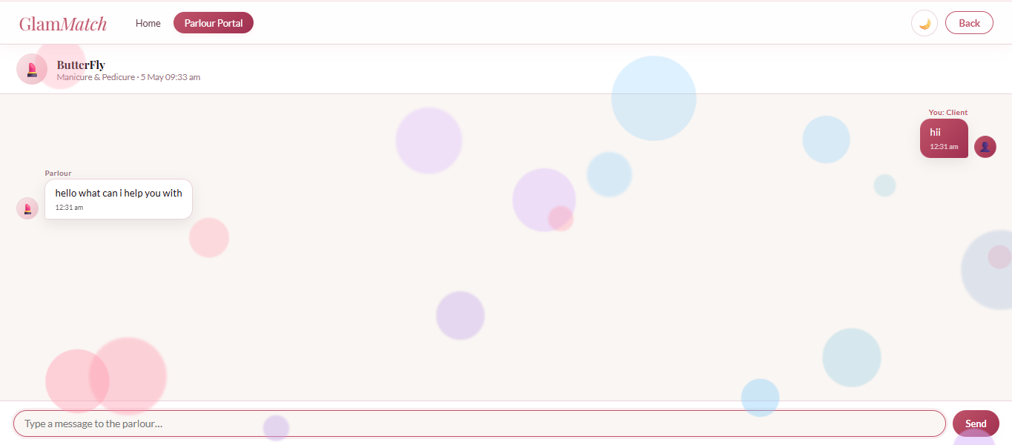
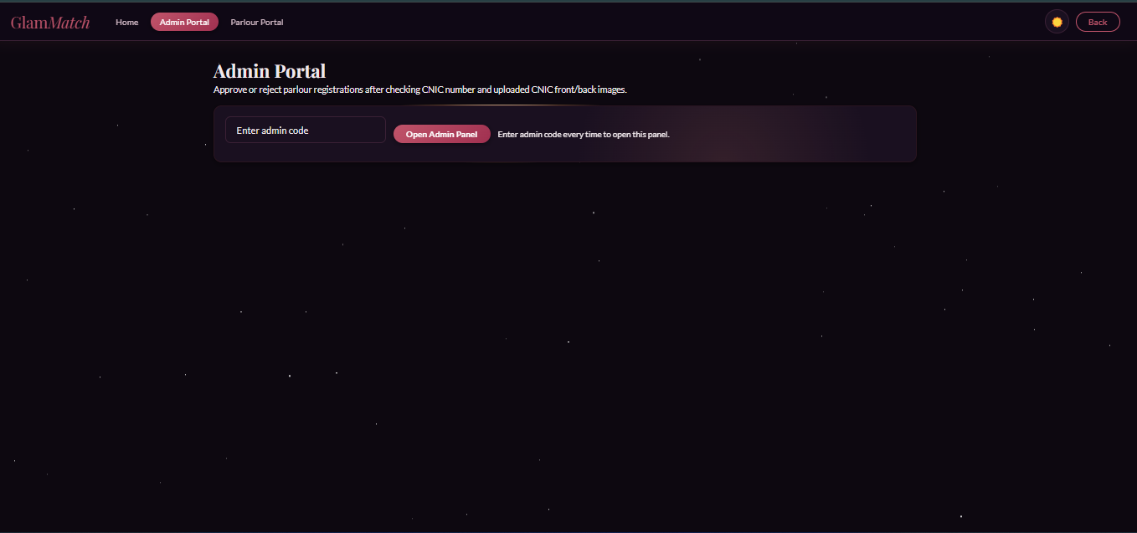
f. Actual Implementation Screenshots
[ screenshot ]
[ screenshot ]
[ screenshot ]
[ screenshot ]
[ screenshot ]
S1
S1
S1
S2
S2
Login / Register
Undertone Quiz
Color Palette
Photo Analysis
Wardrobe & Outfits
JWT-secured auth with inline validation
Step-by-step quiz with progress bar
Clothing & makeup swatches with hex codes
Skin tone + face shape from selfie
Upload items, generate event outfits
[ screenshot ]
[ screenshot ]
[ screenshot ]
[ screenshot ]
[ screenshot ]
S2
S3
S3
S3
S3
Style Suggestions
Salon Finder
Booking & My Bookings
Chat Interface
Admin Portal
Hairstyle, Hijab & Earring cards
Filter by city, service, price range
Status tracking with 2-hr cancel lock
WhatsApp-style booking chat
CNIC review, approve/reject parlours
Replace [ screenshot ] placeholders with actual app screenshots before presenting.

Slide 9
g. Work Division Between Group Members
S1
Sprint 1: Sprint planning, user stories US-01 to US-05, structured specifications SS-01 & SS-02, NFR docs, burn-down chart, Trello setup.
Ayza Ahmed
S2
Sprint 2: Sprint 2 backlog setup, US-06 to US-10 stories & acceptance criteria, NFR definitions, report compilation.
24L-2577
S3
Sprint 3: Sprint 3 backlog, US-11 to US-16 stories & acceptance criteria, rework table, BVA documentation, final report compilation.
Project Lead & Requirements Engineer
Overall: End-to-end project planning, all requirement documents, iteration tracking, report & presentation structure across all 3 sprints.
S1
Sprint 1: Database schema (users, quiz_log, bookmarks, palette tables), Auth & quiz APIs, JWT implementation, quiz scoring algorithm.
Eman Adil
S2
Sprint 2: Photo upload & image analysis APIs, wardrobe CRUD, color detection service, outfit suggestion engine, product & wishlist APIs.
24L-2589
S3
Sprint 3: Salon, booking, chat & review routes; parlour_notifications table; CNIC verification flow; admin portal endpoints; validation.
Backend & Database Developer
Overall: Complete Flask REST API (33 endpoints), SQLite schema design (13 tables), authentication, business logic, and all backend validation.
Anoushay Fatima
S1
Sprint 1: UI design & implementation of Login, Register, Home, Quiz, Color Palette, and Body Type screens; SS-03 & SS-04; test cases US-01 to US-03.
S2
Sprint 2: Photo Upload, Analysis Results, Product Recommendations, Wardrobe, Outfit Suggestions, and Style Suggestions screens; QA test cases US-06 to US-08.
24L-2585
S3
Sprint 3: Salon Finder, Salon Profile, Booking, My Bookings, Chat & Review screens; UI testing; Trello snapshot management.
Frontend Developer · UI/UX · QA Tester
Overall: Complete SPA frontend in index.html, all 15+ screen designs, face-api.js integration, styling consistency, and QA across all sprints.

Slide 10
h. Lessons Learnt
→
Iterative Development Works
→
Boundary Testing Uncovers Real Gaps
Each sprint delivered a working, testable increment before the next module began, reducing integration risk and keeping scope controlled across all three sprints.
BVA edge cases like 7-character passwords, past-dated bookings, ratings outside 1–5, and unauthenticated admin requests would have shipped as bugs without systematic testing.
→
Clear Acceptance Criteria = Done Means Done
→
Role-Based Access Control Matters Early
Well-defined user stories and acceptance criteria helped the team identify when a feature was truly complete, preventing scope creep and keeping sprint goals measurable.
Separating admin-only endpoints behind a dedicated auth check kept parlour verification secure and completely independent from the regular user flow — retrofitting this would have been costly.
→
Layered Architecture Simplifies Debugging
→
Trello Boards Prevent Blockers
Three-tier separation meant a frontend display issue, a backend logic error, and a database query problem could each be traced and fixed in isolation — without touching adjacent tiers.
Tracking To Do / In Progress / Review / Done states across all sprint features made blockers visible during mid-sprint check-ins, keeping all three team members aligned.
→
Database Planning is Critical
Sprint 3's interdependent tables — parlours, parlour_bookings, parlour_chat_log, parlour_notifications — had to be designed together upfront to support cascading status changes and notifications.

Slide 11
Project Summary
16 User Stories
across 3 sprints — all completed
GlamMatch
95 Story Points
planned and delivered on schedule
Thank You
33 REST API Endpoints
Flask backend, JWT-secured
13 Database Tables
SQLite, auto-created & migrated
1 SPA Frontend
15+ screens in a single index.html
AI-Powered
face-api.js client-side face analysis
Ayza Ahmed · Eman Adil · Anoushay Fatima

