Slide 1
Inheritance and Polymorphism
Giuseppe Attardi

Slide 2
What You Will Learn
What is polymorphism
Notions
  virtual methods
  abstract classes
  Liskov Substitution Principle
Techniques
  vtable
  late binding

Slide 3
Motivations

Slide 4
Inheritance and Polymorphism
Code Factoring
Extensibility
Reuse

Slide 5
Problem with Variety of Types
Given these types of objects:
There are functions for drawing each object:
  draw_circle()
  draw_triangle()
  draw_rectangle()
  draw_square()
Consider a picture made of several such of objects
How do you draw the picture?
Circle
Triangle
Rectangle
Square

Slide 6
Solution: Polymorphism
Create a class hierarchy:
Add (virtual) method draw() in each class
Invoke method draw() on each element of the picture
How do you draw() a Shape object?
Shape
Circle
Triangle
Rectangle
Square

Slide 7
Polymorphism
When a program invokes a method through a superclass variable,
  the correct subclass version of the method is called,
  based on the type of the object stored in the superclass variable
The same method name and signature can cause different actions to occur,
  depending on the type of object on which the method is invoked

Slide 8
Introduction
Polymorphism
  Enables “programming in the general”
  The same method invocation can take “many forms”
Interfaces
  Specify common functionality for possibly unrelated classes

Slide 9
Polymorphism
Polymorphism enables programmers to deal in generalities and
  Let the specifics be determined at run time
Programmers can command objects to behave in manners appropriate to those objects,
  without knowing the specific types of the objects
  as long as the objects belong to the same inheritance hierarchy

Slide 10
Polymorphism Promotes Extensibility
Software that invokes polymorphic methods
  stays independent of the object types on which methods are invoked
New object types that can respond to existing method calls can be
  added to a system without requiring modification to the code that uses them
Only client code that instantiates new objects must know about new types

Slide 11
Requirements for Polymorphism
Inheritance Hierarchy
  Subclass
  Interfaces
Virtual Methods
  Explicit keyword virtual (C++, C#)
  Implicit (Java [unless final], Python, etc.)

Slide 12
Some Theory

Slide 13
Liskov Substitution Principle
Sub-Typing/Sub-Classing defines the class relation “B is a sub-type of A”, marked B <: A.
According to the substitution principle,
if B <: A, then an object of type B can be substituted for an object of type A.
Therefore, it is legal to assign an instance b of B to a variable of type A
  A a = b;

Slide 14
Subtyping
Class Inheritance:
  if class B derives from class A then:
    B <: A
Interface Inheritance:
  If class B implements interface A then:
    B <: A

Slide 15
Demonstrating Polymorphic Behavior
A variable of one type can be assigned a value of a subclass
  a subclass object “is-a” superclass object
  the type of the actual object, not the type of the variable, determines which method is called

Slide 16
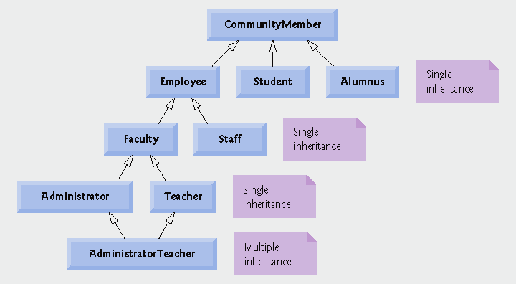
Inheritance: Single or Multiple

Slide 17
Multiple inheritance:
  C++
Single class inheritance, but multiple interface inheritance:
  Java, C#

Slide 18
Hierarchy

Slide 19
Root of Hierarchy
Abstract class
Interface

Slide 20
Abstract Classes and Methods
Abstract classes
  Are root of a class hierarchy
  Cannot be instantiated
  Incomplete
    subclasses fill in the "missing pieces"
Concrete classes
  Can be instantiated
  Implement every method they declare
  Provide specifics

Slide 21
Abstract Classes
Declares common attributes and behaviors of the various classes in a class hierarchy.
Typically contains one or more abstract methods
  Subclasses must override if the subclasses are to be concrete.
Instance variables and concrete methods of an abstract class subject to the normal rules of inheritance.

Slide 22
Abstract Classes
Classes that are too general to create real objects
Used only as abstract superclasses for concrete subclasses and to declare reference variables
Many inheritance hierarchies have abstract superclasses occupying the top few levels

Slide 23
Keyword abstract
Used for declaring a class abstract
Also used for declaring a method abstract
Abstract classes normally contain one or more abstract methods
All concrete subclasses must override all inherited abstract methods

Slide 24
C++ Abstract Classes
C++ has no keyword abstract
A class is abstract if it has a pure virtual method:
  class Shape {
  public:
  void virtual draw() = 0; // pure virtual
  …
  };

Slide 25
C++ Interfaces
C++ has no keyword interface
An abstract class can play a role of an interface since
C++ has multiple inheritance

Slide 26
Abstract Classes and Methods
Iterator class
  Traverses all the objects in a collection, such as an array
  Often used in polymorphic programming to traverse a collection that contains objects from various levels of a hierarchy

Slide 27

Beware! Compile Time Errors
Attempting to instantiate an object of an abstract class
Failure to implement a superclass’s abstract methods in a subclass
  unless the subclass is also declared abstract.

Slide 28
Creating Abstract Superclass Employee
abstract superclass Employee,
earnings is declared abstract
    No implementation can be given for earnings in the Employee abstract class
  An array of Employee variables will store references to subclass objects
    earnings method calls from these variables will call the appropriate version of the earnings method

Slide 29
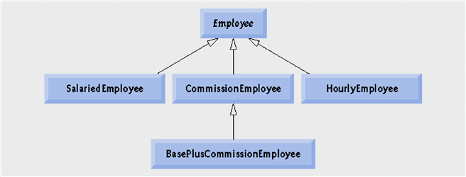
Example Based on Employee
Abstract Class
Concrete Classes
Click on Classes to see source code

Slide 30
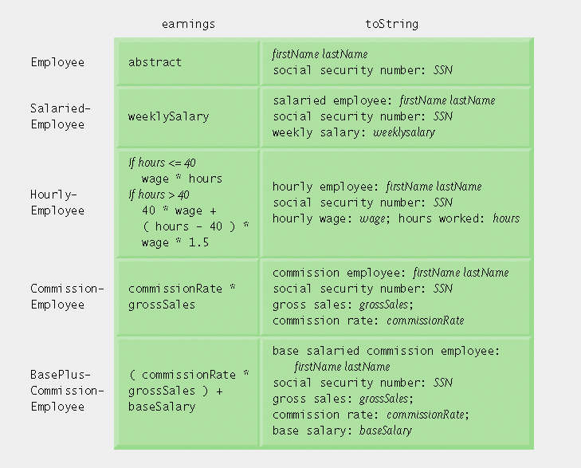
Polymorphic interface for the Employee hierarchy classes.

Slide 31
Note in Example Hierarchy
Dynamic binding
  Also known as late binding
  Calls to overridden methods are resolved at execution time, based on the type of object referenced
instanceof operator
  Determines whether an object is an instance of a certain type

Slide 32
How Do They Do That?
How does it work?
  Access a derived object via base class pointer
  Invoke an abstract method
  At run time the correct version of the method is used
Design of the vtable
  Note description from C++

Slide 33
Note in Example Hierarchy
Downcasting
  Convert a reference to a superclass to a reference to a subclass
  Allowed only if the object has an is-a relationship with the subclass
getClass method
  Inherited from Object
  Returns an object of type Class
getName method of class Class
  Returns the class’s name

Slide 34
Inheritance
If the class A inherits from class B (A<:B) when an object of class B is expected an object of class A can be used instead
Inheritance expresses the idea of adding features to an existing type (both methods and attributes)
Inheritance can be single or multiple

Slide 35
Example
class A {
int i;
int j;
int foo() { return i + j; }
}
class B : A {
int k;
int foo() { return k + super.foo(); }
}

Slide 36
Questions
Consider the following:
  A a = new A();
  A b = new B();
  Console.WriteLine(a.foo());
  Console.WriteLine(b.foo());
Which version of foo is invoked in the second print?
What is the layout of class B?

Slide 37
Upcasting
Late binding happens because we convert a reference to an object of class B into a reference of its super-class A (upcasting):
  B b = new B();
  A a = b;
The runtime should not convert the object: only use the part inherited from A
This is different from the following implicit cast where the data is modified in the assignment:
  int i = 10;
  long l = i;

Slide 38
Downcasting
Once we have a reference of the super-class we may want to convert it back:
  A a = new B();
  B b = (B)a;
During downcast it is necessary to explicitly indicate which class is the target: a class may be the ancestor of many sub-classes
Again this transformation informs the compiler that the referenced object is of type B without changing the object in any way

Slide 39
Upcasting, downcasting
We have shown upcasting and downcasting as expressed in languages such as C++, C# and Java; though the problem is common to OO languages
Note that the upcast can be verified at compile time whereas the downcast cannot
Upcasting and downcasting do not require runtime type checking:
  in Java casts are checked at runtime
  C++ simply changes the interpretation of an expression at compile time without any check at runtime

Slide 40
Late Binding
The output of invoking b.foo() depends on the language: the second output may be the result of invoking A::foo() or B::foo()
In Java the behavior would result in the invocation of B::foo
In C++ A::foo would be invoked
The mechanism which associates the method B::foo() to b.foo() is called late binding

Slide 41
Late Binding
In the example the compiler cannot determine statically the exact type of the object referenced by b because of upcasting
To allow the invocation of the method of the exact type rather than the one known at compile time it is necessary to pay an overhead at runtime
Programming languages allow the programmer to specify whether to apply late binding in a method invocation
In Java the keyword final is used to indicate that a method cannot be overridden in subclasses: thus the JVM may avoid late binding
In C++ only methods declared as virtual are considered for late binding

Slide 42
Late Binding
With inheritance it is possible to treat objects in a generic way
The benefit is evident: it is possible to write generic operations manipulating objects of types inheriting from a common ancestor
OOP languages usually support late binding of methods: which method should be invoked is determined at runtime
This mechanism involves a small runtime overhead: at runtime the type of an object should be determined in order to invoke its methods

Slide 43
Example (Java)
class A {
final void foo() {…}
void baz() {…}
void bar() {…}
}
class B extends A {
// Suppose it’s possible!
final void foo() {…}
void bar();
}
A a = new A();
B b = new B();
A c = b;
a.foo(); // A::foo()
a.baz(); // A::baz()
a.bar(); // A::bar()
b.foo(); // B::foo()
b.bar(); // B::bar()
c.foo(); // A::foo()
c.bar(); // B::bar()

Slide 44
Abstract classes
Sometimes it is necessary to model a set S of objects which can be partitioned into subsets (A₀, … A_{n}) such that their union covers S:
  ∀x ∈ S ⇒ ∃A_{i} ⊂ S, x ∈ A_{i}
If we use classes to model each set it is natural that
  ∀ A ⊂ S, A<:S
Each object is an instance of a subclass of S and no object is an instance of S.
S is useful because it abstracts the commonalities among its subclasses, allowing to express generic properties about its objects.

Slide 45
Example
We want to manipulate documents with different formats
The set of documents can be partitioned by type: doc, pdf, txt, and so on
For each document type we introduce a class that inherits from a class Doc that represents the document
In the class Doc we may store common properties to all documents (title, location, …)
Each class is responsible for reading the document content
It doesn’t make sense to have an instance of Doc though it is useful to scan a list of documents to read

Slide 46
Abstract methods
Often when a class is abstract some of its methods could not be defined
Consider the method read() in the previous example
In class Doc there is no reasonable implementation for it
We leave it abstract so that through late binding the appropriate implementation will be called

Slide 47
Syntax
Abstract classes can be declared using the abstract keyword in Java or C#:
  abstract class Doc { … }
C++ assumes a class is abstract if it contains an abstract method
  it is impossible to instantiate an abstract class, since it will lack that method
A virtual method is abstract in C++ if its definition is empty:
  virtual string Read() = 0;
In Java and C# abstract methods are annotated with abstract and no body is provided:
  abstract String Read();

Slide 48
Inheritance
Inheritance is a relation among classes
Often systems impose some restriction on inheritance relation for convenience
We say that class A is an interface if all its members are abstract; has no fields and may inherit only from one or more interfaces
Inheritance can be:
  Single (A <: B ⇒ (∀C. A <: C ⇒ C = B))
  Mix-in (S = {B | A <: B}, ∃1 B∈S ∧ ¬interface(B))
  Multiple (no restriction)

Slide 49
Multiple inheritance
Why systems should impose restrictions on inheritance?
Multiple inheritance introduces both conceptual and implementation issues
The crucial problem, in its simplest form, is the following:
  B <: A ∧ C <: A
  D <: B ∧ D <: C
In presence of a common ancestor:
  The instance part from A is shared between B and C
  The instance part from A is duplicated
This situation is not infrequent: in C++ ios:>istream, ios:>ostream and iostream<:istream, iostream<:ostream
The problem in sharing the ancestor A is that B and C may change the inherited state in a way that may lead to conflicts

Slide 50
Java and Mix-in inheritance
Both single and mix-in inheritance fix the common ancestor problem
Though single inheritance can be somewhat restrictive
Mix-in inheritance has become popular with Java and represents an intermediate solution
Classes are partitioned into two sets: interfaces and normal classes
Interfaces constraints elements of the class to be only abstract methods: no instance variables are allowed
A class inherits instance variables only from one of its ancestors avoiding the diamond problem of multiple inheritance

Slide 51
Implementing Single and Mix-in inheritance
Consists only in combining the state of a class and its super-classess
Note that Upcasting and Downcasting comes for free: the pointer at the base of the instance can be seen both as a pointer to an instance of A or B
A
B<:A
C<:B<:A
D<:C<:B<:A
A
A
A
A
B
B
B
D

Slide 52
Implementing multiple inheritance
With multiple inheritance becomes more complex than reinterpreting a pointer!
A
B<:A
C<:A
D<:B, D<:C
D<:B, D<:C
A
A
A
A
A (B)
B
C
B
A (C)
C
B
D
C
D

Slide 53
Late binding
How to identify which method to invoke?
Solution: use a v-table for each class that has polymorphic methods
Each virtual method is assigned a slot in the table pointing to the method code
Invoking the method involves looking up in the table at a specific offset to retrieve the address to use in the call instruction
Each instance holds a pointer to the v-table
Thus late binding incurs an overhead both in time (2 indirections) and space (one pointer per object)
The overhead is small and often worth the benefits

Slide 54
Late binding: an example (Java)
A’s v-table
V-pointer
class A {
void foo() {…}
void f() {…}
int ai;
}
class B extends A {
void foo() {…}
void g() {…}
int bi;
}
foo
ai
a
f
b
B’s v-table
V-pointer
foo
c
ai
f
bi
g
A a = new A();
a.foo();
a.f();
B b = new B();
b.foo();
b.g();
b.f();
A c = b;
c.foo();
c.f();

Slide 55
Overriding and Overloading
A’s v-table
V-pointer
class A {
void foo() {…}
void f() {…}
int ai;
}
class B extends A {
void foo(int i) {…}
void g() {…}
int bi;
}
foo()
ai
a
f
b
B’s v-table
V-pointer
foo()
c
ai
f
bi
foo(int)
g
A a = new A();
a.foo();
a.f();
B b = new B();
b.foo();
b.g();
b.f();
A c = b;
c.foo(3);
c.f();

Slide 56
JVM invokevirtual
A call like:
  x.equals("test")
is translated into:
  aload_1 ; push local variable 1 (x) onto the operand stack
  ldc "test" ; push string "test" onto the operand stack
  invokevirtual java.lang.Object.equals(Ljava.lang.Object;)Z
where java.lang.Object.equals(Ljava.lang.Object;)Z is a method specification
When invokevirtual is executed, the JVM looks at method specification and determines its # of args
From the object reference it retrieves the class, searches the list of methods for one matching the method descriptor.
If not found, searches its superclass

Slide 57
Invokevirtual optimization
The Java compiler can arrange every subclass method table (mtable) in the same way as its superclass, ensuring that each method is located at the same offset
The bytecode can be modified after first execution, by replacing with:
  invokevirtual_quick mtable-offset
Even when called on objects of different types, the method offset will be the same

Slide 58
Virtual Method in Interface
Optimization does not work for interfaces
interface Incrementable { public void incr(); }
class Counter implements Incrementable {
public void incr(); }
class Timer implements Incrementable {
public void decr();
public void inc(); }
Incrementable i;
i.incr();
Compiler cannot guarantee that method incr() is at the same offset.

Slide 59
Runtime type information
Execution environments may use the v-table pointer as a mean of knowing the exact type of an object at runtime
This is what happens in C++ with RTTI, in .NET CLR and JVM
Thus the cost of having exact runtime type information is allocating the v-pointer to all objects
C++ leaves the choice to the programmer: without RTTI no v-pointer is allocated in classes without virtual methods

Slide 60
Superclass And Subclass Assignment Rules
Assigning a superclass reference to superclass variable straightforward
Subclass reference to subclass variable straightforward
Subclass reference to superclass variable safe
  because of is-a relationship
  Referring to subclass-only members through superclass variables a compilation error
Superclass reference to a subclass variable a compilation error
  Downcasting can get around this error

Slide 61
final Methods and Classes
final methods
  Cannot be overridden in a subclass
  private and static methods implicitly final
  final methods are resolved at compile time, this is known as static binding
    Compilers can optimize by inlining the code
final classes
  Cannot be extended by a subclass
  All methods in a final class implicitly final

Slide 62
Interfaces

Slide 63
Why Use Interfaces
Java has only single inheritance
A child class inherits from only one parent class
Sometimes multiple inheritance would be convenient
Interfaces give Java some of the advantages of multiple inheritance without incurring the disadvantages

Slide 64
Why Use Interfaces
Provide capability for unrelated classes to implement a set of common methods
Define and standardize ways people and systems can interact
Interface specifies what operations must be permitted
Does not specify how performed

Slide 65
What is an Interface?
An interface is a collection of constants and method declarations
An interface describes a set of methods that can be called on an object
The method declarations do not include an implementation
  there is no method body

Slide 66
What is an Interface?
A child class that extends a parent class can also implement an interface to gain some additional behavior
Implementing an interface is a “promise” to include the specified method(s)
A method in an interface cannot be made private

Slide 67
When A Class Definition Implements An Interface
It must implement each method in the interface
Each method must be public (even though the interface might not say so)
Constants from the interface can be used as if they had been defined in the class (They should not be re-defined in the class)

Slide 68
Declaring Constants with Interfaces
Interfaces can be used to declare constants used in many class declarations
  These constants are implicitly public, static and final
  Using a static import declaration allows clients to use these constants with just their names

Slide 69
Class vs. Interface Inheritance
Class Inheritance
Functionality high in the hierarchy
Each new subclass inherits one or more methods declared in superclass
Subclass uses superclass declarations
Interface Inheritance
Functionality lower in hierarchy
Superclass specifies one or more abstract methods
Must be declared for each class in hierarchy
Overridden for subclass-specific implementations

Slide 70
Creating and Using Interfaces
Declaration begins with interface keyword
Classes implement an interface (and its methods)
Contains public abstract methods
  Classes (that implement the interface) must implement these methods

Slide 71
Creating and Using Interfaces
Consider the possibility of having a class which manipulates mathematical functions
You want to send a function as a parameter
  Note that C++ allows this directly
  Java does not
This task can be accomplished with interfaces

Slide 72
Creating and Using Interfaces
Declare interface Function
Declare class MyFunction which implements Function
Note other functions which are subclass objects of MyFunction
View test program which passes Function subclass objects to function manipulation methods

Slide 73
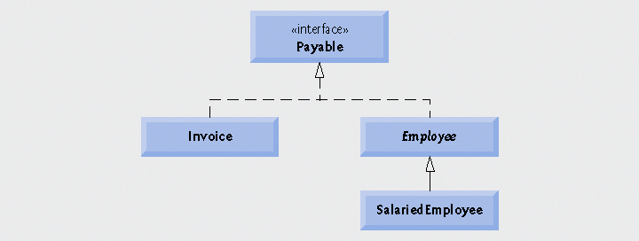
Case Study: A Payable Hierarchy
Payable interface
  Contains method getPaymentAmount
  Is implemented by the Invoice and Employee classes

Slide 74
Source Code for Shape Superclass Hierarchy
Shape superclass, Figure 10.6
  Note abstract method, getName
Point subclass, Figure 10.7
  Note, extends Shape, override of getName
Circle subclass, Figure 10.8
  Note extends Point, override of getArea, getName, and toString
Cylinder subclass, Figure 10.9
  Note extends Circle, override of getArea, getName, and toString

Slide 75
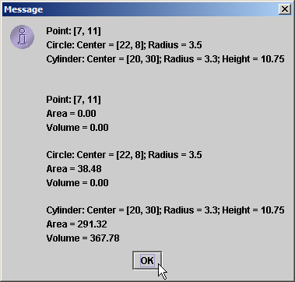
Source Code for Shape Superclass Hierarchy
Driver program to demonstrate,
Note array of superclass references
Output of
program

Slide 76
Polymorphic Payroll System
Employee
SalariedEmployee
CommissionEmployee
HourlyEmployee
BasePlusCommissionEmployee
Class hierarchy for polymorphic payroll application

Slide 77
Polymorphic Payroll System
Abstract superclass, Employee,
Figure 10.12
  Note abstract class specification, abstract earnings method
Abstract subclass, SalariedEmployee,
Figure 10.13
  Note extends Employee, override of earnings method
Look at other subclasses in text, pg 461 …
  Note here also the override of earnings

Slide 78
Polymorphic Payroll System
View test program
  Note array of superclass objects which are pointed at various subclass objects
  Note generic calls of toString method
  Note use of instantceof operator
  Consider use of downcasting
  Note use of getClass().getName() method
    Gives access to the name of the class

Slide 79
class CommissionEmployee {
public:
CommissionEmployee( const string &, const string &, const string &,
double = 0.0, double = 0.0 );
void setFirstName( const string & ); // set first name
string getFirstName() const; // return first name
void setLastName( const string & ); // set last name
string getLastName() const; // return last name
void setSocialSecurityNumber( const string & ); // set SSN
string getSocialSecurityNumber() const; // return SSN
void setGrossSales( double ); // set gross sales amount
double getGrossSales() const; // return gross sales amount

Slide 80
void setCommissionRate( double ); // set commission rate
double getCommissionRate() const; // return commission rate
double earnings() const; // calculate earnings
private:
string firstName;
string lastName;
string socialSecurityNumber;
double grossSales; // gross weekly sales
double commissionRate; // commission percentage

Slide 81
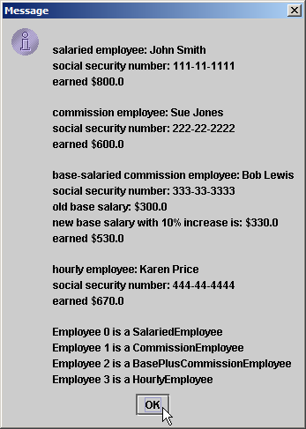
Polymorphic Payroll System
Output of the
payroll testing
program
Note results of
getClass().getName()
calls

Slide 82
Creating and Using Interfaces
View implementation of the interface Shape, Figure 10.19
Note the following:
  Line 4
  public class Point extends Object implements Shape { …
  Declaration of additional methods
  Declaration of abstract methods getArea, getVolume, and getName

Slide 83
Nested Classes
Top-level classes
  Not declared inside a class or a method
Nested classes
  Declared inside other classes
  Inner classes
    Non-static nested classes
Demonstrated in Figure 10.22
  Run the program
  Audio

Slide 84
Mentioned In The Audio
Inheritance Hierarchy
Panes of a JFrame
  Background
  Content
  Glass
Object
Component
Container
Window
Frame
JFrame

Slide 85
Mentioned In The Audio
Three things required when performing events
  Implement the interface
  Register the event handlers
  Specifically implement the actionPerformed methods

Slide 86
Nested Classes
An inner class is allowed to directly access its inner class's variables and methods
When this used in an inner class
  Refers to current inner-class object
To access outer-class using this
  Precede this with outer-class name

Slide 87
Nested Classes
Anonymous inner class
  Declared inside a method of a class
  Has no name
Inner class declared inside a method
  Can access outer class's members
  Limited to local variables of method in which declared
Note use of anonymous inner class, Figure 10.23

Slide 88
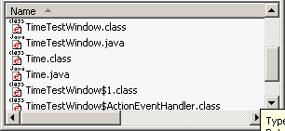
Notes on Nested Classes
Compiling class that contains nested class
  Results in separate .class file
  OuterClassName$InnerClassName.class
Inner classes with names can be declared as
  public, protected, private or package access

Slide 89
Notes on Nested Classes
Access outer class’s this reference
  OuterClassName.this
Outer class is responsible for creating inner class objects
OuterClassName.InnerClassName innerRef =
ref.new InnerClassName();
Nested classes can be declared static
  Object of outer class need not be created
  Static nested class does not have access to outer class's non-static members

Slide 90
Type-Wrapper Classes for Primitive Types
Each primitive type has one
  Character, Byte, Integer, Boolean, etc.
Enable to represent primitive as Object
  Primitive values can be processed polymorphically using wrapper classes
Declared as final
Many methods are declared static

Slide 91
Invoking Superclass Methods from Subclass Objects
Recall the point and circle hierarchy
  Note :
  Assignment of superclass reference to superclass variable
  Assignment of subclass reference to subclass variable
No surprises … but the "is-a" relationship makes possible
  Assignment of subclass reference to superclass variable
See Figure 10.1

Slide 92
Using Superclass References with Subclass-Type Variables
Suppose we have a superclass object
Point3 point = new Point3 (30, 40);
Then a subclass reference
Circle4 circle;
It would be illegal to have the subclass reference aimed at the superclass object
circle = point;

Slide 93
Subclass Method Calls via Superclass-Type Variables
Consider aiming a subclass reference at a superclass object
  If you use this to access a subclass-only method it is illegal
Note Figure 10.3
  Lines 22 - 23

Slide 94
Summary of Legal Assignments between Super- and Subclass Variables
Assigning superclass reference to superclass-type variable OK
Assigning subclass reference to subclass-type variable OK
Assigning subclass object's reference to superclass type-variable, safe
  A circle "is a" point
  Only possible to invoke superclass methods
Do NOT assign superclass reference to subclass-type variable
  You can cast the superclass reference to a subclass type (explicitly)

Slide 95
Polymorphism Examples
Suppose designing video game
Superclass SpaceObject
  Subclasses Martian, SpaceShip, LaserBeam
  Contains method draw
To refresh screen
  Send draw message to each object
  Same message has “many forms” of results
Easy to add class Mercurian
  Extends SpaceObject
  Provides its own implementation of draw
Programmer does not need to change code
  Calls draw regardless of object’s type
  Mercurian objects “plug right in”

Slide 96
Abstract Classes and Methods
Abstract classes not required, but reduce client code dependencies
To make a class abstract
  Declare with keyword abstract
  Contain one or more abstract methods
    public abstract void draw();
  Abstract methods
    No implementation, must be overridden

Slide 97
Inheriting Interface and Implementation
Make abstract superclass Shape
Abstract method (must be implemented)
  getName, print
  Default implementation does not make sense
Methods may be overridden
  getArea, getVolume
    Default implementations return 0.0
  If not overridden, uses superclass default implementation
Subclasses Point, Circle, Cylinder

Slide 98
Polymorphic Interface For The Shape Hierarchy Class
getArea
getVolume
getName
toString
0.0
0.0
abstract
default Object implement
Shape
0.0
0.0
"Point"
[x,y]
Shape
Point
Point
πr²
0.0
"Circle"
center=[x,y]; radius=r
Circle
Circle
2πr² +2πrh
πr²h
"Cylinder"
center=[x,y]; radius=r; height=h
Cylinder
Cylinder

Slide 99
Creating and Using Interfaces
All the same "is-a" relationships apply when an interface inheritance is used
Objects of any class that extend the interface are also objects of the interface type
  Circle extends Point, thus it is-a Shape
Multiple interfaces are possible
  Comma-separated list used in declaration

