Slide 1
Project Presentation 1 • Progress checkpoint
Problem 4: Commercial Banking, Lending, Payments and Compliance
Modelling a bank with classes and inheritance, without reducing everything to “account”
Khizar Rizwan • 25L-5668
CS2012 Introduction to Object-Oriented Programming • Instructor: Bilal Nadeem
Notes:
[0:00-0:20] Assalam-o-Alaikum. Mera naam Khizar Rizwan hai, roll number 25L-5668. Mera project Problem 4 hai: ek commercial bank ka object-oriented model, jis mein customers, loans, payments, cards aur compliance sab shamil hain. Agle paanch minute mein main aap ko apni research, design, ab tak ki progress aur agle steps dikhaunga.

Slide 2
Progress › Research › Design › Build › Next
Where the project stands
Six planned phases: research and design complete, implementation and GUI under way
1
2
3
4
5
6
Domain research
Assumptions & requirements
Class & inheritance design
Implementation (Python)
GUI (Tkinter)
Final report & viva
Done
Done
Done
In progress
In progress
Next
8
27
36
71
4
sources studied
banking terms defined
documented assumptions
classes designed
multi-level hierarchies
The brief asks for at least 30 meaningful classes and one multi-level hierarchy
Notes:
[0:20-0:55] Main ne project ko chhe phases mein plan kiya. Pehle teen phases mukammal hain: domain research, assumptions aur requirements, aur class aur inheritance design. Chautha phase, yani Python implementation, is waqt jaari hai, aur us ke saath Tkinter GUI par bhi kaam chal raha hai. Aakhri phase final report aur viva hai. Neeche diye gaye numbers meri research aur design ke hain: aath sources, sattaees banking terms, chhattees documented assumptions, aur ikhattar classes ka design, jin mein chaar multi-level hierarchies hain.

Slide 3
Progress › Research › Design › Build › Next
Domain research: what I studied
Eight sources, chosen to cover every research area the brief lists
1
2
3
4
FATF Recommendations
State Bank of Pakistan
Basel Committee
ISO 20022
Customer due diligence; beneficial owners (Rec. 10, 24, 25)
AML/CFT regulations: local KYC practice
Managing money-laundering risk in banks
Payment statuses: pending, held, posted, rejected
5
6
7
8
Visa & Mastercard
IFRS 9
BIAN
Fowler, Analysis Patterns
Disputes, reason codes, chargebacks
Loan modification and restructuring
Product catalogue vs customer agreement
Party roles and time-dated records
Full references and a 27-term glossary are in the design report, section 1
Notes:
[0:55-1:40] Brief kehta hai ke model banane se pehle industry ko samjho. Is liye main ne aath sources study kiye. FATF Recommendations aur State Bank of Pakistan ki AML regulations se customer due diligence aur beneficial ownership samjha. Basel Committee se risk management. ISO 20022 se payment ka lifecycle, ke payment sirf "hui" ya "nahi hui" nahi hoti, balkay pending, held, posted aur failed jaise statuses se guzarti hai. Visa aur Mastercard ke dispute rules se reversal, refund aur chargeback ka farq. IFRS 9 se loan restructuring, BIAN se product aur customer agreement ka farq, aur Martin Fowler ki Analysis Patterns se roles aur time-dated records.

Slide 4
Progress › Research › Design › Build › Next
How the research changed my design
My first idea, what the research showed, and the design I adopted
One person, many roles
Nothing is erased
Offer ≠ what a customer holds
First idea
First idea
First idea
Customer, Director, Signatory as subclasses of Person
Mark a wrong payment as “refunded”
One class for a product and a customer’s account
After research
After research
After research
One Person record; roles are dated objects (Mandate, OfficerRole)
Reversal and Chargeback: new transactions linked to the original
ProductDefinition (versioned terms) vs Arrangement (pins its version)
Notes:
[1:40-2:20] Is research ne mera design badal diya. Pehle mera khayal tha ke Customer, Person ki subclass hogi. Lekin KYC rules batate hain ke customer, director, owner aur signatory ek hi insaan ke roles hain. Is liye ek Person class hai, aur roles alag, dated objects hain. Doosra: bank kabhi galat payment ko mitata nahi, balkay nayi entry post karta hai. Is liye Reversal aur Chargeback nayi transactions hain. Teesra: product band ho jaye to purane customers apni purani terms par rehte hain, is liye ProductDefinition aur customer ka Arrangement alag classes hain.

Slide 5
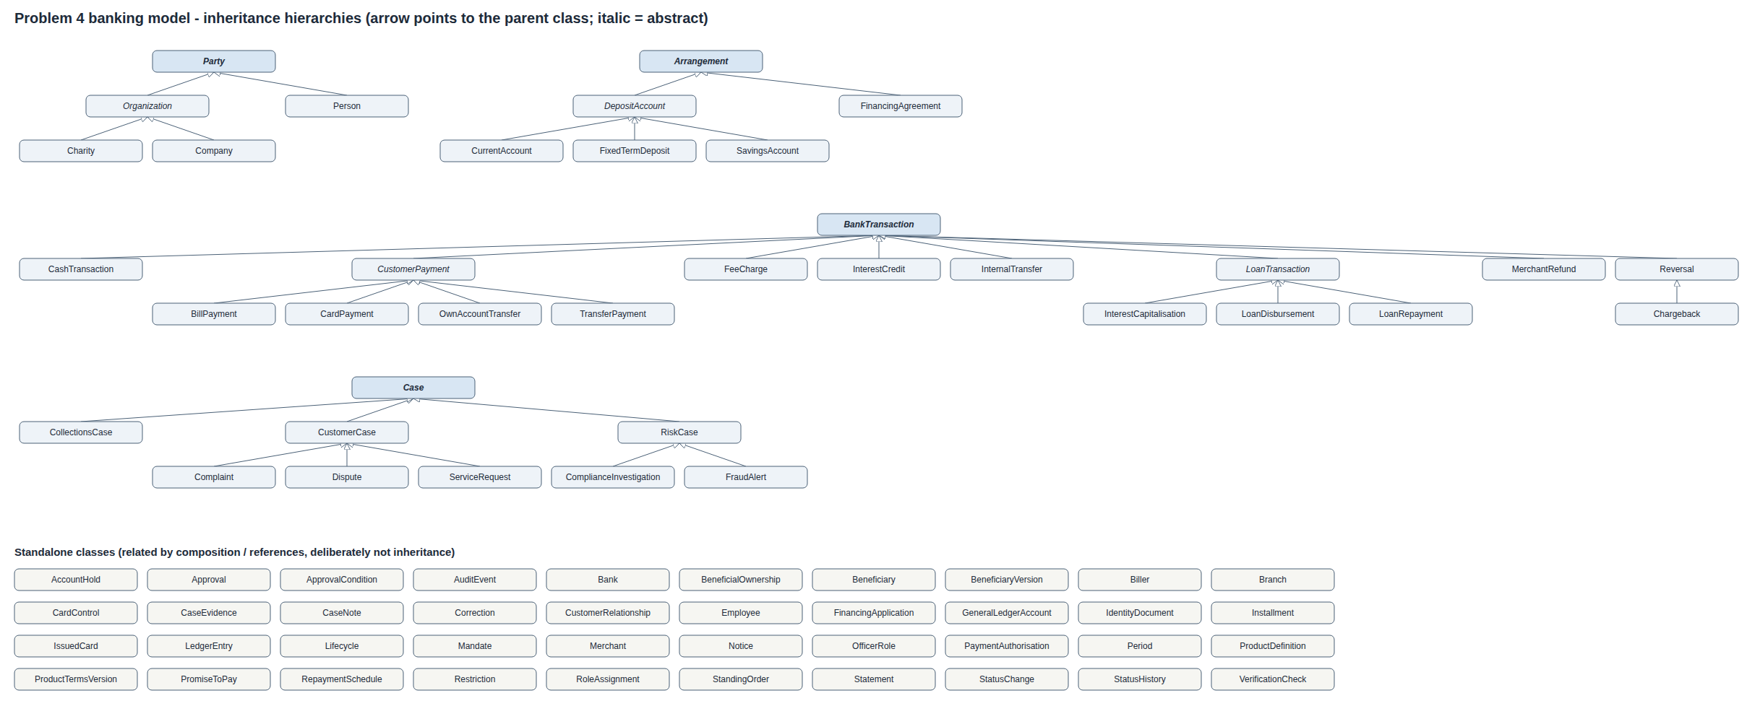
Progress › Research › Design › Build › Next
Class model after research
Four hierarchies (inheritance) plus standalone classes linked by association
Inheritance only for a true “is-a”; everything else is association
Notes:
[2:20-2:50] Yeh research ke baad ka class diagram hai. Is mein chaar hierarchies hain: Party, Arrangement, BankTransaction aur Case. Baqi cheezen, jaise cards, mandates, branches aur employees, association se jurri hain, kyunke woh ek doosre se related hain magar ek doosre ki qism nahi. Mera usool yeh tha: inheritance sirf wahan jahan sach mein "is-a" rishta ho.

Slide 6
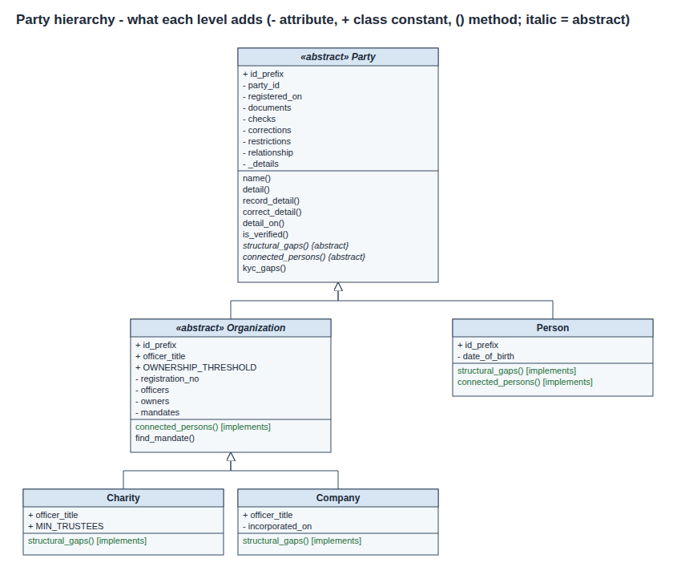
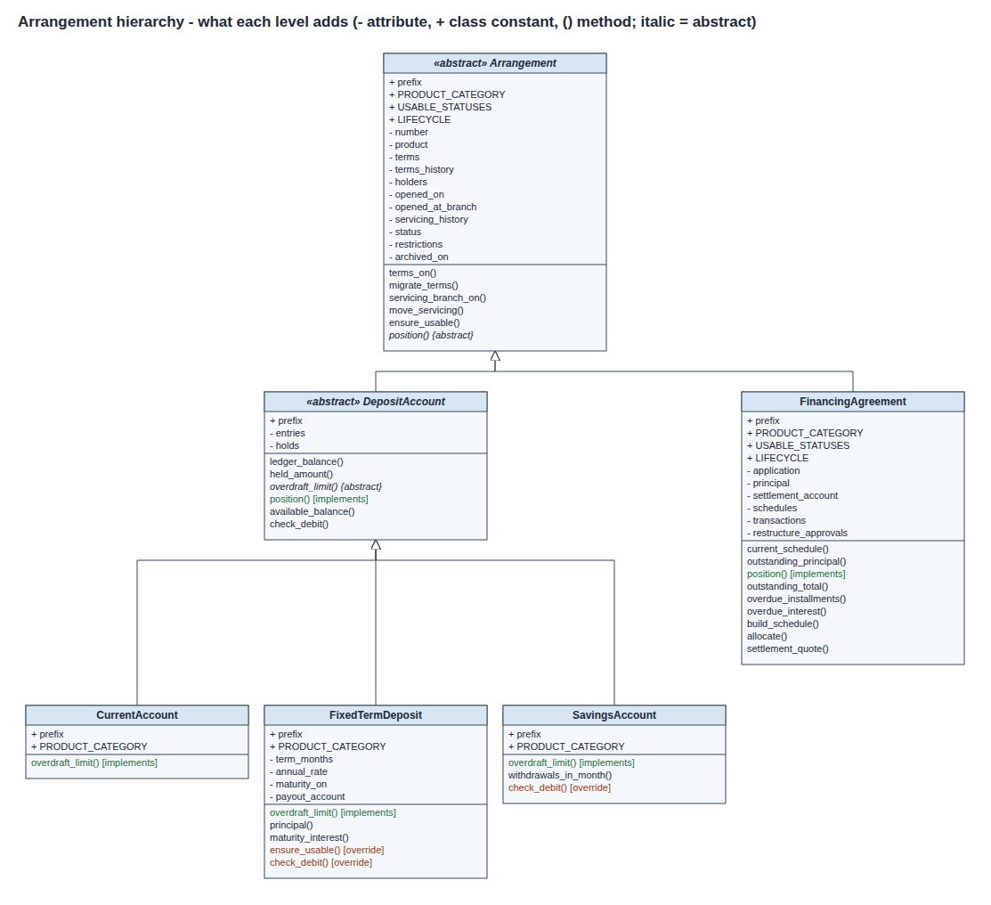
Progress › Research › Design › Build › Next
Multi-level inheritance, and what I rejected
UML: shared data sits at the highest level where every subclass needs it
Rejected
Customer(Person): a role that starts and ends, not a kind of person
Card(Account): a card holds no money; it is linked to an account
SoleTrader(Organization): legally the person is liable
MerchantRefund(Reversal): the purchase stays valid
Party › Organization › Company / Charity
Arrangement › DepositAccount › Current / Savings / Term
Notes:
[2:50-3:25] Yeh do multi-level hierarchies UML mein hain. Party se Organization, aur Organization se Company aur Charity. Aur Arrangement se DepositAccount, phir Current, Savings aur Term Deposit. Shared data hamesha us sab se oonche level par hai jahan har subclass ko us ki zaroorat hai. Daayen taraf woh inheritance hai jo main ne soch kar reject ki: card account nahi kyunke us mein paisa nahi hota, sole trader alag legal entity nahi, aur merchant refund reversal nahi kyunke asal purchase valid rehti hai.

Slide 7
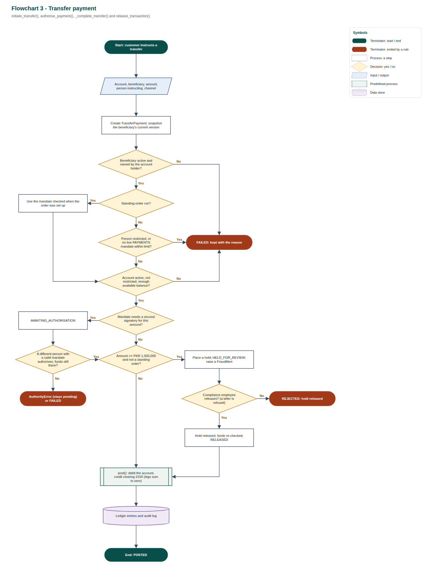
Progress › Research › Design › Build › Next
One workflow end to end: a large transfer
Flowchart in standard symbols, in the order the rules are checked
1
Authority
Does this person hold a live payments mandate?
2
Funds and limits
Enough available balance, within the mandate limit?
3
Dual control
Above the threshold, a second signatory must approve
4
Compliance hold
Very large transfers wait for review, then release
5
Refused?
Kept on record as FAILED, with the rule that stopped it
Notes:
[3:25-3:55] Yeh flowchart ek poora workflow dikhata hai: digital banking se ek bara transfer, jo brief ka apna case hai. Pehle authority check hoti hai, phir funds aur limit, phir dual control jahan doosre signatory ki approval chahiye, aur phir compliance review. Agar koi rule fail ho to payment mitti nahi, balkay wajah ke saath record mein rehti hai.

Slide 8
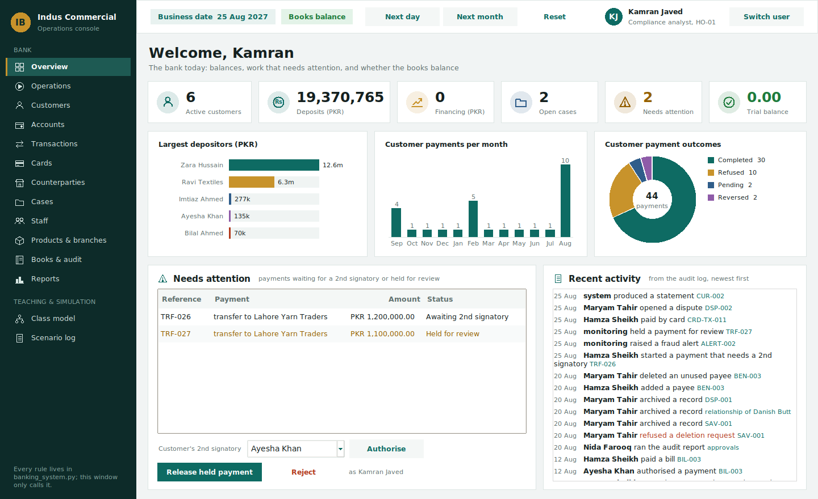
Progress › Research › Design › Build › Next
Implementation and GUI: in progress
Python, standard library only; GUI in Tkinter
Built
Party, Arrangement and Transaction hierarchies
Double-entry ledger: balances derived, never stored
KYC checks and dated mandates
In progress
Card and lending workflows
Exception scenarios from the brief
GUI screens for staff and customers
GUI prototype: staff overview screen
Notes:
[3:55-4:35] Ab implementation ki progress. Core model Python mein ban raha hai: parties, accounts, transactions aur double-entry ledger ka kaam ho chuka hai, aur har rule ke saath test likh raha hoon. Is waqt main cards aur lending ke workflows aur brief ke exception scenarios par kaam kar raha hoon. Saath hi Tkinter mein GUI ka prototype ban raha hai, yeh us ki screen hai, jahan staff aur customer dono apne role ke hisaab se kaam kar sakenge.

Slide 9
Progress › Research › Design › Build › Next
Next steps to the final submission
What remains, in order
Finish the implementation and GUI screens
Now
Test every critical case from the brief with automated tests
Next
Save and load records with files / JSON; review against SOLID (weeks 6, 11)
Next
Complete the design report and diagrams; prepare the viva
Final
Shukriya — questions welcome
Notes:
[4:35-5:00] Agle steps: implementation aur GUI mukammal karna, brief ke har critical case ko automated tests se check karna, files aur JSON se data save karna, aur SOLID principles ke mutabiq design review karna. Aakhir mein final report aur viva. Shukriya, main sawalat ke liye hazir hoon.

