Slide 1
Problem 4
Commercial Banking, Lending, Payments and Compliance
An object model where nothing is deleted and every past state can be rebuilt
Prepared by: Khizar Rizwan
Roll number: 25L-5668
CS2012 Introduction to OOP - Instructor: Bilal Nadeem
Notes:
Introduce the project: a teaching model of a commercial bank. The assessed concepts are classes and inheritance. The central idea is that history is never overwritten.

Slide 2
The project at a glance
One Python file, standard library only - banking_system.py
71
98
4
business classes (+6 supporting)
Bank operations (80 commands)
multi-level hierarchies
16
73
0.00
complex scenarios
automated tests
trial balance total
Notes:
The brief asks for at least 30 classes and 30 meaningful operations. Even counting only the 71 business classes and the 80 state-changing commands we are more than double. The trial balance is zero at the end of the demo, so no scenario created or lost money.

Slide 3
Core rule: nothing that happened is ever deleted
Four techniques answer every question of the form "what was true on date X?"
1
Periods
2
Status histories
Mandates, officer roles, ownerships, restrictions and RM assignments are valid from-to. Revoking closes the period.
Every lifecycle keeps each status with date, actor and reason, so status_on(date) is answerable.
3
Versions
4
Counter-records
Product terms, beneficiary details and repayment schedules change by adding a version, never by editing.
Money is never edited: a Reversal posts equal and opposite entries; the original stays.
Notes:
This is the answer to the brief's question about deletion. Closing an account, ending a relationship or revoking a mandate are status changes or closed periods. Bank.party_snapshot rebuilds what the bank knew about a customer on any past date.

Slide 4
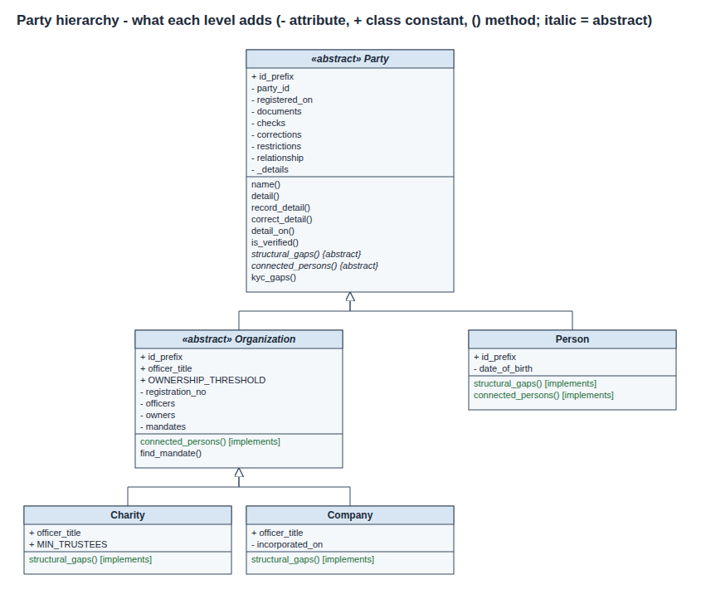
Party -> Organization -> Company / Charity
Party: identity, documents, checks, corrections, restrictions
Organization adds officers, owners, mandates and a stricter KYC rule (connected persons must be verified too)
Company needs a director; Charity needs two trustees: structural_gaps() overridden
Customer, director, signatory are ROLES, not subclasses
Notes:
Three levels because each level has a rule that is genuinely true there and not above it. Ayesha is one Person record with five capacities.

Slide 5
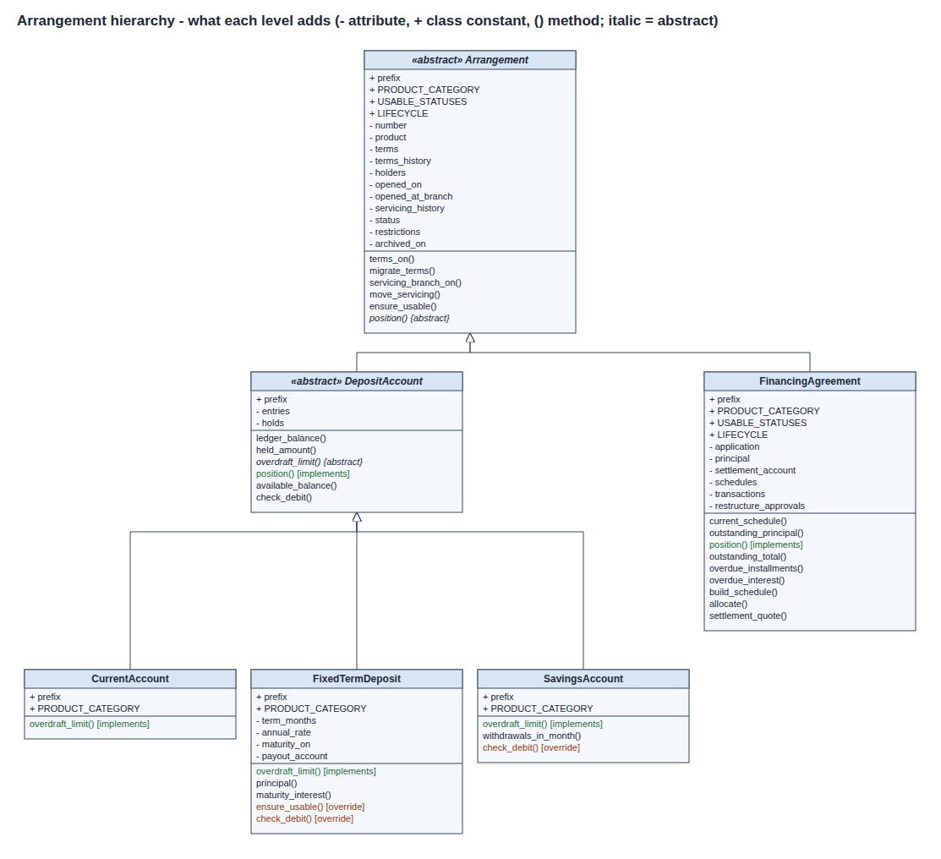
Arrangement -> DepositAccount -> Current / Savings
Arrangement: product, pinned terms, holders, branch history, status, restrictions
DepositAccount adds what only accounts holding money have: ledger, holds, available balance
Current overrides overdraft_limit(); Savings and FixedTermDeposit extend check_debit()
FinancingAgreement sits beside DepositAccount: it holds no customer money
Notes:
The middle level exists because holding customer money is a real behavioural difference. A loan inheriting a ledger balance would be meaningless.

Slide 6
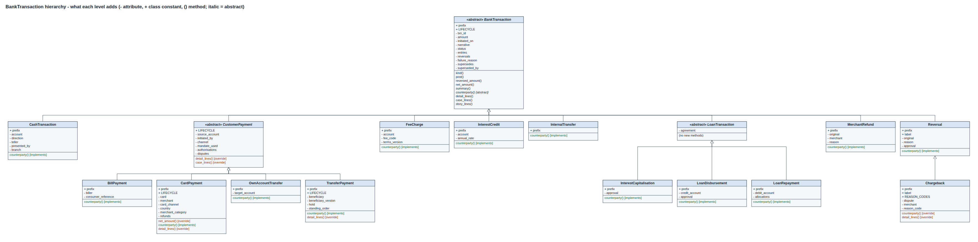
BankTransaction -> CustomerPayment / LoanTransaction / Reversal
Every movement is double-entry; post() refuses legs that do not sum to zero
CustomerPayment adds initiator, channel, mandate used, 2nd signatory, disputes; Transfer, Card, Bill, OwnAccount add their own facts
LoanTransaction groups disbursement, repayment and interest capitalisation
Reversal -> Chargeback: a card reversal claimed from the merchant with a scheme reason code; a MerchantRefund is NOT a reversal
Notes:
Only customer payments can be disputed, which is why that level exists. A reversal is a transaction of its own, pointing at the original. Research on card schemes showed three different things: the bank's reversal, the merchant's refund and the chargeback. A chargeback has everything a reversal has plus a dispute, a merchant and a reason code, so it is a subclass; a refund is started by the merchant with no bank approval and leaves the purchase posted, so it is not.

Slide 7
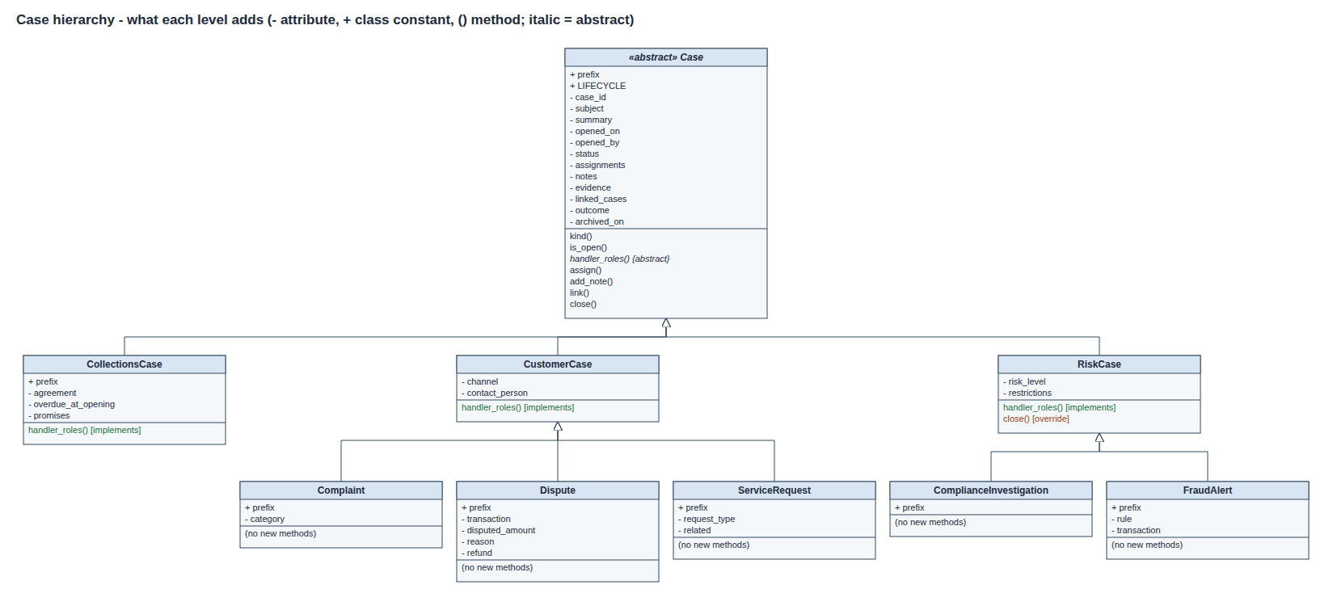
Case -> CustomerCase / RiskCase
Separate, linked records: the branch complaint and the compliance investigation
CustomerCase: arrives through a channel from a contact person (dispute, complaint, service request)
RiskCase: bank-initiated; overrides close() so it cannot close while its restrictions are live
CollectionsCase: opened by the arrears batch
Notes:
Scenario 5 shows the override: closing the investigation is refused until the debit block is lifted.

Slide 8
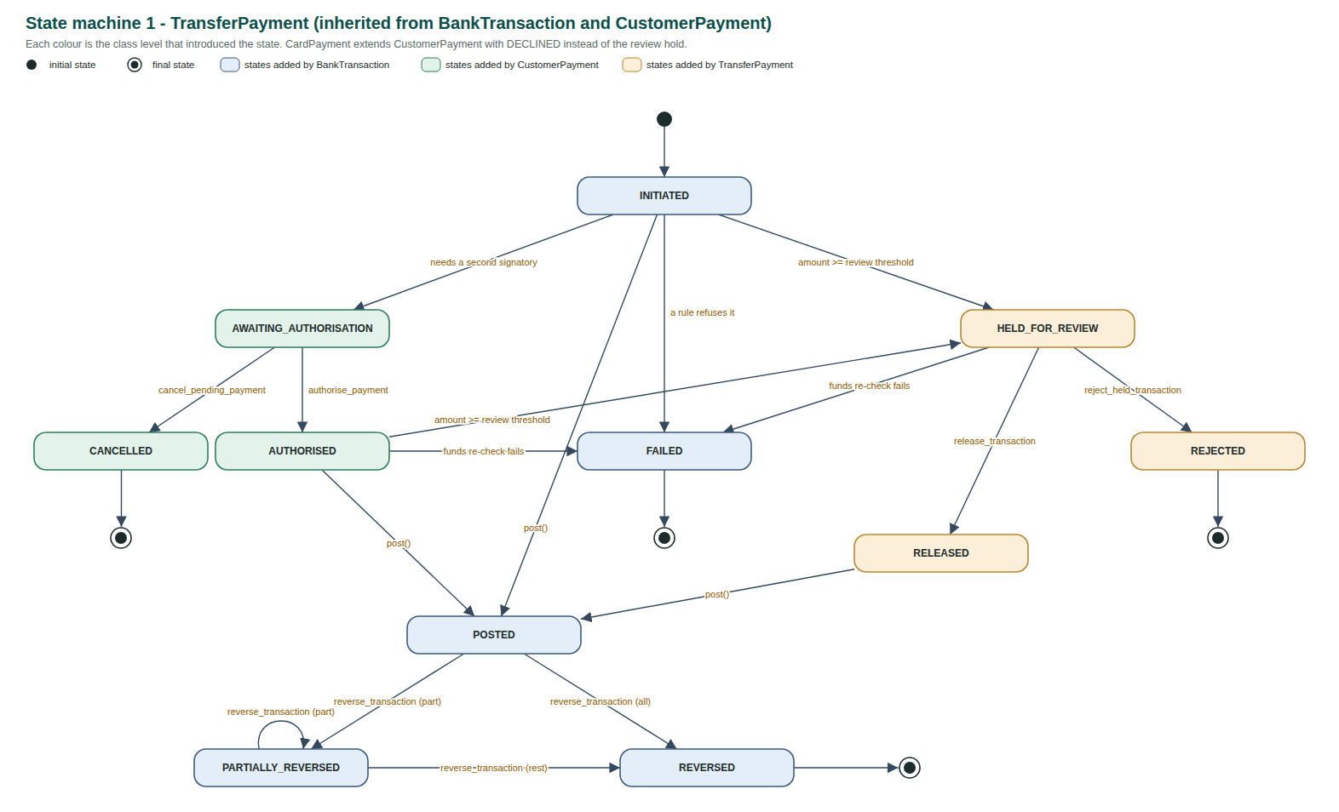
Abstract classes and inherited state machines
Hierarchy roots are abstract (abc): no "plain" transaction or party can exist
Abstract methods differ by class: counterparty(), overdraft_limit(), position(), handler_roles()
Type checks replaced by polymorphism: transaction_story is txn.story_lines()
Each class declares its LIFECYCLE; StatusHistory refuses any other move
Subclasses extend it: CustomerPayment adds dual control, TransferPayment the review hold
Notes:
Colours on the state diagram show which class introduced each status: blue BankTransaction, green CustomerPayment, amber TransferPayment. The diagram is drawn from the LIFECYCLE declarations, the same objects the code enforces, and CI fails if the committed diagram differs from the code.

Slide 9
Tempting inheritances we rejected
Fourteen in the report; four of the strongest
x
Customer(Person)
x
IssuedCard(DepositAccount)
One human is customer, director and signatory at once; roles start and end on different dates.
A card holds no money and many cards share one account: it is a credential.
x
FinancingAgreement(DepositAccount)
x
MerchantRefund(Reversal)
A loan has no ledger of customer funds, holds or available balance.
The merchant starts it, no bank approval, and the purchase stays POSTED: not an undo.
Notes:
The obvious alternative, 'everything is an account with flags', fails every critical case: a flag change destroys the fact that it was once different.

Slide 10
Why not the obvious alternative?
An account-centric model: Customer with flags, Account with a type field, edits in place
Critical case | Account-centric alternative | This design
Signatory loses authority | is_signatory = False erases the past | Mandate with a Period; payments keep it
Posted, reversed, disputed | amount edited, original lost | Reversal, re-post and Chargeback records
Card replaced several times | one card_number overwritten | IssuedCard chain; each payment keeps its card
Loan restructured | installments rewritten | new schedule version; paid stay PAID
Product withdrawn | is_active blocks old customers too | sale status + pinned terms version
The alternative fails all ten critical cases (report section 7.1).
Notes:
The brief asks us to defend the design against at least one plausible alternative. The account-centric model is simpler and would pass the class count, but it answers every historical question with the current value only.

Slide 11
16 scenarios break the normal workflow
All ten critical cases in the brief are covered, plus every participant it names
1
Document expires mid-onboarding
9
Evidence keeps corrected data
2
Large transfer: dual control, hold, release
10
Product withdrawn, terms pinned
3
Card stolen, replaced twice, found
11
Branch closes; all moves
4
Posted, reversed, re-posted, disputed
12
Savings limit; closure not deletion
5
Restricted then cleared
13
Staff and customer leave
6
Financing: limits, arrears, restructure
14
Sole trader, private client, term deposits
7
Director leaves; authority provable
15
Card controls, bills, card search
8
Beneficiary changes bank details
16
Auditor review; archive vs delete
Notes:
Run python banking_system.py to show them live. Each refusal prints the exact rule, e.g. AuthorityError: the initiator cannot also be the second signatory.

Slide 12
Everything the brief names is modelled
Found by rereading Problem 4 line by line; each has a test
Sole traders & private clients
Fixed-term deposits
Card controls
Person with a trading name; PRIVATE needs verified source of wealth (EDD)
Third DepositAccount subclass: no early debits, maturity payout, break penalty
Online, international, cash, merchant category - each with a validity period
Billers
Collections staff
Auditors & retention
BillPayment is a CustomerPayment: same mandates, restrictions, dual control
Collections officer works the case; promise to pay marked kept or broken
Approvals audit with role at the time; archive, never delete (10-year retention)
Notes:
Report section 3.2 maps every participant, research area and scope item in the brief to a class, operation and scenario. Section 3.1 answers the brief's eight open questions one by one.

Slide 13
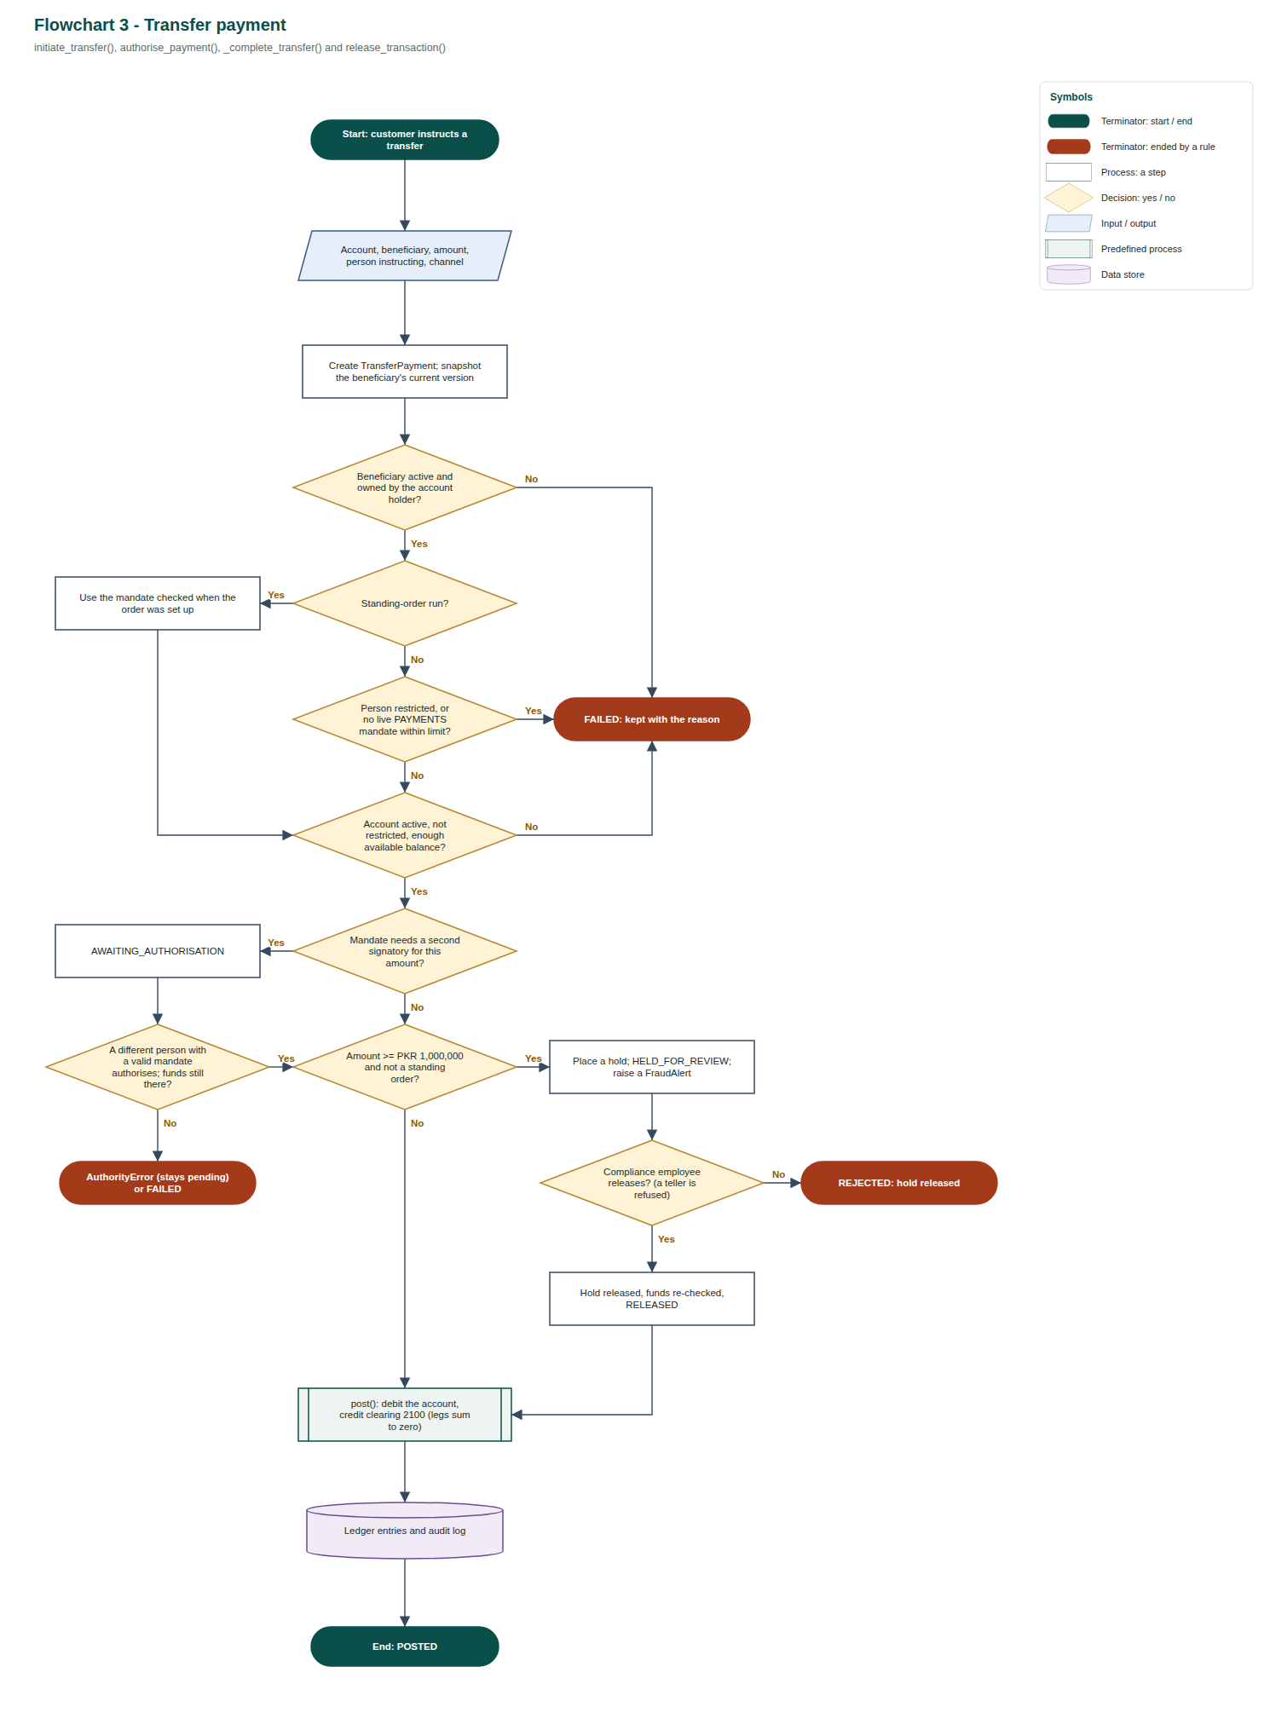
Behaviour: six flowcharts traced from the code
Standard symbols (ISO 5807); the diamonds are in the order the code checks the rules
Start / end; red = refused
1. Program overview
2. Onboarding
3. Transfer payment
4. Card purchase
5. Financing lifecycle
6. Desktop console
Process: one step
Decision: Yes / No
Input / output
A named Bank operation
Ledger / audit log
Report section 4.1 (flowcharts) and 4.2 (state machines)
Notes:
The class diagrams show structure; the flowcharts show behaviour. Walk through the transfer: beneficiary, authority (mandate within limit), funds, dual control, then the PKR 1,000,000 compliance hold. Every red terminator is a refusal that is still kept on record.

Slide 14
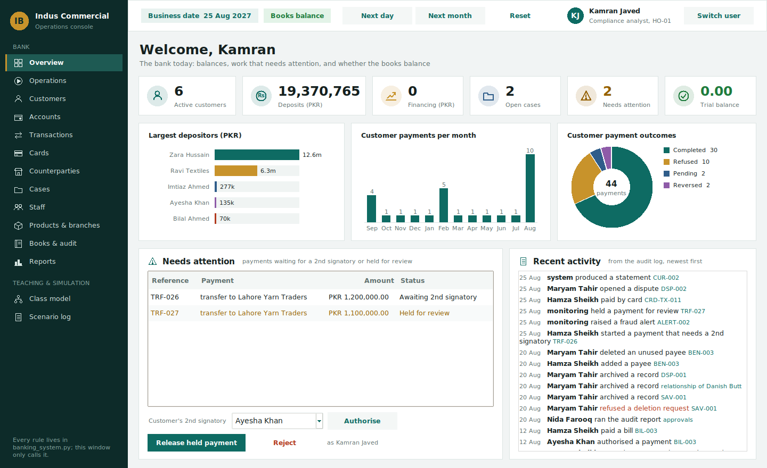
Live demo: staff console and digital banking
banking_gui.py - pure Python (Tkinter); every button calls one Bank operation
Sign in as staff or as a customer; the model checks that person's authority
Staff: forms list what your role may do and record you automatically
Digital banking: own accounts plus companies under a mandate; approvals, cards, disputes
80 forms and 14 guided checks cover every workflow in the brief
GUI classes inherit too: Page -> MasterDetailPage, CustomerView, Chart
Notes:
Sign in as Kamran (compliance) and show the Overview and a guided check. Then switch user to digital banking: Noor is refused (view only), Hamza starts a PKR 1.2m payment that waits for a 2nd signatory, Ayesha approves it. The GUI contains no business rules: refusals come from the model and name its rule.

Slide 15
Code review: 20 defects fixed, each with a test
A refused loan overpayment still marked installments as paid
Resolving a dispute twice refunded the customer twice
Recording an ACTIVE card as found destroyed it
Replacement cards blocked once the product was withdrawn
Bank fees used up customers' savings withdrawals
Account closure ignored holds and pending payments
No delegated limit on credit approvals
20
defects found and fixed, each with a regression test
Notes:
Full table in docs/Code_Review.md. Every fix is protected by a test, so it cannot silently come back.

Slide 16
Limitations and how it would scale
Today
At scale
Single currency (PKR)
In-memory storage
Two-signatory dual control only
Fixed review threshold, simple interest
Period -> valid_from / valid_to columns in a database
Bank split into services linked by events
Login supplies the acting person
Islamic products as new Arrangement subclasses
Thank you - questions?
Notes:
The Arrangement level is where the design pays off for new business models: an Ijarah or Murabaha contract is a new kind of arrangement, not a change to existing classes.

