Slide 1
USER
EXTERNAL
CLOUD
1
2
3
4
5
6
7
8
POST /users
9
10
11
12
13
14
15
Notes:
Generated on Sun Aug 17 2025 07:04:08 GMT+0000 (Coordinated Universal Time)

Slide 2
Region
VPC
Zone
Subnet
The Internet

Slide 3







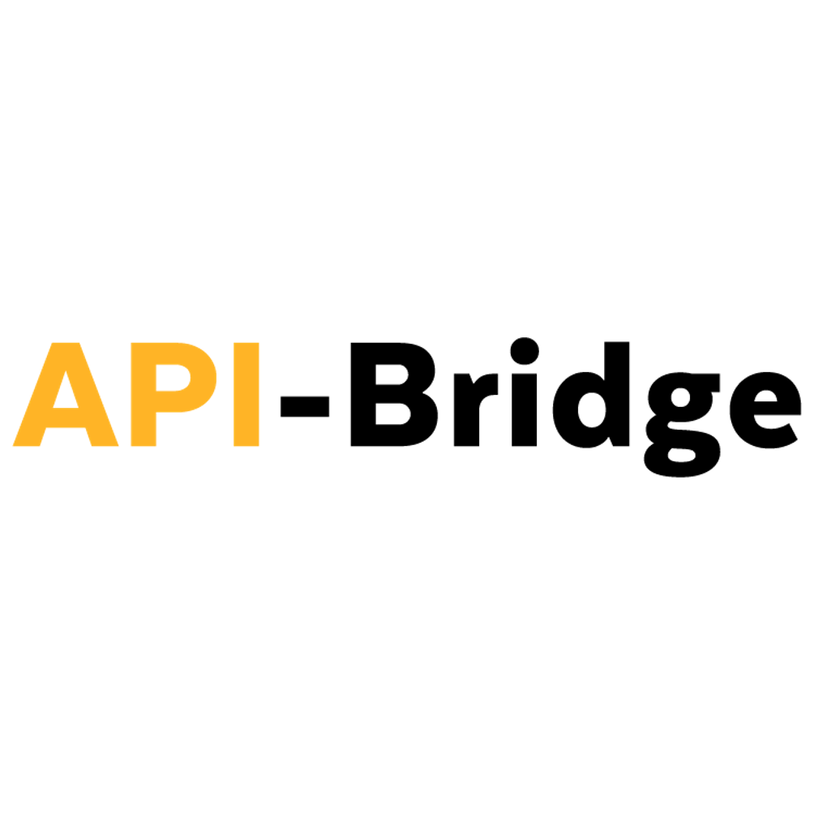























CATALOG
AGILECDN
AISOLVED - SEEKERS OF KNOWLEDGE MEET AI SOLUTIONS
AKASIA FINOPS MODELER
ALICE
ANALYTICS ENGINE
ANONTECH VIZIVAULT PLATFORM
ANYCLOUD BACKUP FOR 365
API CONNECT
API-BRIDGE FOR I
APP CONFIGURATION
APP ID
AUTO SCALE FOR VPC
BARE METAL SERVER FOR CLASSIC
BARE METAL SERVERS FOR VPC
BESPOKEN AUTOMATED TESTING FOR IVR AND CHAT
BLOCK STORAGE FOR CLASSIC
BLOCK STORAGE FOR VPC
BLOCK STORAGE SNAPSHOTS FOR VPC
BUS4I SYSTEM COPY - MIGRATE 23 FOR POWER I
CAVEONIX RISKFORESIGHT
CELERITY COPYASSURE FOR POWERVS
CELERITY PROFESSIONAL SERVICES FOR POWERVS
CHECK-A-ROO
CITRIX NETSCALER VPX
CLIENT VPN FOR VPC
CLOUD BACKUP FOR CLASSIC
CLOUD BACKUP FOR VPC
CLOUD HSM
CLOUD LOAD BALANCER
CLOUD LOGS
CLOUD MONITORING
CLOUD NATIVE STORAGE AND DATA SERVICE
CLOUD OBJECT STORAGE
CLOUD OBJECT STORAGE (CLASSIC)
CLOUD PLATFORM PROFESSIONAL SERVICES
CLOUD RESERVATIONS FOR VPC

Slide 4



































CLOUD SECURE VIRTUALIZATION
CLOUDANT
CLOUDSWAY CDN PRO
CLUSTER NETWORK
COBALT IRON - SECURE AUTOMATED BACKUP WITH COMPASS
CODE ENGINE
COMPLIANCE AND CUSTOMER EXPERIENCE AUTOMATION
COMPOSE FOR ELASTICSEARCH
COMPOSE FOR ETCD
COMPOSE FOR MONGODB
COMPOSE FOR POSTGRESQL
COMPOSE FOR RABBITMQ
COMPOSE FOR REDIS
CONTAINER REGISTRY
CONTAINER SECURITY SERVICES
CONTINUOUS DELIVERY
CONVERLISTICS
CONVERTIO VMWARE WORKLOAD MIGRATION AND CONVERSION
CRUSHBANK
CUSTOM MIGRATIONS DR AND MANAGEMENT AS A SERVICE
CVVKEY
CYBERSTRONG BY CYBERSAINT
DATA PRODUCT HUB
DATA REPLICATION
DATA VIRTUALIZATION
DATABASES FOR ELASTICSEARCH
DATABASES FOR MONGODB
DATABASES FOR MYSQL
DATABASES FOR POSTGRESQL
DATABASES FOR REDIS
DATASTAGE
DB2
DB2 WAREHOUSE
DEDICATED HOST FOR VPC
DIRECT LINK CONNECT
DIRECT LINK CONNECT ON CLASSIC

Slide 5
























DIRECT LINK DEDICATED
DIRECT LINK DEDICATED HOSTING ON CLASSIC
DIRECT LINK DEDICATED ON CLASSIC
DIRECT LINK EXCHANGE ON CLASSIC
DIZZION FLEX
DNS SERVICES
EMAIL DELIVERY, POWERED BY SENDGRID
ENTERPRISE APPLICATION SERVICE
ETICLOUD SECURE DIGITAL AGILE WORKPLACE
EVENT NOTIFICATIONS
EVENT STREAMS
F5 BIG-IP
FALCONSTOR STORSAFE FOR POWER ON-PREMISES
FILE STORAGE FOR CLASSIC
FILE STORAGE FOR VPC
FLOATING IP FOR VPC
FLOW LOGS FOR VPC
FNTS CLOUD MIGRATION SERVICES
FNTS MANAGED SERVICES FOR POWERVS CLOUD
FORTIGATE SECURITY APPLIANCE
FORTIGATE SECURITY APPLIANCE 10GBPS
FORTIGATE VIRTUAL APPLIANCE
FORTINET VIRTUAL FORTIGATE SECURITY APPLIANCE (VFSA)
FRESCHE KTLO APPLICATION MANAGEMENT
FRESCHE LPAR OPERATIONS MANAGEMENT
FRESCHE PRESTO
FRESCHE SECURITY SUITE
FRESCHE X-ANALYSIS SUITE
HARDWARE FIREWALL
HCX
HDM VMWARE WORKLOAD ANALYZER
HORIZON 7
HYBRID CLOUD INFRASTRUCTURE AS A SERVICE
HYPER PROTECT CRYPTO SERVICES
HYTRUST CLOUDCONTROL
HYTRUST DATACONTROL

Slide 6

























HYTRUST KEYCONTROL
I MANAGED ON POWER VIRTUAL SERVER
IMAGE SERVICE FOR VPC
INSTANCE METADATA FOR VPC
INTERNET SERVICES
IPSEC VPN
JUNIPER VSRX
KEY PROTECT
KMIP FOR VMWARE
KNOWLEDGE STUDIO
KOMPRISE ELASTIC DATA MIGRATION
KOMPRISE INTELLIGENT DATA MANAGEMENT SUITE
KUBERNETES SERVICE
LOAD BALANCER FOR VPC
LYVE DATA TRANSFER SERVICES
MANAGED BACKUP SERVICES
MANAGED DISASTER RECOVERY SERVICES
MANAGED NETWORK SECURITY SERVICES
MANAGED VMWARE SERVICES
MATCH 360 WITH WATSON
MESSAGES FOR RABBITMQ
MINIO
MONO-X ONE FOR POWERVS
MQ
MULTI VOLUME SNAPSHOTS FOR VPC
NATURAL LANGUAGE UNDERSTANDING
NETAPP ONTAP SELECT
NETEZZA PERFORMANCE SERVER
NETWORK ACL
NEURALSEEK
NEURALSEEK PROFESSIONAL SERVICES
OPENPAGES
PARTNER WITH TECHNOLOGY EXPERT LABS
PARTNER WITH TECHNOLOGY EXPERT LABS - BUILD IBM STORAGE PROTECT FOR POWERVS
PARTNER WITH TECHNOLOGY EXPERT LABS - BUILD SAP HANA STARTER EDITION
PARTNER WITH TECHNOLOGY EXPERT LABS - MIGRATE WORKLOADS TO IBM POWER VIRTUAL SERVER

Slide 7













PLACEMENT GROUPS FOR VPC
PLANNING ANALYTICS
PORTWORX ENTERPRISE
POWER I MIGRATE 23 SERVICES
POWER I MIGRATE WHILE ACTIVE SERVICES
POWER VIRTUAL SERVER
POWER VIRTUAL SERVER DEDICATED HOST
POWER VIRTUAL SERVER DR AUTOMATION
POWER VIRTUAL SERVER IMAGE
POWER VIRTUAL SERVER NETWORK
POWER VIRTUAL SERVER NETWORK ADDRESS GROUP
POWER VIRTUAL SERVER NETWORK INTERFACE
POWER VIRTUAL SERVER NETWORK SECURITY GROUP
POWER VIRTUAL SERVER PLACEMENT GROUP
POWER VIRTUAL SERVER ROUTE
POWER VIRTUAL SERVER SHARED PROCESSOR POOL
POWER VIRTUAL SERVER SHARED PROCESSOR POOL PLACEMENT GROUP
POWER VIRTUAL SERVER SNAPSHOT
POWER VIRTUAL SERVER VIRTUAL MACHINE
POWER VIRTUAL SERVER VOLUME
POWERVS MIGRATION AS A SERVICE
PRIVATE PATH SERVICE FOR VPC
PROFESSIONAL SERVICES FOR GOVERNMENT(ONLY AVAILABLE IN US)
PROFI POWERVS SERVICE
PROTECTIO DRAAS MANAGED SERVICE
PUBLIC GATEWAY
PVS ONE MANAGED SERVICE
PX-BACKUP FOR KUBERNETES
QISKIT RUNTIME
RAXAK PROTECT
RED HAT AI INSTRUCTLAB
RED HAT OPENSHIFT ON IBM CLOUD
SATELLITE
SCHEMATICS
SECONDARY SUBNETS
SECRETS MANAGER

Slide 8


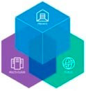






















SECURITY AND COMPLIANCE CENTER WORKLOAD PROTECTION
SECURITY GROUP FOR VPC
SINGLE-NODE TRIAL FOR DATA PROTECTION AND DISASTER RECOVERY
SINGLE-NODE TRIAL FOR MIGRATION AND APP MODERNIZATION
SPECTRUM PROTECT PLUS
SPEECH TO TEXT
SSH KEY FOR VPC
SSL CERTIFICATES
STANDARD LIVE PAYMENT HSM SERVICE
STAR VIRTUAL LEARNING PLATFORM (VLP)
STORAGE CEPH AS A SERVICE
STREAMING ANALYTICS
SUBNET
TAPESTRYX
TECHD PROFESSIONAL SERVICES
TEXT TO SPEECH
TOOLCHAIN
TRADESCREEN
TRANSIT GATEWAY
VCF AS A SERVICE - CLOUD DIRECTOR SITE
VCF AS A SERVICE - USAGE METER
VCF AS A SERVICE - VIRTUAL DATA CENTER
VEEAM
VERIFY
VIRTUAL NETWORK INTERFACE
VIRTUAL PRIVATE CLOUD
VIRTUAL PRIVATE ENDPOINT FOR VPC
VIRTUAL ROUTER APPLIANCE
VIRTUAL SERVER FOR CLASSIC
VIRTUAL SERVER FOR VPC
VLAN
VMWARE CLOUD MIGRATION SERVICES
VMWARE SOLUTIONS
VMWARE VCENTER SERVER
VMWARE VSPHERE
VPC COAAS (VPC COST OPTIMIZATION AS A SERVICE)

Slide 9














VPC+ CLOUD MIGRATION
VPC+ DRAAS (VPC+ DISASTER RECOVERY AS A SERVICE)
VPN FOR VPC
VREALIZE OPERATIONS AND LOG INSIGHT
WATSON DISCOVERY
WATSONX
WATSONX ASSISTANT
WATSONX BI
WATSONX CODE ASSISTANT
WATSONX ORCHESTRATE
WATSONX.AI RUNTIME
WATSONX.AI STUDIO
WATSONX.DATA
WATSONX.DATA INTEGRATION
WATSONX.DATA INTELLIGENCE
WATSONX.GOVERNANCE
WEALTHGROWTH.AI
ZERTO

Slide 10




































KUBERNETES
DOCKER
NGINX
MYSQL
GIT
SPRING BOOT
CLOUD FOUNDRY
PHP
API
APP UI
ACCESS CONTROLL LIST
ACCOUNT MANAGEMENT
ALERT NOTIFICATION
APPLICATION SERVER
AUTO SCALING
BACKEND SERVER
BANK SERVICES
BOT
BREAK CIRCUIT
BROKERAGE
CLOUD SHELL
COMPOSER PLAYGROUND
COMPOSER REST SERVER
CONFIGURE
CONVERBELT
CUSTOMER DATABASE
DEVELOPER PORTAL
DISCOVERY COLLECTION
DISTRIBUTION CENTER
EMAIL
EXAMPLE DATA SET
EXTERNAL SERVICE
FILE
FINANCIAL RISK MANAGEMENT
GENERATE
HYPERLEDGER

Slide 11



























IBM CLOUD
IBM DATA SCIENCE EXPERIENCE
IBM DATAPOWER
IBM Z
IDE
INSTALL
INVENTORY
IVESTMENT PORTFOLIO
LIST
LOAD BALANCING
LOCAL NETWORK
MARKET DATA
MEDIA
MICROPHONE
ONLINE NEWS CONTENT
OUTBOUND CALLS
OUTLET
PREDICTIVE MARKET SCENARIO
RECOMMENDATION SERVICE
SENSOR
SERVICE PROVIDER
SERVICE
STORE SALES
STORE
VIEW LOGS
VIRTUAL REALITY
ZOS

Slide 12







ANALYTICS
ANALYTICS
DATA INTEGRATION
DATA REPOSITORIES
DECISION MANAGEMENT
DEVICE ANALYTICS
MACHINE LEARNING
STREAMING COMPUTING

Slide 13




















APPLICATIONS
API DEVELOPER PORTAL
API POLYGLOT RUNTIMES
ACTIONABLE INSIGHT
ANNOTATE
APP SERVER
APPLICATION LOGIC
AUTOMATION TOOLS
ENTERPRISE APPLICATIONS
IOT APPLICATION
INDEX
MICROSERVICE
MOBILE APP
ONTOLOGY
OPESOURCE TOOLS
RUNTIME SERVICES
SAA S APPLICATIONS
SERVICE BROKER
SPEECH TO TEXT
VISUAL RECOGNITION
VISUALIZATION

Slide 14
















DATA
CACHES
CONTENT
CONVERSATION
DAT SCIENCE
DATA LAKE
DATA MART
DATA SERVICES
DATA SOURCES
DEVICE REGISTRY
DEVIDE IDENTITY SERVICE
ENTERPRISE DATA
ENTERPRISE USER DIRECTORY
FILE REPOSITORY
GROUND TRUTH
MODEL
TMS DATA INTERFACE

Slide 15









DEV OPS
ARTIFACT MANAGEMENT
BUILD AND TEST
CODE EDITOR
COLLABORATIVE DEVELOPMENT
CONFIGURATION MANAGEMENT
CONTINUOUS DEPLOY
CONTINUOUS TESTING
DEVOPS
RELEASE MANAGEMENT

Slide 16










E COMMERCE
COMMERCE BUSINESS PROCESS
COMMERCE CUSTOMER CARE
COMMERCE DIGITAL EXPERIENCE
COMMERCE DISTRIBUTED ORDER
COMMERCE MARKETING
COMMERCE MERCHANDISING
COMMERCE PAYMENT
COMMERCE SUPPLY CHAIN MGMT
COMMERCE WAREHOUSE MGMT
COMMERCE E COMMERCE APPL

Slide 17





















INFRASTRUCTURE
CHANNELS
CLOUD MESSAGING
CONTAINER CATALOG
DIAGNOSTICS
EDGE SERVICES
ENTERPRISE MESSAGING
EVENT FEED
EXISTING ENTERPRISE SYSTEMS
INFRASTRUCTURE SERVICES
INTEGRATION
INTERSERVICE COMMUNICATION
LOAD BALANCING AND ROUTING
MOBILE BACKEND
MOBILE PROVIDER NETWORK
MONITORING AND LOGGING
PEER SERVICES
PROCESS
RUNTIME
SERVICE DISCOVERY AND CONFIGURATION
SERVICES
TRANSFORMATION AND CONNECTIVITY

Slide 18














MANAGEMENT
API MANAGEMENT
ALERT NOTIFICATION
CLUSTER MANAGEMENT
CONTENT MANAGEMENT
DATA SERVICES
DEVICE MANAGEMENT
IT SERVICE MANAGEMENT
INFORMATION GOVERNANCE
MANAGEMENT
MONITORING AND METRICS
PROCESS MANAGEMENT
PROVIDER CLOUD PORTAL SERVICE
PUSH NOTIFICATIONS
SERVICE MANAGEMENT TOOLS

Slide 19















SECURITY
API SECURITY
APPLICATION SECURITY 19
BLOCKCHAIN SECURITY SERVICES
DATA SECURITY
DEV OPS SECURITY 20
FIREWALL
GATEWAY
GOVERNANCE RISK AND COMPLIANCE
IDENTIRTY AND ACCESS MANAGEMENT
IDENTITY PROVIDER
INFRASTRUCTURE SECURITY
PHYSICAL SECURITY
SECURITY MONITORING AND INTELLIGENCE
SECURITY SERVICES
TRUSTED COMPUTING
VPN

Slide 20





SOCIAL
COMMUNITIES
FILE SYNC
LIVE COLLABORATION
MESSAGING
NETWORKING

Slide 21
USERS
BROWSER
DEVICE
INTEGRATED DIGITAL EXPERIENCES
PHYSICAL ENTITY
SENSOR
USER INTERFACE
USER

Slide 22





























VPC
BLOCK STORAGE
BRIDGE
CLASSIC TAG
DATACENTER
DIRECT LINK
ENTERPRISE
ENTERPRISE TAG
FLOATING IP
IBM CLOUD TAG
IMAGE
INSTANCE
INTERNET
INTERNET SERVICES
KEY
LB LISTENER ICON
LB POOL ICON
LOAD BALANCER
OBJECT STORAGE
PUBLIC GATEWAY
PUBLIC TAG
REGION TAG
ROUTER
RULES
SUBNET TAG
VPC TAG
VPN CONNECTION
VPN GATEWAY
VPN POLICY
ZONE TAG

