Slide 1
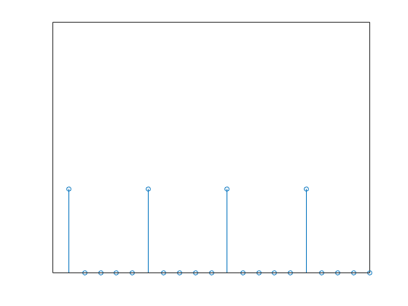
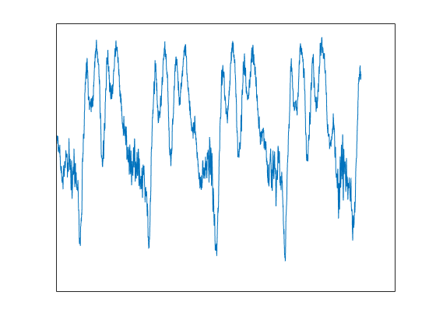
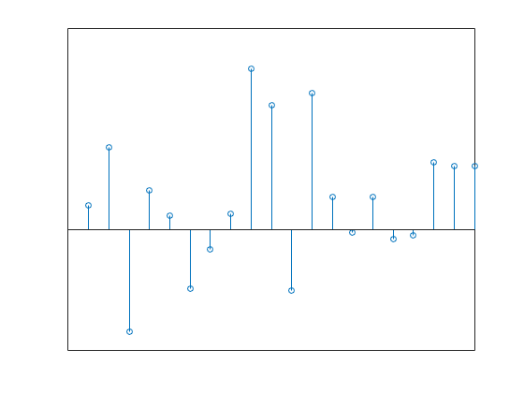
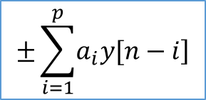

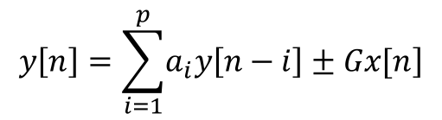
Linear Predictive Coding Model of Speech
Voiced/ unvoiced switch
Impulse train generator
$$Σ$$
Gain
Speech
White noise generator
$$±\sum_{i=1}^{p}{\left.a_{i}y[n−i\right]}$$
$$y\left[n\right]=\sum_{i=1}^{p}{\left.a_{i}y\left[n−i\right]±Gx[n\right]}$$

