Slide 1
Neural Network: Introduction
It was more than 2000 years ago, our ancestors had started to discover the architecture and behavior of human brain.
Ramon Y. Cajal and Hebb continued the work of Aristotle and tried to build the artificial "thinking machine".
Based on the information about the functions of the brain and the quest for obtaining a mathematical model for our learning habits, a new technology Artificial Neural Networks was started.

Slide 2
Neural Network: Introduction
Our brain can process information quickly and accurately. You can recognize your friend's voice in a noisy railway station. How is the brain able to process the voice signal added with the noise and retrieve the original signal?
Can we duplicate this amazing process through a machine? Can we make a machine to duplicate some learning habits of a human? Can a machine be made to learn from experience?
We will get answer during the study of Neural Network.

Slide 3
Neural Network: Definition
An artificial neural network is an information processing system that has been developed as a generalization of the mathematical model of human cognition (sense of knowing).
A neural network is a network of interconnected neurons, inspired from the studies of the biological nervous system. In other words, neural network functions in a way similar to the human brain.
The function of a neural network is to produce an output pattern when presented with an input pattern.

Slide 4
Neural Network: Definition
Neural network is the study of networks consisting of nodes connected by adaptable weights, which store experimental knowledge from task examples through a process of learning.
The nodes of the brain are adaptable; they acquire knowledge through changes in the node weights by being exposed to samples.

Slide 5
Neural Network: Biological Neural Net.
Neural network architectures are motivated by models of the human brain and nerve cells. Our current knowledge of human brain is limited to its anatomical and physiological information.
Neuron (from Greek, meaning nerve cell) is the fundamental unit of the brain. The neuron is a complex biochemical and electrical signal processing unit that receives and combines signals from many other neurons through filamentary input paths, the dendrites (Greek: tree links).

Slide 6
Neural Network: Biological Neural Net.
A biological neuron has three types of components namely dendrites, soma and axon. Dendrites are bunched into highly complex "dendritic trees", which have an enormous total surface area. The dendrites receive signals from other neurons.
Dendritic trees are connected with the main body of the neuron called the soma (Greek: body).

Slide 7
Neural Network: Biological Neural Net.
The soma has a pyramidal or cylindrical shape. The soma sums the incoming signals. When sufficient input is received, the cell fires.
The output area of the neuron is a long fiber called axon. The impulse signal triggered by the cell is transmitted over the axon to other cells.

Slide 8
Neural Network: Biological Neural Net.
The connecting point between a neuron's axon and another neuron’s dendrite is called a synapse (Greek: contact). The impulse signals are then transmitted across a synaptic gap by means of a chemical process.
A single neuron may have 1000 to 10000 synapses and may be connected with around 1000 neurons. There are 100 billion neurons in our brain, and each neuron has 1000 dendrites.

Slide 9
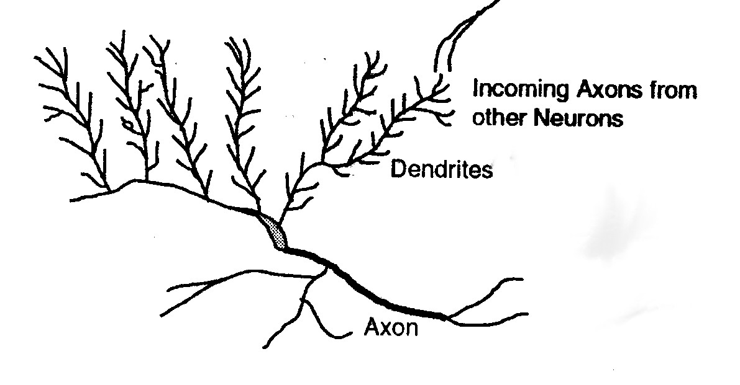
Neural Network: Biological Neural Net.

Slide 10
Neural Network: Artificial Neuron
The artificial neuron (also called processing element or node) mimes the characteristics of the biological neuron. A processing element possesses a local memory and carries out localized information processing operations.
The artificial neuron has a set of ‘n’ inputs x_{i}, each representing the output of another neuron.
The subscript i in x_{i} takes values between i and n and indicates the source of the vector input signal.

Slide 11
Neural Network: Artificial Neuron
The inputs are collectively refered to as X.
Each input is weighed before it reaches the main body of the processing element by the connection strength or the weight factor (or simply weight) analogous to the synaptic strength.
The amount of information about the input that is required to solve a problem is stored in the form of weights. Each signal is multiplied with an associated weight w₁, w₂, w₃,...,w_{n} before it is applied to the summing block.

Slide 12
Neural Network: Artificial Neuron
In addition, the artificial neuron has a bias term w₀, a threshold value ‘θ ‘ that has to be reached or extended for the neuron to produce a signal, a nonlinear function 'F' that acts on the produced signal 'net' and an output 'y' after the nonlinearity function.

Slide 13
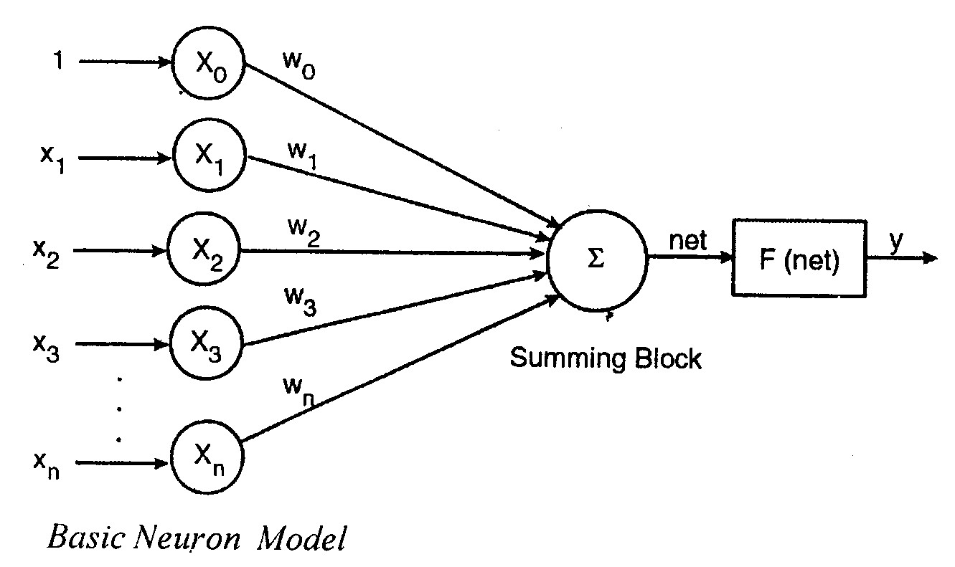
Neural Network: Artificial Neuron

Slide 14
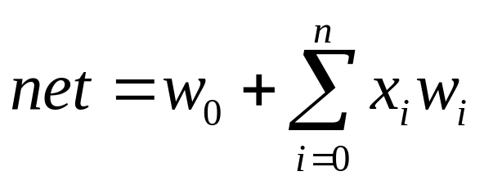
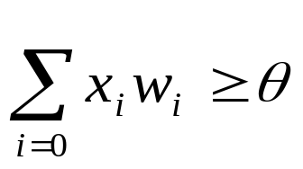

Neural Network: Artificial Neuron
The following relation describes the transfer function of the basic neuron model.
y = F (net)
Where
net = w₀ + x₁w₁ + x₂w₂ + x₃w₃ +...... + x_{n}w_{n}
or
and the neuron firing condition is:
[for linear activation function], x₀=1
or
[for nonlinear activation function]

Slide 15
Neural Network: Classification
Artificial neural networks can be classified on the basis of
1. Pattern of connection between neurons, (architecture of the network)
2. Activation function applied to the neurons
3. Method of determining weights on the connection (training method)

Slide 16
Neural Network: ARCHITECTURE
The neurons are assumed to be arranged in layers, and the neurons in the same layer behave in the same manner.
All the neurons in a layer usually have the same activation function. Within each layer, the neurons are either fully interconnected or not connected at all.
The neurons in one layer can be connected to neurons in another layer.
The arrangement of neurons into layers and the connection pattern within and between layers is known as network architecture.

Slide 17
Neural Network: ARCHITECTURE
lnput layer:
The neurons in this layer receive the external input signals and perform no computation, but simply transfer the input signals to the neurons in another layer.
Output layer:
The neurons in this layer receive signals from neurons either input layer or in the hidden layer.
Hidden layer:
The layer of neurons that are connected in between the input layer and the output layer is known as hidden layer.

Slide 18
Neural Network: ARCHITECTURE
Neural nets are often classified as single layer networks or multilayer networks.
The number of layers in a net can be defined as the number of layers of weighted interconnection links between various layers.
While determining the number of layers, the input layer is not counted as a layer, because it does not perform any computation.
The architecture of a single layer and a multilayer neural network is shown in the following figures.

Slide 19
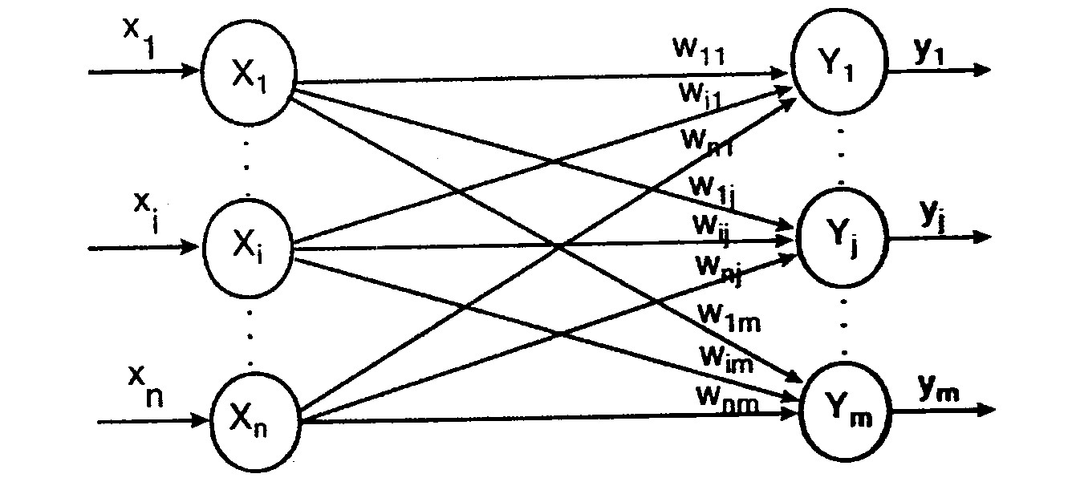
Neural Network: ARCHITECTURE
Single Layer Network
A single layer network consists of one layer of connection weights. The net consists of a layer of units called input layer, which receive signals from the outside world and a layer of units called output layer from which the response of the net can be obtained.
This type of network can be used for pattern classification problems

Slide 20
Neural Network: ARCHITECTURE
Multilayer Network:
A multilayer network consists of one or more layers of units (called hidden layers) between the input and output layers. Multilayer networks may be formed by simply cascading a group of layers; the output of one layer provides the input to the subsequent layer.
A multilayer net with nonlinear activation function can solve any type of problem.
However training a multilayer neural network is very difficult.

Slide 21
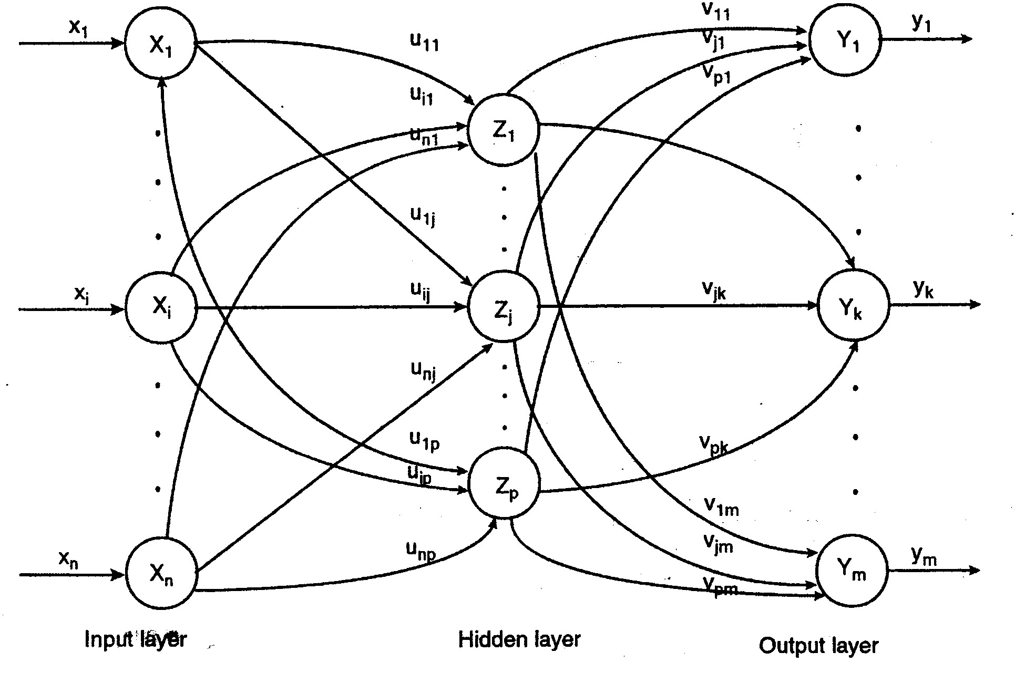
Neural Network: ARCHITECTURE
Multilayer Network:

Slide 22
Neural Network: ACTIVATION FUNCTIONS
The purpose of nonlinear activation function is to ensure that the neuron's response is bounded - that is, the actual response of the neuron is conditioned or damped, as a result of large or small activating stimuli and thus controllable.
Further, in order to achieve the advantages of multilayer nets compared with the limited capabilities of single layer networks, nonlinear functions are required.
Different nonlinear functions are used, depending upon the paradigm and the algorithm used for training the network.

Slide 23
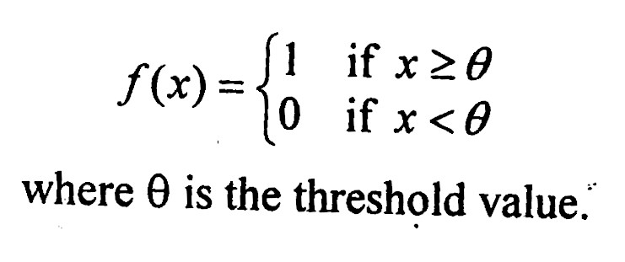
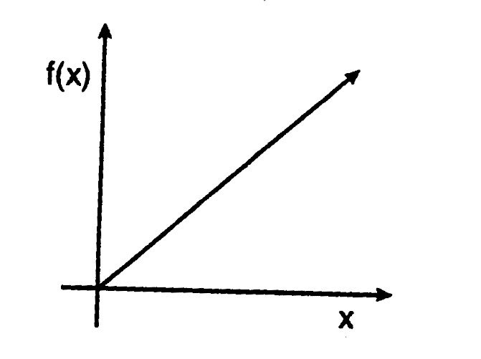
Neural Network: ACTIVATION FUNCTIONS
The various activation functions are:
Identity function (Linear function):
Identity function can be expressed:
f(x) = x for all x.
Binary step function: Binary step function is defined as:

Slide 24
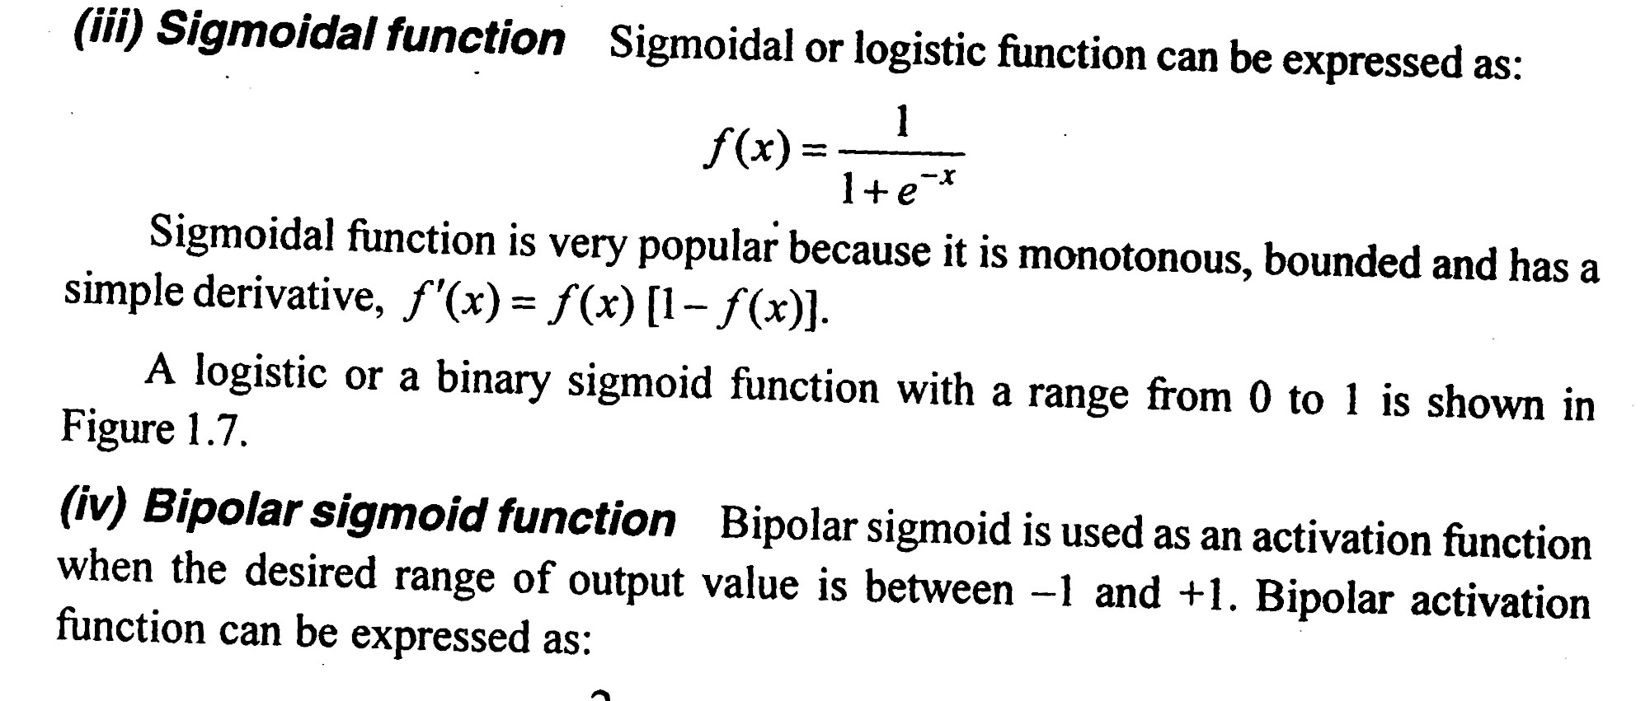
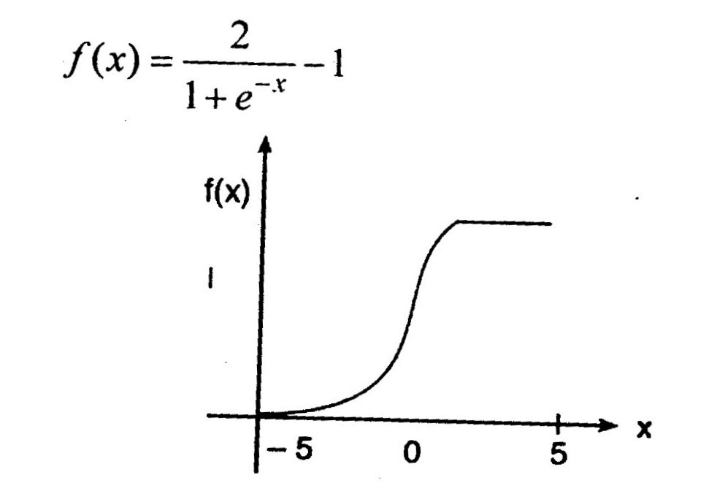
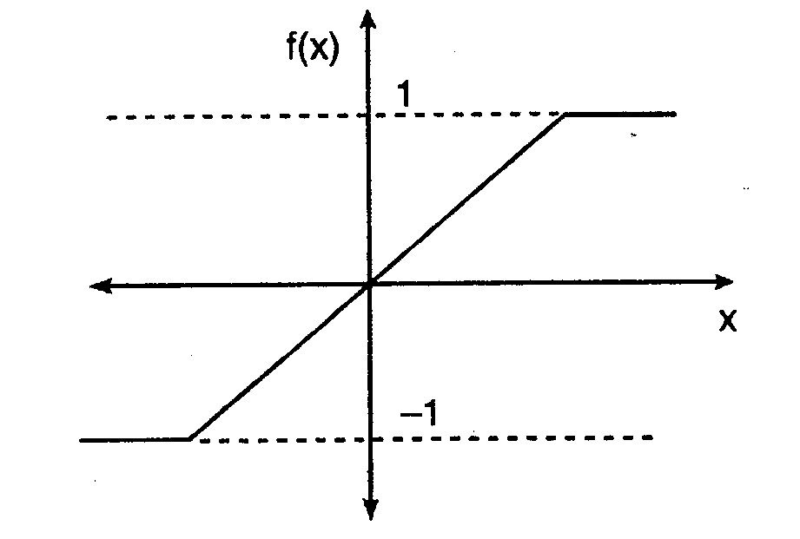
Neural Network: ACTIVATION FUNCTIONS

Slide 25
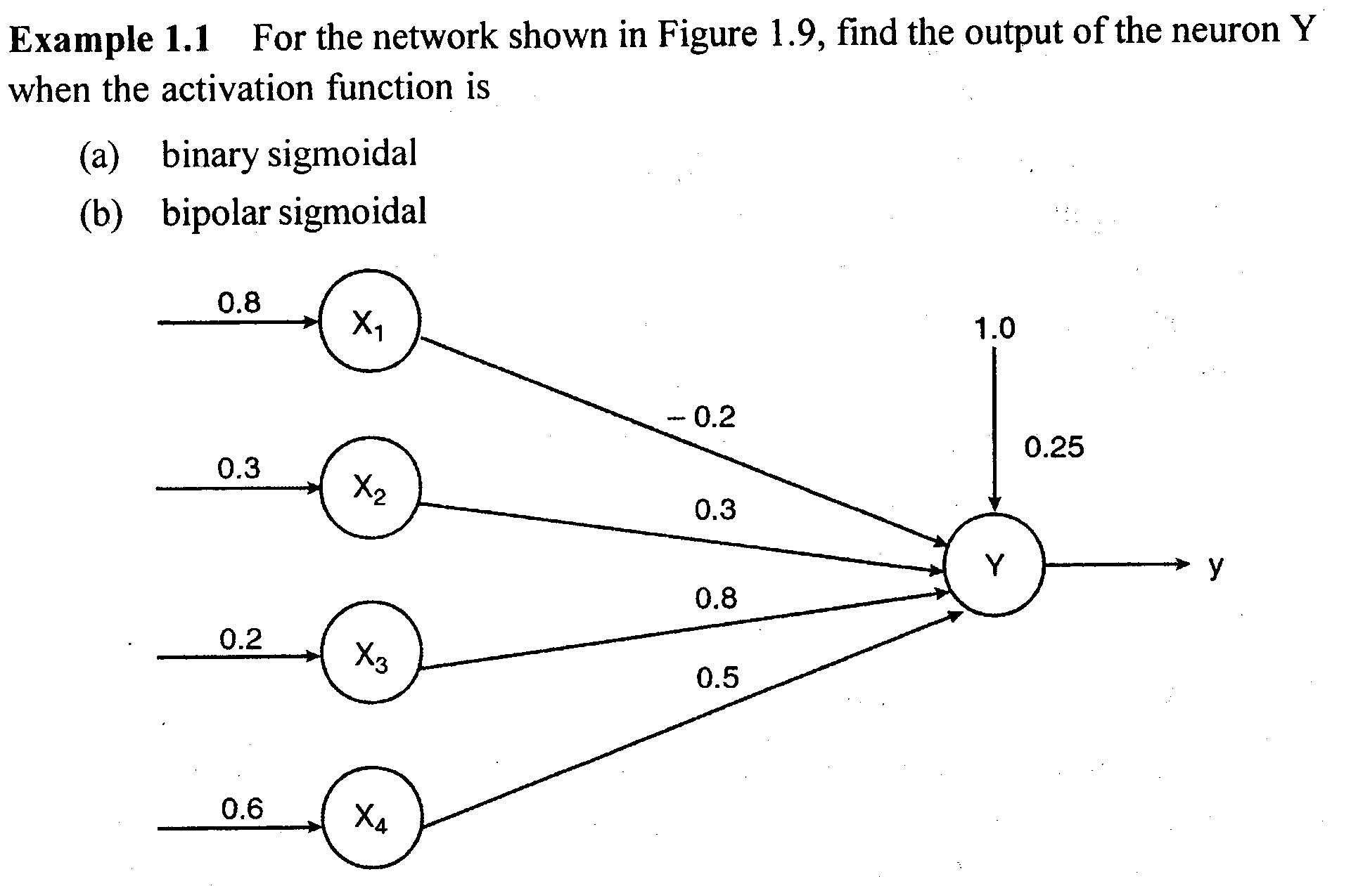
Neural Network: ACTIVATION FUNCTIONS

Slide 26
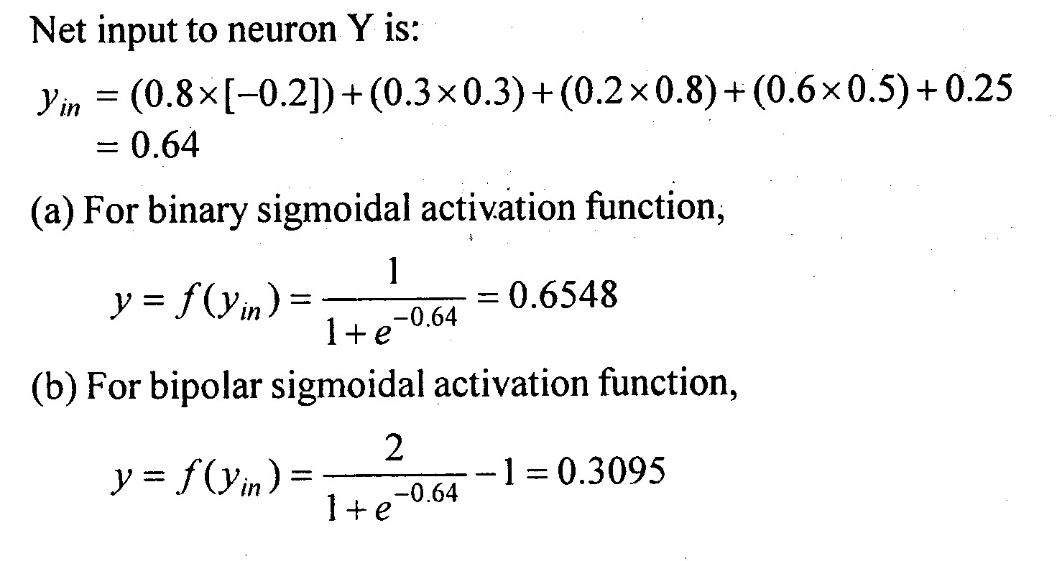
Neural Network: ACTIVATION FUNCTIONS

