Slide 1
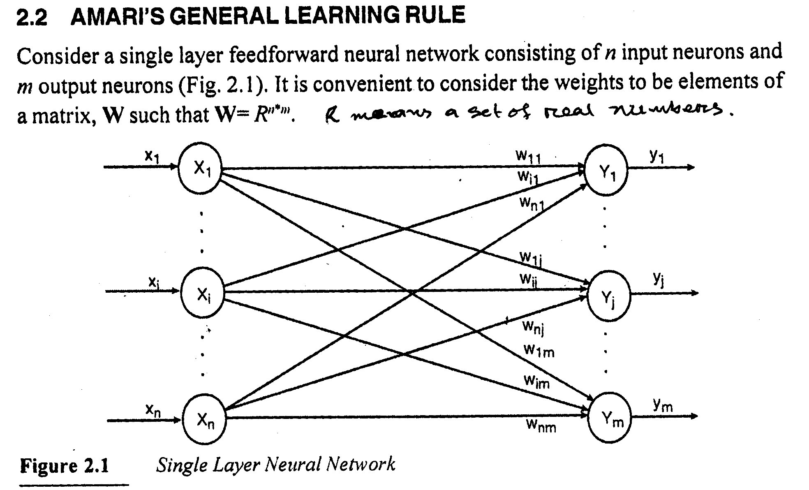
HEBB Net, ADALINE, MADALINE AND PERCEPTRON

Slide 2
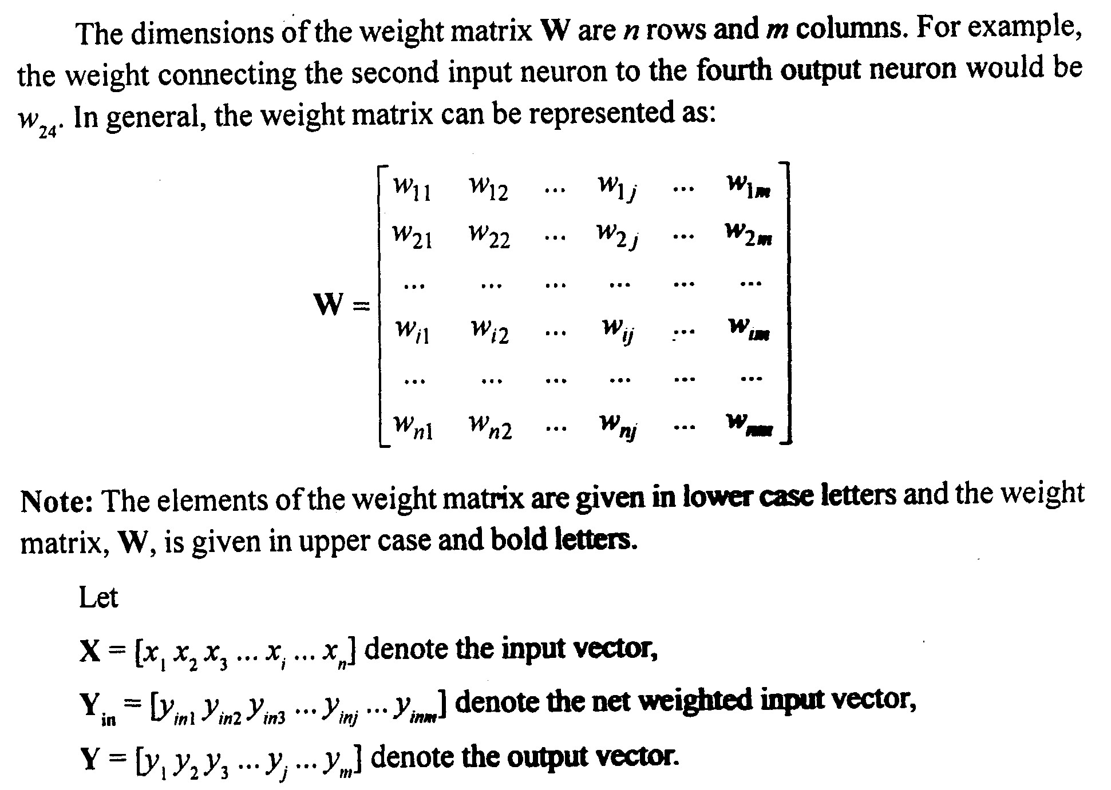
AMARI’S GENERAL LEARNING RULE

Slide 3
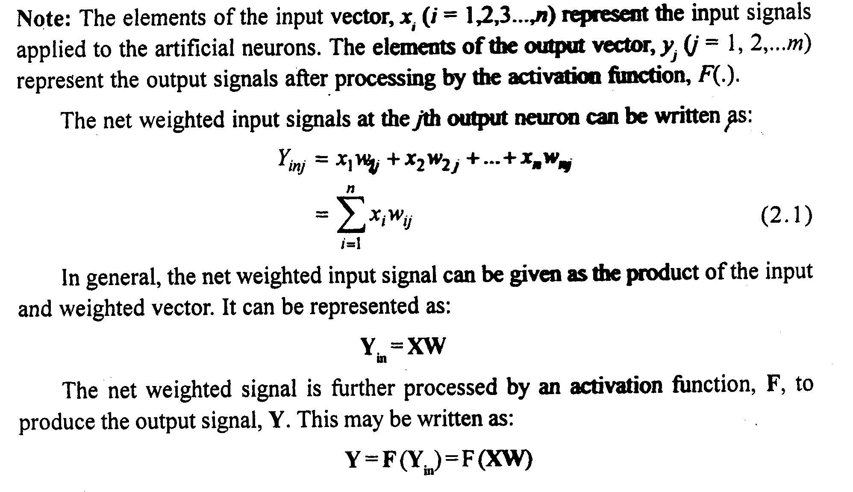
AMARI’S GENERAL LEARNING RULE

Slide 4
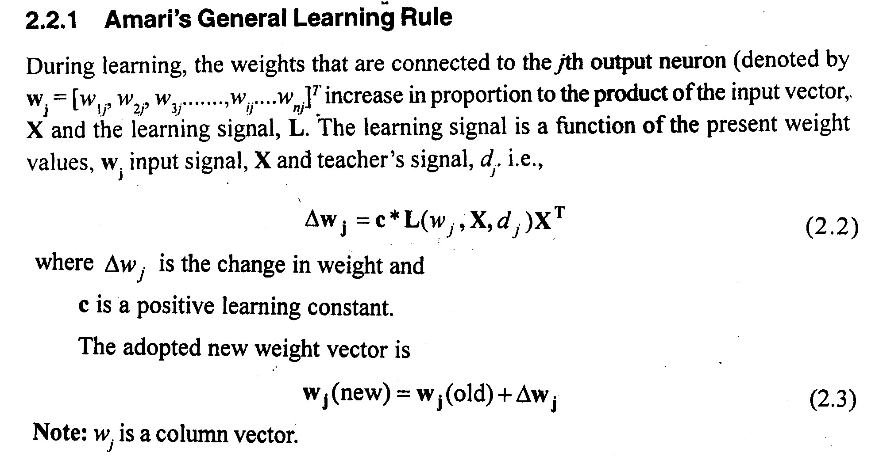
AMARI’S GENERAL LEARNING RULE

Slide 5
HEBB LEARNING RULE
In the brain, learning is particularly done by the change in the synaptic gap (strength).
The first person to comment upon this was the psychologist Donald Hebb in 1949.
Hebb's original statement was:
"When an axon of cell A is near enough to excite a cell B and repeatedly or persistently takes place in firing it, some growth process or metabolic change takes place in one or both cells such that A’s efficiency, as one of the cells firing B, is increased."

Slide 6
HEBB LEARNING RULE
To put it in a more accurate manner, Hebb's hypothesis may be stated as:
"Increase the value of weight if the output is active when the input associated with that weight is also active.“
If we assume the input x and the output y have binary values, the weight value will be incremented only when the output is 1 and the corresponding input is 1.

Slide 7
HEBB LEARNING RULE
Stent [73] rephrased the Hebb's hypothesis as:
1. If two neurons on either side of a synapse (connection) are activated simultaneously, then the strength of that synapse is selectively increased.
2. If two neurons on either side of a synapse are activated asynchronously, then synapse is selectively weakened or eliminated.
For Hebbian rule, the weight vector increases proportional to the product of input and the learning signal, where the learning signal is equal to the neuron's output.

Slide 8
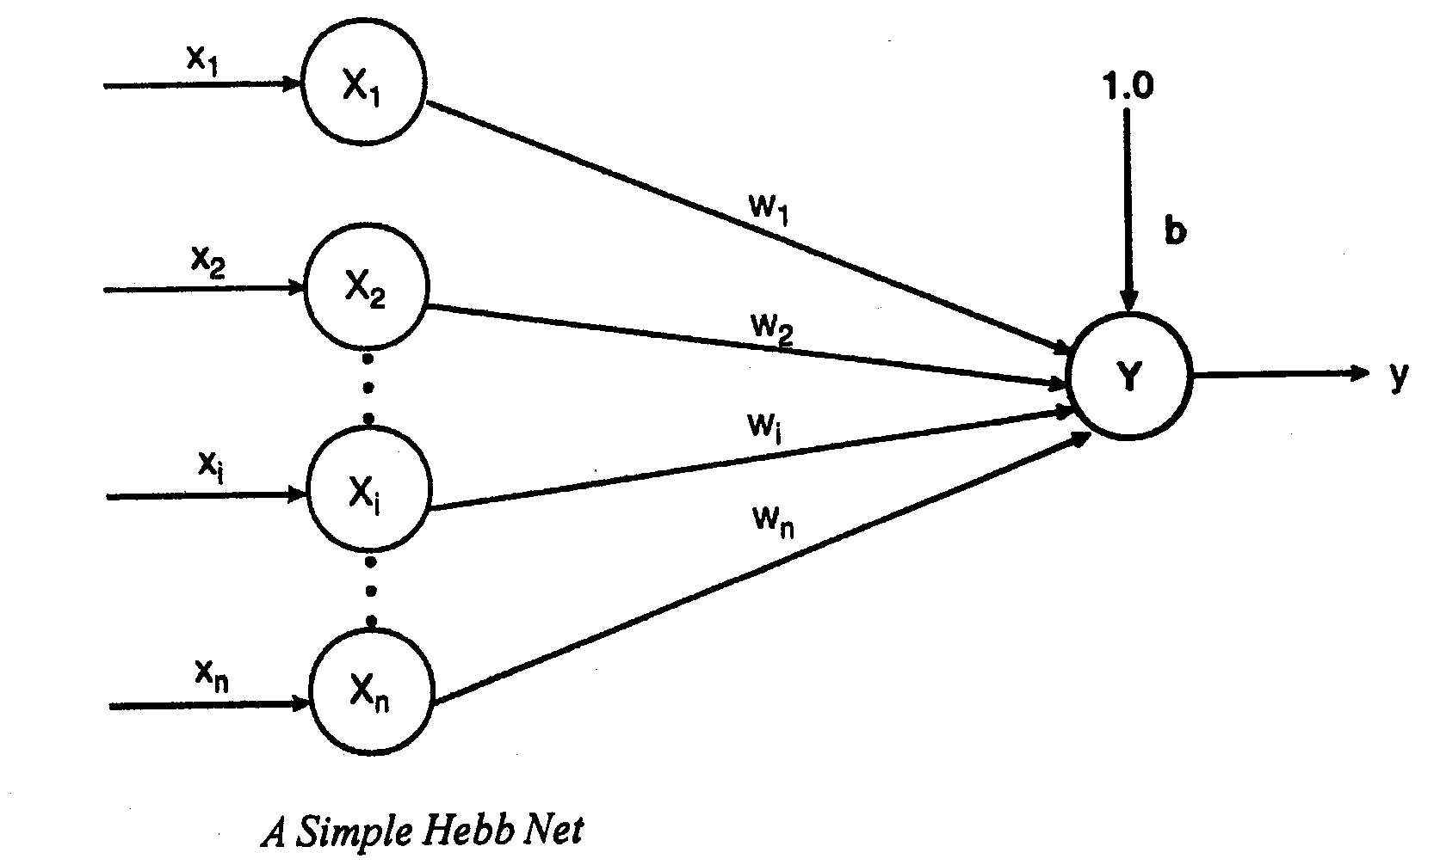
Hebb Net
Based on Hebbian Learning rule, McClelland and Rumelhart (1988) developed the Hebb net.
This net consists of a single layer feed forward neural network. This net has a fixed bias value of 1. The input and the output patterns must be of bipolar form.
The Hebb net does not learn if the input-output patterns are in binary form. This is the extreme limitation of Hebb net.

Slide 9
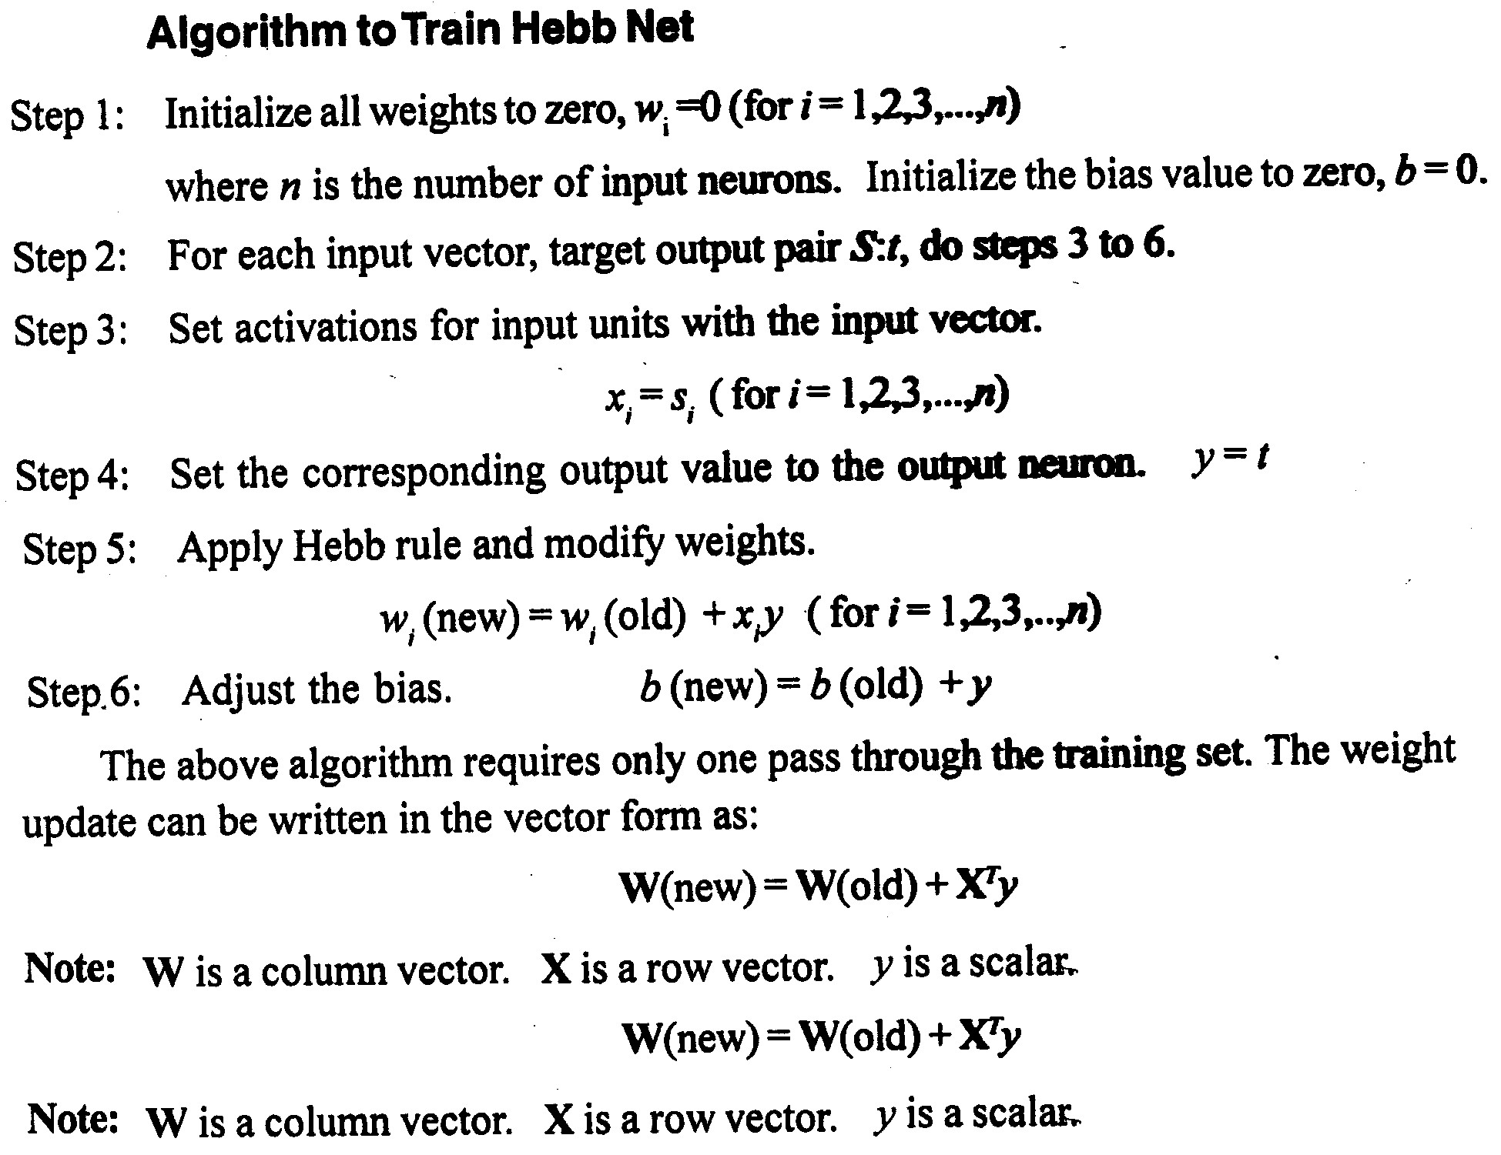
Hebb Net

Slide 10
Linear Separability
The intension of training a network is to find the weights that will respond correctly when the net is presented with a input pattern that is similar to one of the training pattern. The activation function of the output neuron is a step function.
Consider a sample neural net with n input neurons and one output neuron. If the response of the output neuron is 1 for an input pattern then the input pattern is a member of the class. If the response of the output is -1 then the input pattern does not belong to the class.

Slide 11
Linear Separability
The net input to the output neuron can be written as
Y_{m} = w₀ + ∑ x_{i}w_{i}
Using the above equation, the decision boundary between the region where y_{in}> 0 and yin< 0 can be determined. Depending on the number of input neurons in the network, this equation represents a line or a plane or a hyper plane.
If it is possible to find the weights so that all of the training input vectors for which the correct response is 1 lie on one side of the boundary and all of the training patterns for which the correct response is -1 lie on the either side , then the problem is linearly separable otherwise the problem is non separable.

Slide 12
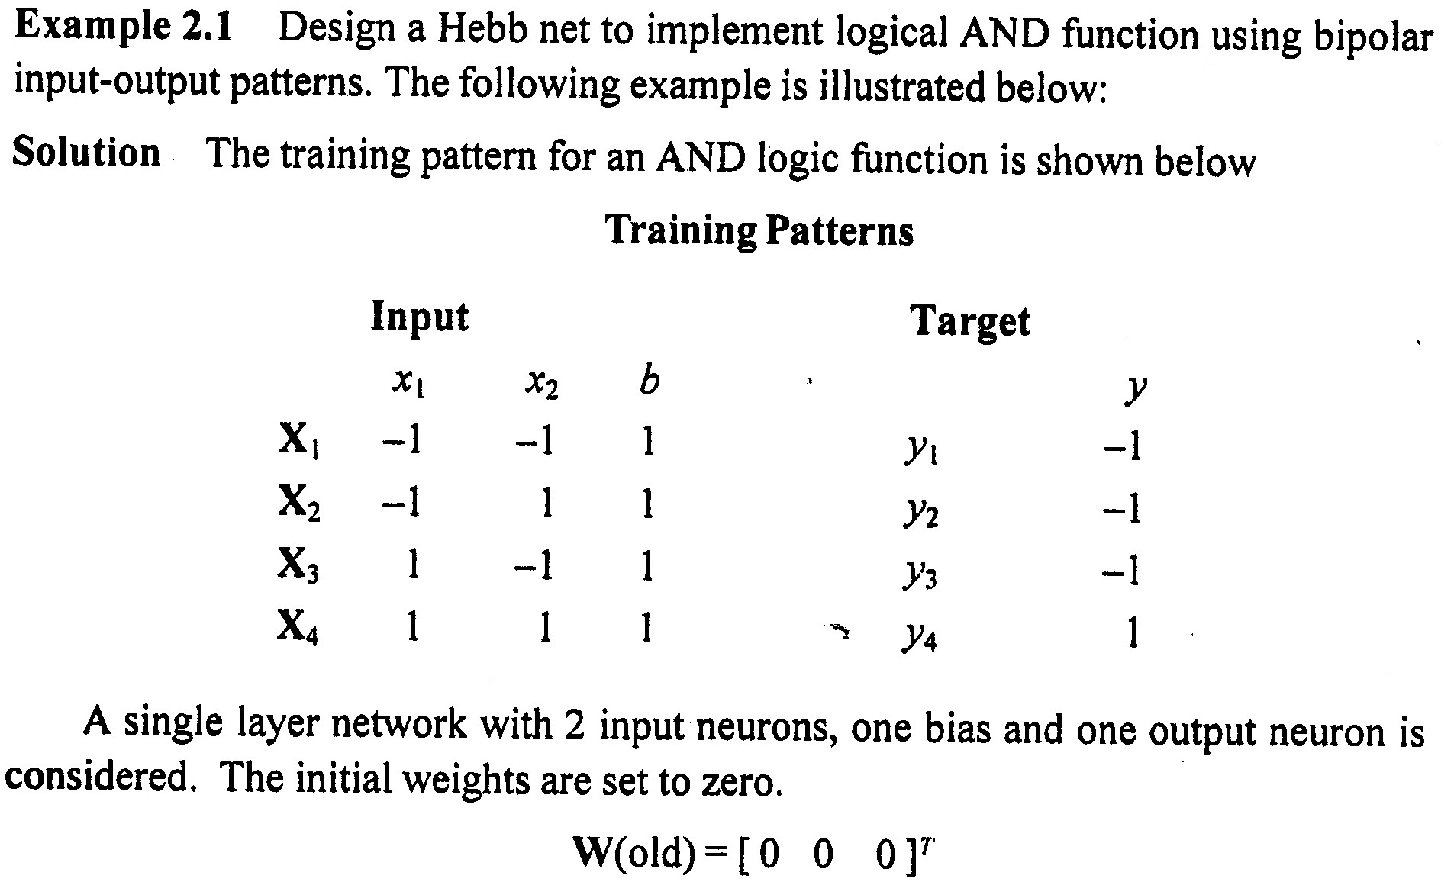
Example: AND get Implementation

Slide 13
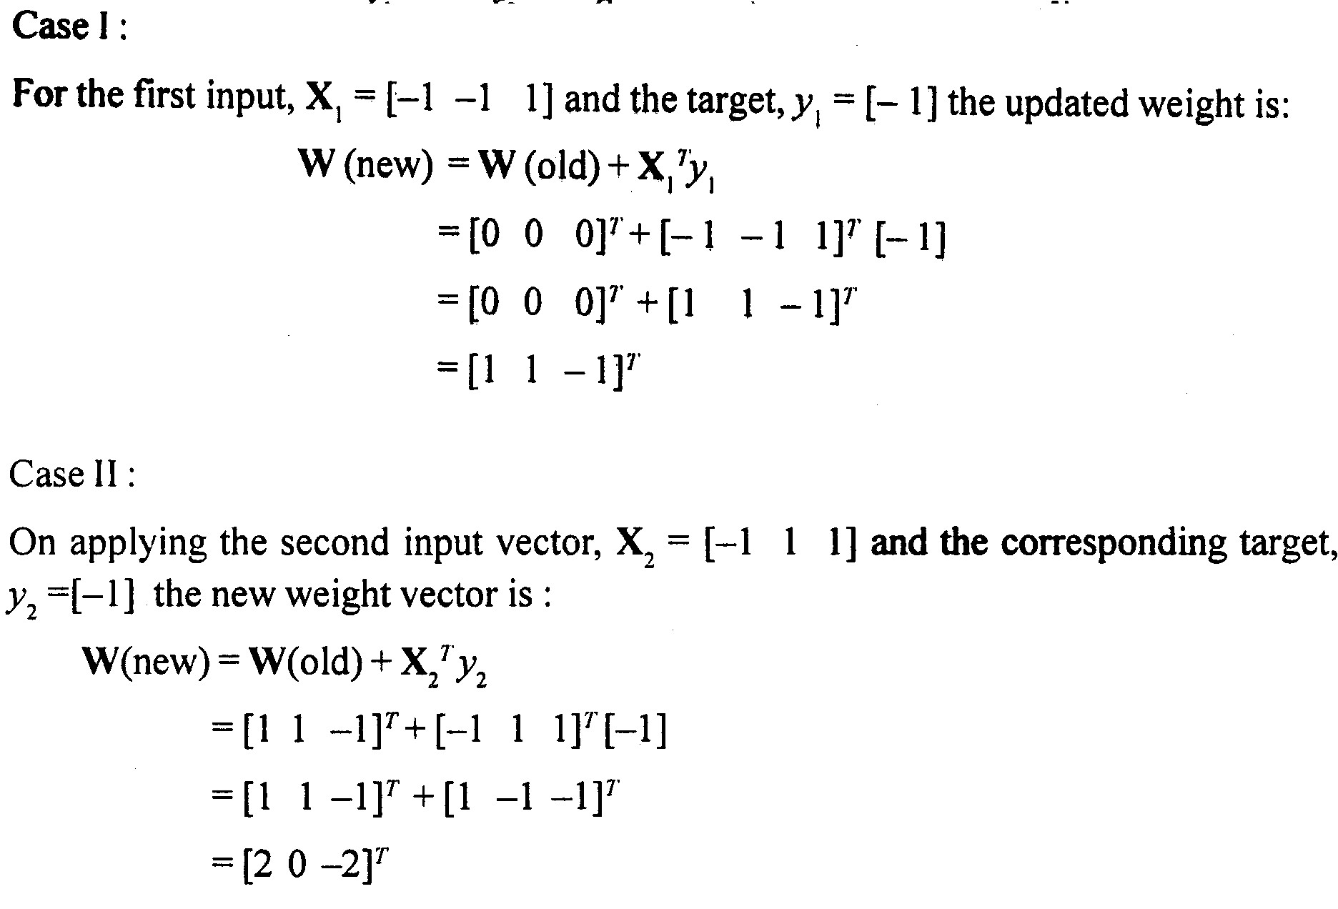
Example: AND get Implementation

Slide 14
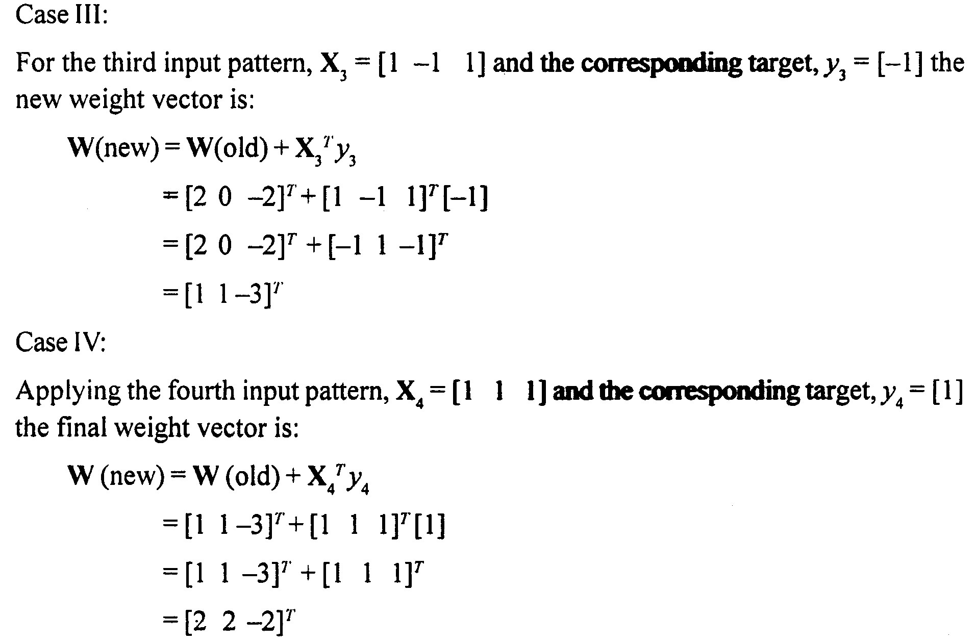
Example: AND get Implementation

Slide 15
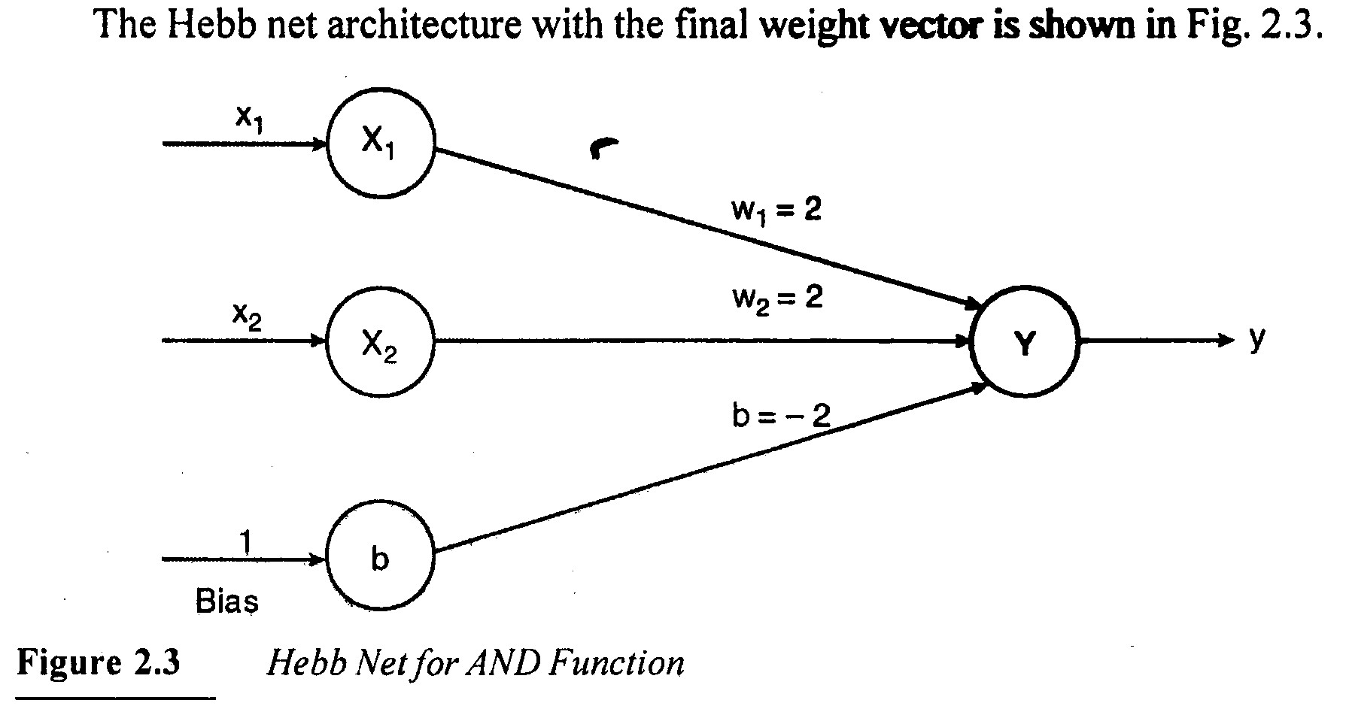
Example: AND get Implementation

Slide 16
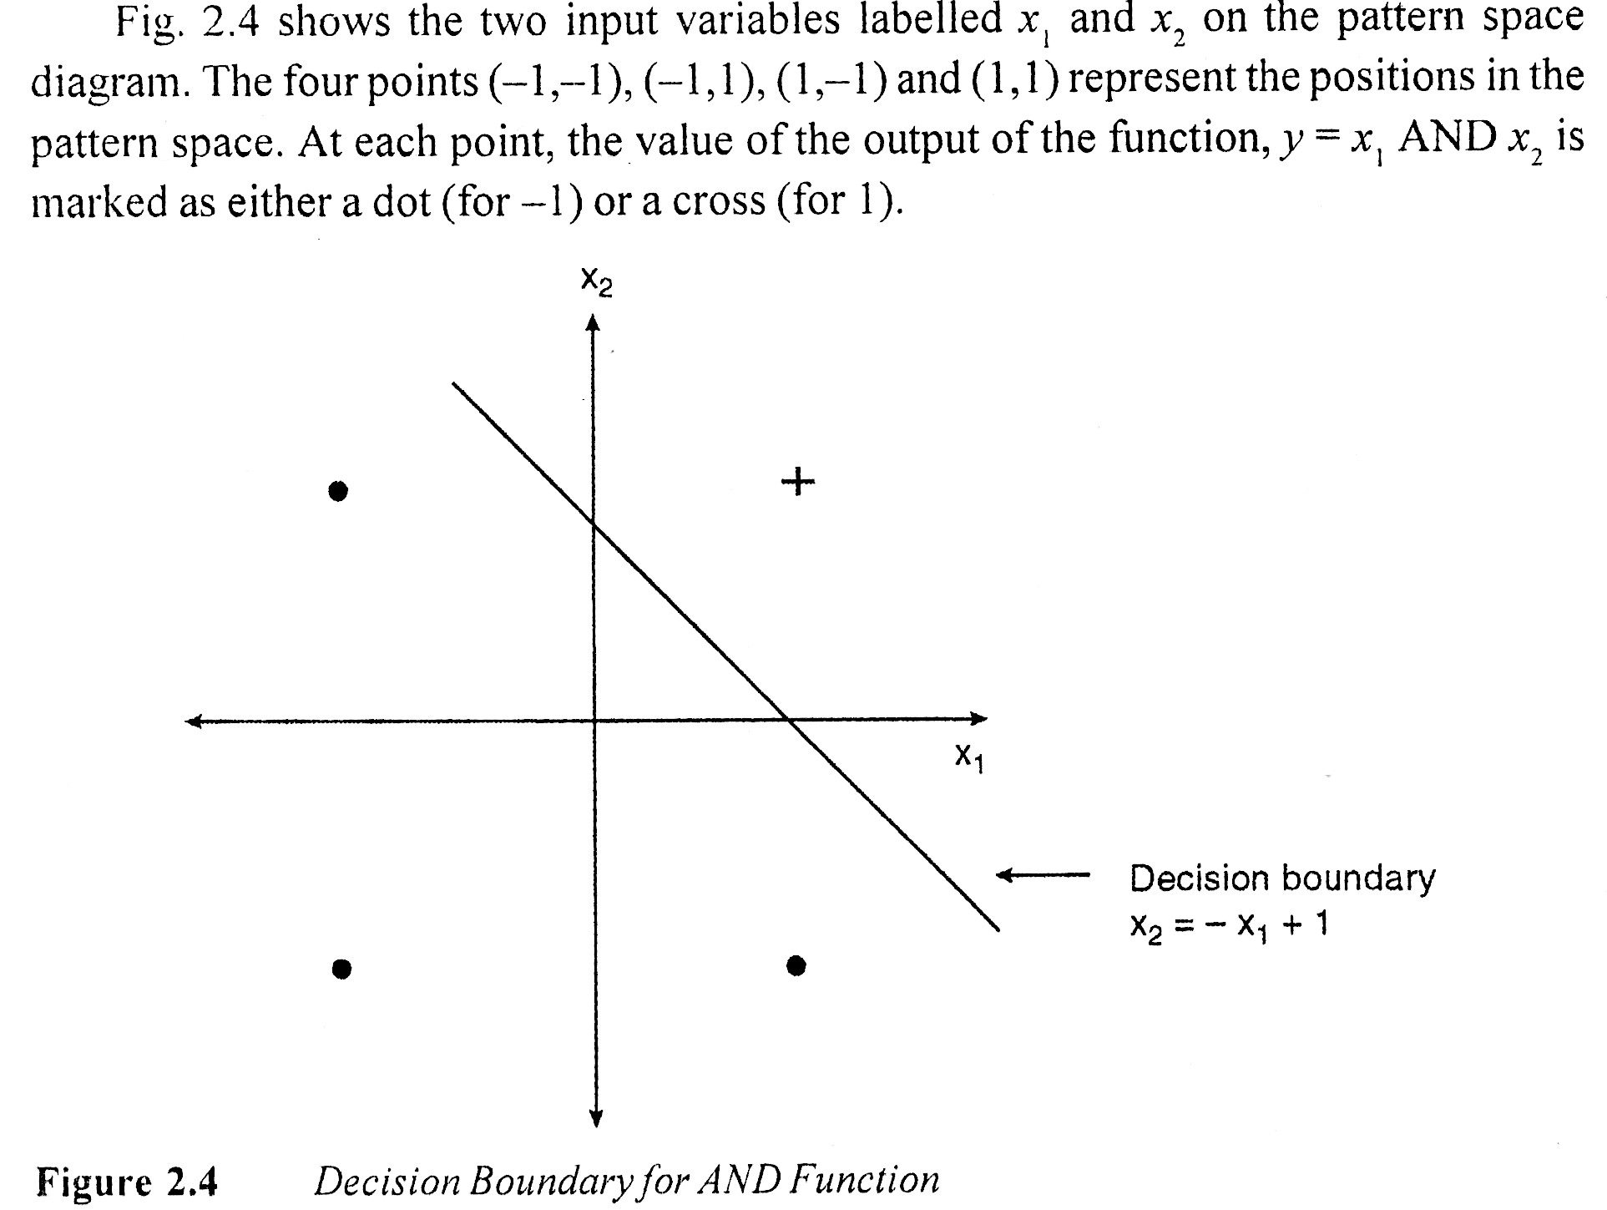
Example: AND get Implementation

Slide 17
Example: The T-C Problem
The objective of T-C problem is to distinguish the letters T and C. Below is the data representation for T and C by 3x3 matrix.
Empty cell’s is filled by -1 and is not shown here
1 | 1 | 1
 | 1
 | 1
1 | 1 | 1
1
1 | 1 | 1

Slide 18
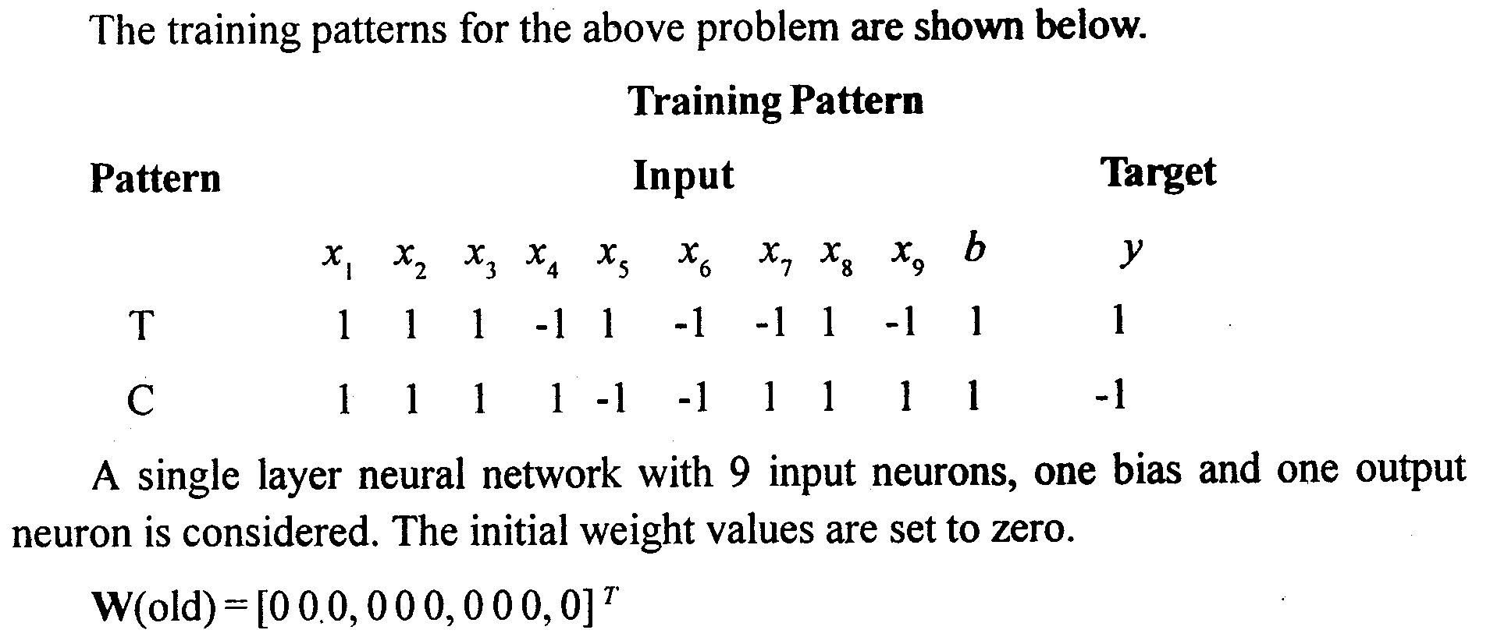
Example: The T-C Problem

Slide 19
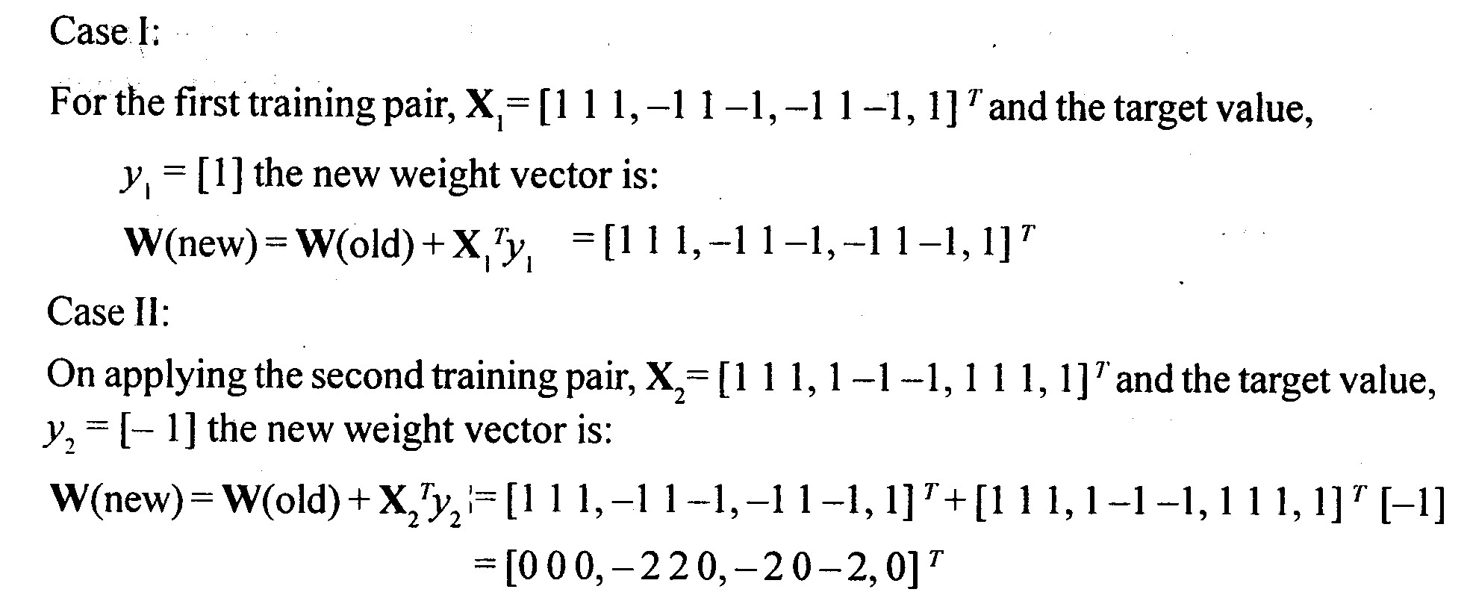
Example: The T-C Problem

Slide 20
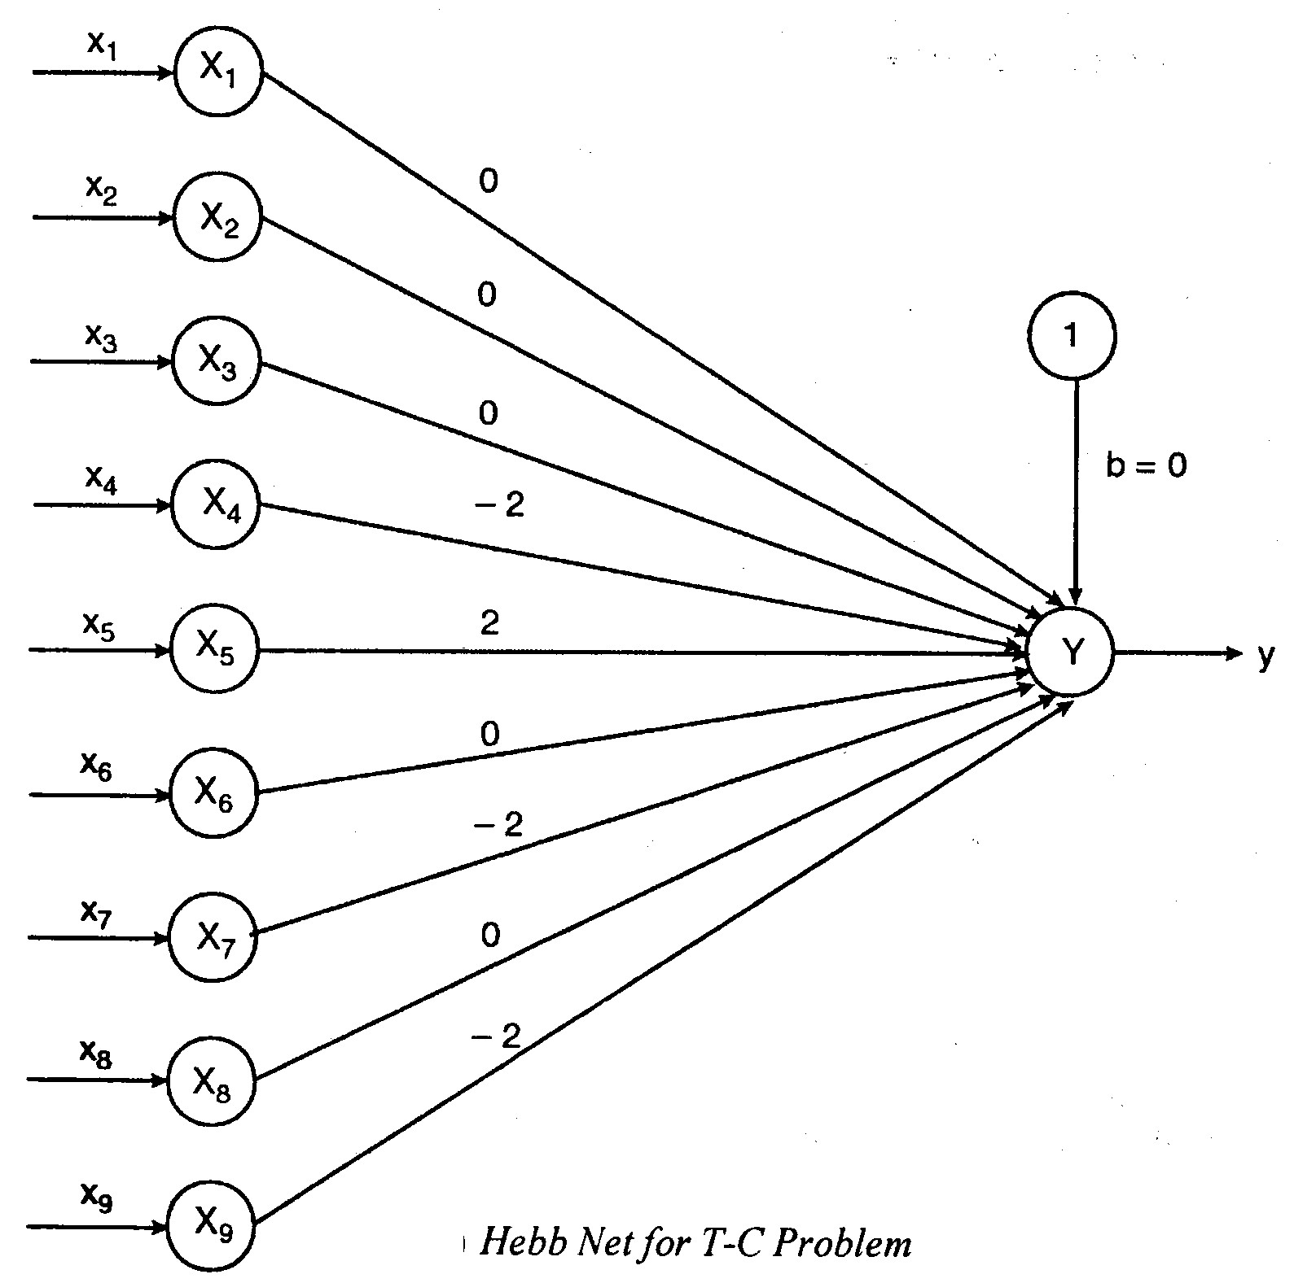
Example: The T-C Problem

