Slide 1


DELTA RULE
Delta rule is also called Widrow–Hoff rule or least mean squire (LMS) rule.
It is applicable for supervised training of NN.
Here the change in weight is directly proportional to error signal (t_{j}-y_{j}) and the input.

Slide 2
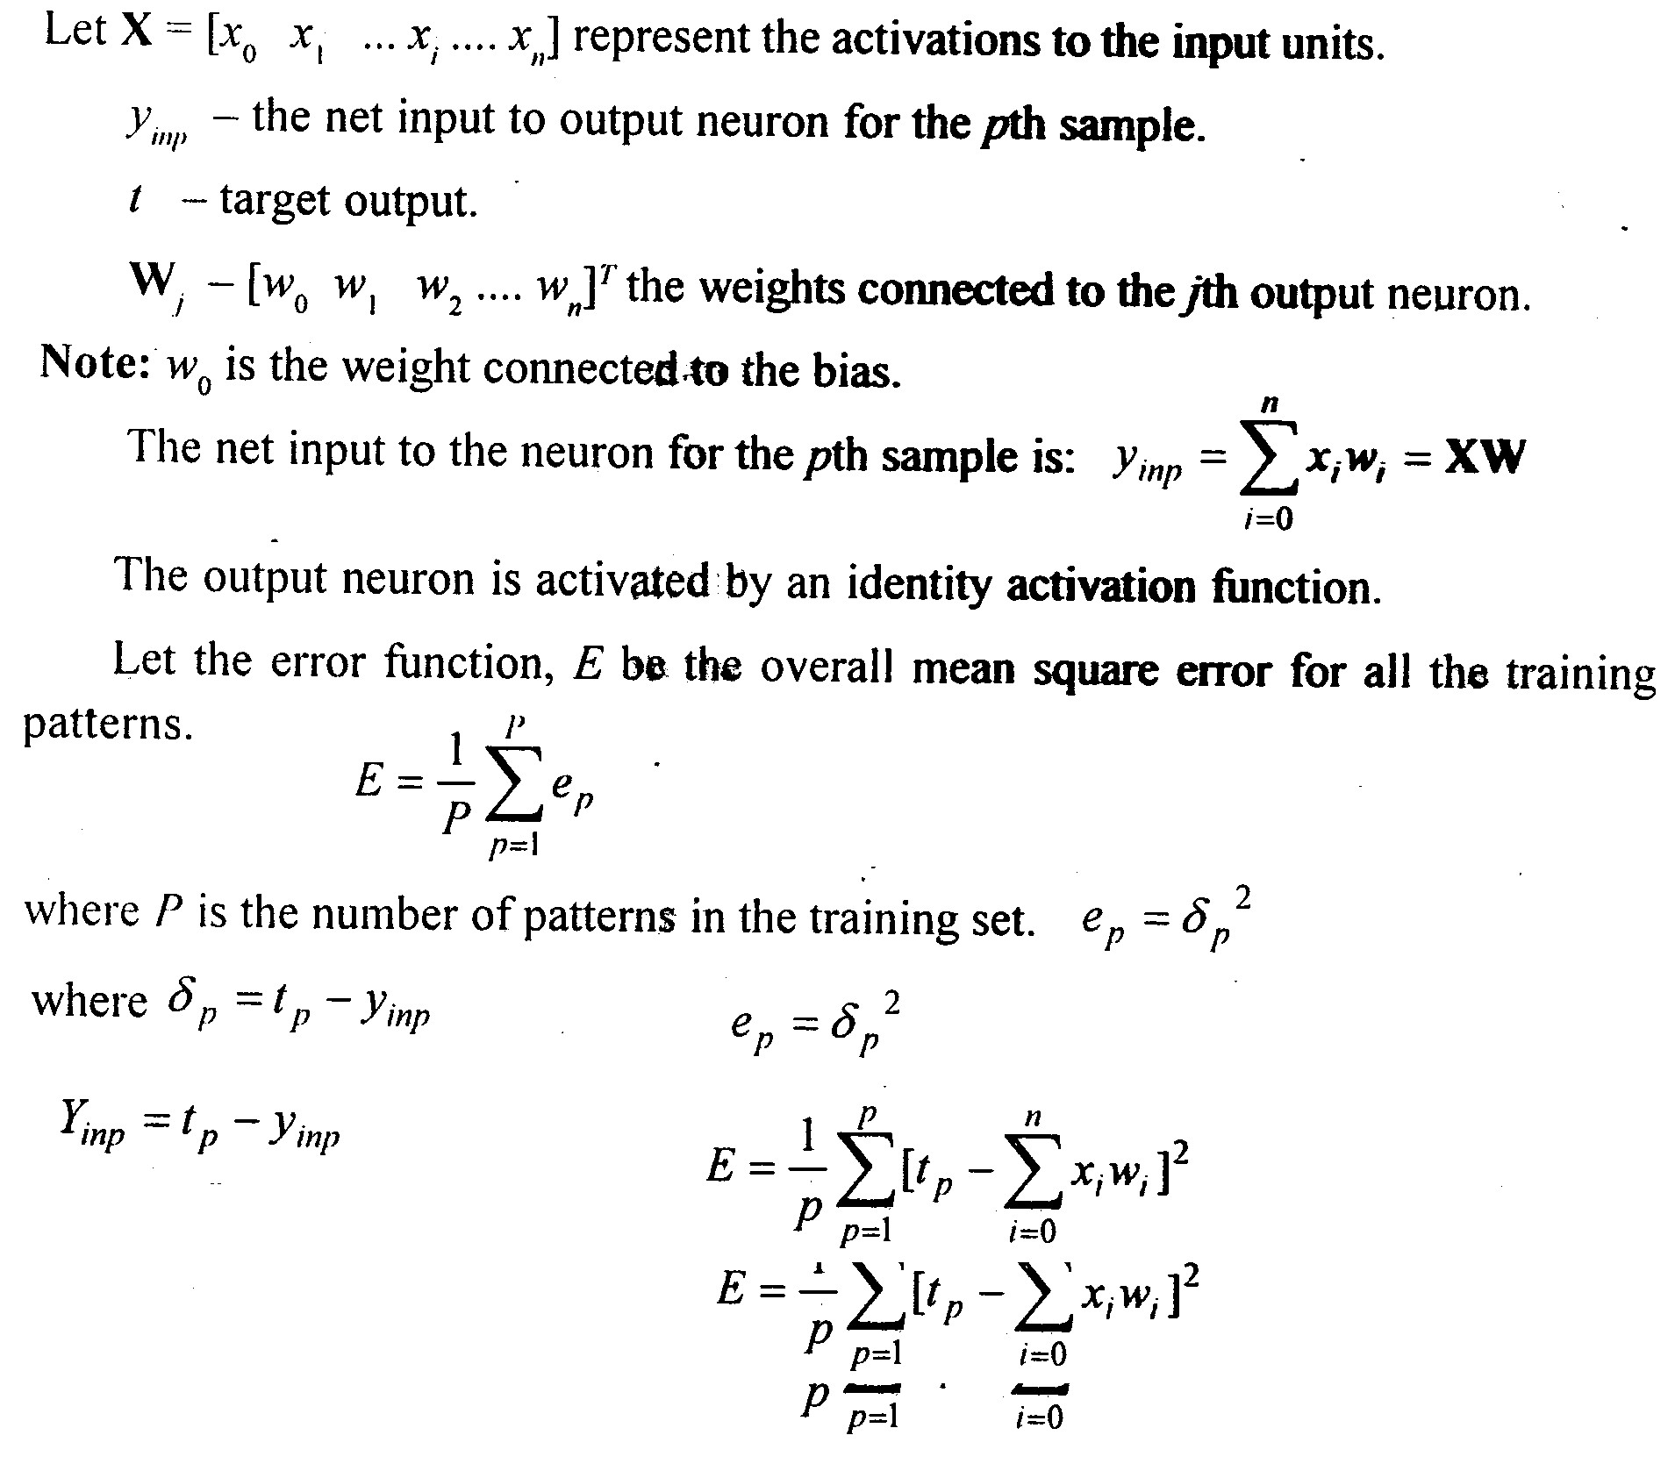
DELTA RULE

Slide 3
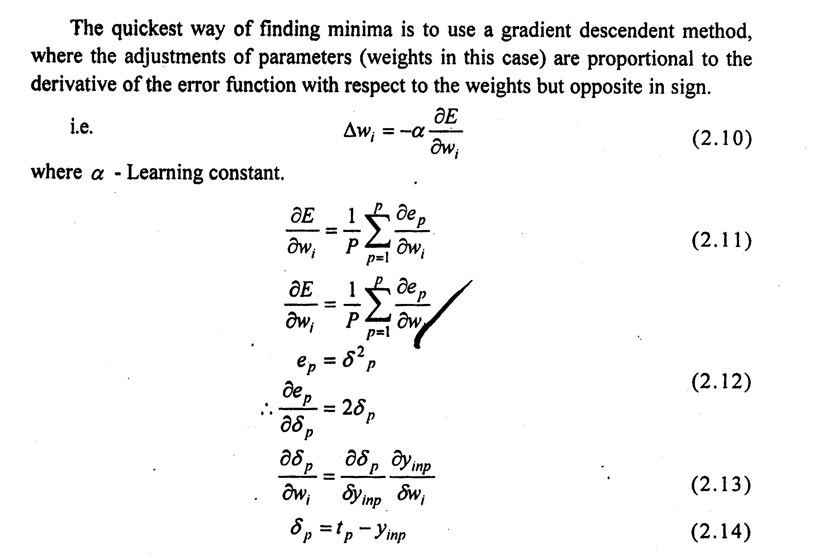
DELTA RULE

Slide 4
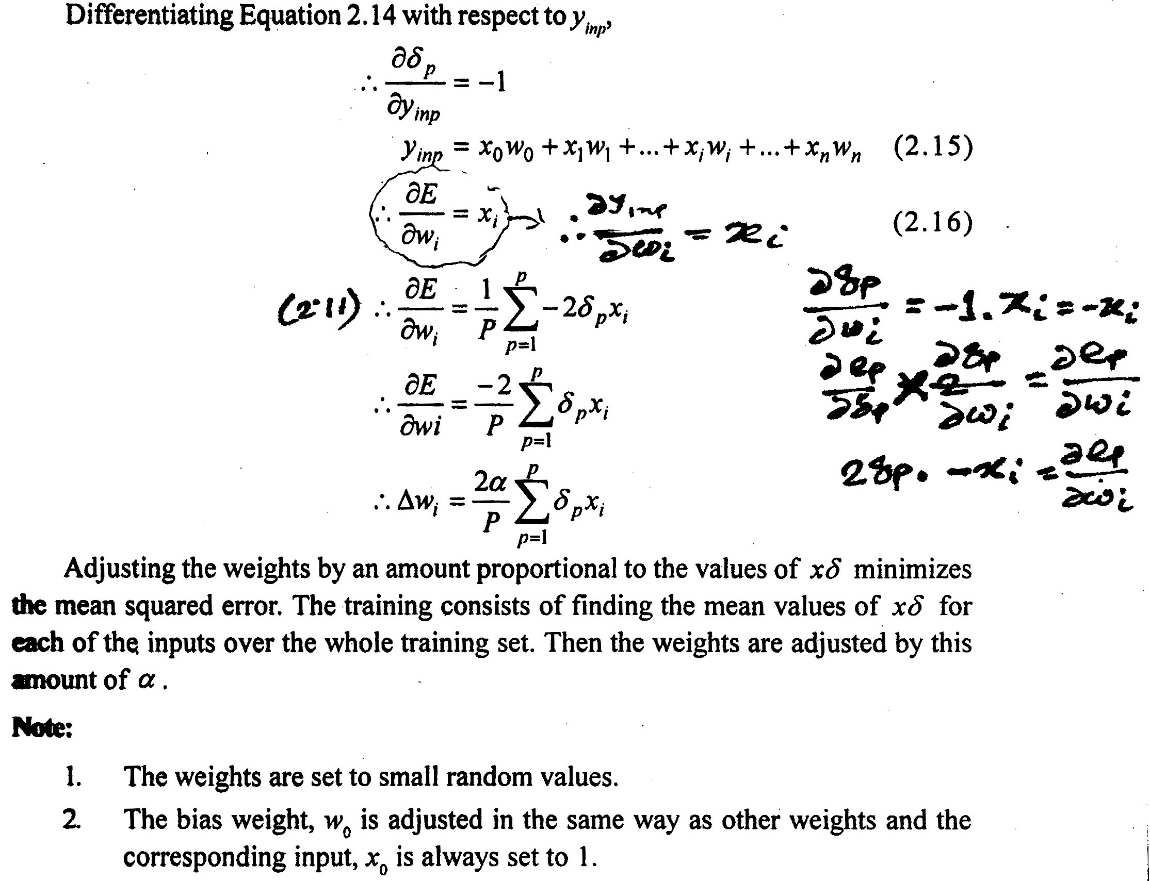
DELTA RULE

Slide 5
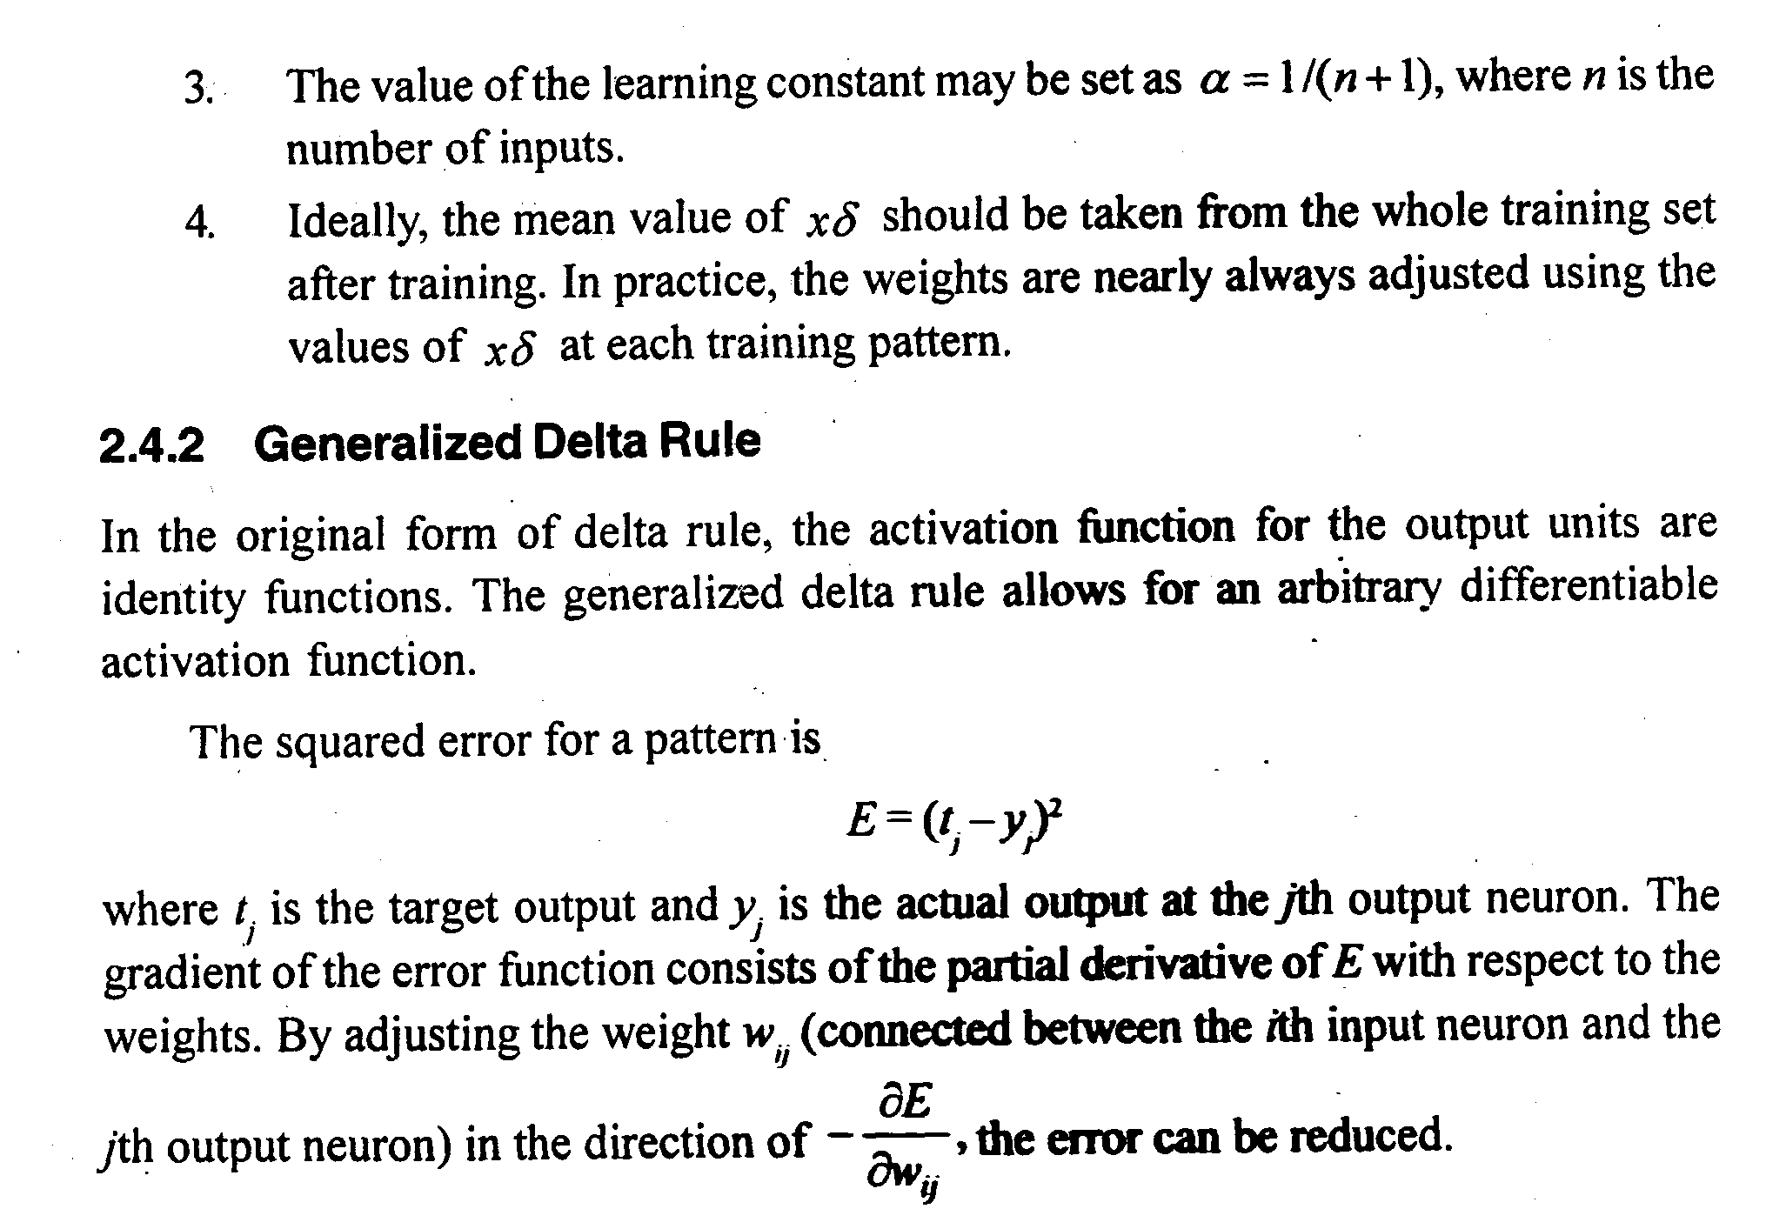
DELTA RULE

Slide 6
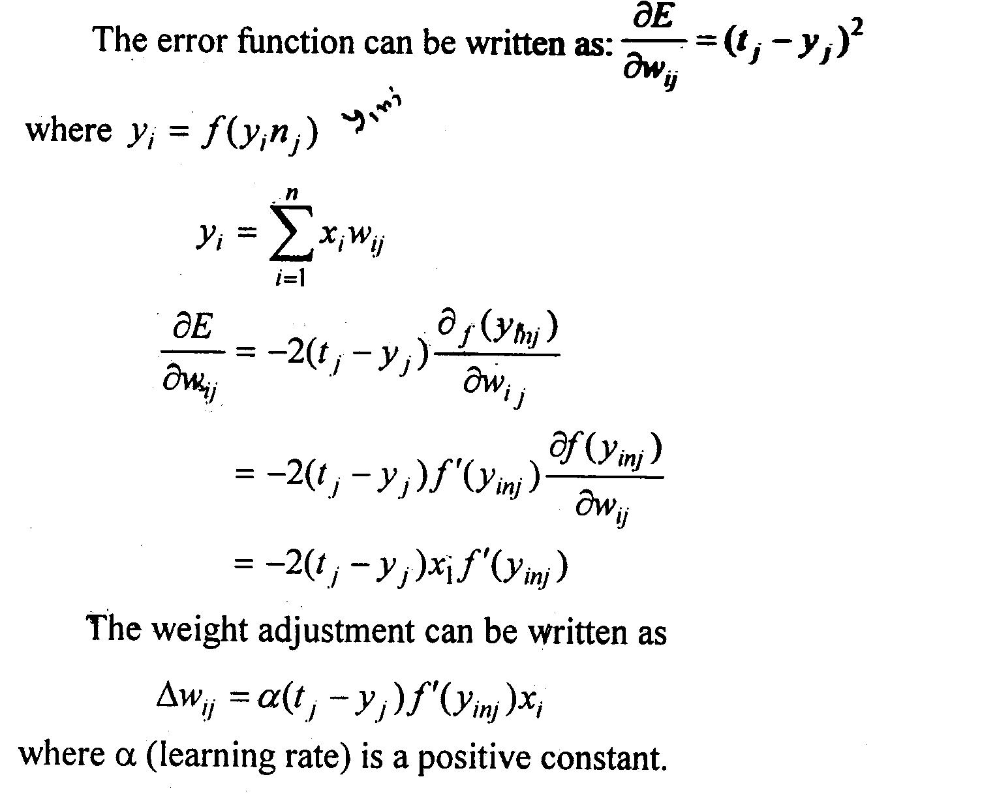
DELTA RULE

Slide 7

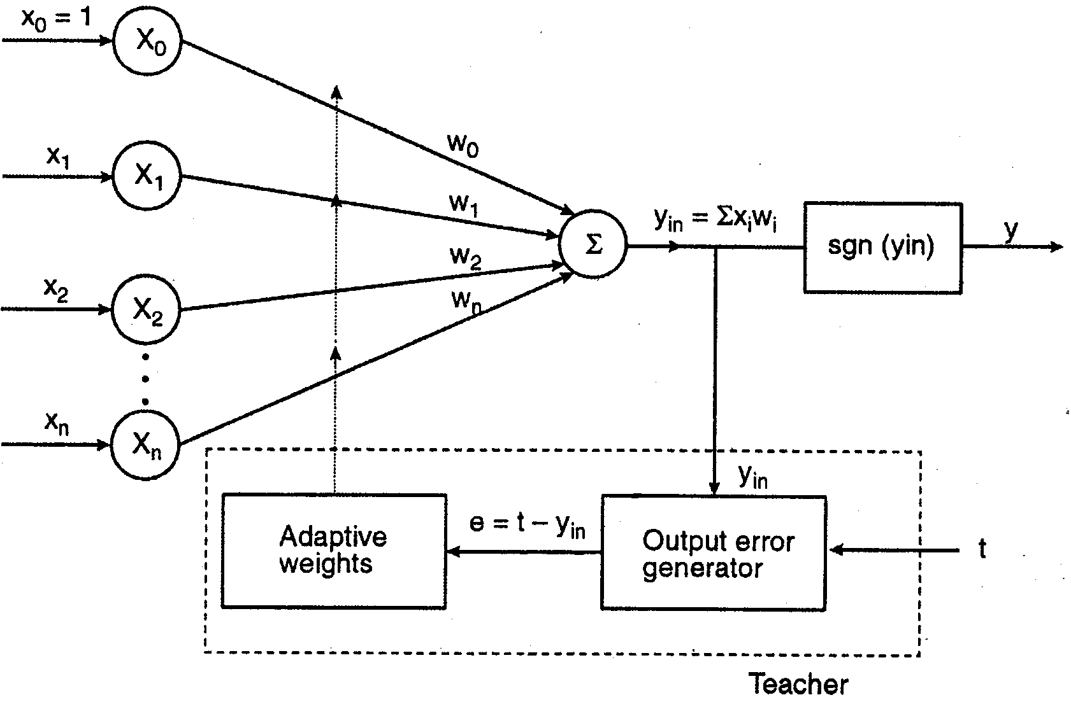
ADALINE

Slide 8
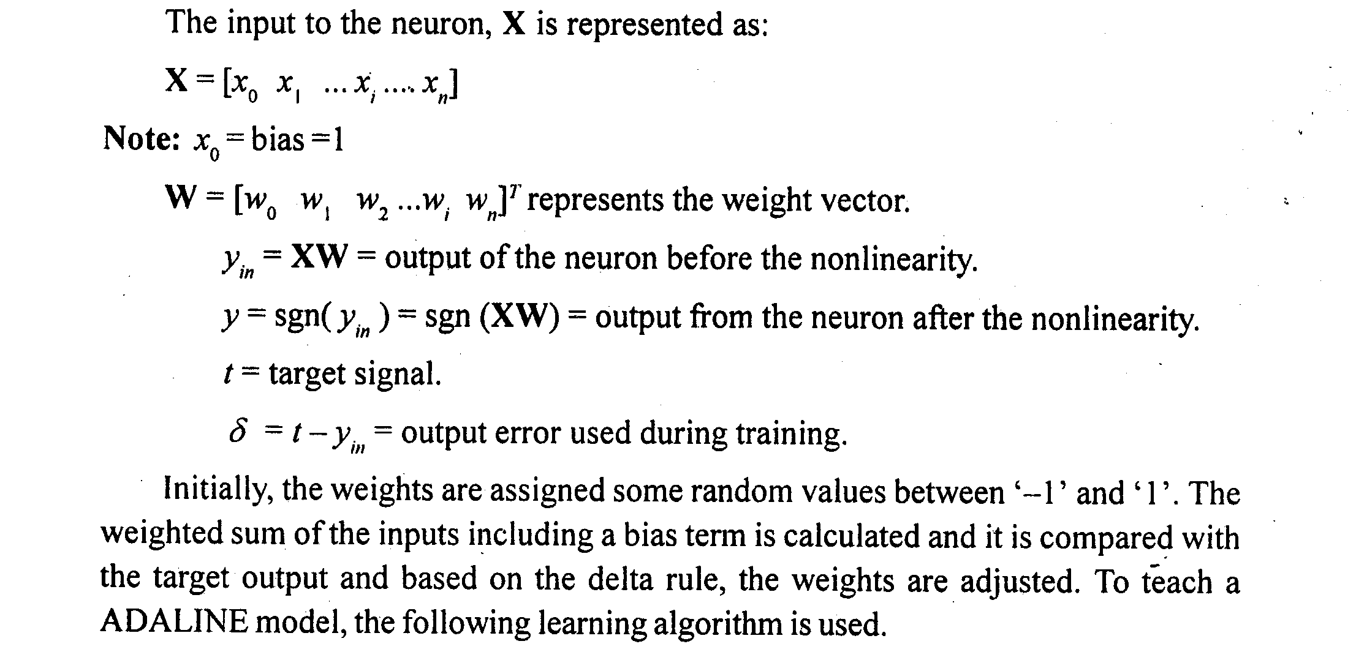
ADALINE

Slide 9

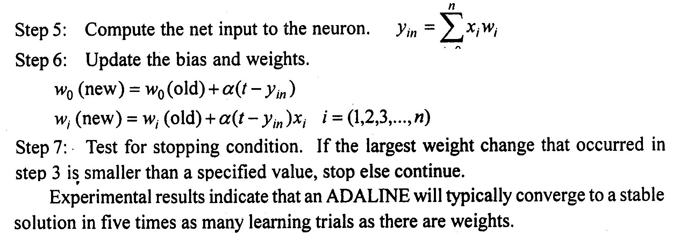
DELTA RULE

Slide 10
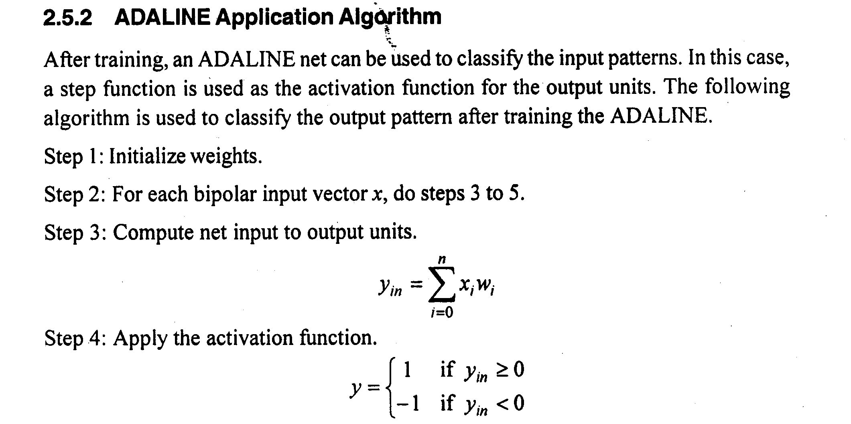
ADALINE

Slide 11
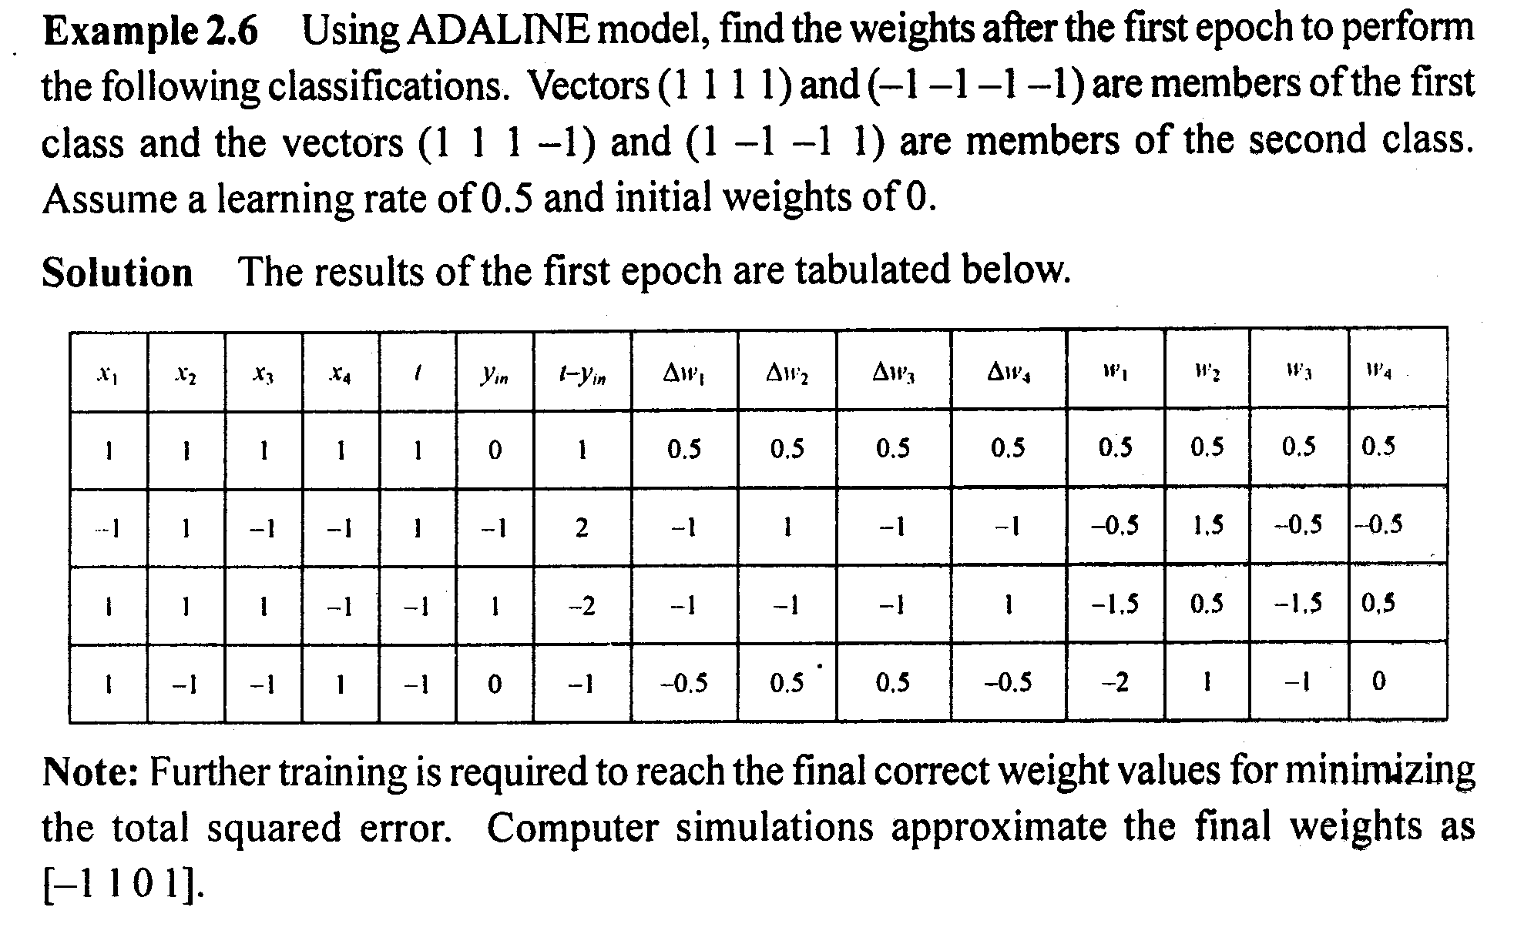
DELTA RULE

Slide 12
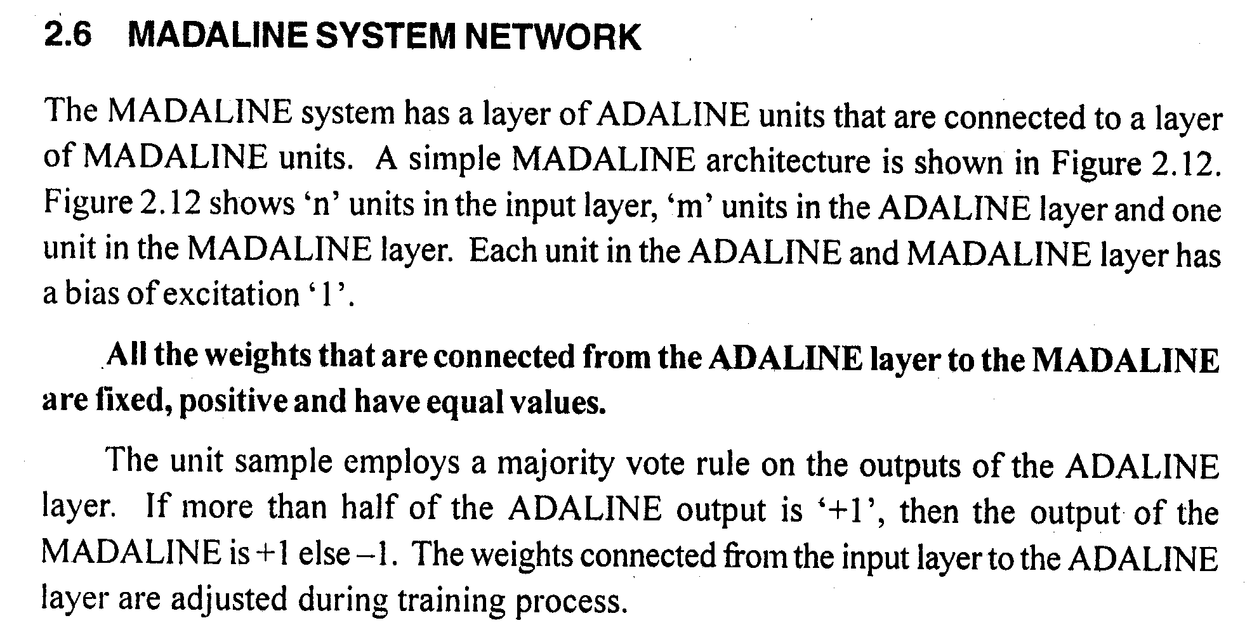
MADALINE

Slide 13
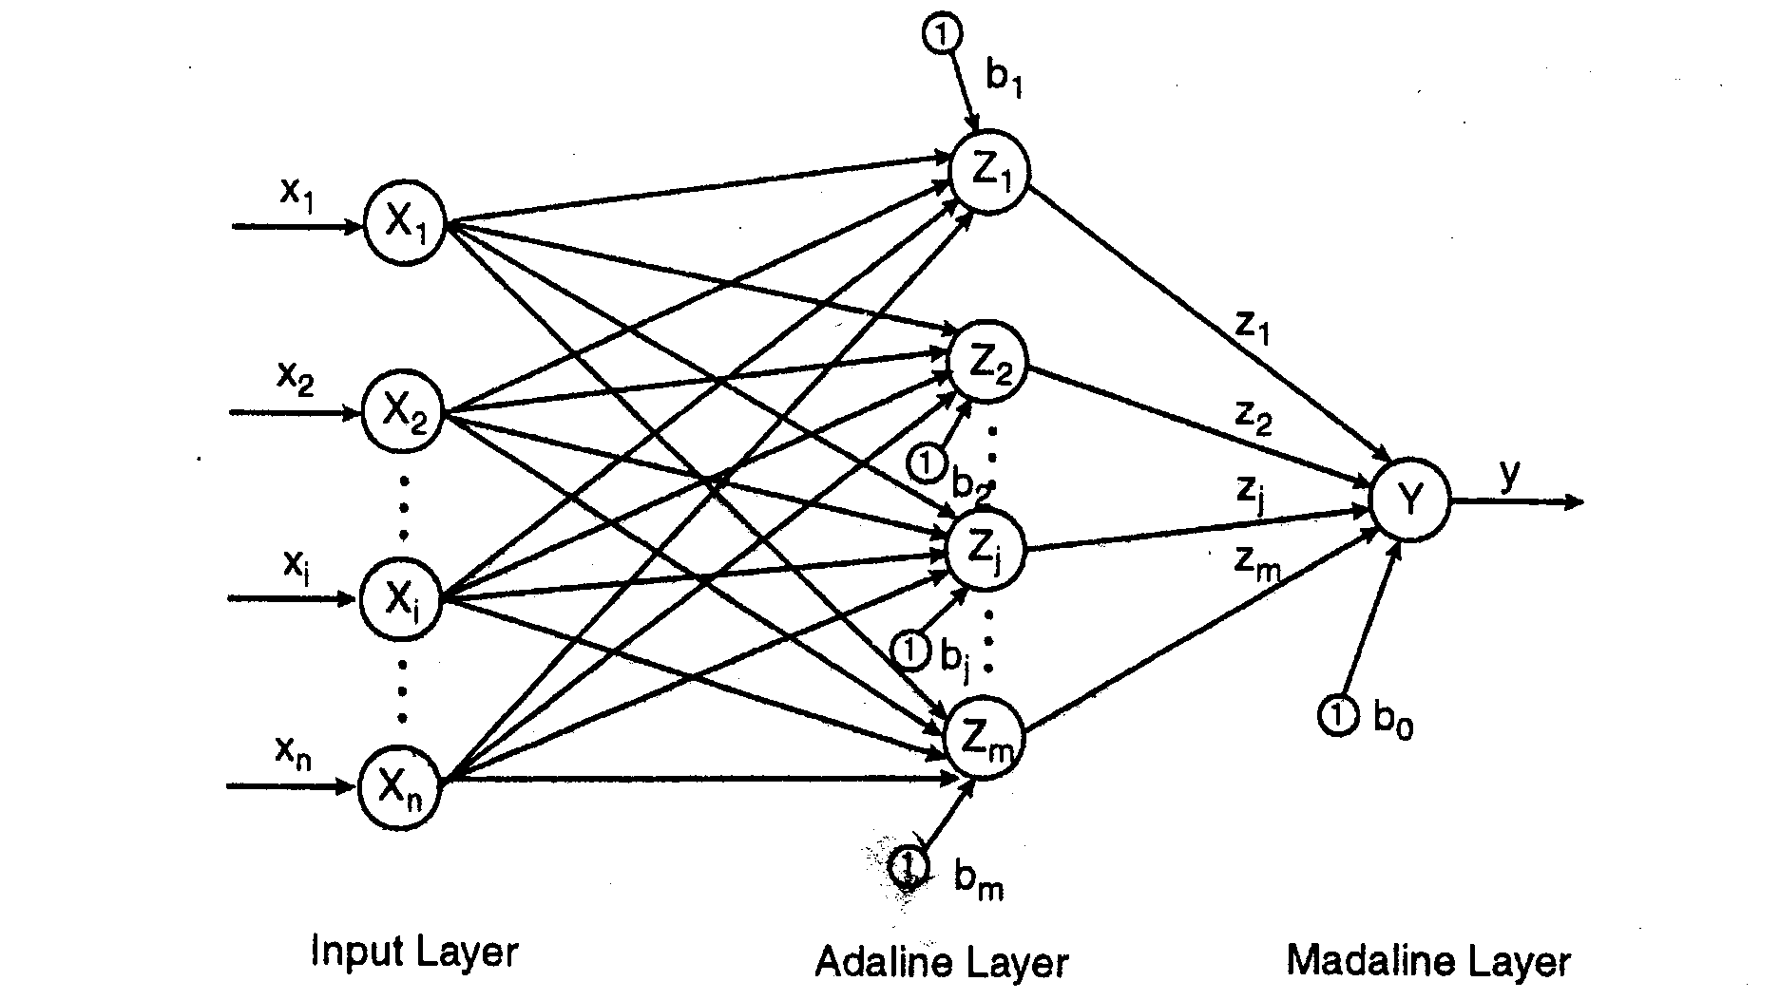
MADALINE

Slide 14
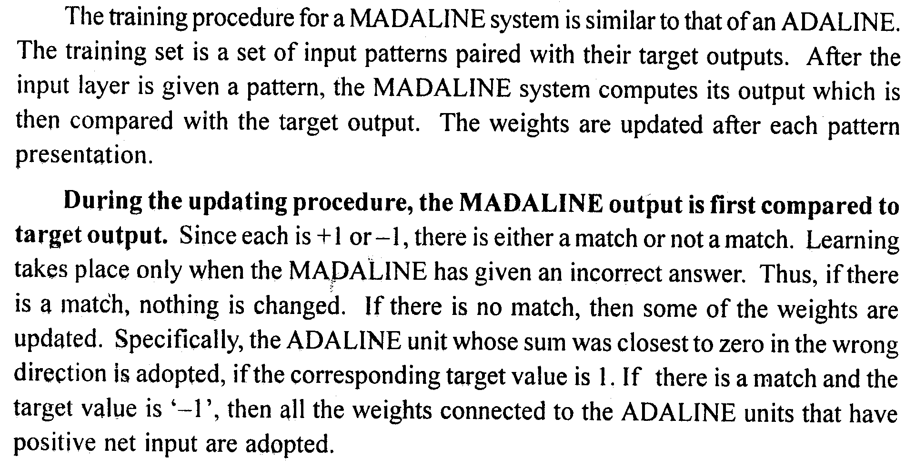
MADALINE

Slide 15
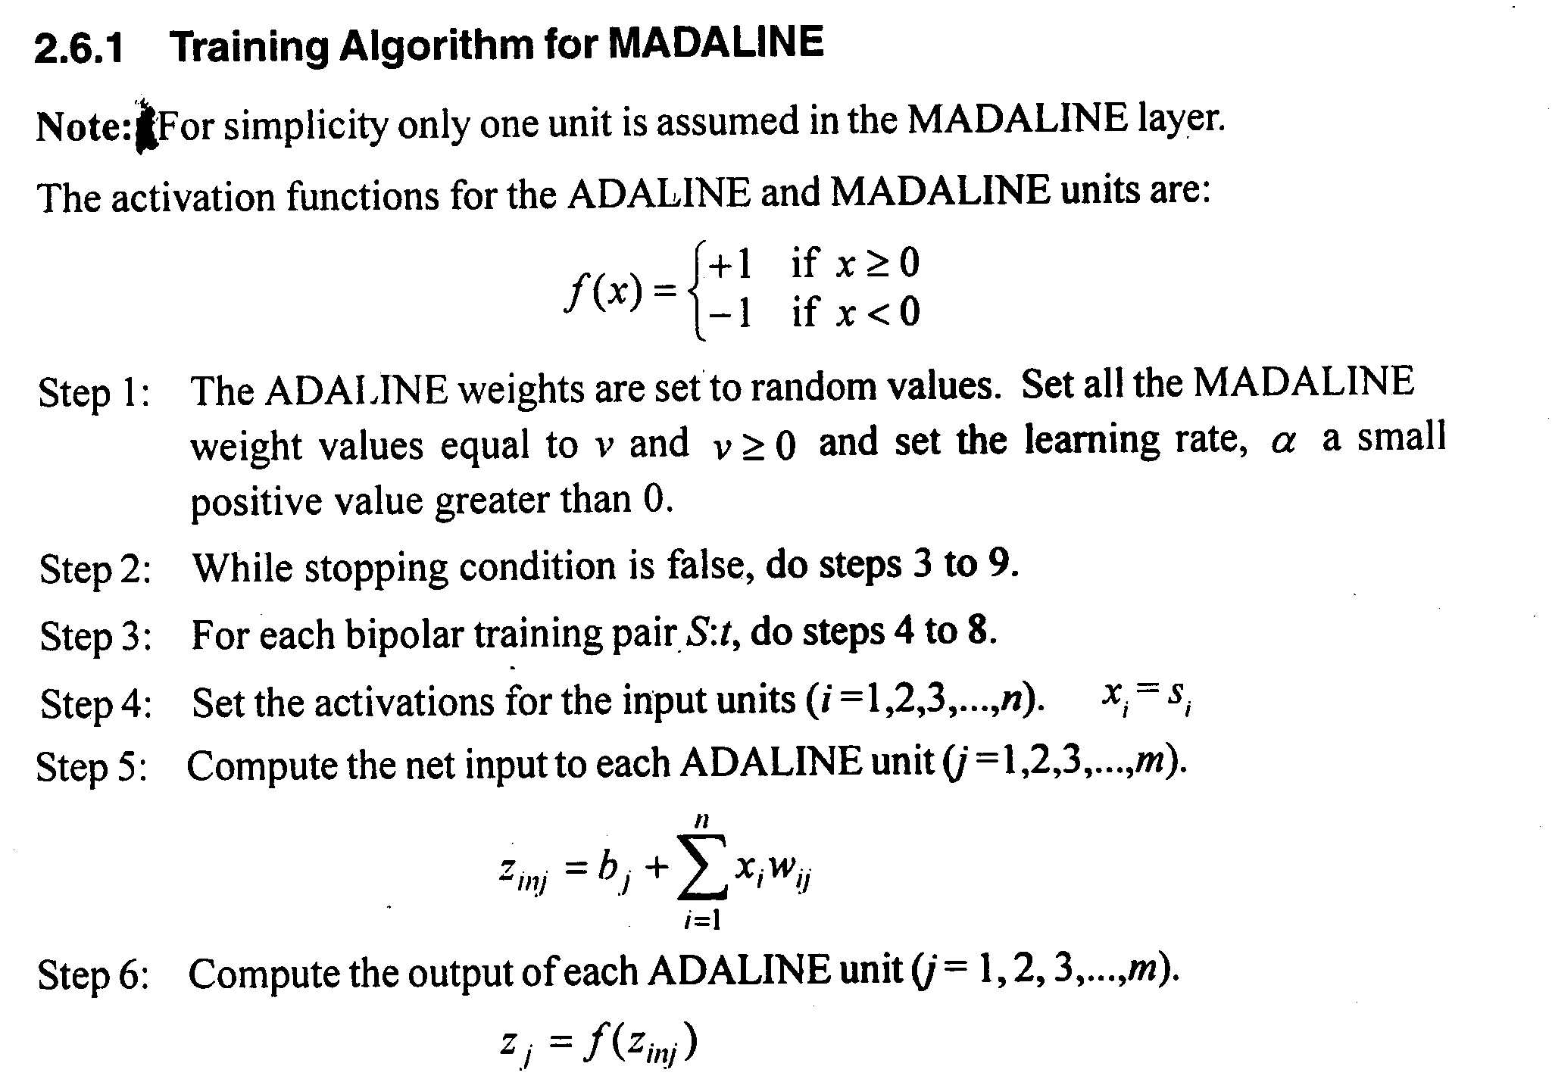
MADALINE

Slide 16
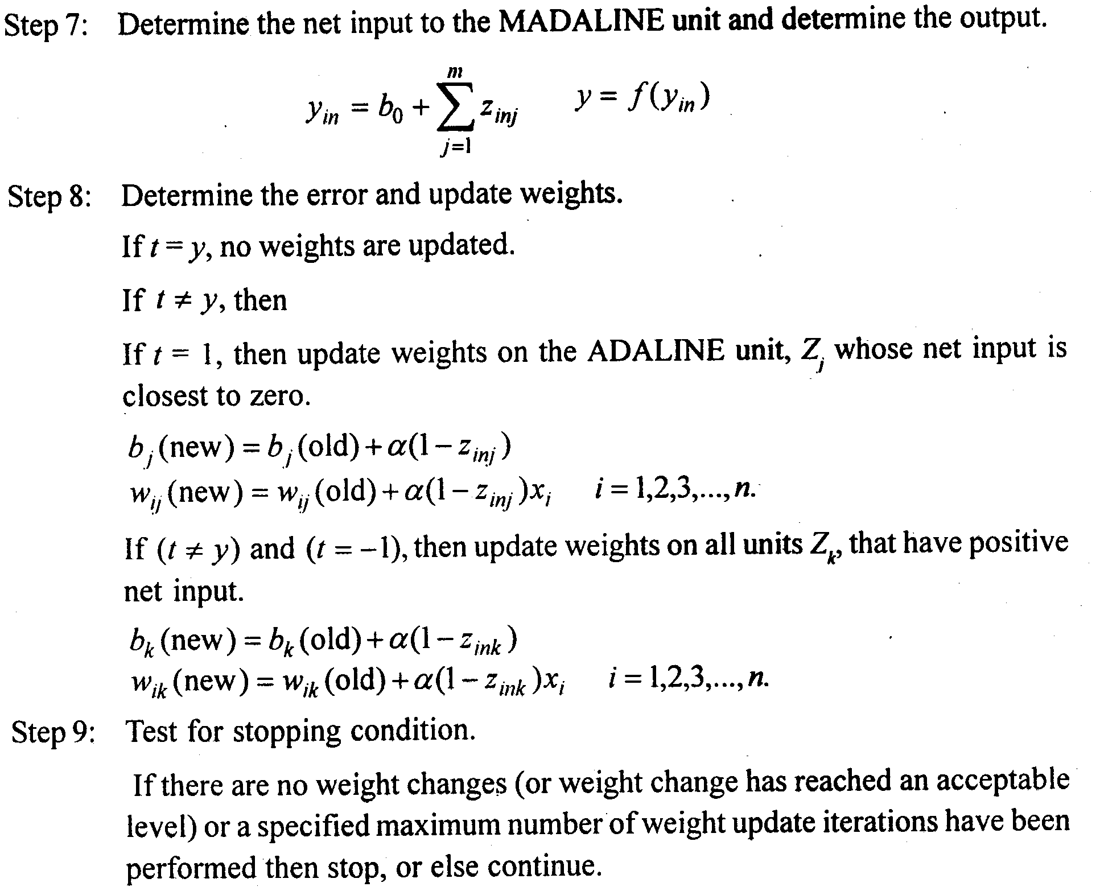
MADALINE

Slide 17
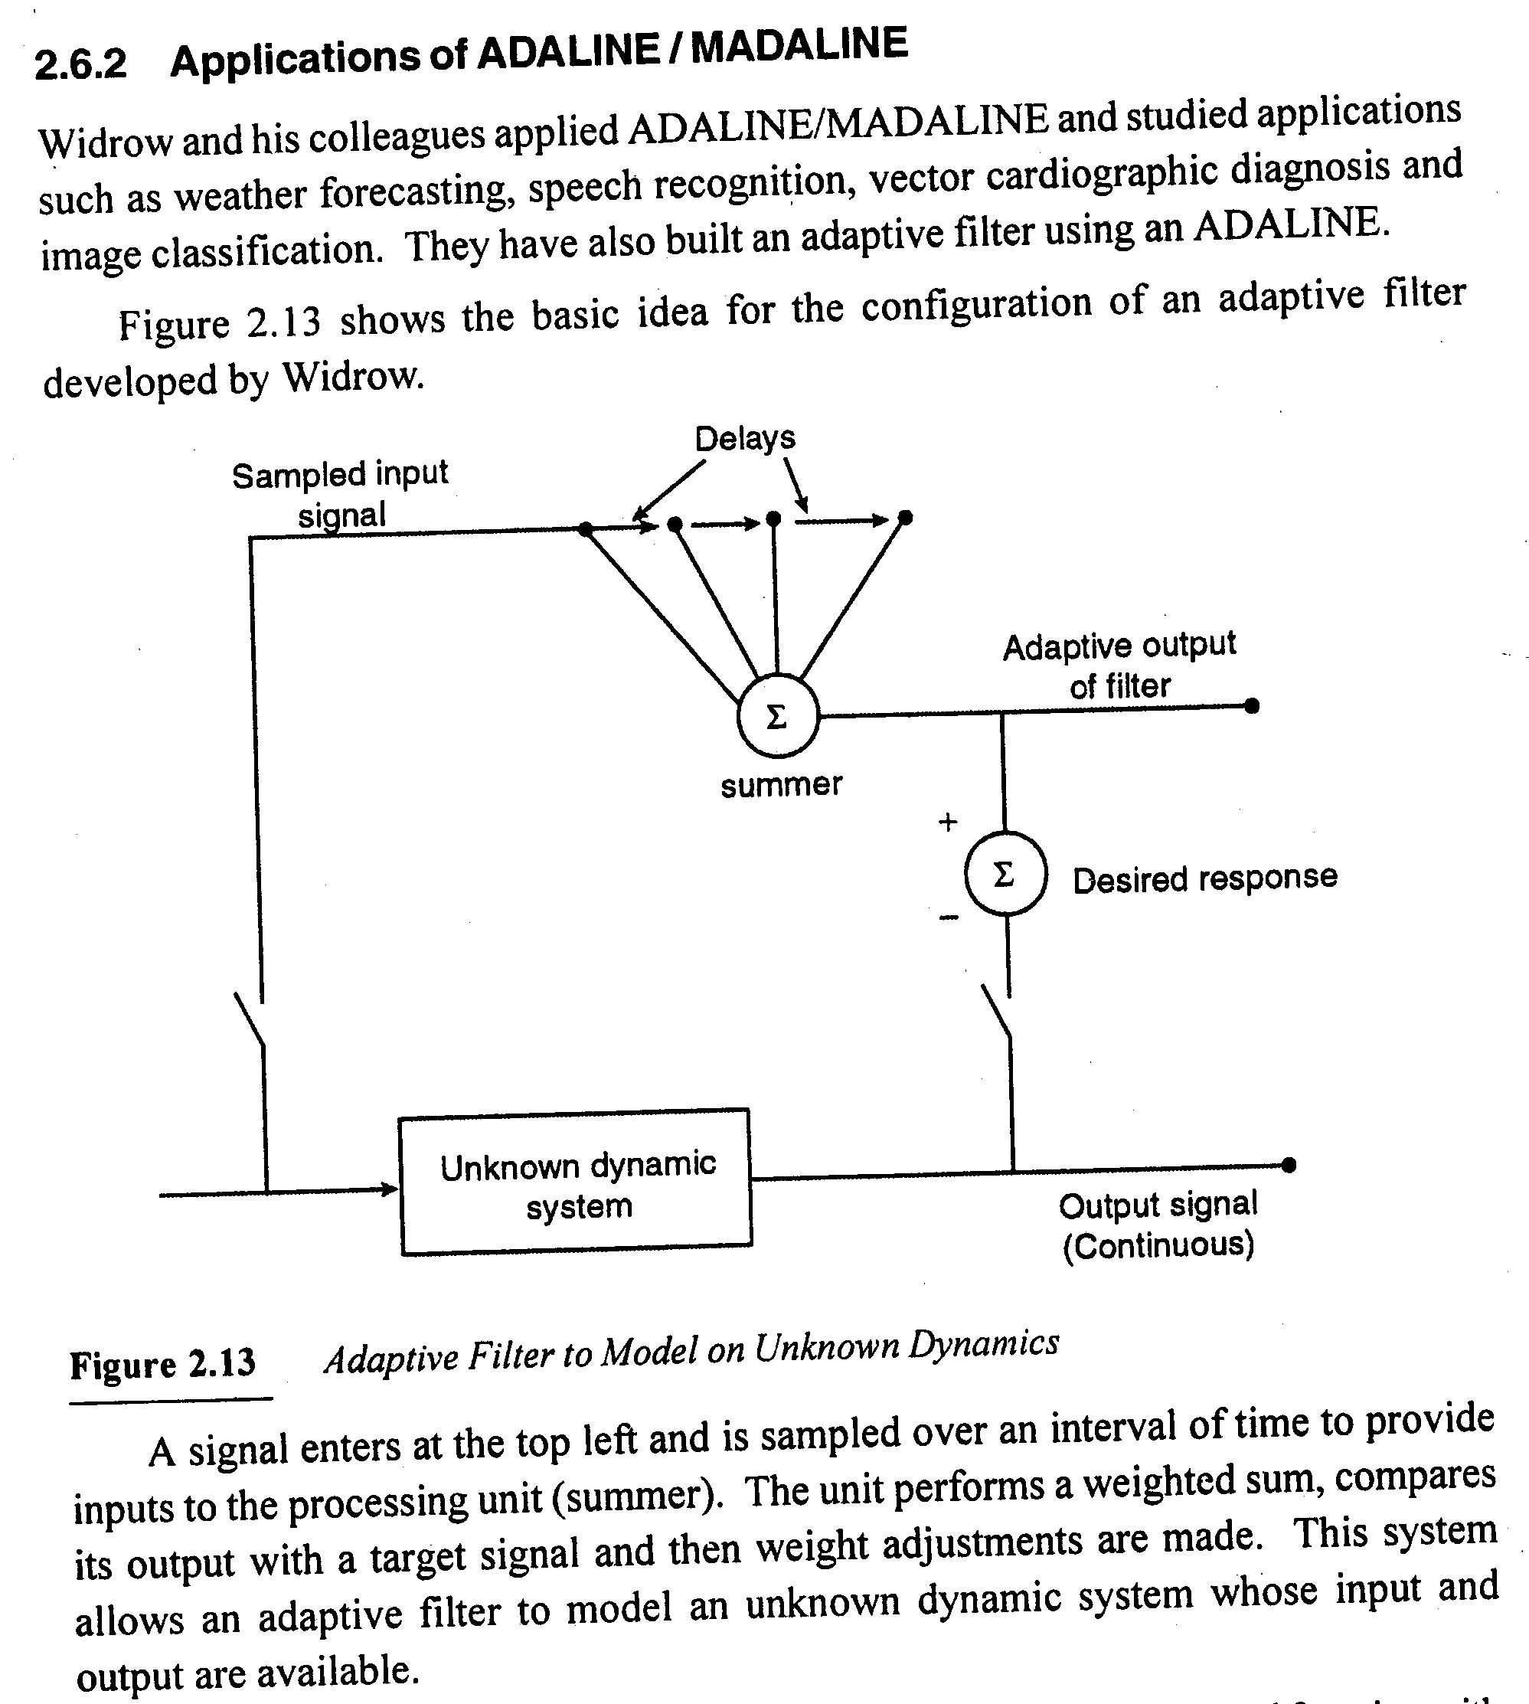
MADALINE

Slide 18
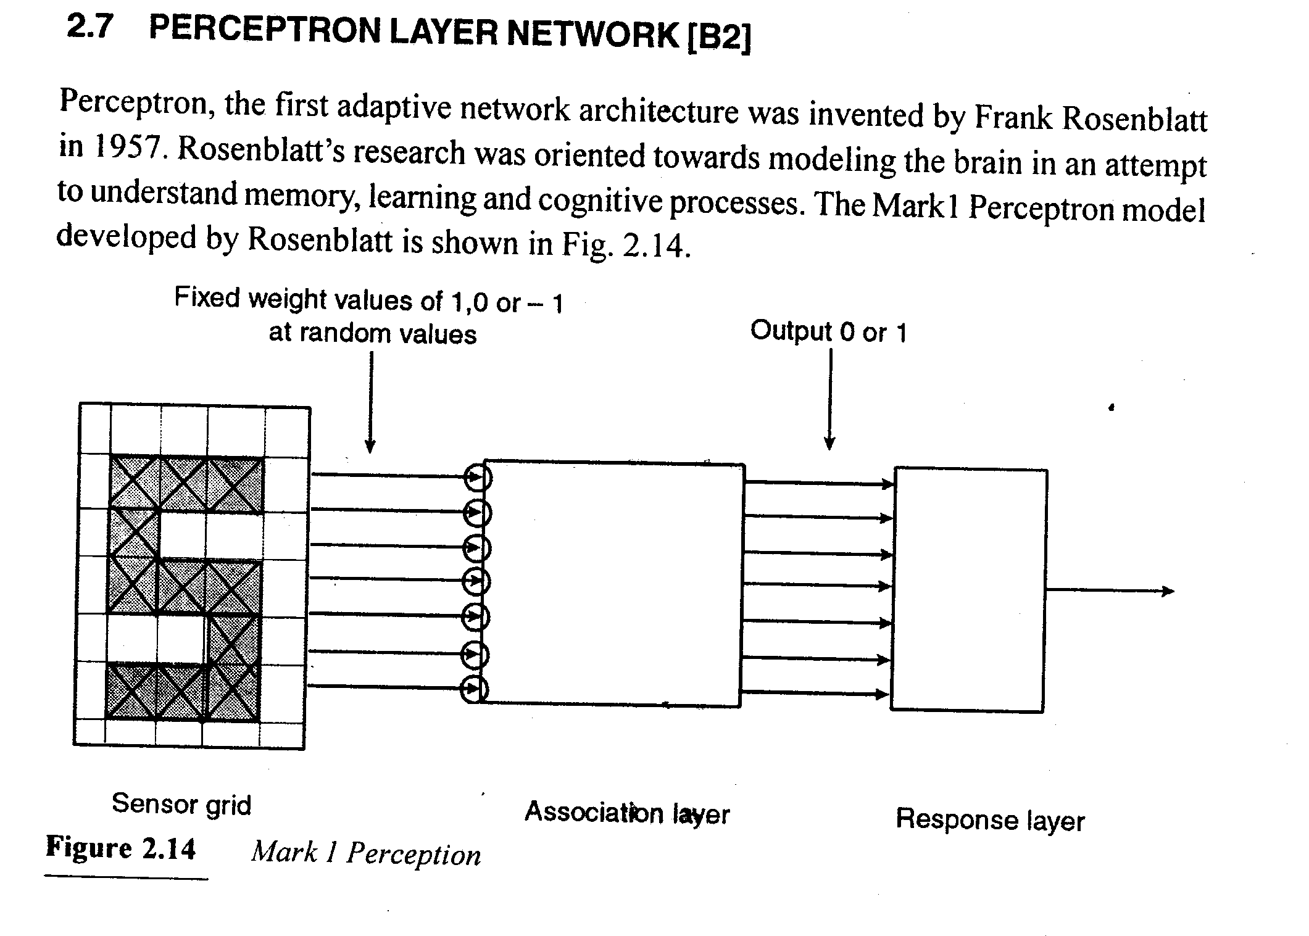
MADALINE

Slide 19
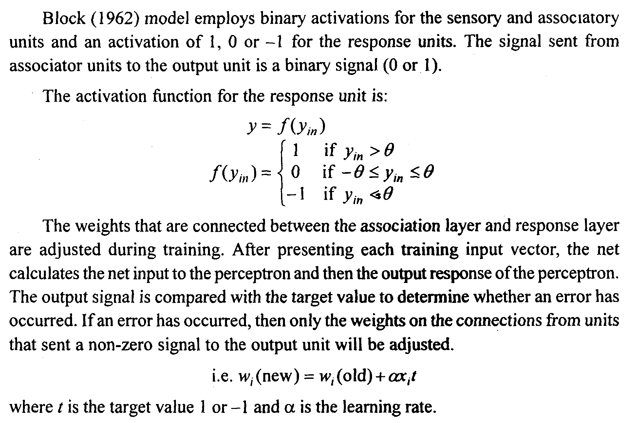
MADALINE

Slide 20
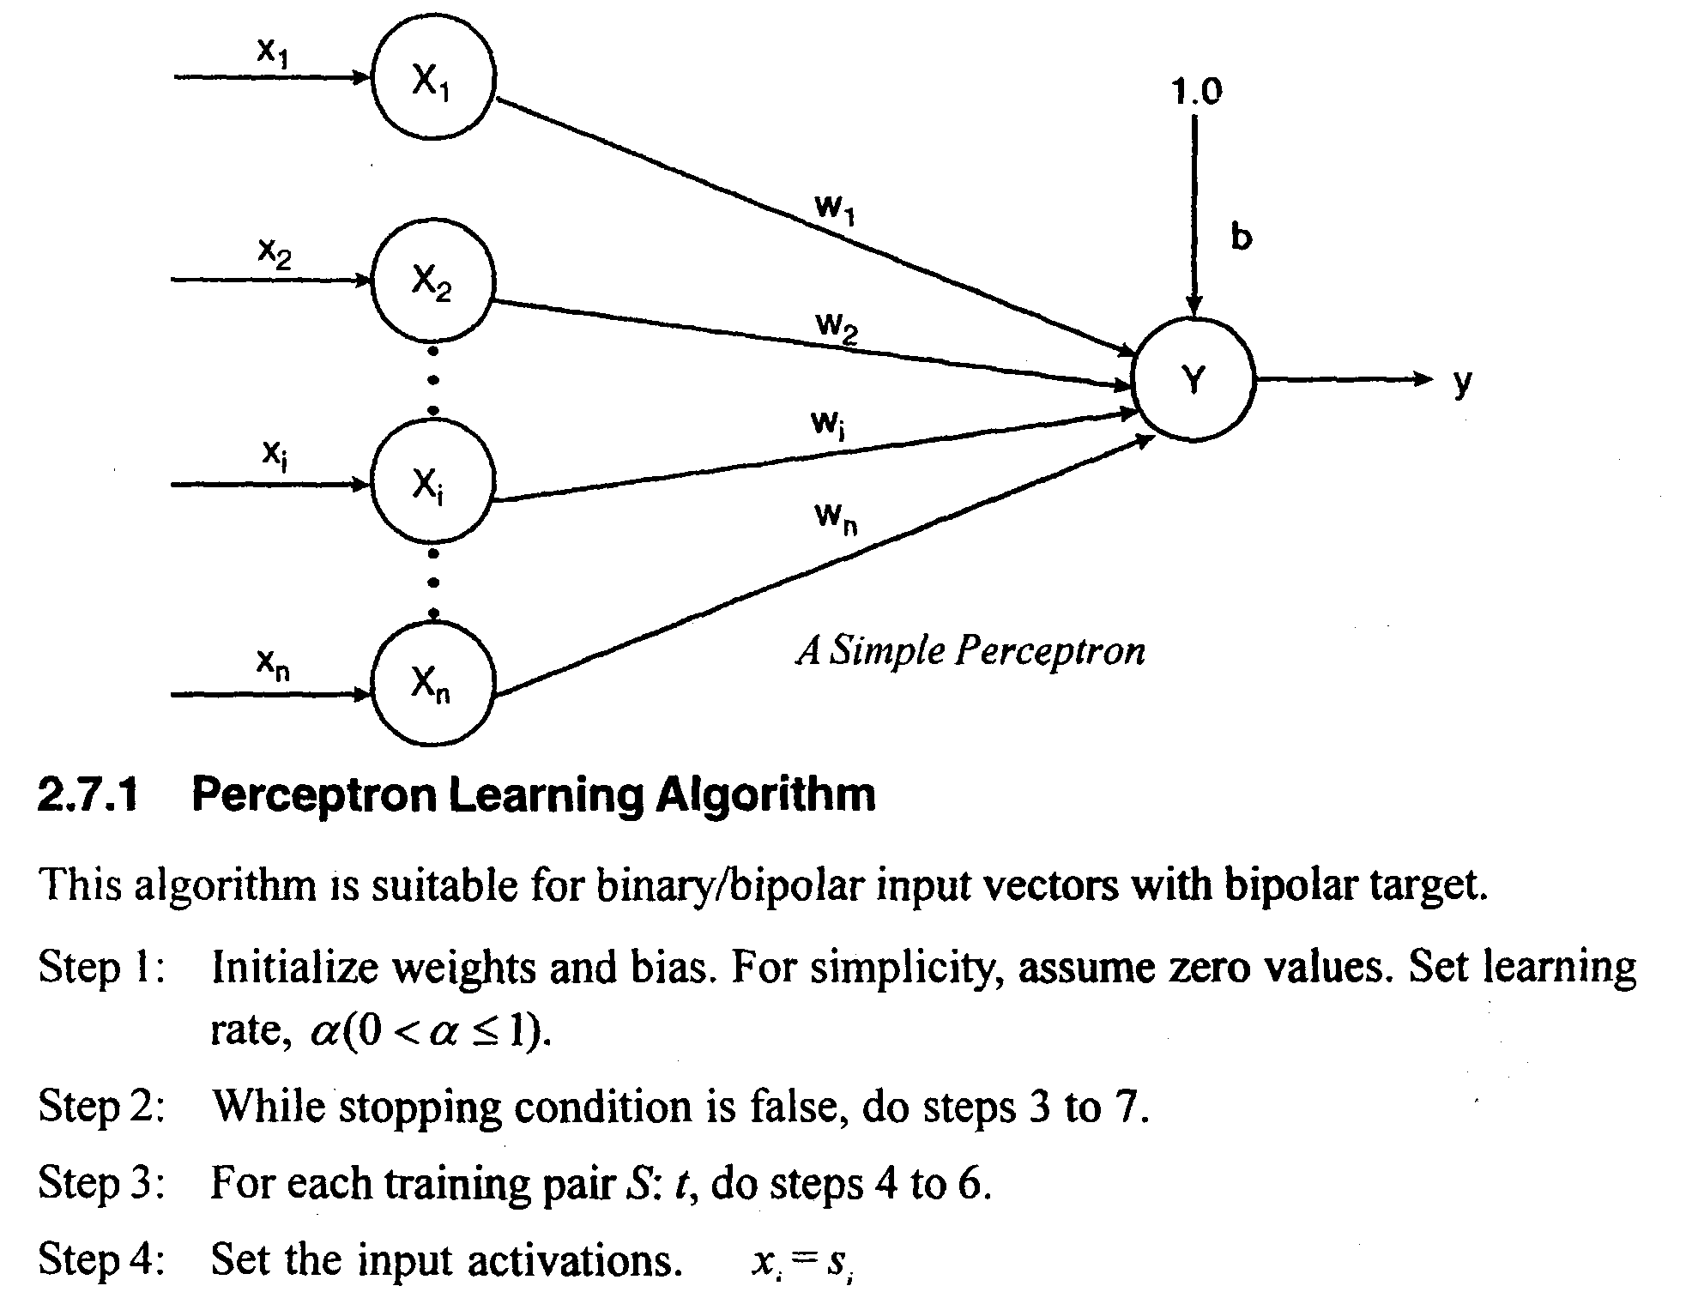
MADALINE

Slide 21
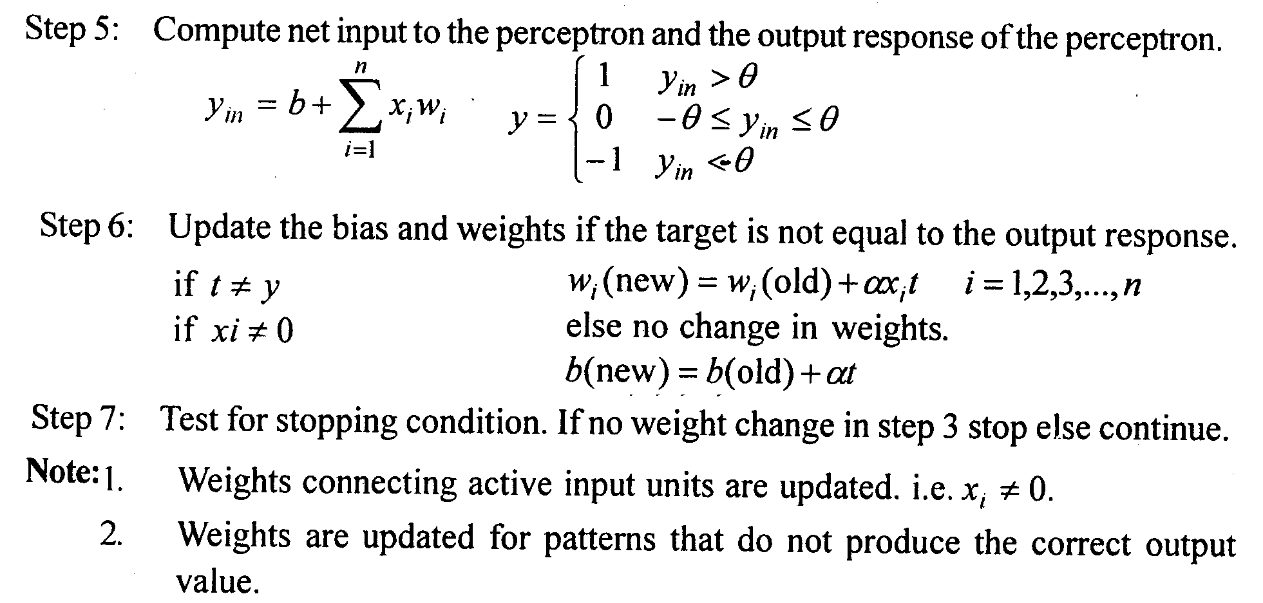
MADALINE

Slide 22
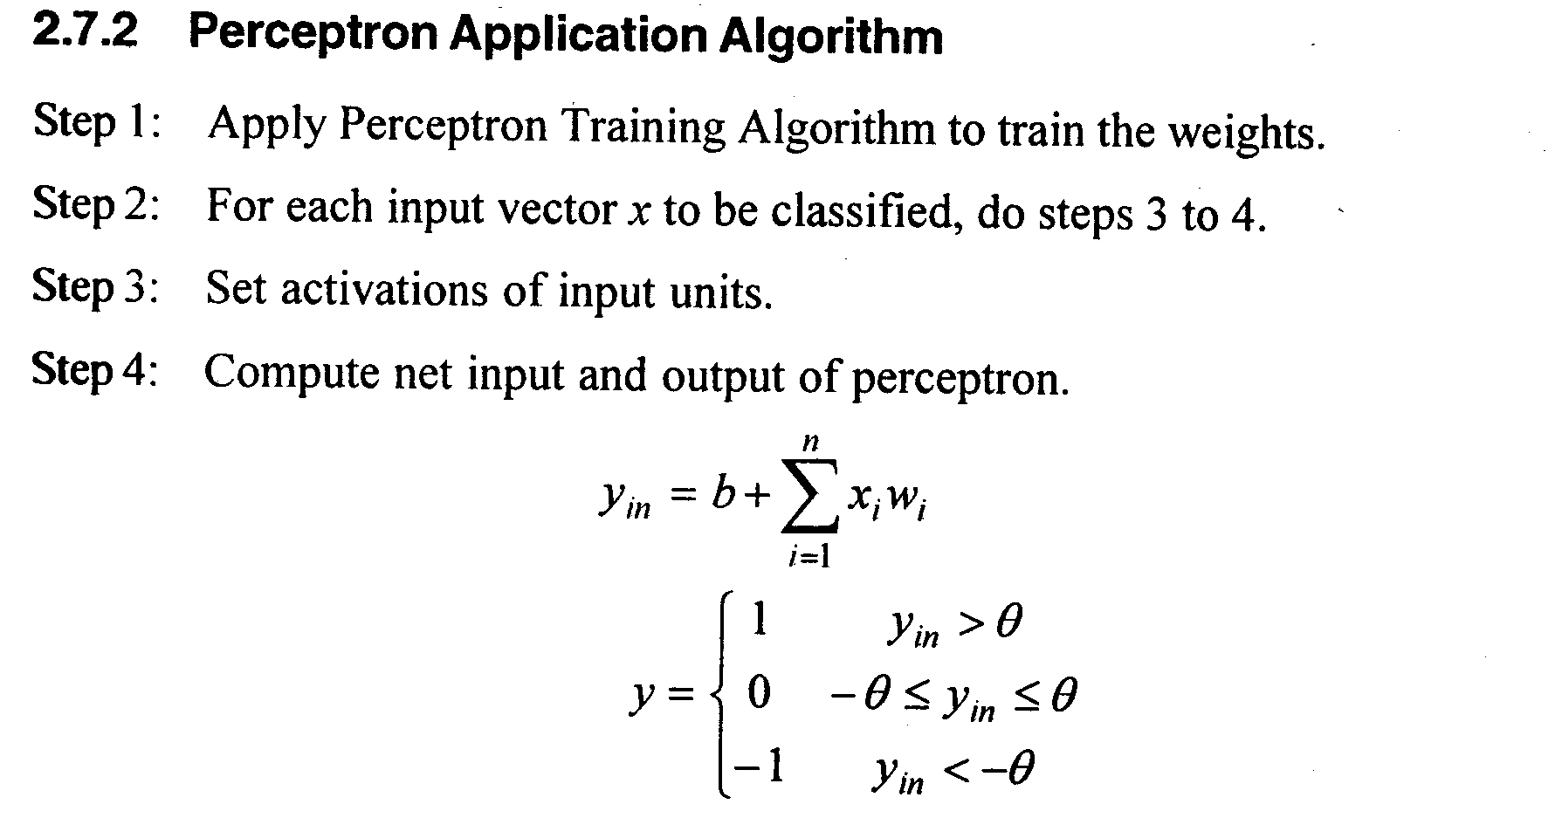
MADALINE

Slide 23
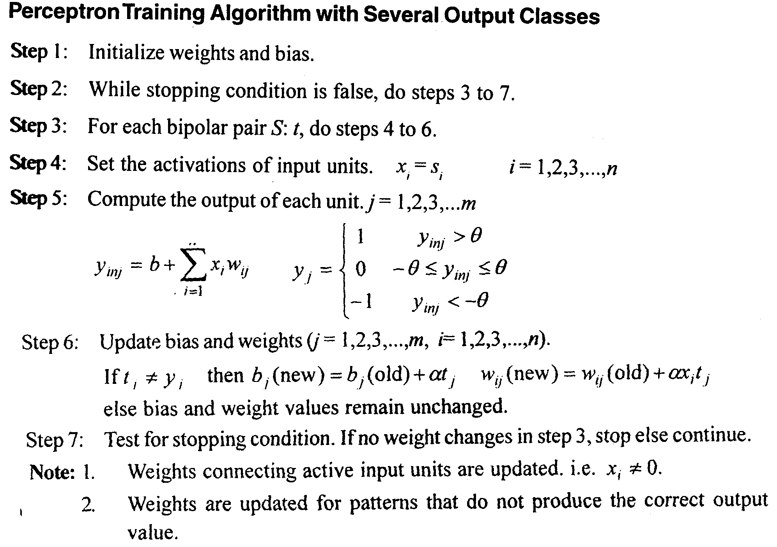
MADALINE

Slide 24
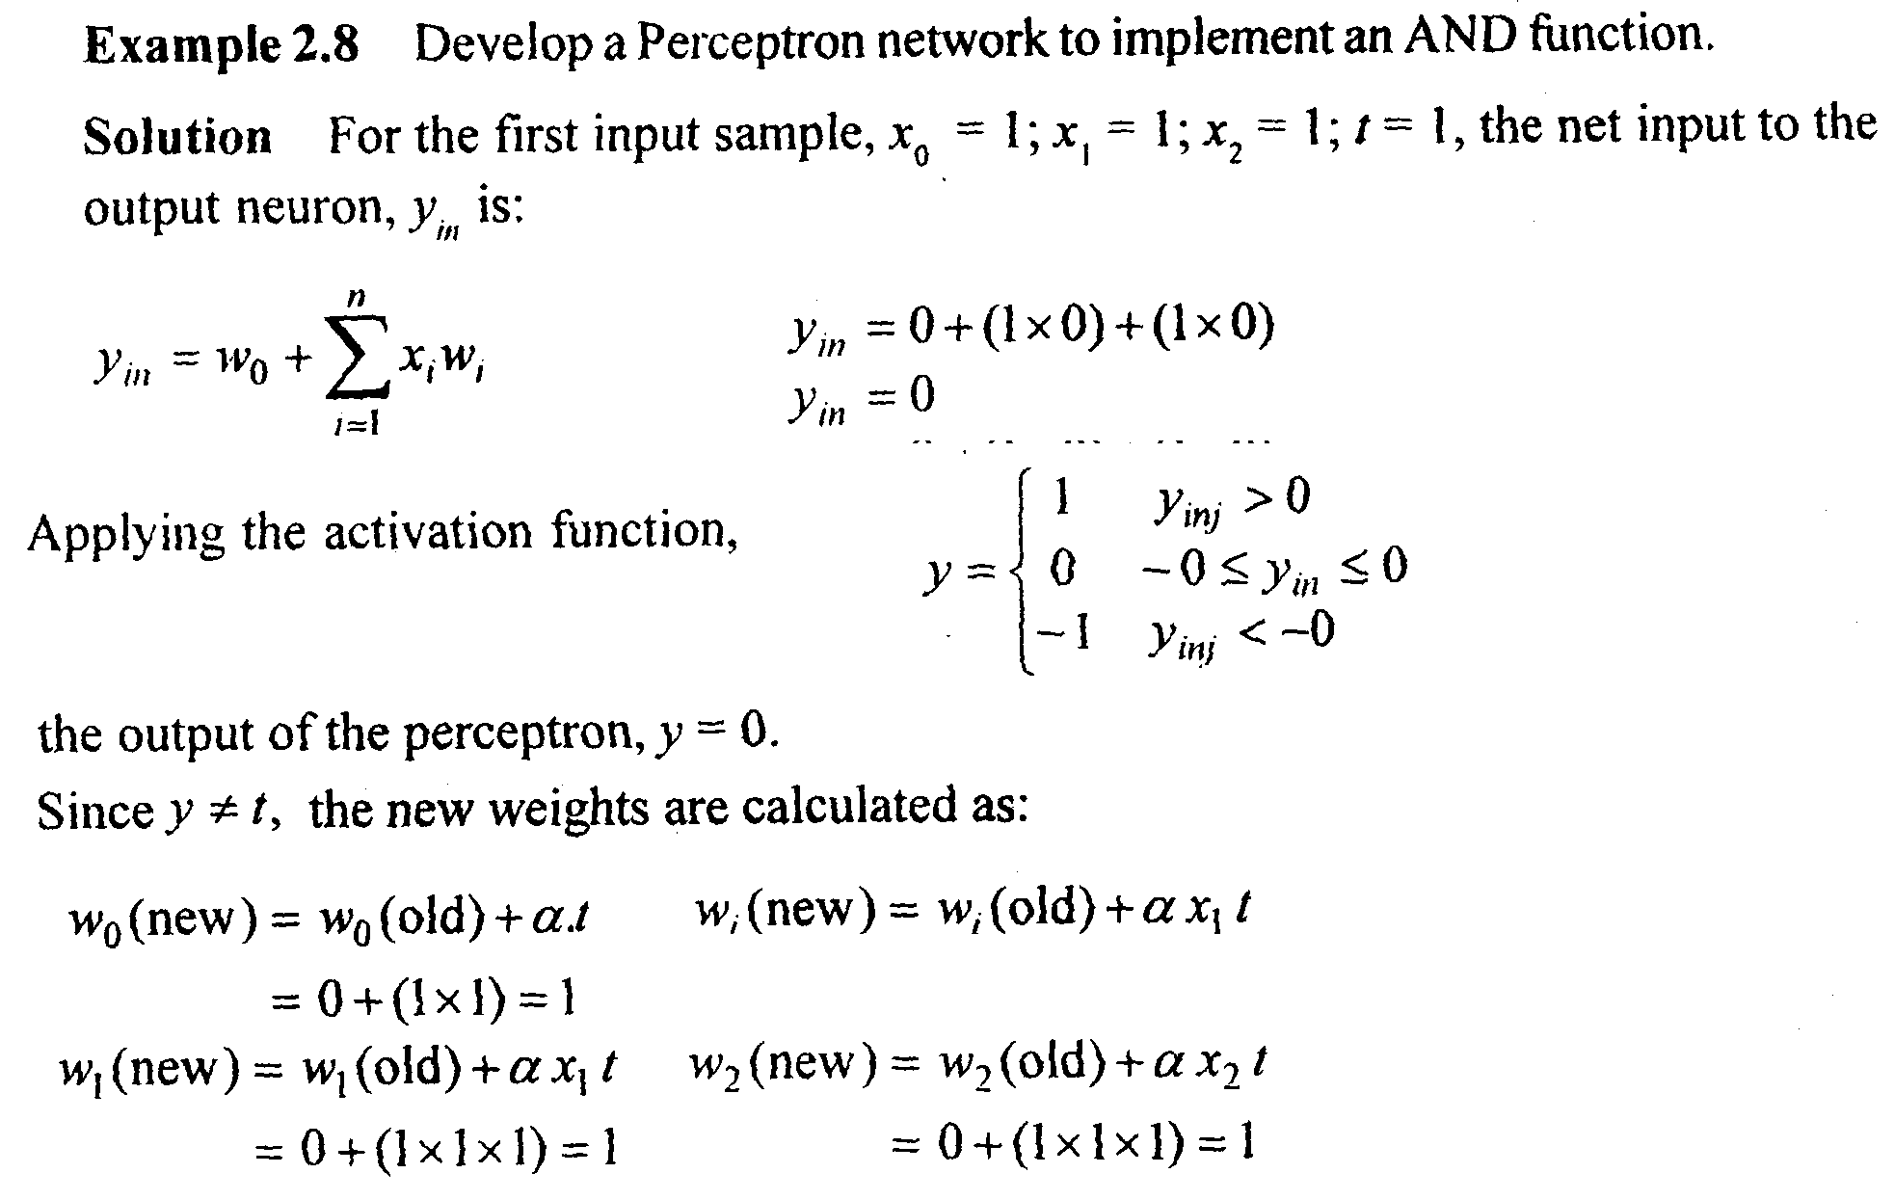
MADALINE

Slide 25
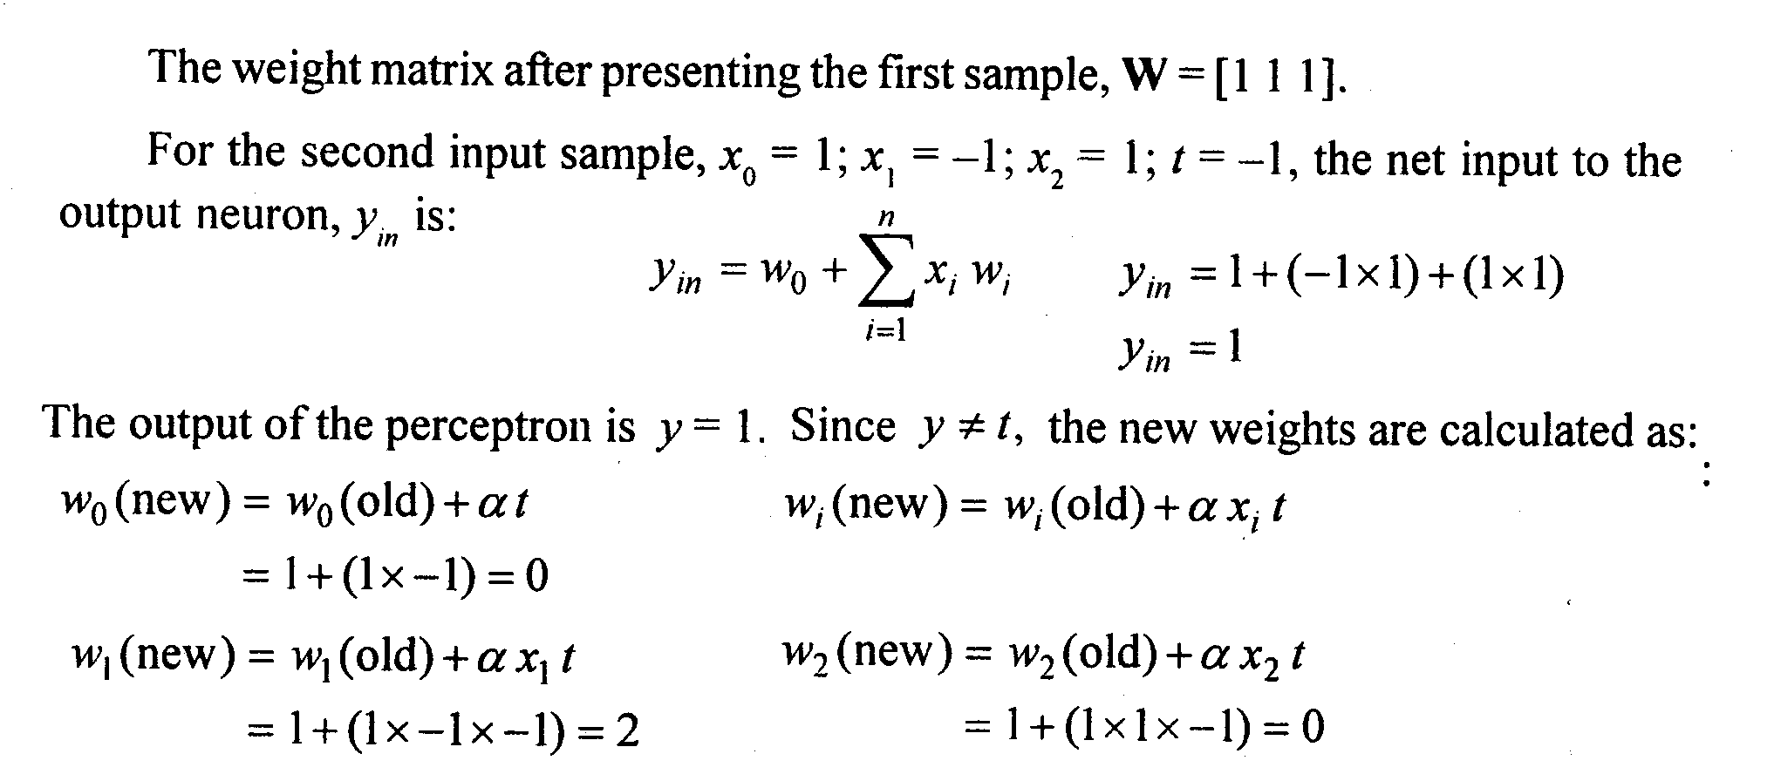
MADALINE

Slide 26
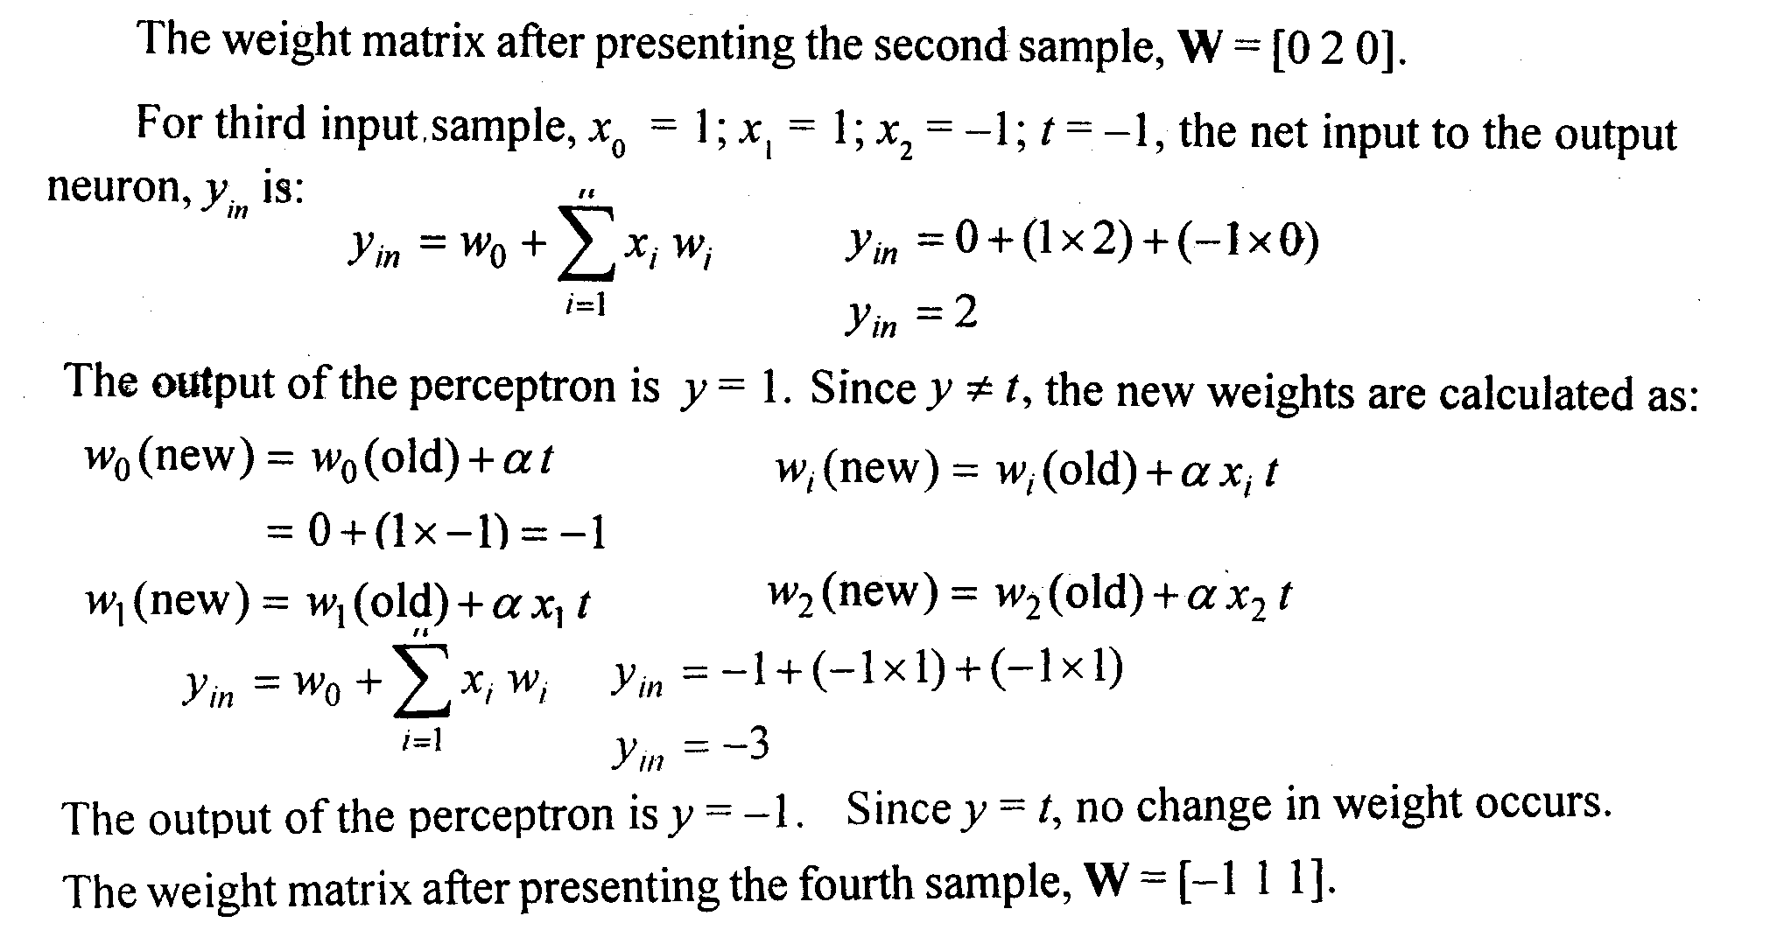

MADALINE

