Slide 1

Associative Memory
In 1982, John Hopfield published a very influential paper which drew the attention to the associative properties of a class of neural nets.
The analysis is based on a definition of “energy” in the net and a proof that the net operates by minimizing this energy when settling into suitable patterns of operation.
It is based on the properties of interconnected cells of simple linear devices such that the system has stable states.
Its states can be created by changing the strength of the interconnection between cells.

Slide 2
Associative Memory
Associative memories belong to a class of neural networks that learns according to the input/output patterns.
Neural network usually acquire prior information and their connectivity matrices most often need to be formed in advance.
Associative memory usually enables a parallel search within a stored data file. The purpose of the search is to output one or all stored data items that match the given search argument and to retrieve it entirely or partially.
It is also believed that biological memory operates according to associative memory principles. No memory locations have addresses; storage is distributed over a large, densely interconnected assembly of neurons.

Slide 3
Associative Memory
Retrieving information is content addressability, which for a computer system can be sequential or indexed.
Sequential is similar to looking for name in jumbled up telephone directory; every entry would have to be scanned until correct one was found.
Indexed is a similar process except that the telephone book would be in correct order.
The Artificial Neural Networks plays the role of an associative memory in which data is collectively stored in the form of a weight matrix or memory and the process of developing the weight matrix is referred to as learning or storing the desired patterns, while retrieval or recall refers to the generation of output pattern when an input is presented to the network.

Slide 4
Autoassociative Memory
An autoassociative memory requires suppression of the output noise at memory output.
This can be done by thresholding the output and by recycling the output followed by a feedforward pass through a neural network.
Such a network has a feedback, nonlinear mapping in the form of thresholding and dynamical.

Slide 5
Autoassociative Memory
The ideal characteristics of a autoassociative memory are given below:
l. Many associated pattern pairs should be stored.
2. This storage should be accomplished through a self-organizing process.
3. The information should be stored in a distributed manner.
4. The appropriate output response should be generated on receipt of the associated input pattern.
5. The correct output response should be generated even if the input pattern is distorted or incomplete.
6. It should be able to add new associations to the existing memory.

Slide 6
Autoassociative Memory
Autoassociative Net
For an autoassociative net, the training input and target output vectors should be identical.
The process of training is often called storing the vectors, which may be binary or bipolar. A stored vector can be retrieved from distorted partial (noisy) input, if the input is sufficiently similar to it.
The performance of the net is judged by its ability to reproduce a stored pattern from noisy input; performance is in general better for bipolar vectors than binary vectors.

Slide 7
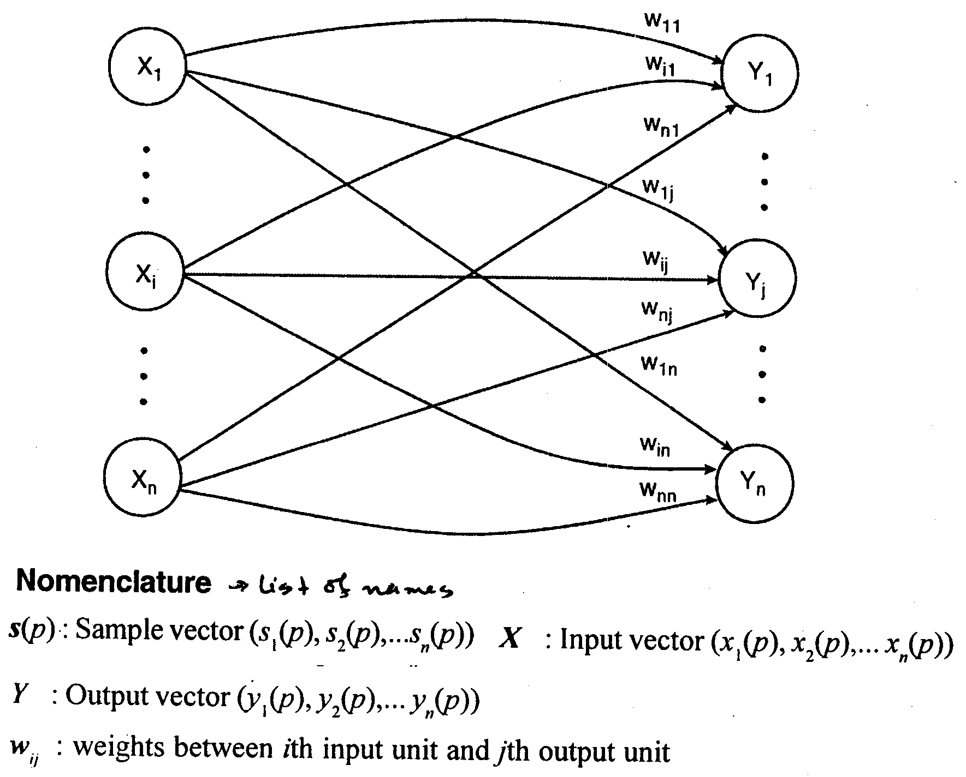
Autoassociative Memory: Architecture

Slide 8
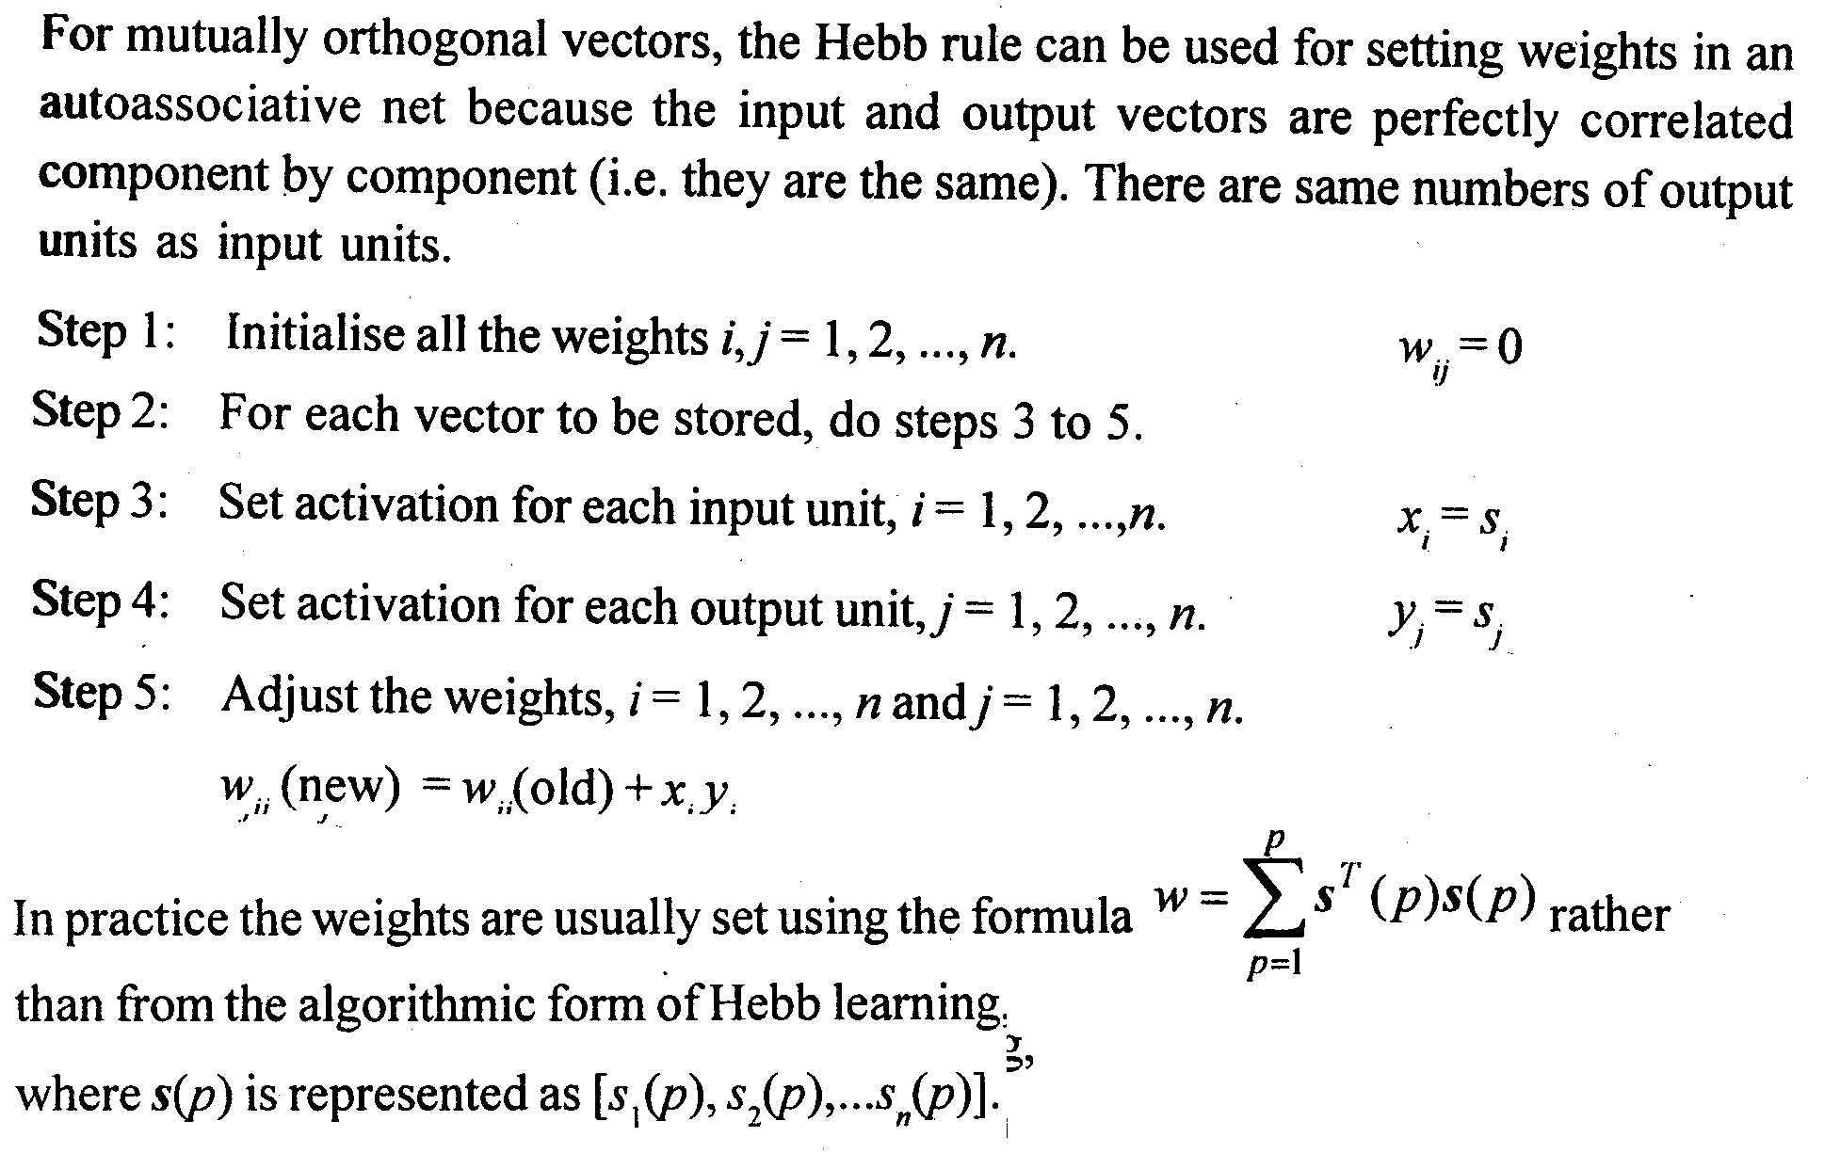
Autoassociative Memory: Algorithm

Slide 9
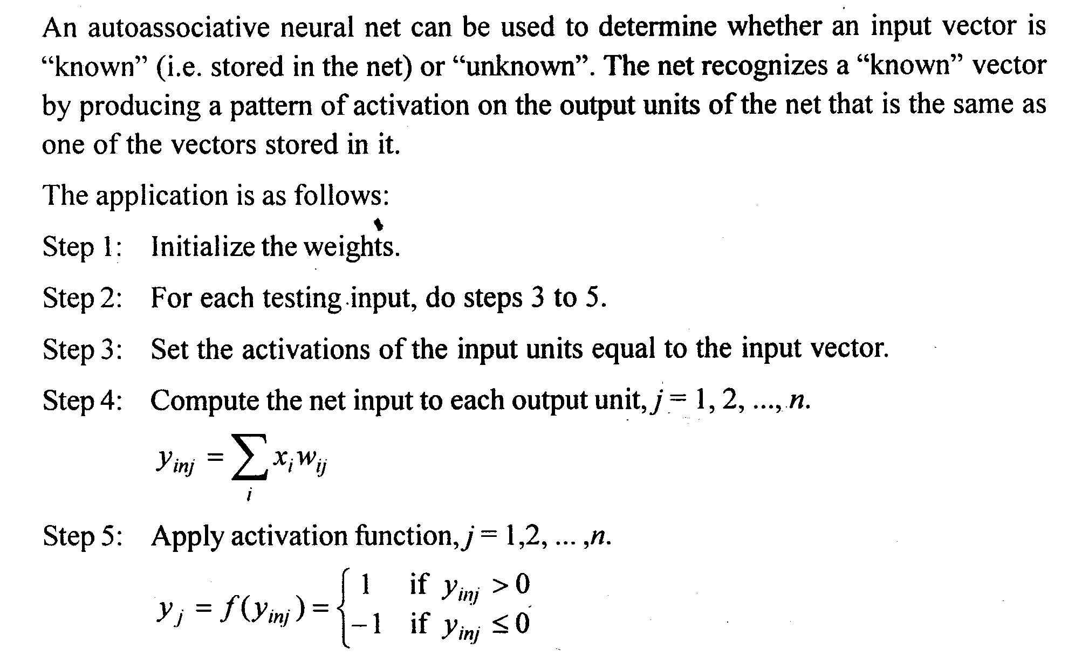
Autoassociative Memory: Application

Slide 10
Autoassociative Memory: Advantage
The autoassociative net has the power of recurrent neural processing within a parallel architecture.
The recurrences through the thresholding layer of processing neurons tend to eliminate gradually noise superimposed on the initializing input vector. This forces the incorrect pattern bits toward one of the stored memories.
The network's computational ability makes it possible to apply it in speech processing, database retrieval, image processing, pattern classification and other fields.

Slide 11
Autoassociative Memory: Limitations
The associative memories whether designed by Hebbian learning rule or by a modified rule suffer from substantial capacity limitations.
Capacity limitations cause diversified symptoms. It can amount to convergence of spurious memories and difficulties with recovery of stored patterns if they are close to each other in Hamming distance sense.
Overload memory may not be able to recover data stored or may recall spurious outputs.
Another inherent problem is that the memory convergences to stored pattern complements.

Slide 12
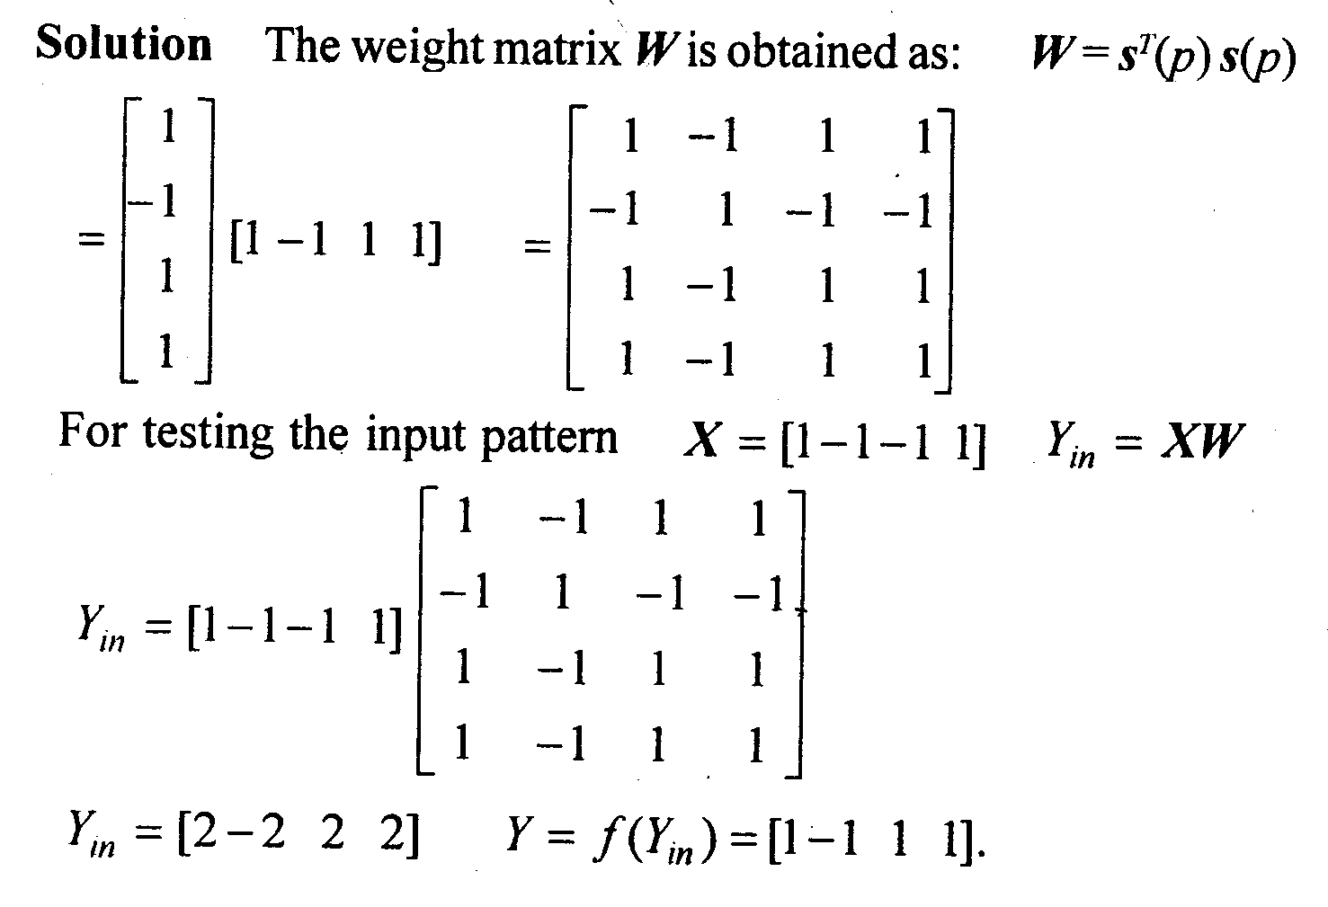
Autoassociative Memory: Example
Use an autoassociative network to store a vector s(p)= [1 -1 1 1]. Examine whether the associative net accurately retrieves the input vector [ 1 -1 -1 1].

Slide 13
ITERATIVE AUTOASSOCIATIVE NET
In some cases, the net does not respond immediately to an input signal with a stored target pattern, but the response may be enough like a stored pattern at least in the sense of having more nodes committed to the values of +1 or -1 and fewer nodes with the unsure response of 0 to suggest using this first response as input to the net again.
Discrete Hopfield Net
An iterative autoassociative net has been developed by Hopfield [1952].
The net is fully interconnected in the sense that each unit is connected to every other unit.
The net has symmetric weights with no self-connections, i.e. w_{ij} = w_{ji} and w_{ii} = 0.
The small difference between this network and the autoassociative net with the threshold function is that it can have significant effect in terms of whether or not the nets converge for a particular input pattern.

Slide 14
ITERATIVE AUTOASSOCIATIVE NET
The limitations that are in the Hopfield net are presented here.
Only one unit updates its activation at a time (based on the signal it received from each other unit) and
unit continues to receive an external signal in addition to the signal from other units in the net.
The asynchronous updating of the unit allows a function, known as energy or Lyapunov function, to be found on the net.
The existence of such a function enables us to provide a net that will converge to a stable set of activations rather than oscillating.
The original formulation of discrete Hopfield net showed the usefulness of the net as content addressable memory.
Later, extensions for continuous-valued activations can be used either for pattern association or constrained optimization.

Slide 15
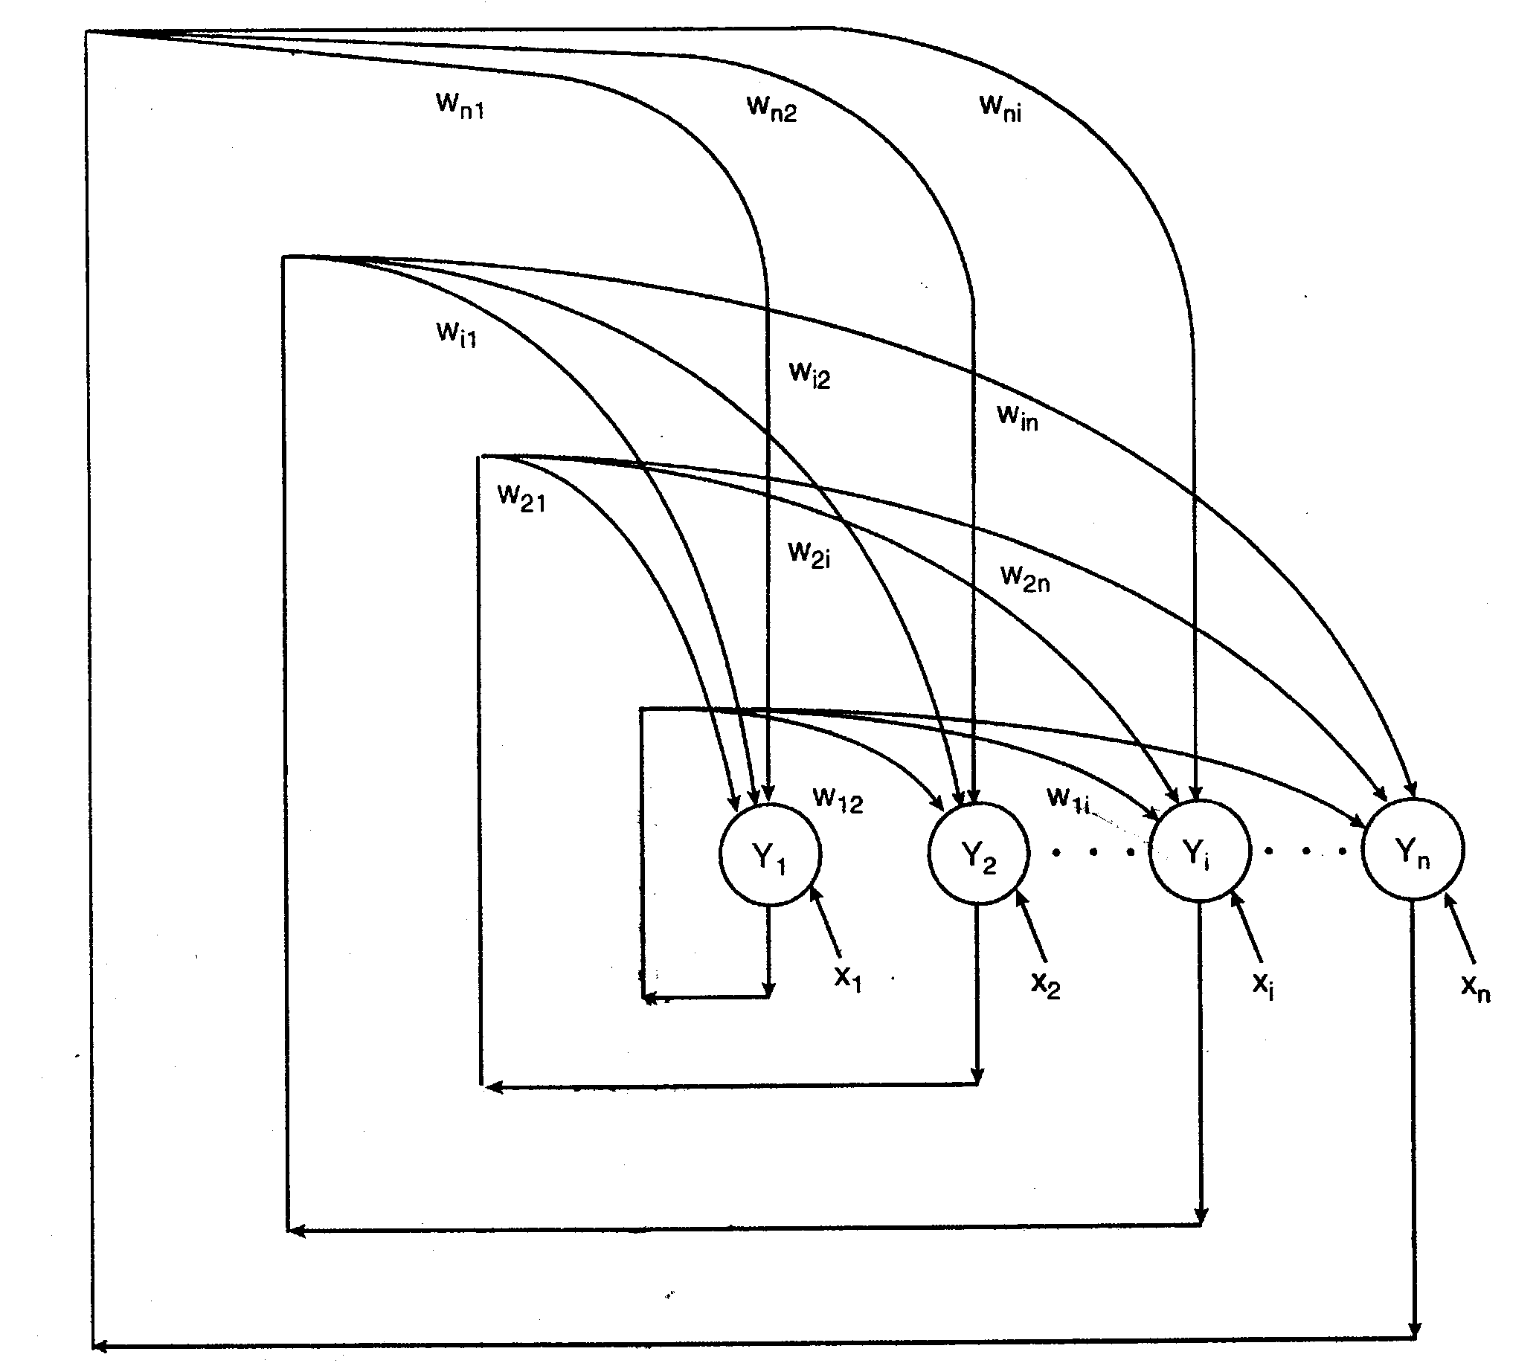
ITERATIVE AUTOASSOCIATIVE NET
Architecture

Slide 16
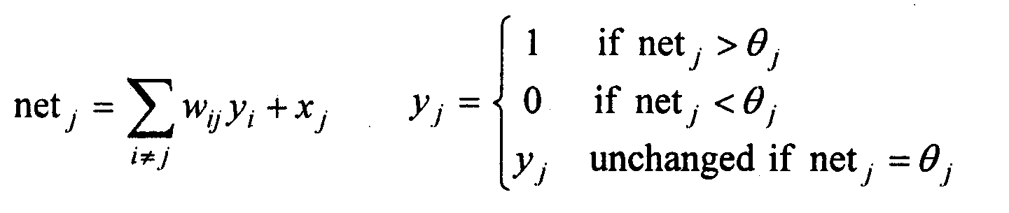
ITERATIVE AUTOASSOCIATIVE NET
Activation function: In Hopfield network, the activation function is a simple threshold as below
Energy
Hopfield has made an analogy between training the neural network and minimizing a value which has been interpreted as its global 'energy'.

Slide 17
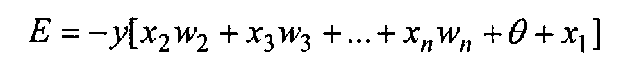
ITERATIVE AUTOASSOCIATIVE NET: Energy
A neuron that has a large positive weight associated with it is likely to fire when the input to the neuron is one, i.e., a large positive weight means that the neuron fires easily with a stimulus on one of its inputs.
On the other hand, an input with a small positive value will probably not be able to make the neuron fire on its own.
In this case, a lot of stimulus or energy is required. Finally, inputs with negative weights will inhibit the neuron and so even more energy is required on the inputs to cause the neuron to fire.
From the above discussion, it is evident that energy in a neural net is related to the negative sum of all the weighted inputs of the neurons. For a single neuron, the energy at a particular time is defined as:

Slide 18
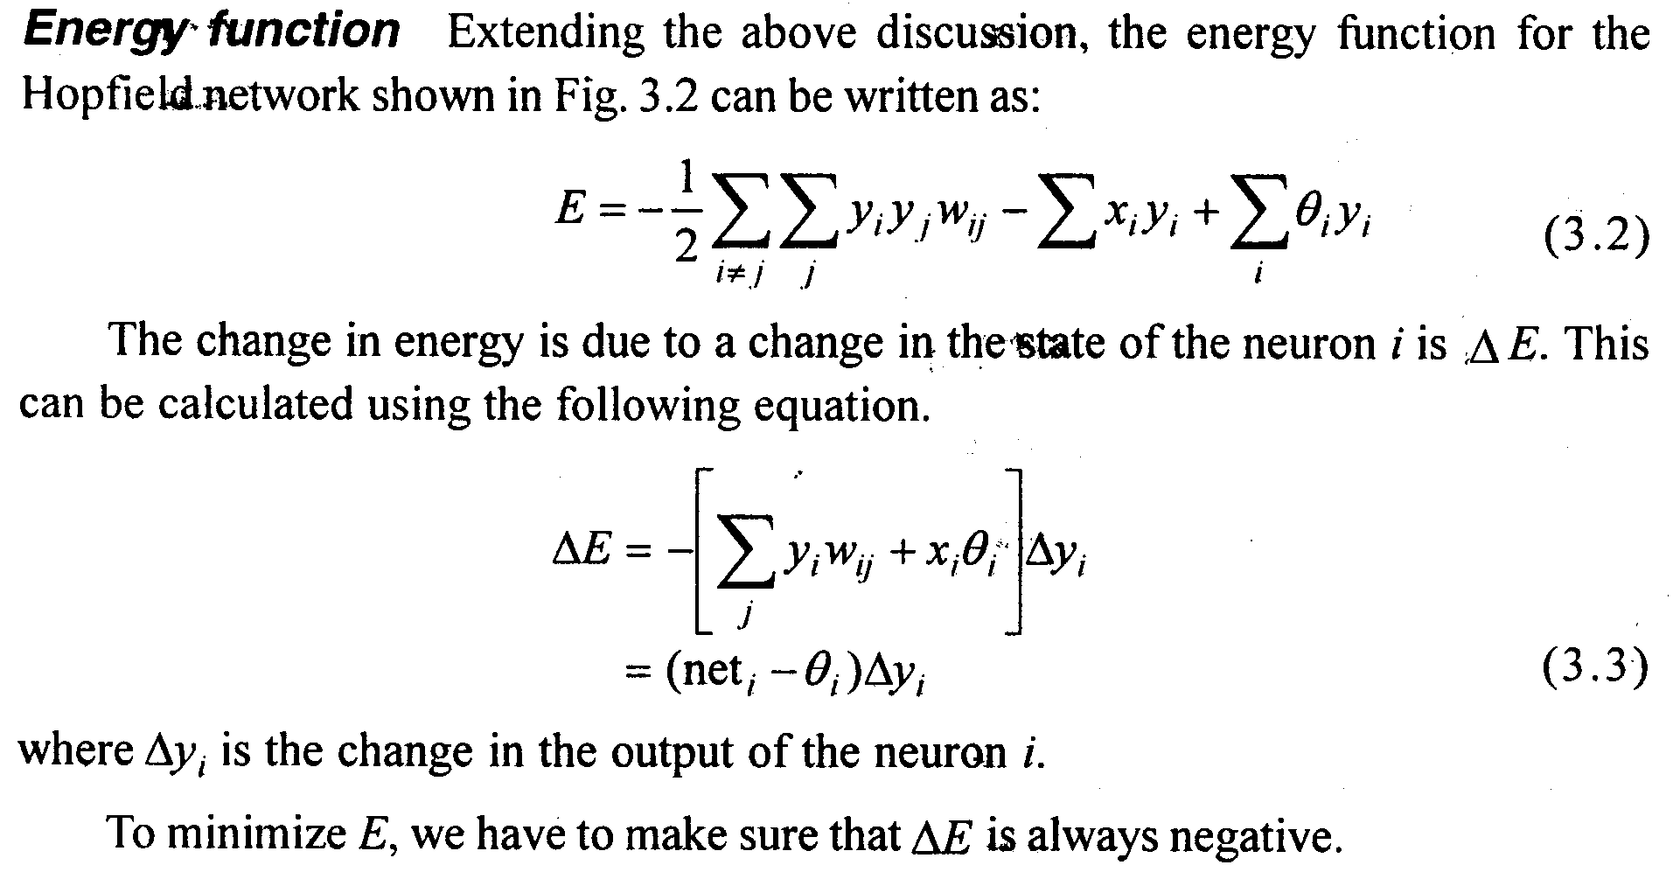
ITERATIVE AUTOASSOCIATIVE NET: Energy

Slide 19
ITERATIVE AUTOASSOCIATIVE NET: Energy
lf the net value of the neuron i is greater than the threshold, the term in the brackets will be positive, and making use of the activation function, it can be further stated that the output of the neuron i must change in the positive direction (or remain constant).
This means that ∆y, can be positive or zero and ∆E must be negative; hence the network energy must decrease or stay constant.
If the net value of the neuron is less than the threshold, then ∆y can be negative or zero; hence again the energy must decrease or remain constant.
Finally, if the net equals the threshold θ_{i}, the energy remains unchanged. It can be observed that any change in the system state will either reduce the energy or maintain its current value. As the energy shows a continuous downward trend, eventually it must find a minimum and stop when the network has attained a stable condition.

Slide 20
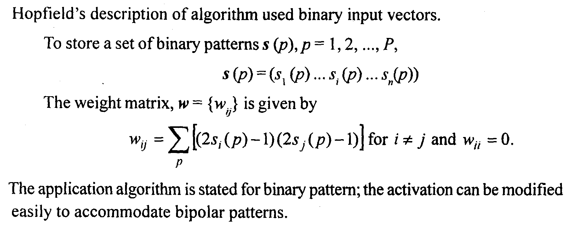
ITERATIVE AUTOASSOCIATIVE NET: Algorithm

Slide 21
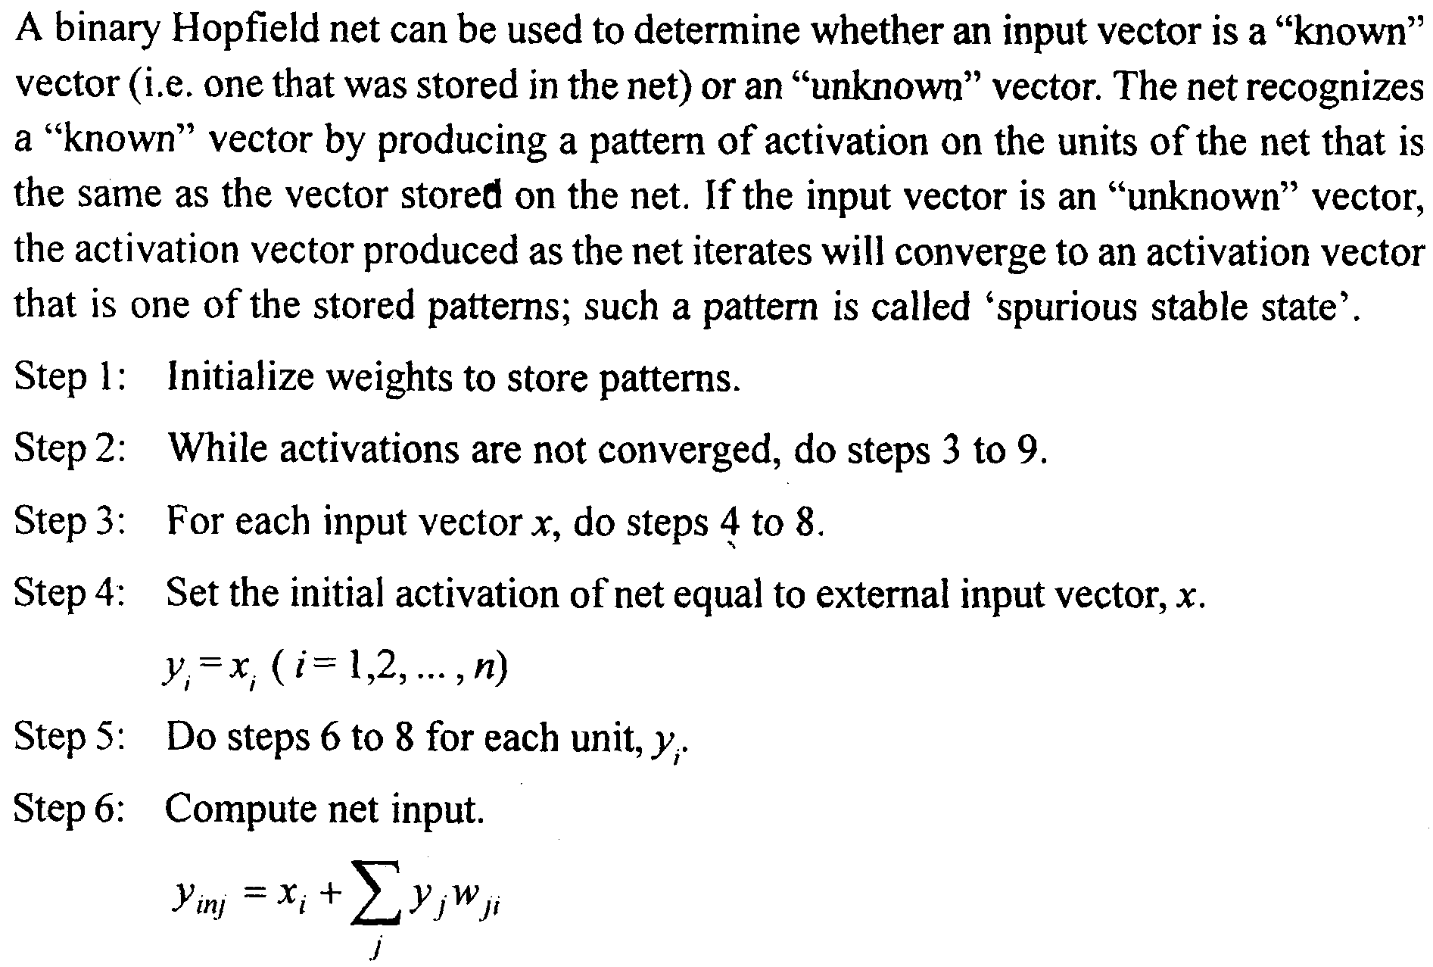
ITERATIVE AUTOASSOCIATIVE NET: Application

Slide 22
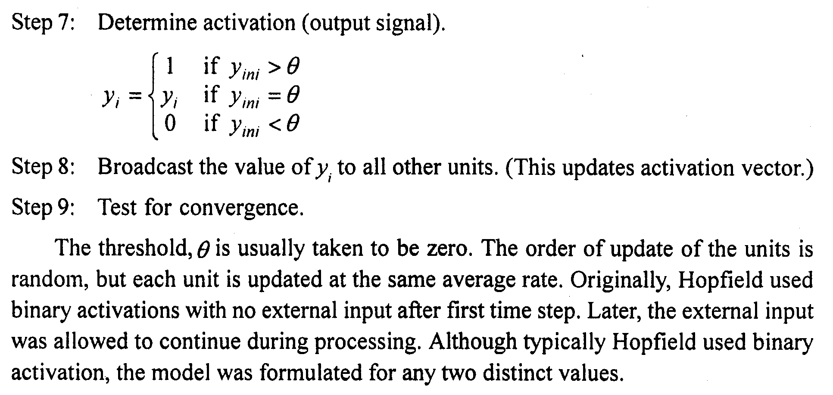
ITERATIVE AUTOASSOCIATIVE NET: Application

