Slide 1
TRAINING AN ARTIFICIAL NEURAL NETWORK
The most important characteristic of an artificial neural network is its ability to learn.
Generally, learning is a process by which a neural network adapts itself to a stimulus by properly making parameter adjustments and producing a desired response.
Learning (training) is a process in which the network adjusts its parameters the (synaptic weights) in response to input stimuli so that the actual output response converges to the desired output response.

Slide 2
TRAINING AN ARTIFICIAL NEURAL NETWORK
When the actual output response is the same as the desired one, the network has completed the learning phase and the network has acquired knowledge.
Learning or training algorithms can be categorized as:
Supervised training
Unsupervised training
Reinforced training

Slide 3
TRAINING AN ARTIFICIAL NEURAL NETWORK
Supervised Training:
Supervised training requires the pairing of each input vector with a target vector representing the desired output. These two vectors are termed together as training pair.
During the training session an input vector is applied to the net, and it results in an output vector.
This response is compared with the target response. If the actual response differs from the target, the net will generate an error signal.
This error signal is then used to calculate the adjustment that should be made in the synaptic weights so that the actual output matches the target output.

Slide 4
TRAINING AN ARTIFICIAL NEURAL NETWORK
The error minimization in this kind of training requires a supervisor or a teacher, hence the name supervised training.
In artificial neural networks, the calculation that is required to minimize errors depends on the algorithm used, which is normally based on the optimization techniques.
Supervised training methods is used in to perform nonlinear mapping in pattern classification nets. pattern association nets and multilayer neural nets.

Slide 5
TRAINING AN ARTIFICIAL NEURAL NETWORK
Unsupervised Training:
Unsupervised training is employed in self-organizing nets and it does not require a teacher.
In this method, the input vectors of similar types are grouped without the use of training data to specify how a typical member of each group looks or to which group a member belongs.
During training the neural network receives input patterns and organizes these patterns into categories. When new input pattern is applied, the neural network provides an output response indicating the class to which the input pattern belongs.

Slide 6
TRAINING AN ARTIFICIAL NEURAL NETWORK
lf a class cannot be found for the input pattern, a new class is generated.
Even though unsupervised training does not require a teacher, it requires certain guidelines to form groups.
Grouping can be done based on color, shape or any other property of the object. If no guidelines are given grouping may or may not be successful.
Reinforced Training
Reinforced training is similar to supervised training. In this method, the teacher does not indicate how close is the actual output to the desired output, but yields only a pass or a fail indicator. Thus, the error signal generated during reinforced training is binary.

Slide 7
McCULLOCH - PITTS NEURON MODEL
Warren McCulloch and Walter Pitts presented the first mathematical model of a single biological neuron in 1943. This model is known as McCulloch - Pitts model.
This model is not require learning or adoption and the neurons are binary activated. If the neuron fires, it has an activation of l and otherwise, it has an activation of 0.
The neurons are connected by excitatory or inhibitory weights. Excitatory connection has positive weights, and inhibitory connection has negative weights.

Slide 8
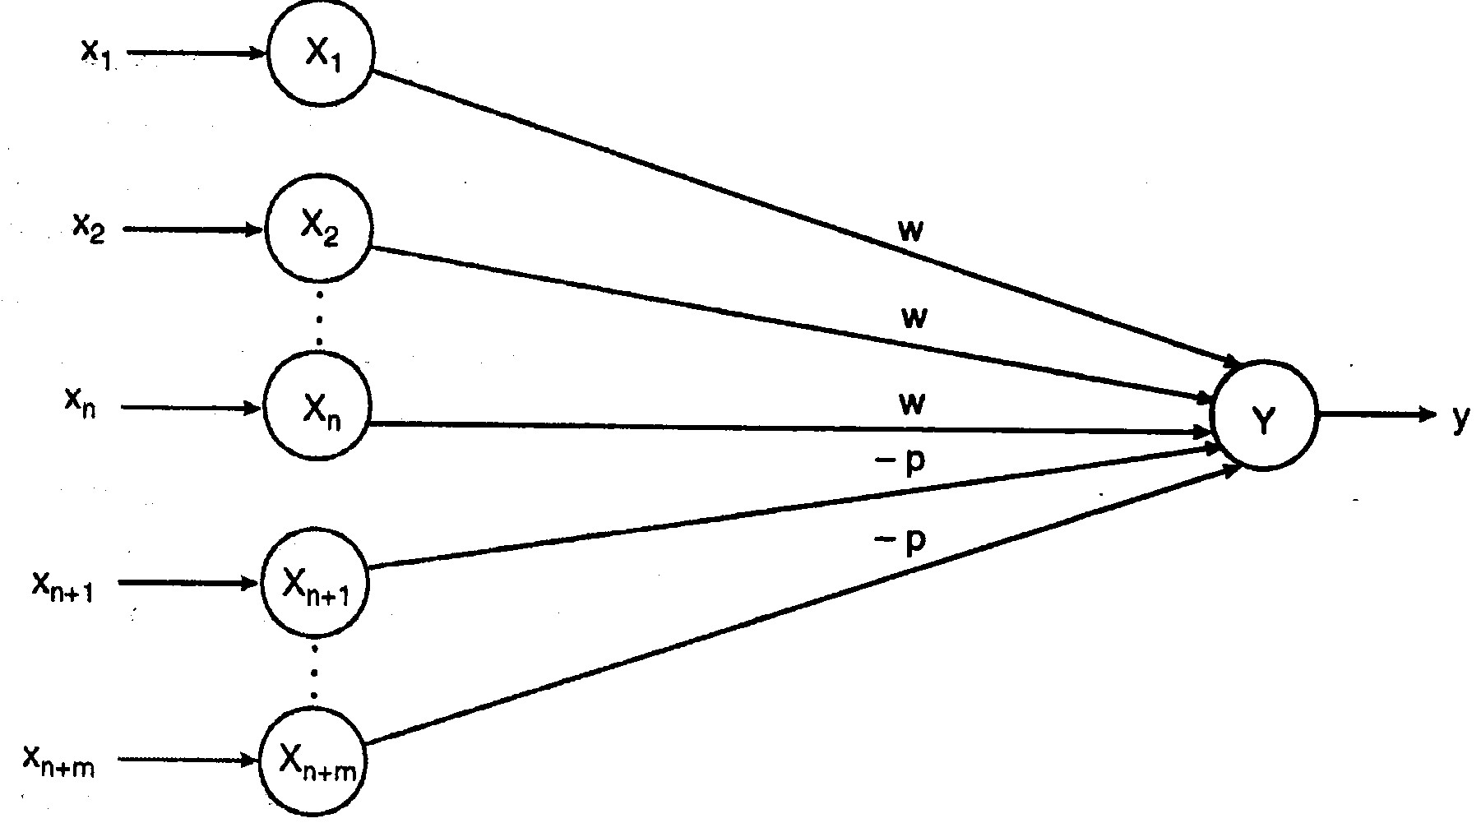
McCULLOCH - PITTS NEURON MODEL
All the excitatory connection in a particular neuron have the same weight. Each neuron has a fixed threshold such that if the net input to the neuron is greater than the threshold the neuron should fire.
The threshold is set such that the inhibition is absolute. This means any non-zero inhibitory input will prevent the neuron from firing.

Slide 9
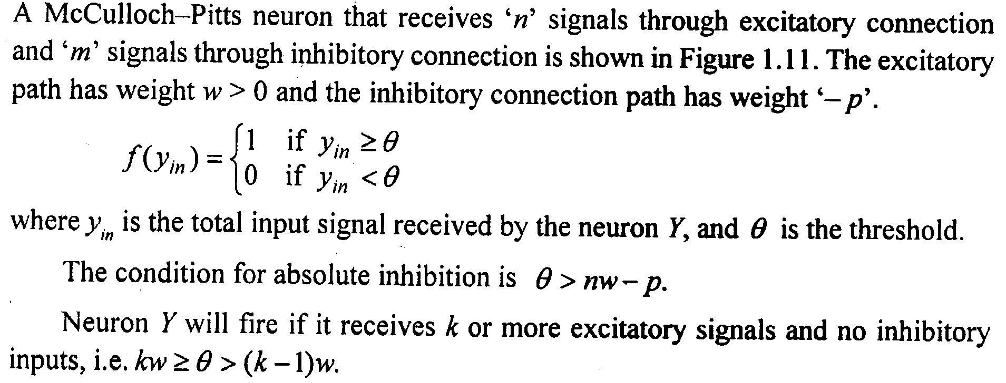
McCULLOCH - PITTS NEURON MODEL

Slide 10
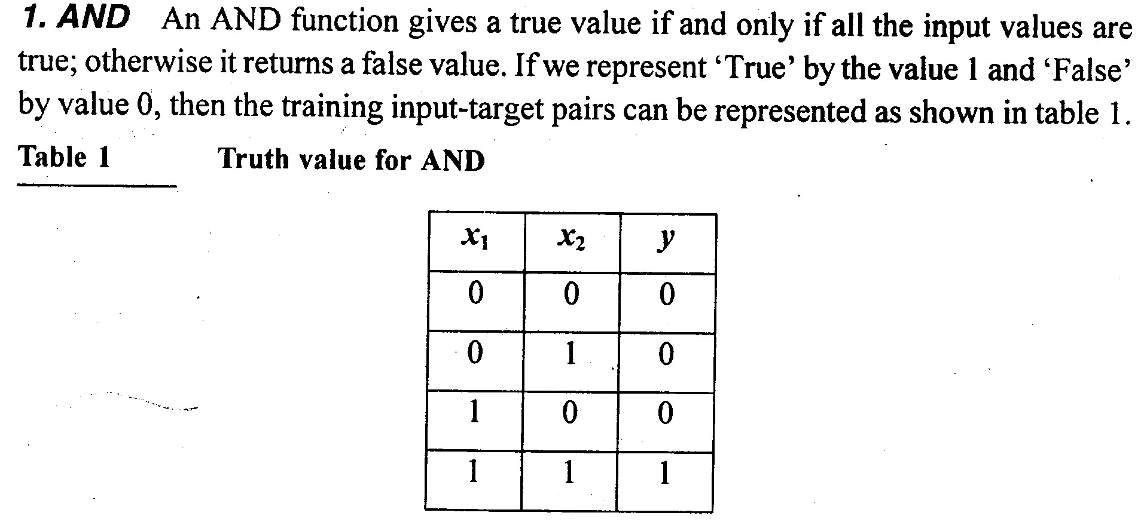
McCULLOCH - PITTS NEURON MODEL
Implementation of McCULLOCH - PITTS Networks for logic functions

Slide 11
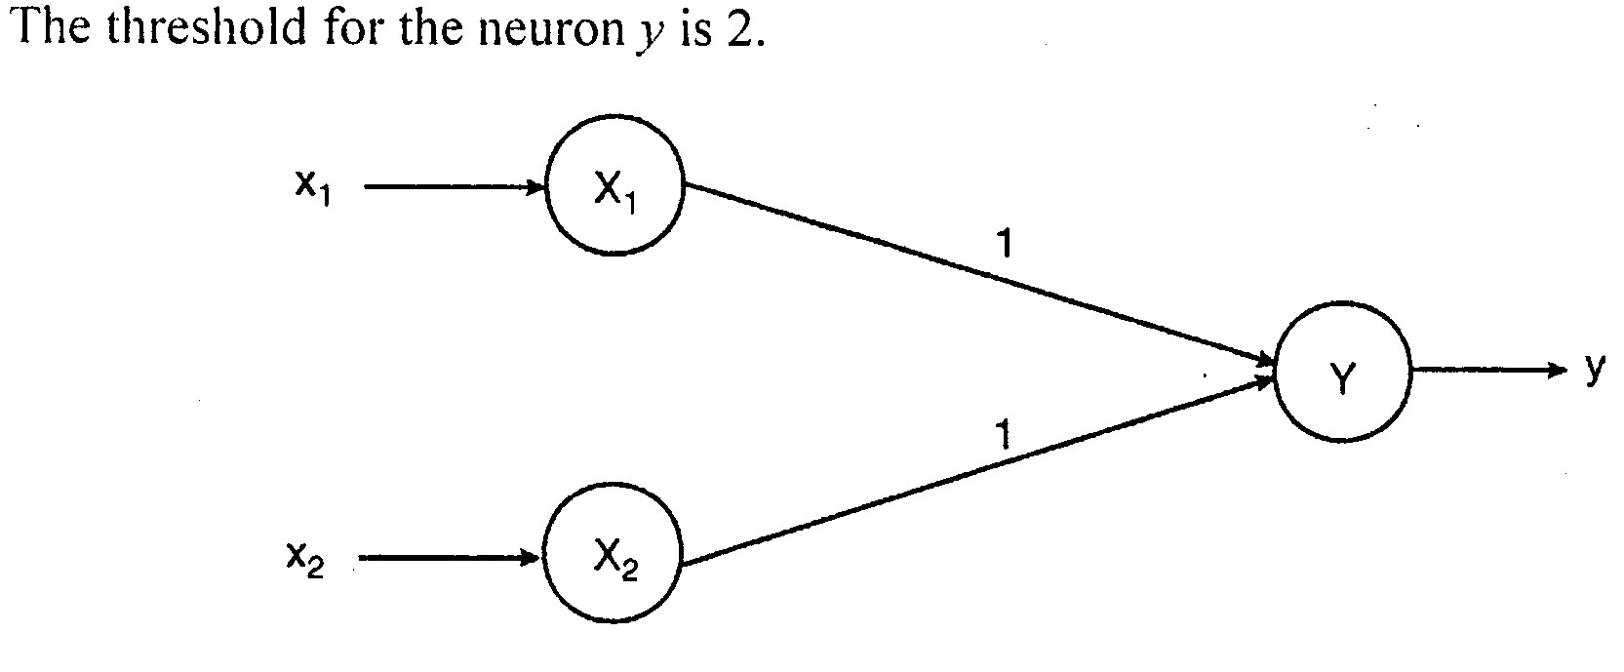
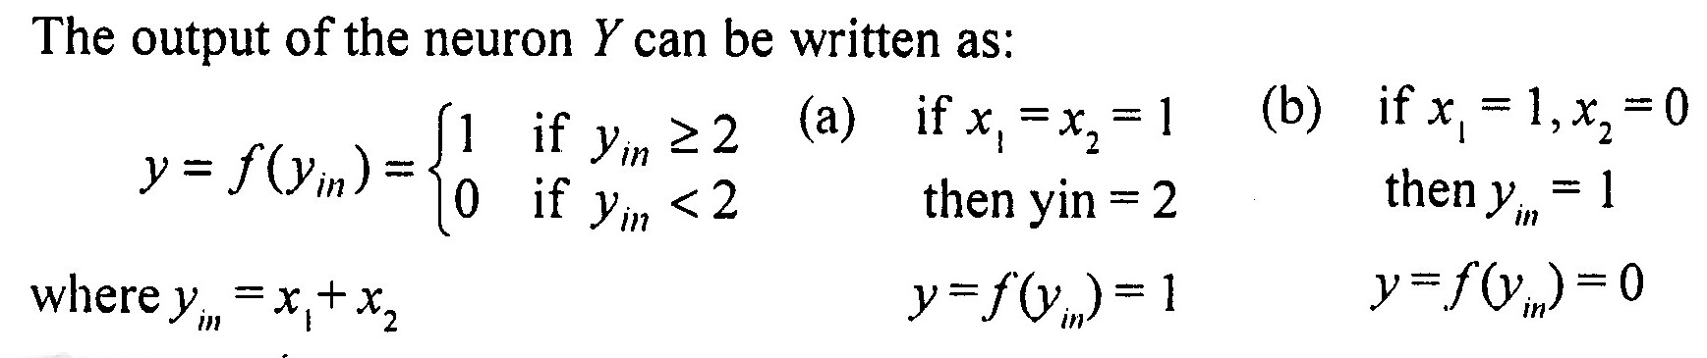
McCULLOCH - PITTS Networks for logic functions

Slide 12
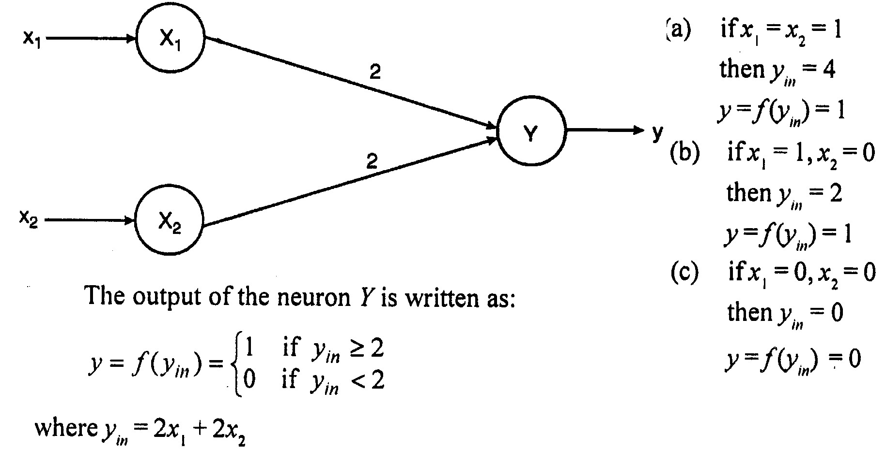
McCULLOCH - PITTS Networks for logic functions
2. OR Function

Slide 13
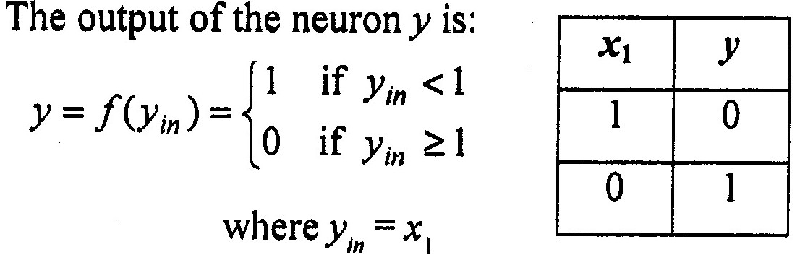
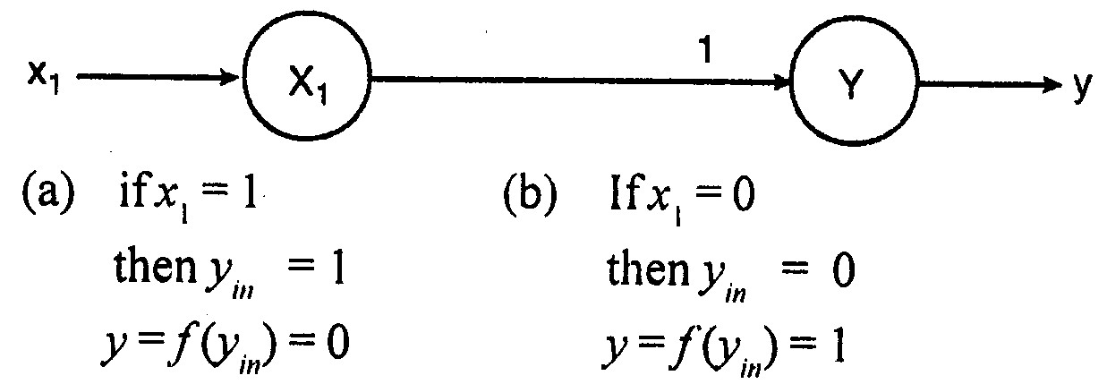
McCULLOCH – PITTS: NOT Function
3. NOT Function

Slide 14
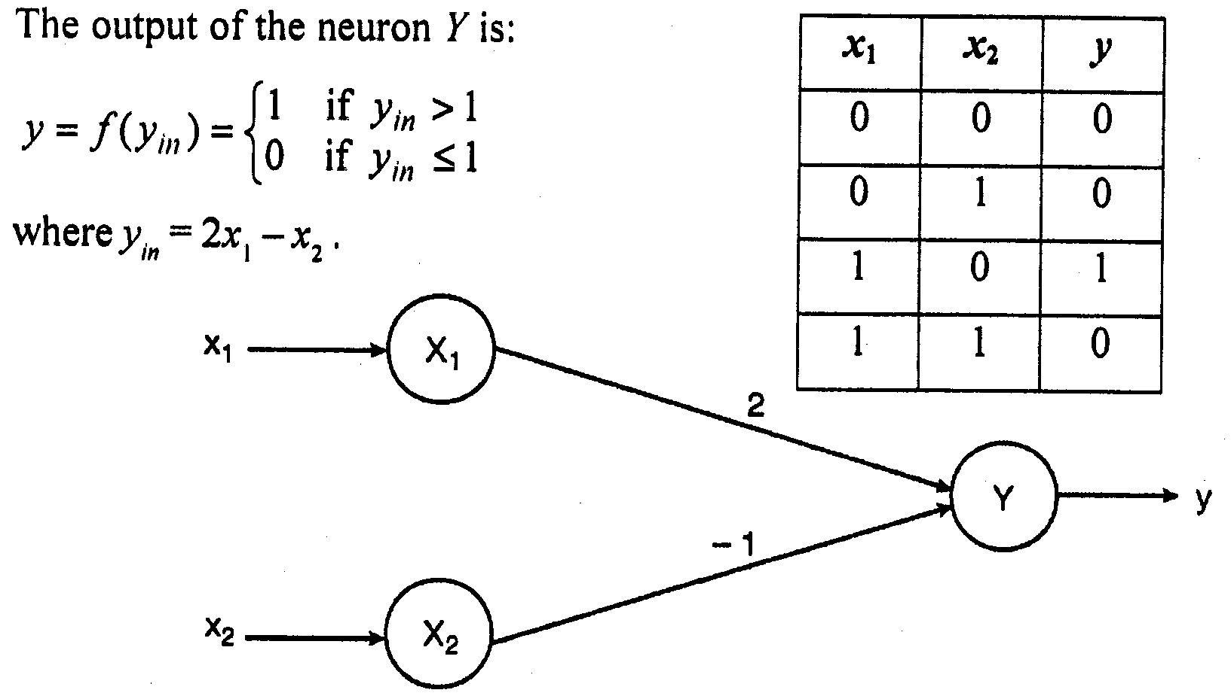
McCULLOCH – PITTS: AND NOT Function
4. AND NOT Function

Slide 15
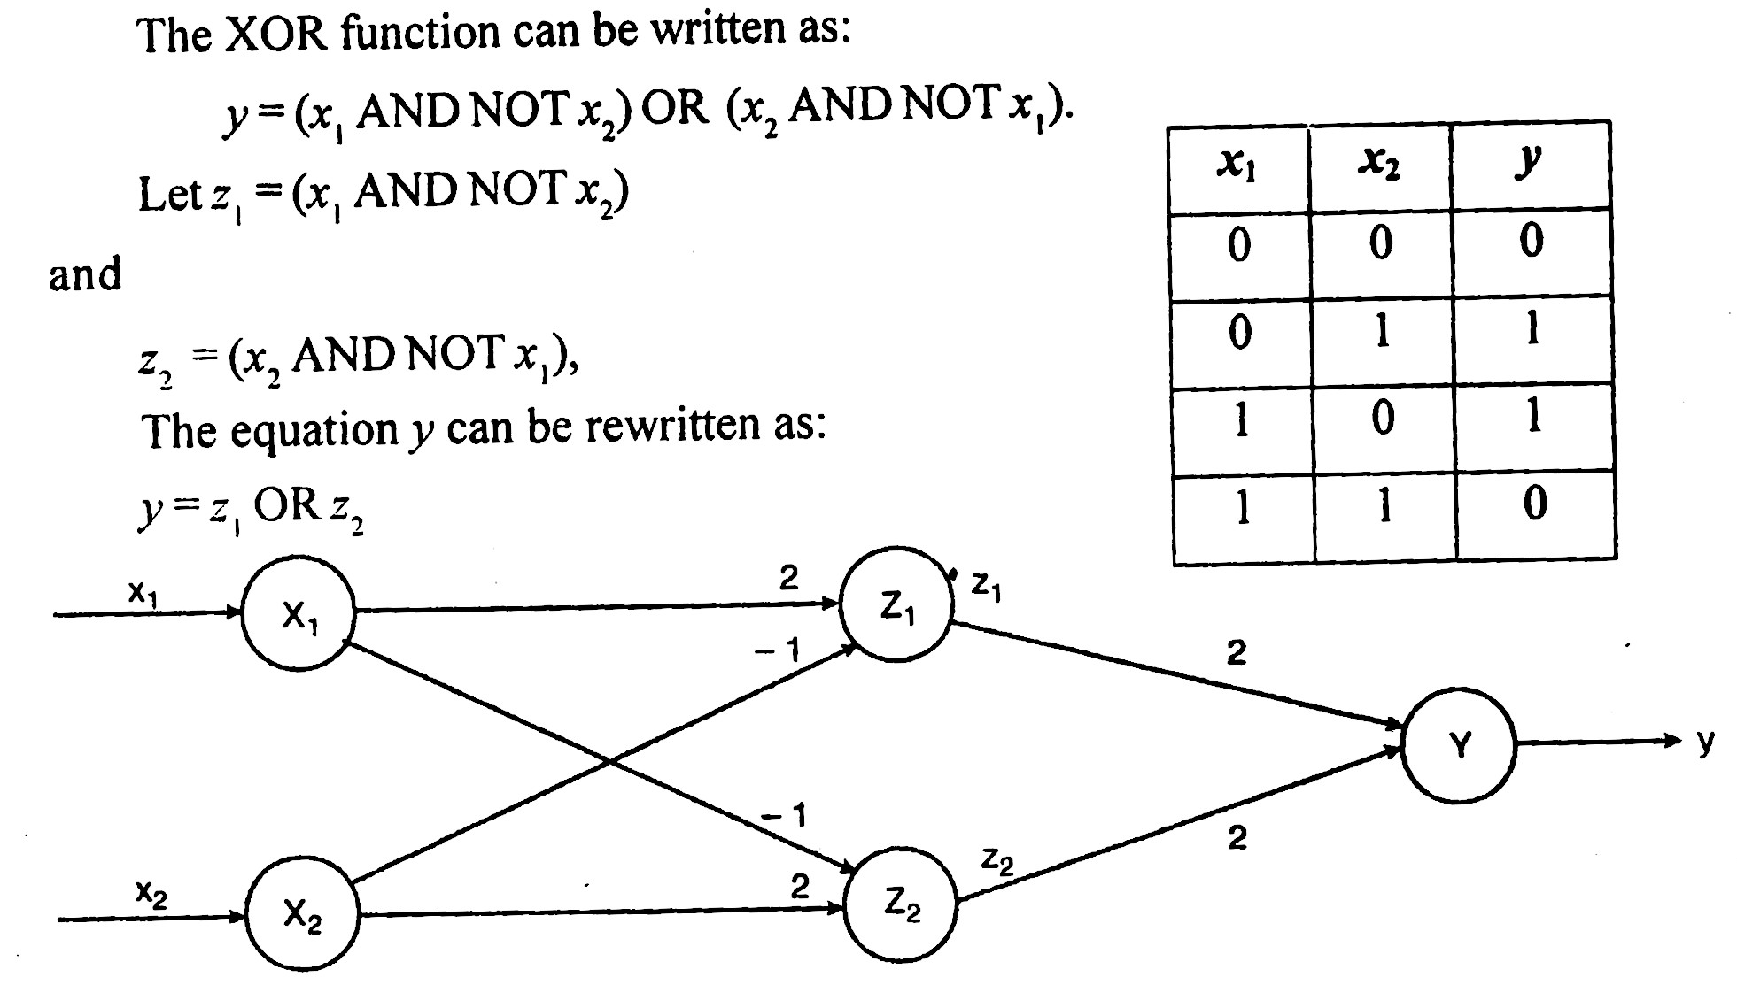
McCULLOCH – PITTS: XOR Function
5. XOR Function

Slide 16
Applications of Neural Networks
There have been many impressive demonstrations of artificial neural networks. A few areas where neural networks are mentioned below.
Classification
which is an important aspect in image classification. Neural successfully in a large number of classification tasks which includes
(a) Recognition of printed or handwritten characters.
(b) Classification of SONAR and RADAR signals.

Slide 17
Applications of Neural Networks
Signal Processing
In digital communication systems, distorted signals cause inter-signal interference.
One of the first commercial applications of ANN was to suppress noise cancellation and it was implemented by Widrow using ADALINE.
The ADALINE is trained to remove the noise from the telephone line signal.

Slide 18
Applications of Neural Networks
Speech Recognition
In recent years, speech recognition has received enormous attention.
It involves three modules namely, the front end which samples the speech signals and extracts the data.
The word processor, finds the probability of words in the vocabulary.
The sentence processor, to determine the sense in the sentence.

Slide 19
McCULLOCH – PITTS: NOT Function
Medicine
Intelligent control
Function Approximation
Financial Forecasting
Condition Monitoring
Process Monitoring and Control
Neuro Forecasting
Pattern Analysis

