Slide 1
DSAI hw2 adder & subtractor
醫資所 Q56084072
陳怡君

Slide 2
Outline
Coding part
Adder model
Subtractor model
Combination-of-adder-and-subtractor model
Report part
Analyze the results under different training epoch and training size
Analyze the results under different number of digits
Can we apply the same training approach for multiplication?
More digits per number ?
More numbers added ?

Slide 3
Coding part
Adder model
Subtractor model
Combination-of-adder-and-subtractor model

Slide 4
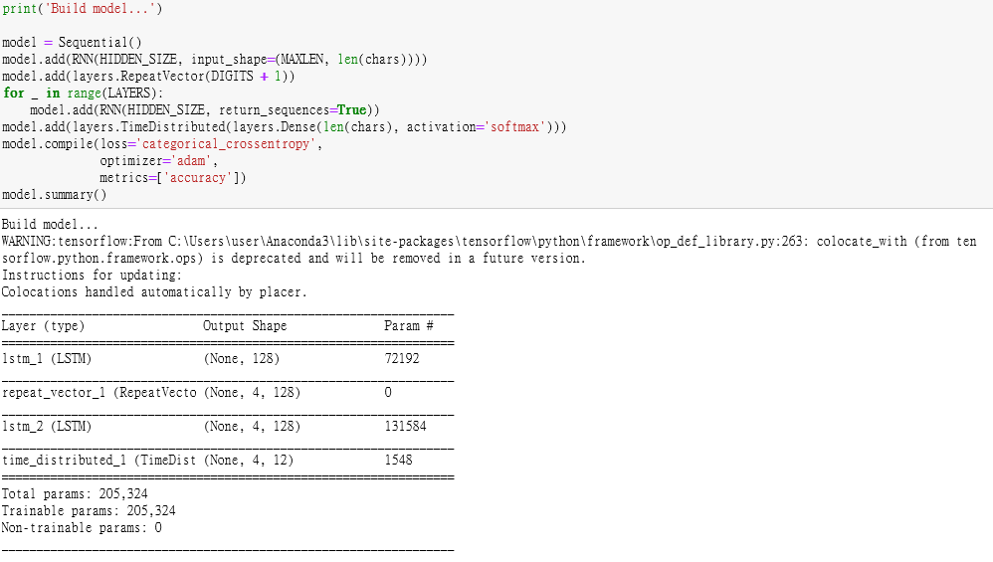
Adder model
Built by LSTM

Slide 5
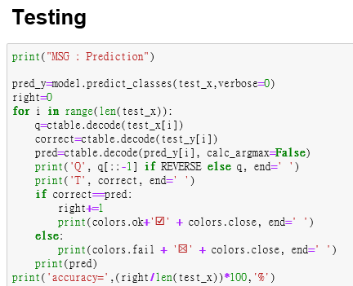
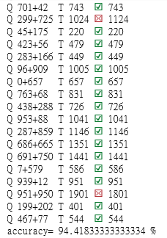
Adder model
Results after iteration=100

Slide 6
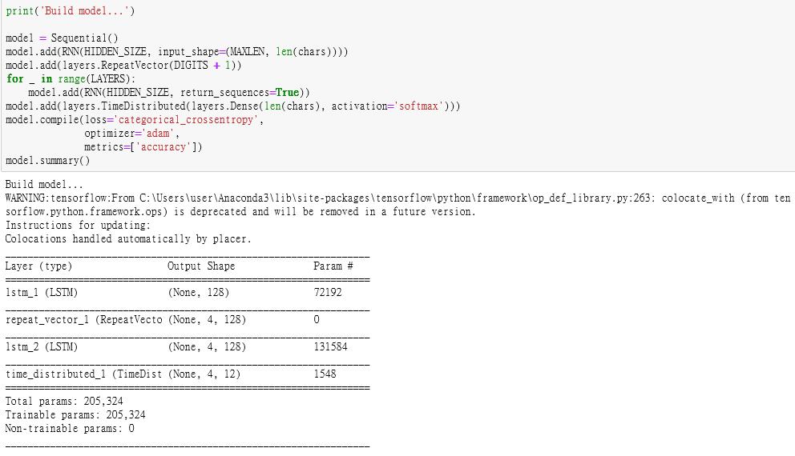
Subtractor model
Built by LSTM, and same as that of adder.

Slide 7
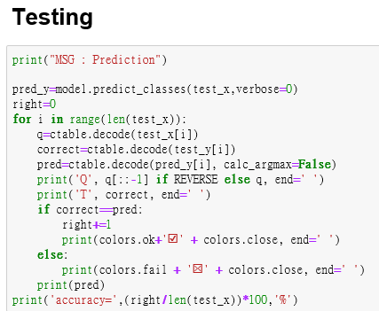
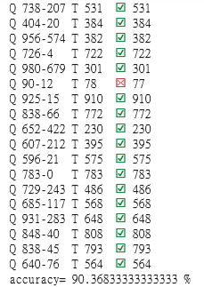
Subtractor model
Results after iteration=100
→The performance is worse than that of adder, probably because subtraction is more complex than addition.

Slide 8
Combination-of-adder-and-subtractor model
Built by LSTM, and same as that of adder.

Slide 9
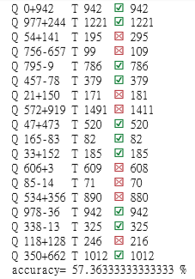
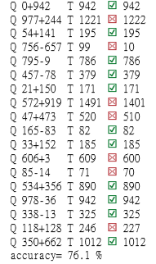
Combination-of-adder-and-subtractor model
Results after iteration=100
Results after iteration=200
→The performance is apparently worse than that of adder and subtractor, probably because combination is more complex than addition or subtraction only.

Slide 10
Reporting part
Analyze the results under different training epoch and training size
Analyze the results under different number of digits
Can we apply the same training approach for multiplication?
More numbers added ?

Slide 11
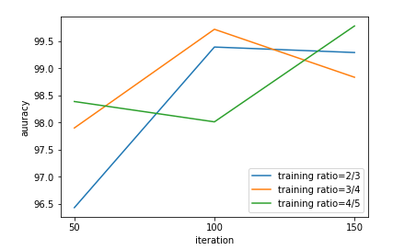
Analyze the results under different training epoch and training size
Training size= 2/3 , 3/4 , 4/5 of all data
Training epoch= 50, 100, 150
→Overall, the performance becomes better as epoch increasing.
→There may be a best number of epoch with different training size.

Slide 12
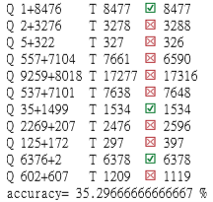
Analyze the results under different number of digits
Addition of two numbers with number of digits=4.
The same model as that of adder.
Results with iteration=100:
→The performance is apparently worse than that of 3-digits, probably because it’s too complex. Therefore, it may need more iterations to compute this well.

Slide 13
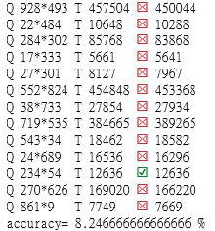
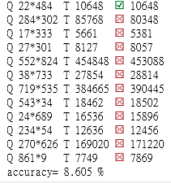
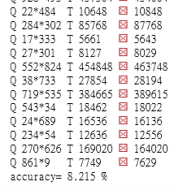
Can we apply the same training approach for multiplication?
The same model as that of adder.
Results:
HIDDEN_SIZE of model=128
iteration=100
HIDDEN_SIZE of model=256
iteration=100
HIDDEN_SIZE of model=128
iteration=200
→The performance is apparently worse than that of adder, subtractor and even combination, probably because it’s too complex. Therefore, this same model may not fit for multiplier.

Slide 14
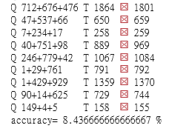
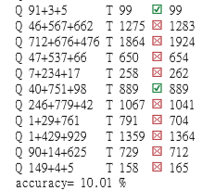
More numbers added ?
Addition of 3 numbers with number of digits=3.
The same model as that of adder.
Results:
Iteration=100
Iteration=200
→The performance is apparently worse than that of two numbers added, probably because it’s too complex. Therefore, it may need larger hidden layers or more iterations to compute this well.

