Slide 1
Contents
1
Problem and Datasources
2
Tools used
3
Algorithms and Models
4
Evaluation and Results
5
Improvements needed

Slide 2
Nil Picking Problem
The nil pick occurs when one or more orders are received for a product and when an insufficient amount of the product exists at the warehouse to satisfy the one or more orders.
This problem is very common for online ordering e-commerce platforms
Amazon
Walmart
Fanatics

Slide 3
Which feature are important?
Order
Row Nil Picked
ORDER_QTY
PROMO_AMT
VEND_NM
PICKER_ID
PICKED_QTY
PICK_STATUS_CD
EPOS_CMPL_LCL
FULFMT_TYPE
Not Nil Picked
ITEM_WT
PO_LINE_NUM
VEND_NM
PICKED_QTY
ITEM_PRICE

Slide 4
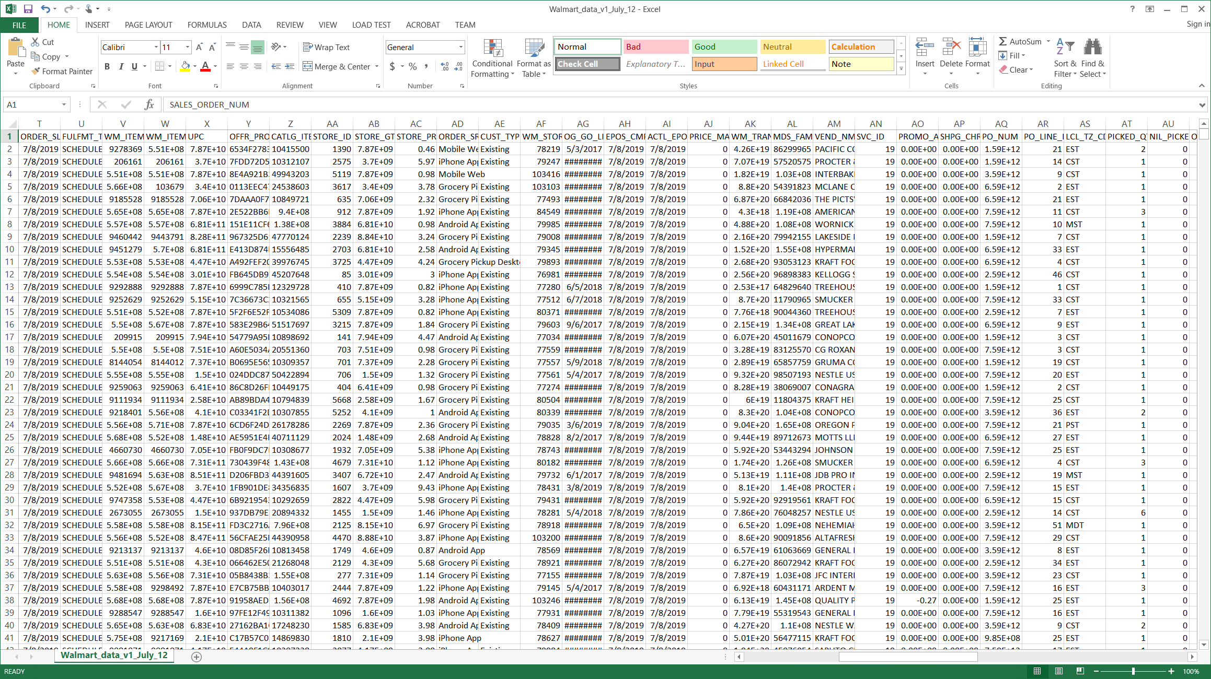
Dataset
Walmart Data Warehouse
Sample data export from Walmart transaction inventory
10GB of collected transactions over a month period
Numerical & Categorical

Slide 5
Tools used
Data Science
Pandas
Numpy
XGBoost
Sklearn
Technical
python
Sql server
json
Pycharm
Visualization
matplotlib
Category plots
Cluster plots

Slide 6
Method used
Visualize
Results
Preprocessing
Test Model
Code Flow
Clustering
XGboost

Slide 7
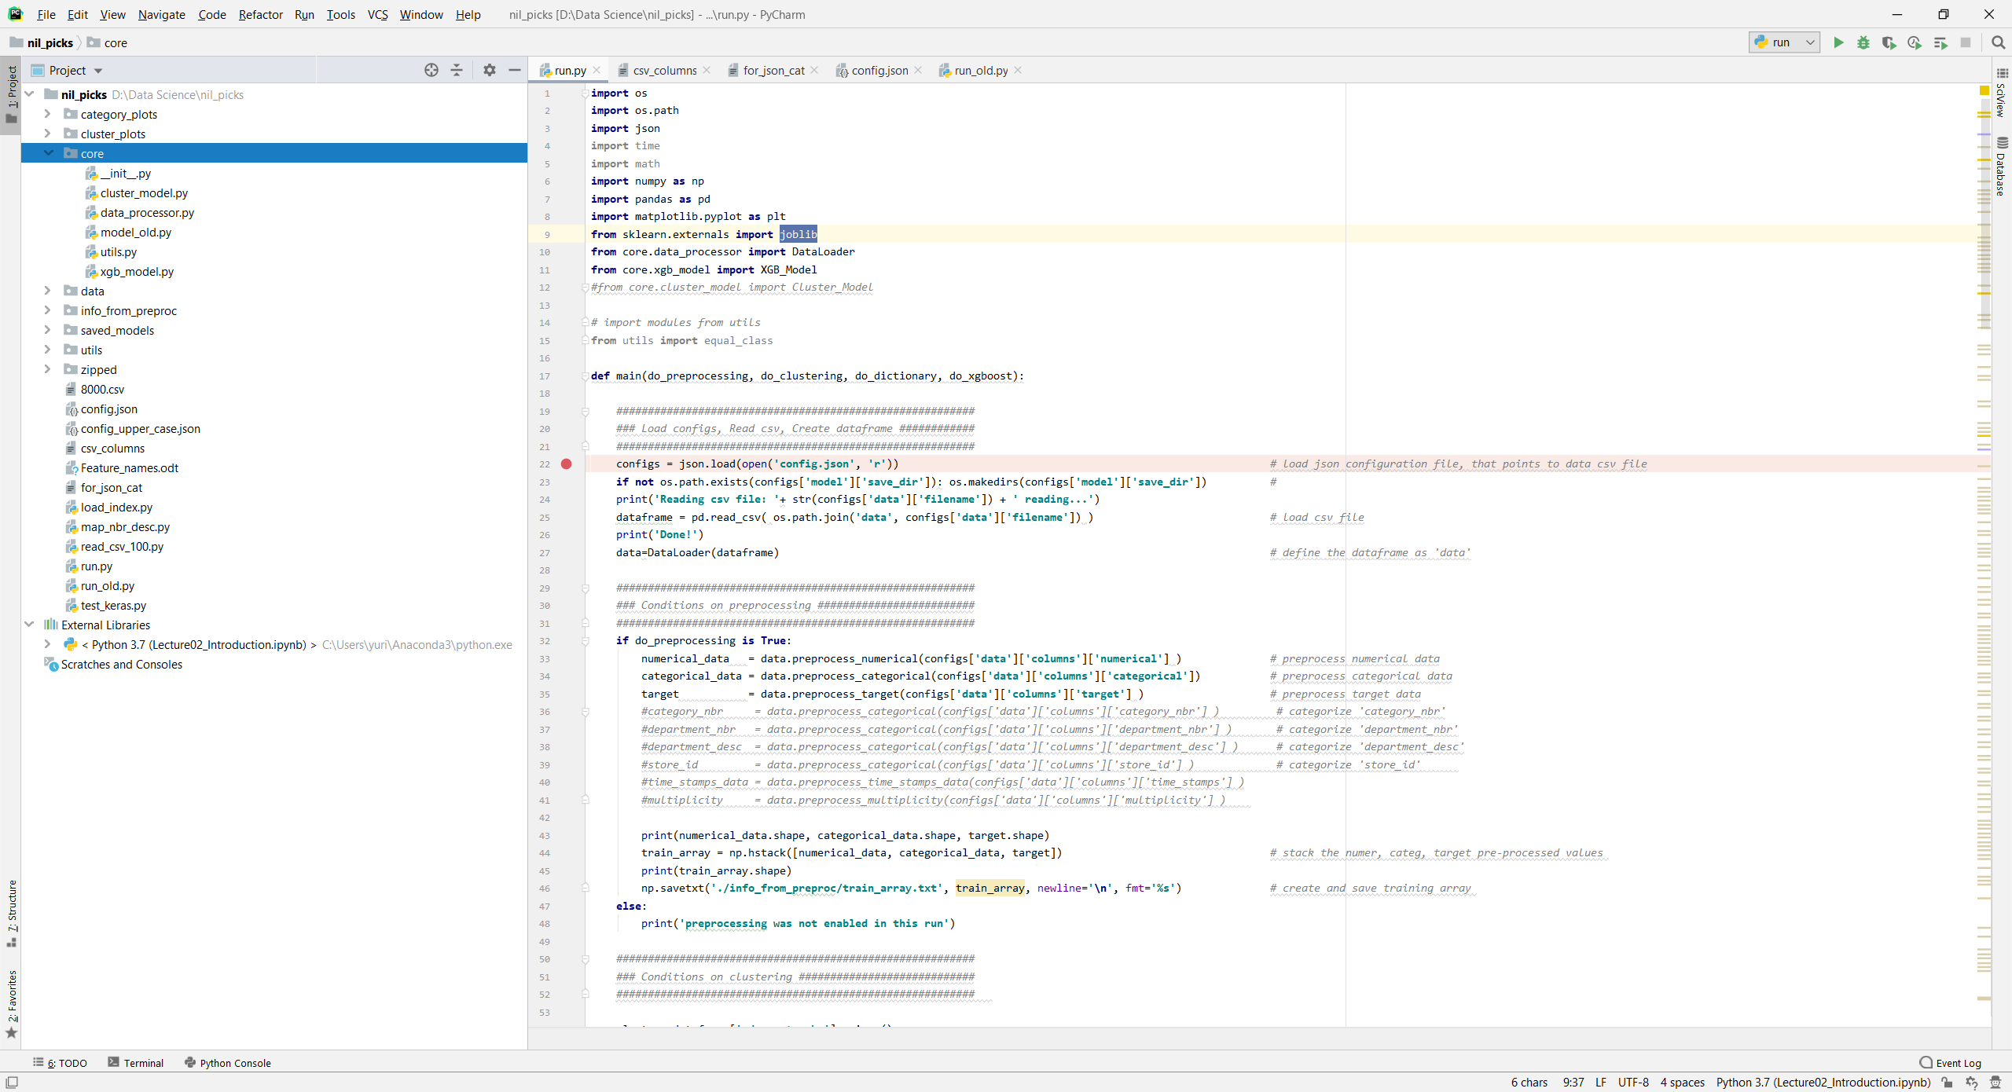
Architecture
Code organized into Core, Configs & Main runner. Core is mostly DataProcessor, ClusterModel, XgbModel
A

Slide 8
Algorithms used
Tree Pruning
B
Parallelization
A
C
Hardware
Optimization
XGBoost
E
D
Gradient Boosting
Decision tree based

Slide 9
Attempted steps
Boosting to succeed
we must have balanced classes in each category, which in the case of ordering platform is not necessary true.
Pre-processing to balance classes
K-Means clustering based on Department
XGBoost
Decision-tree-based ensemble algorithm that uses a gradient boosting framework. XGBoost a good fit: fast & deals with missing data

Slide 10
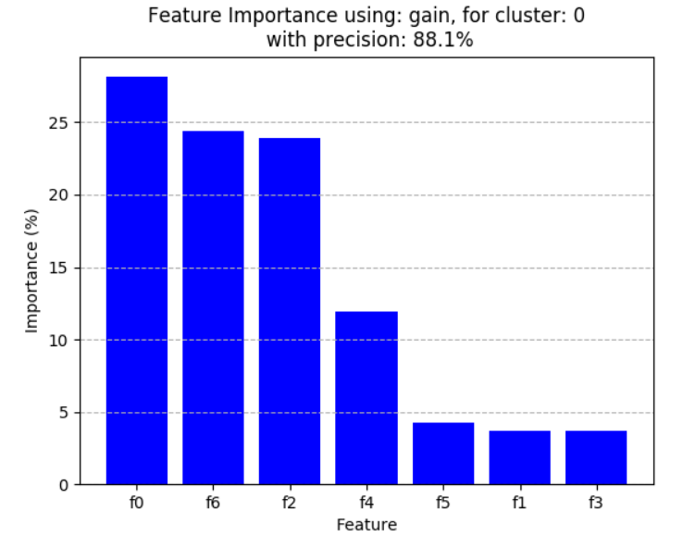
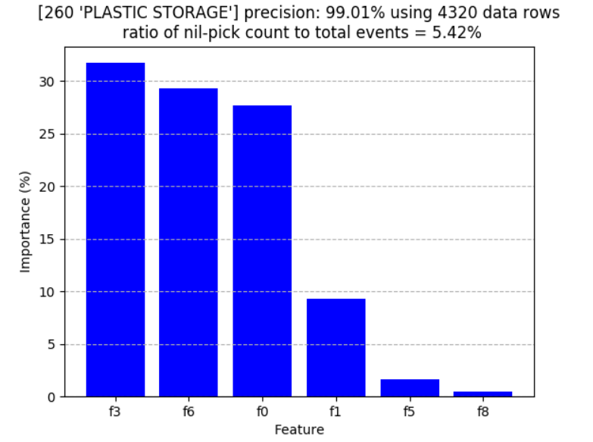
Evaluation
1
2
3
Cluster Plots
Feature importance using gain for clusters
Category Plots
Category importance
Trained Model
Saved pkl model per cluster

Slide 11
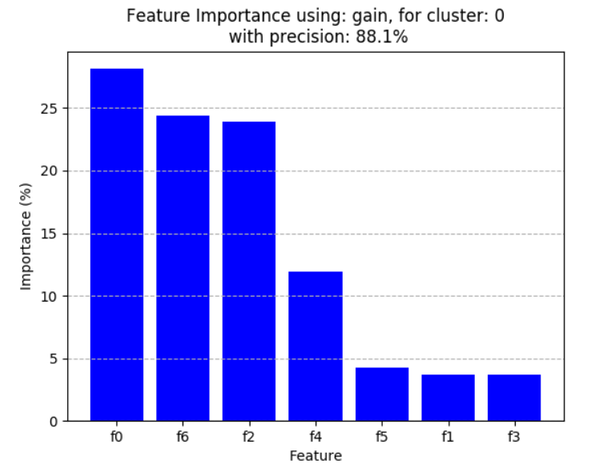
Cluster Plots

Slide 12
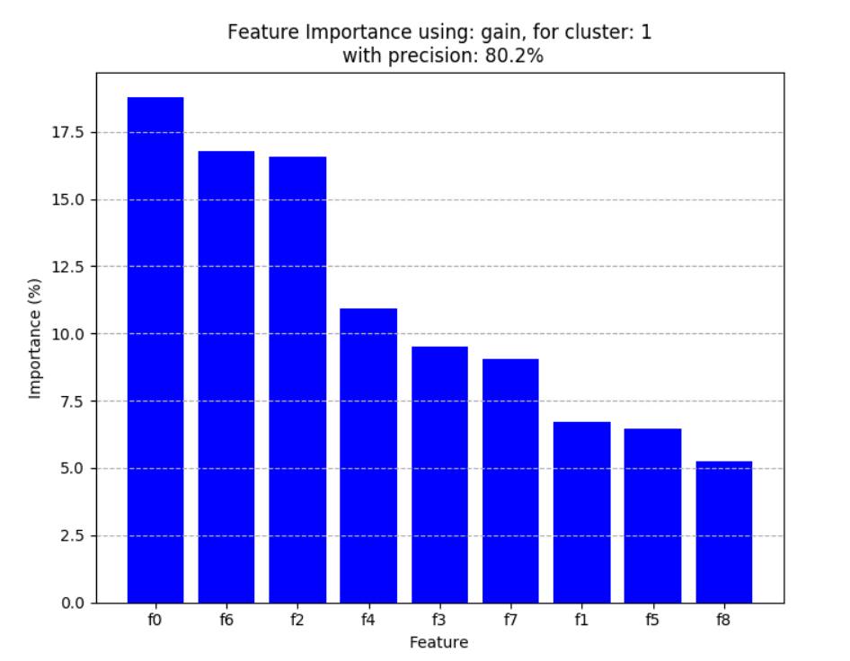
Cluster Plots

Slide 13
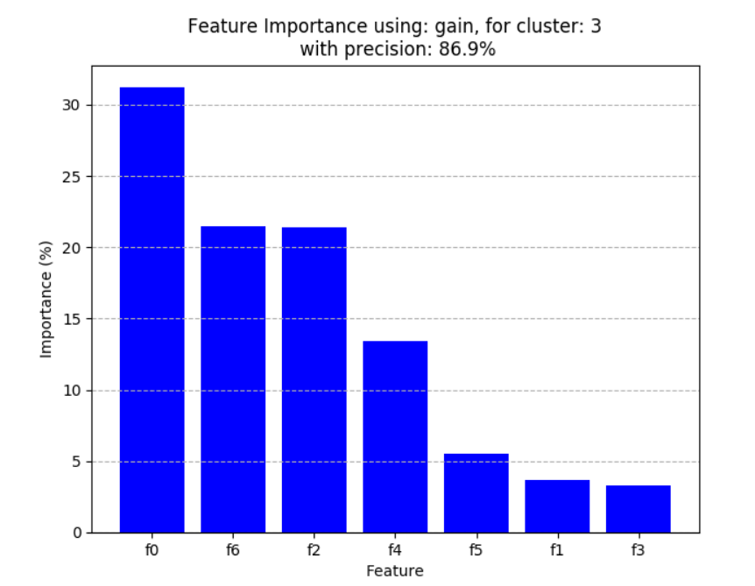
Cluster Plots

Slide 14
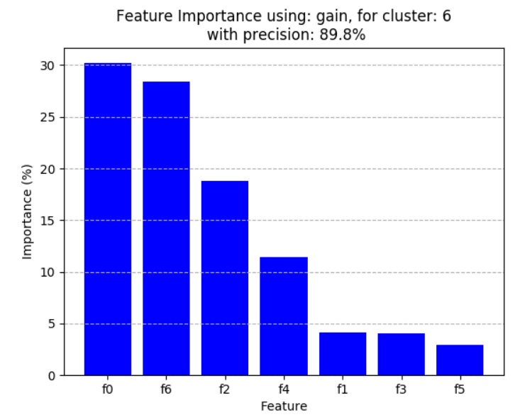
Cluster Plots

Slide 15
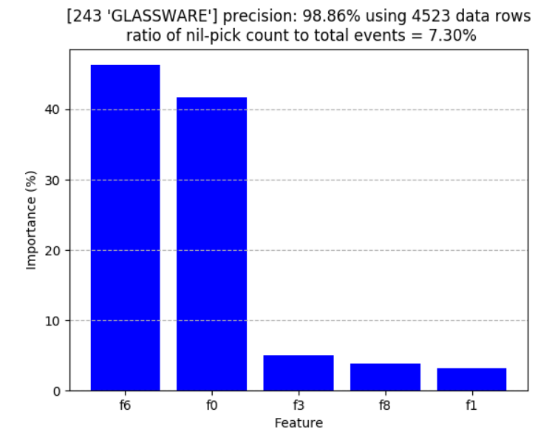
Category Plots

Slide 16
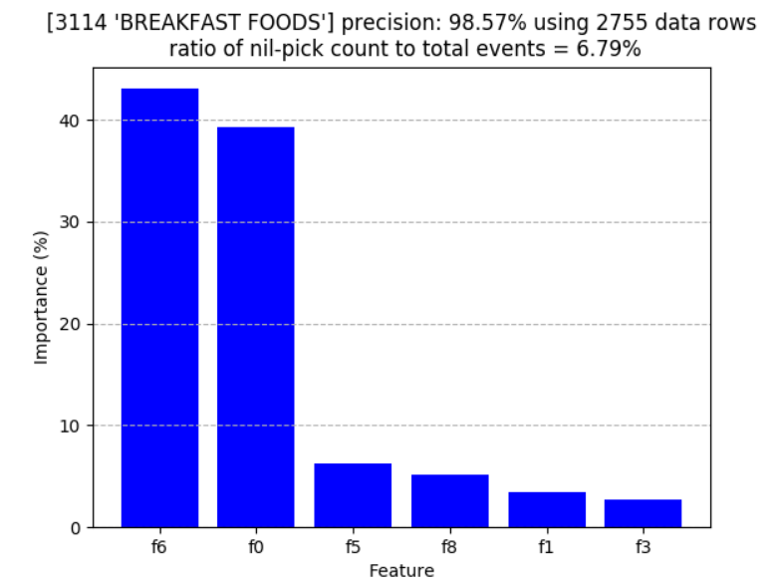
Category Plots

Slide 17
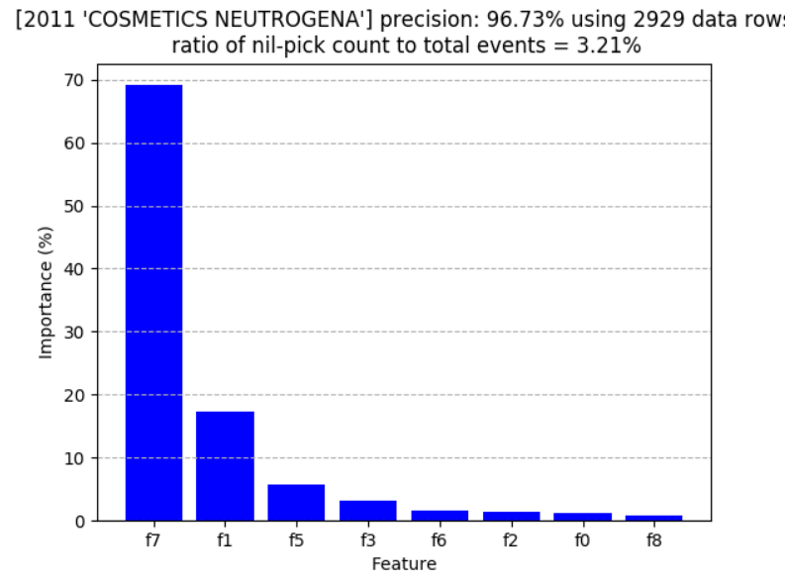
Category Plots

Slide 18
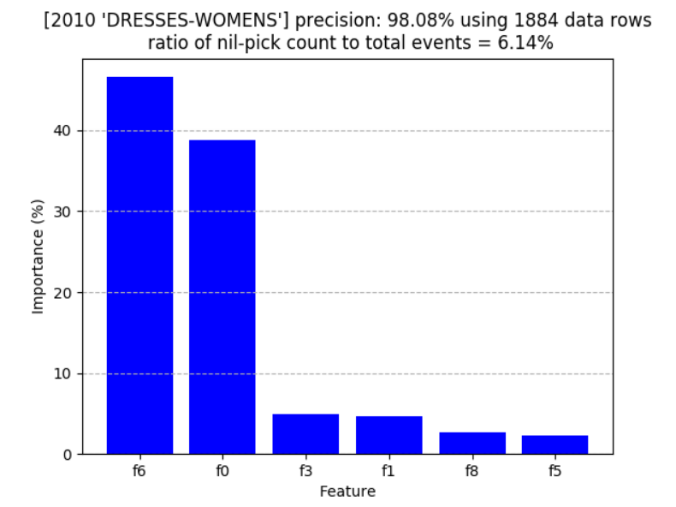
Category Plots

Slide 19
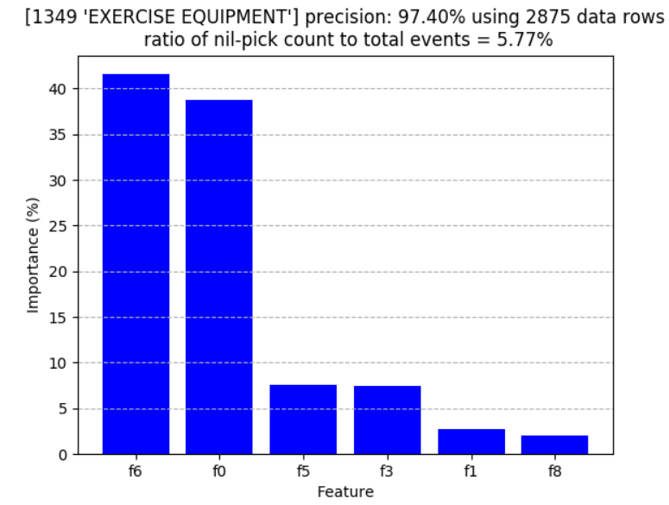
Category Plots

Slide 20
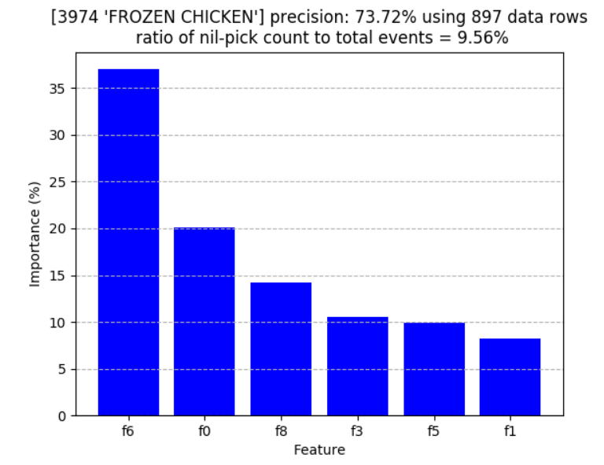
Category Plots

Slide 21
Issues & Improvements needed
Accuracy is not high enough. The requirements are for over 90% accuracy, we are achieving ~85%
To improve we will attempt fine-tuning hyper parameters using Grid search method

