Slide 1

Spectroscopic Investigation of a Repetitively-Pulsed Nanosecond Discharge
by
Benjamin T. Yee
Chair: John E. Foster
Notes:
Welcome; members of the committee, friends, family, and members of the public. Today, I will be presenting on the culmination of my research into pulsed-nanosecond discharges. This work is the culmination of six years of study on the properties of these unique, non-equilibrium plasmas. I hope to convey to you the history associated with these plasmas, what we do not know about them, what I have done in an attempt to improve our understanding, and a bit on where to go from here.

Slide 2
Outline
Plasma fundamentals
Examples and applications
Outstanding questions in pulsed plasmas
Metastable measurements
Global model
Emission measurements
Conclusions
Notes:
I will begin the talk with a review of plasmas and their properties. This will be followed by an abbreviated history of pulsed plasmas up through our current understanding of repetitively pulse-nanosecond discharges or RPNDs. I will then talk about the design of a helium RPND and measurements of a specific excited state in it. These measurements will be used with a zero-dimensional plasma model to infer several plasma properties. Finally, the predicted emissions will be used to analyze the measured emissions for important physics and other potentially useful information. I will conclude with the most important results and future avenues for research.

Slide 3
Plasma
Fundamentals

Slide 4
Bohr Atom
Notes:
I would like to begin with a definition of plasma and some of their major properties. As with all matter, a plasma is fundamentally composed of a collection of atoms. Here, you can see the classical model of an atom; a positively charged nucleus, surrounded by negatively charged electrons. The electrons are attracted to the nucleus and are trapped in orbits surrounding it.

Slide 5
Gas
Notes:
Consider a gas composed of many such atoms each with its own nucleus and orbiting electrons. Normally, the electric field of the nucleus screened out by the orbiting electrons. Therefore, the atoms do not electrically interact.

Slide 6
Ionized Gas
Notes:
That said, if enough energy is added to the gas (often with an electric field), some of the electrons can be coaxed to break free from their orbits around their respective atoms, leaving a collection of neutral atoms, positively charged atoms (called ions), and negatively charged electrons. This is what's known as an ionized gas.
Now, in order for this ionized gas to be considered a plasma, it must meet three criteria.

Slide 7
Perturbation
Notes:
For the first two criteria, let us ignore the neutral particles for a moment and consider what would happen if we put a large positive charge into this ionized gas.

Slide 8
Debye Length
E
Unshielded
Shielded
x
Notes:
The force between this new charge and the electrons will cause them to move toward it. Conversely, the ions will tend to move away from it. This has the effect of shielding out the electric field of the perturbing charge. The shielding would still occur even if the charge had been negative.
This behavior is considered characteristic of a plasma. Thus the ionized gas must be large enough and have enough charged particles for this to occur. These constitute the first two criteria for a plasma.
The length scale of this shielding is referred to as the Debye length and it is proportional to the square root of the electron temperature, divided by the electron density.

Slide 9
Neutral Particle Interactions
Notes:
To illustrate the third criteria, we begin by reintroducing the neutral particles. In reality, the atoms, ions, and electrons of an ionized gas are constantly moving about, randomly colliding with each other. Collisions with the neutral atoms takes place over very short distances, on the order of 10^-10 meters or around 100,000 times thinner than a human hair. For a given pressure and temperature, we can write a frequency for how often the charged particles and neutral particles collide.

Slide 10
Charged-Particle Oscillations
Notes:
Simultaneously, the charged particles can also collide with each other via their, relatively long-range, electric fields. Therefore, a perturbation (in density, or field), can cause large scale oscillations of the electrons in a plasma. The frequency with which the electrons oscillate is known as the plasma frequency.
As it is the electromagnetic properties of a plasma which distinguish it from an ionized gas, these oscillations should be the dominant mode of particle interaction, not the random collisions which are a property of any gas, ionized or not. This is the third, and final criterion for an ionized gas to be a plasma.

Slide 11
Examples and
Applications

Slide 12
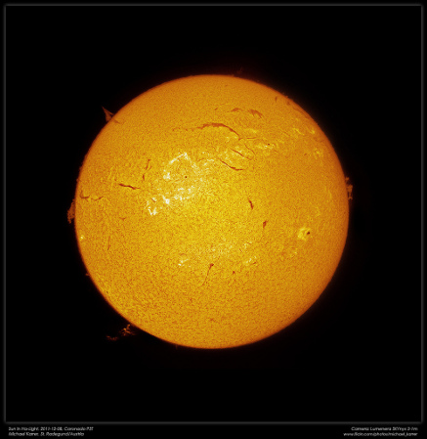
What Is a Plasma?
Notes:
Plasmas are ubiquitous and compose the vast majority of the visible universe (lets no discuss the invisible part). This includes our sun, ...

Slide 13

What Is a Plasma?
Notes:
Lightning, ...

Slide 14
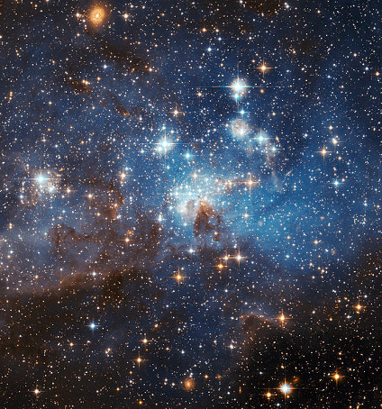
What Is a Plasma?
Notes:
Even the intergalactic medium.

Slide 15

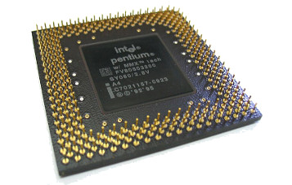
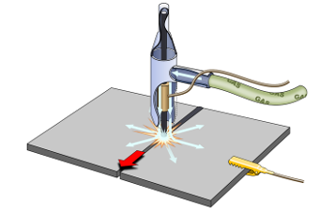
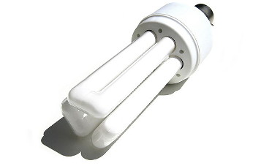
Applications
Bowden, M. “A fluorescent light bulb.” URL: http://www.sxc.hu/photo/203835, Accessed: August 26, 21013.
Shigeru23. “Gas arc welding (TIG & MIG).” URL: https://commons.wikimedia.org/wiki/File:Gas_arc_welding_%28TIG_%26_MIG%29.PNG, Accessed: August 27, 2013.
Schmid, M. “Wasabi-Chips (Migros).” URL: https://commons.wikimedia.org/wiki/File:Wasabi-Chips_%28Migros%29.JPG, Accessed: August 27, 2013.
Volant, L. “LG LV3550 15 R.” URL: http://www.flickr.com/photos/27048731@N03/5589223946/, Accessed: August 27, 2013.
Notes:
That said, plasmas are not limited to natural phenomena. They are also a large part of contemporary life. This includes plasma displays, production of microelectronics, welding, and lighting.

Slide 16
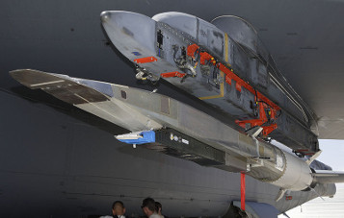
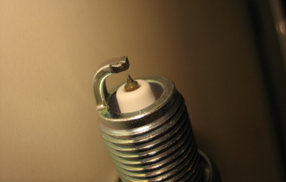

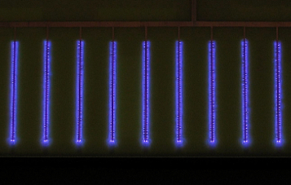
Atmospheric-Pressure Plasma Applications
Bellay, C. “X-51A Waverider on B-52 2009.” URL: https://commons.wikimedia.org/wiki/File:X-51A_Waverider_on_B-52_2009.jpg, Accessed: August 27, 2013.
Wong, N. “Tip of a spark plug.” URL: http://www.flickr.com/photos/14029705@N00/375024452/, Accessed: August 27, 2013.
parfe_alp, “Operation.” URL: http://www.flickr.com/photos/parfe/2239523465/, Accessed: August 27, 2013.
Xunger, “Plasma glow discharge.” URL: https://commons.wikimedia.org/wiki/File:Streamwise.JPG, Accessed: August 27, 2013.
Notes:
New uses for plasmas continue to be discovered. Perhaps the most promising contemporary applications have come from plasmas which are produced at moderate and high pressures. This covers the range from about one-hundredth of atmospheric pressures, to several times it.
Some examples of these new applications include uses in hypersonic flight, improvements in combustion efficiency, destruction of biological and chemical contaminants, and modification of air flows.

Slide 17
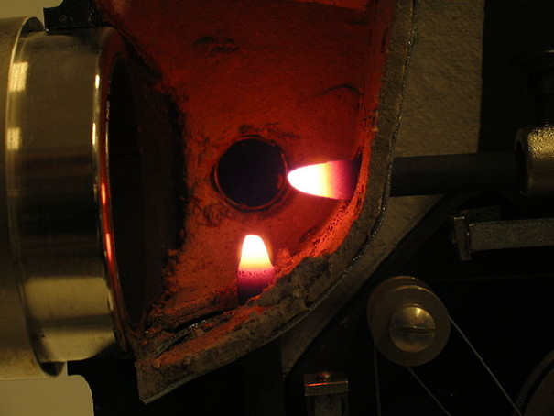
Thermal Plasmas
Notes:
Atmospheric pressure plasmas can be split into two categories: those in thermal equilibrium and those that aren't.
Thermal equilibrium implies that the electrons, ions, and neutral particles all have approximately the same (frequently high) temperature. One example of this plasma are the carbon arc lamps which were used in old movie projectors. While the plasma is not shown here, its high temperature can be seen in the red-hot afterglow of the carbon electrodes which were used to form it.

Slide 18
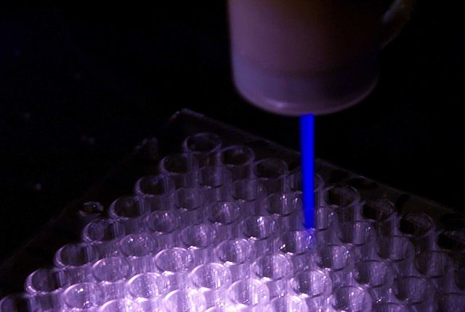
Non-Equilibrium Plasmas
Notes:
Contrast this with, non-equilibrium or low temperature plasmas where the electrons, ions, and neutrals may have significantly different temperatures. This is particularly useful in situations where high temperatures are not desirable, for example, processing heat-sensitive plastics, sterilizing wounds, and lighting.
This is an example of an atmospheric plasma jet intended for used in biomedical applications. While the gas is likely close to room temperature, the electrons are likely close to a few electron-volts, or tens of thousands degrees Celsius. The energy carried by the electrons allows them to do a number of things such as excite atoms and induce chemical changes, without heating the target.
As a result, non-equilibrium plasmas at moderate to high pressures are a particularly promising type of plasma.

Slide 19
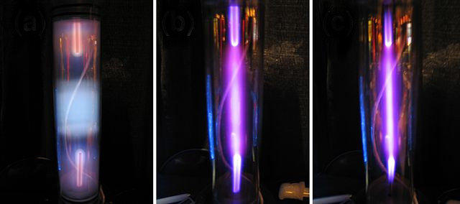
Glow-to-Arc Transition
Notes:
However, production of these plasmas is not easy. This is an example of an argon plasma created by a constant electric field at several different pressures. At the far left is a non-equilibrium plasma generated at a relatively low pressure.. However, as the pressure increases, the plasma constricts and the gas temperature rises. Eventually, the gas temperature becomes similar to that of the electrons and the plasma is considered an arc. This is commonly referred to as the glow-to-arc transition.
This transition results from what is called the ionization instability which involves localized gas heating and rarefaction. For a fixed electric field, and depending on the pressure, its onset can begin within a matter of nanoseconds. In order to avoid it, some mechanism must be used to limit the rate at which energy flows into the plasma.

Slide 20
Pulsed Plasmas and
Outstanding Questions

Slide 21
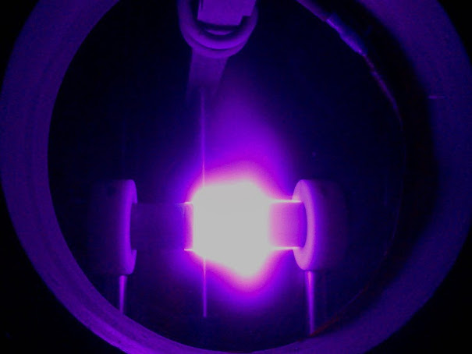
Repetitively-Pulsed Nanosecond Discharge
Notes:
One way to accomplish this is by pulsing the electric field used to generate the plasma. The duration of each pulse is chosen such that the ionization instability does not have time to develop. A steady plasma can be generated by repetitively pulsing the field quickly enough such that the plasma does not die away between pulses.
This is the origin of the repetitively-pulsed, nanosecond discharge or RPND. These types of plasmas typically involved pulses that are less than 100 nanoseconds long and repeated a few thousand times each second.

Slide 22
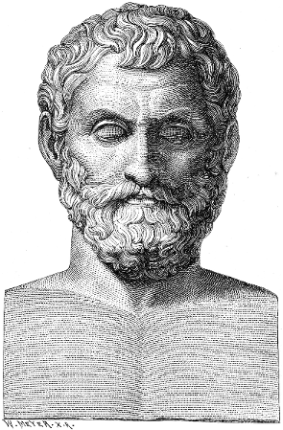
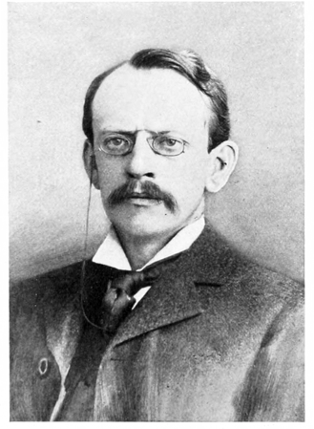
Early History
Wallis, E. et al. "Illustrerad verldshistoria utgifven av E. Wallis. Volume I." (1875).
Stotesbury, H. "J. J. Thomson." Popular Science, Vol. 56 (1899).
Notes:
While RPNDs are a byproduct of modern advances in semiconductor technology, pulsed plasmas have been studied since the ancient Greeks. They were followed by other researchers such as Gottfried Leibniz and Benjamin Franklin. It was later that J.J. Thomson made some of the first observations of how a pulsed plasma developed.

Slide 23
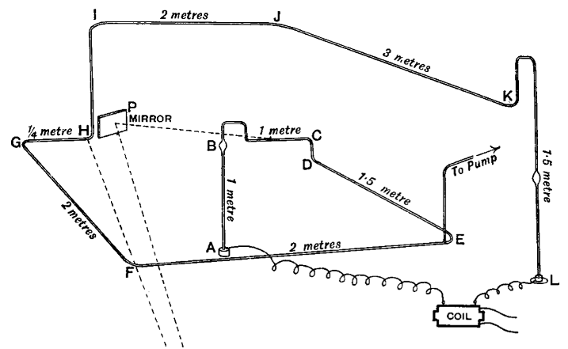
First Pulsed Plasma Measurements
Notes:
Thomson's research concerned the development of a pulsed plasma in a very long tube. A voltage pulse was applied to an electrode at one end and the other end was maintained at ground potential.
Using a spinning mirror, he was able to determine that the pulsed plasma did not develop simultaneously throughout the volume between the electrodes. Instead, the plasma appeared to travel from the powered electrode to the grounded one, at a significant fraction of the speed of light.

Slide 24
Electron Avalanche
Electric Field
Neutral particle
Electron
Notes:
This behavior was later explained by the streamer discharge theory, initially developed by Flegler and Raether in 1936.
A streamer begins with a single electron. The source of this first electron can vary—in some cases it may be caused by cosmic radiation, in others it may be left over from a previous pulse. This electron is accelerated by an electric field.
Once it crosses a threshold energy, it eventually ionize one of the neutral atoms. This event produces a positive ion which, as a result of its mass, is essentially motionless for time scale we're concerned with. It also produces a second electron. After the ionization, both electrons are now accelerated until more ionization events occur. This process repeats itself in what is known as an electron avalanche.

Slide 25
Streamer Discharge
A
-
-
-
-
-
-
-
-
-
-
-
-
-
-
-
-
+
+
+
+
+
+
+
+
+
+
+
+
+
+
-
-
K
Notes:
In a streamer discharge, the density of the electrons in this avalanche becomes so great, that their own electric field becomes comparable to the applied field. This modifies the external electric field and reduces the power transferred to the avalanche.
At this point, the streamer continues to propagate by several other mechanisms. The space charge in the avalanche head is often so great that it can “inject” electrons toward the anode, continuing the avalanche process.
Additionally, excited atomic states can emit photons which photo-ionize the surround gas. The resulting electrons are then attracted toward the positive tail of the avalanche, producing smaller avalanches of their own. Eventually, these form a conductive channel which bridges the gap between the two electrodes.

Slide 26
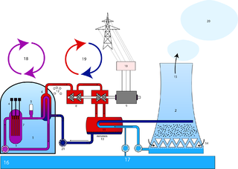
Questions: Energy Coupling
Line radiation
Charged Particles
(electrons, ions)
Electric Field
Continuum radiation
Collisions
Heating
Neutral Particles
(atoms, molecules)
Excited States
Chemical Compounds
Notes:
Since its inception, the streamer discharge theory has been used to predict quantities such as the streamer velocity and electron densities in a number of plasmas, including RPNDs. However, the theory is largely concerned with a description of the electric fields in a streamer and its charged particle densities.
This leaves a vast array of properties which it does not address. First among these is how the energy is coupled into the neutral particles of the RPND. In low temperature plasmas the neutral particles play a very large role in the light emissions, chemistry, and persistence of the plasma. In fact, few applications are concerned with the charged particle dynamics except as means of producing some byproduct.
This leads us to ask where the energy is going in an RPND.

Slide 27
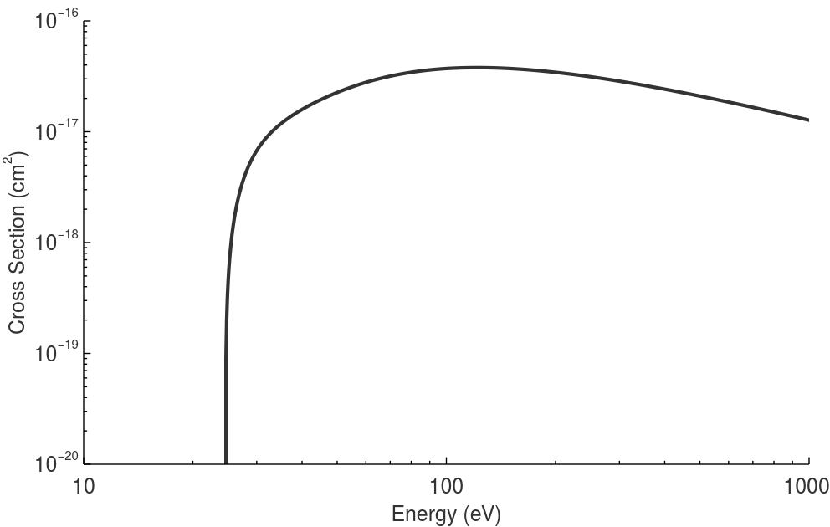
Questions: Electron Energy Distribution
Notes:
That said, the byproducts of electron-induced reactions are a function of the number of electrons, the number of target particles, and two functions of energy: the cross section, and the electron energy distribution function, or EEDF.
When an electron is incident on a target, the likelihood that it will cause a particular reaction is expressed by a quantity known as a cross section. Here, the cross section for ionization of helium is shown. It the electron must exceed a threshold energy of 24 eV in order to ionize the helium atom, and the cross section peaks for an electron energy of 100 eV.

Slide 28
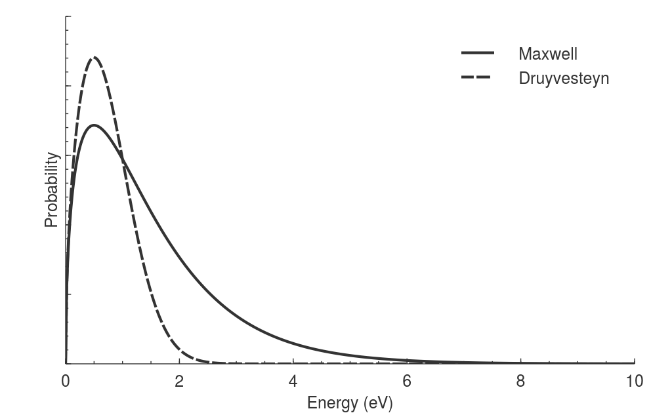
Questions: Electron Energy Distribution
Notes:
The EEDF expresses the probability of finding an electron with a particular energy within an ensemble of electrons. This has the implication that if we know the number of electrons, the number of target atoms, the EEDF, and the cross section, we can calculate the total number of reactions which will happen over a given period of time.
It is common to use numerical techniques to estimate the EEDF, or to assume a particular type of distribution, like those shown here. However, these approaches generally require a number of assumptions which are not true for the RPND. Some examples of these assumptions are weak electric fields and relatively long periods of time.
As a result, we must ask whether any of these EEDFs are adequate to describe the RPND.

Slide 29
Metastable
Measurements

Slide 30
Discharge Geometry
Inlet
Ground Shell
Pump
Transmission Line
Inner Conductor
Outer Conductor
Insulator
Notes:
Initial efforts to answer these questions focused on the detection of triplet metastable atoms in a helium RPND. Before discussing the measurements, I would like to describe the discharge apparatus.
Shown here is an illustration of the discharge geometry. On the right is a hollow metal tube which serves as anode, or positive electrode. The RPND is generated by a positive voltage pulse which is sent to this electrode by a coaxial transmission line. The anode is connected by a hollow glass tube to an electrode which is nominally at ground potential.
The ground electrode is connected to a series of metal shells surrounding the discharge geometry and is ultimately connected to the outer shield of the transmission line.

Slide 31
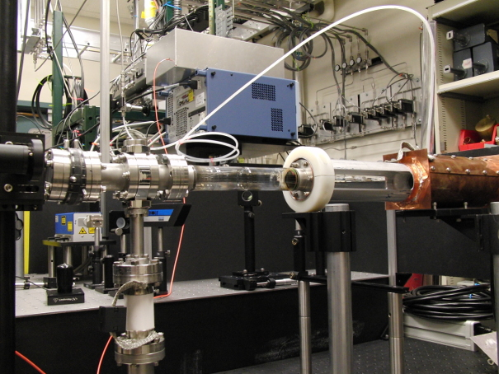
Experimental Setup
Notes:
This is a photo of the actual RPND setup.
During operation, the tube was evacuated of air to a pressure of 15 mTorr. Ultra-high purity was then flowed into the tube at a mass flow rate of 25 sccm. A series of metering valves were used to vary the pressure between 0.3 and 16 Torr, (1/2500th to 1/50th of atmospheric pressure). Measurements of the leak rate in the system suggested a maximum impurity level of 80 ppm.
Helium was used for several reasons. First, RPND research has largely focused on air plasmas, neglecting rare gases. However, several properties of rare gas plasmas—such as their minimal gas heating, extreme ultraviolet emissions, make them attractive for certain applications. Furthermore, the properties and cross sections of atomic helium are particularly well understood, which made it possible to develop a very detailed model of the discharge process.

Slide 32
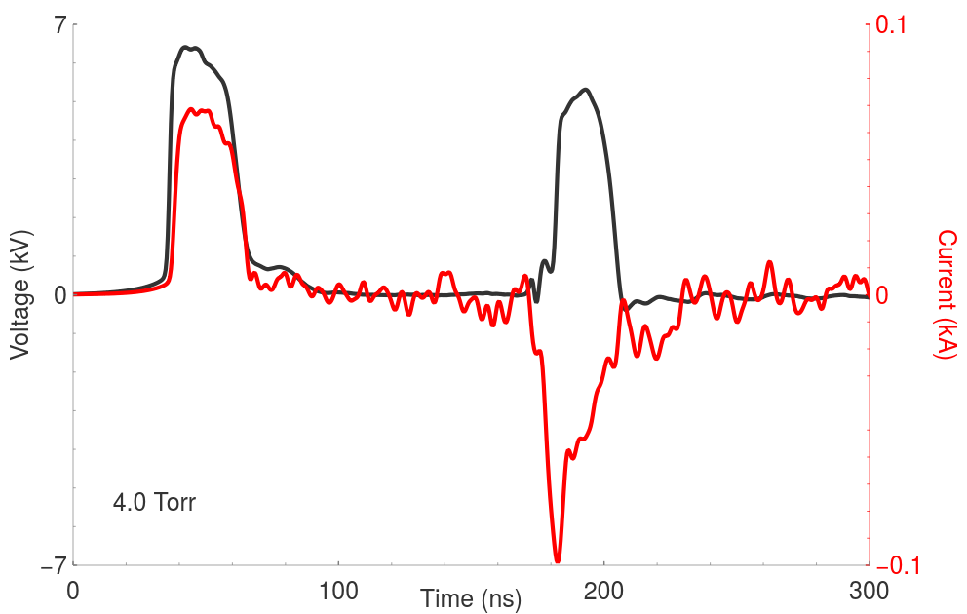
Example Waveform
Notes:
This is an example of the voltage and current waveforms which were observed in the generation of the RPND. The incident pulse, shown on the left, is about 6.6 kilovolts in amplitude with a forward current of about 60 amps.
A reflected pulse can be seen 140 nanoseconds later. This delay is determined by the length of the transmission line which was used.
The energy coupled into the plasma can be calculated by the product of the current and voltage, integrated over the incident and reflected pulses.

Slide 33
What Can Be Measured?
Notes:
Given this system, there is then the question of what we can measure in order to follow the energy. The physical probes used in most plasmas can be ruled out for a number of reasons: they would alter the discharge, the theory is not well-developed at these pressures, and they do respond quickly enough.
This leaves a variety of optical techniques. The first candidate for measurement would be the electrons. Unfortunately, they do not emit readily detectable light. Likewise, while it is possible to measure some properties of the electron population by laser scattering, the electron density is too low in an RPND.
As a result, the next logical candidate are the helium atoms.

Slide 34
Excited States of Helium
Energy
Notes:
As alluded to earlier, each atom possesses a number of excited states. In these excited states, an electron has been moved from its usual orbit to a further one. Each state has a different amount of potential energy associated with it. An atom can transition between states by emitting a photon (transition to a lower energy state), or by absorbing a photon (transition to a higher energy state).
The downward transitions are responsible for the light emitted by a plasma (the orange glow of a neon light for example). The color or wavelength of the light corresponds to the initial and final states.
Unfortunately, the downward transitions and thus the emissions, require a finite amount of time to occur. As a result, the emissions tend to reflect changes which occur on over periods of time longer than the development of the RPND.

Slide 35
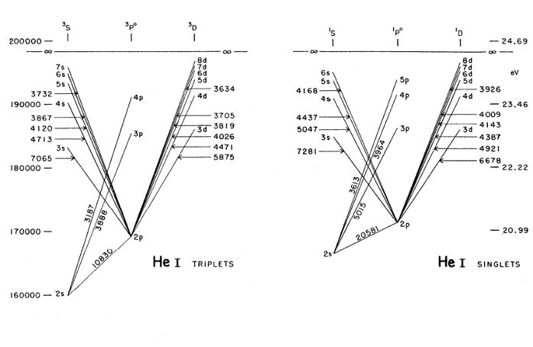
Excited States of Helium
Notes:
While we will eventually return to helium emission measurements, there is an alternative with much better time resolution.
As I said before, the atoms can also absorb light as long as its wavelength matches the energy separating two states. The RPND represents a system with a many helium atoms in a variety of excited states. If a laser with a wavelength matching a particular transition is shined upon it, the degree to which the laser is absorbed should be proportional to the number of atoms in the lower excited state.
This is better known by the name: laser-absorption spectroscopy.
Shown here are only some of the excited states of helium and the allowed transitions between them. The question, then, is which excited state should be selected for analysis.

Slide 36
Triplet Metastables
Notes:
In this work, the triplet metastable state was chosen for absorption spectroscopy. The transition used is highlighted here.
This is the lowest energy excited state in helium. As excited atoms tend to relax to lower energy states, there is good reason to believe that there will be a lot of triplet metastable states, making them easier to detect. In addition, the state is called metastable because, for quantum mechanical reasons, it cannot relax to the unexcited state of helium and only does so through collisions. As a result, a lot energy in a helium plasma ends up in this the triplet metastable state.
The triplet metastable state can transfer this excited state energy to other atoms long after the exciting pulse has ended. Likewise, it can generate electrons and ions through Penning and associative ionization for many microseconds after the pulse.

Slide 37
Laser-Absorption Spectroscopy Setup
PD
AP
AP
DFB
FI
S
ND
AP
PD
Notes:
This is an illustration of the laser absorption spectroscopy setup that was used to measure the triplet metastable densities. The light was generated by a distributed feedback laser. The transmitted laser light was detected by a photodiode with a response time of 5 ns.
Measurements were made at eight different pressures: 0.3, 0.5, 1.0, 2.0, 3.0, 4.0, 8.0, and 16.0 Torr. Each series of pressure measurements was made at three different locations along the length of the discharge: 5.1, 12.7, and 20.3 cm from the anode. These are referred to as the “upstream,” “midstream,” and “downstream” positions, in reference to the gas flow.
Having said that, I'll skip the boring details about the analysis and get on to the results.

Slide 38
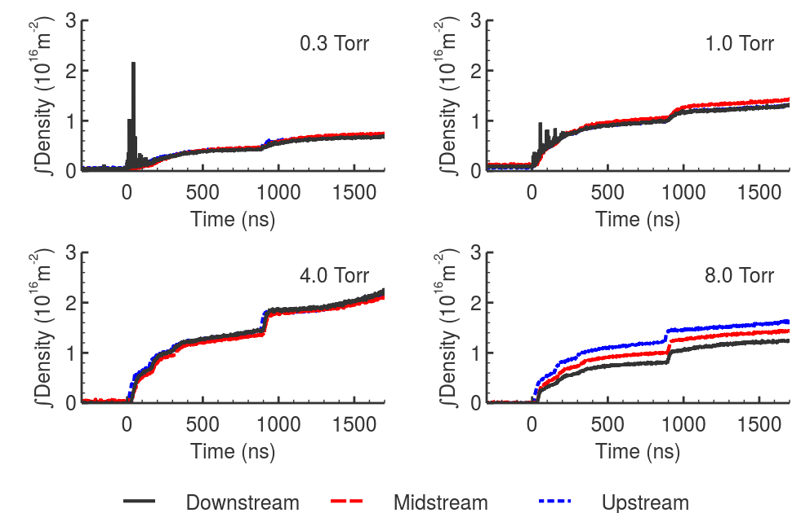
Metastable Densities
Notes:
These are the line-integrated metastable densities for four of the eight pressures. These exhibit the range of behaviors observed in the RPND. Aside from some noise caused by the pulse, the evolution of the curves are relatively clean.
Though the pulse is over after 25 nanoseconds, the metastable density continues to rise throughout the measurement period. The discontinuities or bumps can be traced back to absorption of the reflected pulses in the system. The more steady rise of the metastable densities is likely the result of the relaxation of higher excited states, as previously described.
Only the 8 and 16 Torr cases possessed significant variations with respect to the measurement location. The trends, a reduction in metastables as a functions of distance from the anode, suggests that wave or streamer lacks sufficient energy to cross the inter-electrode gap at these higher pressures. While other studies have shown that a higher pulse voltage can be used to overcome this effect, there is a practical limit to the magnitude of the pulse. Therefore, this behavior reflects a limit in the size of a RPND for a given pressure.

Slide 39
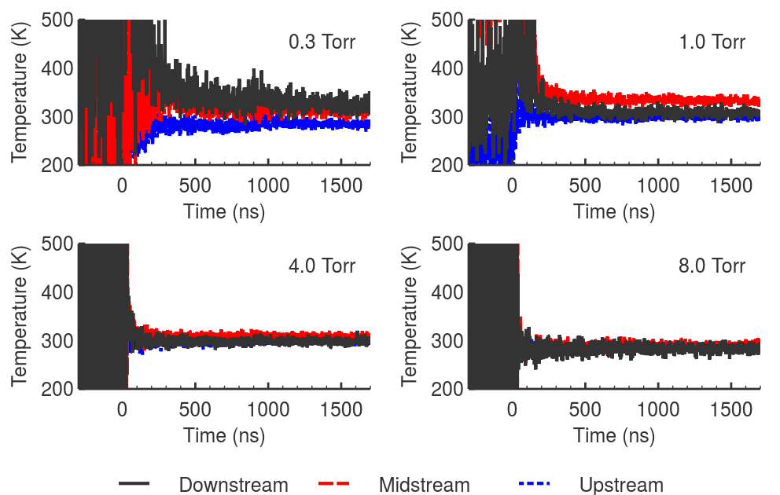
Temperatures

Slide 40
Global Model

Slide 41
Emission
Measurements

Slide 42
Conclusions

Slide 43
Summary of results

Slide 44
Future Work

Slide 45
Acknowledgements

Slide 46
Questions

Slide 47
Backup Slides

Slide 48
Pumping System
Upstream Shutoffs
Discharge Tube
MFC
Pressure
Gauge
Bypass
He
Primary
Pump

Slide 49
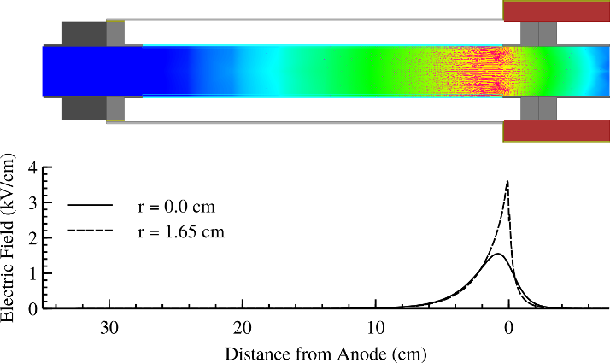
RPND Electric Fields

Slide 50
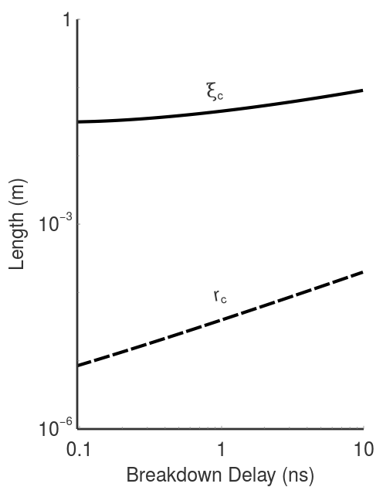
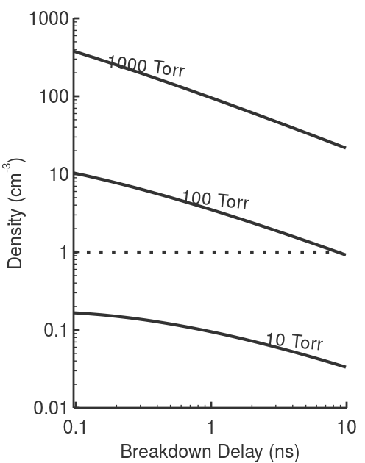
Homogeneous Streamers

Slide 51
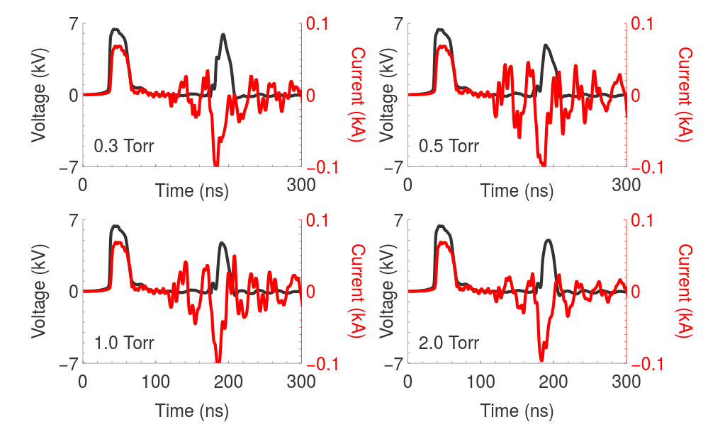
Waveforms 1

Slide 52
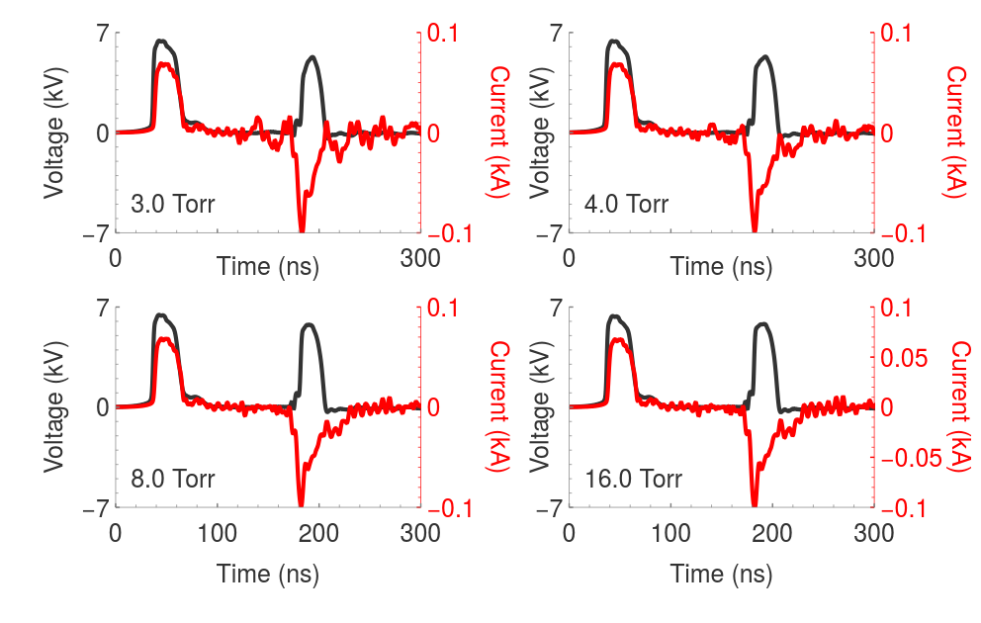
Waveforms 2

Slide 53
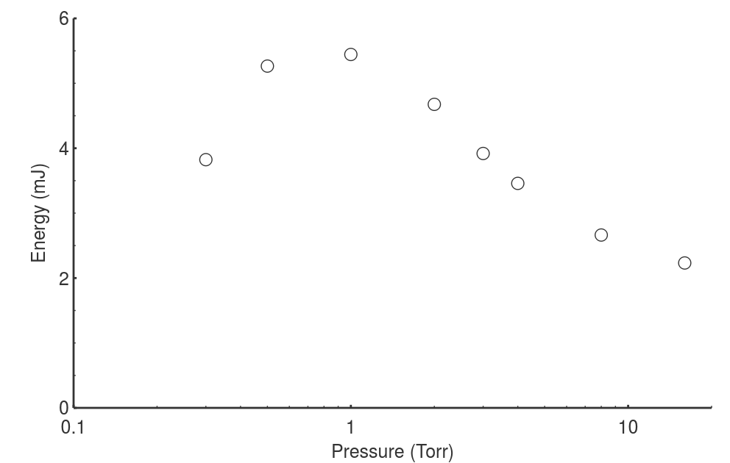
Energy Coupling

Slide 54
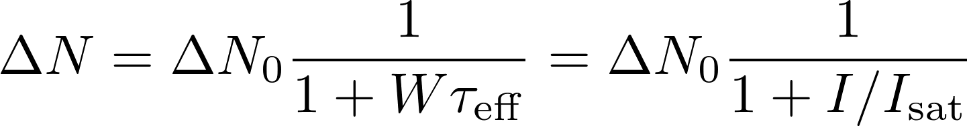
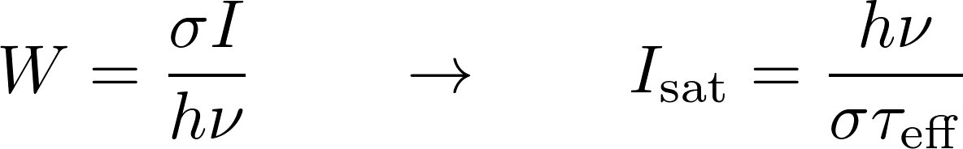

Two-Level Saturation
Notes:
We begin with the steady state population difference between the two levels of interest. Delta N_0 represents the density change which results from the small signal value. The saturation intensity is commonly defined as the intensity which results in a population difference equal to half of the small signal value.
The simulated absorption probability can be solved for as a function of intensity and substituted into the steady state solution. This provides a functional expression for the saturation intensity of the system. This depends on the transition energy, absorption cross section, and the lifetime of the state.
If we assume an isotropic medium and an unbroadened transition, we find that the saturation intensity for the 2^3S-2^3P transition is about 0.45 mW/cm^2.

Slide 55
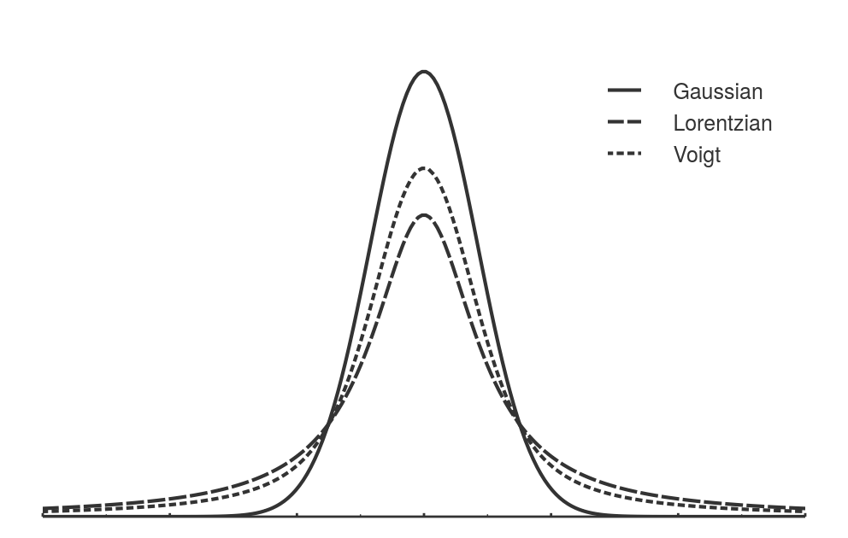
Lineshapes

Slide 56
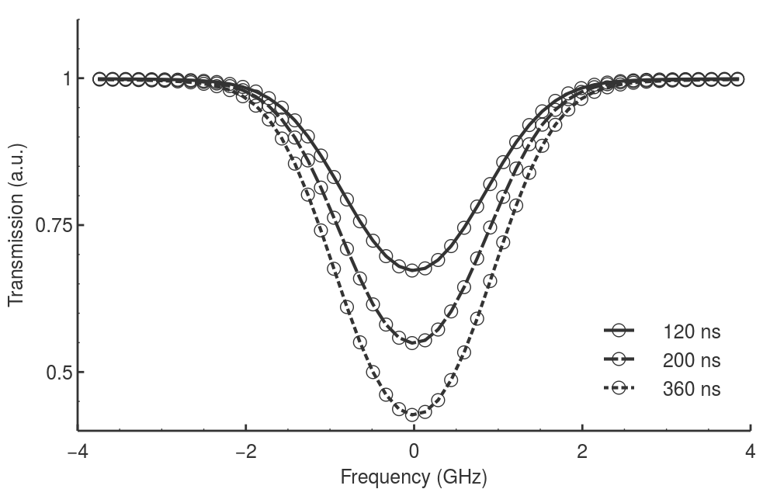
Absorption Spectra Matching

Slide 57
Wave Velocity

