Slide 1
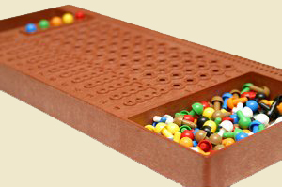
Mastermind: FPGA Design and VGA Implementation
Carlos Lemus | Zach Nelson

Slide 2
The Concept
Mastermind is a game in which a player attempts to decipher a code, that is predetermined either by another player, or computer generated.
4 colors (out of 8) are chosen by the code-maker (or in this case a computer) and the main player must figure that code out within 10 tries while receiving hints: letting the player know if they have a color in the correct position (denoted by red) or a correct color in the sequence (denoted by white).

Slide 3
Project Responsibilities
Zach Nelson
Carlos Lemus
Counter
Register Files
Decoder
VGA Controller
Image Sources
VGA Display
Collaboration:
Control Unit Design
Functionality
Compare design

Slide 4
The Design
Components
- 12-bit Counter - VGA Controller
- RGB Decoder - Clock Multiplier
- Register Files (PLL)
- Control Unit
- Image Sources
(Game Boxes & Text)

Slide 5
Background Theory
RGB Decoder:
3-bit address input
8 colors [0 . . 7]
Read-only register file
10-bit strings of R,G,B.
12-bit Counter:
Generates 4 random 3-bit addresses
101000111011
1 2 3 4
RGB Decoder
0011111111 = 255
100
R
G
0001010101 = 85
B
0001010101 = 85

Slide 6
Background Theory
Register Files:
-Tries RF
-Check RF
-64 3-bit (64x3) addresses in each RF
Clock Multiplier
-input 27 MHz clock
-manipulates internal clock
-output 25.2 MHz clock (pixel clock)
-DE2 VGA limited to 640x480 resolution

Slide 7
Background Theory
Image Sources:
Game Boxes
Used to generate all the boxes on the screen (player tries, as well as check)
py
px min
py min
py max
px max
px

Slide 8
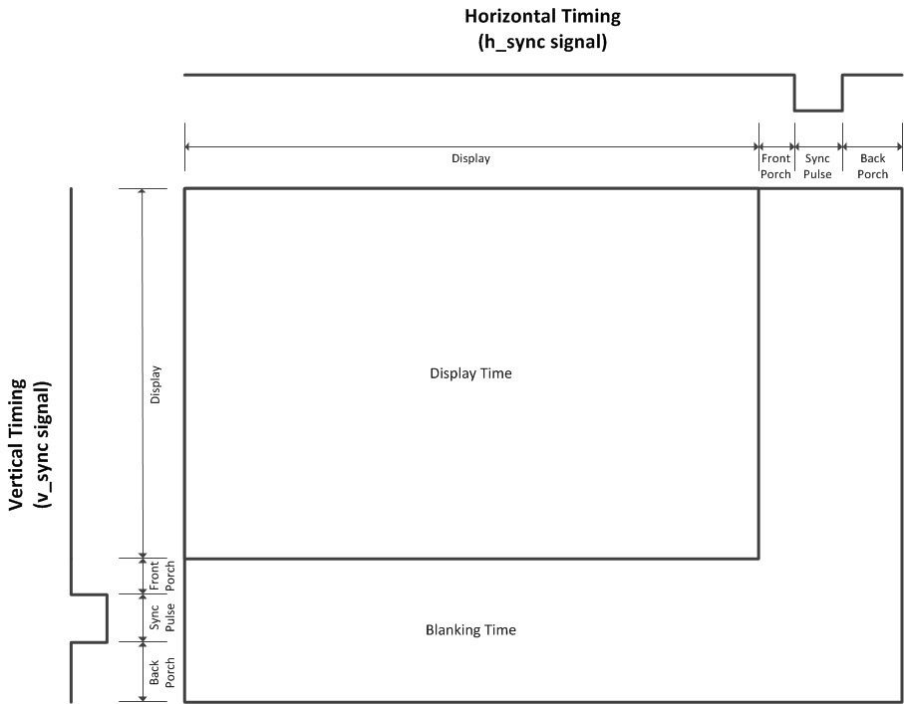
BACKGROUND THEORY
VGA Controller:
-Controls Vertical and Horizontal Timing

Slide 9
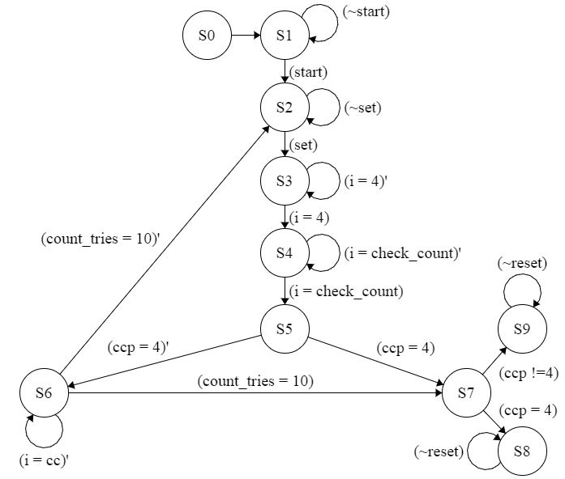
Control Unit FSM
S0: clear
S1: init
S2: tries
S3: compare
S4: check_count
S5: check_ccp
S6: check_ cc
S7: ends
S8: win
S9: lose

Slide 10
Compare Logic
If a player color is in the right position they receive a red peg
If a player color is found in the sequence they receive a white peg
If there are duplicate colors, they are not all awarded a peg unless they correspond to the same number of duplicate colors in the sequence.
If no colors are in the right position and no colors are found in the sequence no pegs are awarded

Slide 11
Example Guess Scenarios
# | Randomly Generated Code | Player Input | Red Pegs | White Pegs
1 | Blue, Blue, Yellow, Yellow | Blue, Blue, Blue, Yellow | 2 | 1
2 | Blue, Yellow, White, Blue | Blue, Yellow, White, Blue | 4 | 0
3 | Blue, Blue, White, Yellow | Blue, Yellow, Blue, Yellow | 2 | 0

Slide 12
Sample Code
Compare state
begin
if(counter != 4)
if(counter = 0)
if(color1 == randomcolor1)
correct_color_position++;
else
if(color1 == randomcolor2 or . . . color1 == randomcolor4)
correc_color++;
.
.
.
.
counter++;
end

Slide 13
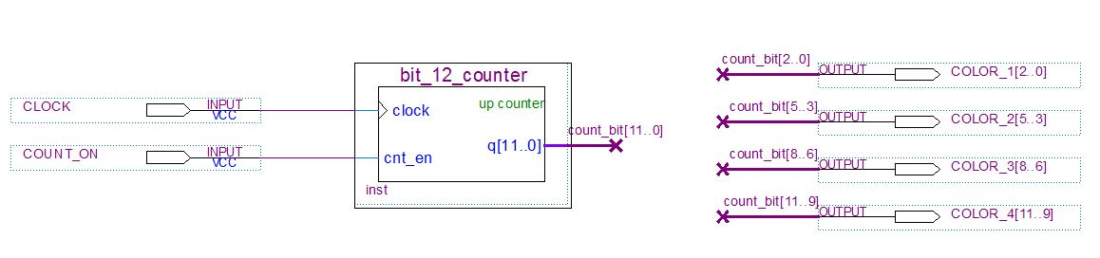
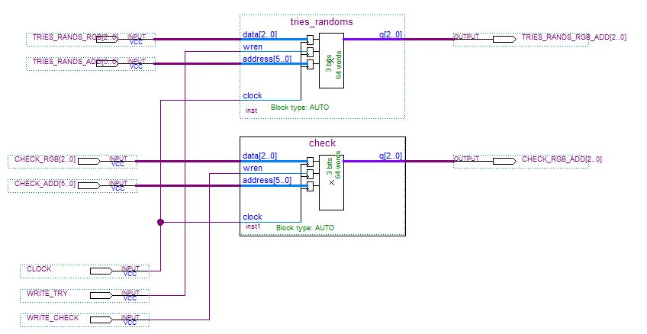
Sample Schematic
Random Address Generator
Register Files

Slide 14
Problems Encountered
Compare Logic:
Using loops to perform compare logic as well as write to registers
Correct Color check would indicate any repetitive color in the sequence

Slide 15
Problems Encountered
VGA:
Display was unable to read any signal from the DE2 board
Timing:
Due to the speed of the generated clock from the clock multiplier many things were not being executed on display

Slide 16
Conclusions
Designing Mastermind forced us to expand our knowledge of FSM’s, memory, VGA, timing complications, Verilog, and DE2. Our familiarity and comfortability has grown with these topics as well as our confidence in overcoming hardships that come with completing complex systems.

Slide 17
Comments & Questions

Slide 18
The End
Thank You

