Slide 1
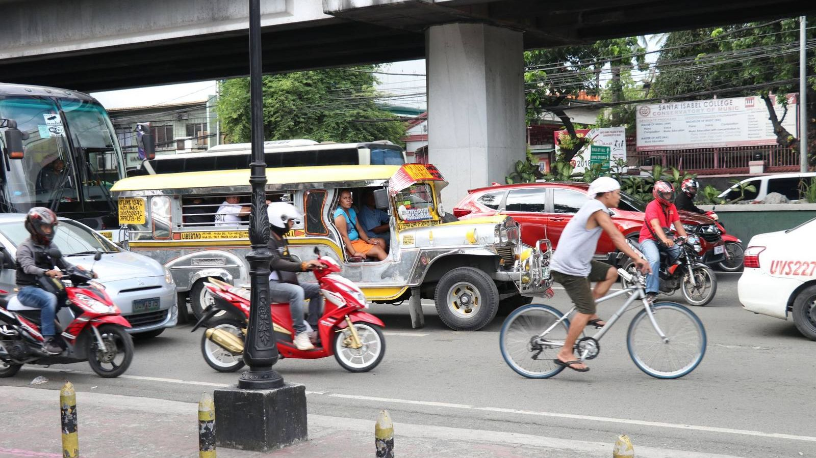

User Guide
ROADWATCH
Report road accidents from your phone. Verify, assign, respond and close them as staff.
Version 1.2.0
November 2026 · www.roadwatch-ph.me
Prepared by Princess Lorellyn Isip, Documentation Lead
with Lenon Adriano, Pauline Lapuz and Carl Ernest Santos
Notes:
Welcome. This guide shows how each of the three roles uses RoadWatch 1.2.0: the Reporter on the Android app, the Traffic Officer on the app or the website, and the Administrator on the website.

Slide 2
What this guide covers
01
Reporter
02
Traffic Officer
Android app: register, report an accident with place and photos, track it, use the guide.
App or website: go on duty, respond to nearby accidents, work assigned reports.
03
Administrator
04
Good to know
Website: priorities, verify and assign, users and alert range, summaries.
The website guide, your account, troubleshooting, privacy and accessibility.

Slide 3



One system, three roles
Reporter
Traffic Officer
Administrator
Android app
Android app or website
Website
Anyone who sees a road accident. Registers, sends a report with the place and photos, and follows its status.
Created by an administrator. Responds to nearby accidents while on duty and works the reports assigned to them.
Reviews and verifies reports, sets priorities, assigns officers, manages accounts and exports summaries.
A report travels: Reporter sends it → a nearby officer confirms it on scene, or an administrator verifies and assigns → the officer works the case → the Reporter sees each status and gets an email.
Notes:
Reporters register themselves in the app. Traffic Officers are created by an administrator. The first administrator is created by the team when the system is installed.

Slide 4




What is new in version 1.2.0
NEW IN 1.2
Report priority
Nearby on-duty officers
Every report gets Low, Medium, High or Urgent from its type and injuries. Staff sort by it; an administrator can change it.
A new report alerts up to 3 on-duty officers nearby. The first to respond confirms or rejects it on scene.
Users toolbar
Guide and Read aloud
Select an account, then Edit or Create officer from one toolbar. Edit now also changes name and phone.
A step-by-step tour of each main screen, with optional Read aloud and a reading speed.
Notes:
Version 1.2.0 adds the four improvements recommended at the system defense. Slides with the amber NEW IN 1.2 tag explain them.

Slide 5
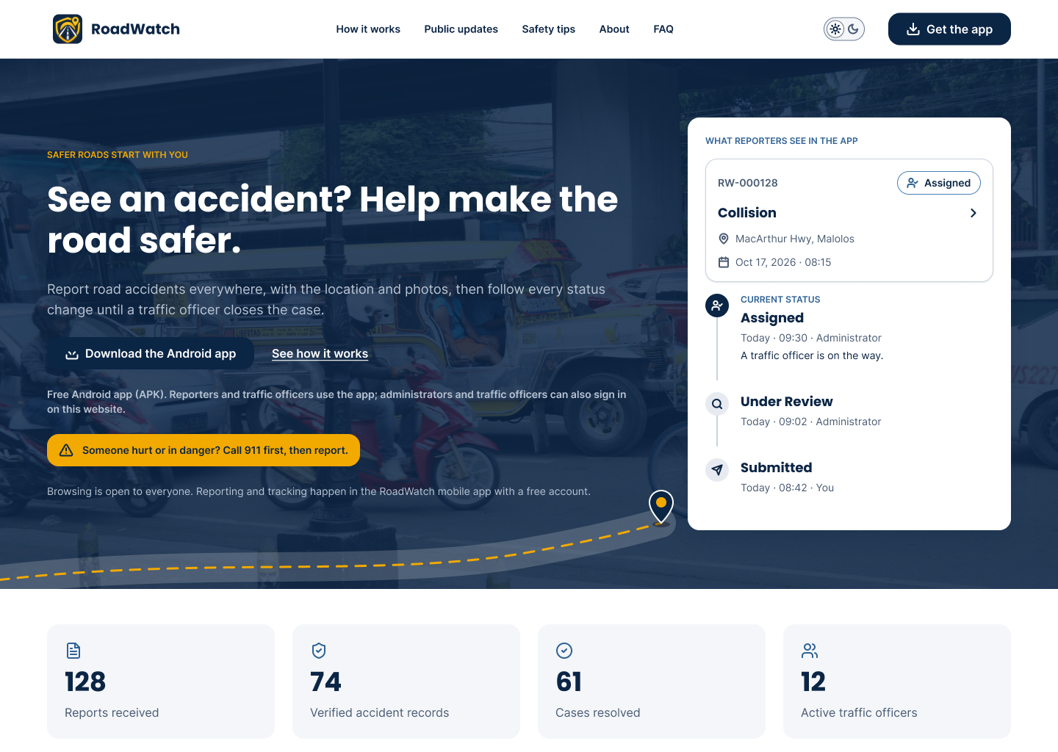



Getting started
Get the Android app
Open www.roadwatch-ph.me/app on an Android phone, or press "Get the Android app" on the website. Open roadwatch.apk and allow installs from this source when Android asks.
Open the website
www.roadwatch-ph.me in any up-to-date browser (Chrome, Edge, Firefox, Safari). Staff sign in from "Staff sign-in" in the footer.
First request of the day
The server sleeps when nobody uses it. The first sign-in can take up to a minute; the app says the server may be waking up. Wait and try again.
The public website: road updates, hotlines, safety tips, the app download and the promotional video.
Notes:
Android only: there is no iPhone app. The APK is installed directly, so Android asks to allow installs from the browser or file manager.

Slide 6
Reporter
01
Register, report an accident with its place and photos, and follow every status update in the Android app.
IN THIS SECTION
Create an account and log in
Report an accident in 3 steps
Track your reports
Notifications, Settings and the Guide
Notes:
Reporters use only the Android app. The website is for staff.

Slide 7
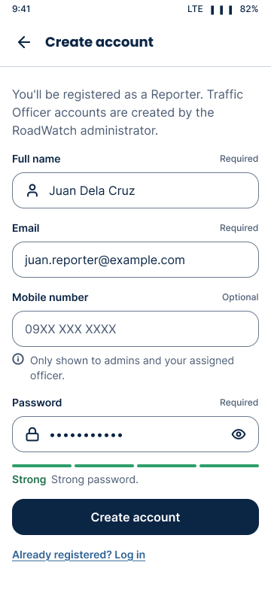
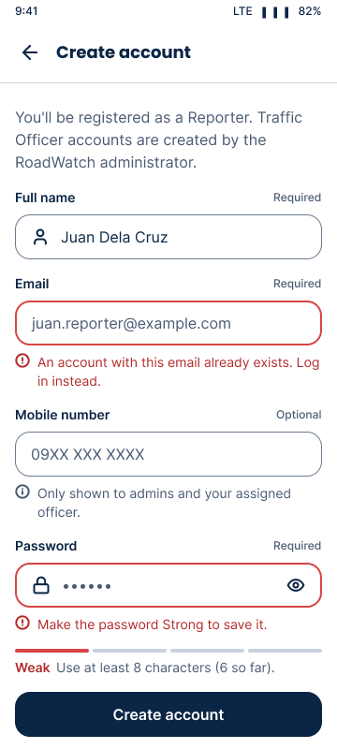
Create your account
1
Open RoadWatch and tap Create an account.
2
Enter your full name, email and (optional) phone number.
3
Choose a password. The meter under the field must reach Strong: 8 or more characters with lowercase, uppercase, a number and a symbol, and not your name or email.
4
Tap Create account. You are signed in as a Reporter right away.
5
Errors appear under each field in red text with an icon; fix them and tap again.
Notes:
Every new account made in the app is a Reporter. Officer and administrator accounts are made by an administrator on the website.

Slide 8
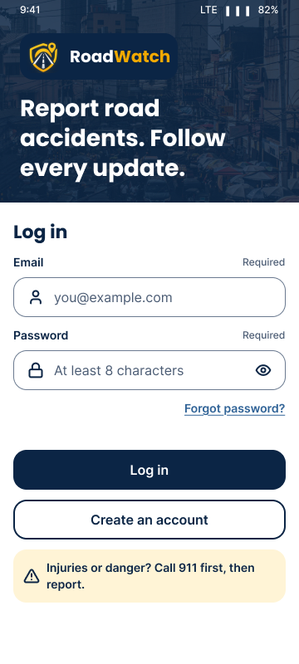
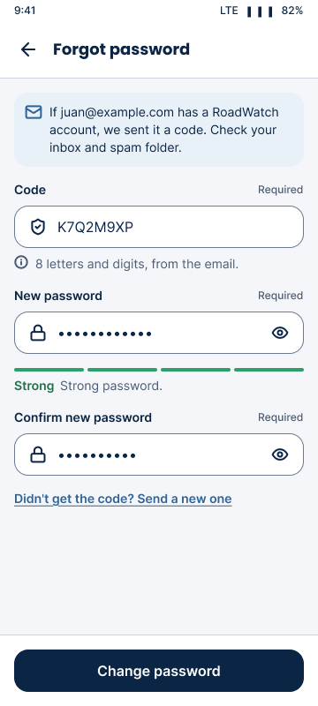
Log in, or reset a forgotten password
1
Enter your email and password and tap Log in. The eye button shows or hides the password.
2
Forgot it? Tap Forgot password?, enter your email and tap Send code.
3
Check your email for an 8-character code (valid 15 minutes, works once).
4
Type the code and a new Strong password, then Change password. Log in with the new one.
5
"Account deactivated" means an administrator turned the account off; contact support.

Slide 9
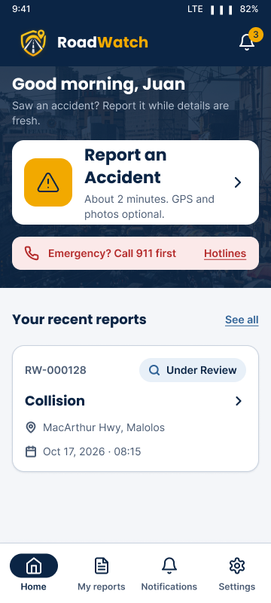
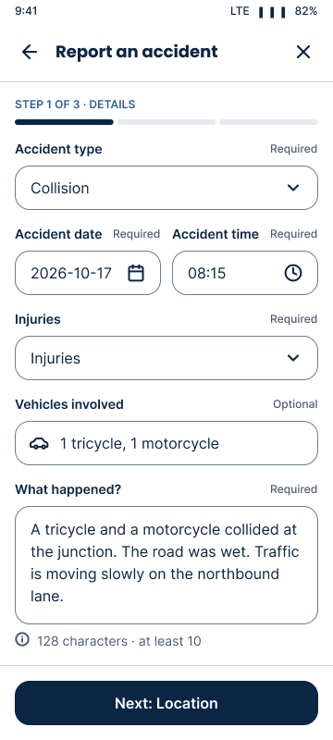
Report an accident: details
1
On Home, tap the large Report an Accident button.
2
Step 1 of 3, Details: date and time, accident type, vehicles involved and injuries (choose Unknown if you are not sure).
3
Describe what happened in a few sentences: what you saw, the lane or direction, hazards on the road.
4
Tap Next. Missing required fields are named under each field.
In an emergency, call first
RoadWatch is not an emergency line. Call 911 (or the PNP and BFP hotlines in Settings) before you report.

Slide 10
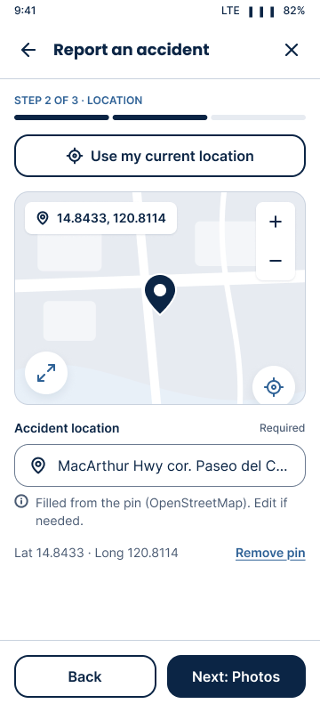
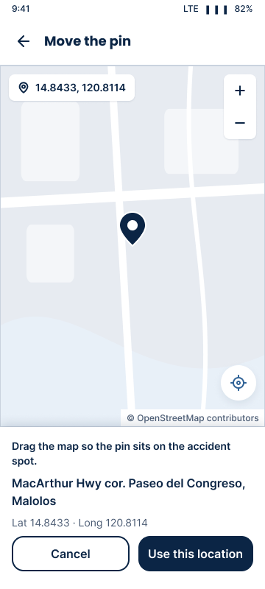
Report an accident: location
1
Step 2 of 3, Location: tap Use my location and allow location access. The pin drops on your GPS position.
2
Not there any more? Drag the map or tap Expand map and move the pin to the exact place, then Use this location.
3
Check the address line (looked up from the map) and edit it if needed, for example a landmark.
4
An exact pin matters: it is how the nearest on-duty officers are found.

Slide 11
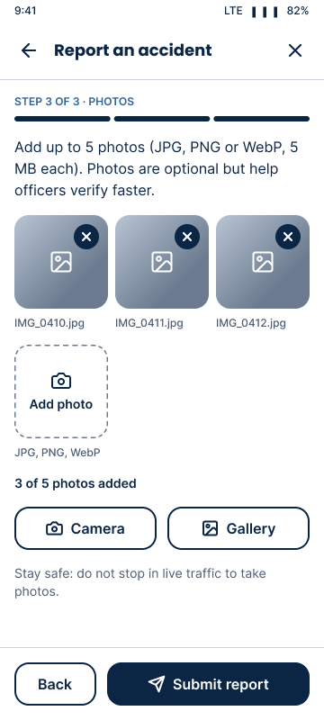
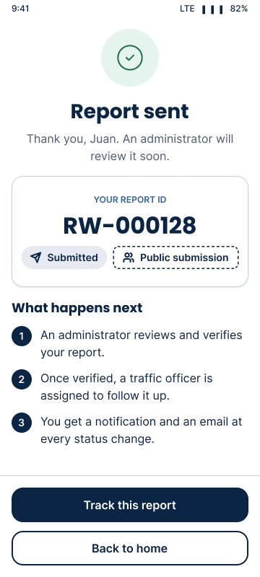
Report an accident: photos and send
1
Step 3 of 3, Photos (optional): take a photo or pick one from the gallery. JPG or PNG, up to the size shown on screen.
2
Remove a photo with its X. Keep faces and plate numbers out of the picture where you can.
3
Tap Submit report. Keep the app open until it finishes uploading.
4
The confirmation shows your report number (for example RW-000128). You also get a "report received" email.

Slide 12
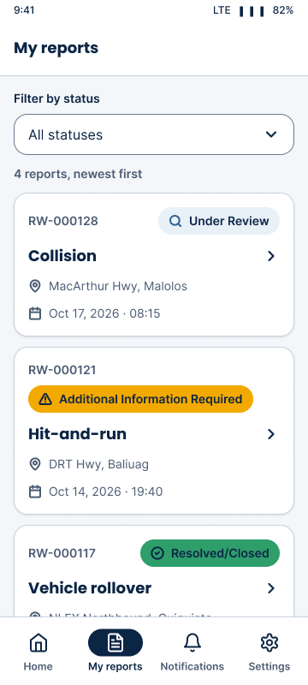
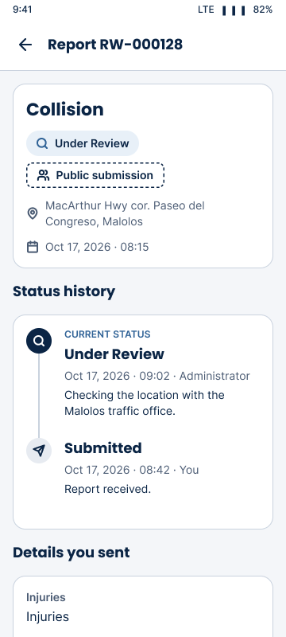
Track your reports
1
Open My reports in the bottom bar. Each report shows its number, place and a status chip with the status name.
2
Filter by status, or tap a report to see its details, photos, map and the full status history.
3
Additional Information Required: read the remarks; the details screen says what is needed.
4
Each status change also arrives in Notifications and by email.

Slide 13
What each status means
Status | What it means for you
Submitted | Received; waiting for a nearby officer or an administrator.
Under Review | An administrator is checking it.
Additional Information Required | Staff need more details; see the remarks.
Verified | Confirmed as an official accident record.
Assigned | A traffic officer is responsible for it.
In Progress | The officer is on scene, responding or investigating.
Resolved/Closed | The case is finished.
Rejected | Not accepted (for example a duplicate); the reason is shown.
Public report or official record?
A report stays a public submission until it is verified, by an administrator or by an officer on scene. Verified reports carry the "Verified record" badge.
Who sets each status
Administrators: Under Review, Additional Information Required, Verified, Assigned, Rejected. Officers: In Progress, Additional Information Required, Resolved/Closed.

Slide 14
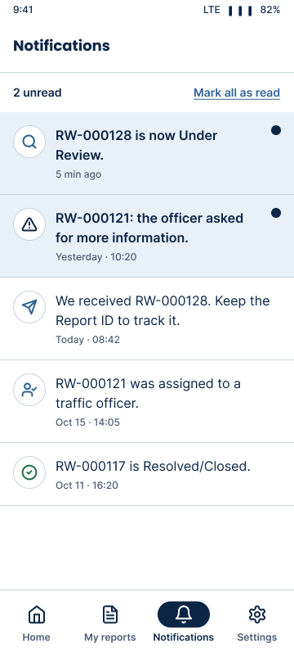
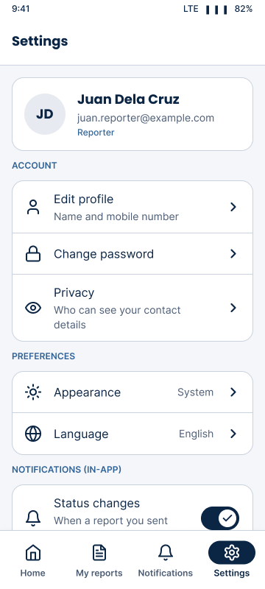
Notifications and Settings
1
Notifications lists submission and status updates; tap one to open the report.
2
Settings: Edit profile, Change password, Appearance (Light, Dark or System), Accessibility, emergency hotlines and How to report.
3
Demo video plays a 30-second clip for your role, with a transcript.
4
About RoadWatch shows the version (1.2.0) and the team. Log out asks you to confirm.

Slide 15
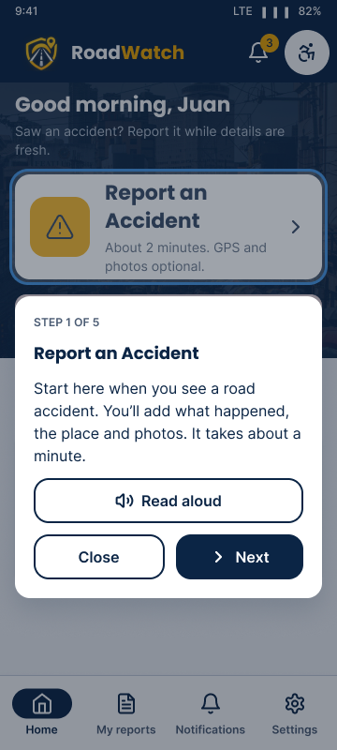
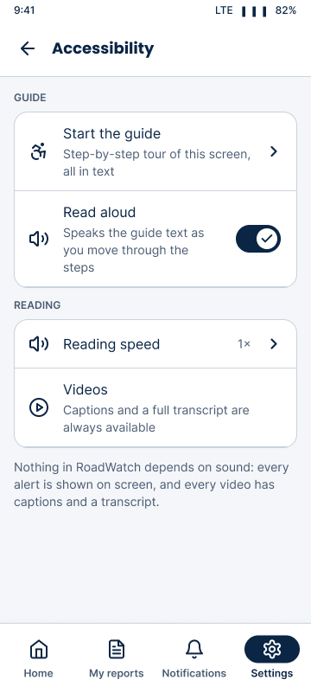
The Guide and Read aloud
NEW IN 1.2
1
Tap Guide in the top bar of Home. A ring marks one part of the screen and a card explains it: STEP 1 OF 5.
2
Use Next and Back; Close or Done ends the tour.
3
Read aloud speaks each step. Everything is also written, so sound is optional.
4
Settings › Accessibility: turn Read aloud on, pick a reading speed, or Start the guide.
Notes:
Officers have the same Guide on the Assigned tab (4 steps). On the website the Guide is in the top bar, or in the account menu on a phone.

Slide 16
Traffic Officer
02
Go on duty, respond to accidents near you, and work the reports assigned to you on the Android app or the website.
IN THIS SECTION
Sign in on the app or the website
On duty and nearby alerts
Confirm or reject on scene
Update the status and remarks
Notes:
Officer accounts are created by an administrator, who gives the officer a temporary password. Change it after the first sign-in.

Slide 17
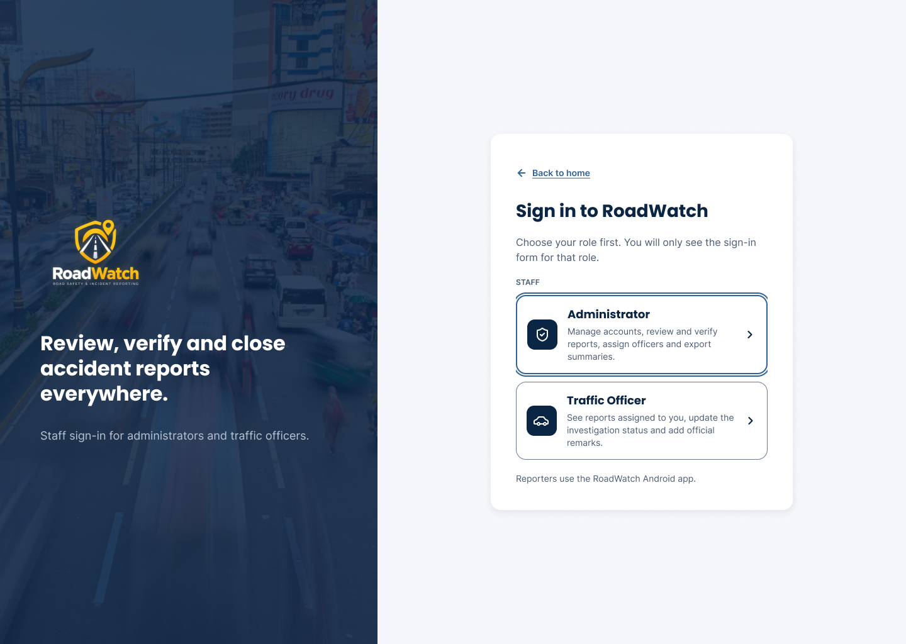
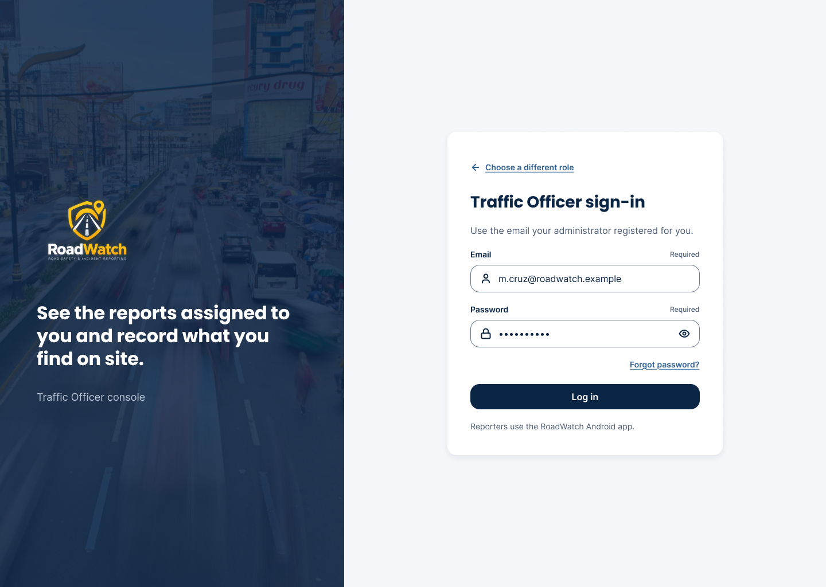
Sign in on the app or the website
1
App: log in with the email and password the administrator gave you.
2
Website: Staff sign-in → Traffic Officer → email and password.
3
Picked Administrator by mistake? The form says "This is a Traffic Officer account"; go back and choose again.
Website: choose the role (top), then the Traffic Officer form (left).
4
Then change the temporary password: Settings (app) or the user menu (web) → Change password.

Slide 18
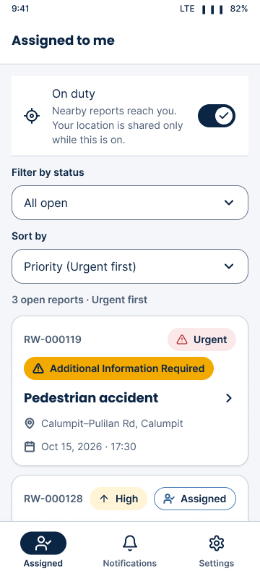
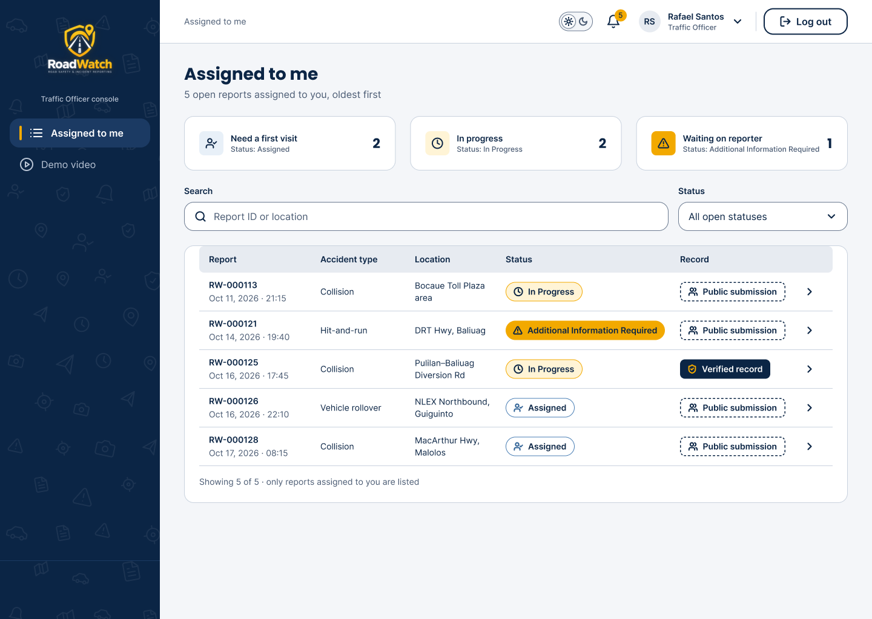
Your assigned reports
NEW IN 1.2
1
Assigned (app) and Assigned to me (web) list only the reports assigned to you.
2
Each report shows a priority chip: Urgent, High, Medium or Low.
3
Sort by Priority (Urgent first) or Newest first; filter by status.
Both lists show the same reports: use whichever is at hand. Only administrators can change a priority.
4
Tap or click a report to open it.

Slide 19
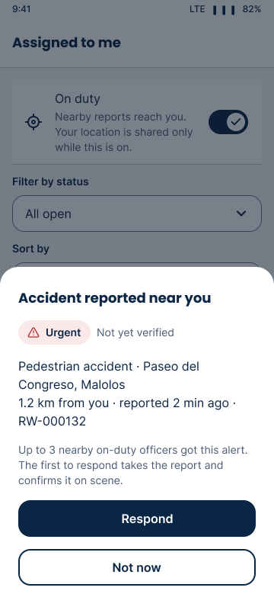
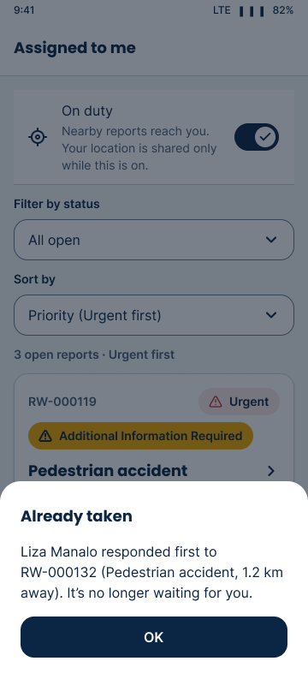
Go on duty and respond to nearby accidents
NEW IN 1.2
1
Switch On duty at the top of Assigned and allow location. Your location is shared only while it is on.
2
When someone reports an accident within the alert range, up to 3 on-duty officers get Accident reported near you with the priority and distance.
3
Tap Respond to take it, or Not now. The first officer to respond gets the report.
4
Already taken means another officer responded first; nothing more to do.
On the website too
Assigned to me has the same On duty switch and alert card (allow location in the browser).

Slide 20
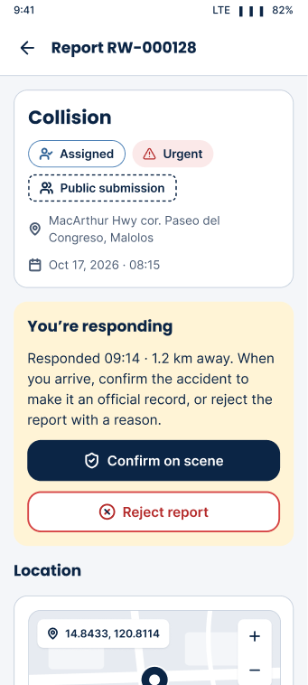
Confirm or reject on scene
NEW IN 1.2
1
The report opens with You're responding and the distance. Use Open in Maps to get there.
If nobody responds
After 10 minutes the alert closes and the report goes to an administrator to verify and assign as usual.
2
At the scene, tap Confirm on scene. The report becomes a Verified record and In Progress.
The reporter sees it
Confirming on scene notifies the reporter, and the administrators see "Responded on scene" with your name.
3
No accident there, or a duplicate? Tap Reject report and give the reason. The administrators are told and can reopen it.
4
Until you confirm, Update status stays hidden.

Slide 21
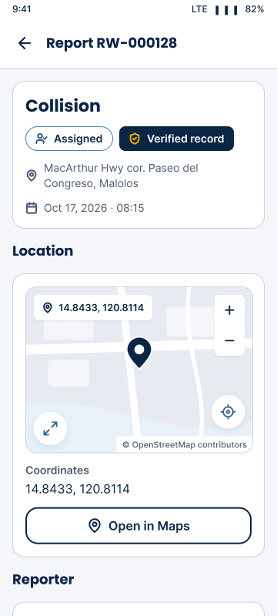
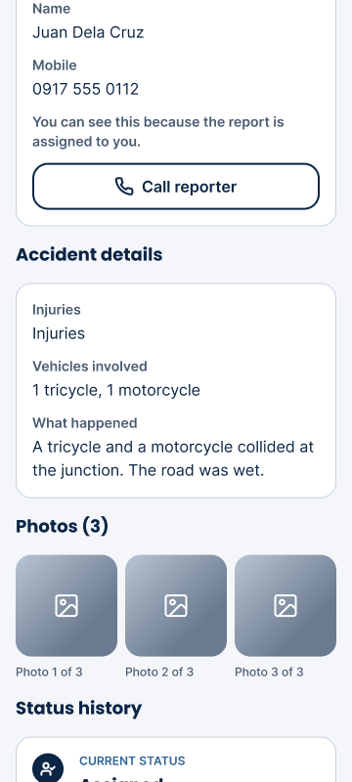
Report details
1
See the place on the map; Open in Maps starts navigation, Expand map shows it full screen.
2
Reporter contact: tap Call to phone the reporter. Use it only for this case.
3
Read the details and open the photos full screen (swipe, zoom).
4
The history shows every status change with the staff member who made it.

Slide 22
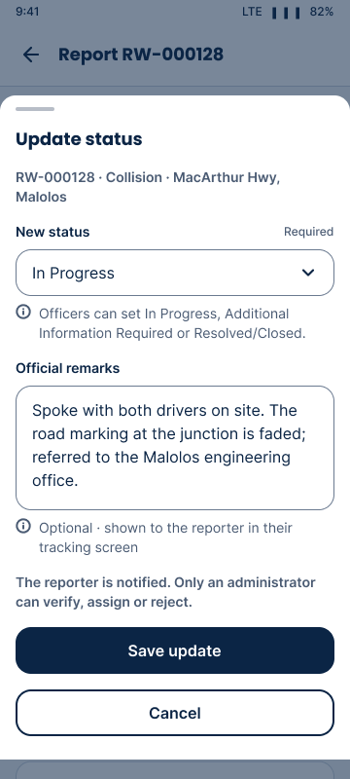
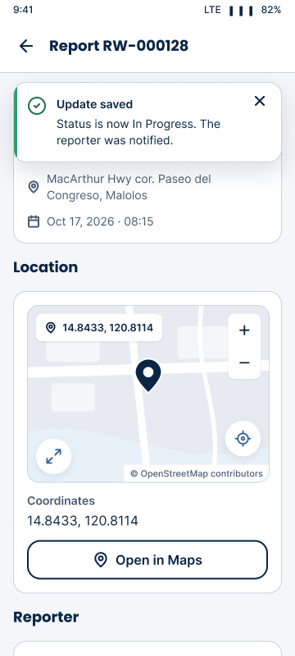
Update the status and add remarks
1
Tap Update status (web: the status panel on the report).
2
Choose In Progress, Additional Information Required or Resolved/Closed.
3
Write the official remarks: what you found and the action taken.
4
Save. The reporter is notified in the app and by email. Rejected reports are read-only.

Slide 23
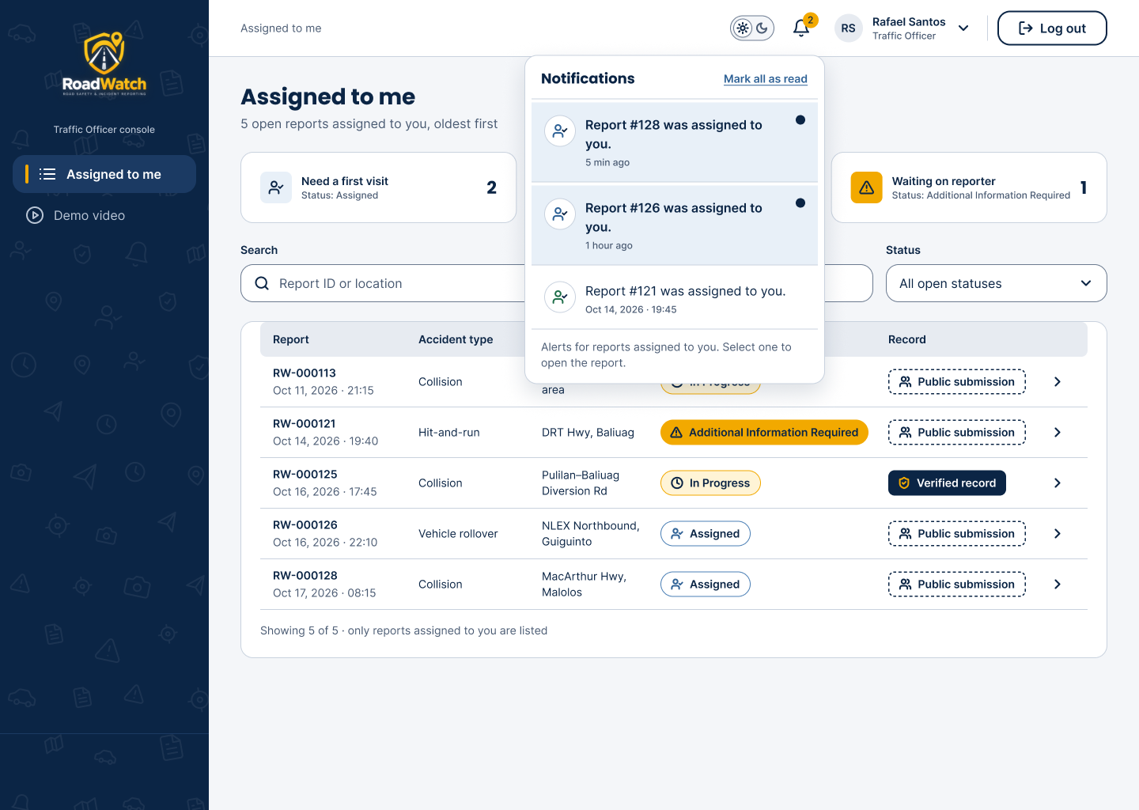
On the website: the notification bell
1
The bell in the top bar shows how many alerts are unread.
2
Open it to see new assignments; select one to open that report.
3
Mark all as read clears the count.
4
Esc or a click outside closes the panel.
Also on the website
Demo video, Action log (your own actions), the Guide and About, from the side bar and the user menu.

Slide 24
Administrator
03
Set priorities, verify and assign reports, manage accounts and the alert range, and export summaries on the website.
IN THIS SECTION
The dashboard and finding reports
Report priority
Verify, reject and assign
Users, alert range and summaries
Notes:
Administrators use only the website. The first administrator account is created by the team with the seed script.

Slide 25
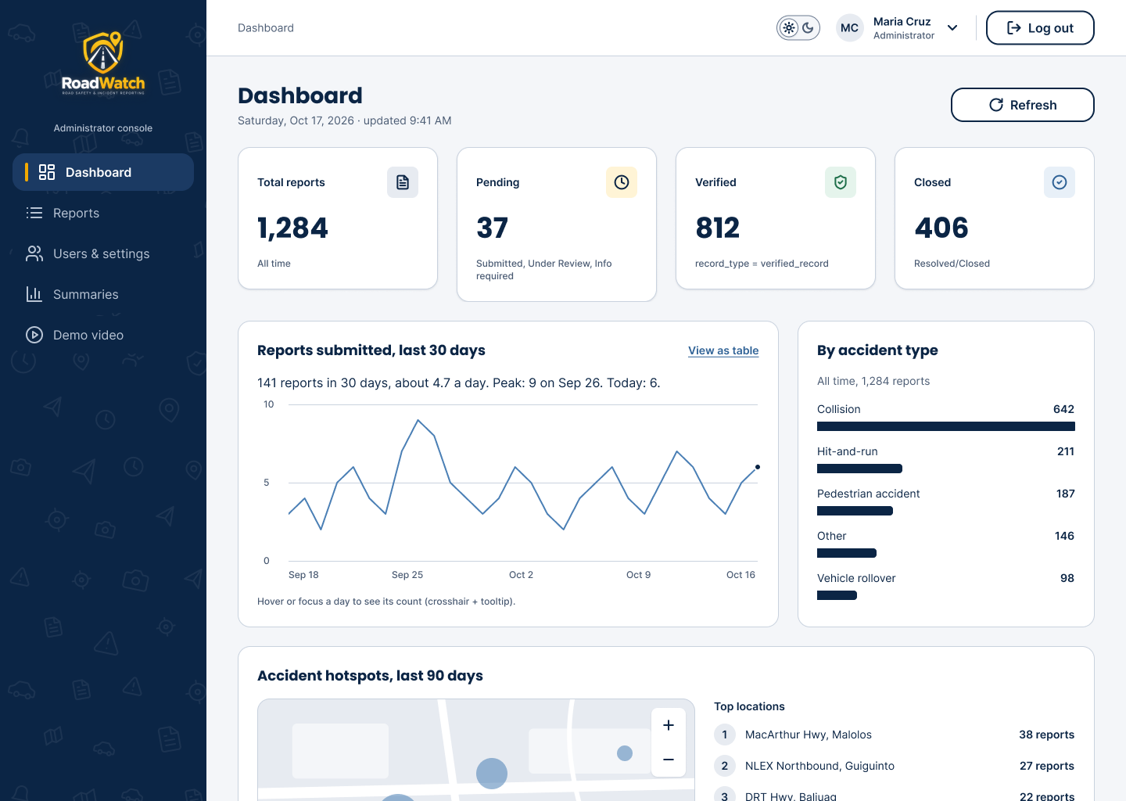
Sign in and the dashboard
1
Website → Staff sign-in → Administrator → email and password.
2
The dashboard shows totals (all, pending, verified, closed), the trend and accident types.
3
The hot-spot map shows where reports cluster. Each chart has a data table for screen readers.
4
Recent reports link straight to their details.

Slide 26
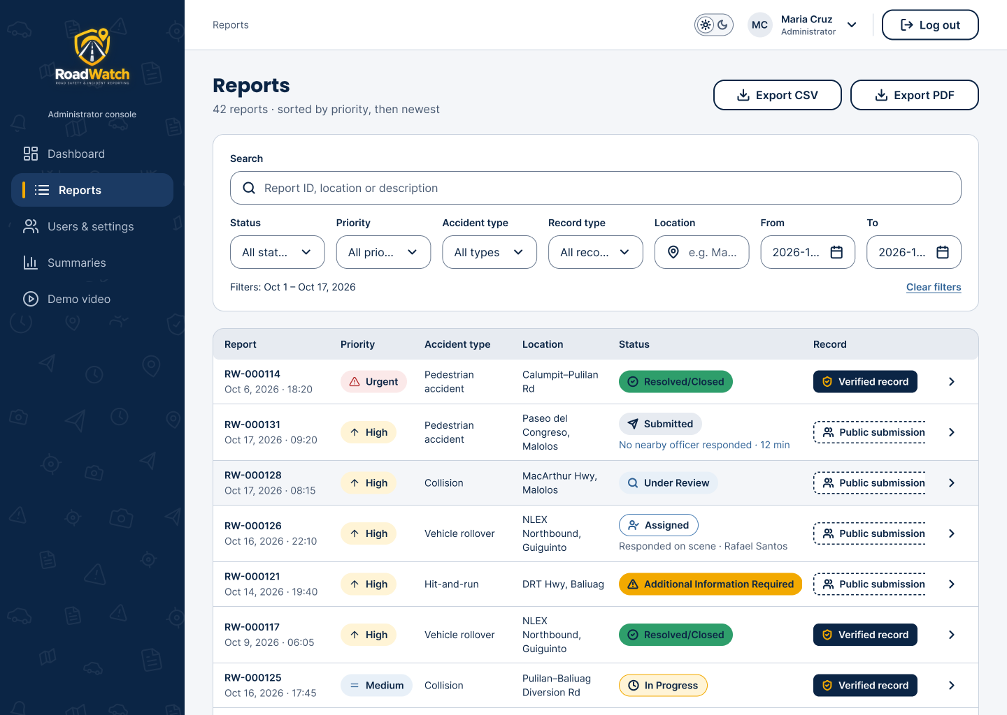
Find reports, most urgent first
NEW IN 1.2
1
Open Reports. The list is sorted by priority, then newest.
2
Search by report number (RW-000128), place or description.
3
Filter by status, priority, accident type, record type, location and dates.
4
A line under the status shows nearby-officer activity, for example "Responded on scene".

Slide 27
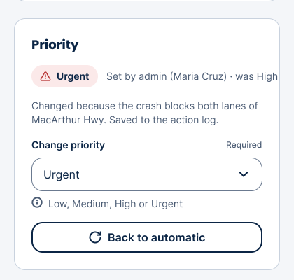
Report priority
NEW IN 1.2
Accident | Automatic priority
Pedestrian accident, hit-and-run, vehicle rollover | High
Collision | Medium
Other types | Low
With fatalities | Urgent
With injuries / injuries unknown | At least High / Medium
1
On a report, Change priority → choose a level → Save priority. The chip says "Set by admin" and what it was.
2
Back to automatic returns to the rule above. Every change is in the Action log.

Slide 28
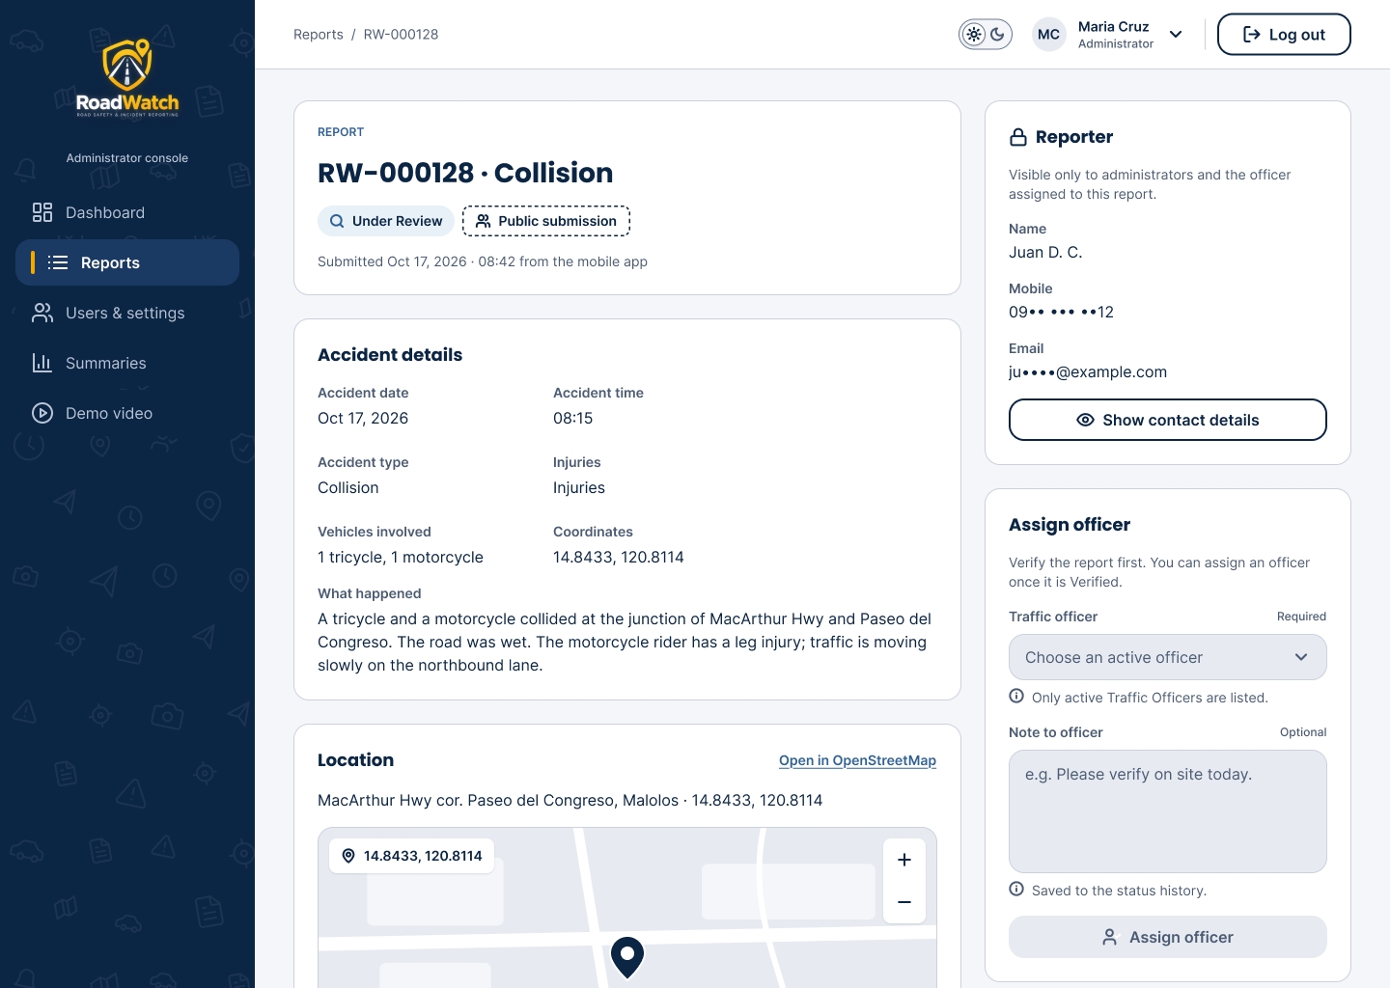
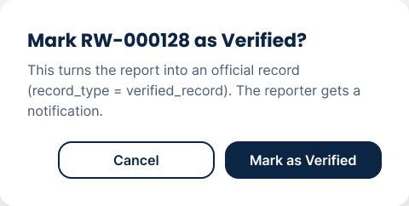
Review and verify a report
1
Check the details, photos (full screen) and the map.
2
Set Under Review while you check, or Additional Information Required with remarks.
3
Verify turns it into an official record (badge "Verified record").
4
Reject needs a reason, which the reporter sees.

Slide 29
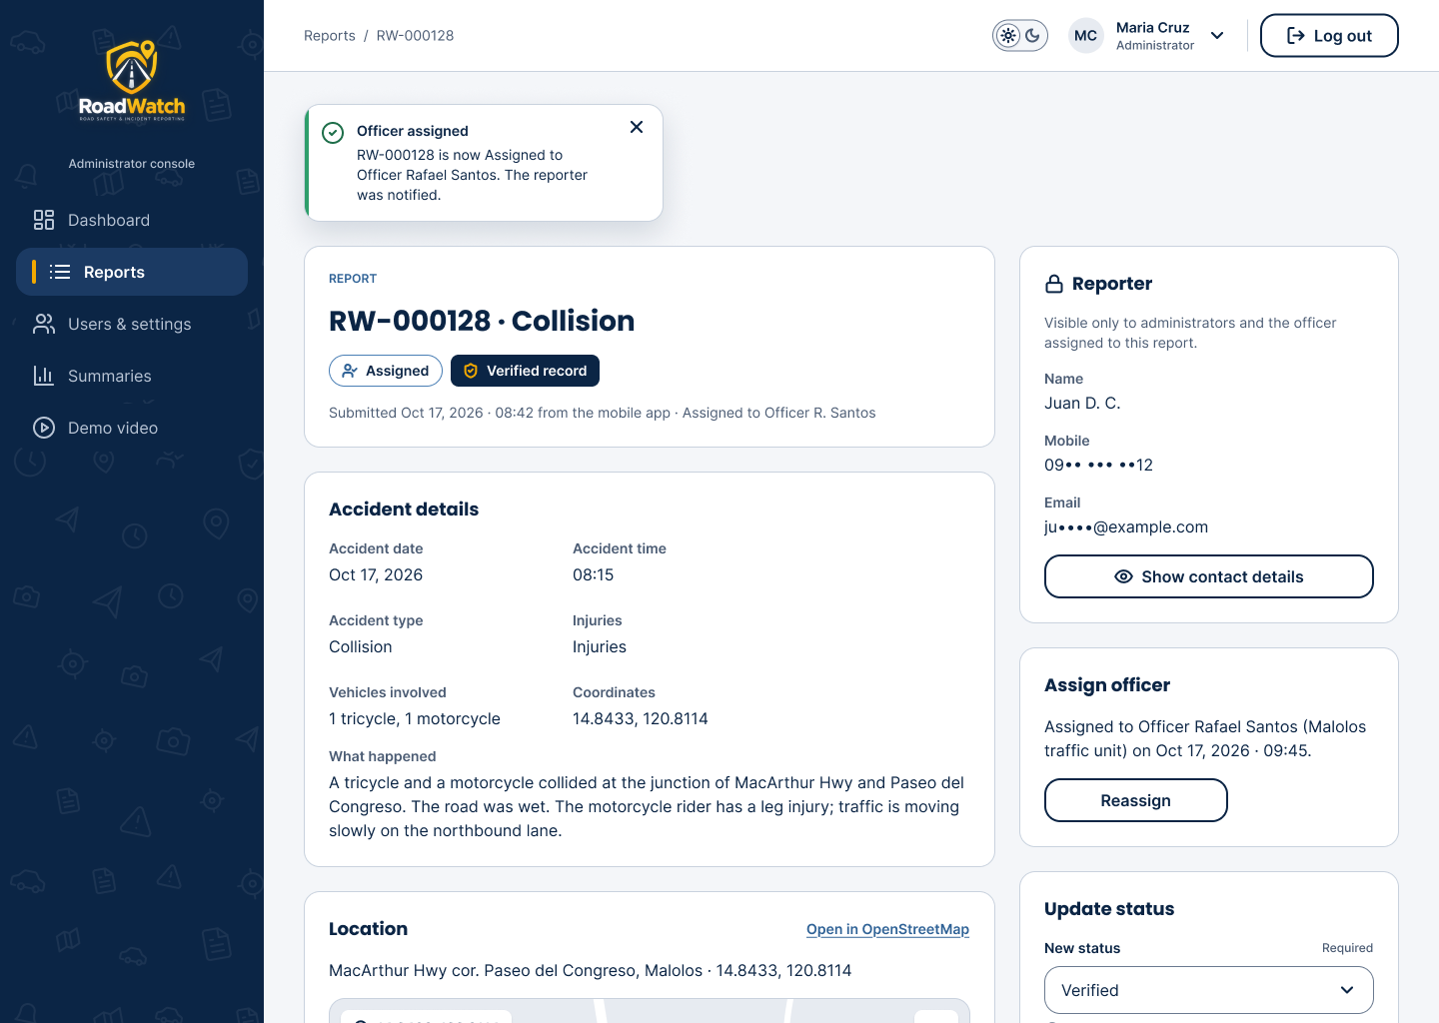
Assign a traffic officer
1
Only a Verified report can be assigned.
2
In Assign officer, choose an active Traffic Officer and save.
3
The status becomes Assigned; the officer gets an alert and the reporter an update.
4
A report a nearby officer already confirmed on scene is assigned to that officer automatically.

Slide 30
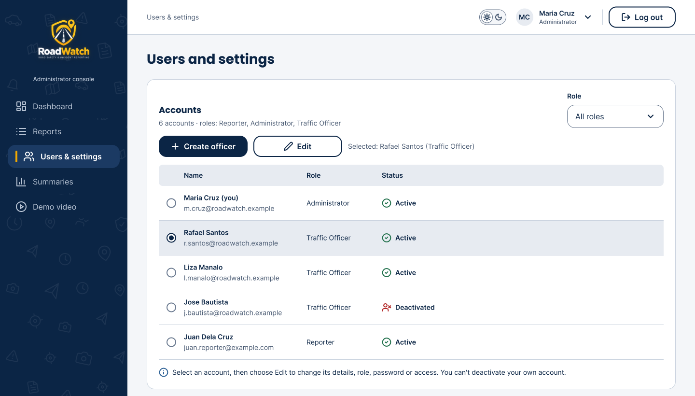
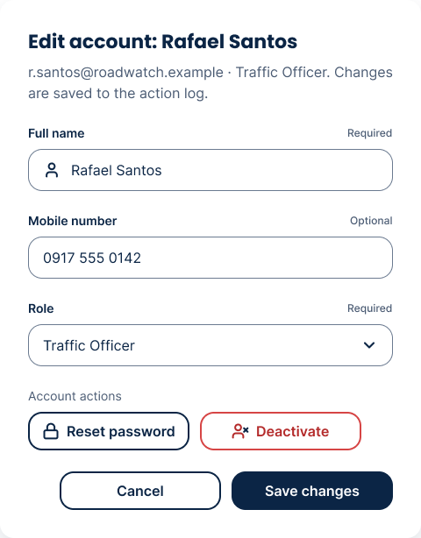
Manage users from the toolbar
NEW IN 1.2
1
Select an account with its round button, then Edit: name, phone, role, reset password, deactivate or reactivate.
2
+ Create officer opens a dialog: name, email, phone and a Strong temporary password.
You cannot change your own role or deactivate yourself.

Slide 31
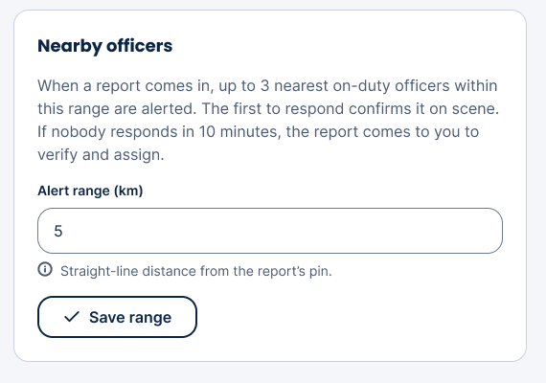
Set the alert range for nearby officers
NEW IN 1.2
1
In Users and settings, find the Nearby officers card.
2
Type the Alert range in kilometres (default 5) and press Save range.
3
New reports then alert up to 3 on-duty officers within that straight-line distance of the report's pin.
4
If nobody responds in 10 minutes, the report comes to you to verify and assign.

Slide 32
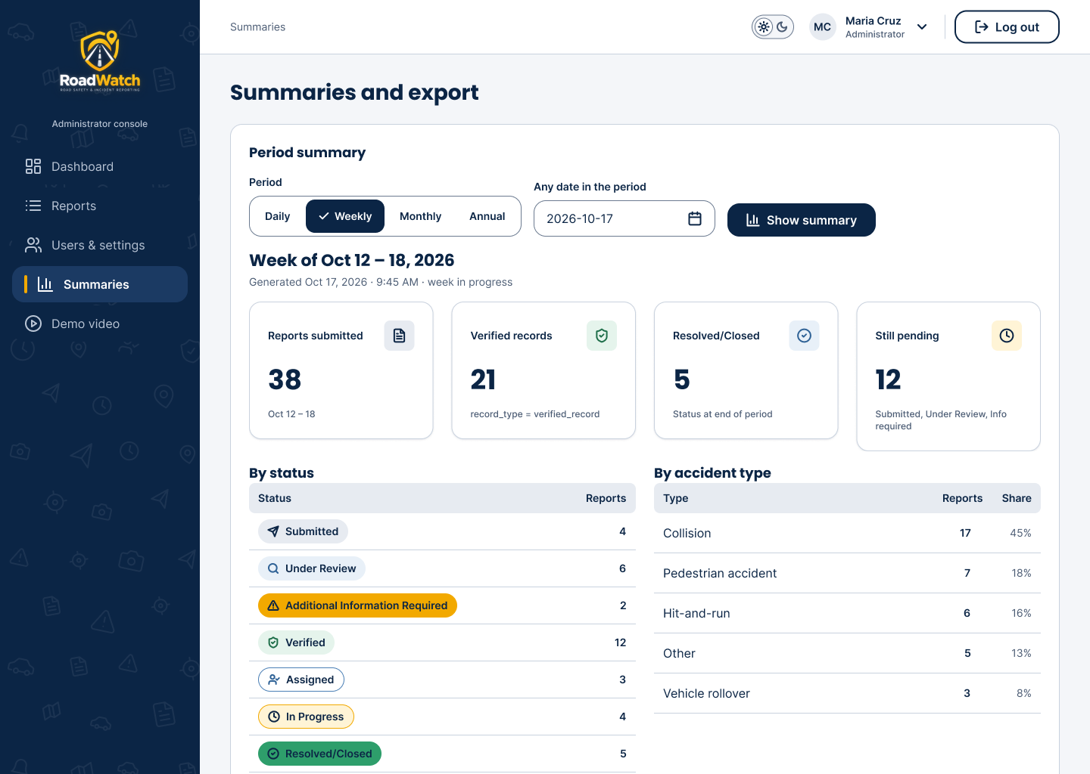
Summaries and exports
1
Open Summaries.
2
Pick the period: daily, weekly, monthly or annual, and the date.
3
Read the totals by status and accident type.
4
Export PDF for printing or Export CSV for a spreadsheet; both include the priority.

Slide 33
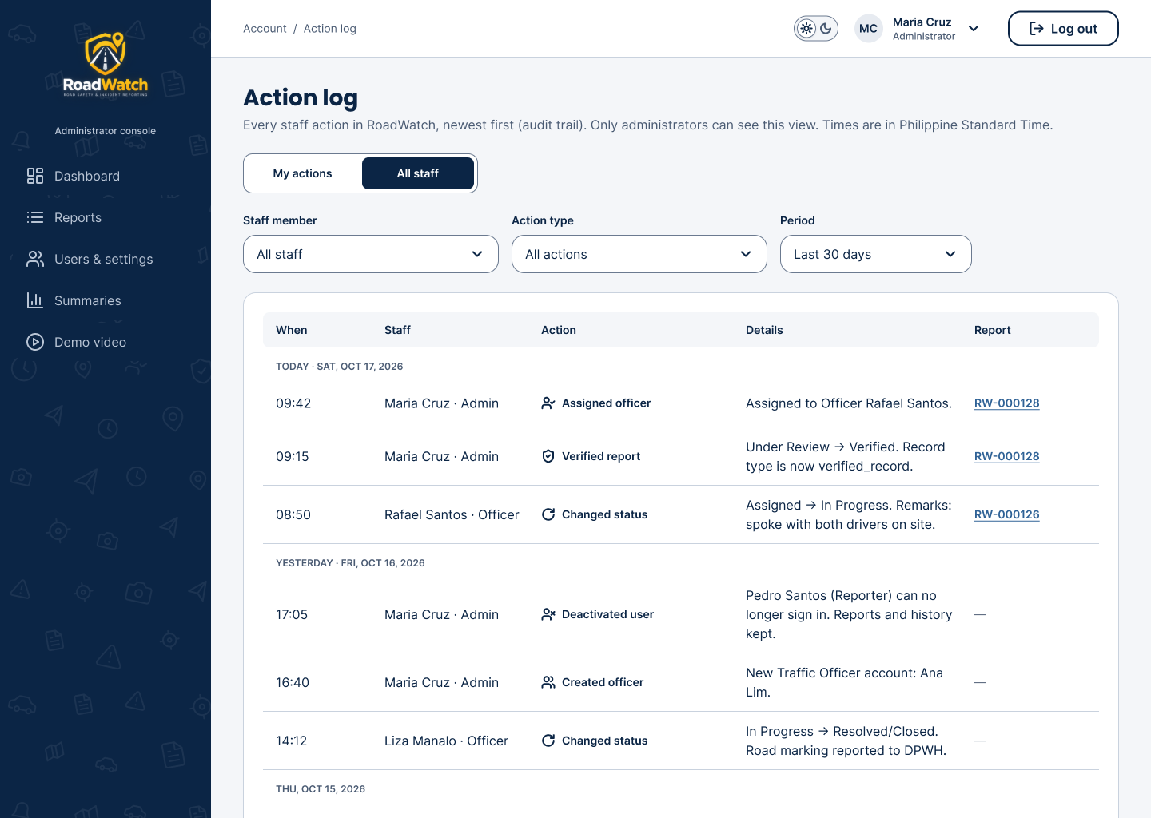
Action log
1
User menu → Action log.
2
My actions lists your own; All staff (administrators only) lists every staff action.
3
Use it to check who verified, assigned, changed a priority or the alert range, or deactivated an account.

Slide 34
Good to know
04
The Guide on the website, your account, and what to do when something goes wrong.
IN THIS SECTION
The Guide on the website
Your account
Troubleshooting
Privacy, safety and accessibility

Slide 35
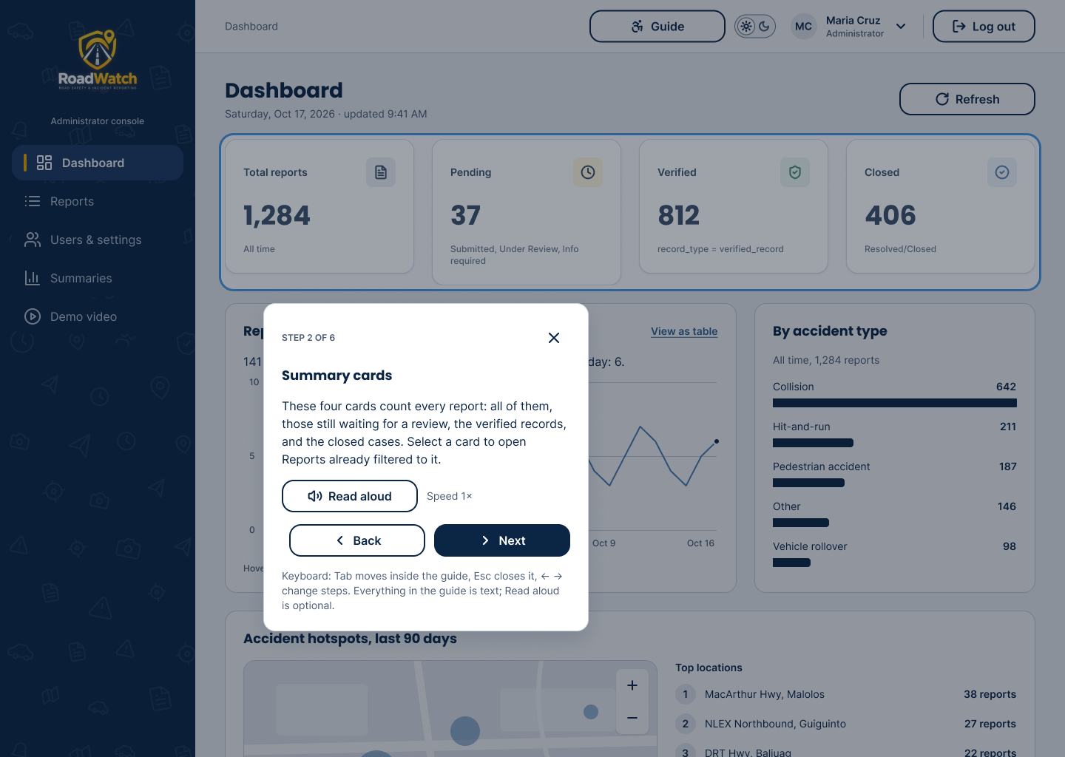
The Guide on the website
NEW IN 1.2
1
Press Guide in the top bar (on a phone: account menu → Guide) on Dashboard, Reports, a report, Users and settings, or Assigned to me.
2
A ring marks one part of the page; the card explains it, step by step.
3
Keyboard: Tab moves inside the card, ← and → change steps, Esc closes it.
4
Read aloud and the speed button are optional; every step is written.

Slide 36
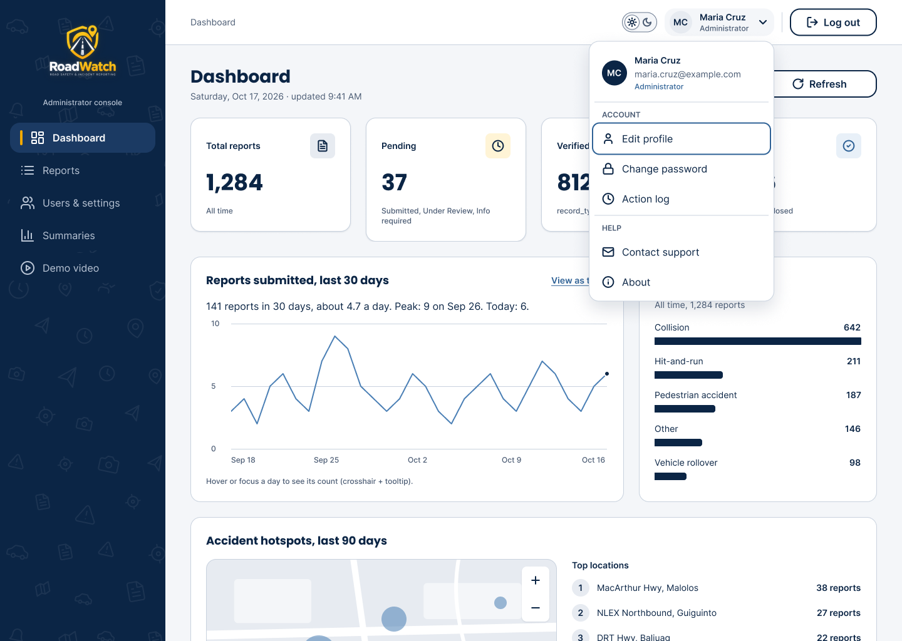
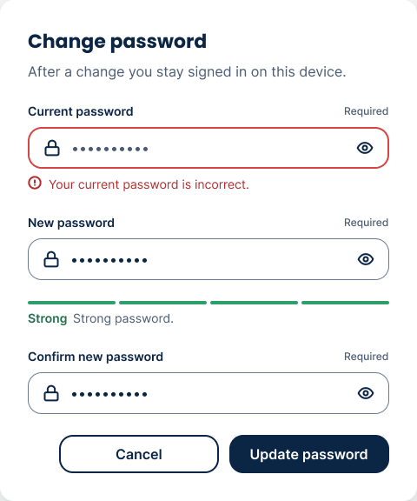
Your account on the website
1
Click your name for the user menu: Edit profile, Change password, Action log, Contact support, About.
2
The sun and moon switch sets Light or Dark.
3
Log out asks you to confirm.
New passwords must reach Strong on the meter.

Slide 37
When something goes wrong
If you see… | Do this
The app says the server may be waking up | Wait up to a minute and try again (the free server sleeps when idle).
"This account uses the mobile app" on the website | It is a Reporter account: use the Android app.
"This is an Administrator / Traffic Officer account" | Go back with "Choose a different role" and pick the right one.
"Account deactivated" or a password that will not save | Contact support; new passwords must reach Strong on the meter.
Forgot the password | Use "Forgot password?"; the code is in your email for 15 minutes.
No nearby alerts as an officer | Turn On duty on, allow location, and keep Assigned open.
"Already taken" | Another officer responded first; the report is in good hands.
No location, or the pin is wrong | Allow location access, or move the pin on the full-screen map.

Slide 38
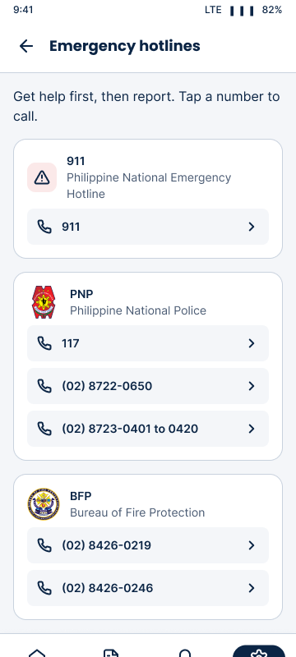


Privacy, safety and accessibility
Your data
Passwords are stored hashed. Reporter contact details are shown only to administrators and the assigned officer. An officer's location is shared only while On duty.
Safety first
Report only when it is safe: pull over, never while driving. Call 911 for emergencies.
Accessible
Built for WCAG 2.1 AA: labels on every field, keyboard use on the web, text on every status and priority, the Guide with Read aloud, Light and Dark.

Slide 39
Need help?
support@roadwatch-ph.me
Website: www.roadwatch-ph.me
Android app: www.roadwatch-ph.me/app
RoadWatch User Guide, version 1.2.0 · Prepared by Princess Lorellyn Isip, Documentation Lead
Notes:
Thank the audience. Mention the demo clips in each app and the promotional video on the website.

