Slide 1
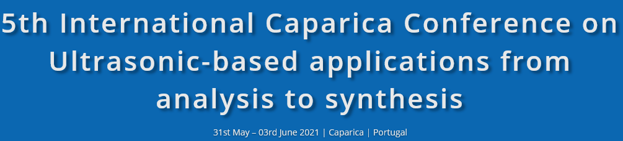


Acoustically Induced Acceleration of Iron Migration in Silicon Solar Cells
Oleg Olikh¹, Vitaliy Kostylyov²,
Victor Vlasiuk², Roman Korkishko²
¹Taras Shevchenko National University of Kyiv, Kyiv, Ukraine
²V.Lashkaryov Institute of Semiconductor Physic, Kyiv, Ukraine

Slide 2
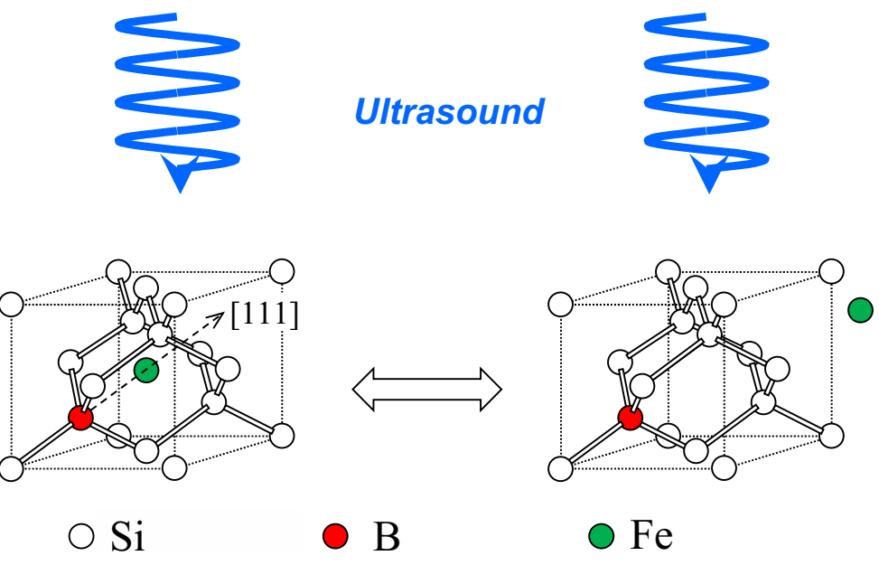
ULTRASONICS 2021 P07. Acoustically Induced Acceleration of Iron Migration in Silicon Solar Cells
Main goal:
to investigate experimentally the FeB pair association in silicon solar cells under ultrasound loading conditions

Slide 3
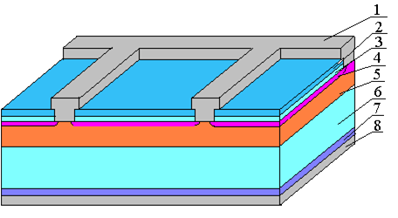
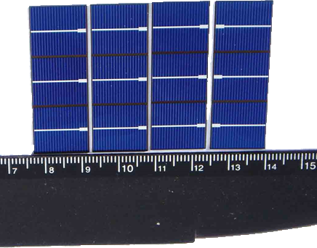
ULTRASONICS 2021 P07. Acoustically Induced Acceleration of Iron Migration in Silicon Solar Cells
Samples:
1 - front metal electrode (Al);
2 - Si₃N₄ (40 nm);
3 - SiO₂ (30 nm);
4 - induced n++ - layer;
5 - diffusion n+ - layer (0.7 μm);
6 - base region (p-Si:B, 10 Ω⋅cm, 380 μm);
7 - diffusion p+ -layer (0.6 μm);
8 - rear metallization (Al)

Slide 4
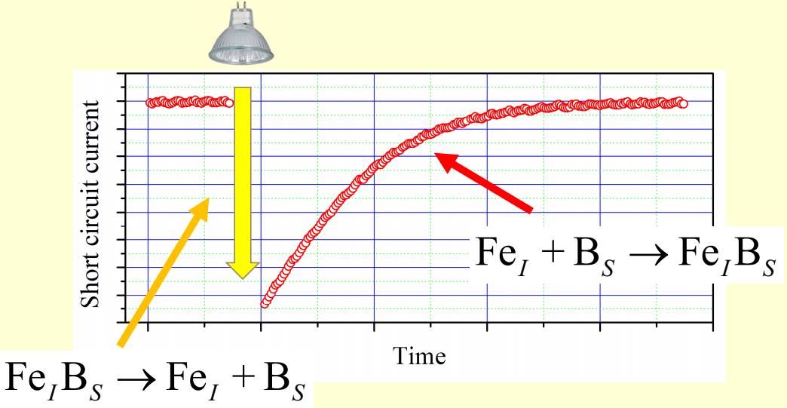
ULTRASONICS 2021 P07. Acoustically Induced Acceleration of Iron Migration in Silicon Solar Cells

Slide 5
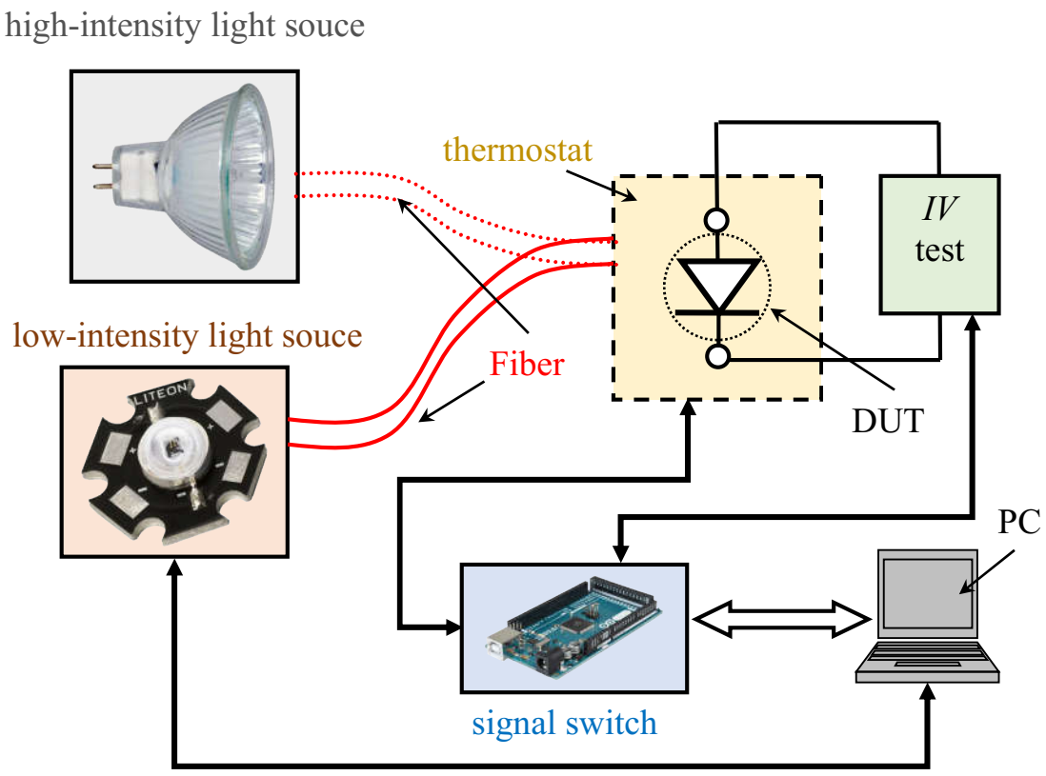
ULTRASONICS 2021 P07. Acoustically Induced Acceleration of Iron Migration in Silicon Solar Cells
Experimental setup:

Slide 6
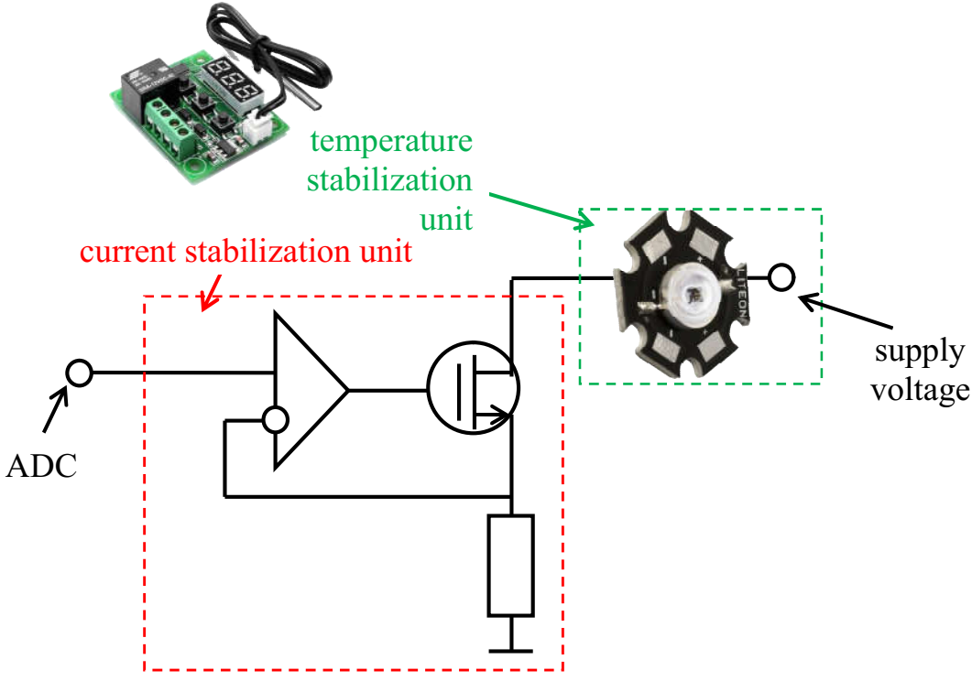
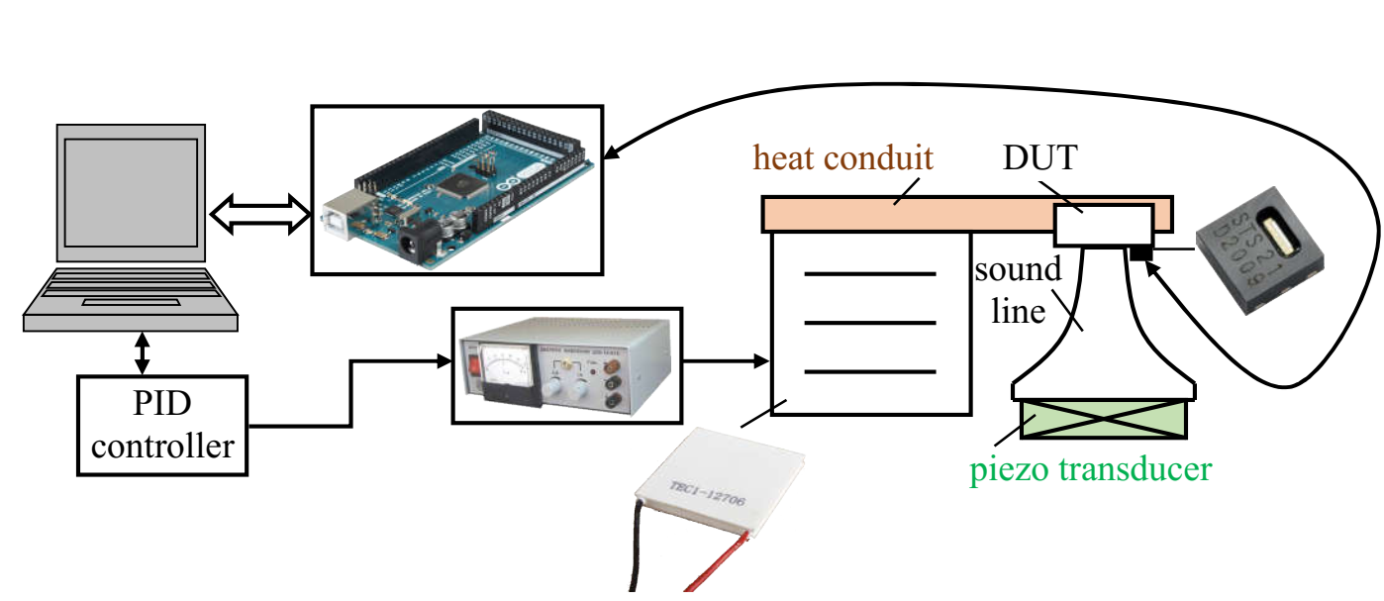
ULTRASONICS 2021 P06. Acoustically Induced Acceleration of Iron Migration in Silicon Solar Cells
scheme of low intensity light source:
thermostat scheme

Slide 7
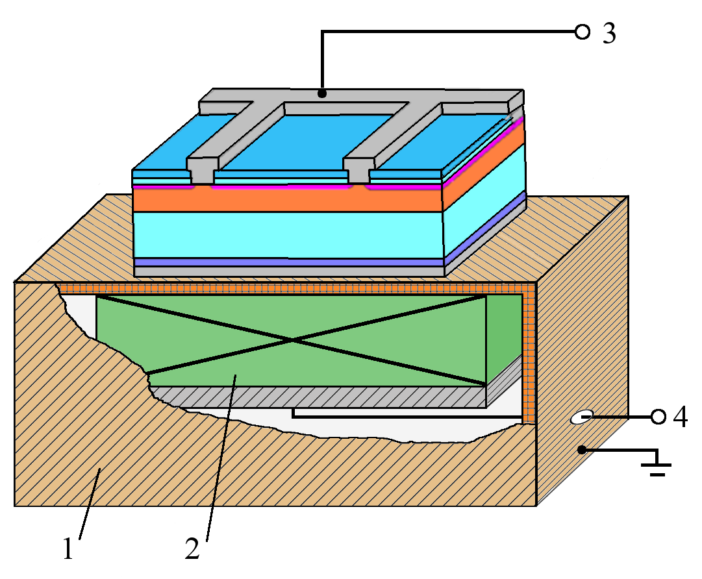
ULTRASONICS 2021 P07. Acoustically Induced Acceleration of Iron Migration in Silicon Solar Cells
Ultrasound loading
shear wave (radial vibrations, f_{US} = 0.3 MHz)
longitudinal wave (thickness vibrations, f_{US} = 4.1 MHz)
1 – Cu foil
2 – piezoelectric transducer
3 – contacts for IV measuring
4 – contacts for US excitation

Slide 8
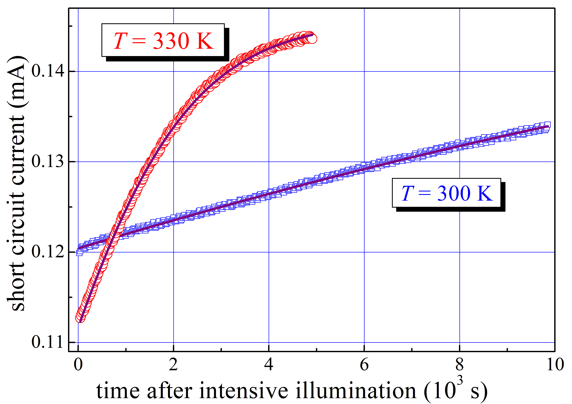
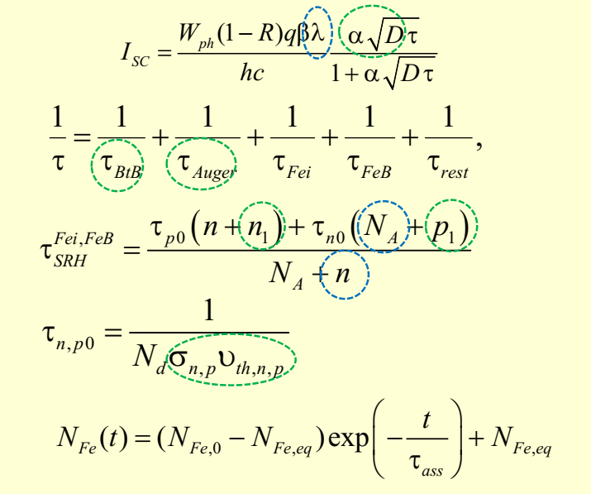
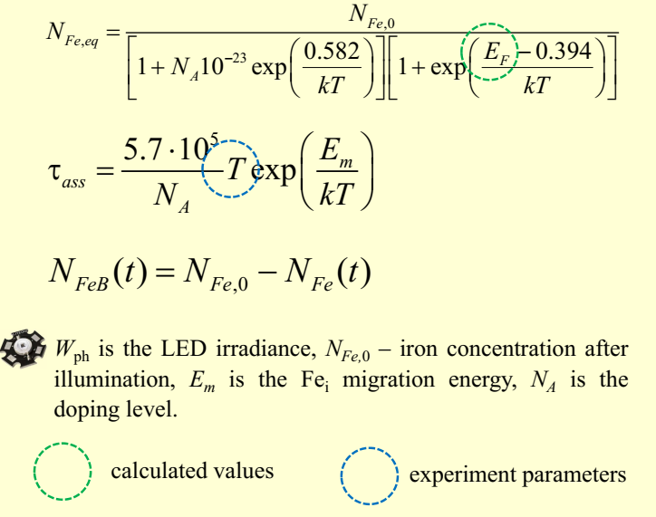
ULTRASONICS 2021 P07. Acoustically Induced Acceleration of Iron Migration in Silicon Solar Cells
N_{Fe} = 2 ⋅ 10¹³ cm⁻³
E_{m} = 0.657 eV
fitting
0.66 eV
[J. Appl.Phys. 116 024503]

Slide 9
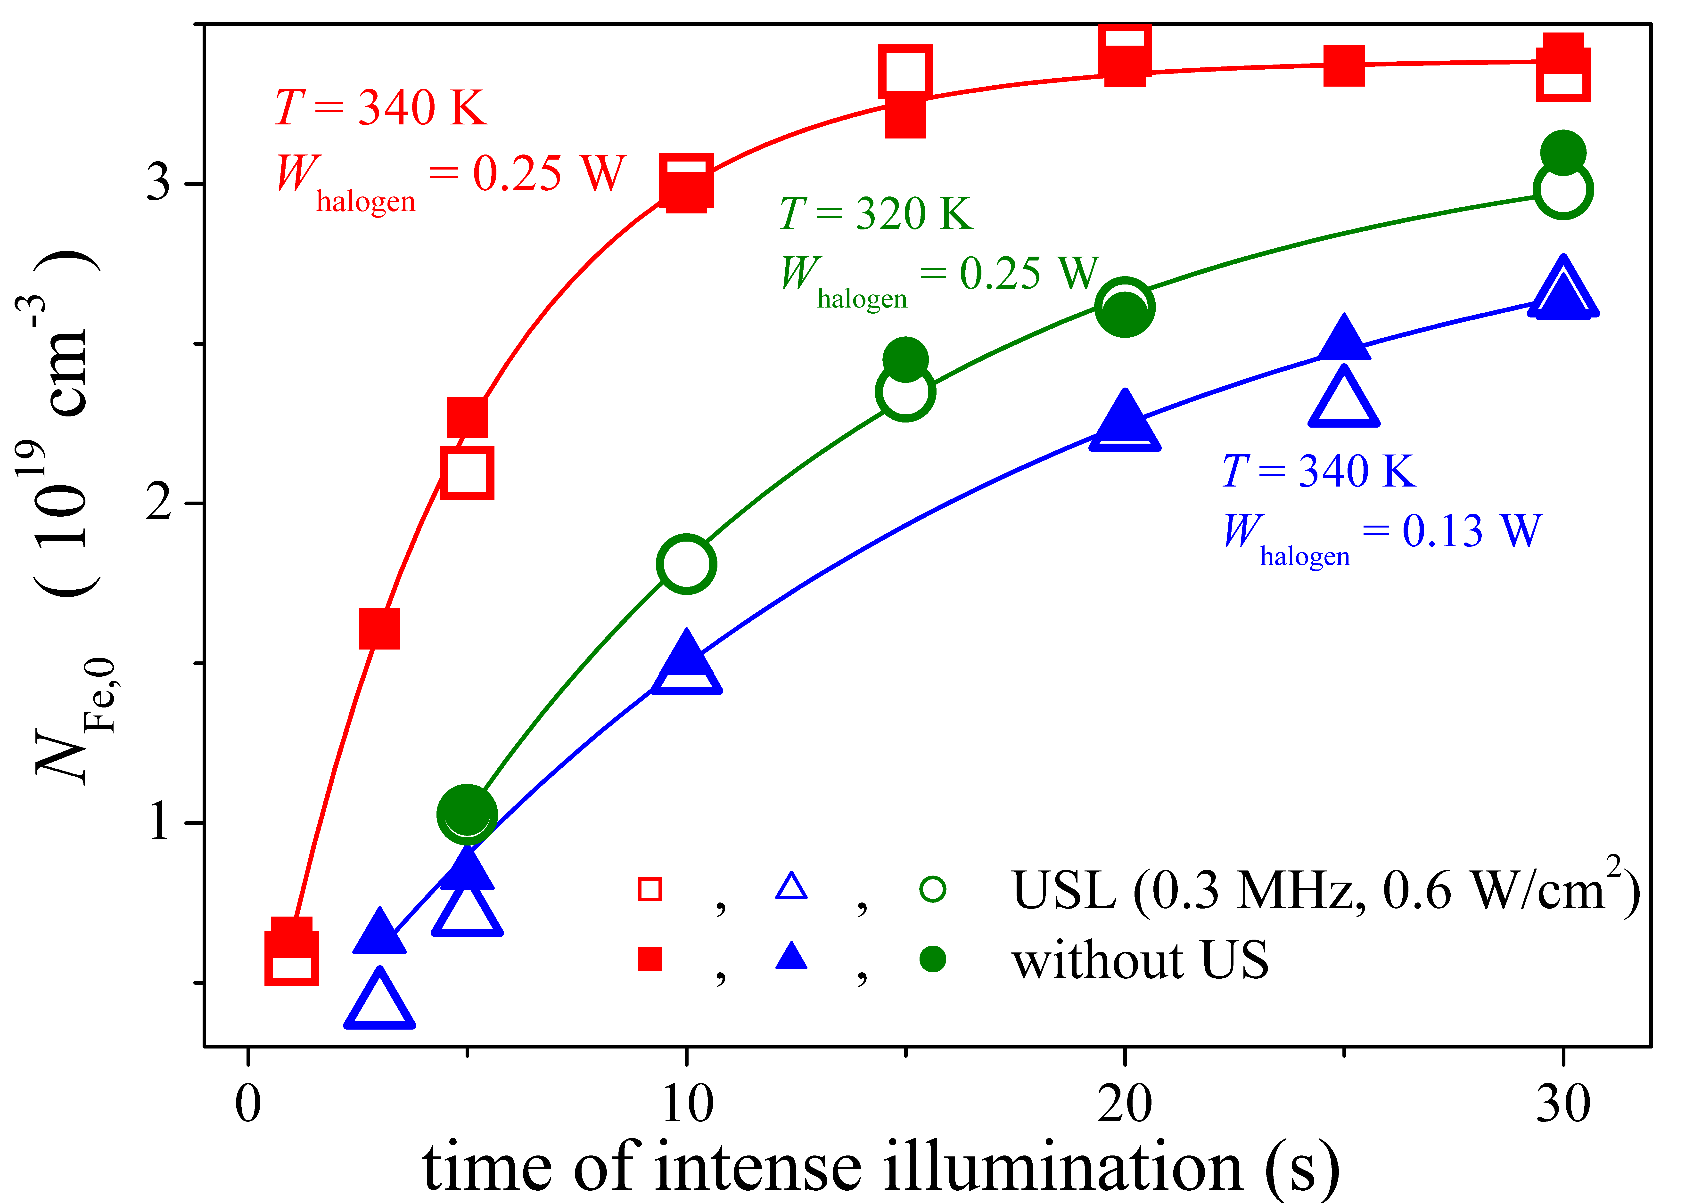

ULTRASONICS 2021 P07. Acoustically Induced Acceleration of Iron Migration in Silicon Solar Cells
kinetic of FeB dissociation with (open marks) and without (closed mark) US loading
T, K | W_{halogen}, W | τ_{diss}, s | τ_{diss},_{US} s
340 | 0.13 | 16±2 | 13±3
340 | 0.25 | 4.6±0.2 | 4.6±0.4
320 | 0.25 | 11±4 | 11±1

Slide 10
ULTRASONICS 2021 P07. Acoustically Induced Acceleration of Iron Migration in Silicon Solar Cells
the dissociation time (τ_{dis})
(i) proportionate to (W_{halogen}) ² [J.Appl.Phys. 116 024503]
(ii) decrease approximately twice per 20°C increase [Appl.Phys.Lett 63 3044]
T, K | W_{halogen}, W | τ_{diss}, s | τ_{diss},_{US} s
340 | 0.13 | 16±2 | 13±3
340 | 0.25 | 4.6±0.2 | 4.6±0.4
320 | 0.25 | 11±4 | 11±1

Slide 11
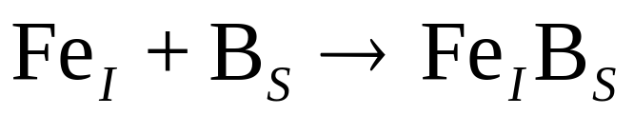
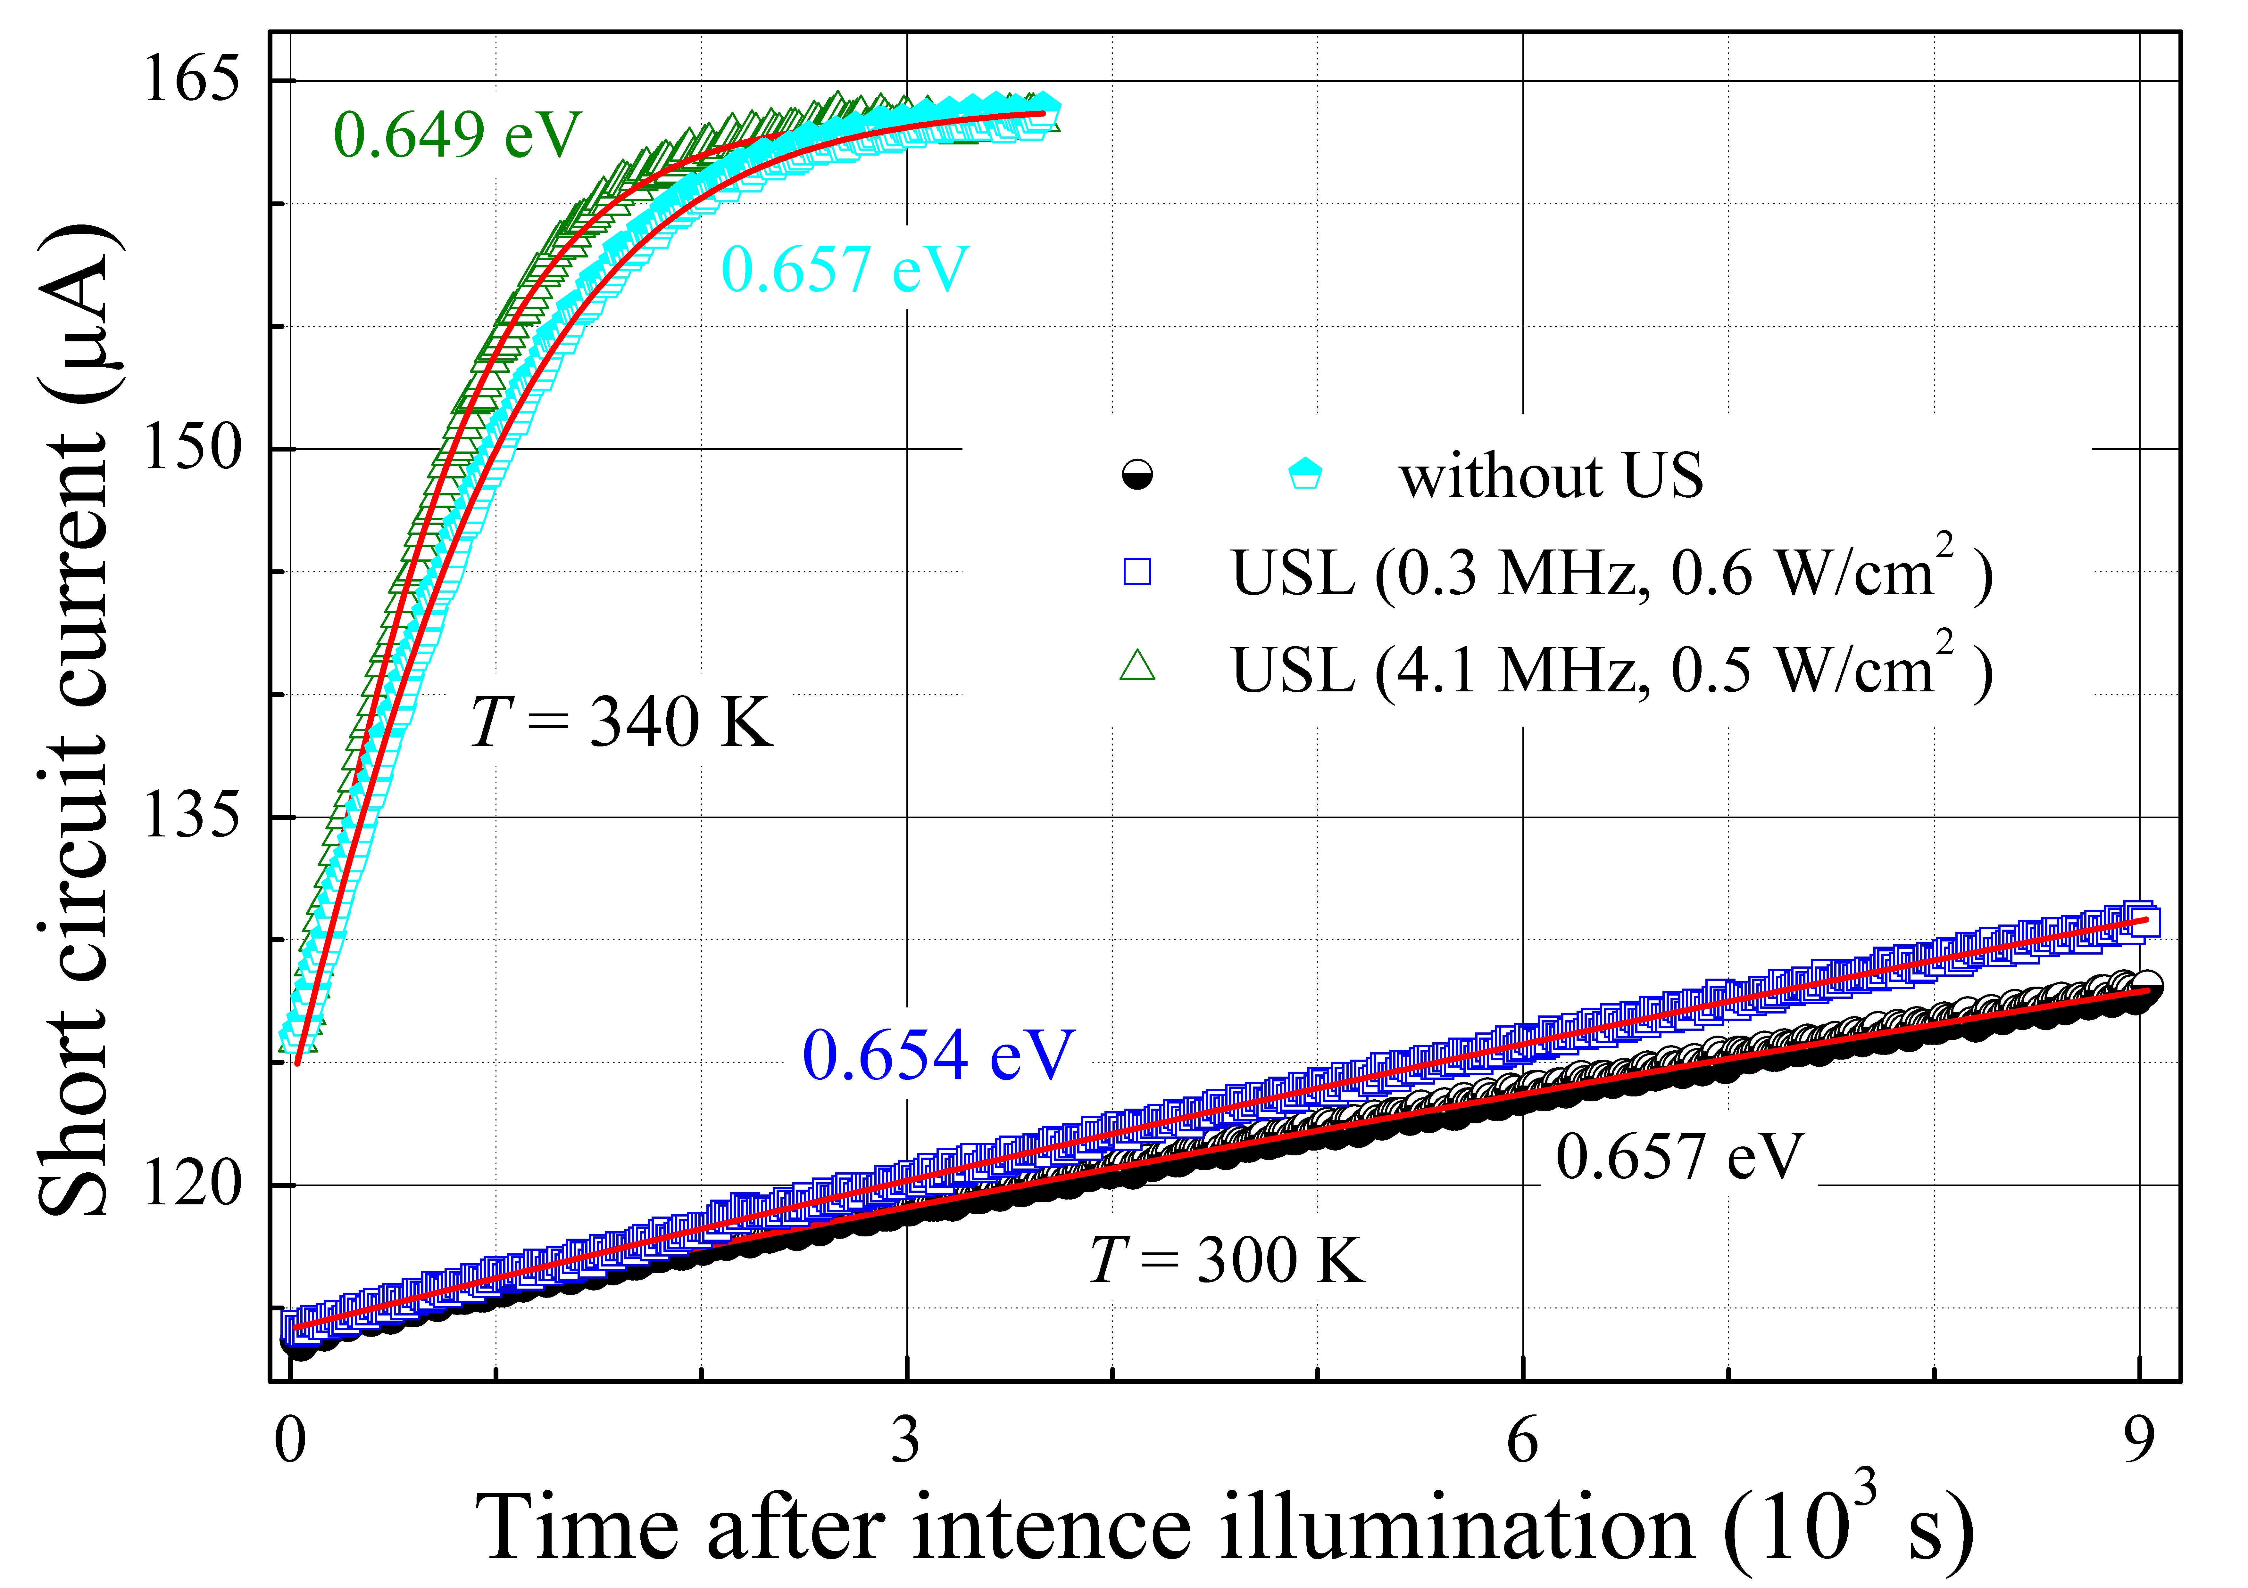
ULTRASONICS 2021 P07. Acoustically Induced Acceleration of Iron Migration in Silicon Solar Cells

Slide 12
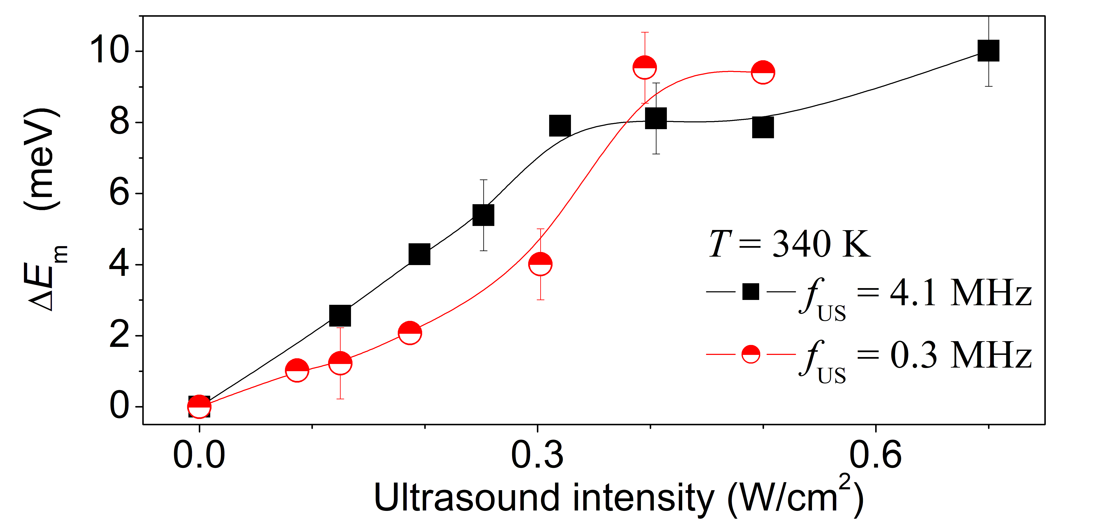
ULTRASONICS 2021 P07. Acoustically Induced Acceleration of Iron Migration in Silicon Solar Cells
acoustically induced decrease in iron migration energy

Slide 13
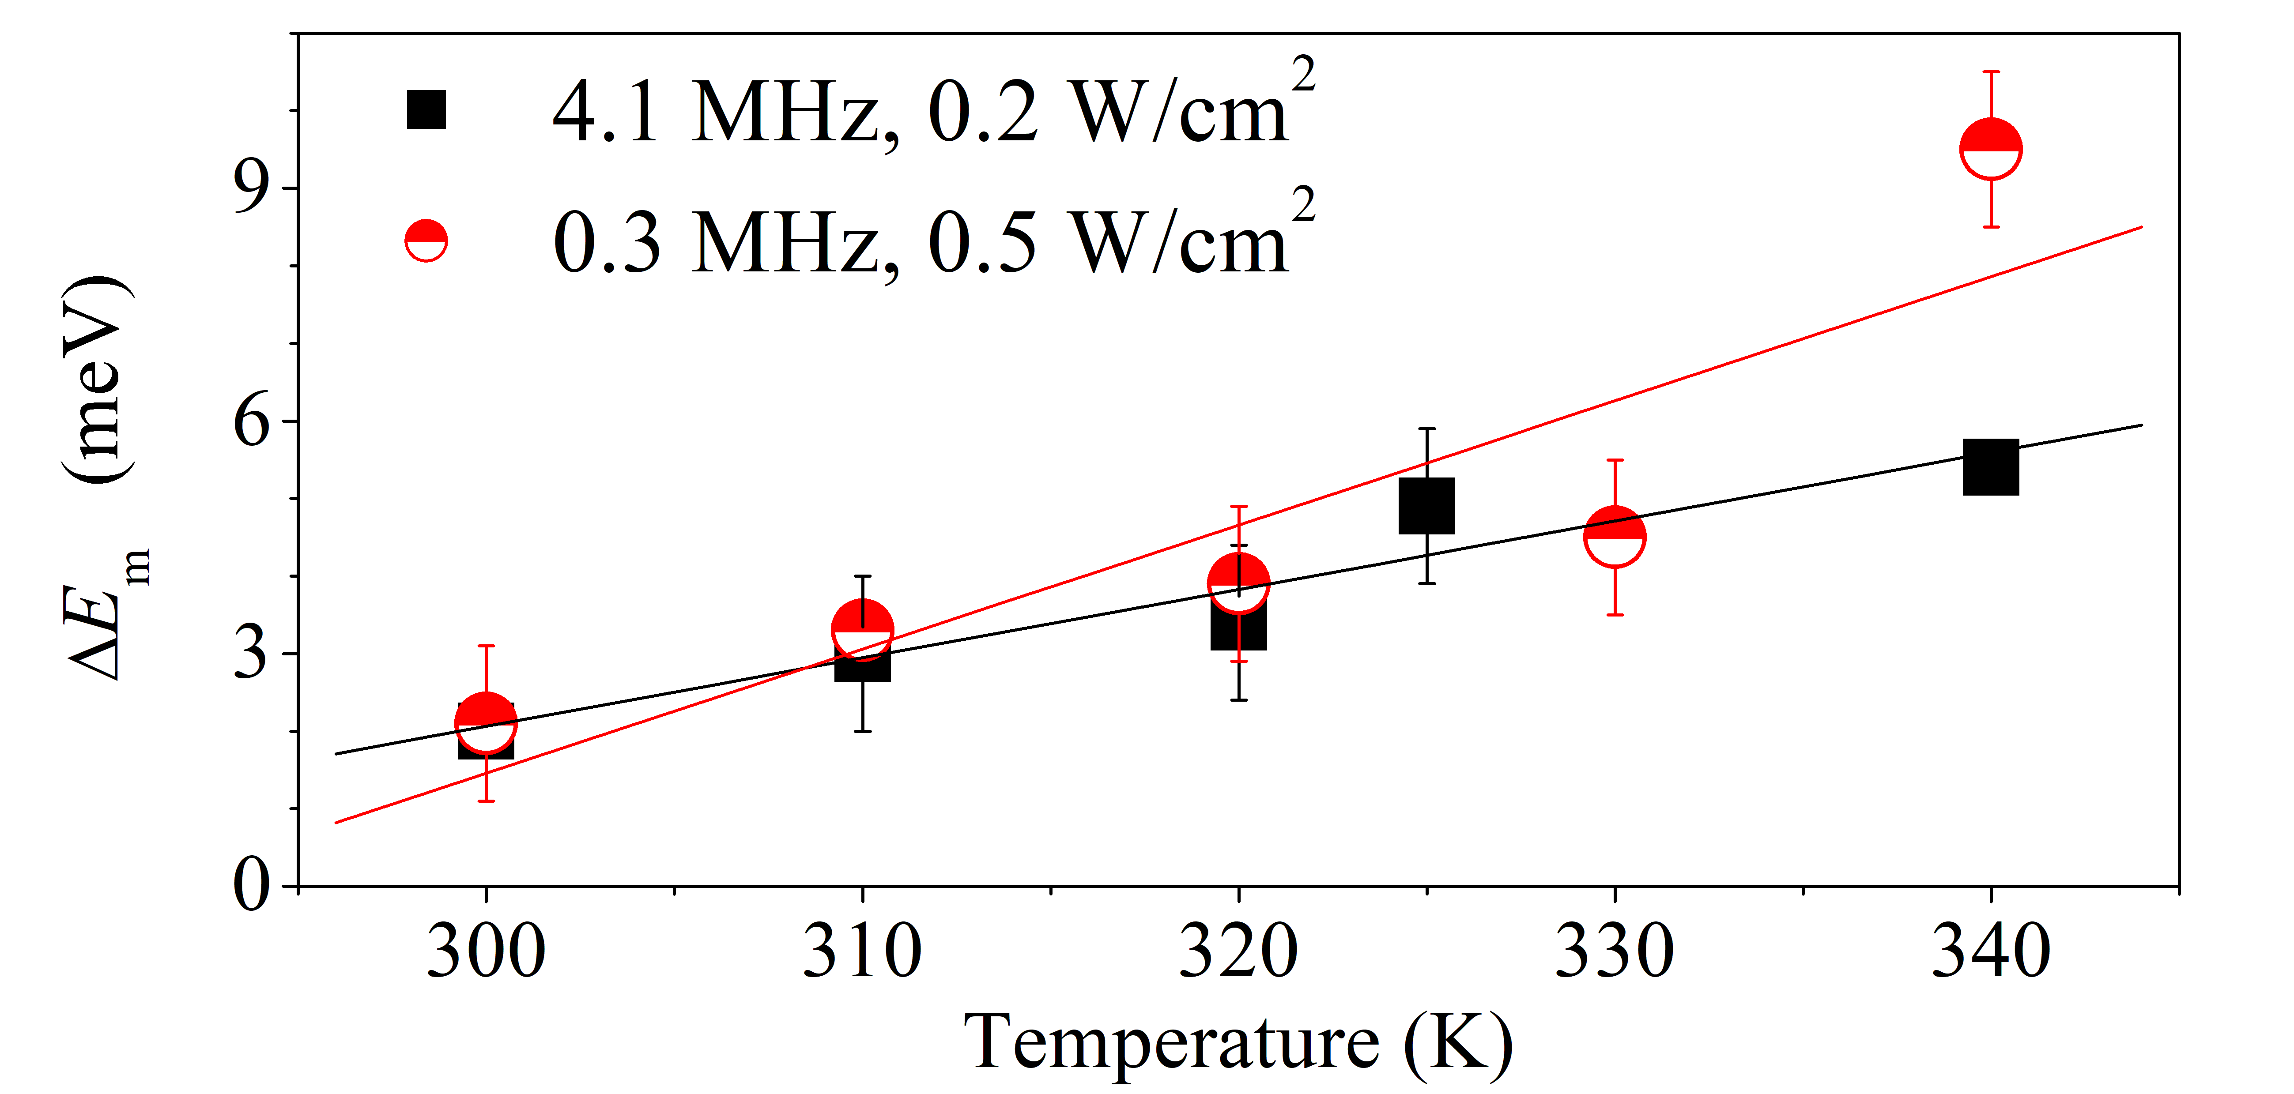
ULTRASONICS 2021 P07. Acoustically Induced Acceleration of Iron Migration in Silicon Solar Cells
acoustically induced decrease in iron migration energy

Slide 14
ULTRASONICS 2021 P07. Acoustically Induced Acceleration of Iron Migration in Silicon Solar Cells
CONCLUSION
The experimental investigation of ultrasound inﬂuence on FeB association and dissociation in silicon solar cell has been carried out. The investigation has revealed the acoustically induced acceleration of FeB pairing, which deals with decrease in iron migration energy;
The value of energy reduction is up to 9 meV, saturates with increase of acoustic wave intensity and decreases at low temperature;
It has been shown that the observed effects can be accounted for by the acoustically induced change of iron equilibrium lattice position. Thus, ultrasound can be an effective tool for driving of defect in silicon structures.

Slide 15

ULTRASONICS 2021 P07. Acoustically Induced Acceleration of Iron Migration in Silicon Solar Cells
olegolikh@knu.ua

