Slide 1



Ultrasound as Functional Influence Tool on FeB Pair Association in Silicon Solar Cells
Oleg Olikh¹, Vitaliy Kostylyov²,
Victor Vlasiuk², Roman Korkishko²
¹Taras Shevchenko National University of Kyiv, Kyiv, Ukraine
²V.Lashkaryov Institute of Semiconductor Physic, Kyiv, Ukraine

Slide 2



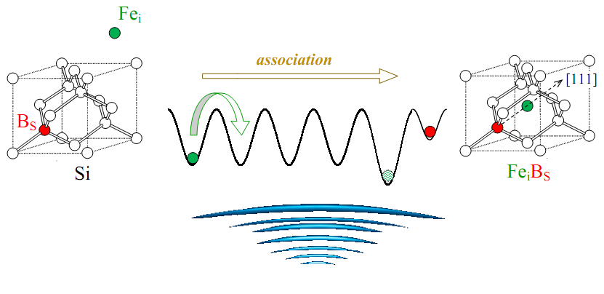
UCLA 2021 817. Ultrasound as Functional Influence Tool on FeB Pair Association in Silicon Solar Cells
Main goal:
to investigate experimentally the FeB pair association in silicon solar cells under ultrasound loading conditions
Ultrasound

Slide 3
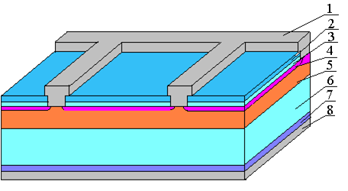
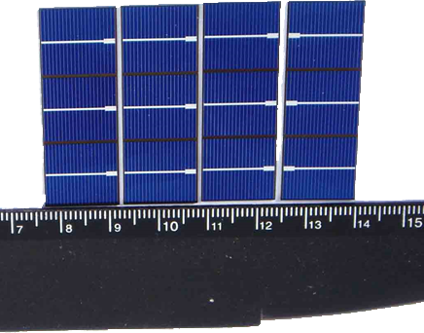
UCLA 2021 817. Ultrasound as Functional Influence Tool on FeB Pair Association in Silicon Solar Cells
Samples:
1 - front metal electrode (Al);
2 - Si₃N₄ (40 nm);
3 - SiO₂ (30 nm);
4 - induced n++ - layer;
5 - diffusion n+ - layer (0.7 μm);
6 - base region (p-Si:B, 10 Ω⋅cm, 380 μm);
7 - diffusion p+ -layer (0.6 μm);
8 - rear metallization (Al)

Slide 4
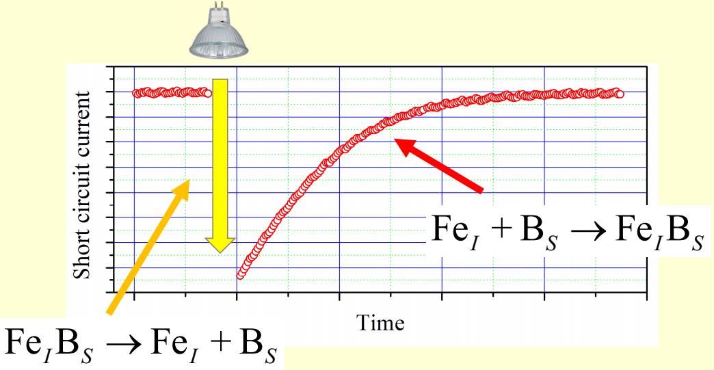
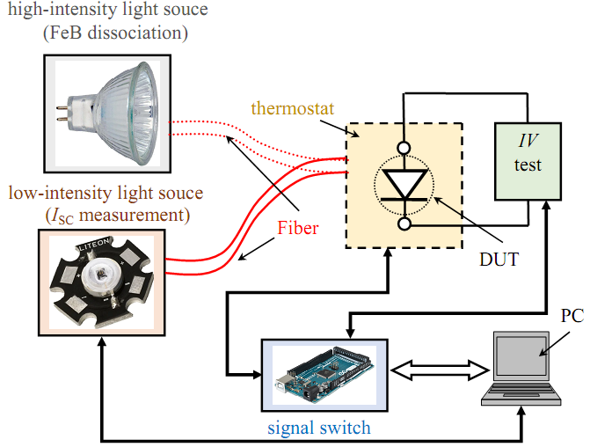
UCLA 2021 817. Ultrasound as Functional Influence Tool on FeB Pair Association in Silicon Solar Cells
Experimental setup:

Slide 5
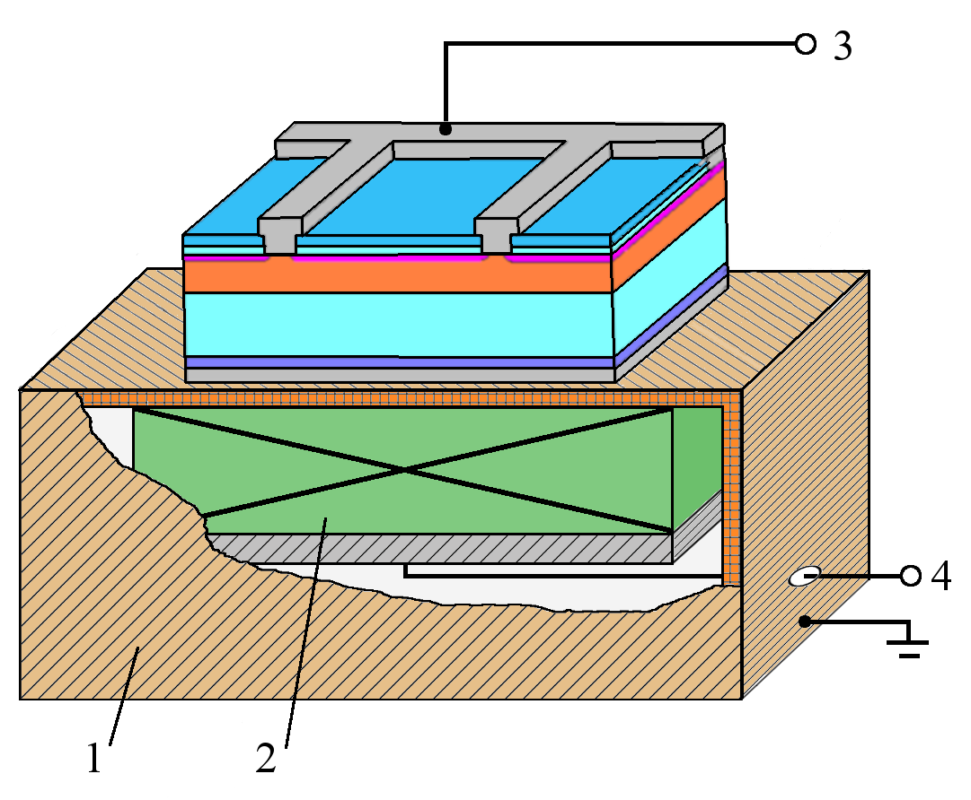
UCLA 2021 817. Ultrasound as Functional Influence Tool on FeB Pair Association in Silicon Solar Cells
Ultrasound loading (USL)
1 – Cu foil
2 – piezoelectric transducer
3 – contacts for IV measuring
4 – contacts for US excitation
longitudinal wave (thickness vibrations) f_{US} = 2.4; 4.1; 5.4; 9.0; 14; 18; 31 MHz
transverse wave (radial vibrations) f_{US} = 0.3 MHz
ultrasound intensity W_{US} ≤ 0.6 W/cm²

Slide 6
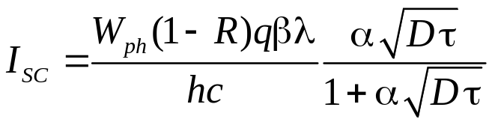
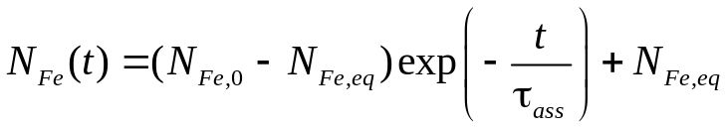
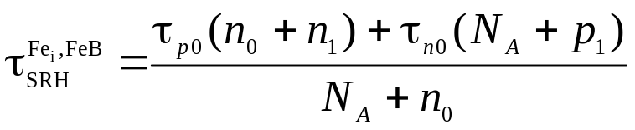
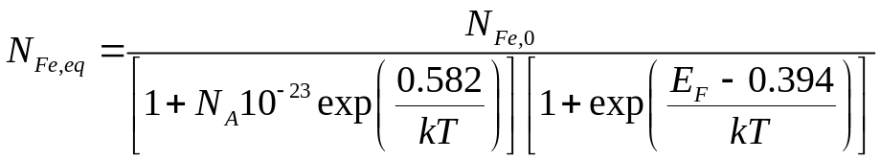
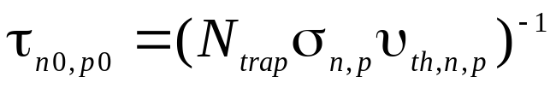
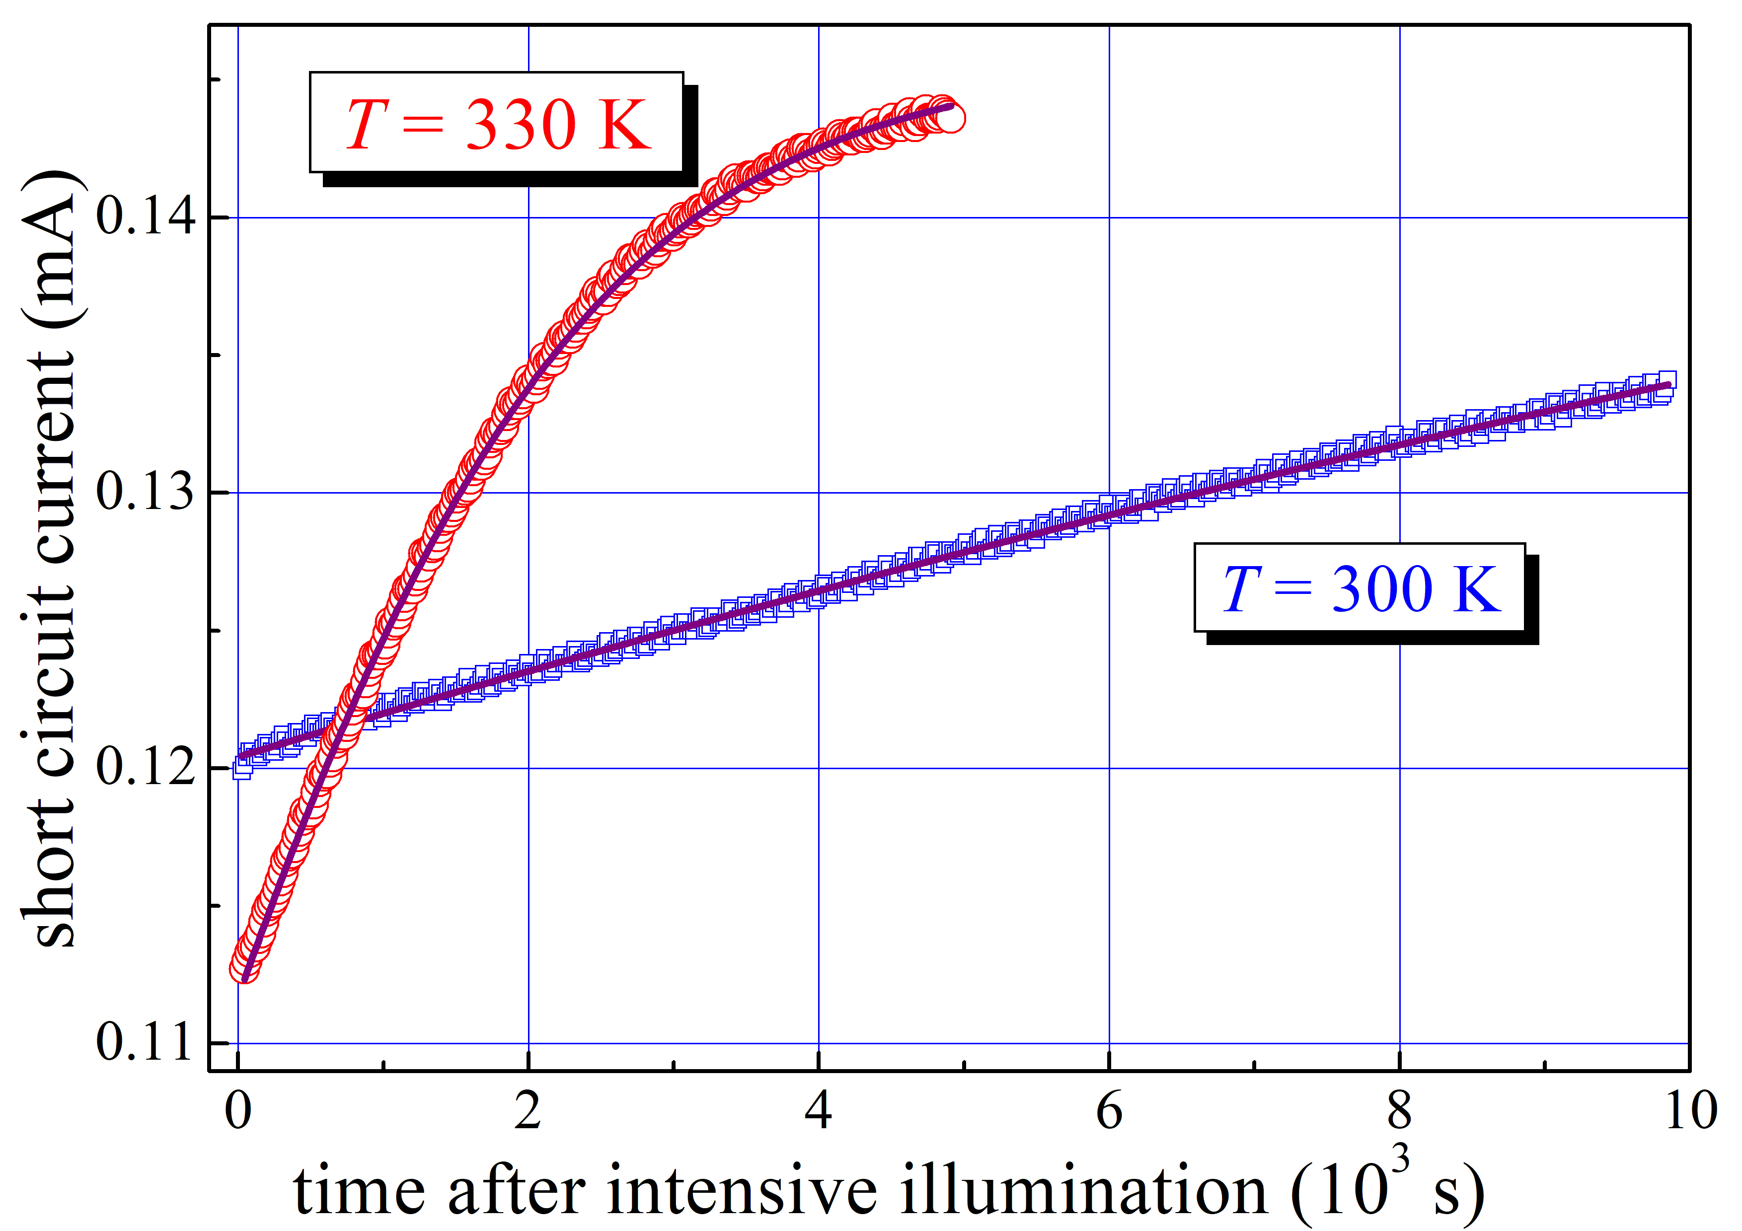
UCLA 2021 817. Ultrasound as Functional Influence Tool on FeB Pair Association in Silicon Solar Cells
calculated values
experiment parameters
extracted parameters
points – experiment, lines - fitting

Slide 7
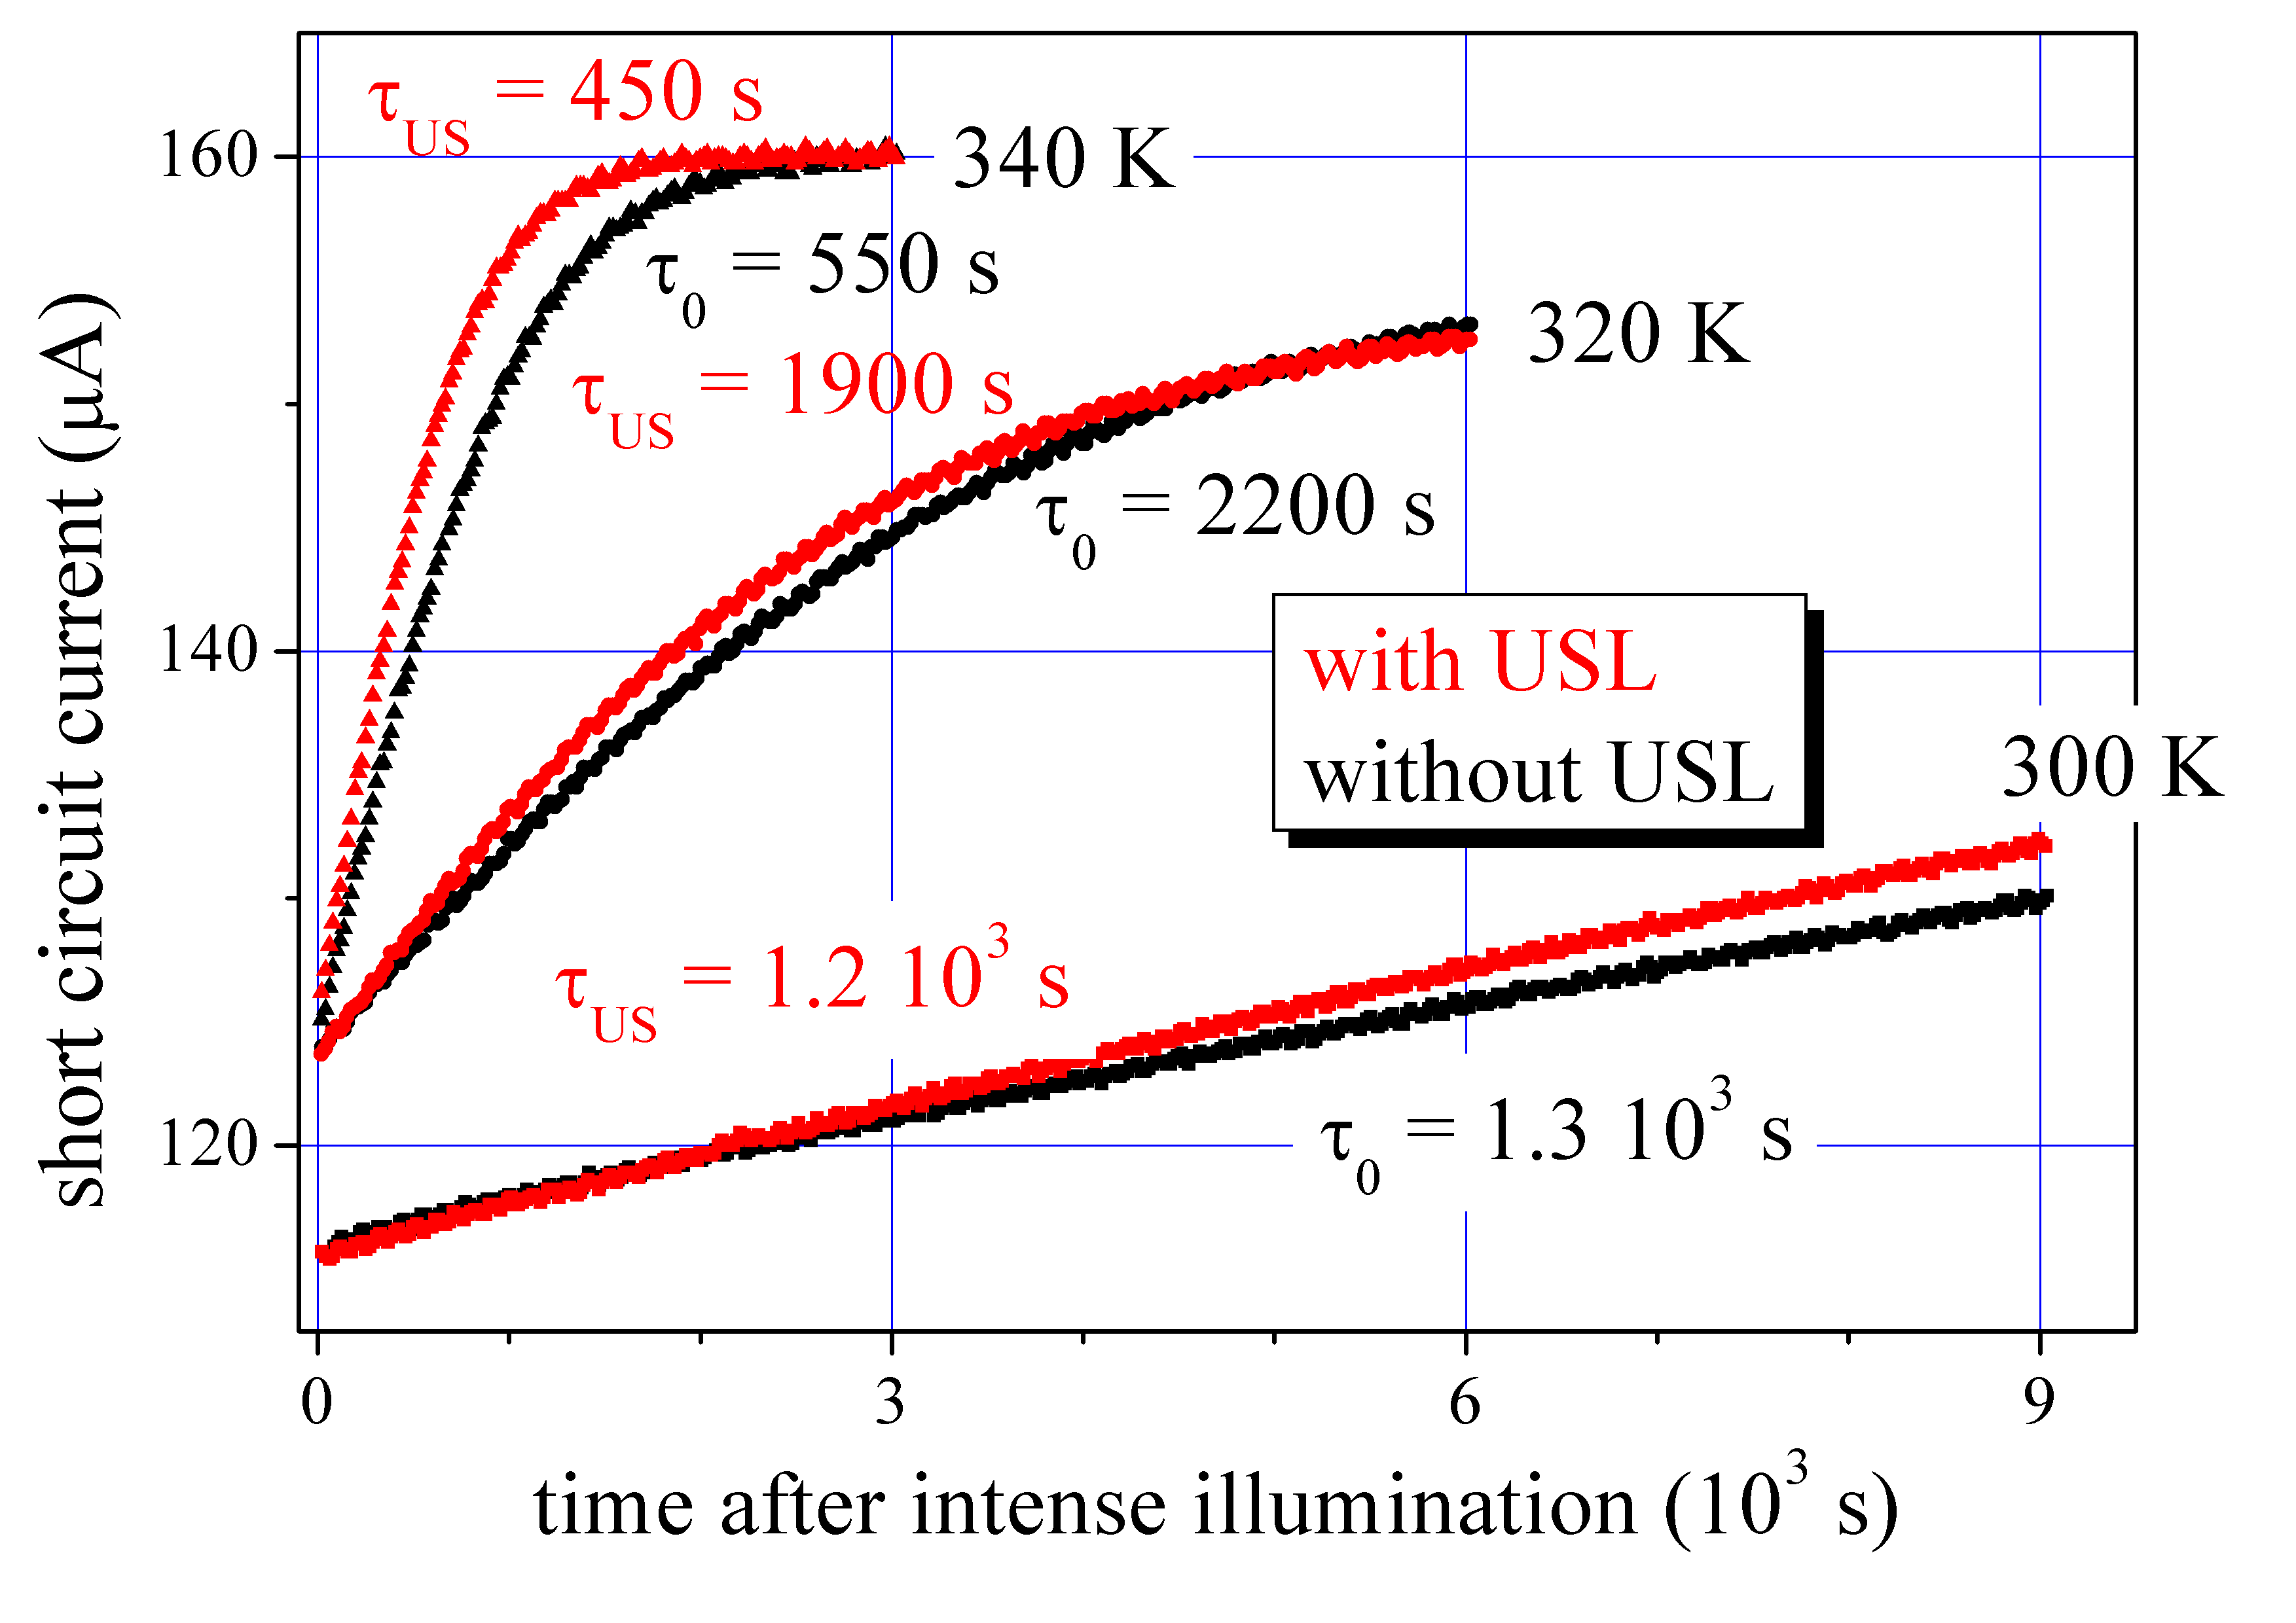
UCLA 2021 817. Ultrasound as Functional Influence Tool on FeB Pair Association in Silicon Solar Cells
Results

Slide 8
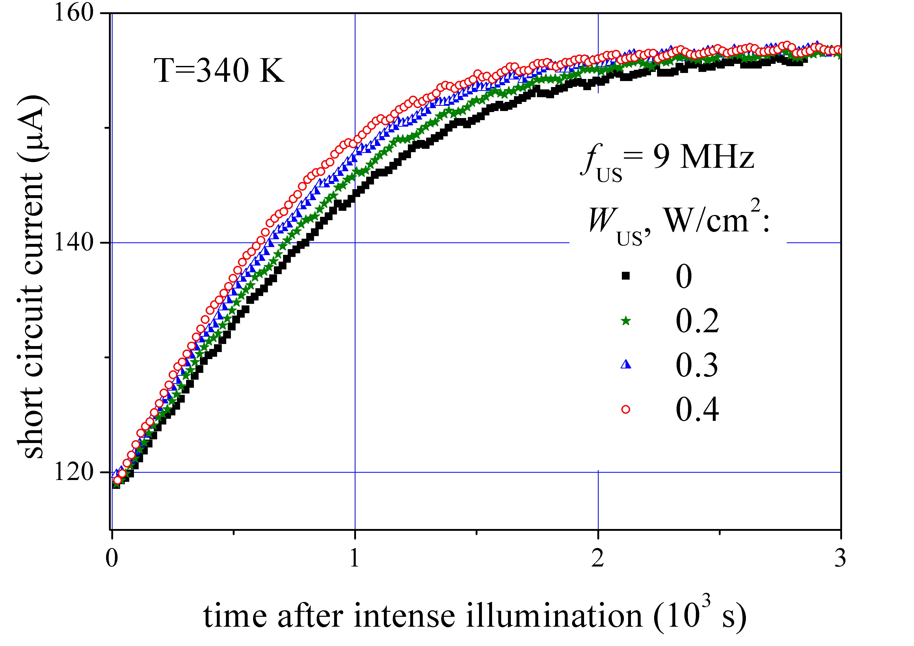
UCLA 2021 817. Ultrasound as Functional Influence Tool on FeB Pair Association in Silicon Solar Cells
Results

Slide 9
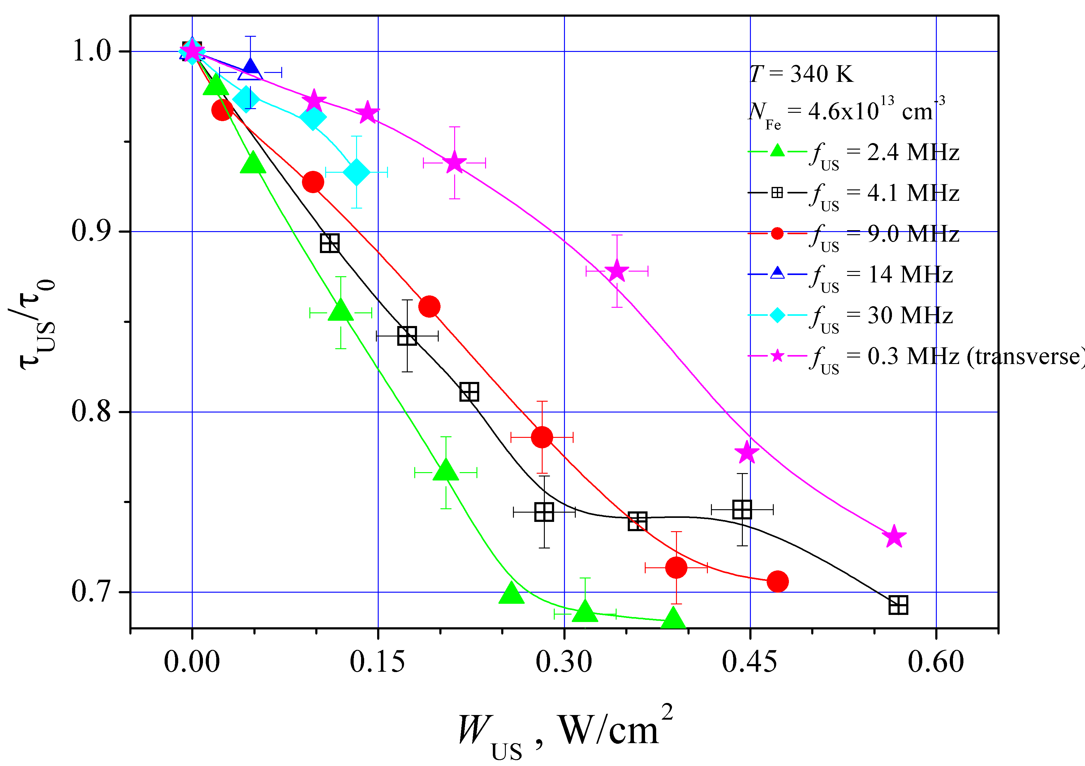
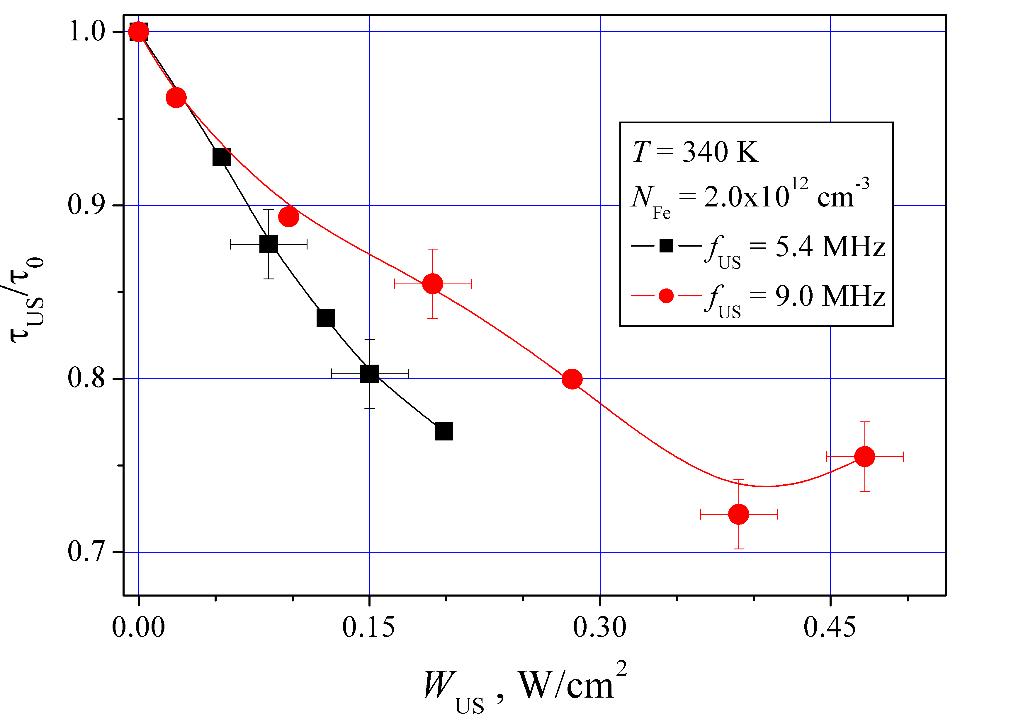
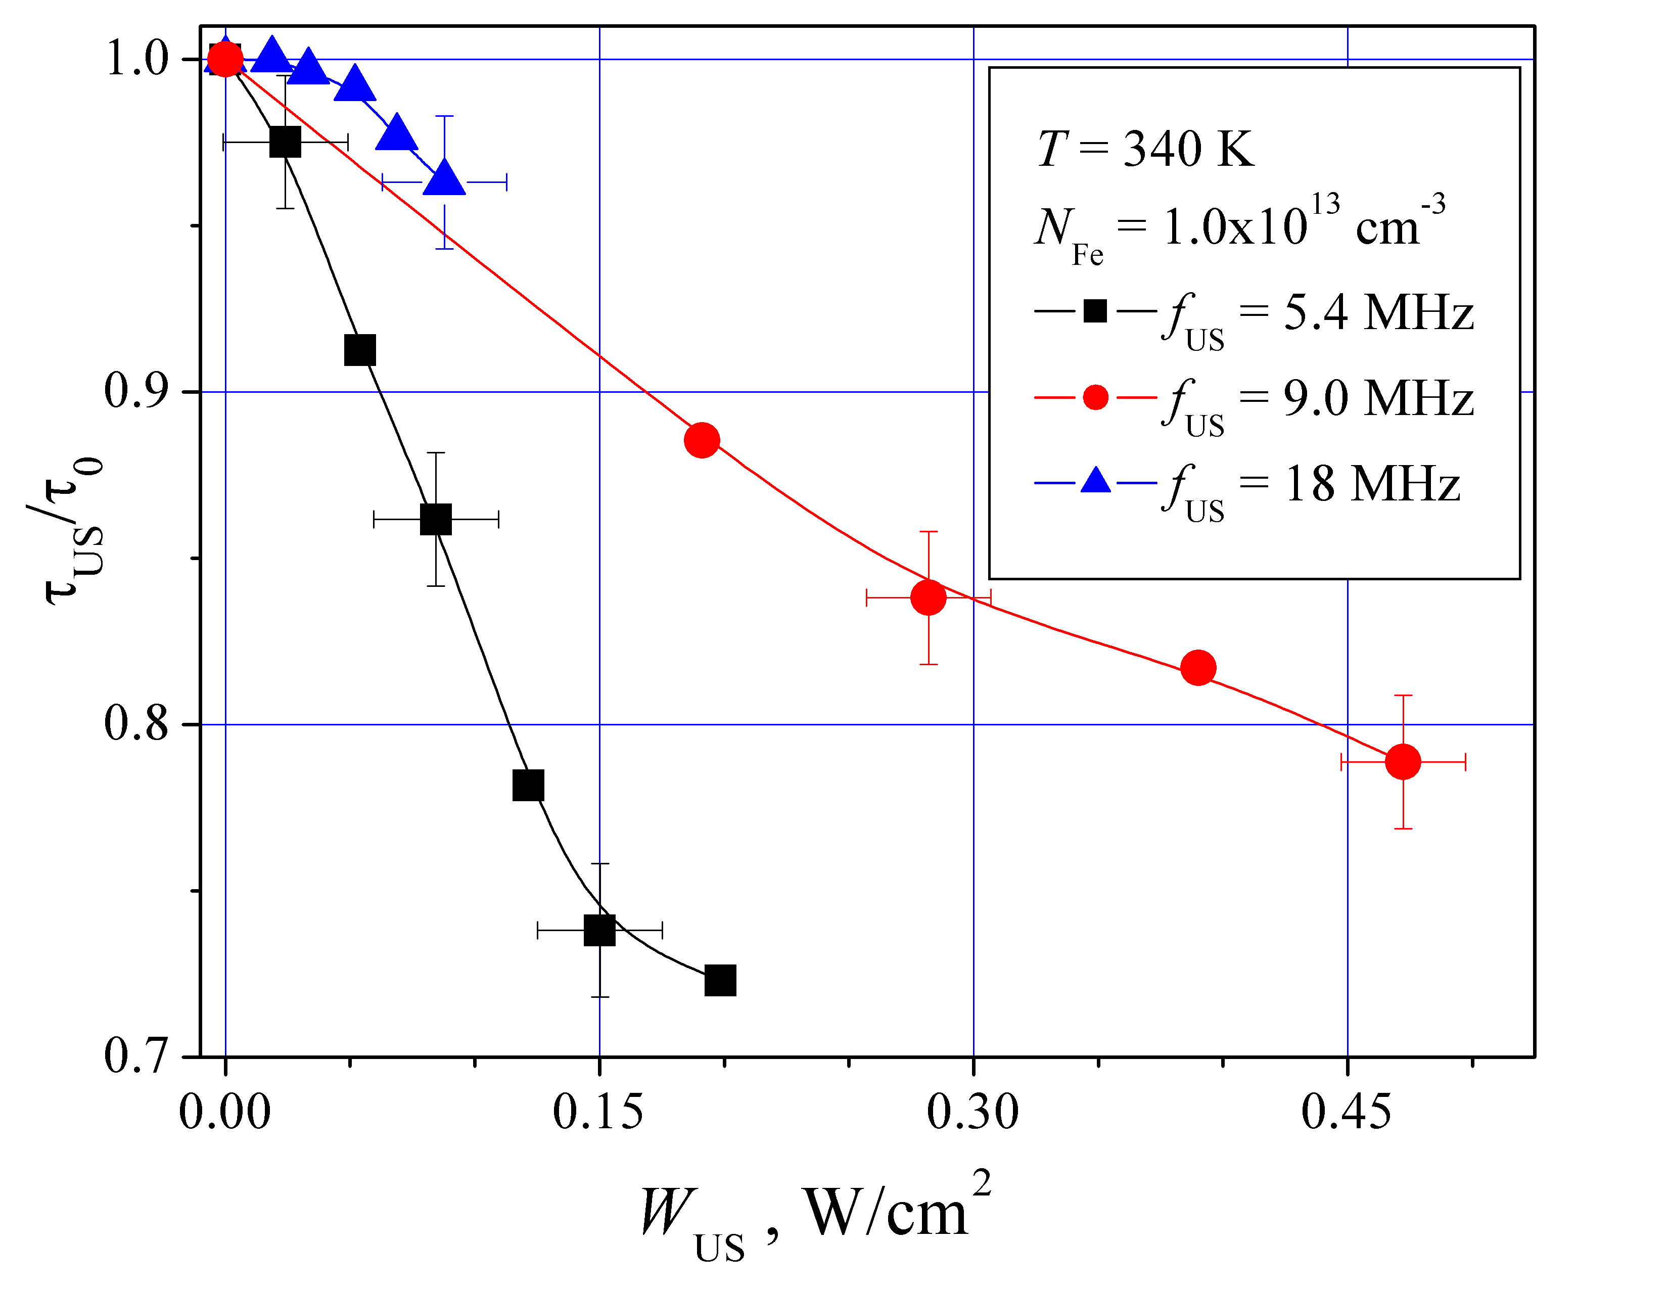
UCLA 2021 817. Ultrasound as Functional Influence Tool on FeB Pair Association in Silicon Solar Cells
Results

Slide 10
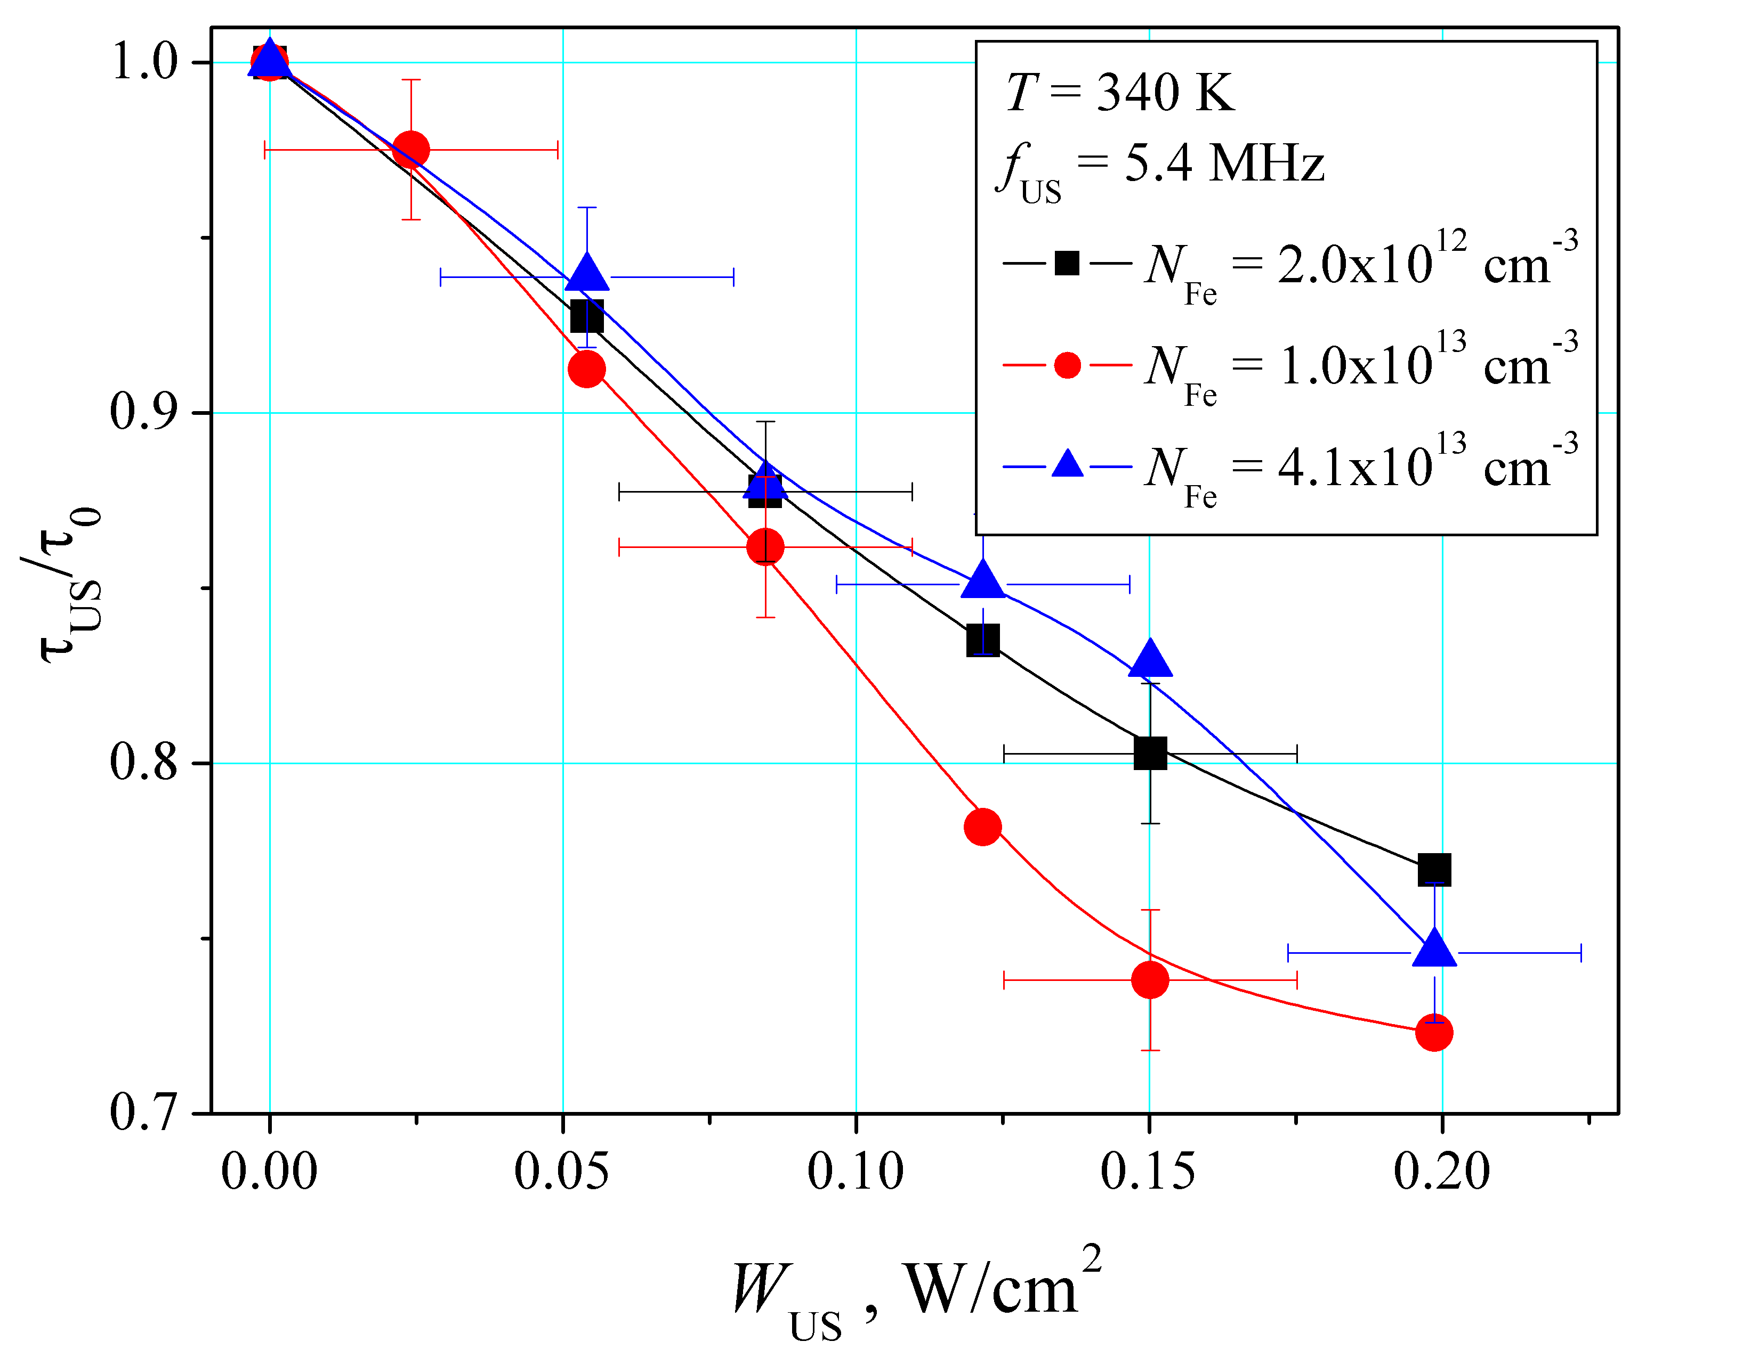
UCLA 2021 817. Ultrasound as Functional Influence Tool on FeB Pair Association in Silicon Solar Cells
Results

Slide 11
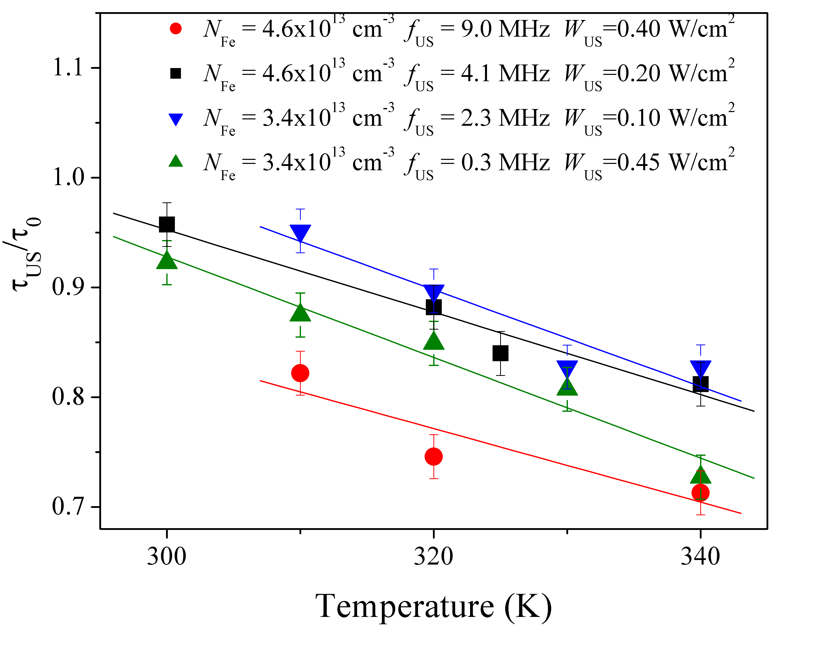
UCLA 2021 817. Ultrasound as Functional Influence Tool on FeB Pair Association in Silicon Solar Cells
Results

Slide 12
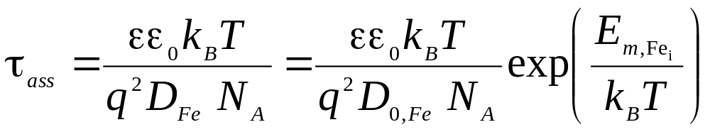

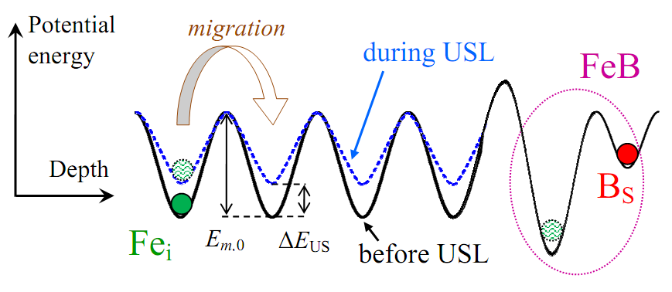
UCLA 2021 817. Ultrasound as Functional Influence Tool on FeB Pair Association in Silicon Solar Cells
Discussion
iron atom migration energy

Slide 13
UCLA 2021 817. Ultrasound as Functional Influence Tool on FeB Pair Association in Silicon Solar Cells
CONCLUSION
The effect of the acoustically induced acceleration of FeB pairing in silicon solar cell has revealed
The efficiency of ultrasound influence decreases with the acoustic waves frequency rising and the temperature drop and does not depend on iron concentration. The effect saturation with ultrasound intensity increase is observed
The analysis has shown that these effects are caused by the acoustically induced decrease in the migration energy of iron atom

Slide 14

UCLA 2021 817. Ultrasound as Functional Influence Tool on FeB Pair Association in Silicon Solar Cells
olegolikh@knu.ua

