Slide 1



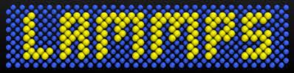
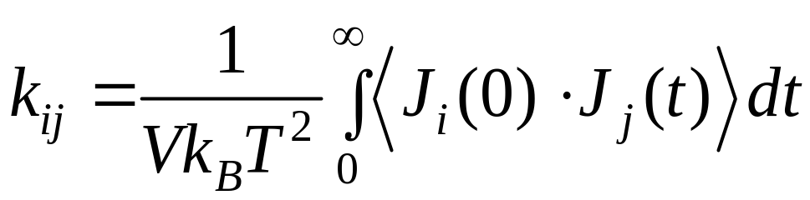
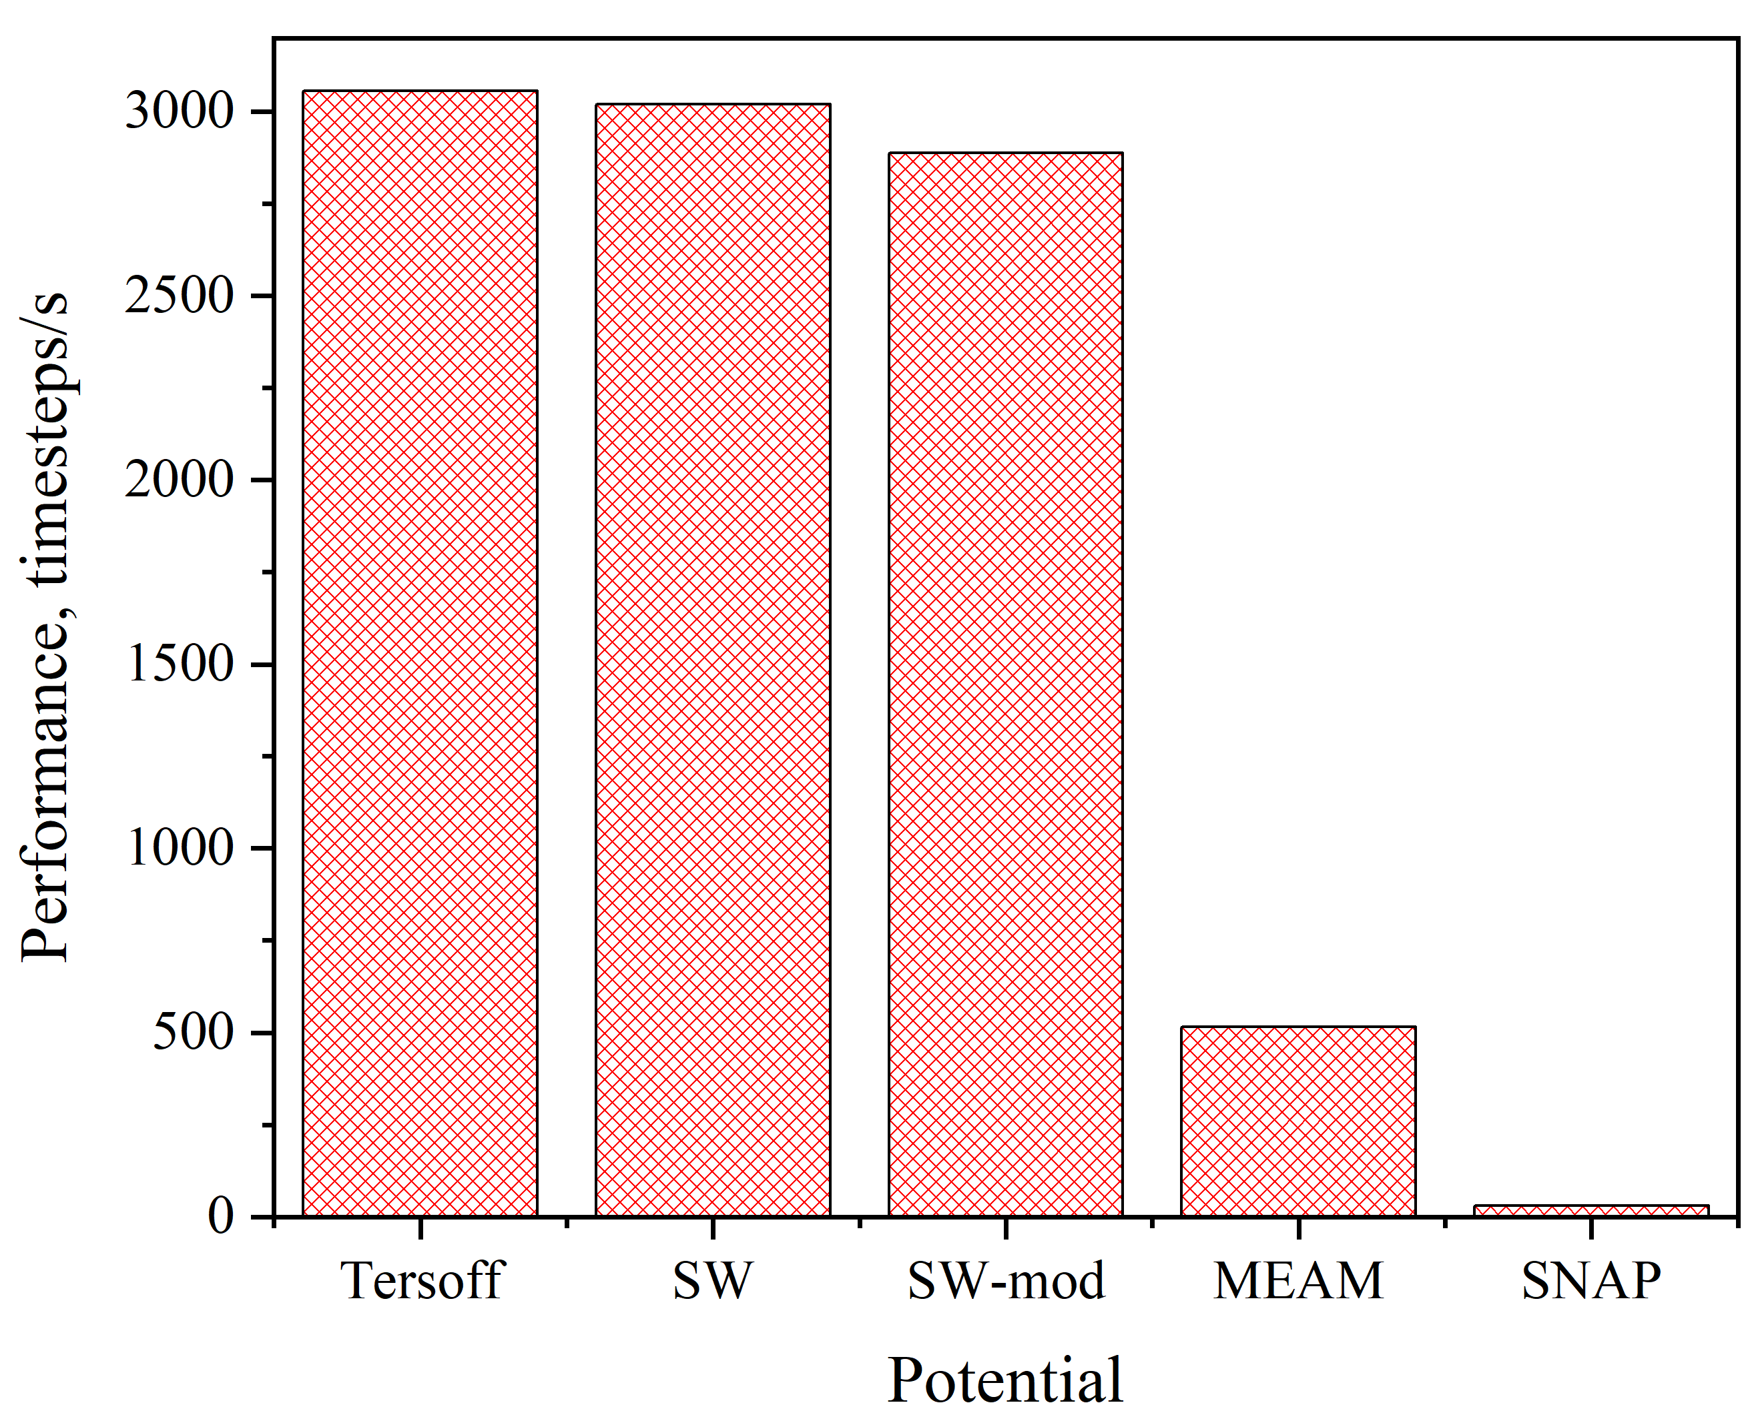
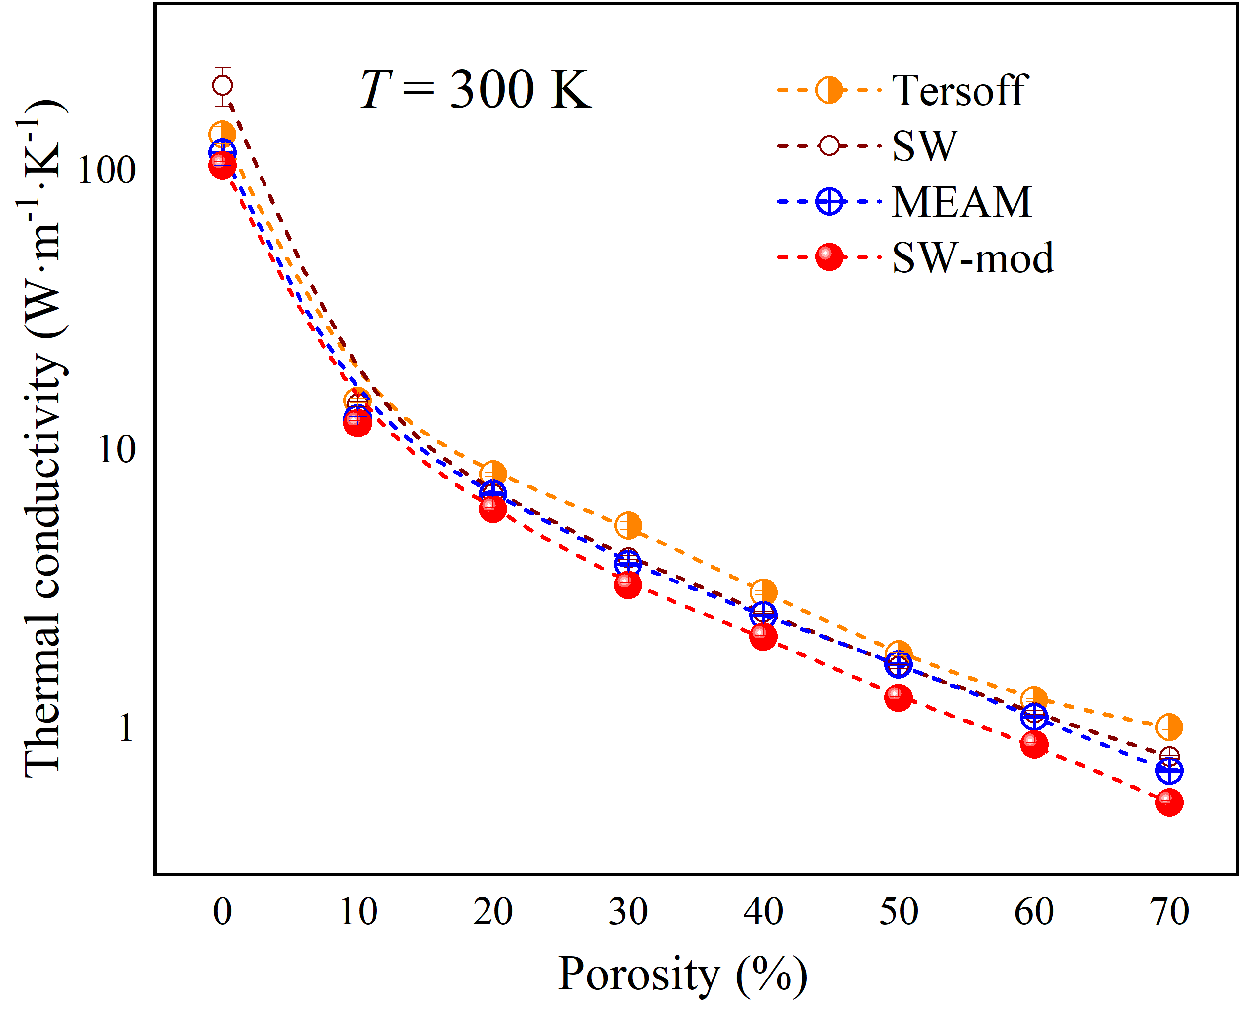
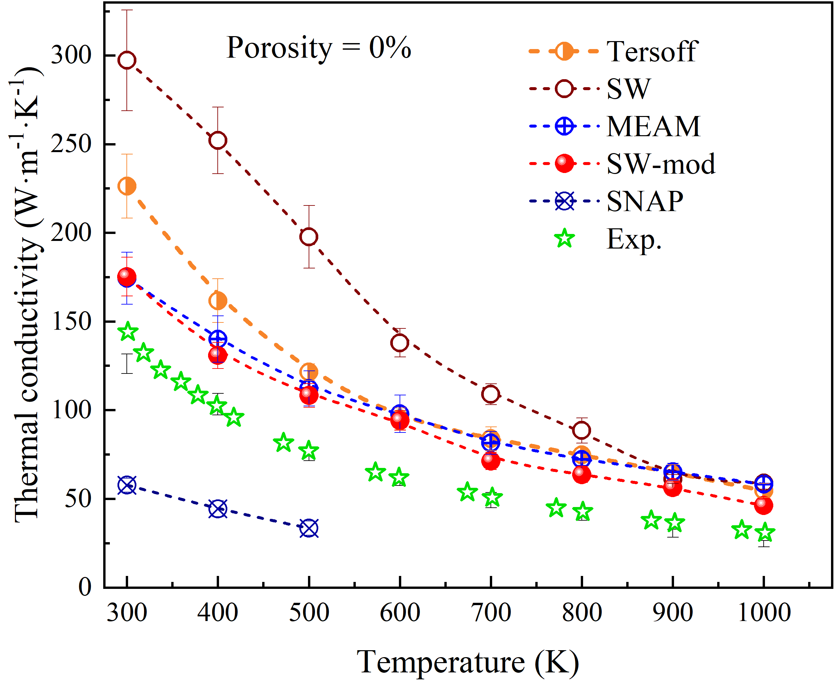
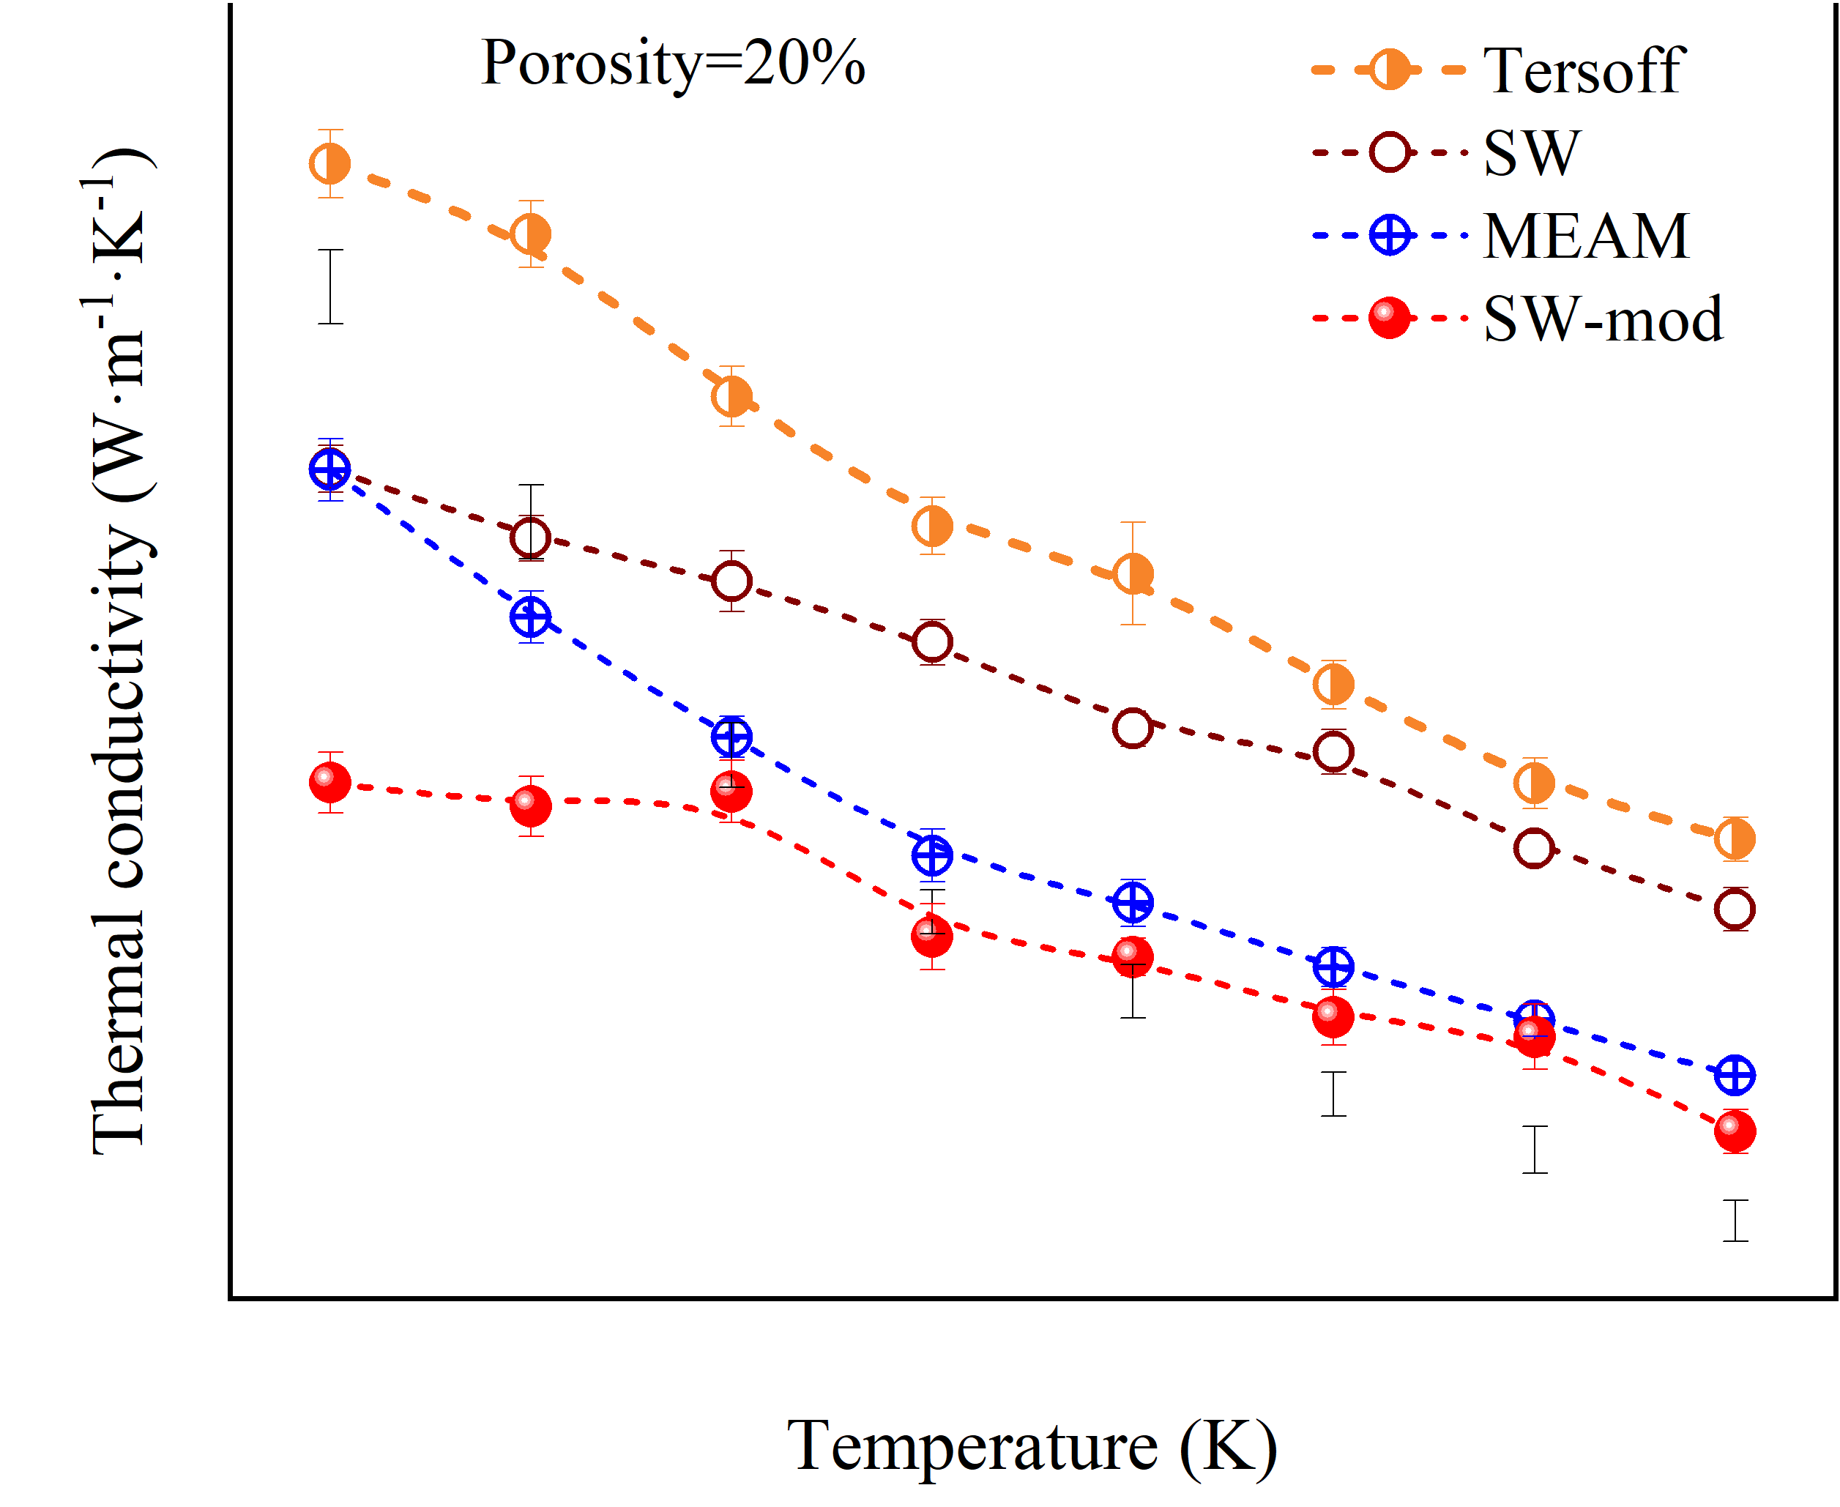
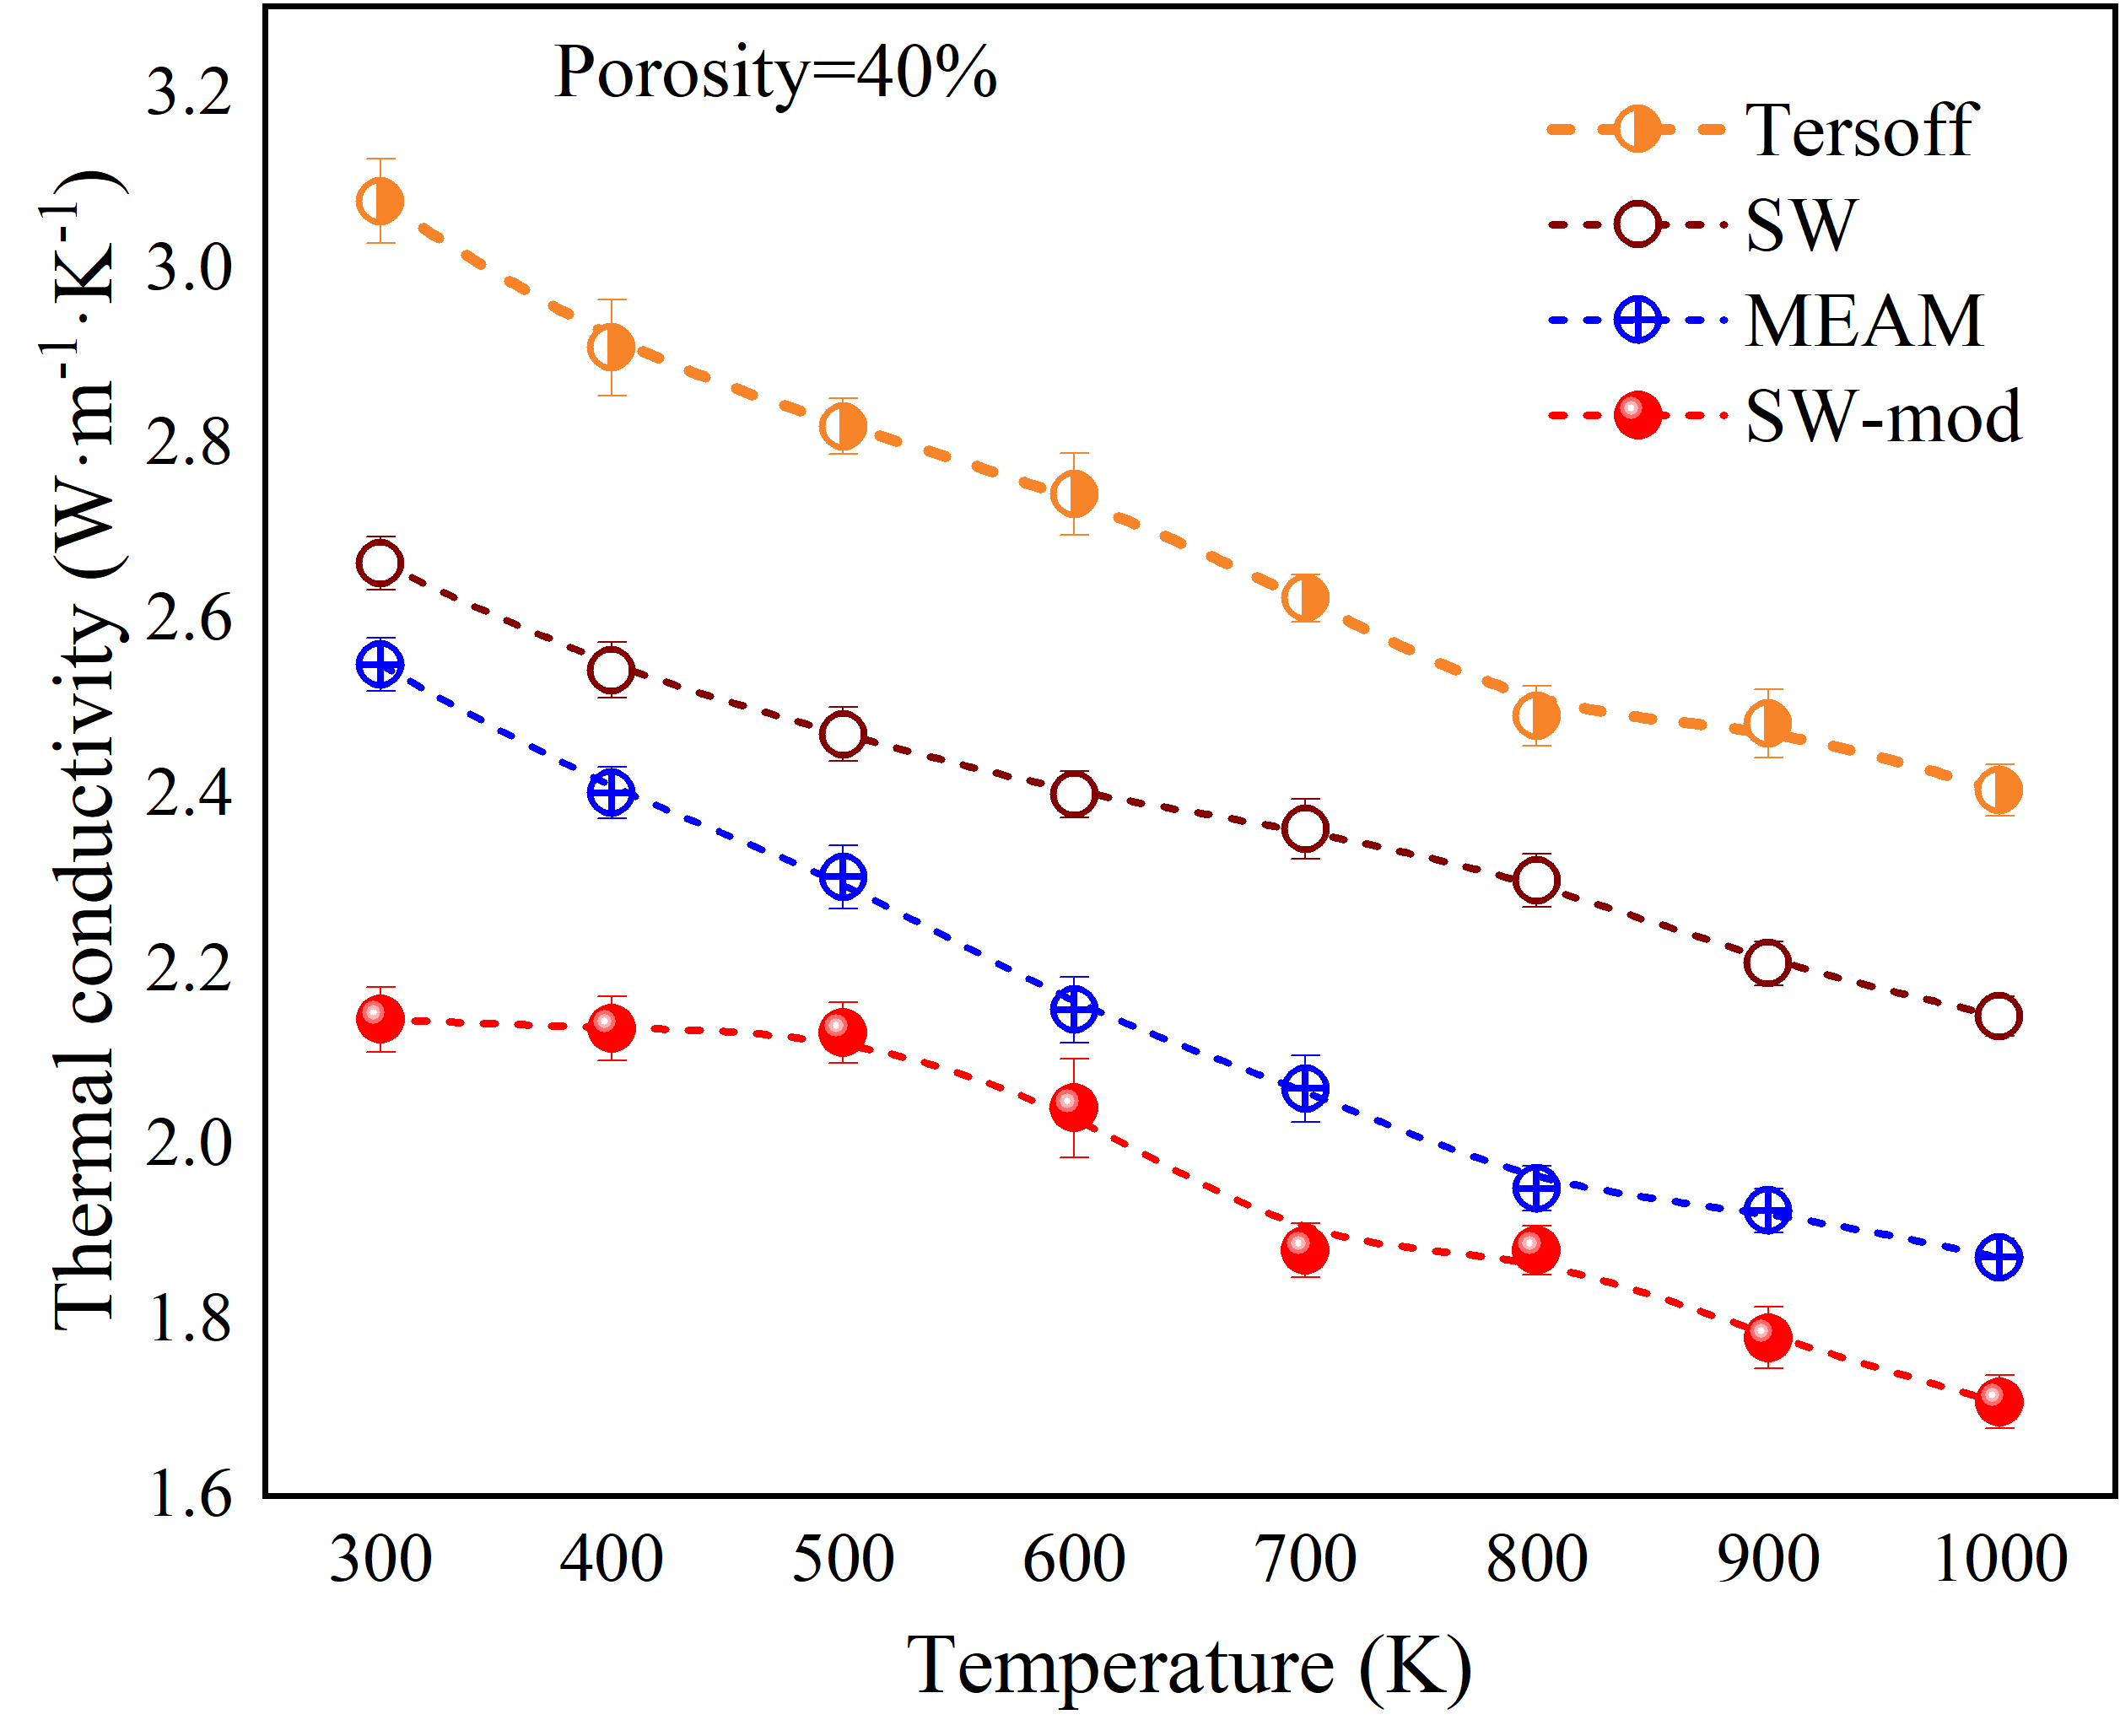


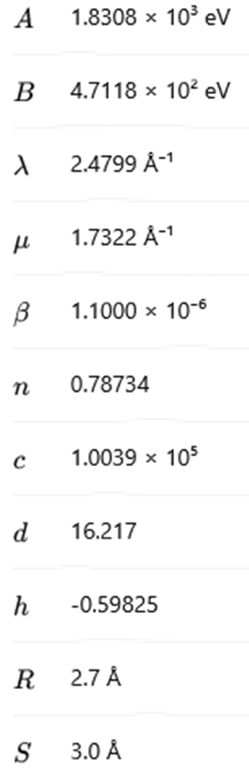





Estimation of the Thermal Conductivity of Porous Silicon Using Molecular Dynamics and Machine Learning Methods
,
V. V. Kuryliuk, O. Olikh¹
Taras Shevchenko National University of Kyiv, 64/13, Volodymyrska Str., Kyiv, Ukraine
olegolikh@knu.ua
Introduction. Porous media are widely used in various applications, such as thermal barriers or thermoelectric materials for enhancing the figure of merit. In particular, porous silicon (p-Si) layers can be effectively utilized in high-efficiency solar-thermal energy storage systems. Efficiently predicting their thermal conductivity (TC) can accelerate the design of porous systems to improve energy efficiency, among other benefits. The accurate TC estimation can be obtained through molecular dynamics simulation. However, such calculations require high computational and time costs. One way to reduce expenses and obtain results for a vast number of cases is to use artificial intelligence methods
MACHINE LEARNING
MOLECULAR DYNAMIC
TC was determined by computing the ensemble average of the heat current autocorrelation function within the Green-Kubo formalism
1 - front metal electrode (Al); 2 - Si₃N₄ (40 nm); 3 - SiO₂ (30 nm); 4 - induced n ++ - layer; 5 - diffusion n + - layer (0.7 μm); 6 - base region (p-Si, KDB10, 380 μm); 7 - diffusion p + -layer (0.6 μm); 8 - rear metallization (Al)
model structure: 8000 atoms
calculations: cluster of 128 cores
Comparison of the performance of the Tersoff, Stillinger-Weber, modified Stillinger-Weber, Modified Embedded Atom Method and Spectral Neighbor Analysis Potentials
RESULTS
Proposed procedure: (i) to dissociate FeB pair (illumination, heating, carrier injection); (ii) to measure kinetic of short circuit current (at monochromatic illumination); (iii) to approximate the measured dependence and extract iron concentration
TERSOFF POTENTIAL
Conclusion. The method to predict iron contamination in silicon solar cell by using kinetic of short circuit current is proposed. These approach envisages the utilization of a simple and widely applicable setup and does not require a much time. The method was validated by studying the temperature and illumination dependences of FeB pair dissociation time.
The work was supported by National Research Foundation of Ukraine (project No. 2023.05/0024)

