Slide 1



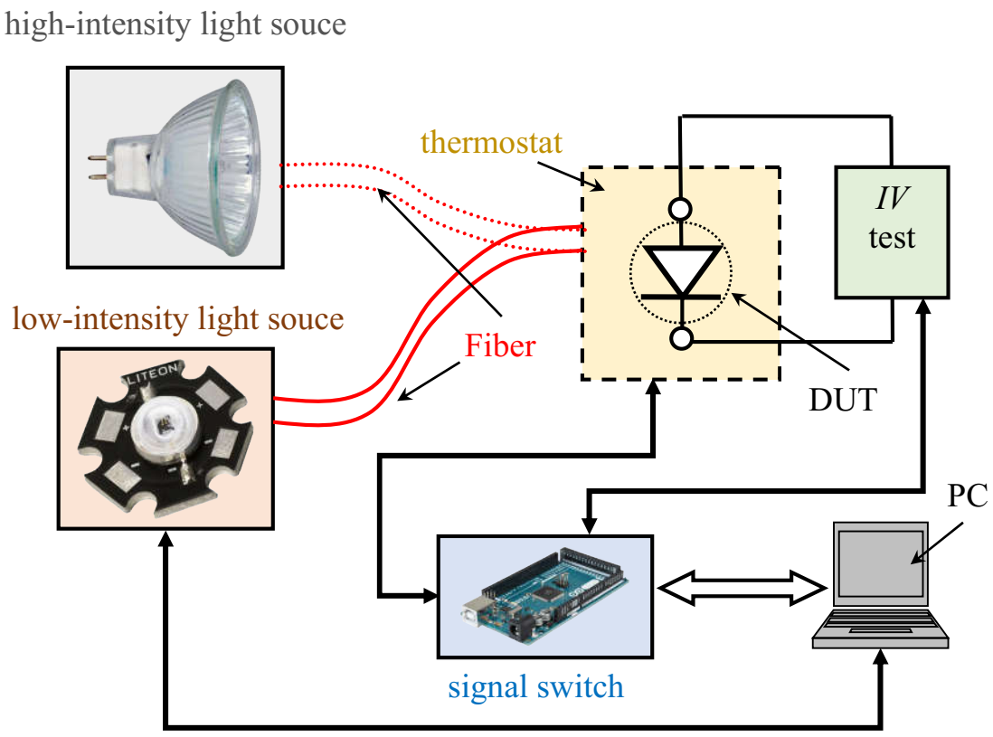
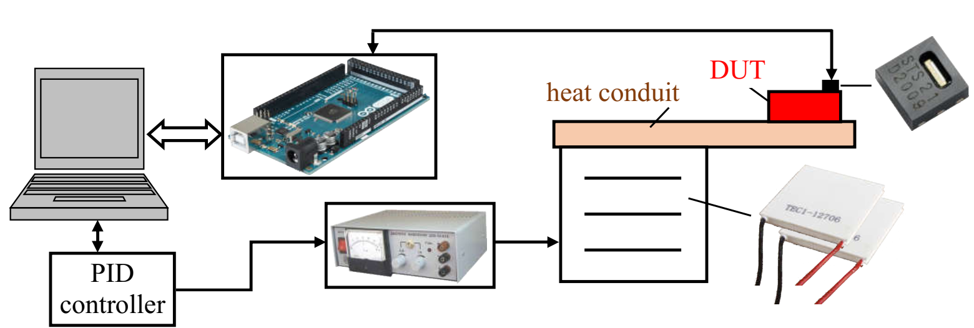
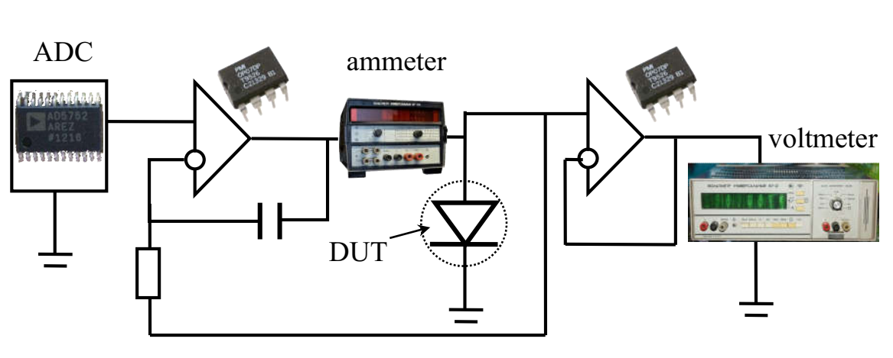
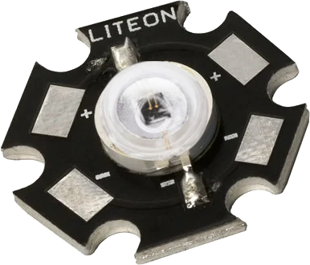
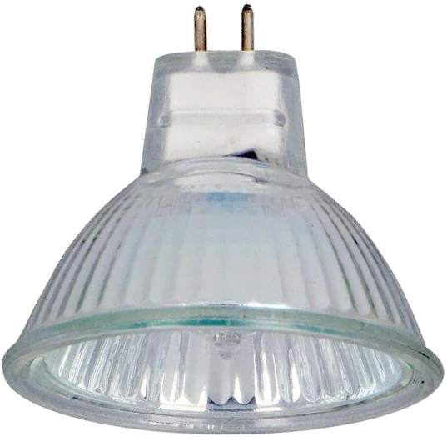
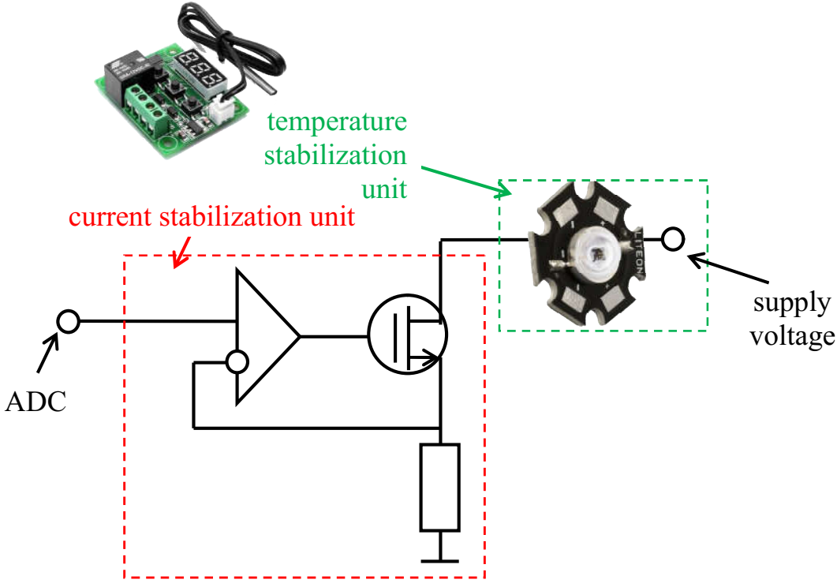
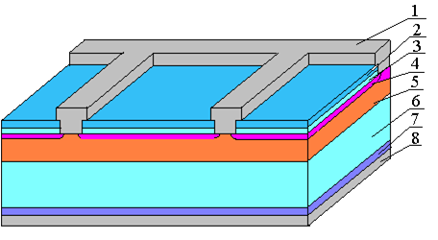
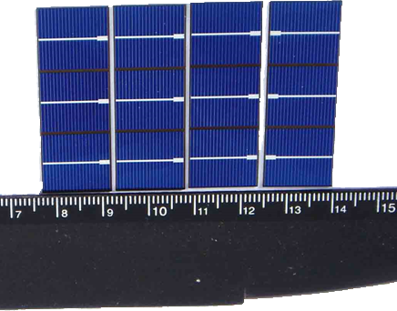
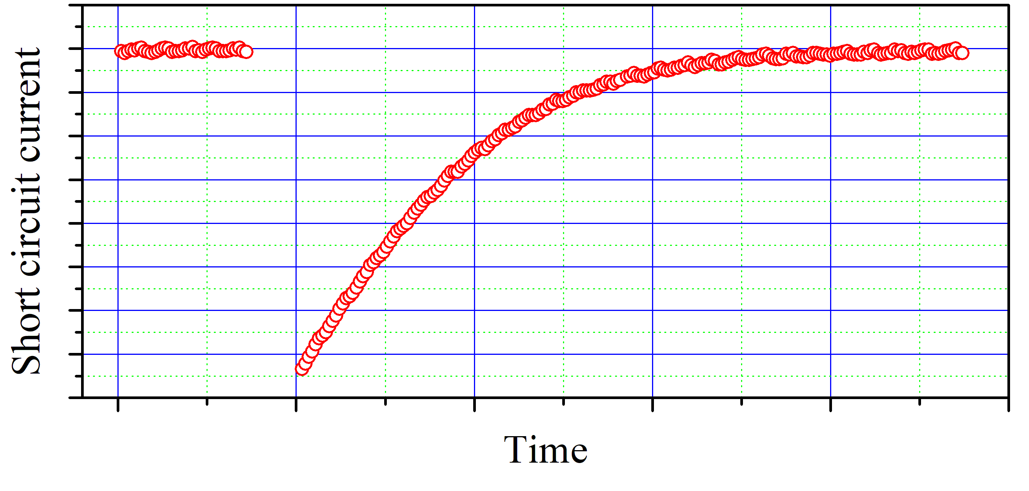
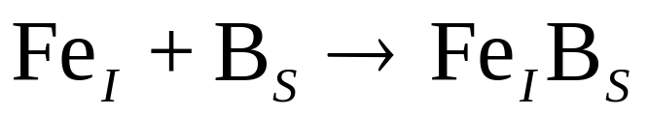
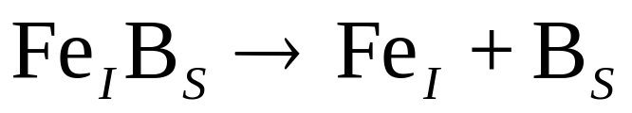
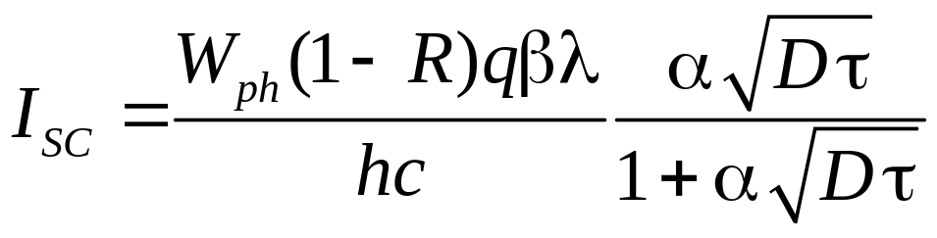
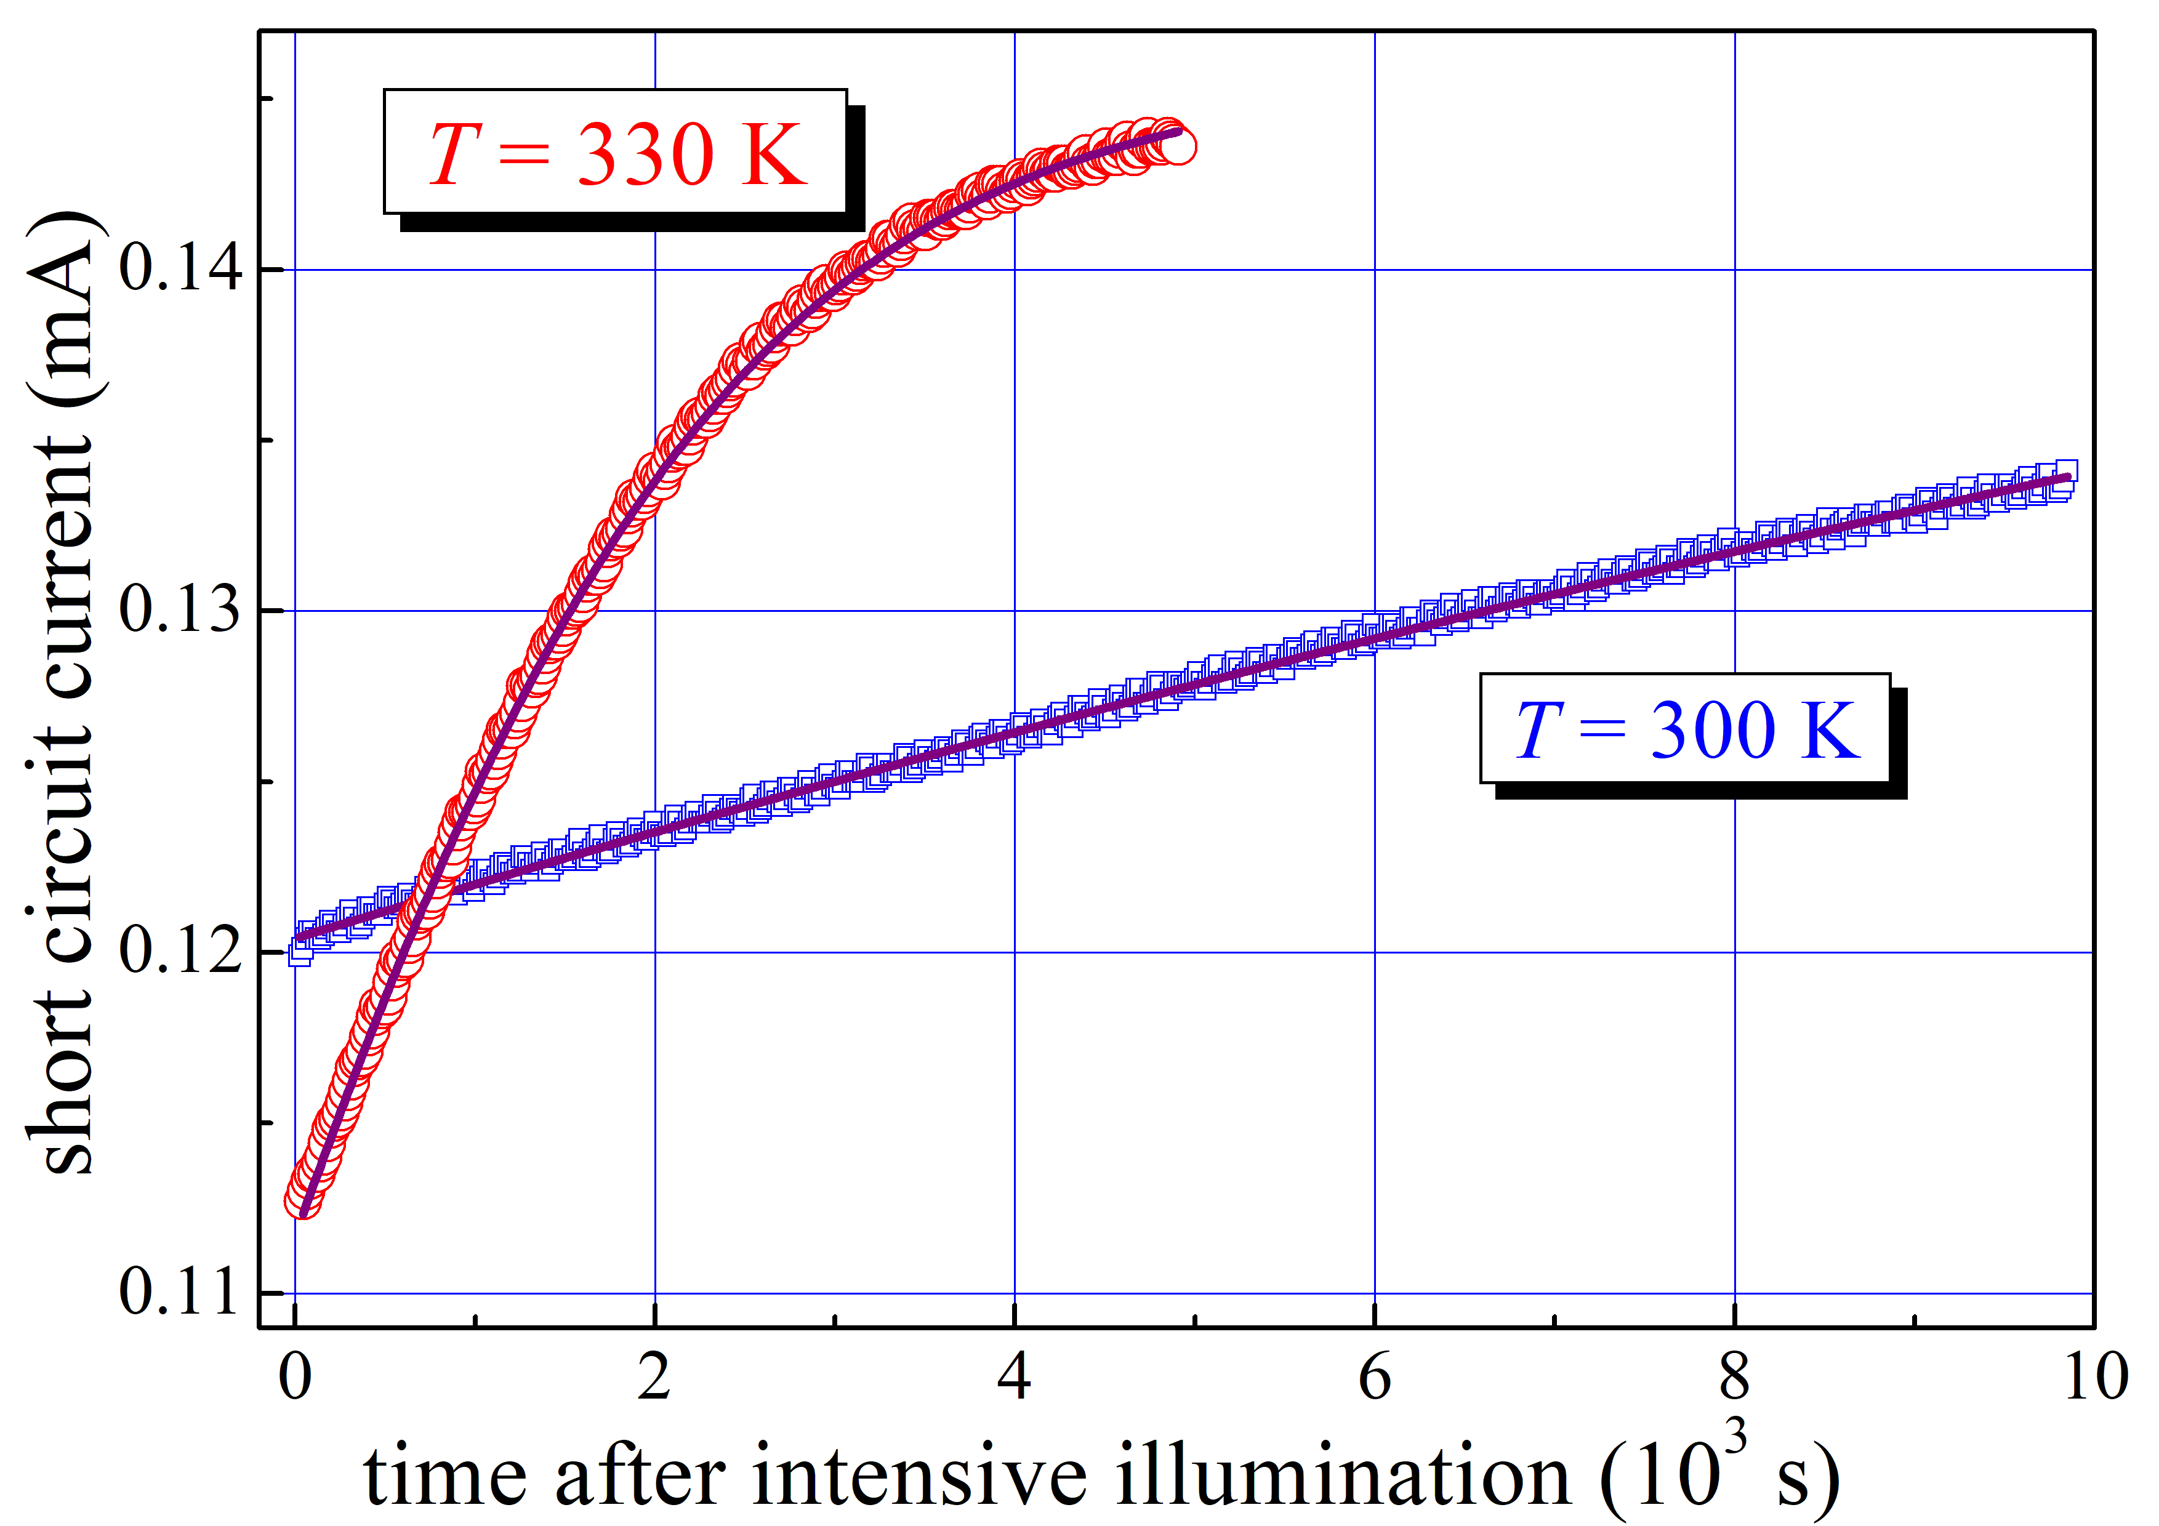
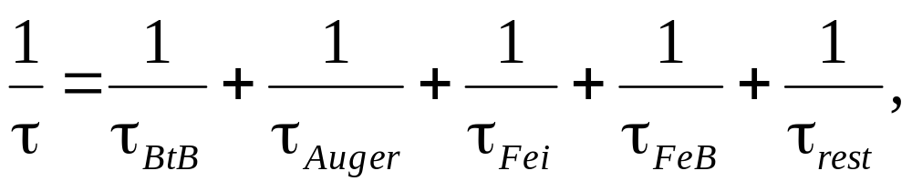
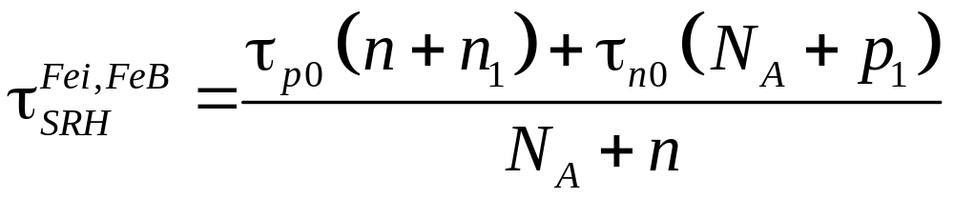
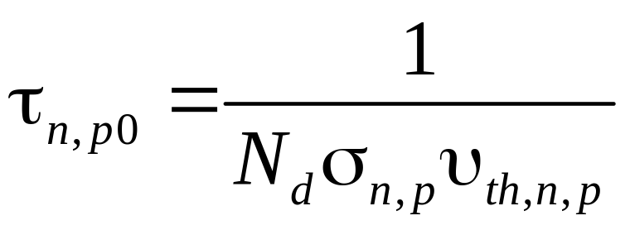
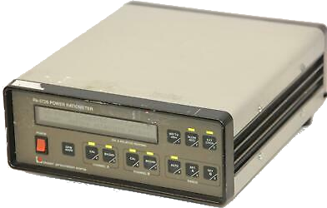
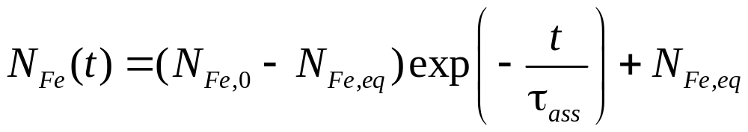
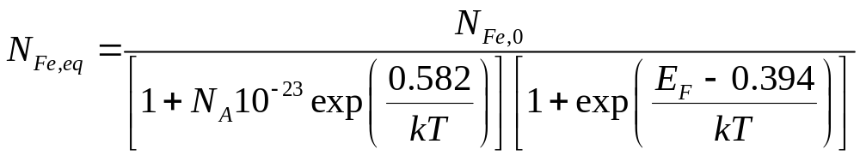
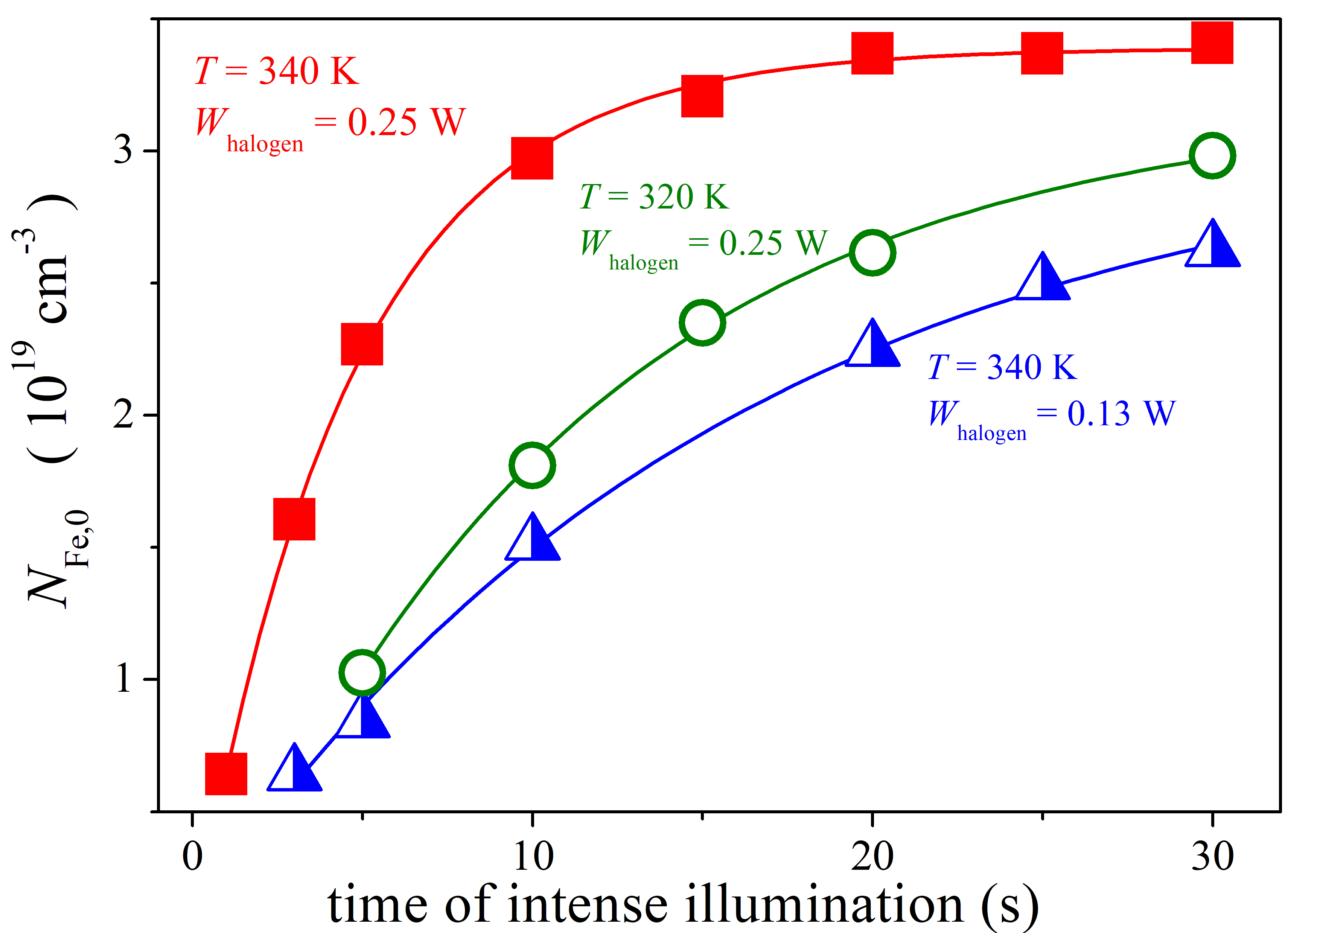
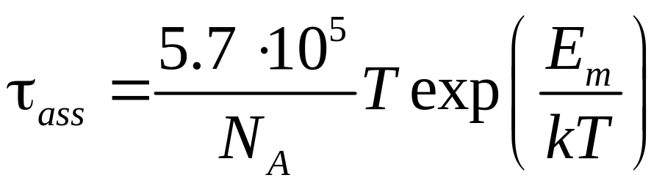
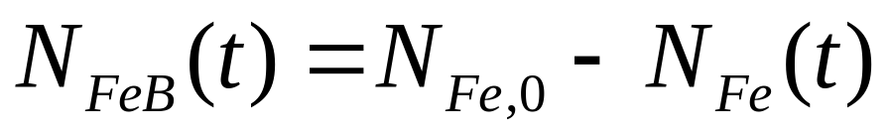
Estimation of Iron Concentration in Silicon Solar Cell by Kinetics of Light-Induced Change in Short-Circuit Current
,
O. Olikh¹, V. Kostylyov², V. Vlasiuk², R. Korkishko²
¹Taras Shevchenko National University of Kyiv, 64/13, Volodymyrska Str., Kyiv, Ukraine
²V. Lashkaryov Institute of Semiconductor Physic of NASU, 41 Nauky Ave., Kyiv, Ukraine
olegolikh@knu.ua
Introduction. Metal contamination control remains an important challenge for silicon processing both for microelectronics, logic technologies and solar cells (SCs). Typically, metal related defect characterization is performed by Fourier-transform infrared spectroscopy, electron-paramagnetic resonance, minority carrier lifetime measurements, deep level transient spectroscopy (DLTS), Laplace DLTS etc. However, these techniques are time-consuming, require special equipment or/and sample preparing. At the same time, the current-voltage (IV) measurement is a standard rapid industrial SC characterization technique. The proposed approach bases on short circuit current measurements, envisages the utilization of a simple and widely applicable setup and does not require a much time.
EXPERIMENTAL SETUP and SAMPLES
IDEA and CALCULATIONS
1 - front metal electrode (Al); 2 - Si₃N₄ (40 nm); 3 - SiO₂ (30 nm); 4 - induced n ++ - layer; 5 - diffusion n + - layer (0.7 μm); 6 - base region (p-Si, KDB10, 380 μm); 7 - diffusion p + -layer (0.6 μm); 8 - rear metallization (Al)
RESULTS
Proposed procedure: (i) to dissociate FeB pair (illumination, heating, carrier injection); (ii) to measure kinetic of short circuit current (at monochromatic illumination); (iii) to approximate the measured dependence and extract iron concentration
N_{Fe} = 2 ⋅ 10¹³ cm⁻³
W_{ph} = 3.2⋅10⁻⁴ W
E_{m} = 0.655 eV
3.1⋅10⁻⁴ W
0.66 eV
fitting
J. Appl.Phys. 116 024503
The marks are the experimental results, and the solid lines are the fitted curves.
Cross-validation: the dissociation time (τ_{dis})
(i) proportionate to (W_{halogen}) ² [J.Appl.Phys. 116 024503]
(ii) decrease approximately twice per 20°C increase [Appl.Phys.Lett 63 3044]
T, K | W_{halogen}, W | τ_{diss}, s
340 | 0.13 | 16±2
340 | 0.25 | 4.6±0.2
320 | 0.25 | 11±1
W_{ph} is the LED irradiance, N_{Fe,0} – iron concentration after illumination, E_{m} is the Fe_{i} migration energy, N_{A} is the doping level.
Conclusion. The method to predict iron contamination in silicon solar cell by using kinetic of short circuit current is proposed. These approach envisages the utilization of a simple and widely applicable setup and does not require a much time. The method was validated by studying the temperature and illumination dependences of FeB pair dissociation time.
calculated values
experiment parameters

