Slide 1



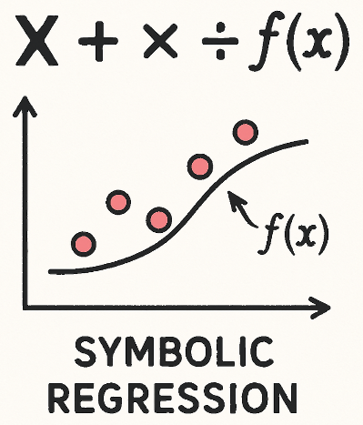
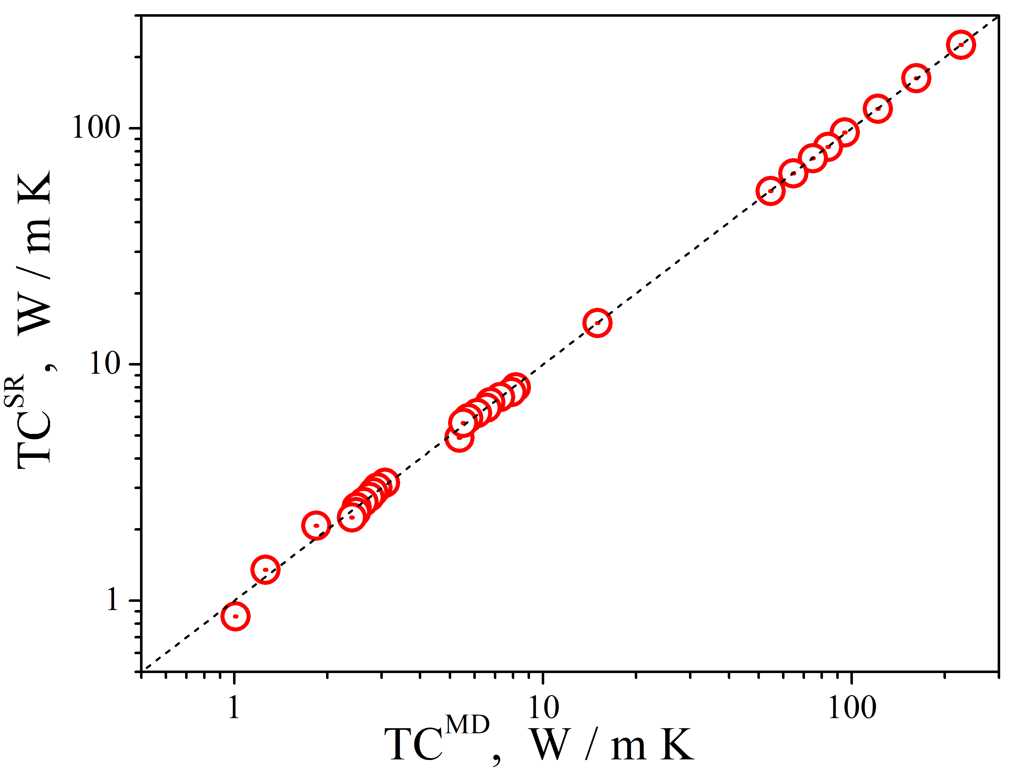
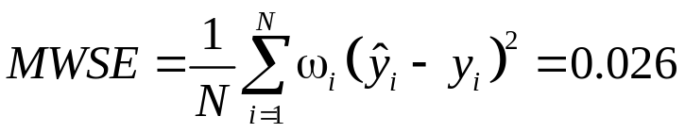
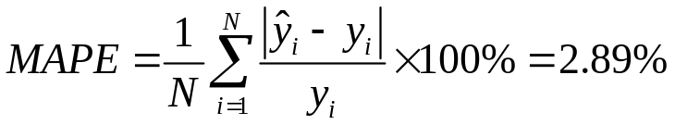
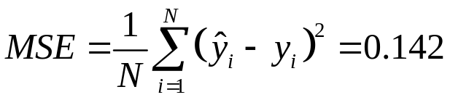
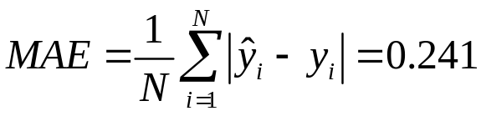
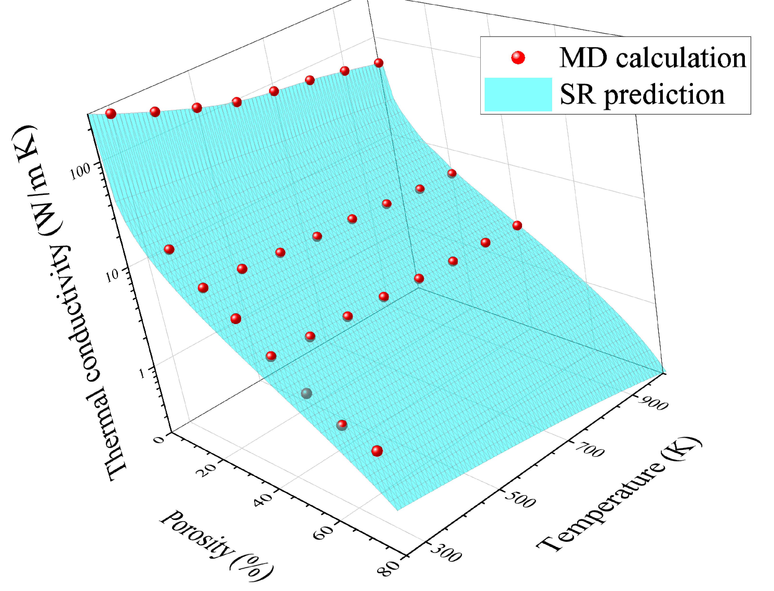

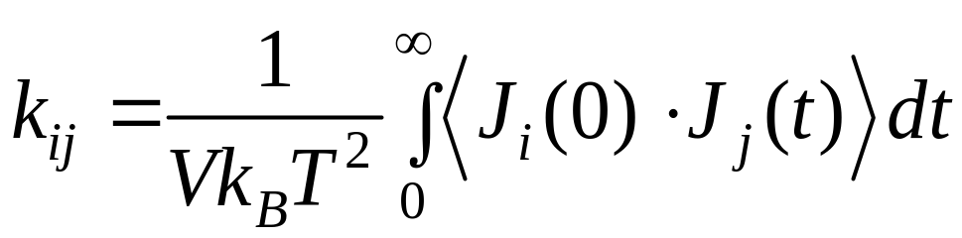
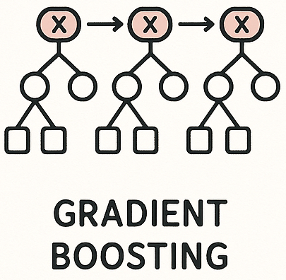
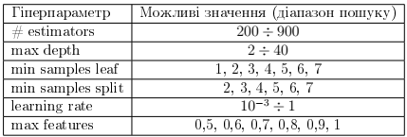
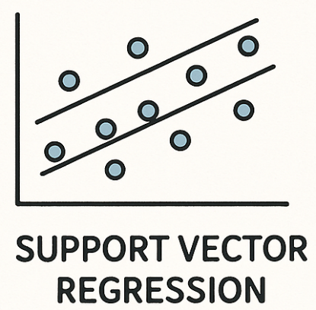
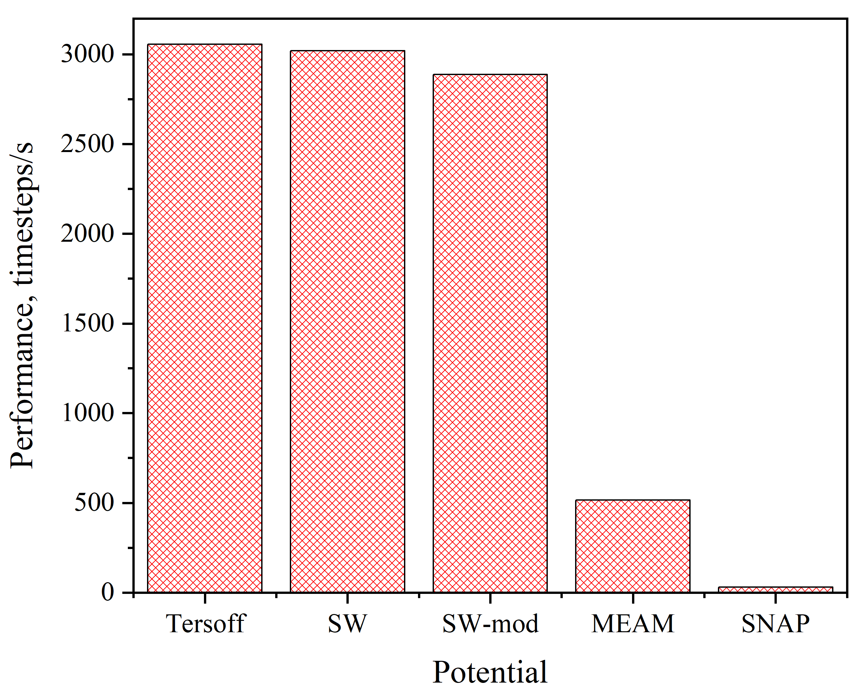
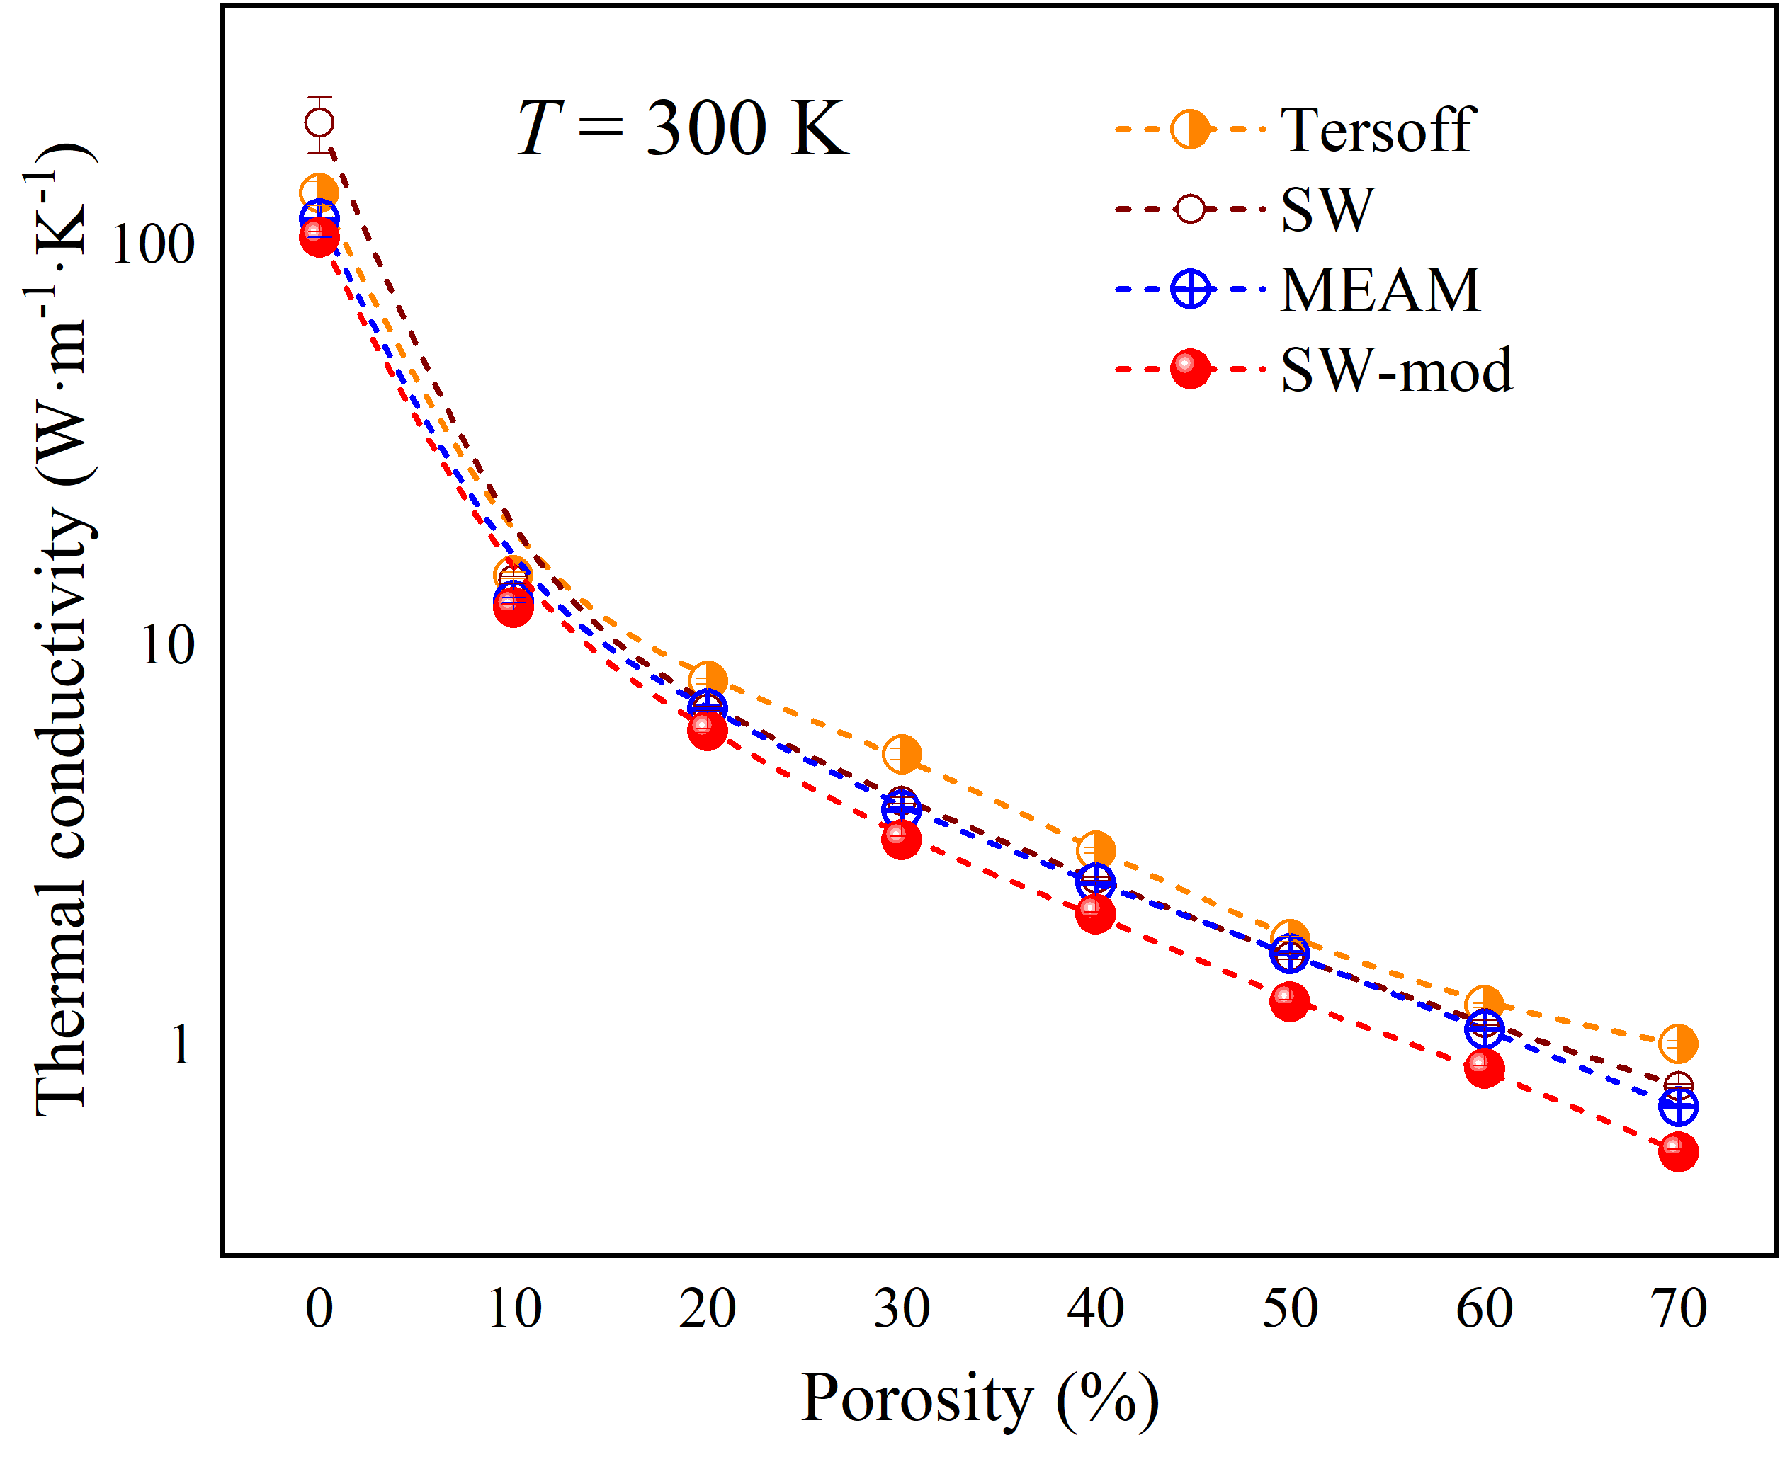
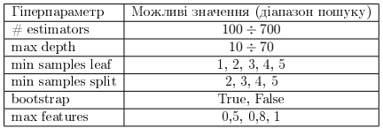
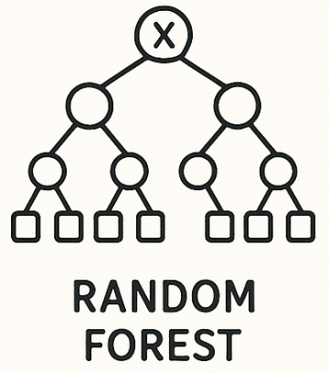
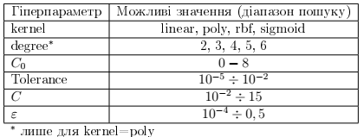
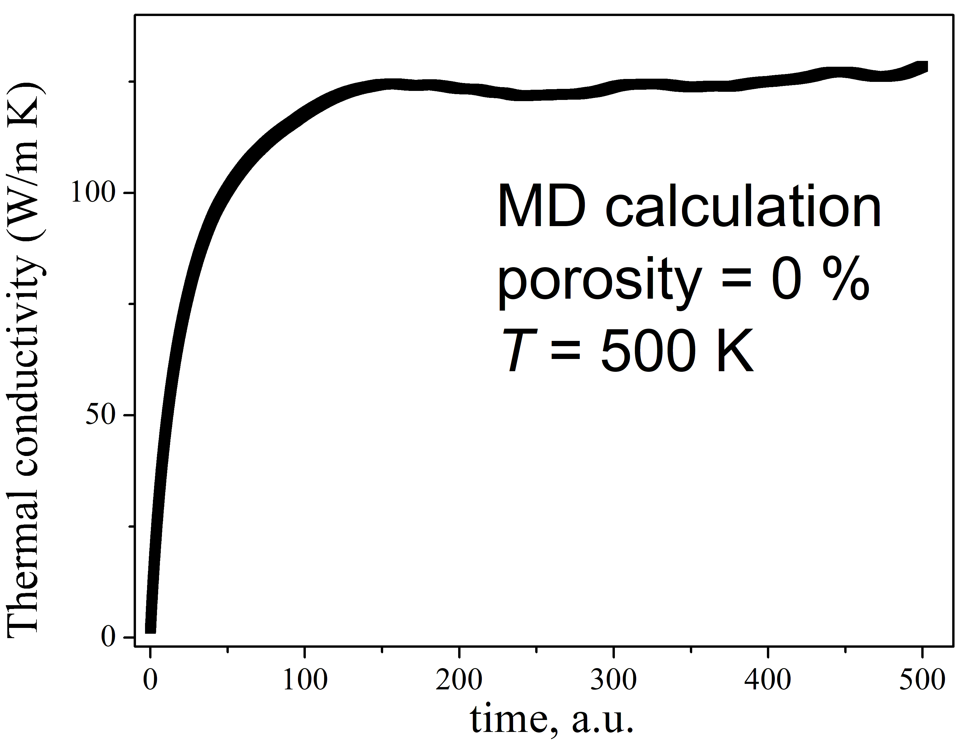
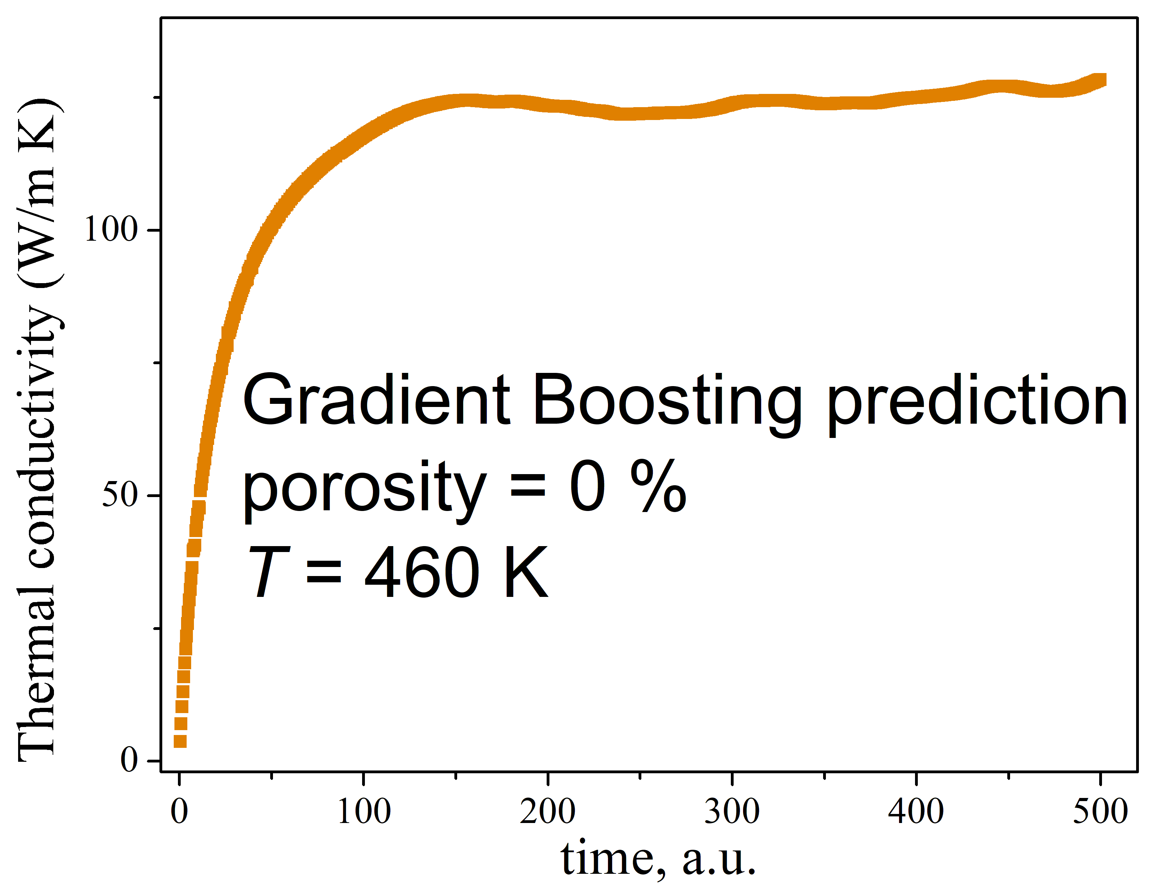
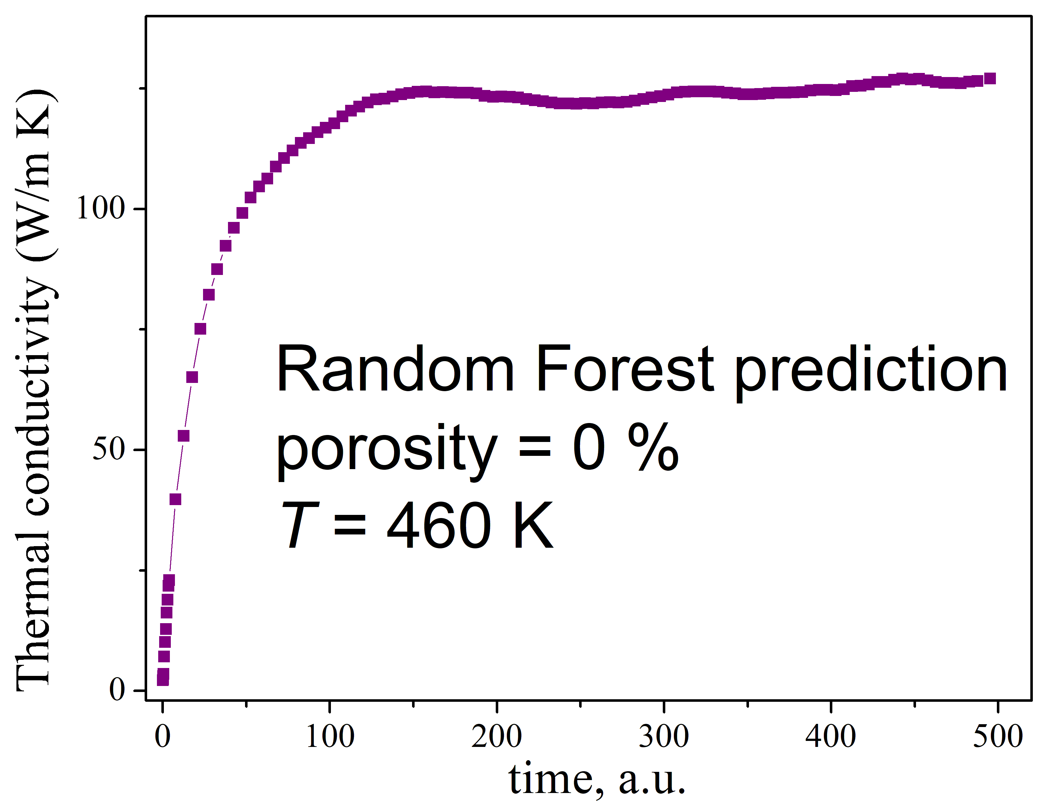
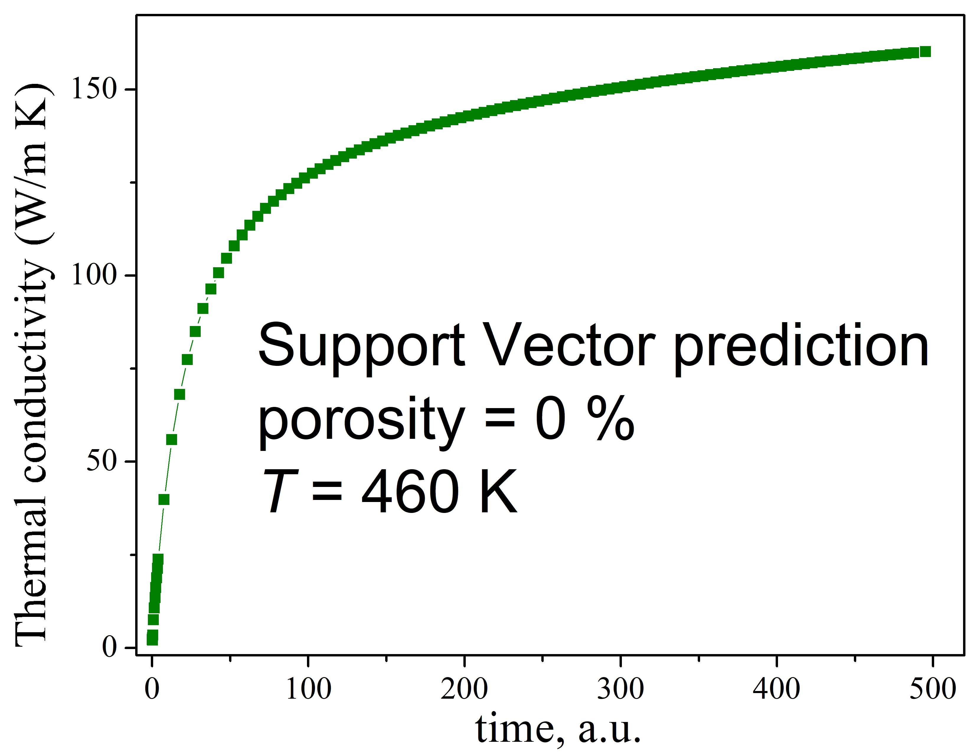
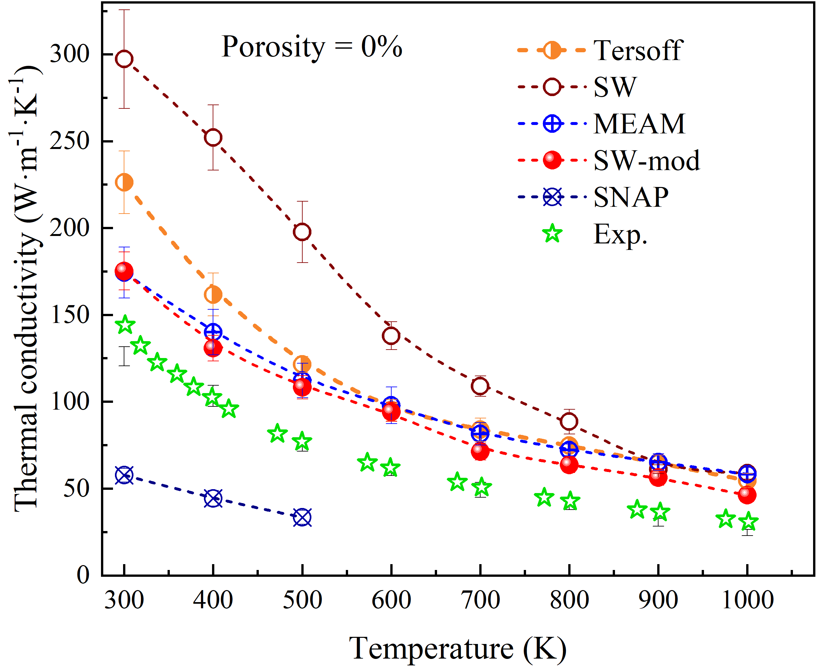
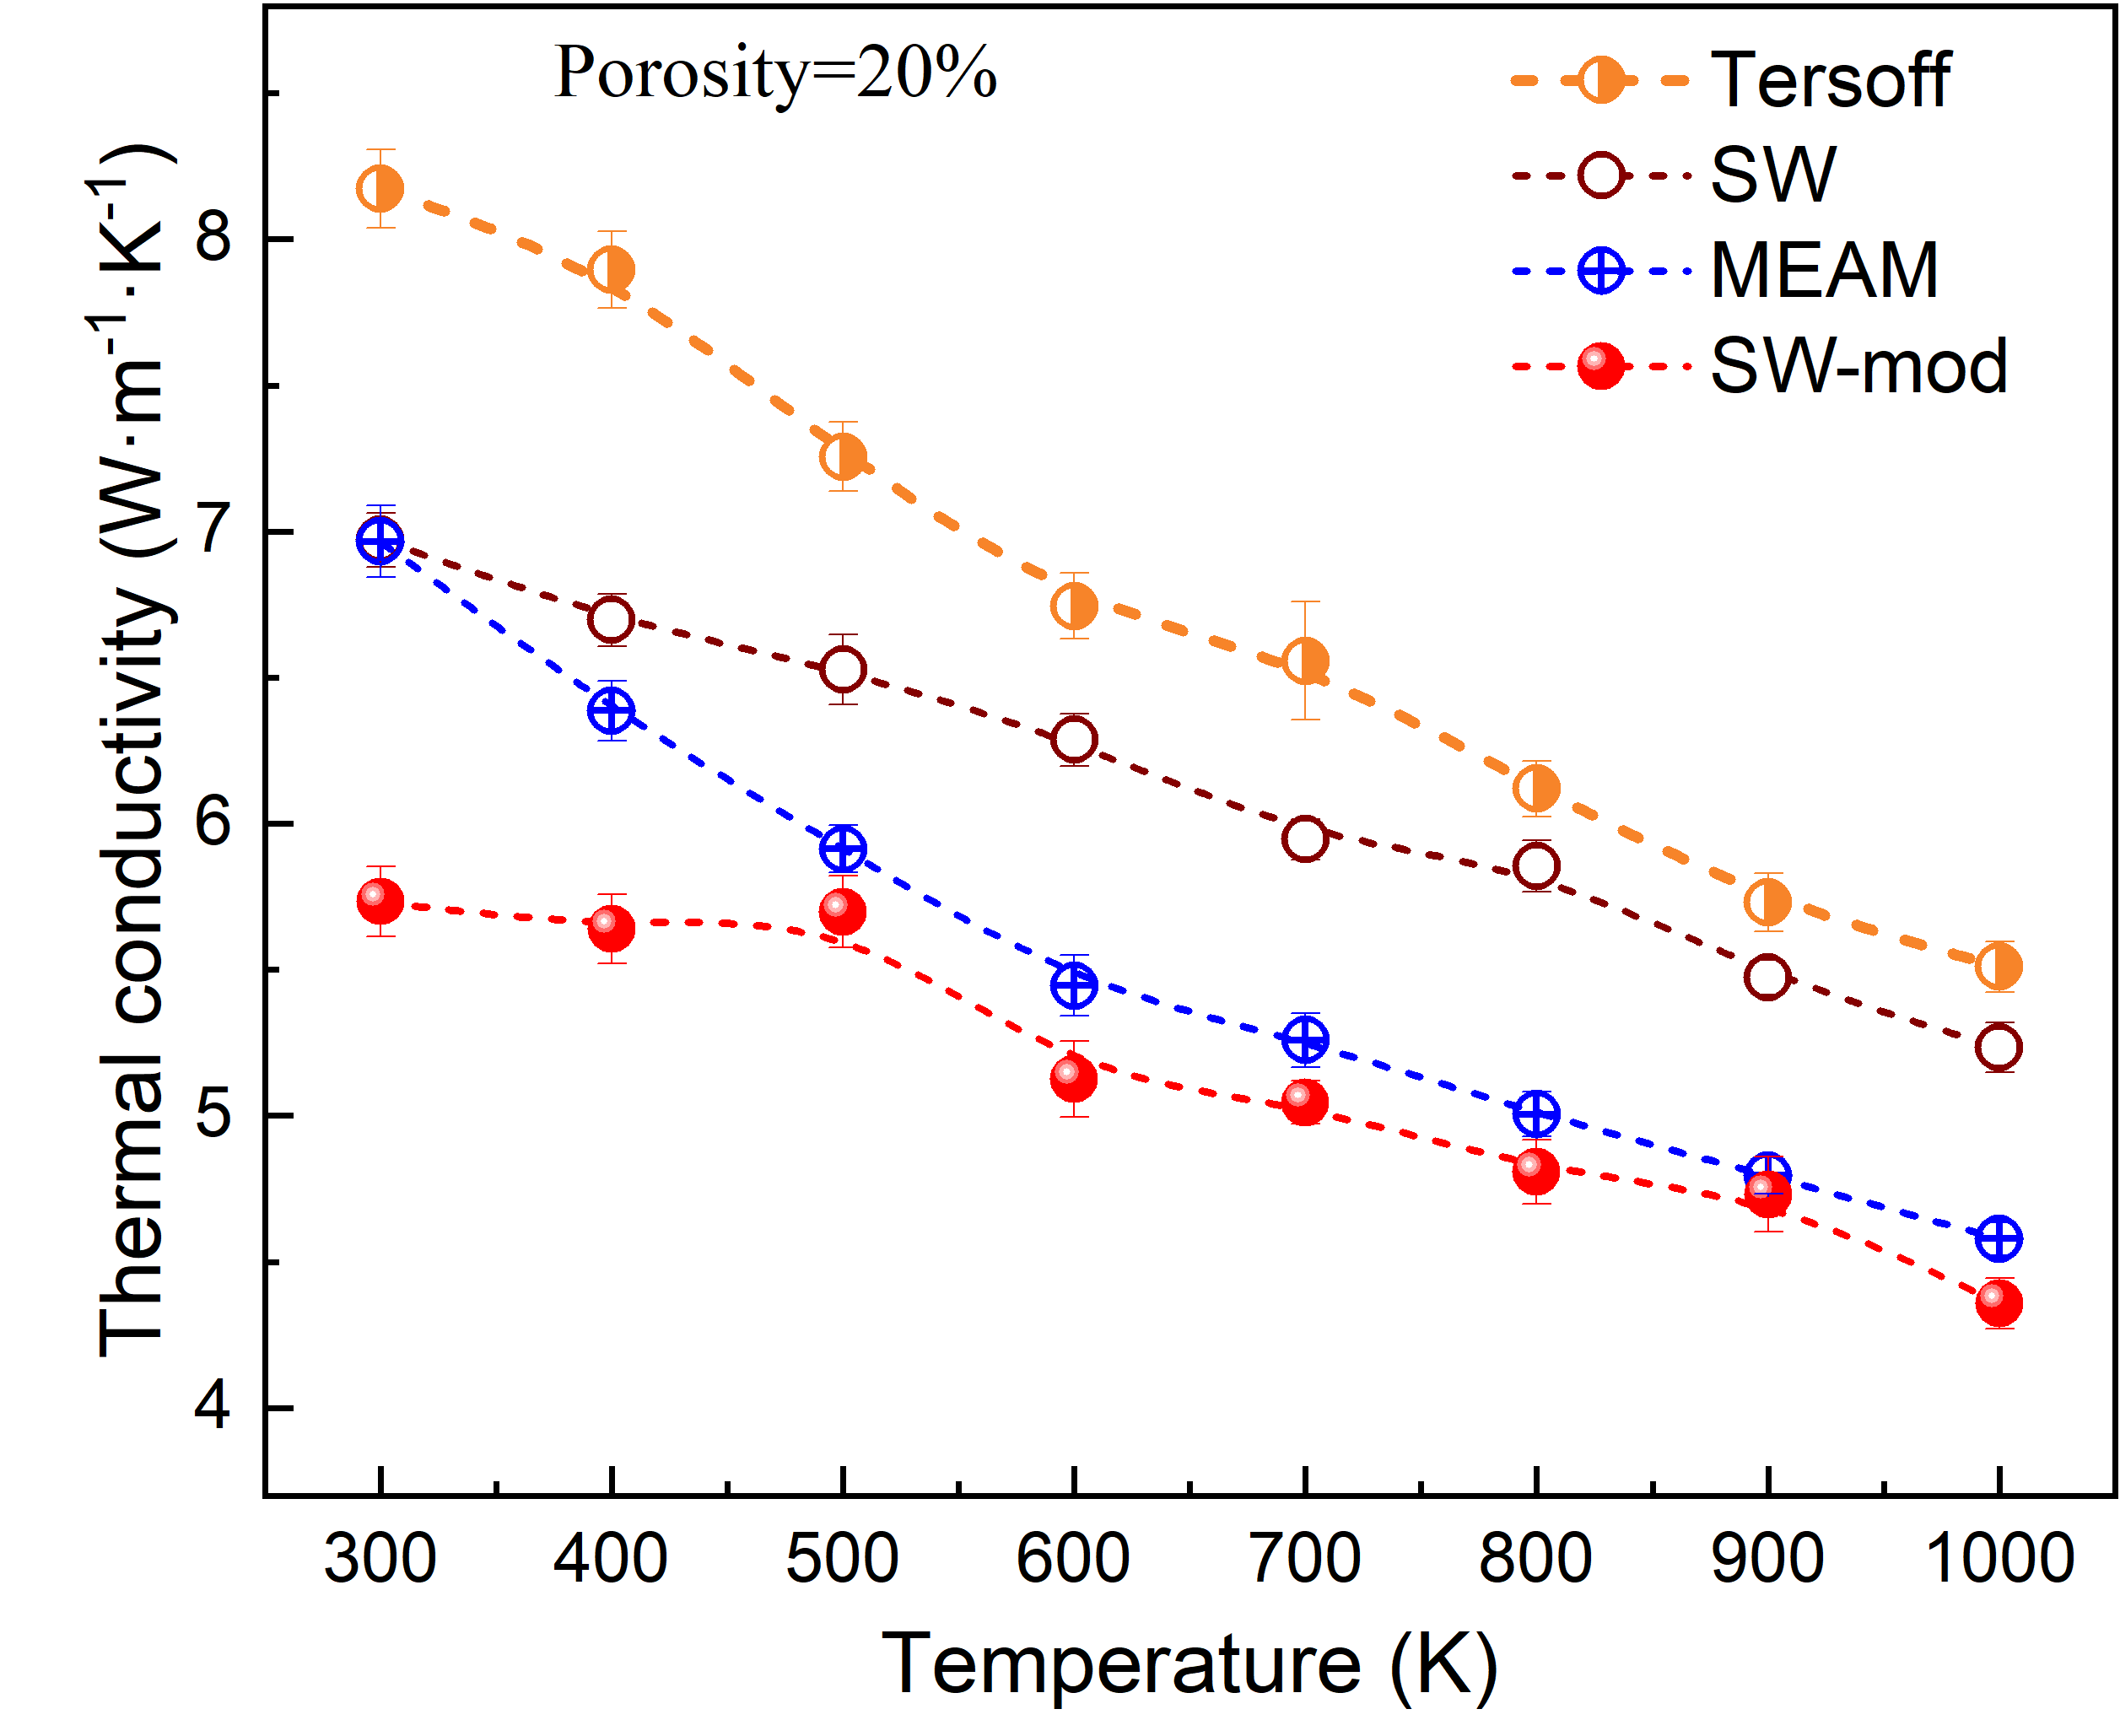
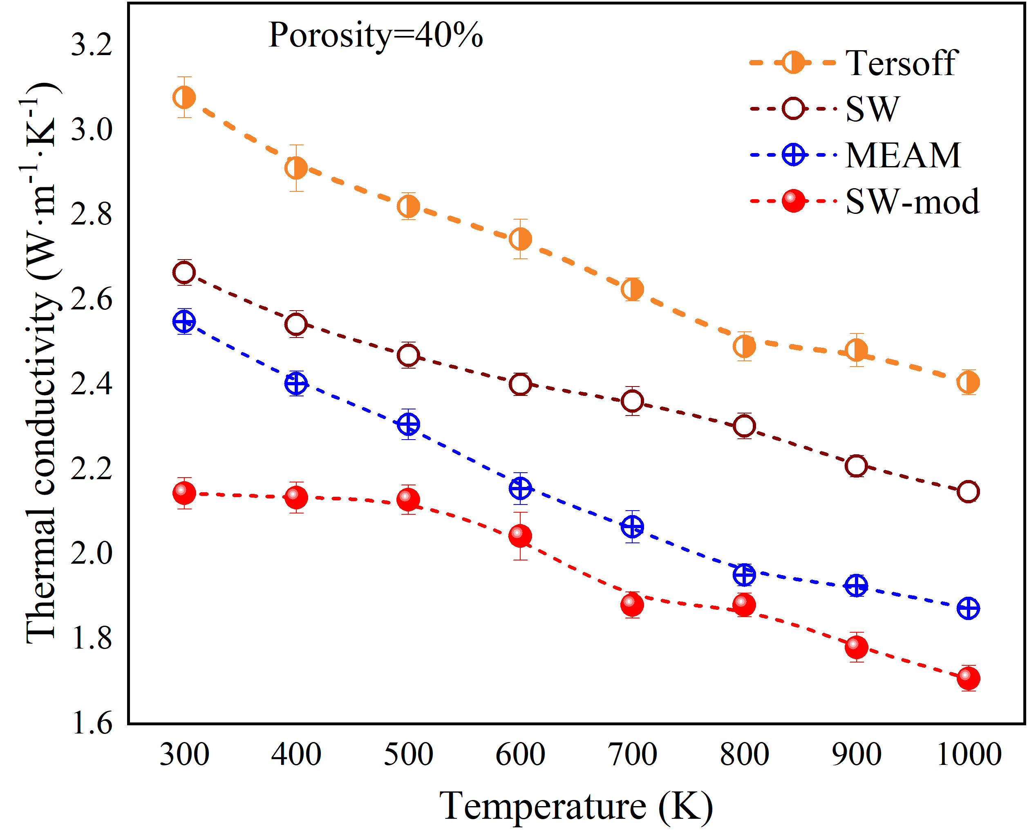
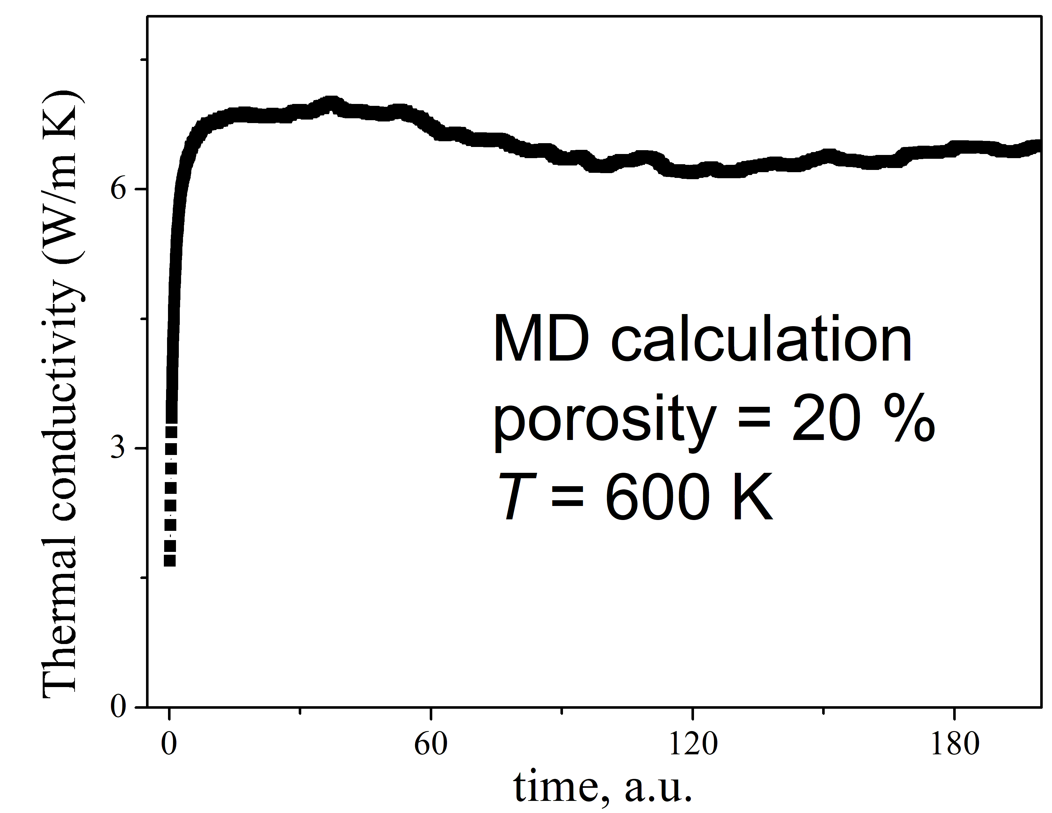
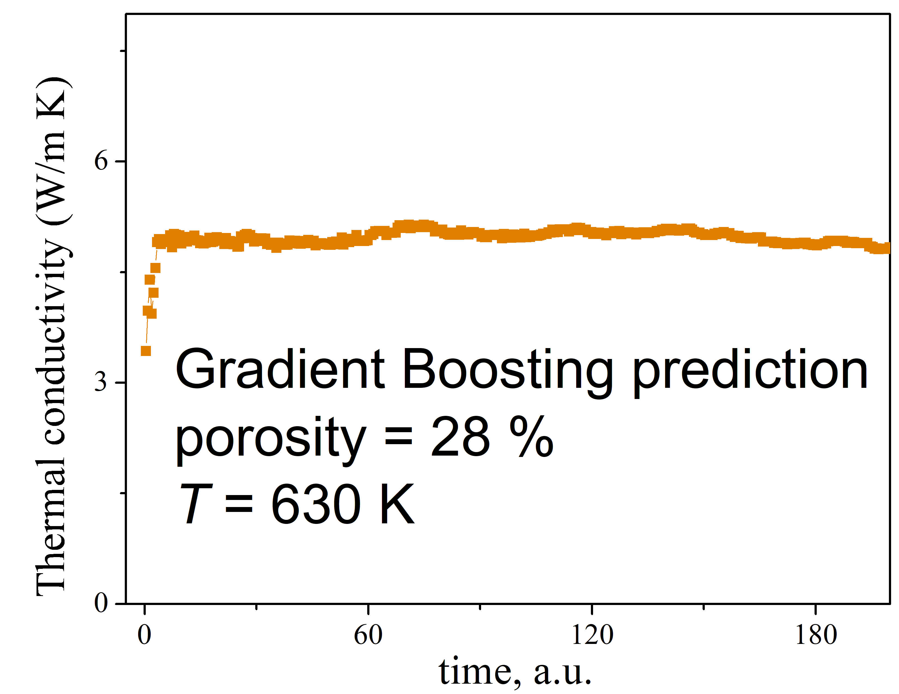
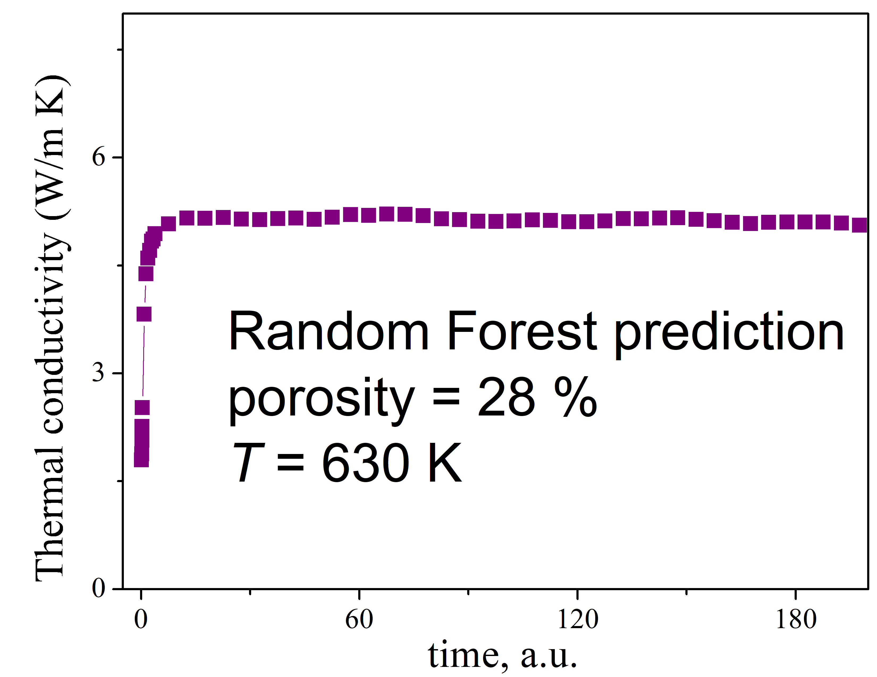
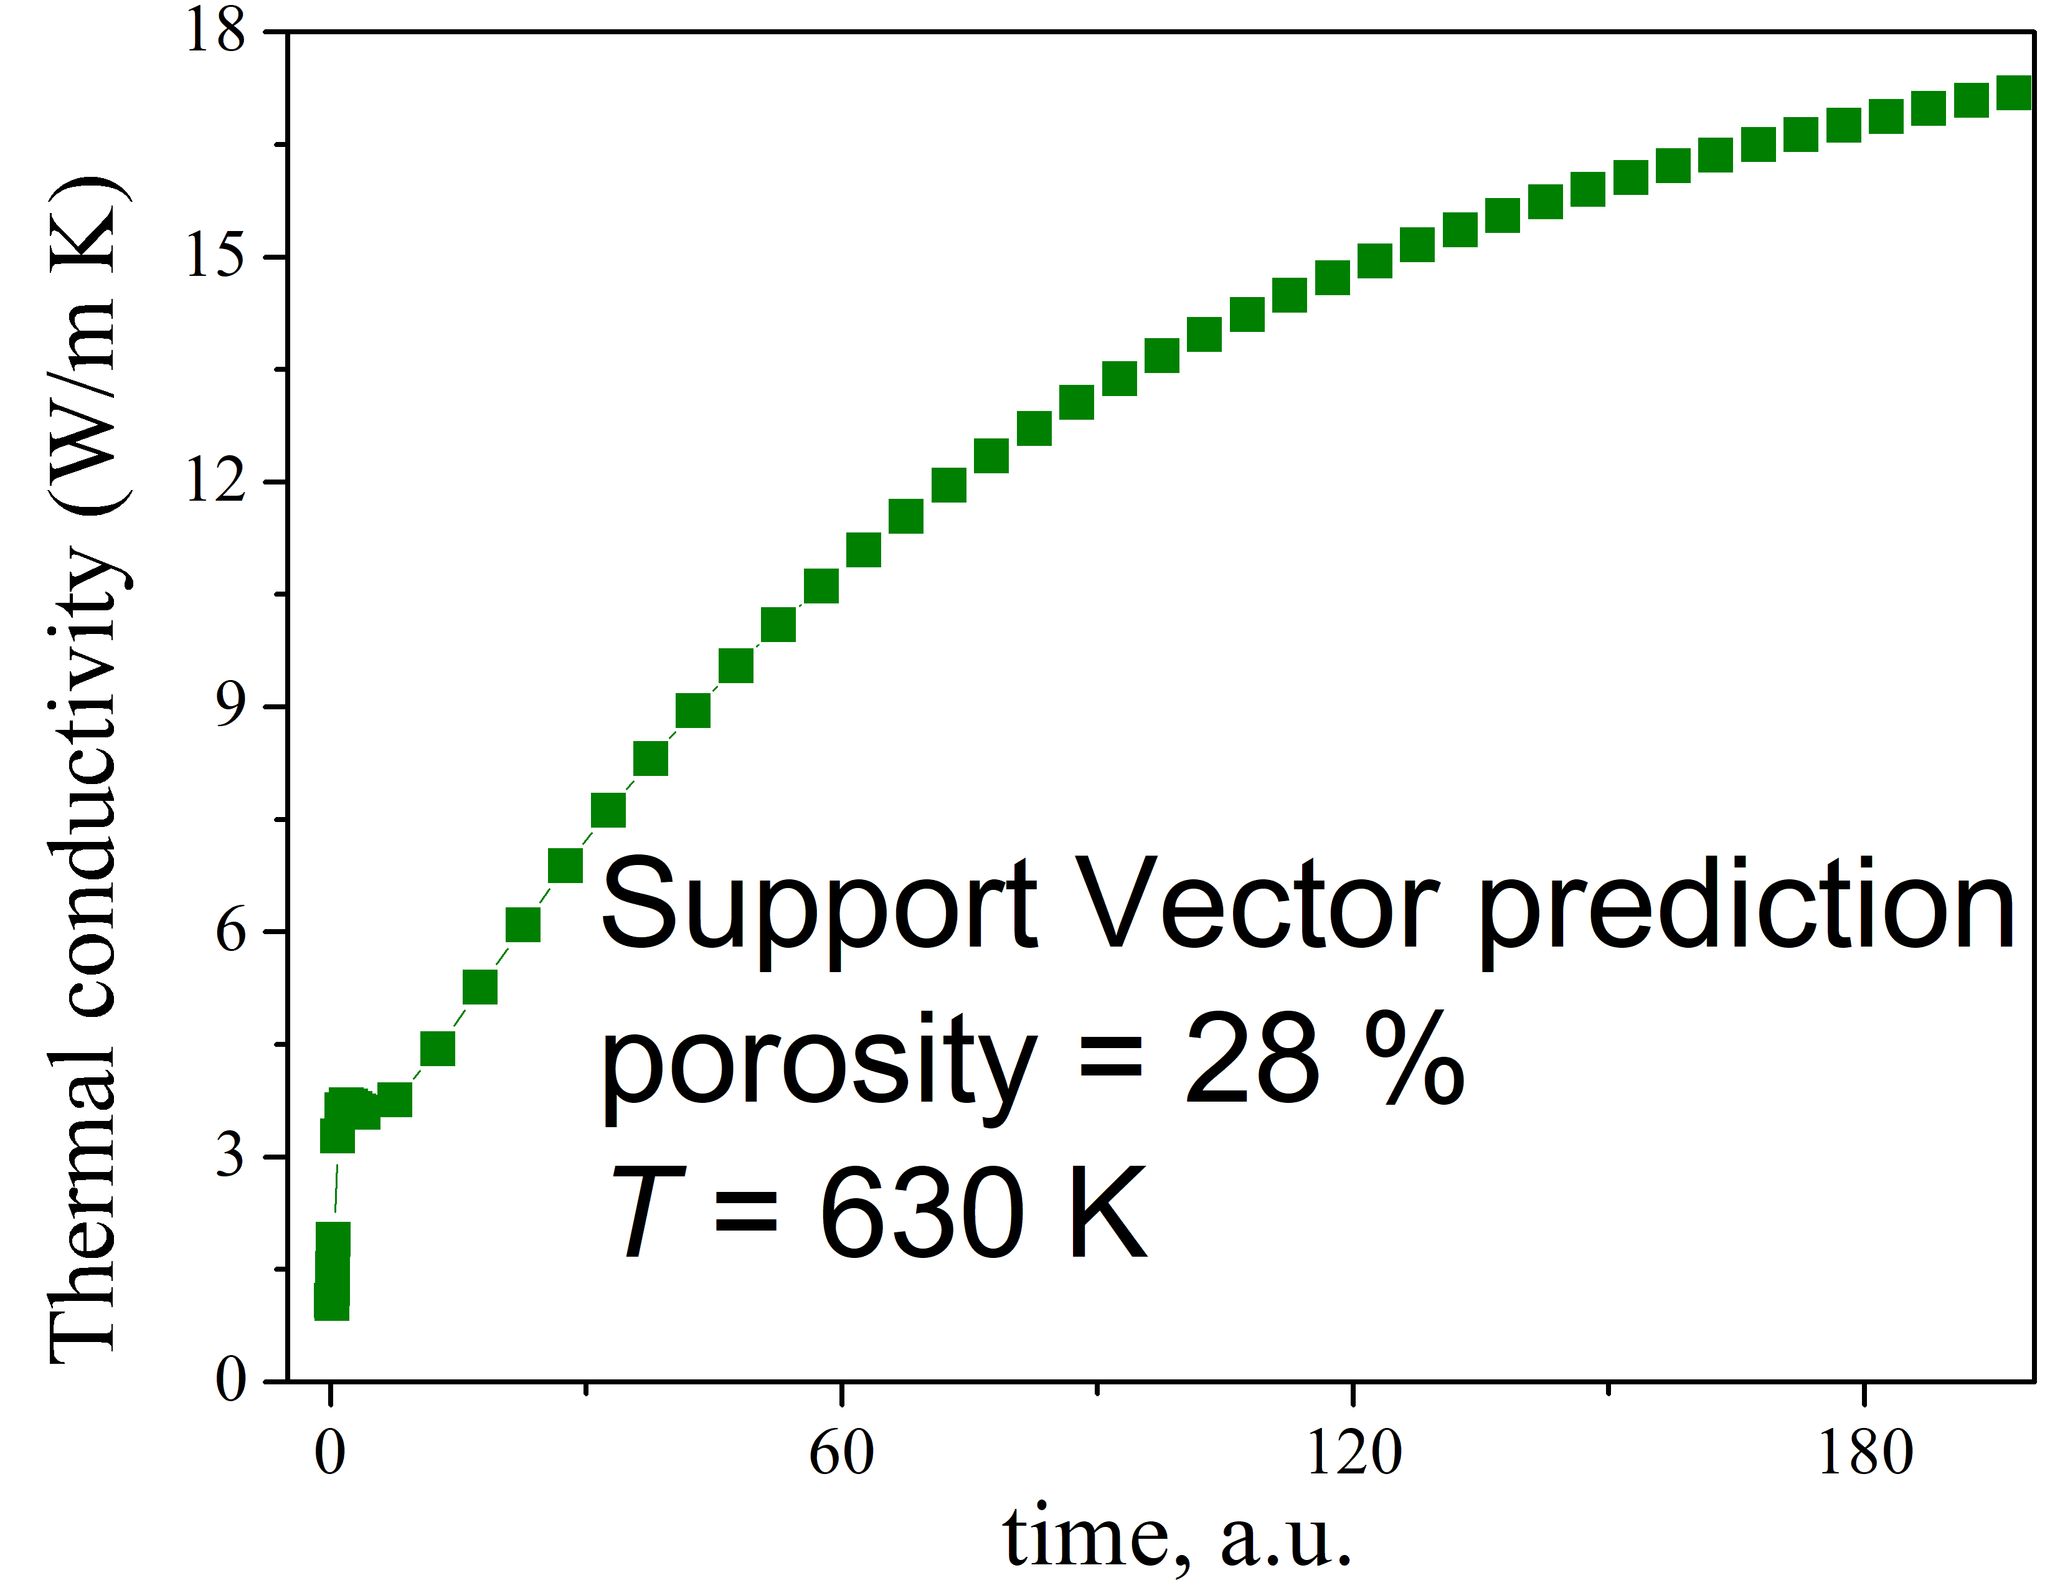
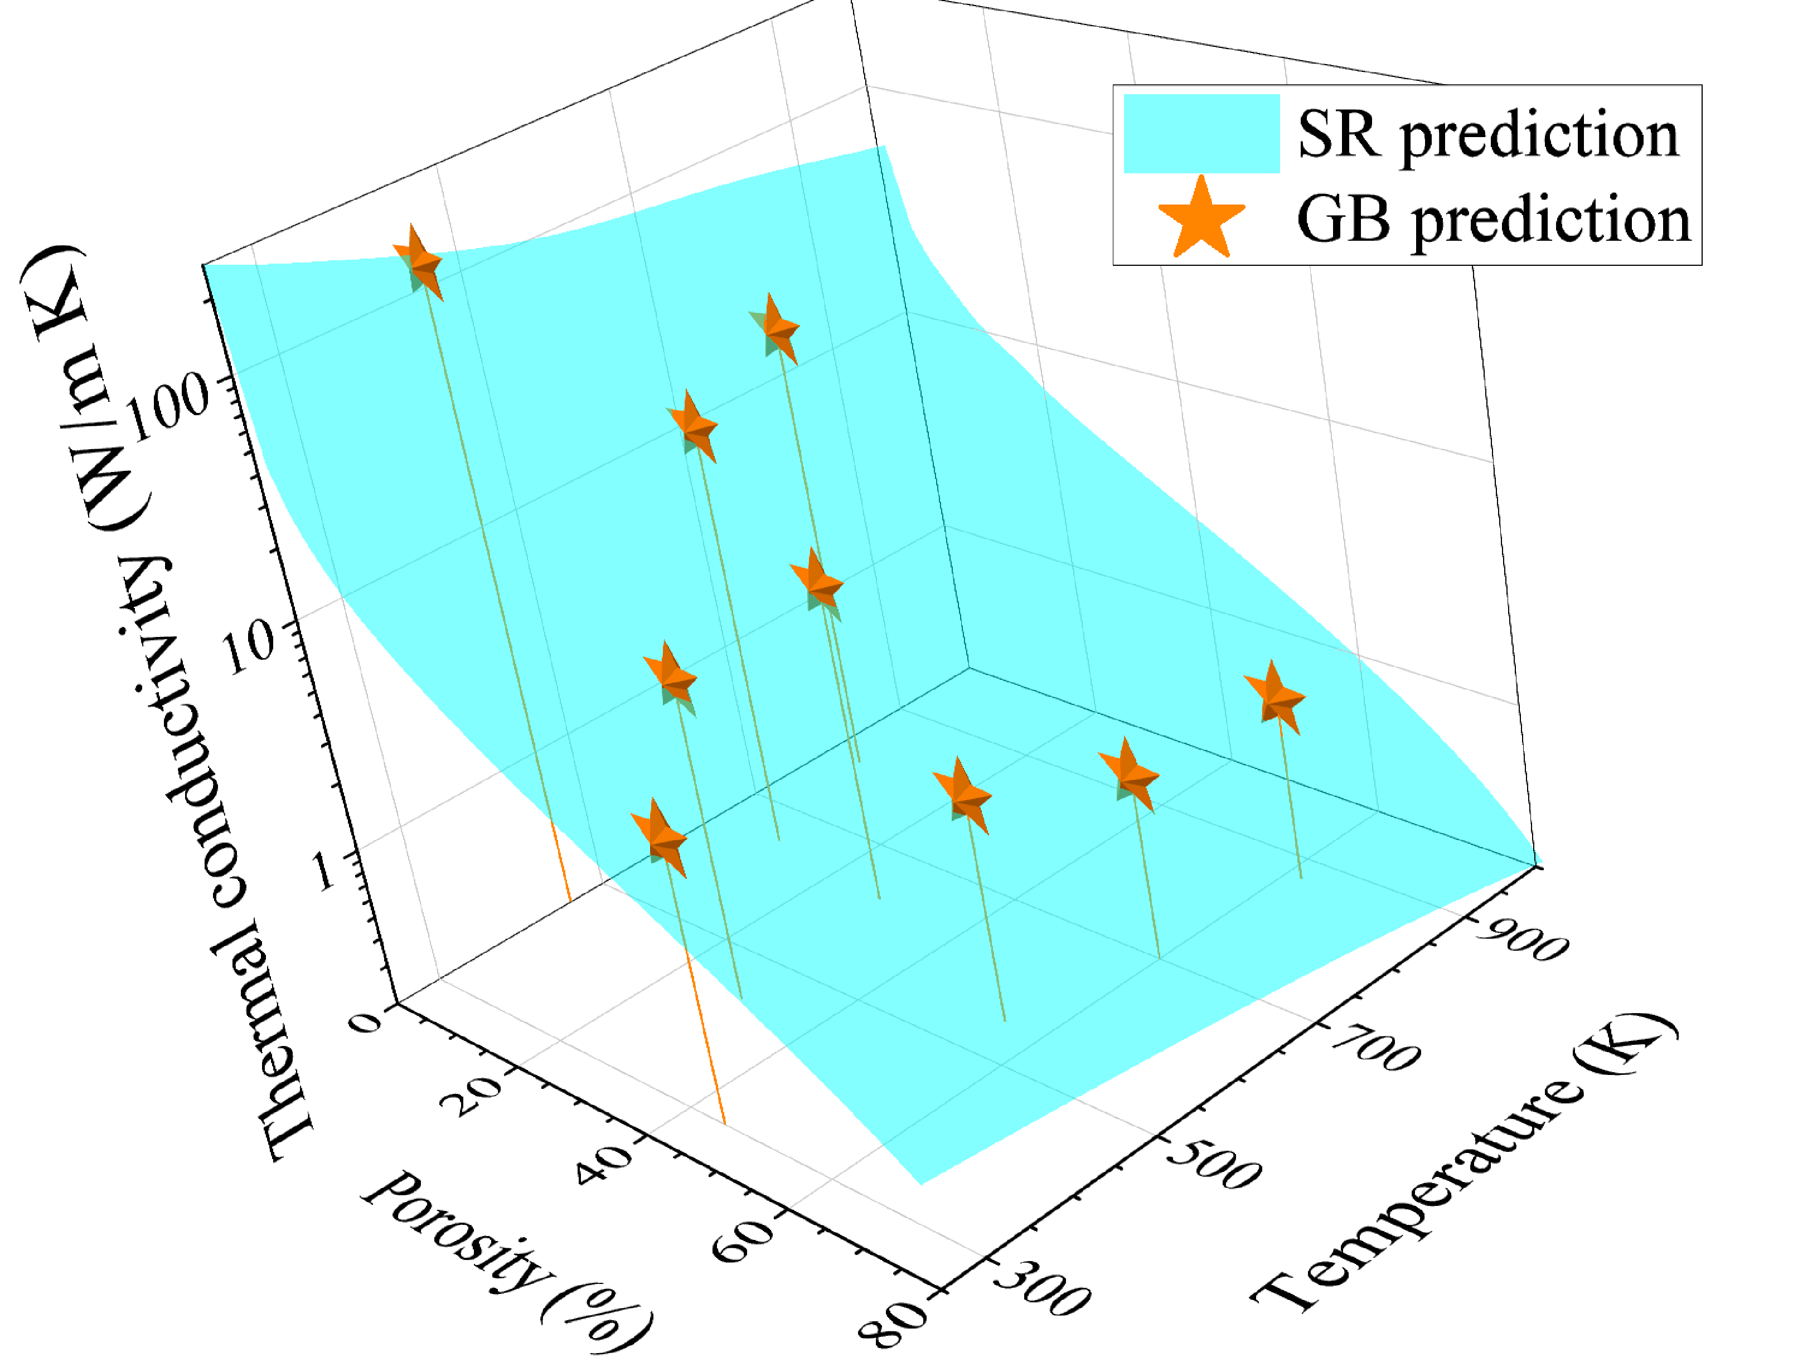
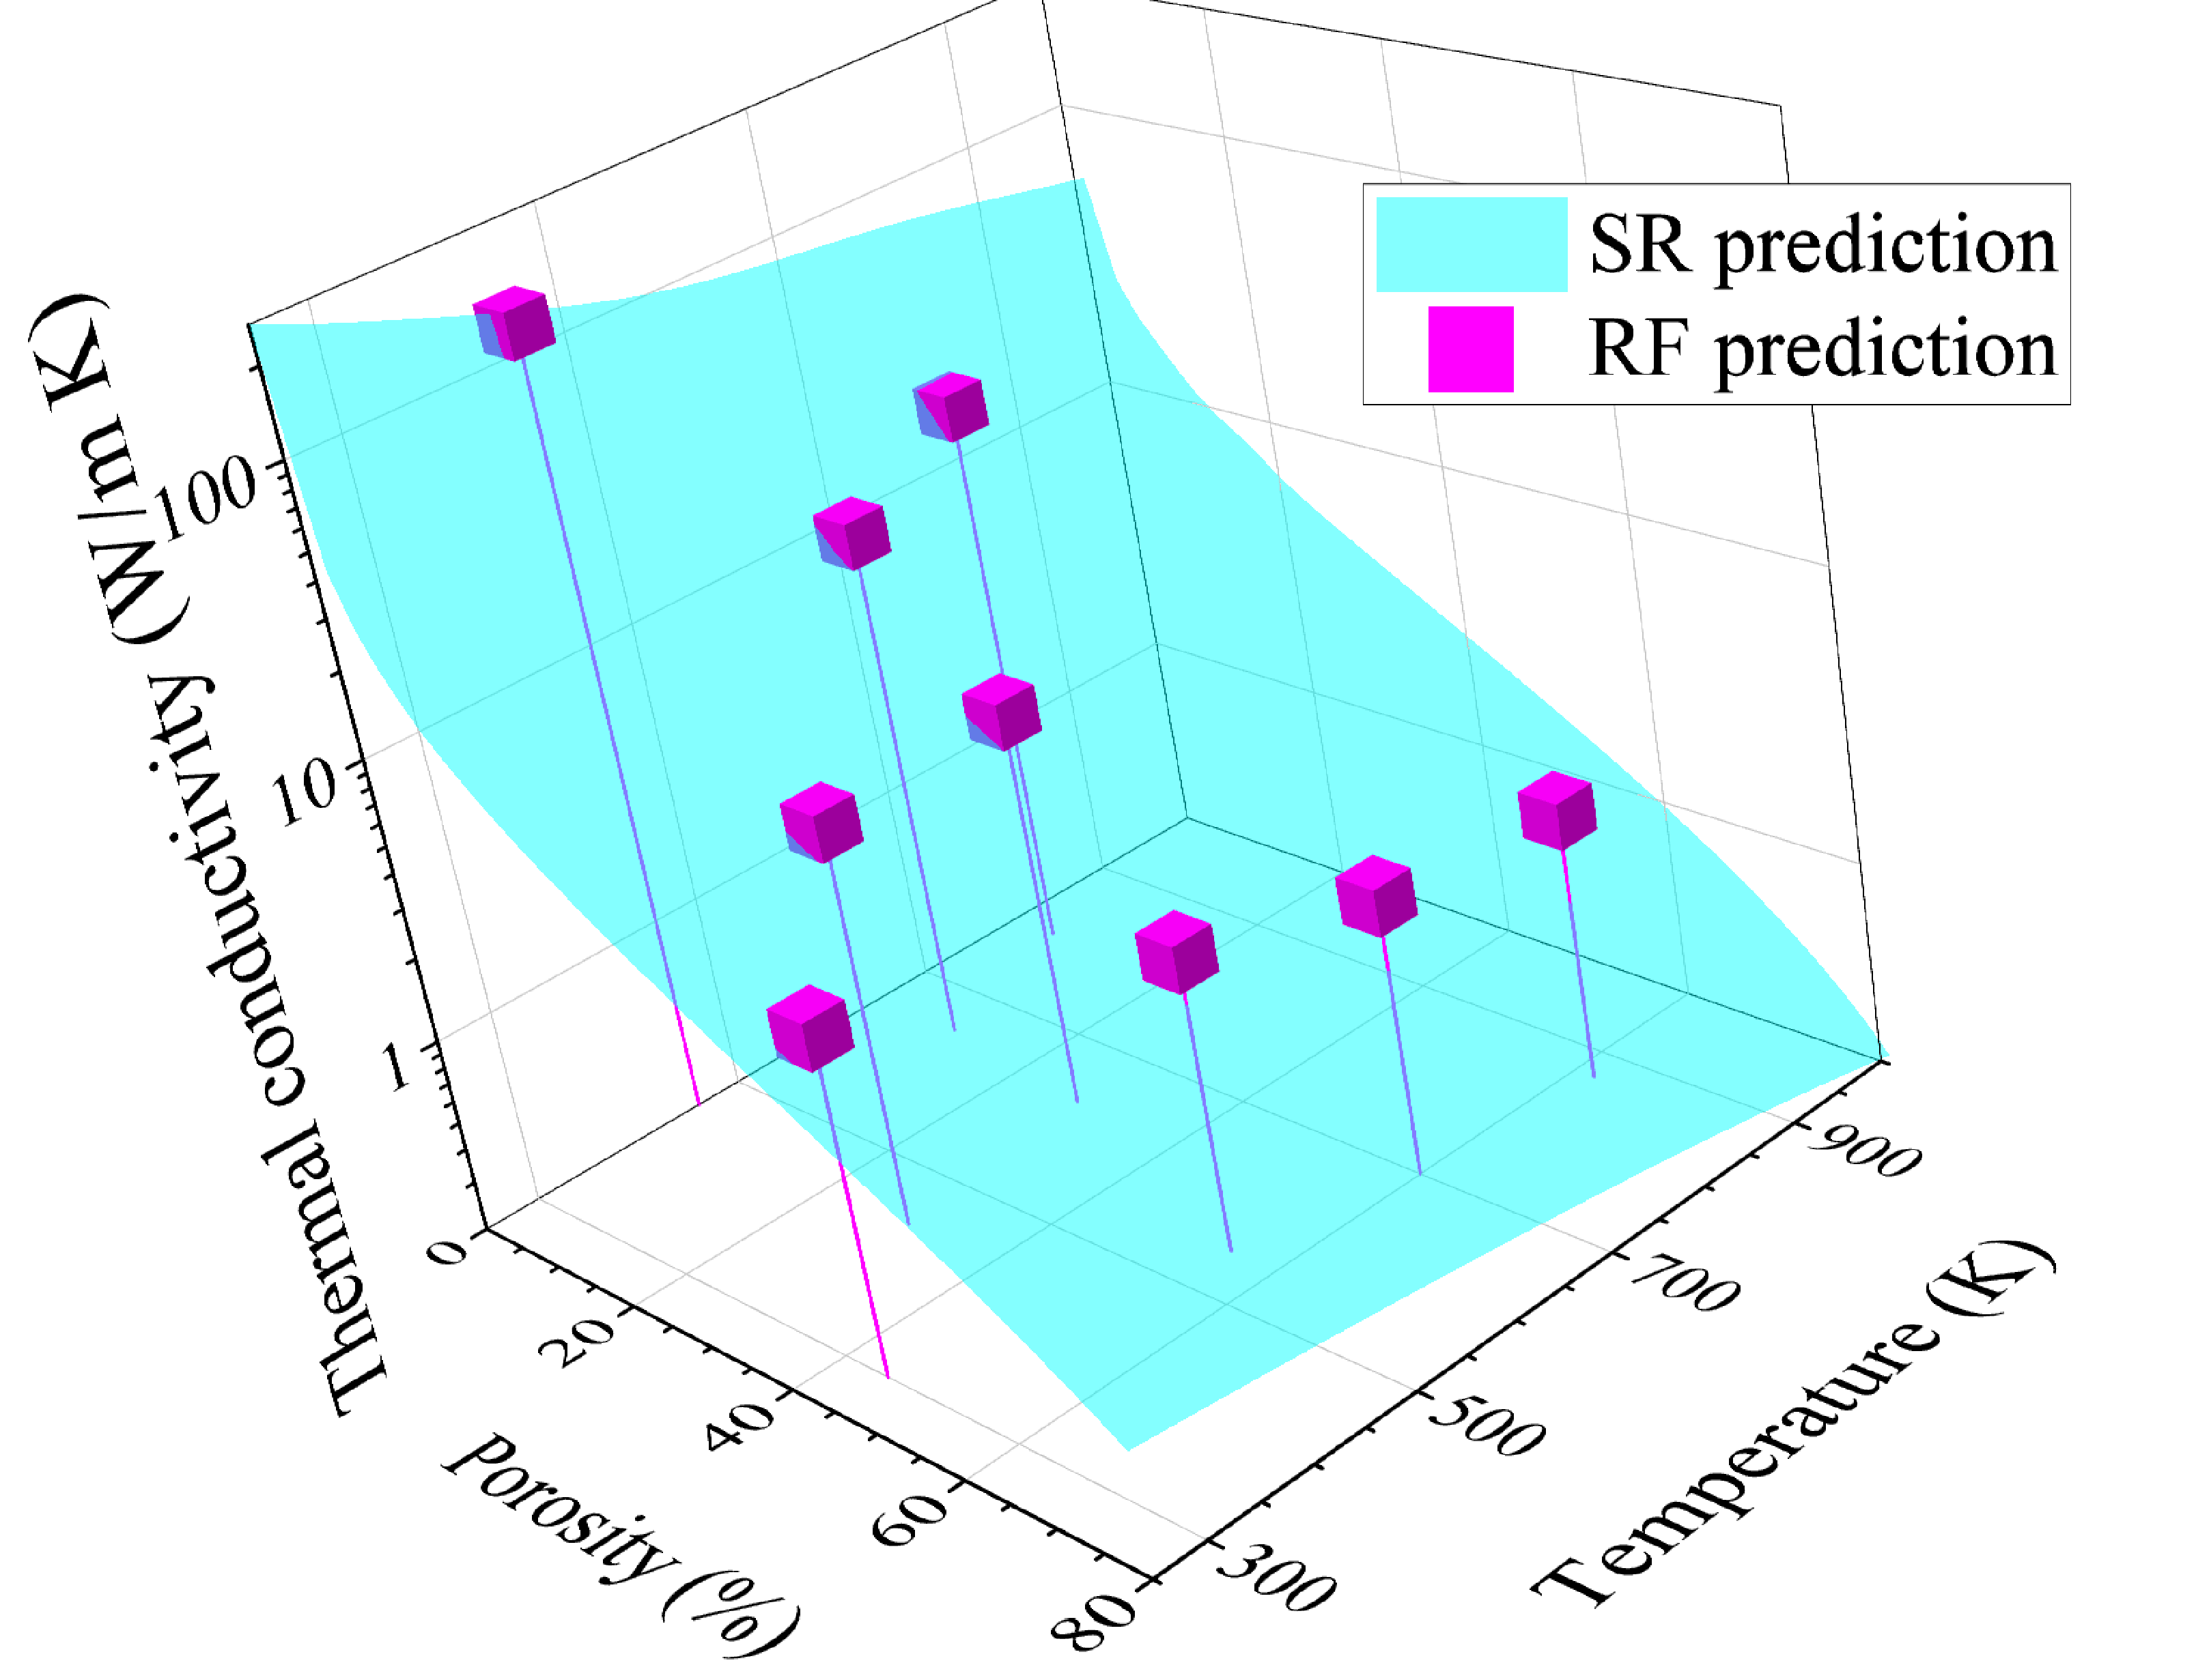
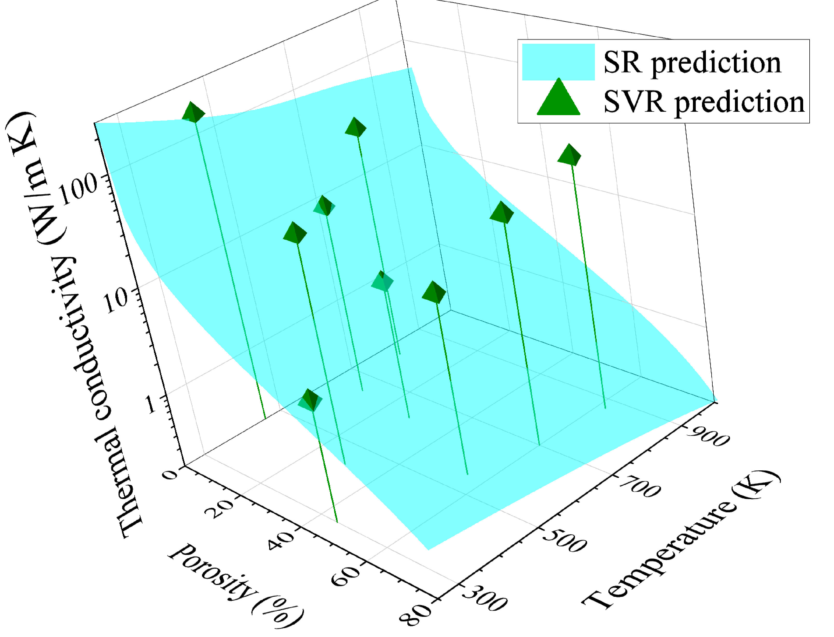


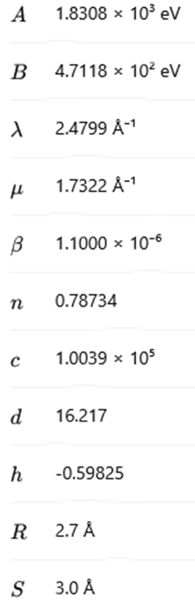





Estimation of the Thermal Conductivity of Porous Silicon Using Molecular Dynamics and Machine Learning Methods
,
V. V. Kuryliuk, O. Olikh
Taras Shevchenko National University of Kyiv, 64/13, Volodymyrska Str., Kyiv, Ukraine
olegolikh@knu.ua
Introduction. Porous media are widely used in various applications, such as thermal barriers or thermoelectric materials for enhancing the figure of merit. In particular, porous silicon (p-Si) layers can be effectively utilized in high-efficiency solar-thermal energy storage systems. Efficiently predicting their thermal conductivity (TC) can accelerate the design of porous systems to improve energy efficiency, among other benefits. The accurate TC estimation can be obtained through molecular dynamics simulation. However, such calculations are computationally expensive and time-consuming. A promising alternative to reduce these costs and enable large-scale predictions is the application of artificial intelligence methods.
MACHINE LEARNING
T_{n} = T / 300
MOLECULAR DYNAMICS
TC was determined by computing the ensemble average of the heat current autocorrelation function within the Green-Kubo formalism
model structure: 8000 atoms
calculations: cluster of 128 cores
Comparison of the performance of the Tersoff, Stillinger-Weber, modified Stillinger-Weber, Modified Embedded Atom Method and Spectral Neighbor Analysis Potentials
TERSOFF POTENTIAL
Conclusion. Using the Green–Kubo formalism, we calculated the thermal conductivity of porous silicon with porosity levels of 0, 20% and 40% over a temperature range of 300–1000 K, employing various interatomic interaction potentials. The results confirm the suitability of the Tersoff potential for thermal conductivity calculations within the framework of equilibrium molecular dynamics. Through the application of a symbolic regression algorithm, we derived a generalized analytical expression describing the temperature dependence of thermal conductivity in silicon with porosity ranging from 0% to 80% over a temperature interval of 250–1000 K. Comparative analysis demonstrates the superiority of the Random Forest and Gradient Boosting algorithms over Support Vector Regression in predicting the heat current autocorrelation function.
The work was supported by National Research Foundation of Ukraine (project No. 2023.05/0024)

