Slide 1
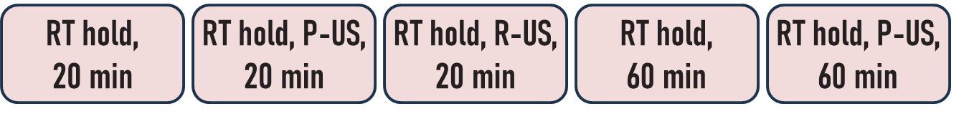
n-type c-Si:P, 1-10 Ω cm, 525 μm width
silicon surface cleaning (15 s in 30% HF solution)
655201-25G, 3.0-4.0% in H₂O, high-conductivity grade
spin-coating PEDOT:PSS solution, 30 s, 3000 rpm
spin-coating PEDOT:PSS solution, 30 s, 5000 rpm
P-US: Primary wave,
2.5 MHz
D520
D520uP
D520uR
D560
D560uP
R-US: Radial wave,
500 kHz
RT hold, 20 min
RT hold, P-US, 20 min
RT hold, P-US, 20 min
RT hold, 60 min
Sample labels
D320
D320uP
D320uR
D360
air condition
sample annealing, 140 °C, 15 min
thermal evaporation, base pressure of 10⁻⁷ mbar
vacuum deposition of Ag contact on PEDOT:PSS
using Zn-Ga eutectic
mechanical alloying of Zn-Ga contact on Si

Slide 2
Ag
PEDOT:PSS
n-Si
Zn-Ga
Sketch of the device structure

